Slide 1

Deep Learning and Generative AI MSCS202
Course Instructor
Dr. Umadevi V
Department of CSE, BMSCE

Slide 2
Disclaimer
Contents given in PPT are brief and for reference only. Should refer to text book/relevant materials for detailed description.

Slide 3
Unit-3
Recurrent Neural Networks: Introduction, Backpropagation in RNNs, Regularization Techniques: Dropout, L1/L2 Regularization, LSTMs and GRUs, Video Understanding using RNNs, Attention in Vision Models: An Introduction, Soft and Hard Attention: Image Captioning, Self-Attention and Transformers, Vision Transformers and Applications

Slide 4
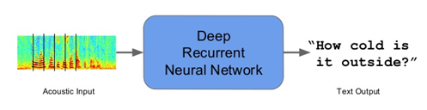

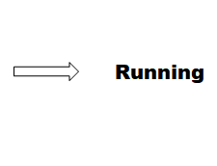
Sequence Modeling
Sequence models are the machine learning models that input or output sequences of data. Sequential data includes text streams, audio clips, video clips, time-series data and etc. Recurrent Neural Networks (RNNs) is a popular algorithm used in sequence models.
Applications of Sequence Models
1. Speech recognition: In speech recognition, an audio clip is given as an input and then the model has to generate its text transcript. Here both the input and output are sequences of data.
2. Video Activity Recognition: In video activity recognition, the model needs to identify the activity in a video clip. A video clip is a sequence of video frames, therefore in case of video activity recognition input is a sequence of data.
Ref. https://towardsdatascience.com/sequence-models-and-recurrent-neural-networks-rnns-62cadeb4f1e1/

Slide 5
Recurrent Neural Networks (RNNs)
Recurrent Neural Network (RNN) is a Deep learning algorithm and it is a type of Artificial Neural Network architecture that is specialized for processing sequential data.
RNNs are mostly used in the field of Natural Language Processing (NLP).
RNN maintains internal memory, due to this they are very efficient for machine learning problems that involve sequential data.
RNNs are also used in time series predictions as well.

Slide 6
Recurrent Neural Network (RNN)
Recurrent Neural Networks (RNNs) were introduced to address the limitations of traditional neural networks, such as FeedForward Neural Networks (FNNs), when it comes to processing sequential data. FNN takes inputs and process each input independently through a number of hidden layers without considering the order and context of other inputs.
Due to which it is unable to handle sequential data effectively and capture the dependencies between inputs. As a result, FNNs are not well-suited for sequential processing tasks such as, language modeling, machine translation, speech recognition, time series analysis, and many other applications that requires sequential processing.
To address the limitations posed by traditional neural networks, RNN comes into the picture.

Slide 7
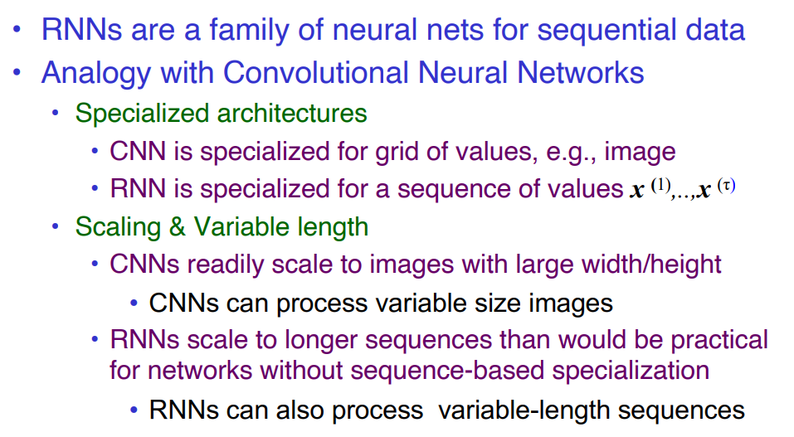
Recurrent Neural Networks process sequential data
Ref.: https://cedar.buffalo.edu/~srihari/CSE676/10.0%20SequenceModeling.pdf

Slide 8
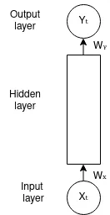
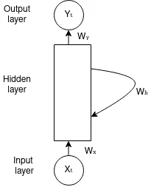
RNN: Recurrent connections
RNN overcome these limitations by introducing a recurrent connection that allow information to flow from one time-step to the next.
This recurrent connection enables RNNs to maintain internal memory, where the output of each step is fed back as an input to the next step, allowing the network to capture the information from previous steps and utilize it in the current step, enabling model to learn temporal dependencies and handle input of variable length.
FeedForward Neural Network (FNN)
Recurrent Neural Network (RNN)

Slide 9
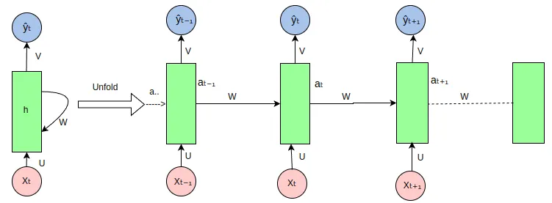
Architecture Of RNN
RNN: Unfolded
Notes:
https://medium.com/@poudelsushmita878/recurrent-neural-network-rnn-architecture-explained-1d69560541ef

Slide 10
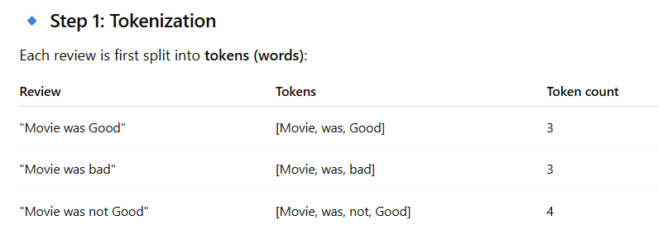
Example: Movie Reviews
"Movie was Good"
"Movie was bad"
"Movie was not Good"

Slide 11
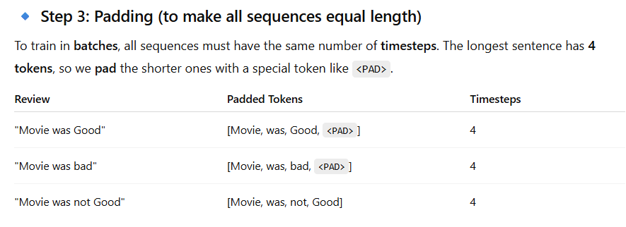
Example: Movie Reviews
Step-2: One hot Encoding
movie=[1,0,0,0,0] ; was=[0,1,0,0,0] ;
good=[0,0,1,0,0] ; bad=[0,0,0,1,0] ;
not=[0,0,0,0,1]

Slide 12
Example: Movie reviews
Final Input Representation
Now, we can construct a batch input tensor with:
batch size = 3 (number of reviews)
timesteps = 4 (after padding)
input features = 5 (embedding size)
So the input shape is: (3, 4, 5)
3 samples (reviews),
Each with 4 tokens (timesteps),
Each token is a 5-dimensional vector (features).

Slide 13
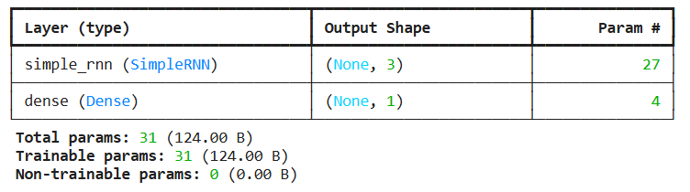
Number of Trainable Parameters
from keras import Sequential
from keras.layers import Dense, SimpleRNN
model=Sequential()
model.add(SimpleRNN(3, input_shape=(4,5)))
model.add(Dense(1, activation='sigmoid'))
model.summary()

Slide 14
Number of trainable parameters in a simple RNN
To calculate the number of trainable parameters in a simple RNN, we can derive the formula by considering the components involved in a vanilla RNN architecture with:
Input size = m
Hidden size = n (number of hidden units in the hidden layer)
Output size = 1 (single neuron in the output layer)
One hidden layer

Slide 15
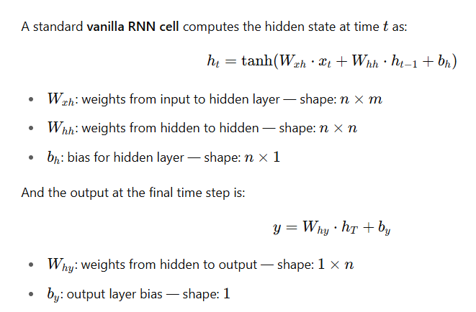
Number of trainable parameters in a simple RNN
Considering number of nodes in input layer as m, Number of hidden nodes as n
And number of nodes in output layer 1.

Slide 16
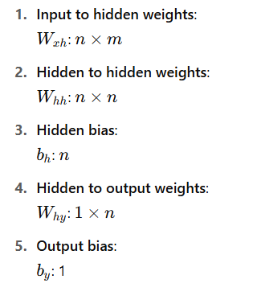
Number of trainable parameters in a simple RNN
Notes:
understand that you want to compute the number of parameters of a RNN, that is, the total count of parameter of a RNN.
In a recurrent neural network RNN we have to compute the number of parameters of the input layer, plus the number of parameters in the hidden layer.
In the input layer, the number of parameters comes from the size of the vocabulary, say ‘m’.
In the hidden layer, the number of parameters comes from the number of units of the layer, say ‘n’
Since the input is m and the hidden layer has n units, the W params of the input layer would be m * n.
Input weights: m*n
Since the network is recurrent, meaning it ‘calls’ itself over and over, then the W parameters in the hidden layer will be n * n.
Recurrent weight: n*n
If we add biases, then we would have ‘m’ biases for the input layer and ‘n’ biases for the hidden layer.
To compute the total number of parameters we add (m * n) + (n * n) + m + n

Slide 17
Number of trainable parameters in a simple RNN
If we consider number of nodes in output layer as k then
Total Parameters=m.n+n.n+n+n.k+k
Notes:
understand that you want to compute the number of parameters of a RNN, that is, the total count of parameter of a RNN.
In a recurrent neural network RNN we have to compute the number of parameters of the input layer, plus the number of parameters in the hidden layer.
In the input layer, the number of parameters comes from the size of the vocabulary, say ‘m’.
In the hidden layer, the number of parameters comes from the number of units of the layer, say ‘n’
Since the input is m and the hidden layer has n units, the W params of the input layer would be m * n.
Input weights: m*n
Since the network is recurrent, meaning it ‘calls’ itself over and over, then the W parameters in the hidden layer will be n * n.
Recurrent weight: n*n
If we add biases, then we would have ‘m’ biases for the input layer and ‘n’ biases for the hidden layer.
To compute the total number of parameters we add (m * n) + (n * n) + m + n

Slide 18
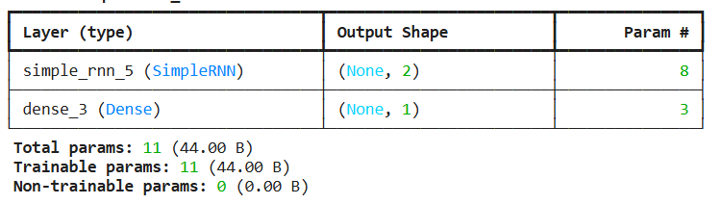
model=Sequential()
model.add(SimpleRNN(2, input_shape=(1,1)))
model.add(Dense(1,activation='sigmoid'))
model.summary()

Slide 19
Architecture Of RNN
RNN: Unfolded
Notes:
https://medium.com/@poudelsushmita878/recurrent-neural-network-rnn-architecture-explained-1d69560541ef

Slide 20
Architecture Of RNN
The RNN takes an input vector X and the network generates an output vector y by scanning the data sequentially from left to right, with each time step updating the hidden state and producing an output. It shares the same parameters across all time steps. This means that, the same set of parameters, represented by U, V, W is used consistently throughout the network. U represents the weight parameter governing the connection from input layer X to the hidden layer h , W represents the weight associated with the connection between hidden layers, and V for the connection from hidden layer h to output layer y. This sharing of parameters allows the RNN to effectively capture temporal dependencies and process sequential data more efficiently by retaining the information from previous input in its current hidden state.

Slide 21
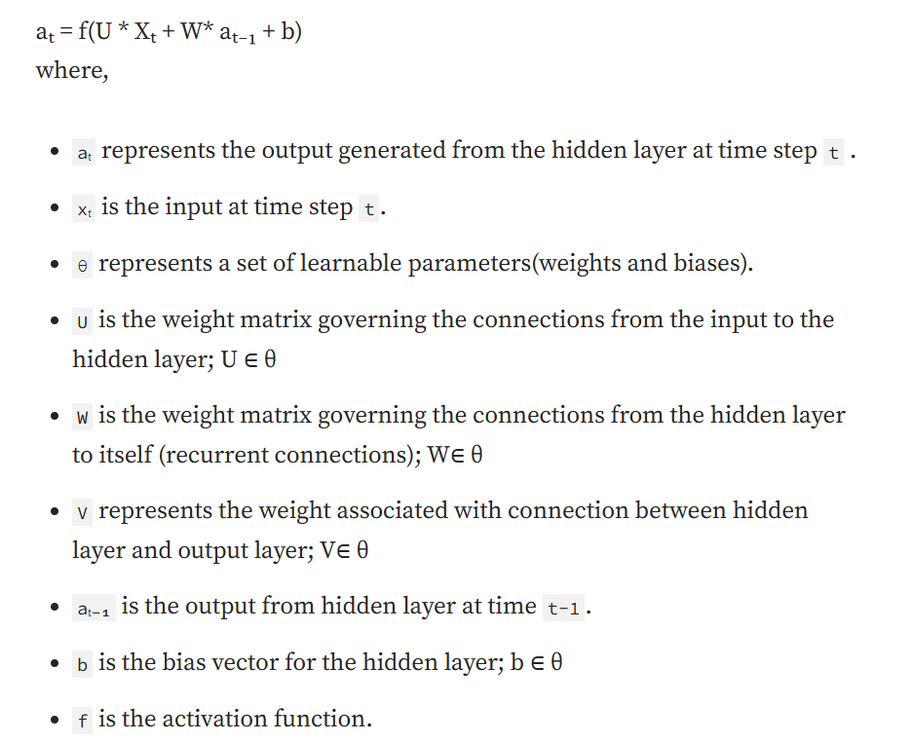
Forward Propagation in RNN
At each time step t, the hidden state aₜ is computed based on the current input xₜ , previous hidden state aₜ₋₁ and model parameters as illustrated by the following formula:
aₜ = f(aₜ₋₁, xₜ; θ) — — — — — (1)
It can also be written as,

Slide 22
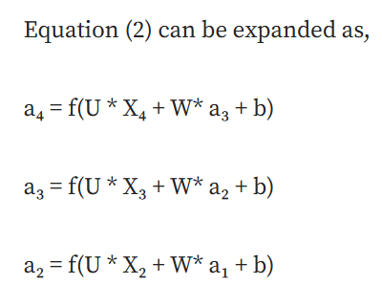
Forward Propagation in RNN
For a finite number of time steps T=4, we can expand the computation graph of a Recurrent Neural Network, illustrated in Figure 3, by applying the equation (1) T-1 times.

Slide 23
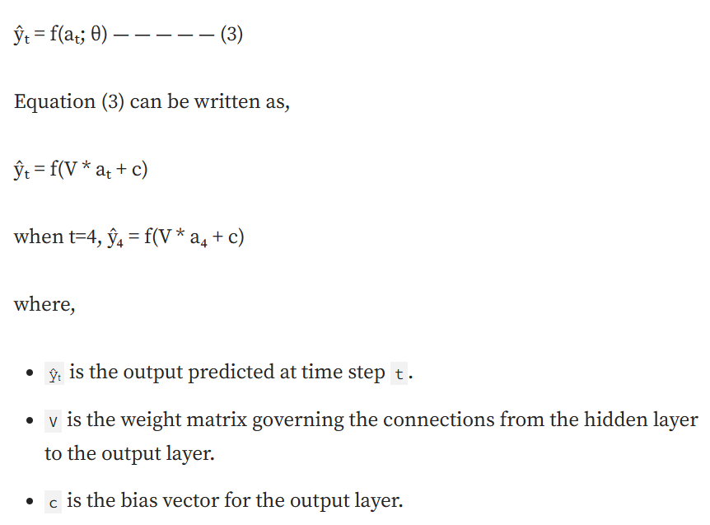
Forward Propagation in RNN
The output at each time step t, denoted as yₜ is computed based on the hidden state output aₜ using the following formula,

Slide 24
RNN: "Backpropagation Through Time" (BPTT) algorithm
For RNNs to learn sequential data, a variant of the backpropagation algorithm known as "Backpropagation Through Time" (BPTT) is used.
In RNNs, the data is processed step-by-step (one at a time). The term "time" is used in BPTT to highlight the fact that the network's computations are performed step by step, simulating the passage of time as the network processes each element of the sequence.
A time step in a Recurrent Neural Network (RNN) refers to a specific moment or instance in a sequence of data being processed by the network. In the context of sequential data, such as text, speech, or time series, the RNN processes one element of the sequence at each time step. This element could be a word in a sentence, a single data point in a time series, or a phoneme in speech.
Backpropagation is applied to each time step, starting from the last one and moving backward to the first. This process is known as Backpropagation Through Time.

Slide 25
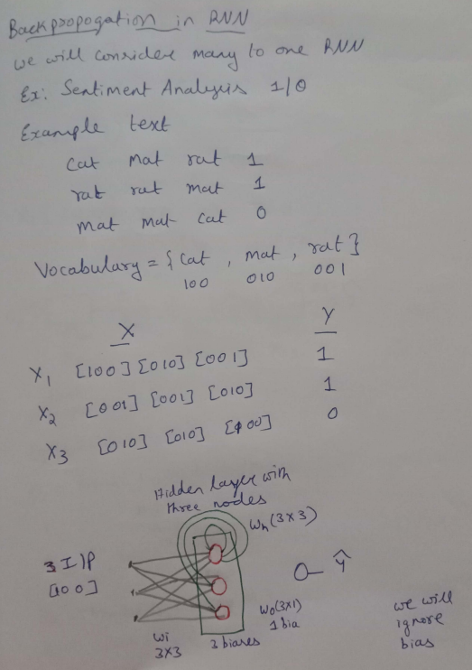
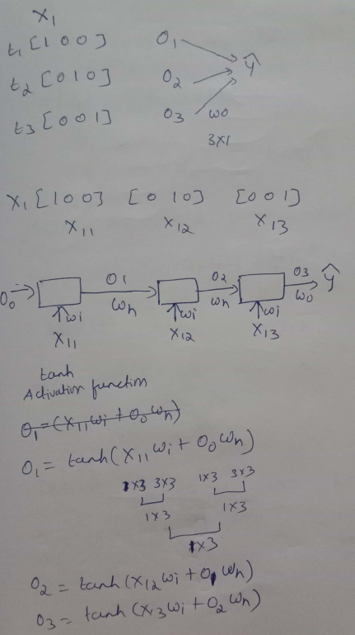
Backward Propagation in RNN

Slide 26
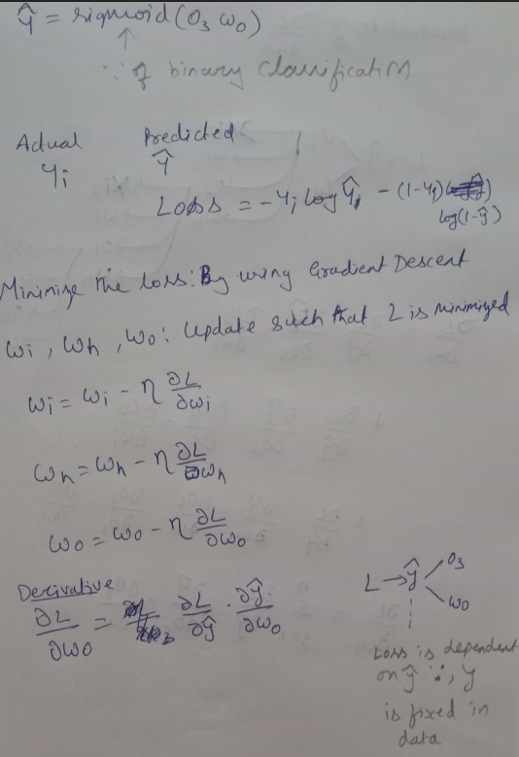
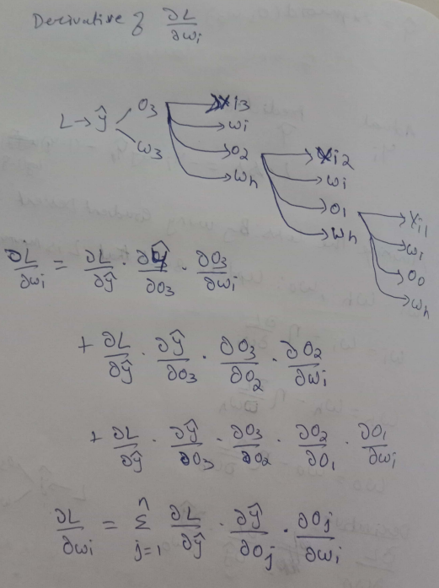
Backward Propagation in RNN

Slide 27
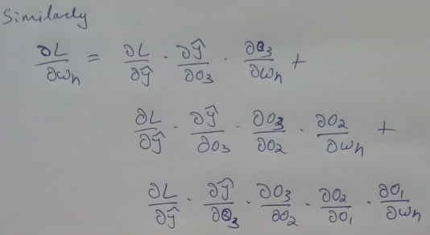
Backward Propagation in RNN

Slide 28
Regularization Techniques: Dropout, L1/L2 Regularization
L1 and L2 Regularization: L1 and L2 regularization are common techniques used to prevent overfitting by adding a penalty term to the loss function. L1 regularization adds the absolute value of the weights to the loss function, encouraging sparsity in the model by driving some weights to zero. L2 regularization, also known as weight decay, adds the squared value of the weights to the loss function, discouraging large weights and promoting a more evenly distributed set of weights. In the context of RNNs and LSTMs, L1 and L2 regularization can be applied to the weights of the network to prevent overfitting. These techniques help ensure that the model does not become too complex and that it generalizes well to new data. The choice between L1 and L2 regularization depends on the specific application and the desired properties of the model.

Slide 29
Regularization Techniques: Dropout, L1/L2 Regularization
Recurrent Dropout
Recurrent dropout is a variant of dropout specifically designed for RNNs and LSTMs. Unlike standard dropout, which is applied to the input and output connections, recurrent dropout is applied to the recurrent connections within the network. This technique helps prevent overfitting by ensuring that the network does not rely too heavily on any single recurrent connection. Recurrent dropout has been shown to be effective in various tasks, including language modeling and speech recognition. By applying dropout to the recurrent connections, the network is forced to learn more robust representations of the temporal dependencies in the data, leading to improved generalization performance

Slide 30

Applications of RNN
Sentiment Analysis

Slide 31
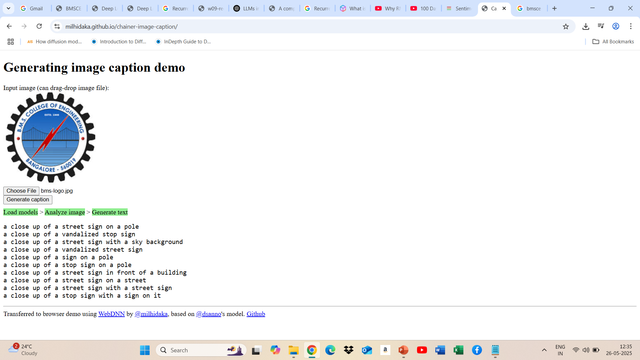
Applications of RNN
Image Caption Generation

Slide 32

Applications of RNN
Language Translation

Slide 33
Challenges with RNNs
One of the biggest challenges with RNNs is the problem of vanishing or exploding gradients. This occurs when the gradients of the loss function with respect to the parameters of the RNN become very small or very large as they propagate through time. This can make it difficult to train the RNN effectively, as the updates to the parameters will be very small or very large, and the network will not learn effectively.
Another challenge with RNNs is that they can be difficult to train. This is because RNNs are typically trained using backpropagation, which can be computationally expensive and time-consuming. Additionally, RNNs can be sensitive to the choice of hyperparameters, such as the learning rate and the number of layers.
Finally, RNNs can be limited in their ability to process long sequences. This is because the gradients of the loss function can become very small or very large as they propagate through time, making it difficult for the RNN to learn long-term dependencies.

Slide 34
Thanks for Listening
Notes:
https://colab.research.google.com/github/ageron/handson-ml2/blob/master/02_end_to_end_machine_learning_project.ipynb#scrollTo=tLb7or7j1rMW

