Slide 1

Deep Learning and Generative AI MSCS202
Course Instructor
Dr. Umadevi V
Department of CSE, BMSCE

Slide 2
Unit-4
Introduction To Gen AI: Historical Overview of Generative modeling, Difference between Gen AI and Discriminative Modeling, Types of Generative models – GANs, VAEs, autoregressive models and Vector quantized Diffusion models, Challenges of Generative Modeling, Future of Gen AI, Ethical Aspects of Gen AI.

Slide 3
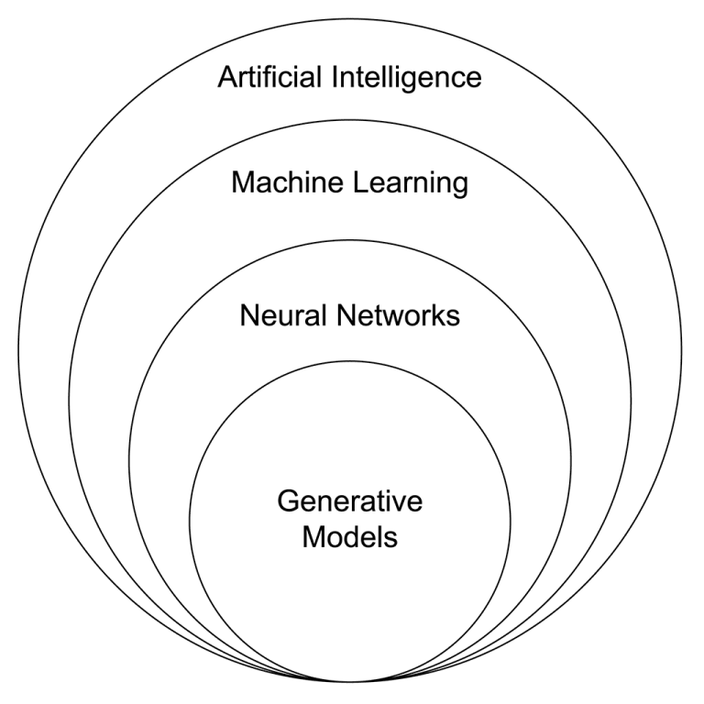
What is Gen AI ?
Generative artificial intelligence, also known as generative AI or gen AI for short, is a type of AI that can create new content and ideas, including conversations, stories, images, videos, and music. It can learn human language, programming languages, art, chemistry, biology, or any complex subject matter. It reuses what it knows to solve new problems.

Slide 4
The Birth of Generative AI
The roots of GenAI trace back to the concept of machine learning. When scientists and researchers introduced machine learning in the late 1950s, they explored the concept of using algorithms to create new data.
One of the first examples of GenAI was the Markov Chain, a statistical model that could be used to generate new sequences of data based on input.
But despite some advances, the computational power and data resources needed for systems like this to flourish weren't yet available.
Machine learning only began to shine in the 1990s and 2000s, when advanced hardware and digital data became more widely available.
The birth of Generative AI, as we know it today, was heralded by the advent of a type of machine learning known as neural networks. Inspired by the human brain, these models use interconnected layers of “neurons” to process and learn from data. A neural network is trained to recognize patterns in a dataset. Once the network is trained, it can make decisions or predictions without being explicitly programmed to perform tasks.
The creative power of Generative AI comes from a specific type of neural network called a Generative Adversarial Network (GAN), which was proposed by Ian Goodfellow and his colleagues in 2014.
Around the same time, other forms of generative models also started to gain traction. Variational Autoencoders (VAEs) and Recurrent Neural Networks (RNNs) began to demonstrate their ability to generate novel content, marking a significant step forward in the field.

Slide 5
Continued Milestones in GenAI
WaveNet (2016): DeepMind’s WaveNet marked a significant advancement in generative models for audio. WaveNet could generate realistic-sounding human speech, which opened doors for more human-like AI assistants and highly accurate text-to-speech synthesis.
Progressive GANs (2017): Progressive GANs, developed by NVIDIA, were a milestone in producing high-resolution, photo-realistic images. These GANs were able to generate images with unprecedented detail and clarity by progressively adding layers during the training process.
GPT-2 and GPT-3 (2019, 2020): OpenAI's generative pre-trained transformer (GPT) models marked a significant leap in the field of GenAI for text. They demonstrated the ability to generate coherent and contextually relevant sentences, making them useful for a wide range of applications, from writing assistance to the chatbot population.
DALL-E (2022): OpenAI launched DALL-E to the public. DALL-E is a deep learning model that can generate digital images from natural language prompts.
ChatGPT (2022): Open AI released ChatGPT, a conversational chatbot based on GPT, and the platform reached one million users within five days.
GPT-4 (2023): The latest GPT model is reportedly more accurate and has advanced reasoning capabilities. Premium ChatGPT users now have optional access to GPT-4 within the chatbot.
Gemini (2023–24) – Google DeepMind Unified multimodal capabilities into one model. Gemini 1.5 demonstrated strong context handling and multi-turn reasoning.
Sora (2024) – OpenAI Text-to-video model generating high-fidelity, realistic videos from short prompts. Ground breaking in visual generative content.
GPT-4o (2025) – OpenAI The first truly multimodal GPT with real-time voice, vision, and text integration. Offers emotional tone and vision-based reasoning.

Slide 6
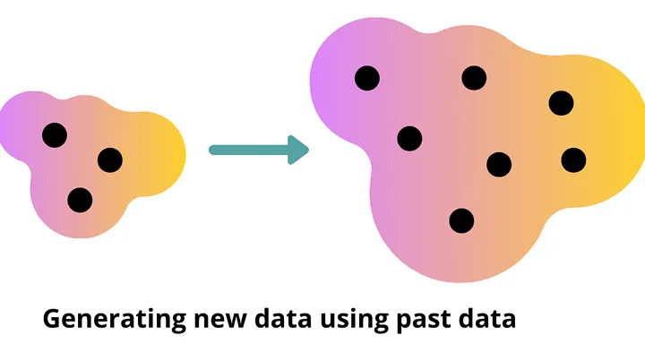
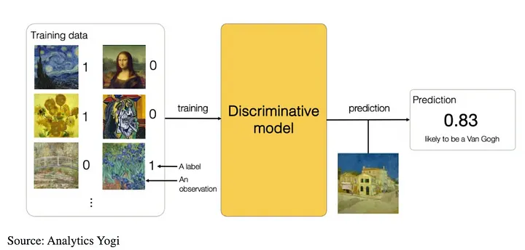
Difference between Gen AI and Discriminative AI
What is Generative AI?
Generative AI means that these AI models will generate new data and information for the user by learning patterns and structures of existing data. While other forms of artificial intelligence are programmed to interpret data, generative AI can create content that is imitation of the fed data. It uses deep learning architectures such as GANs and Transformers to learn and generate data.
What is Discriminative AI?
Discriminative AI can be defined as a type of artificial intelligence where the objective is to opt for the best decision or choose the correct class for the input data by learning from training data and how sample data separates various classes. In this way, discriminative AI models outperform generative AI ones because they are trained to differentiate the data. These models are designed to learn the relationship between the inputs and the outputs or labels/categorical variables.

Slide 7
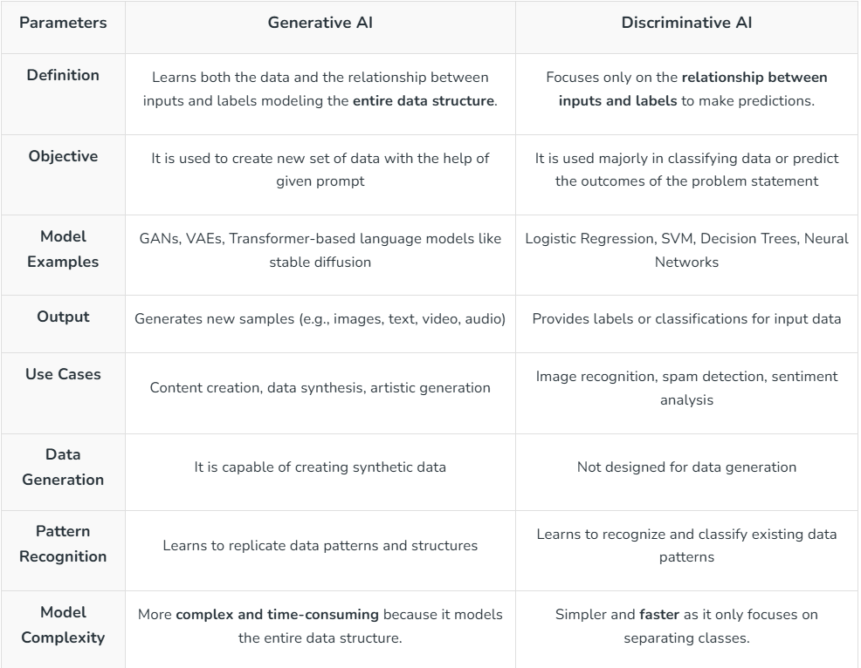
Difference between Gen AI and Discriminative AI

Slide 8
Types of Generative models
Variational Autoencoders (VAEs)
Autoregressive Models
Generative Adversarial Networks (GANs)
Vector Quantized Diffusion Models

Slide 9
Autoregressive Models | Autoregressive models predict the next data point in a sequence based on past data points.
Variational Autoencoders (VAEs) | VAEs learn a probabilistic representation of the data to generate new samples.
Generative Adversarial Networks (GANs) | GANs use a generator and discriminator network in an adversarial game to produce realistic data.
Vector Quantized Diffusion Models | Diffusion models refine noisy data through a denoising process to generate high-quality samples.

Slide 10
Autoregressive (AR) model
An autoregressive (AR) model is a type of time series model that predicts future values based on past values of the same variable.
It essentially uses past data points to "regress" or predict future values, assuming that past trends will continue.
This approach is particularly useful in analyzing and forecasting data that changes over time, like stock prices or weather patterns.

Slide 11
AR models
Autoregressive models (AR models) are a concept in time series analysis and forecasting that captures the relationship between an observation and several lagged observations i.e., previous time steps.
Its idea is that the current value of a time series data can be expressed as a linear combination of its past values with some random noise.
Autoregression (AR):
Concept: Predicts a variable's future value based on its past values.
Example: Predicting stock prices based on past stock prices.
Key Feature: Uses past values of the same variable as predictors.
Focus: Relationship within a single time series.
Time Series: Primarily used for time series data analysis.

Slide 12
AR models
Autoregressive models (AR models) are a concept in time series analysis and forecasting that captures the relationship between an observation and several lagged observations i.e., previous time steps.
Its idea is that the current value of a time series data can be expressed as a linear combination of its past values with some random noise.
Autoregression (AR):
Concept: Predicts a variable's future value based on its past values.
Example: Predicting stock prices based on past stock prices.
Key Feature: Uses past values of the same variable as predictors.
Focus: Relationship within a single time series.
Time Series: Primarily used for time series data analysis.
Linear Regression:
"If I know the weather, traffic, and walking speed, I can predict my commute time."
Autoregression:
"If I know my previous commute times, I can predict my commute time today."

Slide 13
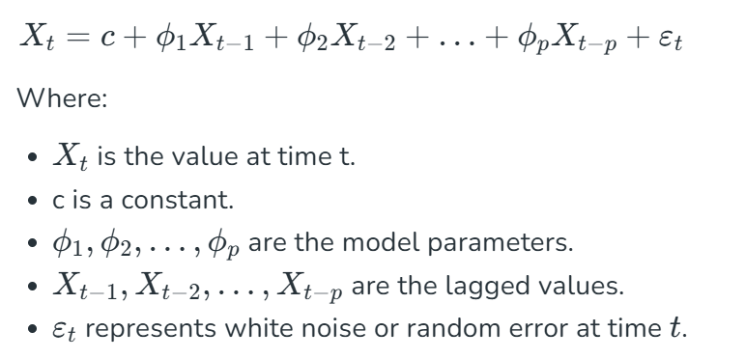
Mathematical Explanation
Mathematically, autoregressive model of order p, denoted as AR(p) and can be expressed as:

Slide 14

Types of Autoregressive Models
Autoregressive models vary based on the number of past values (lags) they use. The two most common types are:
1. AR(1) Model: This is a autoregressive model of order 1 which is the simplest form of an autoregressive model. In this model the current value of the time series depends only on its immediate past value along with a constant and some random noise. This model is particularly useful when the data shows strong autocorrelation at lag 1 i.e the current value depends only on the previous value. It is expressed as:
2. AR(p) Model: It is the generalized form of the autoregressive model where the current value depends on the past p values.

Slide 15
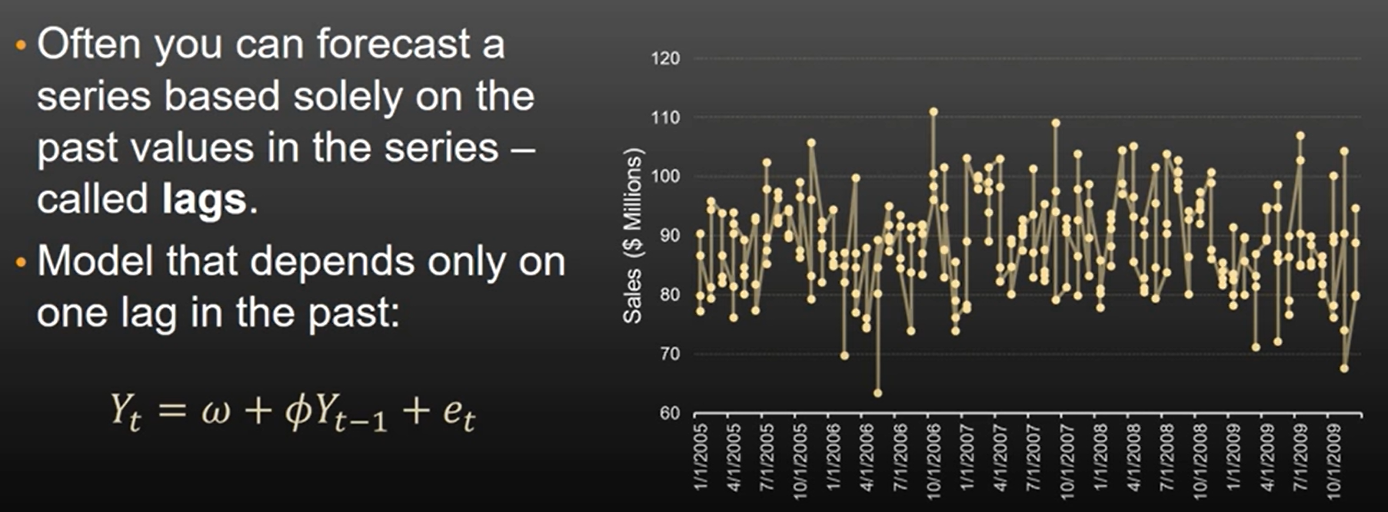
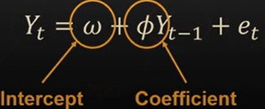
AR (1) Models

Slide 16
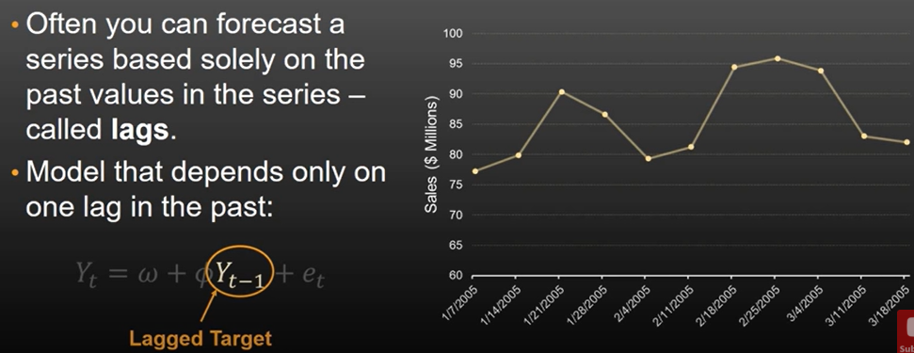
AR (1) Models

Slide 17
Applications of AR models
Weather Forecasting: Estimating future weather parameters such as temperature, pressure, or wind speed.
Financial Forecasting: Analyzing and predicting stock prices, interest rates, and other financial variables.
Traffic Forecasting: Predicting traffic flow on roadways based on historical data.
Sales Forecasting: Predicting future sales based on past sales data and other relevant factors.
Energy Consumption Forecasting: Forecasting energy consumption patterns for efficient resource allocation

Slide 18
Autoencoders
Context— Data compression
Data compression is an essential phase in training a network. The idea is to compress the data so that the same amount of information can be represented by fewer bits. This also helps with the problem of the curse of dimensionality. A dataset with many attributes is different to train with because it tends to overfit the model. Hence dimensionality reduction techniques need to be applied before the dataset can be used for training.
This is where the Autoencoder (AE) and Variational Autoencoder (VAE) come into play.

Slide 19
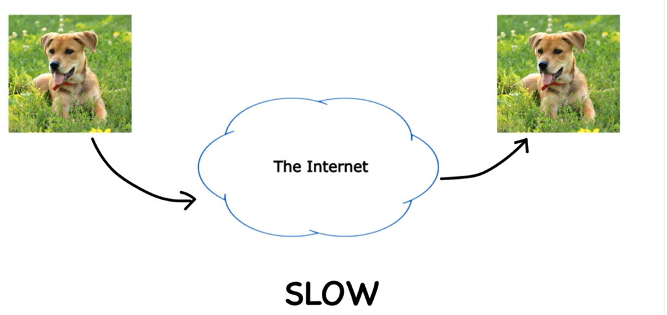
Why Autoencoders are required?

Slide 20
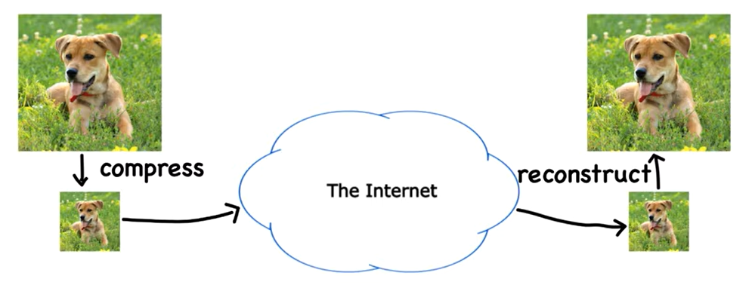
Why Autoencoders are required?

Slide 21
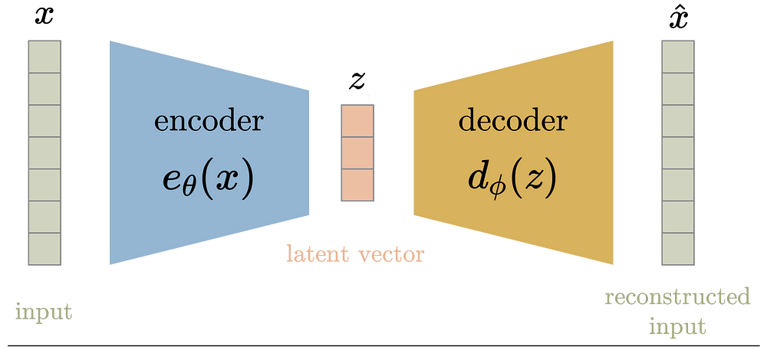
Autoencoder: What it is ?
Autoencoder is used to learn efficient embeddings of unlabeled data for a given network configuration. The autoencoder consists of two parts, an encoder, and a decoder. The encoder compresses the data from a higher-dimensional space to a lower-dimensional space (also called the latent space), while the decoder does the opposite i.e., convert the latent space back to higher-dimensional space. The decoder is used to ensure that latent space can capture most of the information from the dataset space, by forcing it to output what was fed as input to the decoder.
Compression
Reconstruction

Slide 22
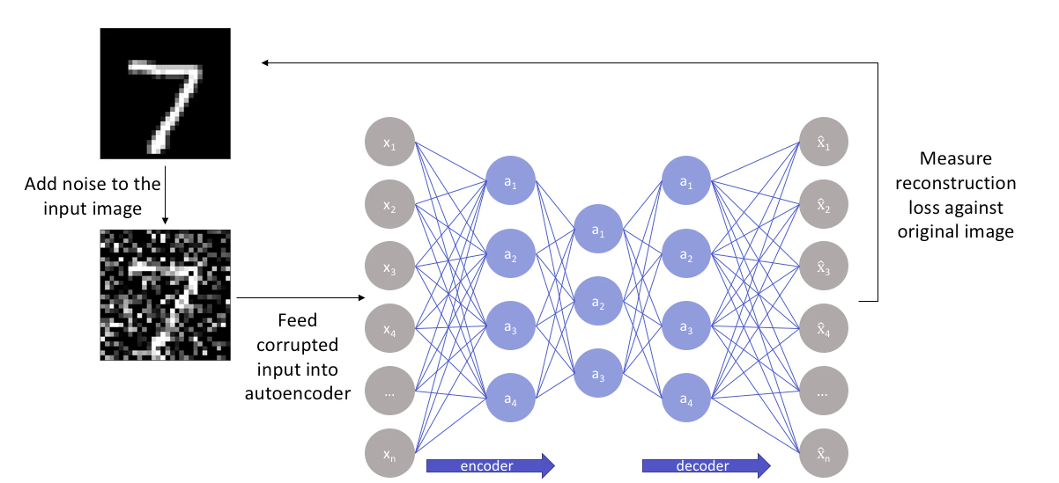
Autoencoder Architecture
Bottleneck

Slide 23
Autoencoder: Architecture
Autoencoders are neural network architectures designed to learn efficient data codings in an unsupervised manner. They consist of three main components:
Encoder,
Bottleneck (or latent space or code), and
Decoder.
The encoder compresses the input data, the bottleneck layer holds the compressed representation, and the decoder reconstructs the input from this compressed form.

Slide 24
Autoencoder: Architecture
1. Encoder: The encoder is a neural network (typically feedforward) that takes the input data and transforms it into a lower-dimensional representation.
This compressed representation is often called the "latent space" or "code".
The encoder's goal is to learn the most important features of the input and discard less relevant information.
2. Bottleneck (Latent Space): This is the layer with the reduced dimensionality, acting as a bridge between the encoder and decoder.
It represents the compressed form of the input data, containing the essential features learned by the encoder.
3. Decoder: The decoder is another neural network (also typically feedforward) that takes the latent space representation as input.
Its task is to reconstruct the original input data from this compressed representation.
The decoder essentially reverses the encoding process, aiming to minimize the difference between the reconstructed output and the original input.
How it works:
The autoencoder is trained to minimize the reconstruction error, which is the difference between the input and the reconstructed output.
By minimizing this error, the autoencoder learns to find a compact and efficient representation of the input data in the latent space.
This learned representation can then be used for various downstream tasks, such as dimensionality reduction, feature extraction, or anomaly detection.
Key Considerations:

Slide 25
Autoencoder: Architecture
Key Considerations:
Number of layers:
Autoencoders can have varying depths, with deeper networks potentially learning more complex representations.
Number of nodes per layer:
The number of neurons in each layer, especially in the bottleneck, is a crucial hyperparameter that affects the level of compression.
Loss function:
Common loss functions include Mean Squared Error (MSE) and Binary Cross-Entropy, depending on the type of data.

Slide 26
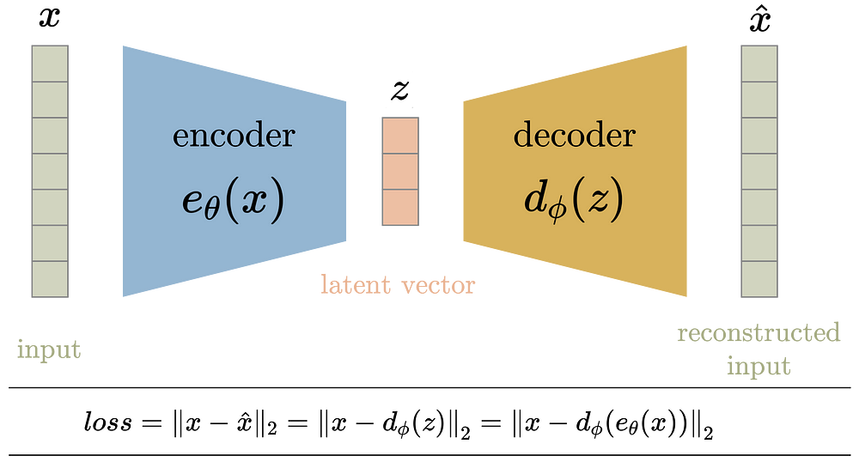
Autoencoder: Loss Function
The entire encoder-decoder architecture is collectively trained on the loss function which encourages that the input is reconstructed at the output. Hence the loss function is the mean squared error between the encoder input and the decoder output.

Slide 27
Variational Autoencoders
Variational autoencoder addresses the issue of non-regularized latent space in autoencoder and provides the generative capability to the entire space.
The encoder in the AE outputs latent vectors. Instead of outputting the vectors in the latent space, the encoder of VAE outputs parameters of a pre-defined distribution in the latent space for every input.
The VAE then imposes a constraint on this latent distribution forcing it to be a normal distribution. This constraint makes sure that the latent space is regularized.

Slide 28
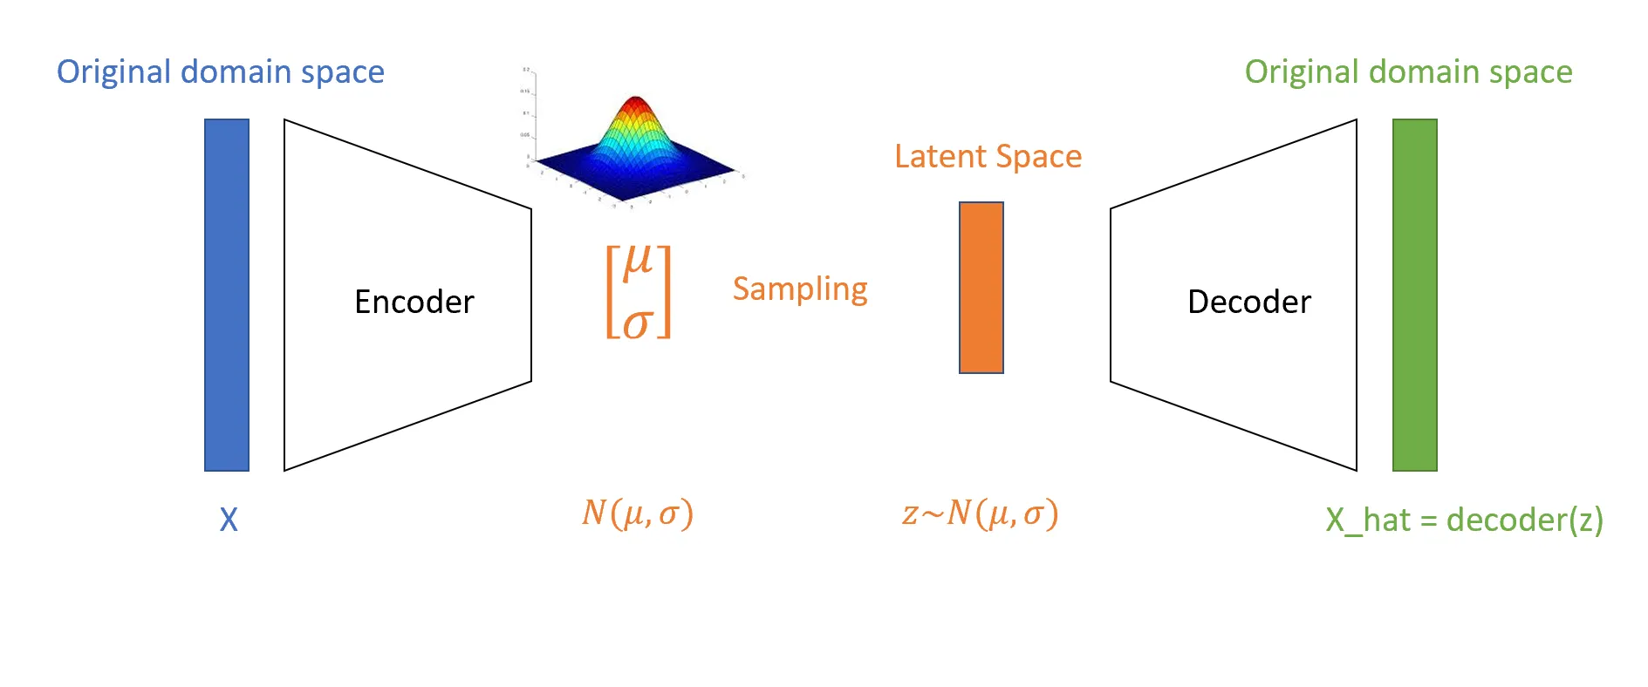
Variational Autoencoders
Variational autoencoder addresses the issue of non-regularized latent space in autoencoder and provides the generative capability to the entire space.
The encoder in the AE outputs latent vectors. Instead of outputting the vectors in the latent space, the encoder of VAE outputs parameters of a pre-defined distribution in the latent space for every input.
The VAE then imposes a constraint on this latent distribution forcing it to be a normal distribution. This constraint makes sure that the latent space is regularized.
Probabilistic Latent Space

Slide 29
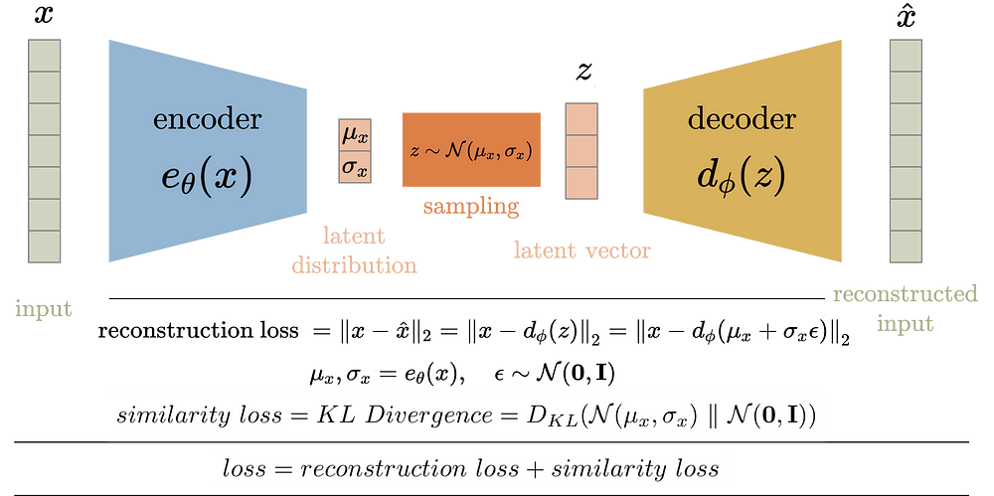
VAE: Block Diagram
The block diagram of VAE can be seen below. During training, the input data x is fed to the encoder function e_theta(x). Just like AE, the input is passed through a series of layers (parameterized by the variable theta) reducing its dimensions to achieve a compressed latent vector z. However, the latent vector is not the output of the encoder. Instead, the encoder outputs the mean and the standard deviation for each latent variable. The latent vector is then sampled from this mean and standard deviation which is then fed to the decoder to reconstruct the input. The decoder in the VAE works similarly to the one in AE.

Slide 30
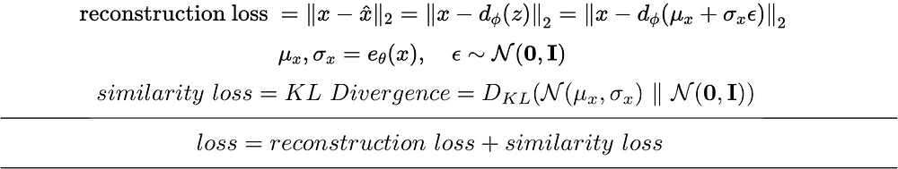
VAE: Loss Function
Training loss of VAE is defined as the sum of these the
reconstruction loss and
the similarity loss.
The reconstruction error, just like in AE, is the mean squared loss of the input and reconstructed output.
The similarity loss is the KL (KL Divergence = Kullback–Leibler Divergence) divergence between the latent space distribution and standard gaussian (zero mean and unit variance).
The loss function is then the sum of these two losses.

Slide 31
VAE: Loss Function
Training loss of VAE is defined as the sum of these the
reconstruction loss and
the similarity loss.
The reconstruction error, just like in AE, is the mean squared loss of the input and reconstructed output.
The similarity loss is the KL (KL Divergence = Kullback–Leibler Divergence) divergence between the latent space distribution and standard gaussian (zero mean and unit variance).
The loss function is then the sum of these two losses.
Kullback–Leibler Divergence: It's a measure of how one probability
distribution diverges from another.

Slide 32
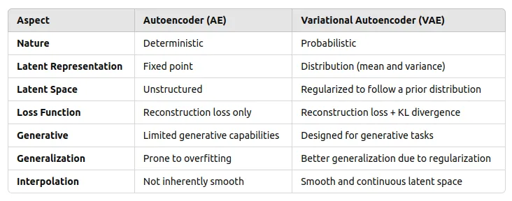
Difference between AE and VAE
Autoencoders (AE)are good for dimensionality reduction and reconstruction, but not for generating new data.
VAEs are more powerful generative models, capable of producing diverse data samples based on the learned latent distribution

Slide 33
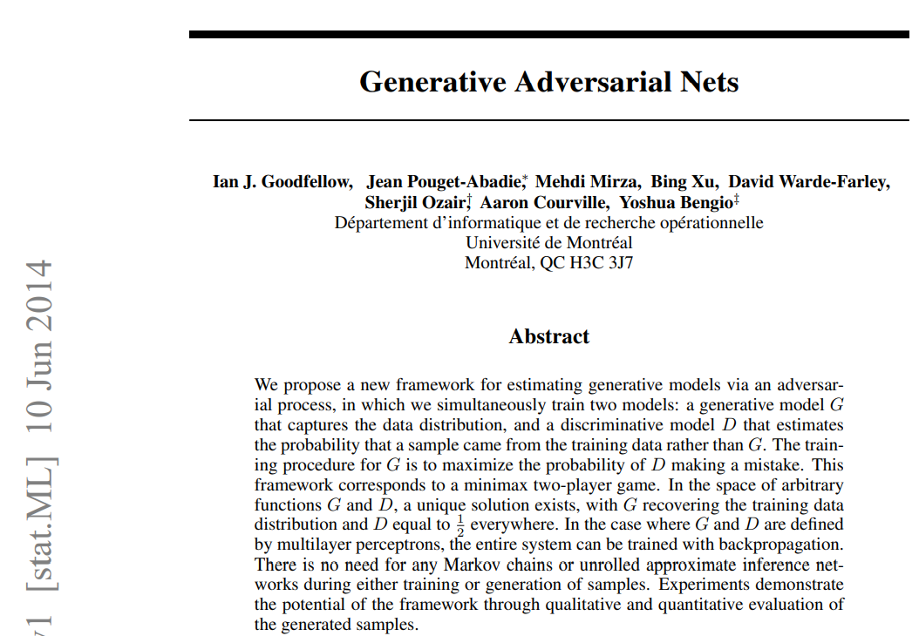
Generative Adversarial Networks (GANs)
Base Research Paper

Slide 34
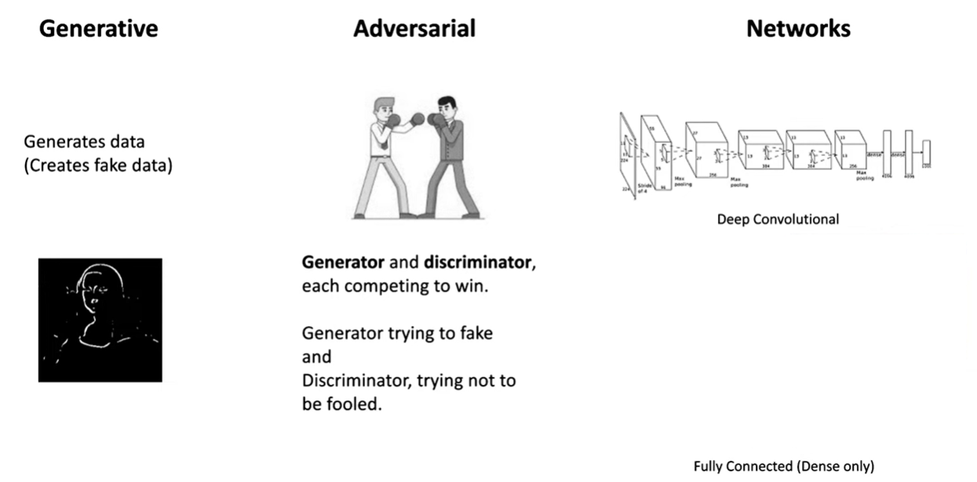
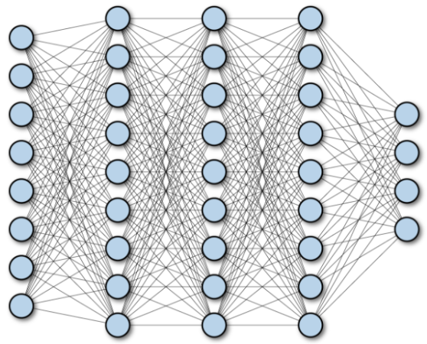
What is GANs?
Many machine learning systems look at some kind of complicated input (say, an image) and produce a simple output (a label like, "cat"). By contrast, the goal of a generative model is something like the opposite: take a small piece of input—perhaps a few random numbers—and produce a complex output, like an image of a realistic-looking face.
A generative adversarial network (GAN) is generative model.

Slide 35
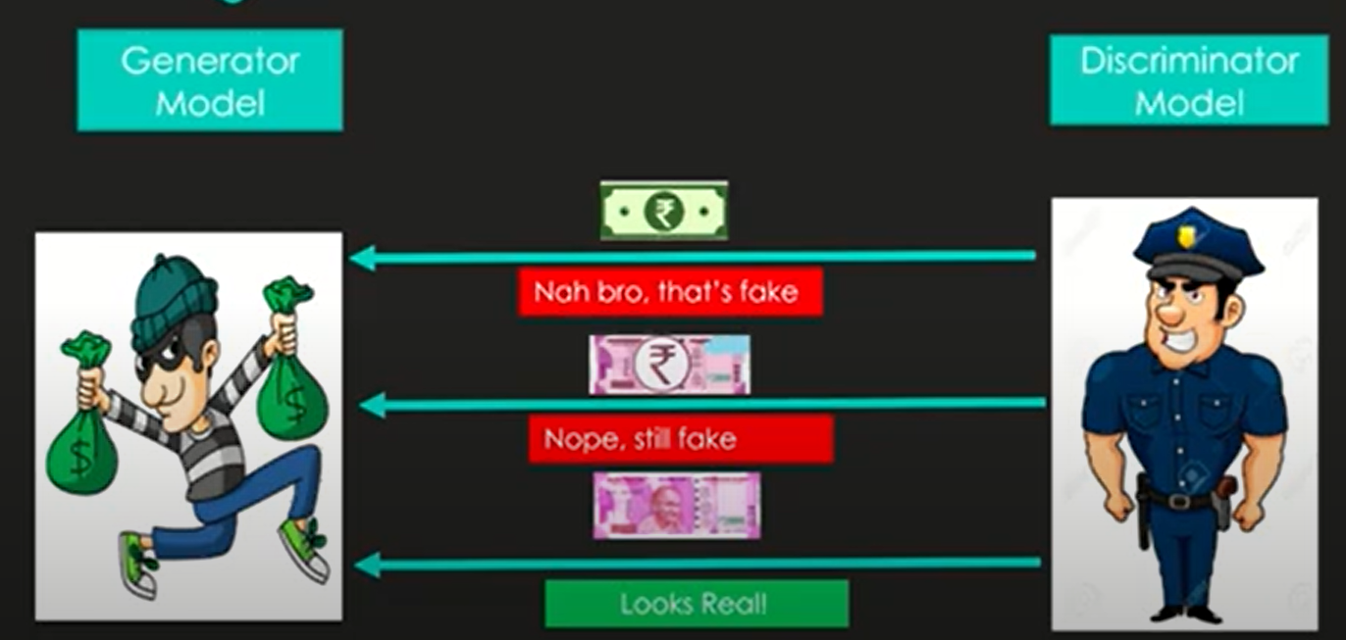
Analogy for Students
Imagine a forger (Generator) trying to make fake currency and a detective (Discriminator) trying to spot fakes.
The forger improves by learning from how well they trick the detective.
The detective improves by getting better at spotting fakes.
Over time, the forger gets so good that the detective can’t tell the difference.

Slide 36
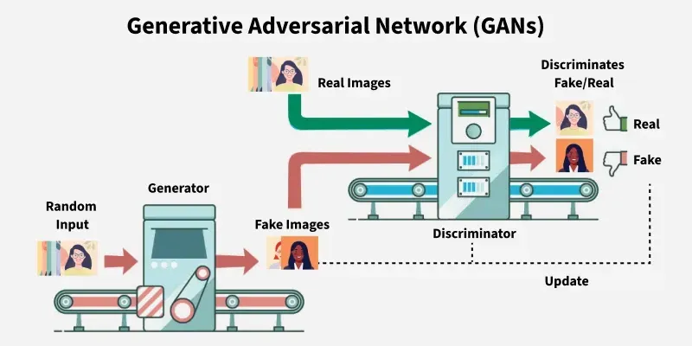
What is GANs?

Slide 37
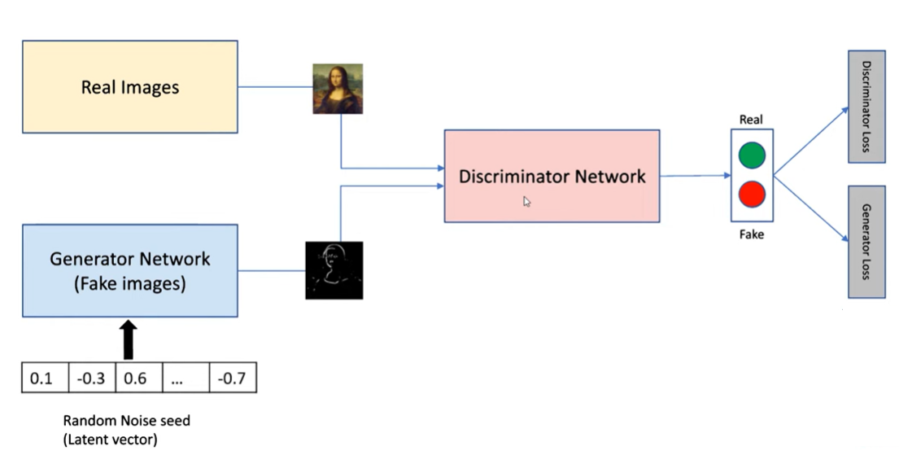
At brief, how GANs work ?

Slide 38
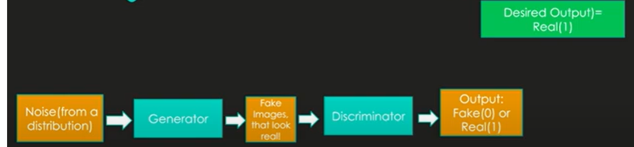
Generator

Slide 39
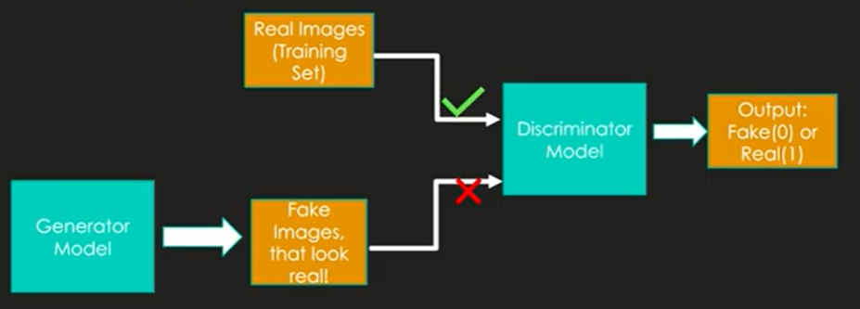
Discriminator

Slide 40
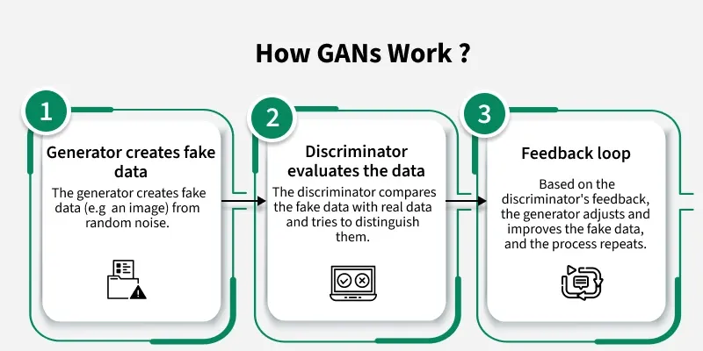
At brief, how GANs work ?

Slide 41
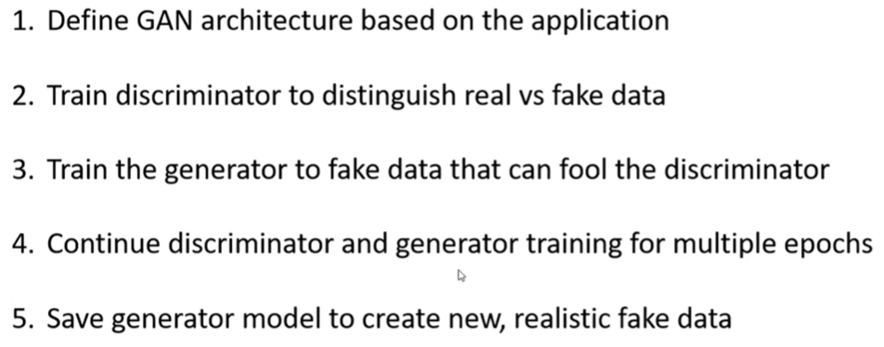
Five steps of GANs

Slide 42
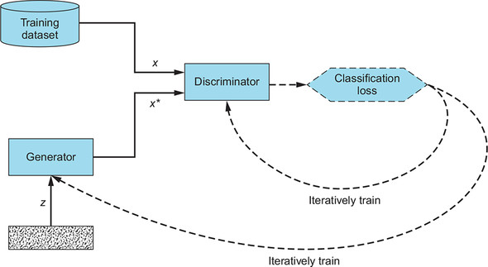
Training GANs
In this GAN architecture diagram, both the Generator and the Discriminator are trained using the Discriminator’s loss. The Discriminator strives to minimize the loss; the Generator seeks to maximize the loss for the fake examples it produces.

Slide 43
GAN training example
Let's contextualize the above with an example of the GAN model in image-to-image translation.
Consider that the input image is a human face that the GAN attempts to modify. For example, the attributes can be the shapes of eyes or ears. Let's say the generator changes the real images by adding sunglasses to them. The discriminator receives a set of images, some of real people with sunglasses and some generated images that were modified to include sunglasses.
If the discriminator can differentiate between fake and real, the generator updates its parameters to generate even better fake images. If the generator produces images that fool the discriminator, the discriminator updates its parameters. Competition improves both networks until equilibrium is reached.

Slide 44
How does a generative adversarial network work?
A generative adversarial network system comprises two deep neural networks—the generator network and the discriminator network. Both networks train in an adversarial game, where one tries to generate new data and the other attempts to predict if the output is fake or real data.
Technically, the GAN works as follows. A complex mathematical equation forms the basis of the entire computing process, but this is a simplistic overview:
The generator neural network analyzes the training set and identifies data attributes
The discriminator neural network also analyzes the initial training data and distinguishes between the attributes independently
The generator modifies some data attributes by adding noise (or random changes) to certain attributes
The generator passes the modified data to the discriminator
The discriminator calculates the probability that the generated output belongs to the original dataset
The discriminator gives some guidance to the generator to reduce the noise vector randomization in the next cycle
The generator attempts to maximize the probability of mistake by the discriminator, but the discriminator attempts to minimize the probability of error. In training iterations, both the generator and discriminator evolve and confront each other continuously until they reach an equilibrium state. In the equilibrium state, the discriminator can no longer recognize synthesized data. At this point, the training process is over.

Slide 45
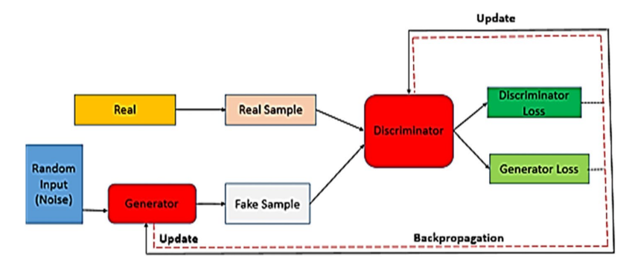
How does a generative adversarial network work?

Slide 46
Types of generative adversarial networks
There are different types of GAN models depending on the mathematical formulas used and the different ways the generator and discriminator interact with each other.
Some commonly used models are listed below, but the list is not comprehensive. There are numerous other GAN types—that solve different types of problems.
Conditional GAN: A conditional GAN (cGAN) introduces the concept of conditionality, allowing for targeted data generation. The generator and discriminator receive additional information, typically as class labels or some other form of conditioning data. For instance, if generating images, the condition could be a label that describes the image content. Conditioning allows the generator to produce data that meets specific conditions.
Deep convolutional GAN: Recognizing the power of convolutional neural networks (CNNs) in image processing, Deep convolutional GAN (DCGAN) integrates CNN architectures into GANs. With DCGAN, the generator uses transposed convolutions to upscale data distribution, and the discriminator also uses convolutional layers to classify data. The DCGAN also introduces architectural guidelines to make training more stable.
Super-resolution GAN: Super-resolution GANS (SRGANs) focus on upscaling low-resolution images to high resolution. The goal is to enhance images to a higher resolution while maintaining image quality and details.
StyleGAN is designed for generating high-resolution, realistic images with fine-grained control over style and attributes, making it suitable for tasks like photo-realistic image synthesis.
CycleGAN, on the other hand, focuses on unpaired image-to-image translation, enabling tasks like style transfer, season translation, and object transformation without the need for paired training data.

Slide 47
Applications of GANs
1. Generating realistic images: GANs can create entirely new, realistic images, such as human faces, landscapes, or objects, based on learned patterns from training data
2. Image-to-image translation: GANs can translate images from one domain to another, like converting a sketch to a realistic photo, changing seasons in a picture, or translating day to night.
3. Super-resolution: GANs can enhance the resolution of low-resolution images, improving clarity and detail.
4. Video prediction: GANs can predict future frames in a video sequence, useful for tasks like video forecasting or generating virtual environments.
5. Text-to-image synthesis: GANs can generate images based on textual descriptions, allowing for AI-generated art and content creation
6. Speech Synthesis: Generating human speech from text or other input. Music Generation: Creating new musical pieces or melodies.

Slide 48
Advantages of GAN
Synthetic Data Generation: GANs produce new, synthetic data resembling real data distributions which is useful for augmentation, anomaly detection and creative tasks.
High-Quality Results: They can generate photorealistic images, videos, music and other media with high quality.
Unsupervised Learning: They don’t require labeled data helps in making them effective in scenarios where labeling is expensive or difficult.
Versatility: They can be applied across many tasks including image synthesis, text-to-image generation, style transfer, anomaly detection and more.

Slide 49
Limitations of GANs
1. Training Instability: This adversarial setup can lead to unstable convergence, where the networks do not improve in a balanced manner. If the discriminator becomes too strong, the generator may struggle to produce realistic data, and vice versa. This instability can result in prolonged training times and inconsistent results.
2. Mode Collapse: Mode collapse is a common issue in GAN training, where the generator produces a limited variety of outputs, failing to capture the diversity of the real data distribution.
3. Sensitivity to Hyperparameters: GANs are highly sensitive to hyperparameters, such as learning rates, batch sizes, and network architectures. Small changes in these parameters can significantly impact the training process and the quality of the generated outputs.
4. High Computational Cost: Training GANs is computationally intensive, often requiring powerful hardware, such as GPUs or TPUs, and substantial time.

Slide 50
Diffusion Models vs GANs
GANs (Generative Adversarial Networks) and Diffusion Models are both types of generative AI models, but they differ significantly in their approach and characteristics.
GANs mine a generator against a discriminator, while diffusion models iteratively add and remove noise to generate data.
GANs are generally faster but can be unstable, while diffusion models are more stable but slower.

Slide 51
Introduction to Diffusion Models
In a seminal 2015 paper named “The Deep Unsupervised Learning using Nonequilibrium Thermodynamics,” Sohl-Dickstein et al. first introduced diffusion models in deep learning. Again in 2019, Song et al. published a paper called, “Generative Modeling by Estimating Gradients of the Data Distribution,” using the same principle but with a different approach. The actual development and training of diffusion models gained momentum in 2020 with the publication of Ho et al.’s paper, “Denoising Diffusion Probabilistic Models,” which has since become widely popular.
Diffusion models are a new class of deep generative models that break the long-time dominance of Generative Adversarial Networks (GANs) in the challenging task of image synthesis in a variety of domains, ranging from computer vision, natural language processing, temporal data modeling to multi-modal modeling.
These models have demonstrated their versatility and effectiveness in addressing challenges and solving problems within diverse areas, including computational chemistry and medical image reconstruction.
Diffusion models work on the core principle of creating data comparable to the inputs they were trained on. They function fundamentally by corrupting training data by successively adding gaussian noise, and then learning to recover the data by reversing this noising process. In this article, we will take a look at some of the technical underpinnings of diffusion models, focusing first on their key concepts, image generation techniques, their comparison with GANs followed by their training and applications.

Slide 52
Why It’s Called a Diffusion Model
The name comes from the fact that the forward process diffuses (adds) noise, and the reverse process tries to invert this diffusion.
This concept is inspired by thermodynamics where particles move from order to disorder (diffusion), and the reverse process seeks to model that backward (denoising).

Slide 53
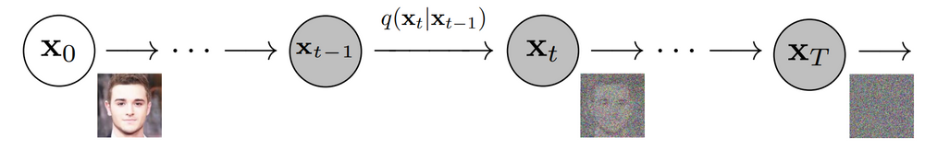
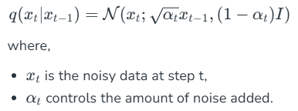
Architecture of Diffusion Models
The architecture of diffusion models typically involves two main components:
Forward Diffusion Process
In this process, noise is incrementally added to the data over a series of steps. This is akin to a Markov chain where each step slightly degrades the data by adding Gaussian noise.
Mathematically, this can be represented as:

Slide 54
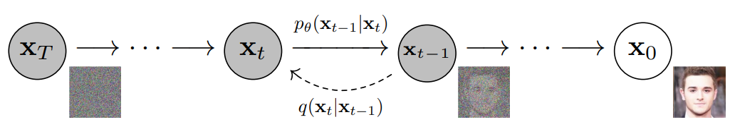

Architecture of Diffusion Models
Reverse Diffusion Process: The reverse process aims to reconstruct the original data by denoising the noisy data in a series of steps, reversing the forward diffusion.
This is typically modelled using a neural network that predicts the noise added at each step:

Slide 55

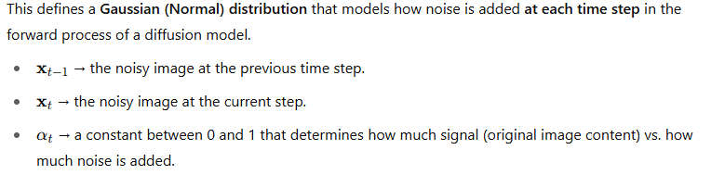
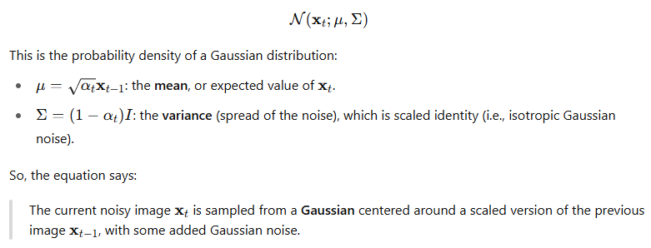
Architecture of Diffusion Models
Let's go deeper into the mathematical representation of the forward process in diffusion models, specifically this equation from the image:

Slide 56
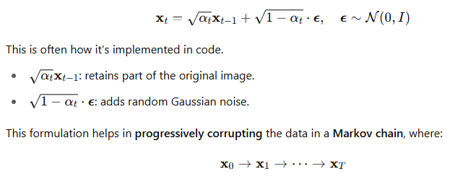
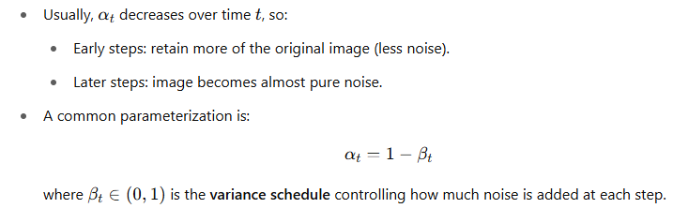
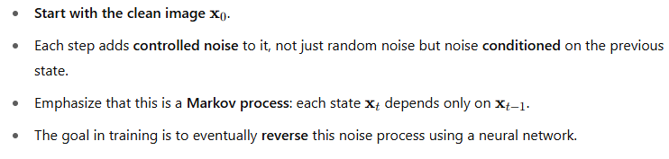
Architecture of Diffusion Models
Notes:
Start with the clean image x0\mathbf{x}_0x0​.
Each step adds controlled noise to it, not just random noise but noise conditioned on the previous state.
Emphasize that this is a Markov process: each state xt\mathbf{x}_txt​ depends only on xt−1\mathbf{x}_{t-1}xt−1​.
The goal in training is to eventually reverse this noise process using a neural network.

Slide 57

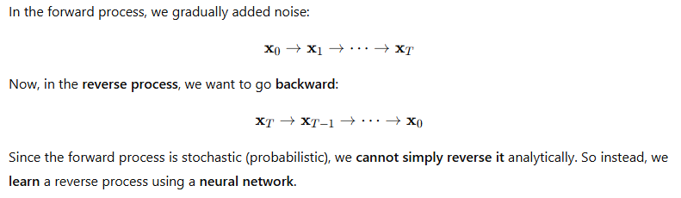
Architecture of Diffusion Models
Reverse Diffusion Process
This is one of the core equations of how diffusion models generate data (e.g., images) from noise.

Slide 58
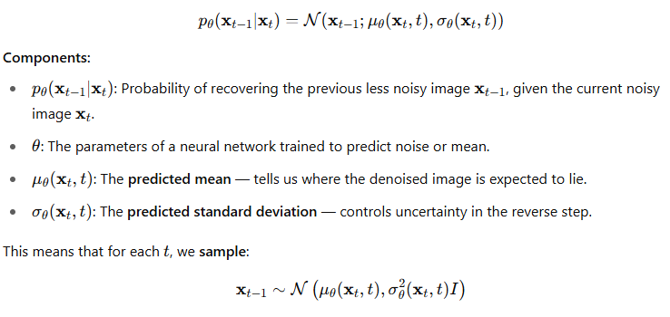
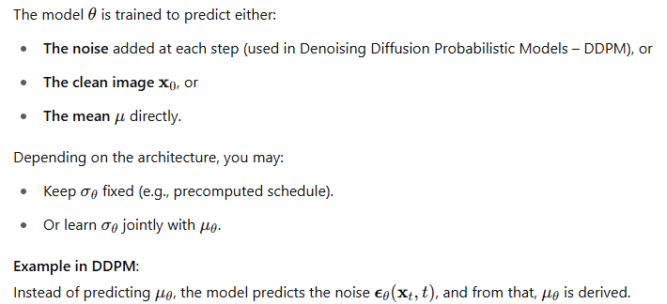
Role of Neural Network

Slide 59
Applications of Diffusion Models
Diffusion models have shown great promise in various applications, particularly in generative tasks. Some notable applications include:
Image Generation: Diffusion models can generate high-quality, realistic images from random noise. They have been used to create diverse datasets for training other machine learning models.
Speech Synthesis: These models can generate human-like speech by modelling the distribution of audio signals.
Data Augmentation: Diffusion models can be used to augment existing datasets with new, synthetic samples, improving the performance of machine learning models.
Anomaly Detection: By modelling the normal data distribution, diffusion models can help identify anomalies that deviate from this distribution.

Slide 60
Advantages of Diffusion Models
Flexibility: They can model complex data distributions without requiring explicit likelihood estimation.
High-Quality Generation: Diffusion models generate high-quality samples, often surpassing other generative models like GANs.
Stable Training: Unlike GANs, diffusion models avoid issues like mode collapse and unstable training dynamics.
Theoretical Foundations: Based on well-understood principles from stochastic processes and statistical mechanics.
Scalability: Can be effectively scaled to high-dimensional data and large datasets.
Robustness: More robust to hyperparameter changes compared to GANs.

Slide 61
Limitations of Diffusion Models
Computationally Intensive: Requires significant computational resources due to the large number of iterative steps.
Slow Sampling: Generating samples can be slow because of the many steps needed for the reverse diffusion process.
Complexity: The architecture and training process can be complex, making them challenging to implement and understand.
Memory Usage: High memory consumption during training due to the need to store multiple intermediate steps.
Fine-Tuning: Requires careful tuning of noise schedules and other hyperparameters to achieve optimal performance.
Resource Demand: High demand for GPUs or TPUs, making them less accessible for small-scale research or applications with limited resources.

Slide 62
Vector Quantized Diffusion (VQ-Diffusion) models
A Vector Quantized Diffusion Model combines vector quantization (VQ) with diffusion models to generate discrete data (like text, code, or quantized image patches). It is especially useful when the output space is discrete, unlike the typical diffusion models which work in continuous pixel space.

Slide 63
What is a Codebook in Vector Quantization?
A codebook is a learned collection of discrete vectors (also called code vectors, embeddings, or prototypes) used to represent high-dimensional continuous data with discrete tokens.
Analogy: Dictionary for Vectors
Think of a codebook like a dictionary:
Each entry in the codebook has a fixed vector (e.g., a 64-dimensional vector).
During encoding, any input vector (like an image patch) is matched to its closest code in this dictionary.
The index of that code is used as the discrete token.

Slide 64
Vector Quantized Diffusion (VQ-Diffusion) models
1. Vector Quantization (VQ)
Converts high-dimensional continuous data (e.g., image patches) into discrete tokens from a codebook.
Each input vector is replaced by the nearest code from a learned set of embeddings.
This is typically done using VQ-VAE (Vector Quantized Variational Autoencoder):
Encoder → maps image to discrete latent tokens.
Decoder → reconstructs the image from the quantized tokens.
2. Diffusion on Discrete Tokens
Instead of adding Gaussian noise to pixels, discrete corruption is applied to tokens:
E.g., randomly replacing tokens with others or masking them .
The reverse diffusion process learns to denoise and recover the original token sequence.

Slide 65
How VQ-Diffusion Works
Pretrain VQ-VAE: Compress images (or other data) into discrete latent tokens.
Apply discrete diffusion:
Corrupt the sequence of tokens step-by-step (e.g., replace some tokens randomly).
Train a Transformer or Diffusion network to reverse this corruption.
Sample from noise (e.g., all-masked or all-random tokens) and denoise iteratively to generate realistic sequences of tokens.
Decode the tokens into final output (image, text, etc.).

Slide 66
Vector Quantized Diffusion (VQ-Diffusion) models
VQ-Diffusion is a two-stage model:
Compress the data into discrete codes using vector quantization.
Apply diffusion not on pixels but on the discrete codes, learning to denoise them over time.
This allows high-quality and efficient generation of structured data (e.g., image synthesis, text generation) in a discrete latent space.

Slide 67
Challenges and Limitations of Generative AI
Generative AI is revolutionizing industries, but it comes with several challenges and limitations that impact its effectiveness and ethical use.
1. Data Quality and Quantity: Generative AI needs a lot of good data to learn. If the data is not good like if it’s biased or incomplete the AI will produce poor results. These risks of generative AI can lead to wrong or harmful content.
2. Bias in AI Models: Bias in AI is a big problem. If the training data has biases related to race, gender, or other factors, the AI will likely repeat these biases in its outputs. The challenges of generative AI can cause ethical issues and harm the reputation of organizations.
3. Intellectual Property Issues: Generative AI can create content similar to existing works, which raises questions about who owns that content. These Generative AI problems can lead to legal problems for organizations.
4. Lack of Interpretability: Many generative AI models are complex and hard to understand. These challenges of generative AI make it difficult for users to know how decisions are made, which can be a problem in sensitive areas like healthcare.
5. Ethical Concerns: Generative AI can be misused, such as creating deepfakes or false information. The limitations of Generative AI pose risks to individuals and society.
6. Resource Intensity: Training generative AI models can use a lot of computing power as well as energy, leading to high costs and environmental concerns, which are significant challenges of generative AI.
7. Consistency in Output: Generative AI can produce different results for the same input, which can also be unpredictable. This is one of the Gen AI challenges in applications where consistency is important.
8. Security Risks: Generative AI can be vulnerable to attacks, and malicious users can manipulate AI to create harmful or misleading content, highlighting one of the critical challenges of generative AI.
9. User Acceptance and Trust: For generative AI to be widely accepted, users need to trust it. Concerns about the reliability of AI-generated content can hinder acceptance, especially in sensitive fields like journalism, representing significant challenges of generative AI.

Slide 68
Future of Gen AI
The future of Generative AI (GenAI) is poised for significant growth and integration across various industries, impacting how we work, create, and interact with technology. Key trends include advancements in Large Language Models (LLMs), integration with other AI technologies, and a focus on responsible development and deployment.
1. Advancements in LLMs and Multimodal AI:
LLMs will continue to evolve, becoming more powerful and efficient, with a focus on domain-specific models tailored to particular industries or tasks.
Multimodal AI, which combines different types of data (text, images, audio, video), will become more prevalent, leading to more sophisticated and versatile AI applications.
2. Increased Integration and Automation:
GenAI will be increasingly integrated into various aspects of business operations, automating tasks, improving efficiency, and driving innovation.
AI agents, capable of performing complex tasks autonomously, are expected to become more common.
3. Domain-Specific Models and Focus on Practical Applications:
While general-purpose models are valuable, there will be a growing demand for domain-specific GenAI models tailored to the unique needs of different industries and business functions.
The focus will shift towards practical applications, such as content creation, automation, and real-time data analysis, rather than just theoretical advancements.
4. Rise of Smaller LLMs: AI development companies are finally looking for smaller LLMs. LLMs, which work behind the scenes in today's popular chatbots, have very large parameters, containing billions of them. However, these are beyond the capabilities of most companies to create. Maintaining smaller LLMs is affordable for companies, and it is also easier to operate them.

Slide 69
Ethical Aspects of Generative AI
Generative AI (GenAI) presents a range of ethical challenges, including bias, misinformation, copyright infringement, and the potential for misuse. Addressing these concerns requires a proactive approach focused on transparency, accountability, and responsible development and deployment.
1. Environmental impacts: Building, training, and using generative AI models requires the use of a significant amount of energy and contributes carbon emissions. It also consumes a lot of water for cooling.
2. Accessibility: Although many generative AI tools are currently free, more and more are applying a cost to access them or to use premium features. This creates barriers for those who are unable to afford access.
3. Copyright and Intellectual Property: GenAI models are trained on vast datasets, and there are concerns about whether this training infringes on copyright and intellectual property rights.
4. Data Privacy and Security: GenAI systems collect and process u ser data, raising concerns about data privacy, security, and the potential for misuse of personal information.
5. Misuse for Malicious Purposes: GenAI can be used to create harmful content, including propaganda, malware, and other malicious tools.

Slide 70
Thanks for Listening
Notes:
https://colab.research.google.com/github/ageron/handson-ml2/blob/master/02_end_to_end_machine_learning_project.ipynb#scrollTo=tLb7or7j1rMW

