Slide 1

Deep Learning and Generative AI MSCS202
Course Instructor
Dr. Umadevi V
Department of CSE, BMSCE

Slide 2
Disclaimer
Contents given in PPT are brief and for reference only. Should refer to text book/relevant materials for detailed description.

Slide 3
Unit-2
Unit-2: Convolutional Neural Networks: Introduction, Filters and Feature Maps, Max Pooling, Popular CNN Architectures: LeNet, AlexNet, VGG, ResNet, Accelerating Training with Batch Normalization, Group Normalization for Memory Constrained Learning Tasks, Residual Learning and Skip Connections for very Deep Networks, Transfer Learning, CNN Applications

Slide 4
Convolutional Neural Networks (CNNs)
Convolutional networks, also known as convolutional neural networks or CNNs, are a specialized kind of neural network for processing data that has a known, grid-like topology.
Examples include time-series data, which can be thought of as a 1D grid taking samples at regular time intervals, and image data, which can be thought of as a 2D grid of pixels.
The name “convolutional neural network” indicates that the network employs a mathematical operation called convolution. Convolution is a specialized kind of linear operation.
Convolutional networks are simply neural networks that use convolution in place of general matrix multiplication in at least one of their layers.

Slide 5
Applications of CNNs
Image classification: CNNs are the state-of-the-art models for image classification. They can be used to classify images into different categories such as cats and dogs.
Object detection: It can be used to detect objects in images such as people, cars and buildings. They can also be used to localize objects in images which means that they can identify the location of an object in an image.
Image segmentation: It can be used to segment images which means that they can identify and label different objects in an image. This is useful for applications such as medical imaging and robotics.
Video analysis: It can be used to analyze videos such as tracking objects in a video or detecting events in a video. This is useful for applications such as video surveillance and traffic monitoring.
Ref. : https://www.geeksforgeeks.org/deep-learning/convolutional-neural-network-cnn-in-machine-learning/

Slide 6
CNNs: Why they are needed ?

Slide 7
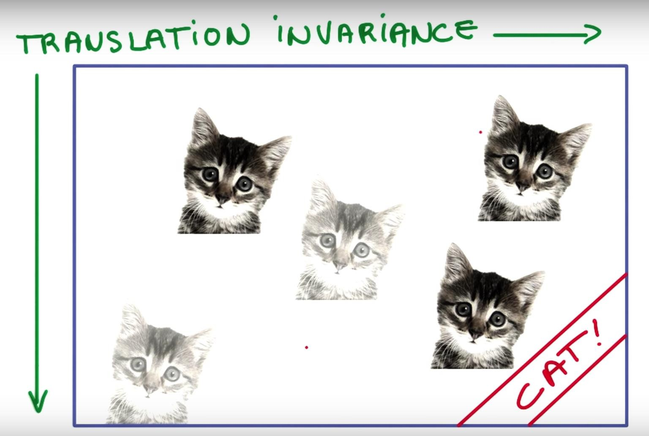
Advantage of Image data
Spatial Locality: Spatial locality is a fundamental advantage of image data, referring to the principle that pixels physically close to each other in an image are highly likely to be related or similar in value. Example: Pixels of cat are next to each other
Translation Invariance: Translation Invariance means that if an object occurs in any image it will be detected irrespective of its position. Example: Cat is cat , where ever it is.
Ref: https://aiplanet.com/learn/getting-started-with-deep-learning/convolutional-neural-networks/267/cnn-transfer-learning-data-augmentation

Slide 8
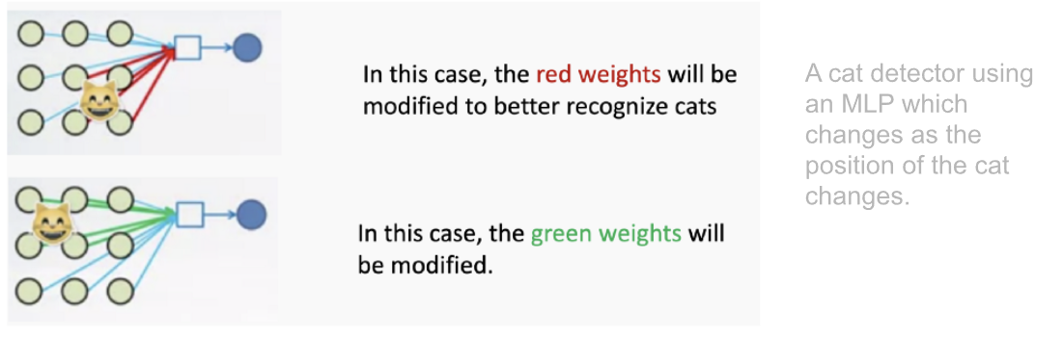
CNNs: Why they are needed ?
Disadvantages of Multi Layer Perceptron (MLP) or Artificial Neural Network (ANN)
Need to connect neurons in the hidden layer to ALL the neurons in the input layer
No spatial information: Since we reshape the image from 2D to 1D, it doesn't understand the spatial structure of the image, i.e., it is not spatially invariant. For example, if a picture of a cat appears in the top left of the image in one picture and the bottom right of another picture, the MLP will try to correct itself and assume that a cat will always appear in this section of the image.
And many, many parameters to be handled. MLPs use one perceptron for each input (e.g. pixel in an image, multiplied by 3 in RGB case). The amount of weights rapidly becomes unmanageable for large images. For a 224 x 224 pixel image with three color channels, there are around 150,000 weights that must be trained!
Ref: https://aiplanet.com/learn/getting-started-with-deep-learning/convolutional-neural-networks/267/cnn-transfer-learning-data-augmentation

Slide 9
CNNs: Why they are needed ?
Spatial Locality: CNNs leverage spatial structure by using convolutions. Convolution operations captures edges, textures and shapes.
https://setosa.io/ev/image-kernels/
Translation Invariance: CNNs use pooling layers and shared weights. Robust to image translation.

Slide 10
What is Convolution?
Image processing utilizes convolution, a mathematical operation where a matrix (or kernel or filter) traverses the image and performs a dot product with the overlapping region. A convolution operation involves the following steps:
Define a small matrix (filter or kernel).
This kernel moves across the input image.
At each location, the convolution operation computes the dot product of the kernel and the portion of the image it overlaps.
The result of each dot product forms a new matrix that represents transformed features of the original image.
The primary goal of using convolution in image processing is to extract important features from the image and discard the rest. This results in a condensed representation of an image.

Slide 11
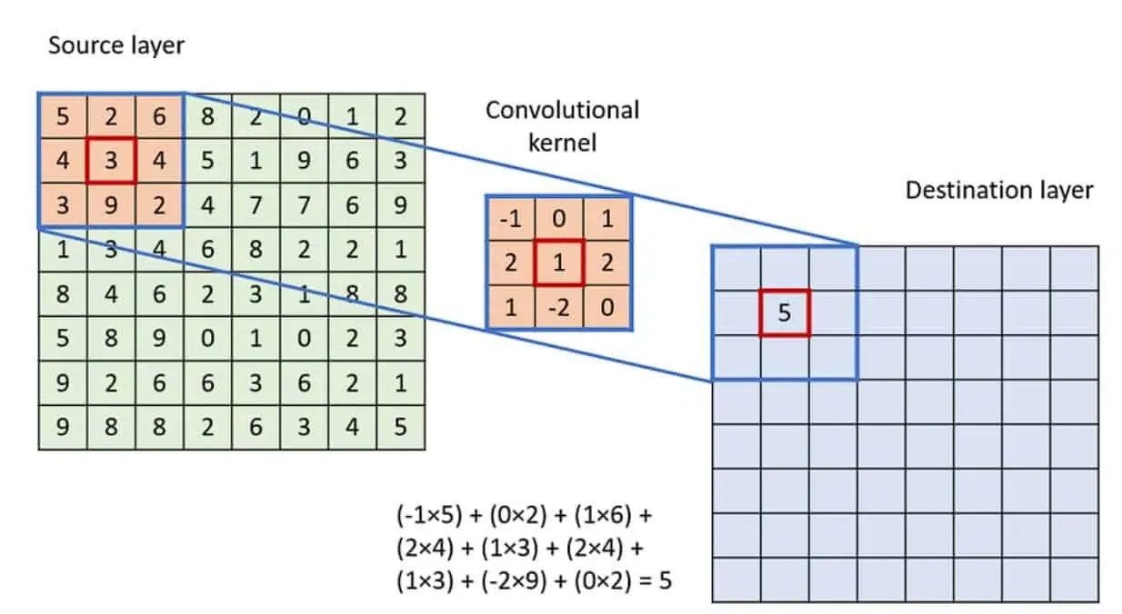
Convolution Operation
To apply the convolution:
Overlay the Kernel on the Image: Start from the top-left corner of the image and place the kernel so that its center aligns with the current image pixel.
Element-wise Multiplication: Multiply each element of the kernel with the corresponding element of the image it covers.
Summation: Sum up all the products obtained from the element-wise multiplication. This sum forms a single pixel in the output feature map.
Continue the Process: Slide the kernel over to the next pixel and repeat the process across the entire image.
Convolution
*
=
Ref.: https://viso.ai/deep-learning/convolution-operations/

Slide 12
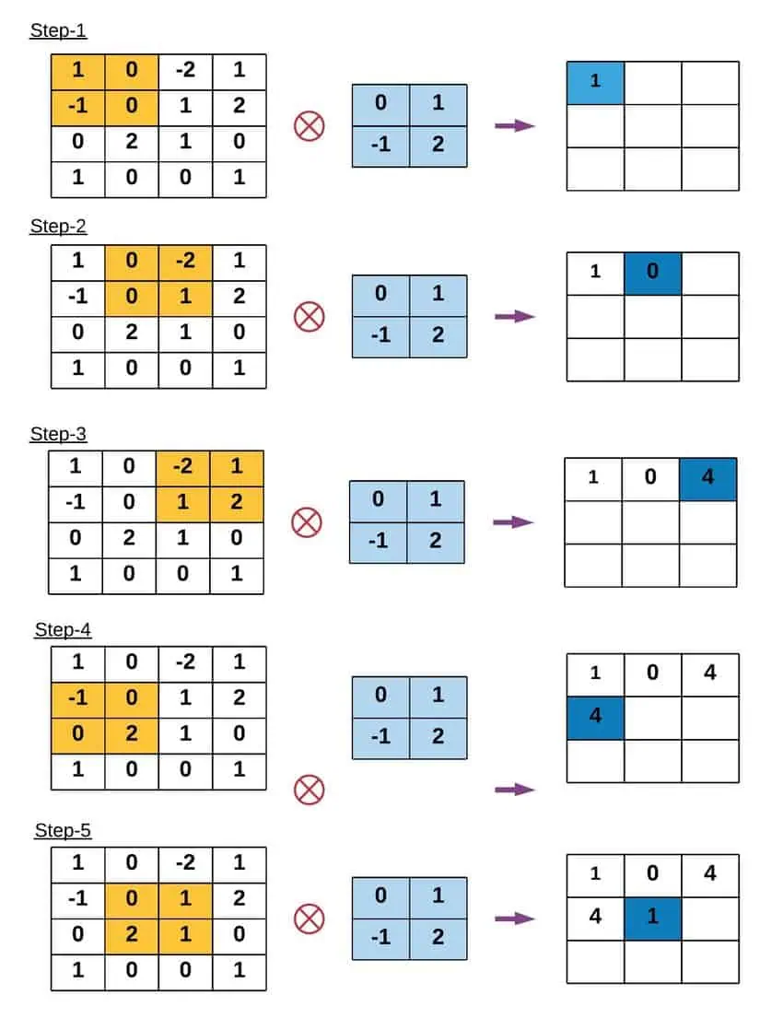
Example of Convolution Operation

Slide 13
Key Terms in Convolution Operation
Kernel Size: The convolution operation uses a filter, also known as a kernel, which is typically a square matrix. Common kernel sizes are 3×3, 5×5, or even larger. Larger kernels analyze more context within an image but come at the cost of reduced spatial resolution and increased computational demands.
Stride: Stride is the number of pixels by which the kernel moves as it slides over the image. A stride of 1 means the kernel moves one pixel at a time, leading to a high-resolution output of the convolution. Increasing the stride reduces the output dimensions, which can help decrease computational cost and control overfitting but at the loss of some image detail.
Padding: Padding involves adding an appropriate number of rows and columns (typically of zeros) to the input image borders. This ensures that the convolution kernel fits perfectly at the borders, allowing the output image to retain the same size as the input image.

Slide 14
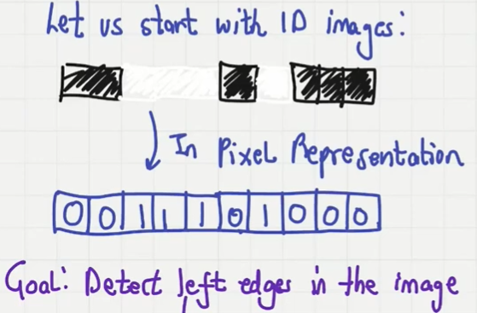

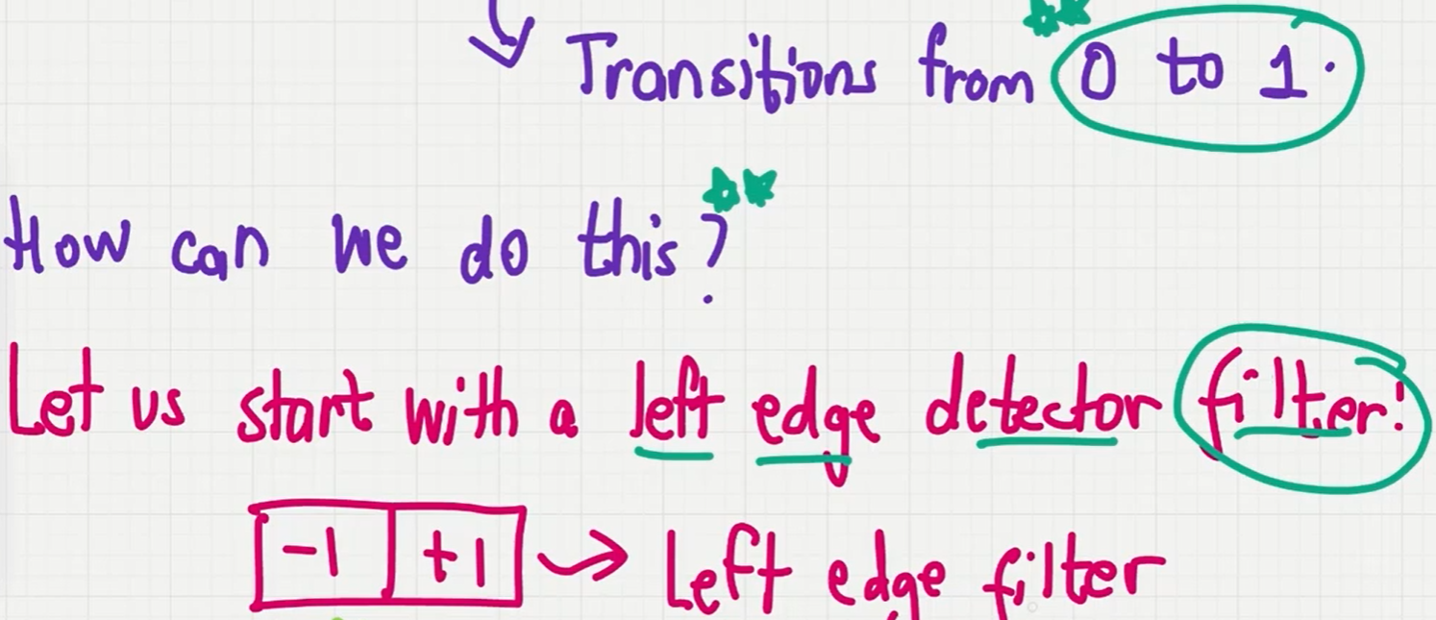
Filters or Kernels: Why do we care about them?
To detect left edge
Ref.: https://www.youtube.com/watch?v=P6d8NbTlEpU

Slide 15
Filters or Kernels: Why do we care about them?
1D image
Padding
0 | 0 | 1 | 1 | 1 | 0 | 1 | 0 | 0 | 0 | 0
Take the dot product
-1 | +1
Filter
0 | 1 | 0 | 0 | -1 | 1 | -1 | 0 | 0 | 0

Slide 16
Filters or Kernels: Why do we care about them?
1D image
Padding
0 | 0 | 1 | 1 | 1 | 0 | 1 | 0 | 0 | 0 | 0
Take the dot product
-1 | +1
Filter
0 | 1 | 0 | 0 | -1 | 1 | -1 | 0 | 0 | 0
Output: Ten data points
+1 is exactly at two locations
Pixel transitions from 0 to 1

Slide 17

Filters or Kernels: Why do we care about them?
Filters help us to detect features in images
-1 | +1
Left edge detector filter
+1 | -1
Right edge detector filter
-1 | +1 | -1
Isolated pixel detector filter

Slide 18
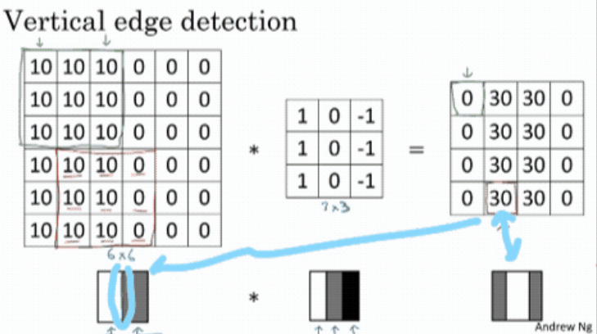
Image data: Example of Vertical Edge detection
Ref.: https://www.linkedin.com/pulse/deep-learning-cnn-edge-detection-chen-yang/

Slide 19
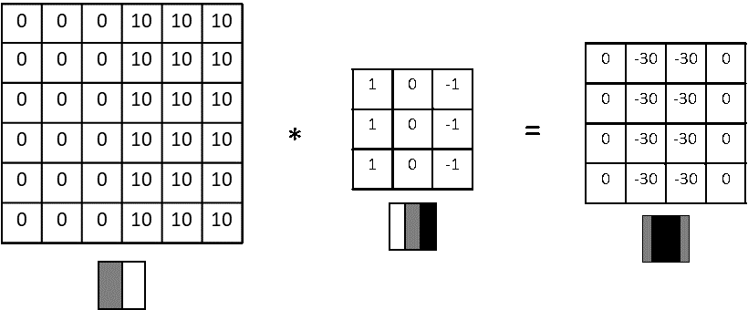
An example of vertical edge detection of dark to light transition

Slide 20
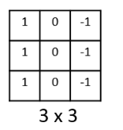
CNN: Vertical Edge Detection
Why This Filter Detects Vertical Edges:
Directional Sensitivity:
The kernel compares left-side pixels (1s) with right-side pixels (-1s).
The middle column (0s) ensures that center pixel values are ignored (don't bias the output).
When this kernel slides over the image, it gives high output values where there is a significant change from left to right i.e., vertical edges.
Mathematical Operation:
At each location, the filter performs an element-wise multiplication (dot product) and sums the result.
If the left and right side of a region differ significantly (e.g., from dark to light), the result will be large → indicating a vertical edge.

Slide 21
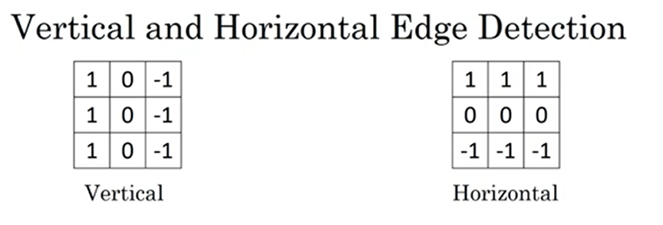
What About Horizontal Edges ?

Slide 22
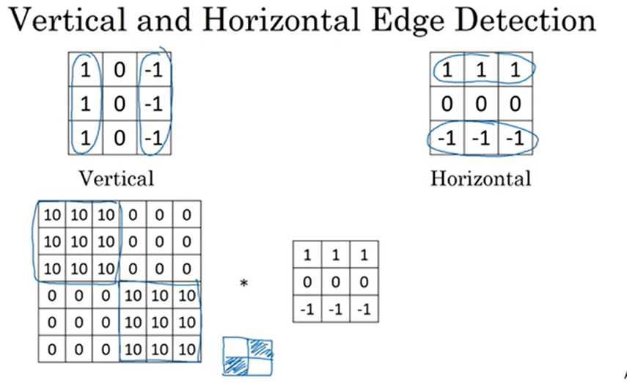
What About Horizontal Edges ?

Slide 23
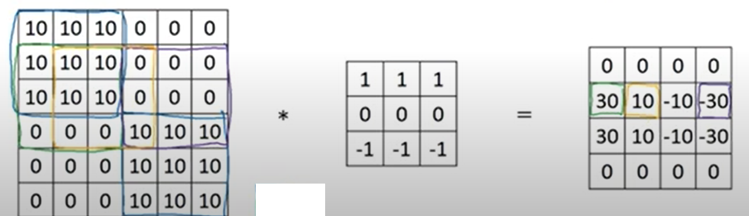

Slide 24
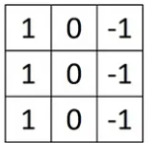
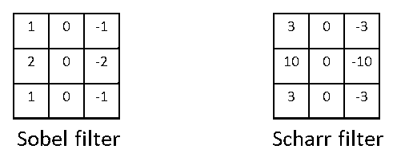
Learning to Detect Edges
It turns out that the 3×3 vertical edge detection filter we’ve used, is just one possible choice and
historically in the computer vision literature, there was a fair amount of debate about what is the best set
of numbers (coefficients) to use. So, here’s something else we could use which is called a Sobel filter.
The advantage of this is that it allows you to put a little bit more weight to the central row of the central pixel,
and this makes it maybe a little bit more robust, but computer vision researchers will use other excessive
numbers for instance, instead of a 1,2,1 it should be a 3,10,3 and also then −3,−10,−3. This is called a
Scharr filter and it has slightly different properties. This is just for vertical edge detection and
if we rotate it 90°, we get a horizontal edge detector.

Slide 25
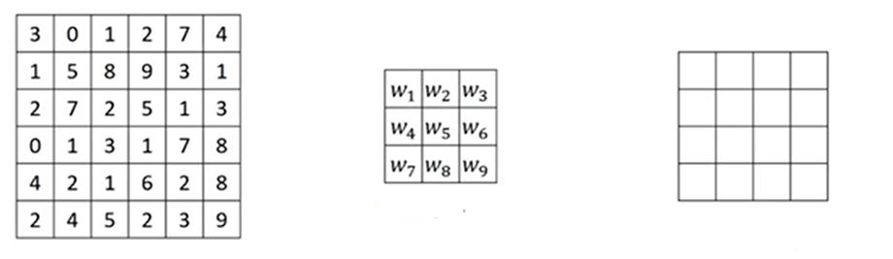
How to choose weights in the filter?
Convolution Operation
*
=
3x3
4x4
With the rise of deep learning one of the things we learned is that when we want to detect edges in some
complicated image, maybe we don’t need to have computer vision researchers handpick these 9 numbers.
It turns out that we can just learn them and treat the 9 numbers of this matrix as parameters, which we can
learn using backpropagation. The goal is to learn 9 parameters so that when we take the 6×6 image and
convolve it with our 3×3 filter, it should construct a good edge detector.
Notes:
https://datahacker.rs/edge-detection-extended/

Slide 26
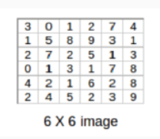
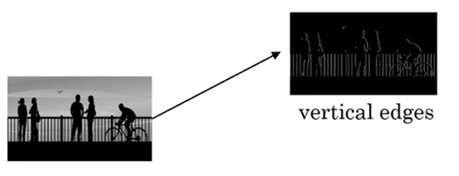
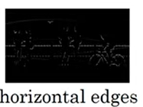
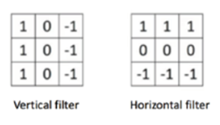
Question
Q1 - Consider the following gray scale image, we need to find the vertical and horizontal edges as following. Convolve the following 6x6 image (1 channel) with a vertical and horizontal filter and a stride of 1 to produce two 4X4 images that detect the edges

Slide 27
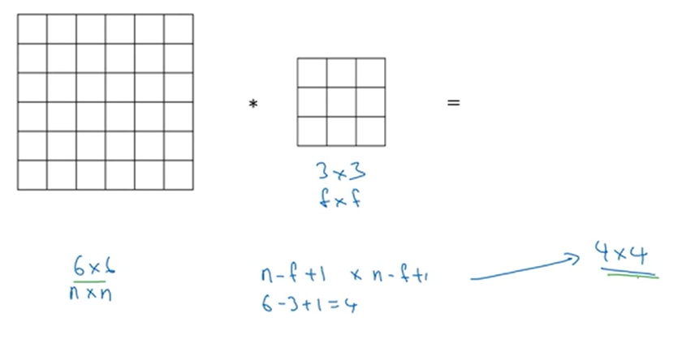
CNN: Padding

Slide 28
CNN: Padding
Why Padding is required ?
During convolution, the size of the output feature map is determined by the size of the input feature map, the size of the kernel, and the stride. If we simply apply the kernel on the input feature map, then the output feature map will be smaller than the input. This can result in the loss of information at the borders of the input feature map. In order to preserve the border information we use padding.

Slide 29
CNN: Padding

Slide 30
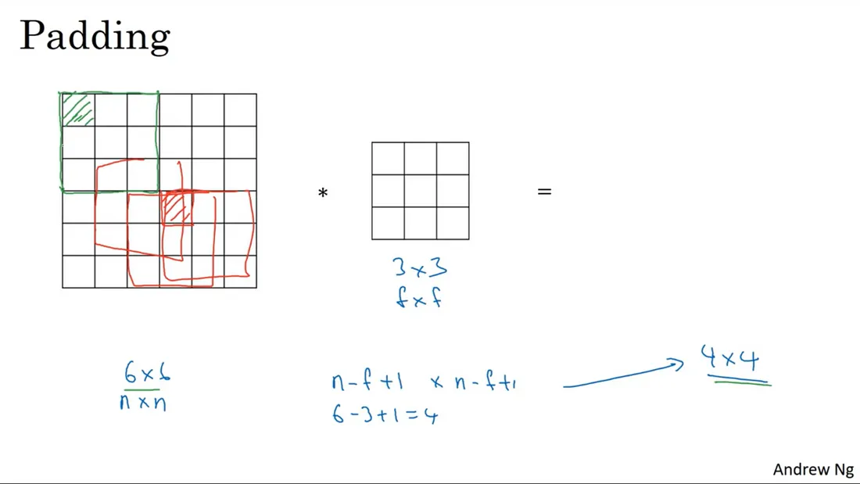
CNN: Padding
How information is lost on the edges. Note that the red-shaded center pixel overlaps with many (red) filters while the green-shaded pixel can only overlaps with just one (green) filter.

Slide 31
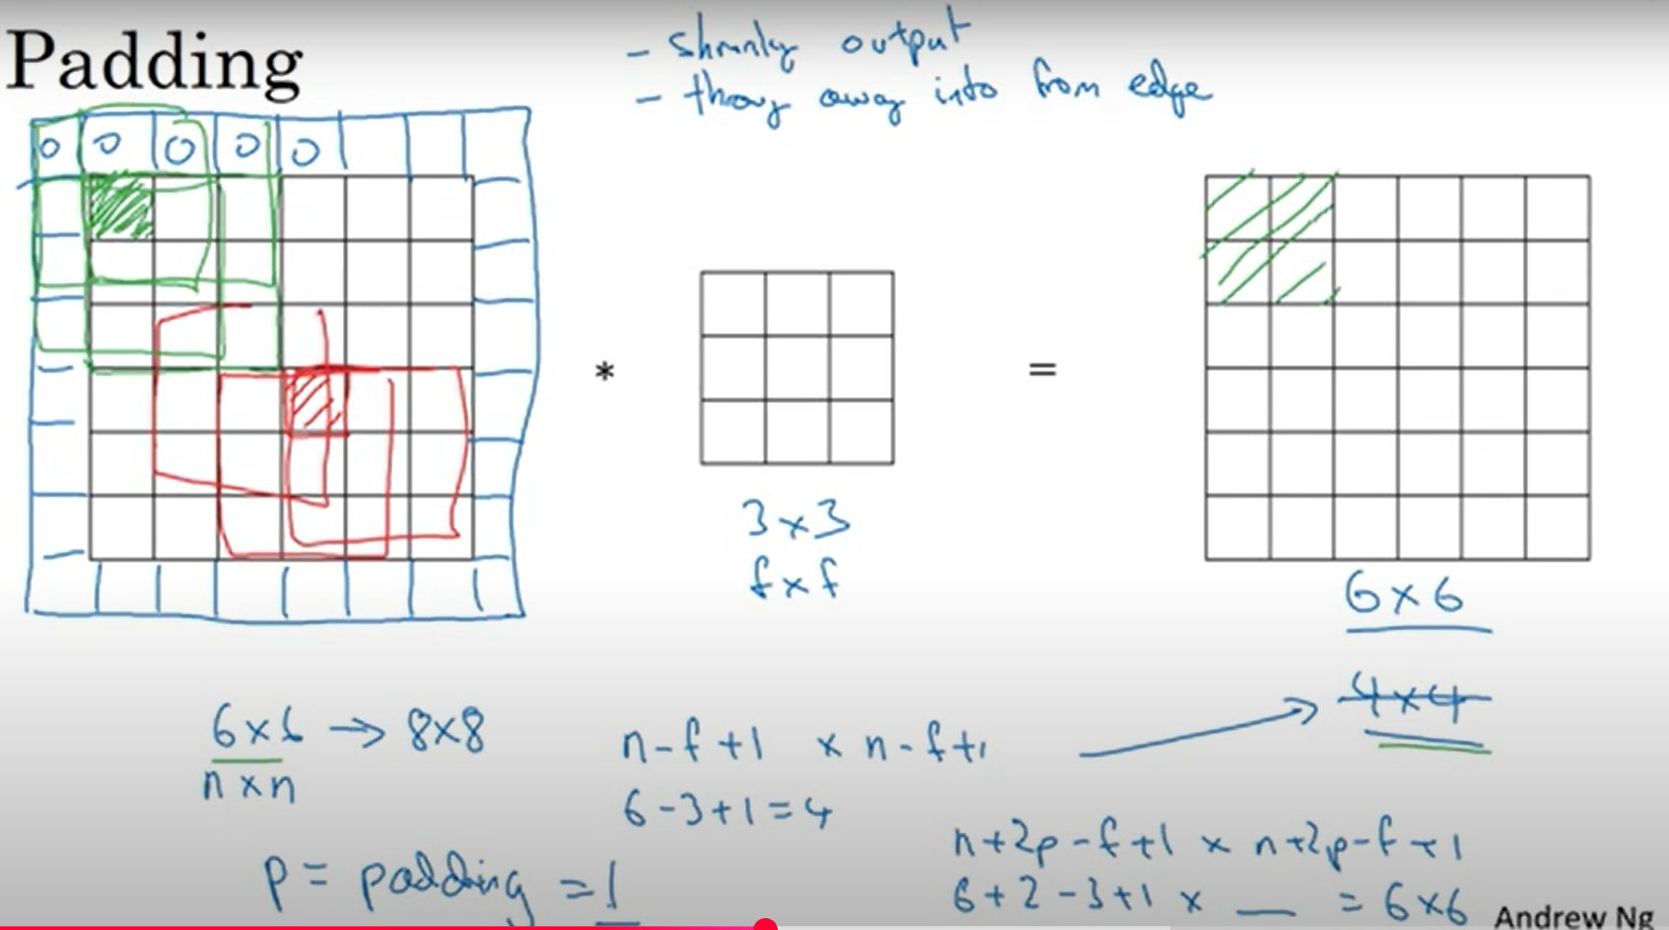
CNN: Padding

Slide 32
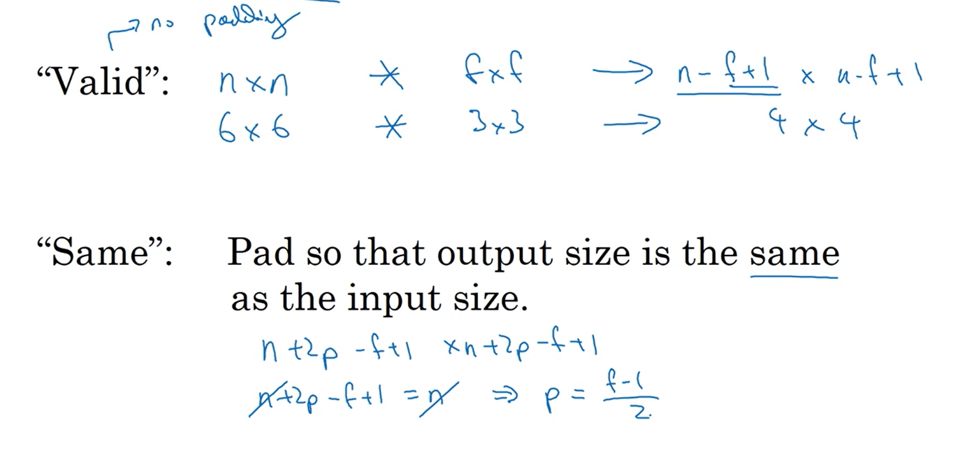
Valid and Same Padding

Slide 33
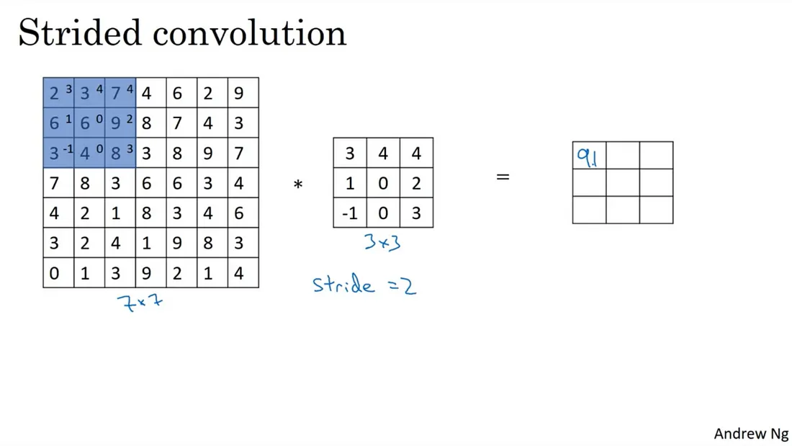
Striding
Notes:
If you want to convolve, let’s say, a7 by 7 image with this 3 by 3 filter with a stride of two, what that means is you take the element Y’s product as usual in this upper left 3 by 3region and then multiply and add (that gives you 91 as the first element of the output).

Slide 34
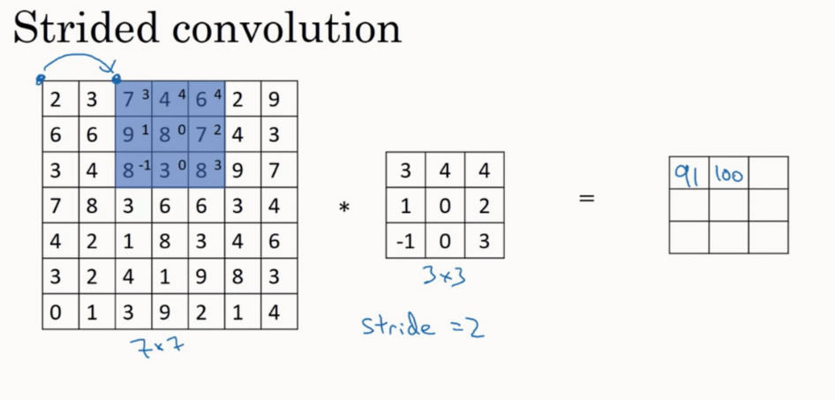
Striding
Notes:
But then instead of stepping the blue box over by one step, we are going to step over by two steps. So, we are going to make it hop over two steps like on GIF 2. Notice how the blue box jump over by two steps. And then you do the usual element Y’s product (summing it turns out 100)and now we are going to do they do that again, and make the blue box jump over by two steps (summing it up gives you 83).

Slide 35
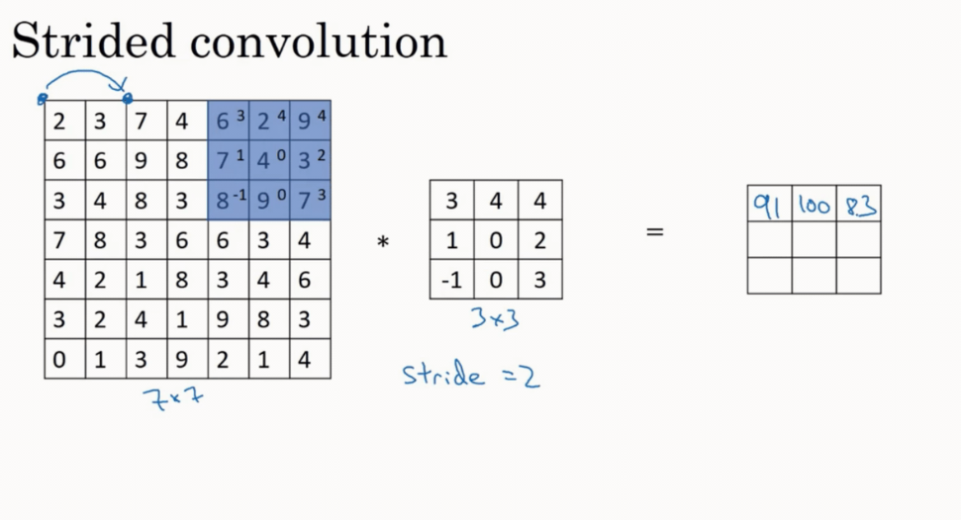

Slide 36
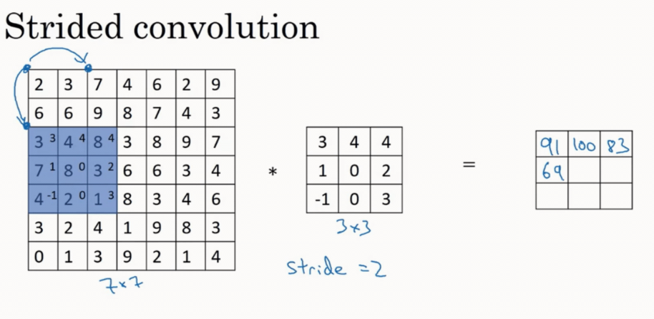

Slide 37
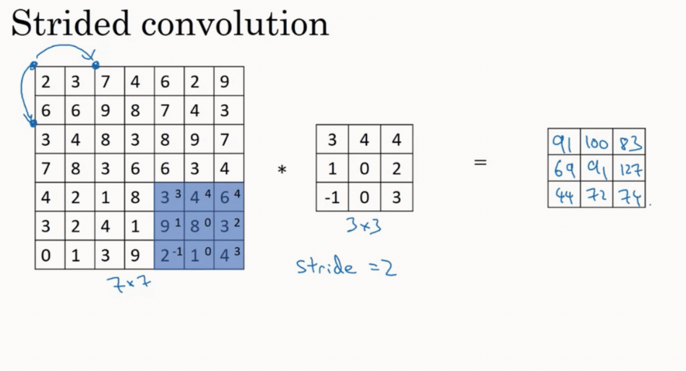

Slide 38
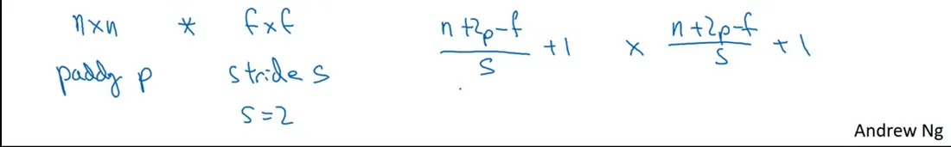
Strided Convolution
And if you use padding p and stride s. In this example, s = 2 then you end up with an output that is n+ 2 — f , and now because you’re stepping S steps of the time, you step just one step of the time, you now divide by S plus one and then can apply the same thing.

Slide 39
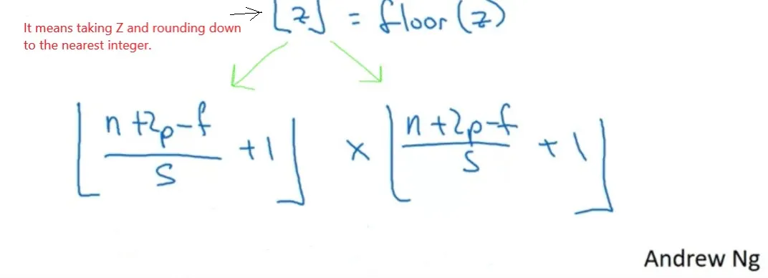
Strided Convolution
Now, just one last detail, what if this
(n+2p — f) /s fraction is not an integer? In that case, we’re going to round the fraction down (i.e take the floor of the fraction).

Slide 40
Question
The input image has been converted into a matrix of size 12 x 12 and a kernel/filter of size 3 x 3 with a stride of 1. Determine the size of the convoluted matrix?

Slide 41
Question
The input image has been converted into a matrix of size 12 x 12 and a kernel/filter of size 3 x 3 with a stride of 1. Determine the size of the convoluted matrix?
To calculate the size of the convoluted matrix, we use the generalized equation, given by:
C = ((n-f+2p)/s)+1
where,
C is the size of the convoluted matrix.
n is the size of the input matrix.
f is the size of the filter matrix.
p is the Padding amount.
s is the Stride applied.
Here n = 12, f = 3, p = 0, s = 1
Therefore the size of the convoluted matrix is 10 X 10.

Slide 42
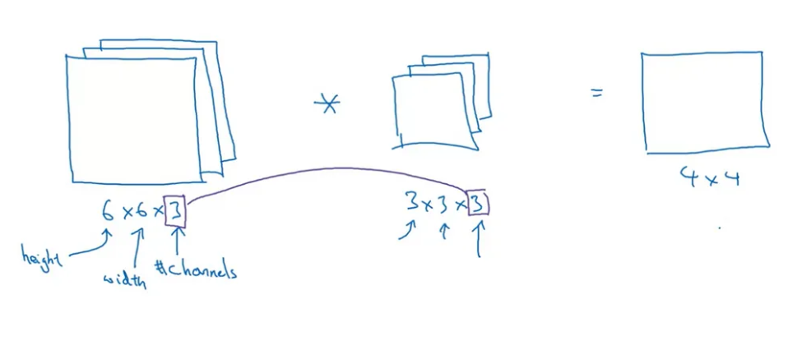
Convolutions Over Volume
Convolutions on RGB images

Slide 43
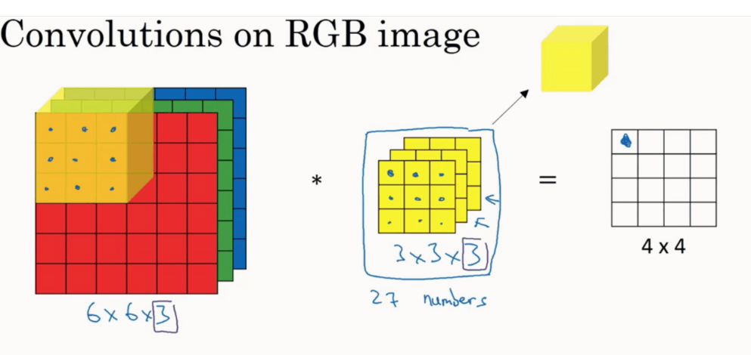
Add up all those 27 numbers and
this gives the first number in the output

Slide 44
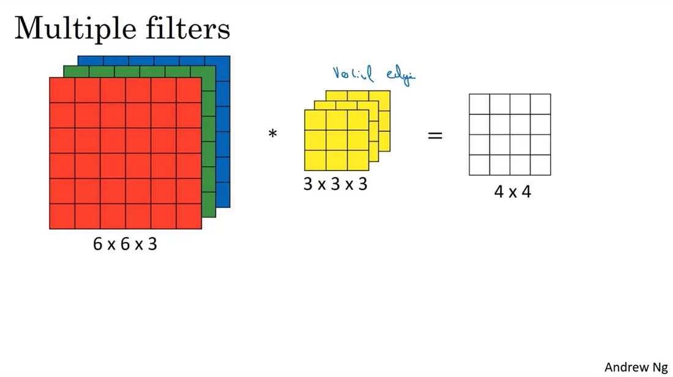
FIGURE : a representation of a 3D convolution that we have seen in the first section.
The yellow filter is now thought of to be a vertical edge filter.

Slide 45
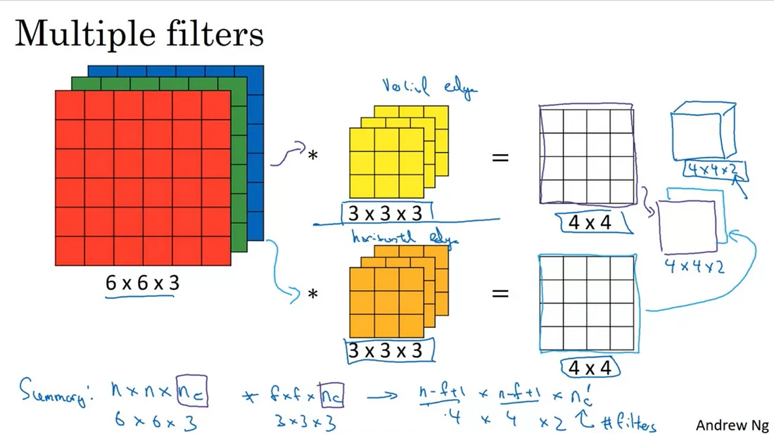
FIGURE : the orange filter at the bottom is thought to be a horizontal edge filter.

Slide 46
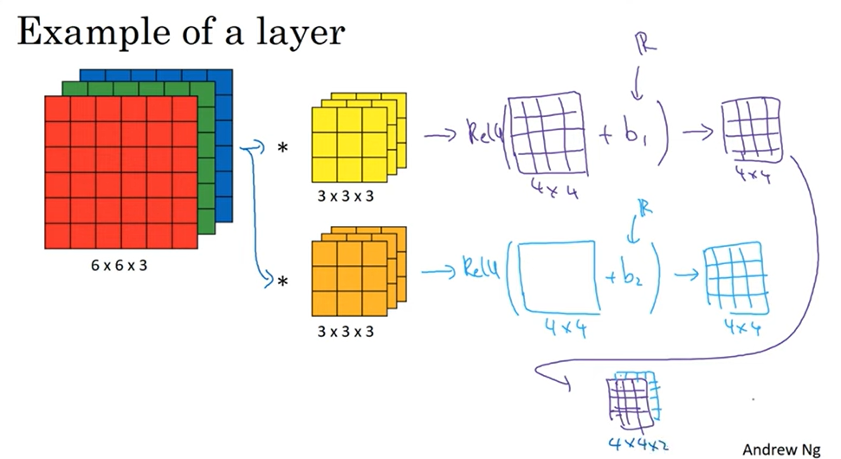
One Layer of CNN

Slide 47
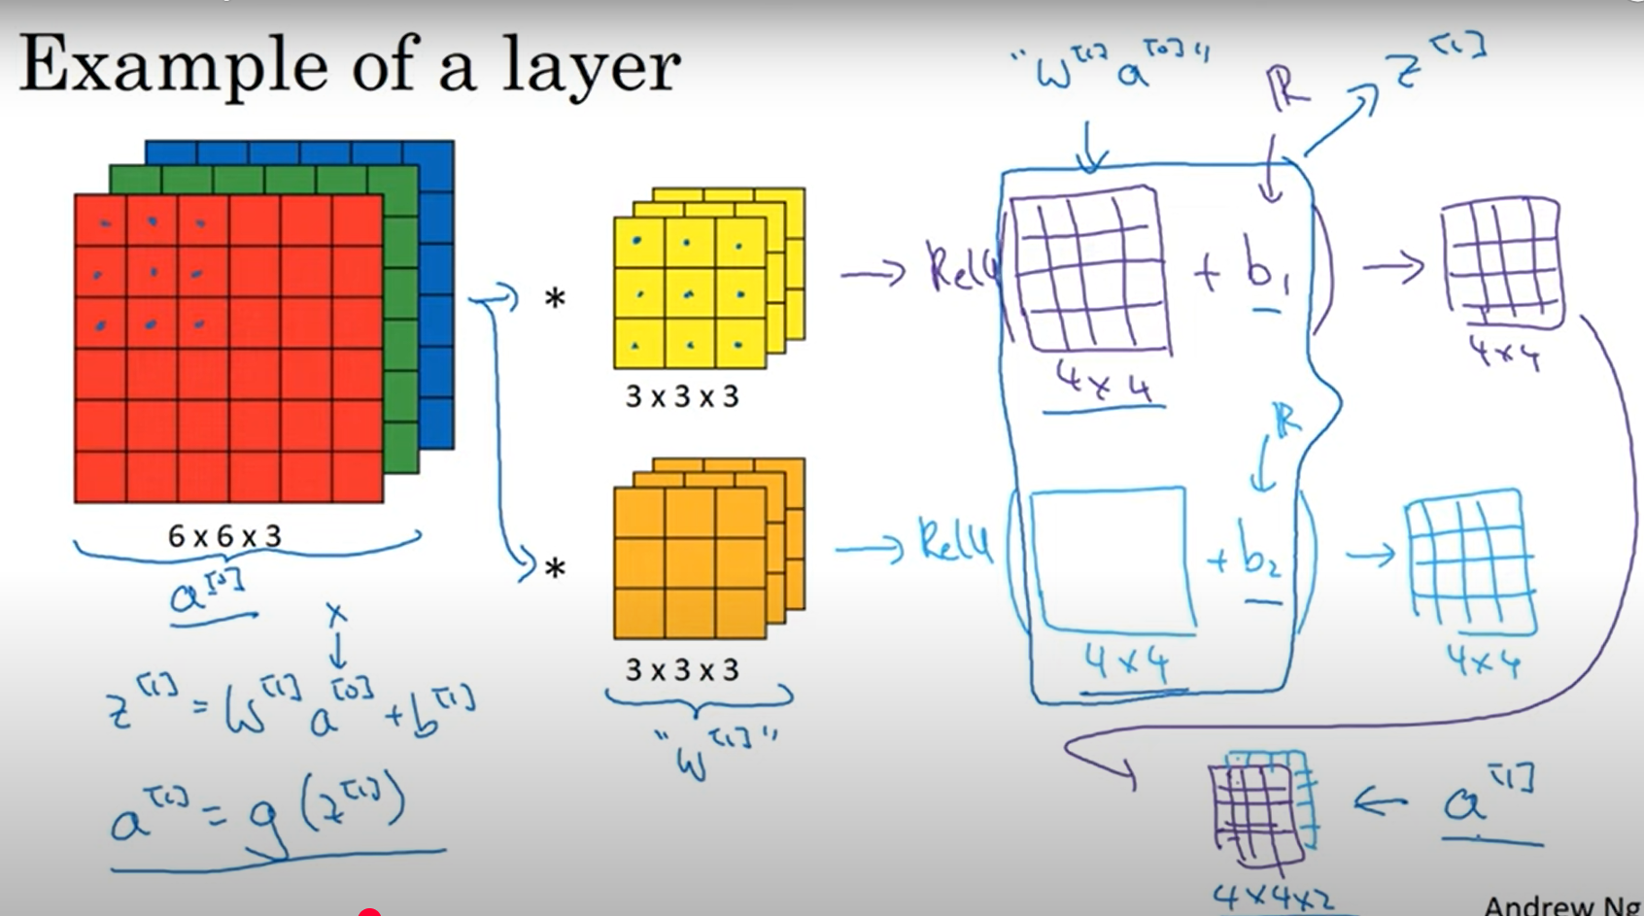
Forward Propagation in CNN
Notes:
The 4 by 4 matrix output matrix, the output of the convolution operation, plays a role similar to w^[1] a^[0]. and the output image plays a role similar to a^[1] = g(z^[1]), where g is the non-linearity function such as the ReLU and z^[1] = w^[1] a^[0] + b^[1]. So we are really just going from a^[0] to a^[1], where a^[0] is the 6 by 6 by 3 input image and a^[1] is the 4 by 4 by 2 output image.

Slide 48
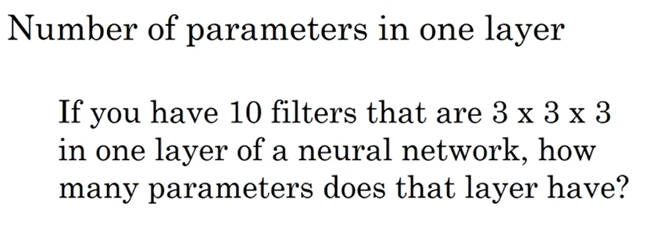
Consider one bias parameter for each 3x3x3 filter

Slide 49
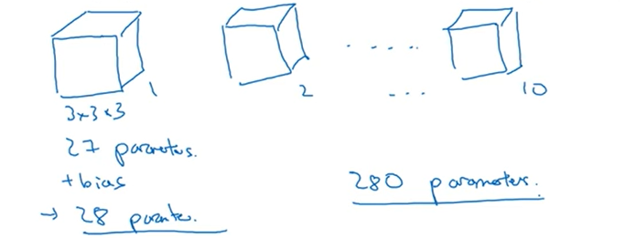
Consider one bias parameter for each 3x3x3 filter

Slide 50
Number of Parameter calculation
Parameters = (FxF * number of channels + bias-term) * D
The size of filter/kernel — > F (FxF)
Depth/Number of feature Maps/Kernels/Filters/Activation maps — > D (integer)

Slide 51
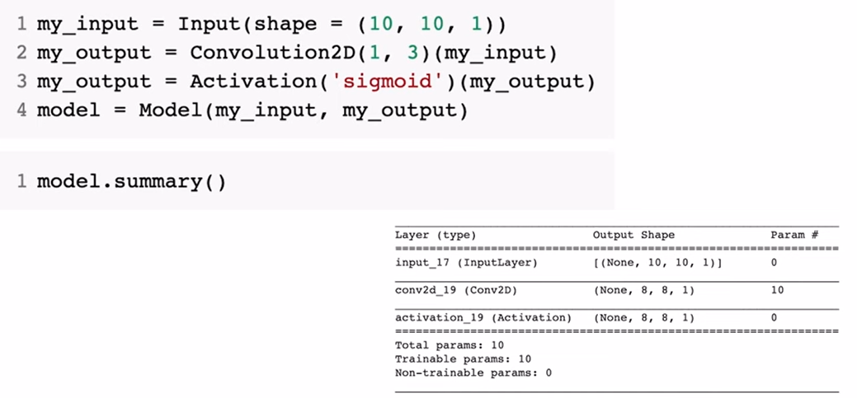
Calculating Number of Parameters
How the number of parameters is calculated:
You have 1 filter of size 3x3.
Each filter has a depth equal to the number of input channels (here, 1 channel).
So, total weights per filter = 3×3×1=9
Plus 1 bias term per filter → total parameters = 9+1=10
Hence, the model will show 10 parameters in the summary.

Slide 52
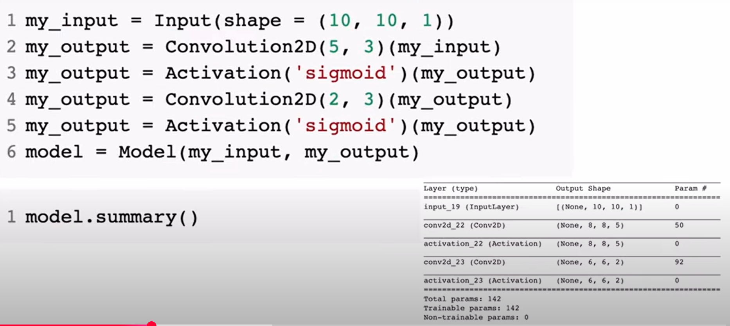
Calculating Number of Parameters

Slide 53
Calculating Number of Parameters

Slide 54
Calculating the output when an image passes through a Convolutional layer
All matrices are square i.e the image width = height.
Parameters that influence the output shape : -
The input dimensions of the image — > I (ixi)
The size of filter/kernel — > F (fxf)
Strides — > S (integer)
Padding — > P (integer)
Depth/Number of feature maps/activation maps/filters — > D (integer)
Convolution Output dimension = [(I +2 *P - F) / S] +1 x D

Slide 55
Example
An input image, I with dimensions (32x32x3) -An input image 32 pixel wide and 32 pixel in height with 3 channels i.e, (I =32),
A filter size 3x3 (F=3)
Stride is1 (S =1),
Zero padding, and
Depth /feature maps are 5 (D =5)
The output dimensions are =
[(32 - 3 + 2 * 0) / 1] +1 x 5 = (30x30x5)

Slide 56
Number of Parameter calculation
The kernel Size is (3x3) with 3 channels (RGB in the input), one bias term, and 5 filters.
Parameters = (FxF * number of channels + bias-term) * D
In our example Parameters = (3 * 3 * 3 + 1) * 5 = 140

Slide 57
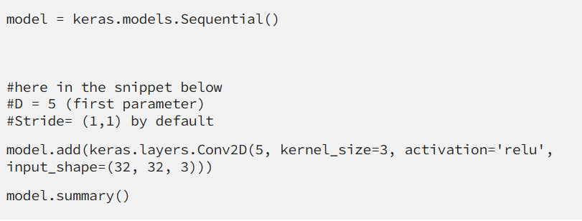
Number of Parameter calculation
The kernel Size is (3x3) with 3 channels (RGB in the input), one bias term, and 5 filters.
Parameters = (FxF * number of channels + bias-term) * D
In our example Parameters = (3 * 3 * 3 + 1) * 5 = 140

Slide 58
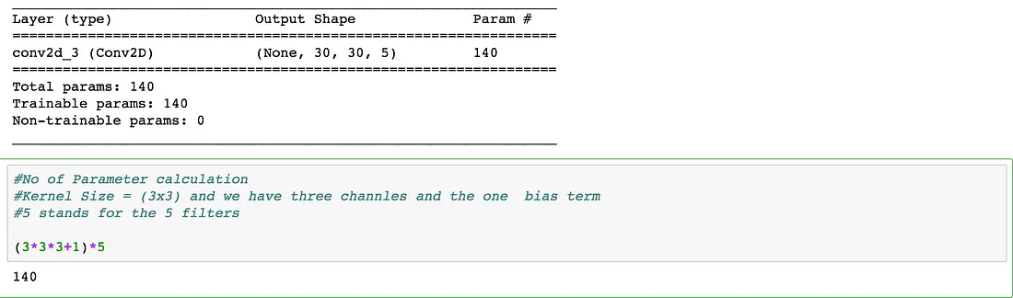

Slide 59
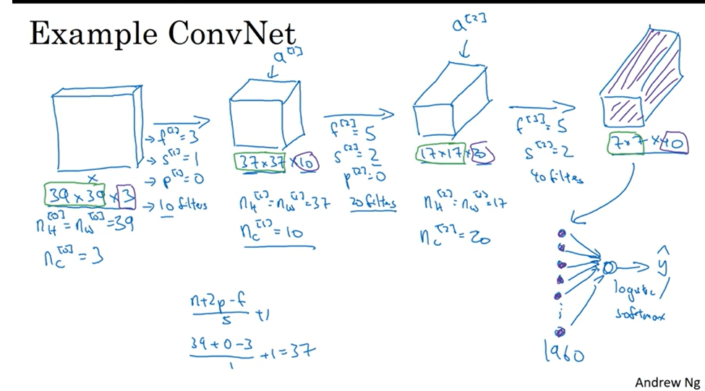

Slide 60
Types of Layers in Convolutional Network
Convolution
Pooling
Fully Connected

Slide 61
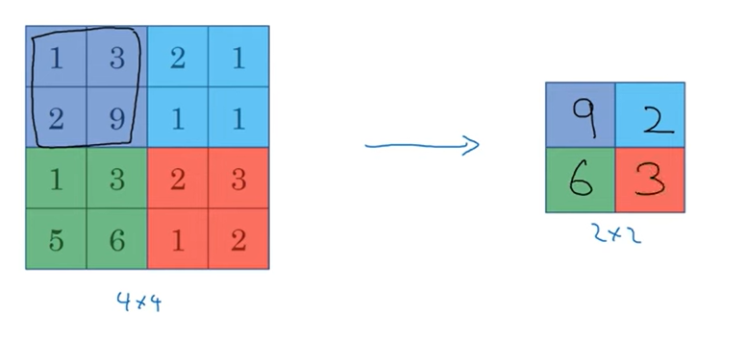
Pooling
Max Pooling
Intuition behind Max Pooling
By selecting the maximum value, it emphasizes the most salient feature within a
region and reduces the impact of less important or noisy activations.
Much bigger max number of a particular quadrant corresponds to a feature detected.

Slide 62
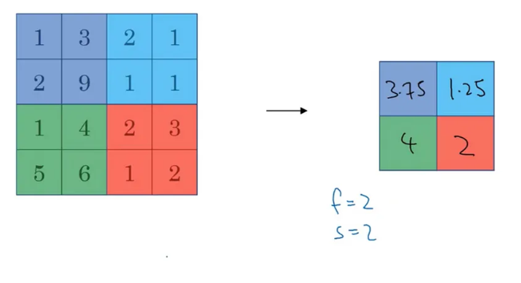
Pooling
Average Pooling

Slide 63
Calculating the output when an image passes through a Pooling (Max) layer
The input dimensions of the image — > I
For a pooling layer, one can specify only the filter/kernel size (F) and the strides (S).
Pooling Output dimension =
[(I - F) / S] + 1 x D
Notes:
Calculating the output when an image passes through a Pooling (Max) layer
The input dimensions of the image — > I
For a pooling layer, one can specify only the filter/kernel size (F) and the strides (S).
Pooling Output dimension =
[(I - F) / S] + 1 x D

Slide 64
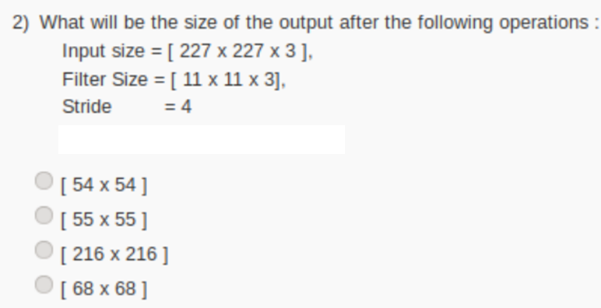

Slide 65


Slide 66
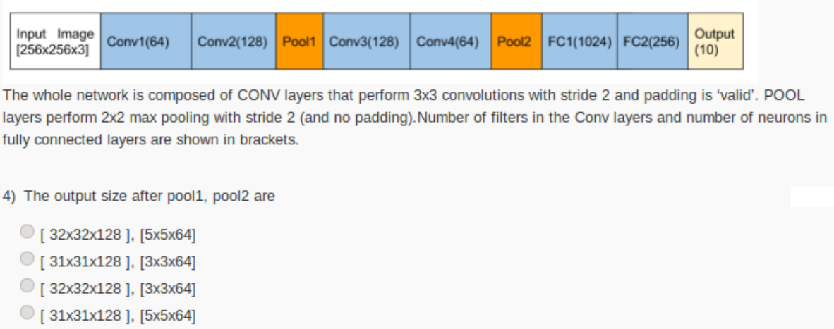

Slide 67
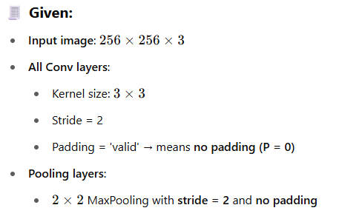
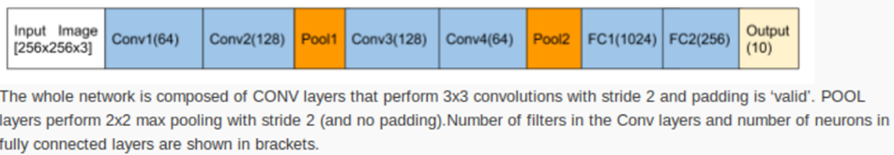

Slide 68
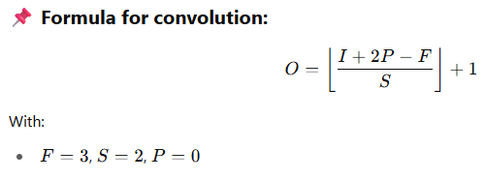

Slide 69


Slide 70


Slide 71


Slide 72


Slide 73


Slide 74

Question
Number of Parameters until Poo1

Slide 75


Slide 76



Slide 77

Question
Calculate the output volume and the number of parameters in each layer in the following CNN.
K= Number of filters

Slide 78

Answer

Slide 79

Key Components of a CNN
1. Input Layer
2. Convolutional Layer
3. Activation Function
4. Pooling Layer
5. Fully Connected Layer
6. Output Layer

Slide 80
Key Components of a CNN
Input Layer: The input layer of a CNN receives the raw image data as input. Each image is represented as a matrix of pixel values. The size of the input layer is determined by the dimensions of the input image.
Feature Extraction through Convolutional Layers: Convolutional layers scan the input data using filters (kernels) to detect patterns like edges, textures, or shapes.
Pooling Layers: Pooling layers preserve key features while reducing computational complexity. This helps reduce multiple dimensions.
Activation Layers: Activation layers apply non-linear functions like ReLU to introduce non-linearity. This enables the network to learn complex patterns.
Flattening and Fully Connected Layers: Once the feature has been extracted, the data is converted into a vector and passed through fully connected layers for classification.
Output Layer: The output layer provides the final prediction using a Softmax function for classification tasks.

Slide 81

Architecture of the CNNs applied to digit recognition

Slide 82
Popular CNN Architectures
LeNet
AlexNet
VGG
ResNet

Slide 83
ImageNet
The ImageNet project is a large visual database designed for use in visual object recognition software research.
The ImageNet project runs an annual software contest, the ImageNet Large Scale Visual Recognition Challenge (ILSVRC), where software programs compete to correctly classify and detect objects and scenes.

Slide 84

ILSVRC winning architectures

Slide 85


LeNet

Slide 86
LeNet5
In the late 1990s, Yann LeCun, Léon Bottou, Yoshua Bengio, and Patrick Haffner created a convolutional neural network (CNN) based architecture called LeNet.
The LeNet-5 architecture was developed to recognize handwritten and machine-printed characters, a function that showcased the potential of deep learning in practical applications.

Slide 87
Features of LeNet-5
Every convolutional layer includes three parts: convolution, pooling, and nonlinear activation functions.
Using convolution to extract spatial features.
The average pooling layer is used for subsampling.
‘tanh’ is used as the activation function.
Using Multi-Layered Perceptron or Fully Connected Layers as the last classifier.

Slide 88

Architecture
The LeNet-5 CNN architecture has seven layers. Three convolutional layers,
two subsampling layers, and
two fully linked layers make up the layer composition.

Slide 89

LeNet Architecture: First Layer
The result of the convolution of an input image with 6 filters has to lead to the change in dimension from (32x32x1) to (28x28x6) and we get our first layer. So, 1 channel is changed to 6 channels as 6 filters are applied to our input image. Also, the image size has been reduced as a result of zero paddings with a kernel size of (5x5).

Slide 90

LeNet Architecture: Second Layer
In the second layer, we implemented an average pooling layer with a filter size of (2x2) and a stride of 2. So, the resultant image dimension will decrease to (14x14x6). Here each unit in each feature map is connected to (2 x 2) neighborhood in the corresponding feature map in C1.

Slide 91

LeNet Architecture: Third Layer
If we proceed further to the third layer, we are applying 16 filters with a kernel size of (5x5) to S2 resulting in a convolution layer C3 with 16 feature maps. This convolution results in changing the dimension of the image from (14 x 14 x 6) in S2 to (10 x 10 x 16) in C3.

Slide 92

LeNet Architecture: Fourth Layer
In the fourth layer, we’ll again apply the average pooling layer with the filter size as (2x2) and a stride of 2. So, the resultant image has a resultant of the average pool which will be of the dimension (5x5x16). Here each unit in each feature map of S4 is connected to (2 x 2) neighborhood in the corresponding feature map in C3.

Slide 93

LeNet Architecture: Fifth Layer
In the fifth layer, we have a fully connected Convolution layer C5 that has 120 neuron units, and each unit of C5 is connected to (5 x 5) neighborhood on all 16 of S4’s feature maps i.e. every unit of C5 is connected to all the feature maps of S4 and, thus C5 is known as Fully Connected Convolution Layer.

Slide 94

LeNet Architecture: Sixth Layer
The Sixth layer F6 consists of 84 neurons Fully connected with C5. Here dot product between the input vector and weight vector is performed and then bias is added to it. The result is then passed through a sigmoidal activation function.

Slide 95

LeNet Architecture: Last Layer
And finally, we have a fully connected softmax output layer with 10 possible values corresponding to the digits from 0 to 9.

Slide 96
VGG Architecture
VGG is an acronym for the Visual Geometric Group from Oxford University and VGG-16 is a network with 16 layers proposed by the Visual Geometric Group.
These 16 layers contain the trainable parameters and there are other layers also like the Max pool layer but those do not contain any trainable parameters.
This architecture was the 1st runner up of the Visual Recognition Challenge of 2014 i.e. ILSVRC-2014 and was developed by Simonyan and Zisserman.
The VGG research group released a series of the convolution network model starting from VGG11 to VGG19.
The main intention of the VGG group on depth was to understand how the depth of convolutional networks affects the accuracy of the models of large-scale image classification and recognition.

Slide 97

VGG-16 Architecture

Slide 98
Features of VGG-16
Input Layer: It accepts color images as an input with the size 224 x 224 and 3 channels i.e. Red, Green, and Blue.
Convolution Layer: The images pass through a stack of convolution layers where every convolution filter has a very small receptive field of 3 x 3 and stride of 1. Every convolution kernel uses row and column padding so that the size of input as well as the output feature maps remains the same or in other words, the resolution after the convolution is performed remains the same.
Max pooling: It is performed over a max-pool window of size 2 x 2 with stride equals to 2, which means here max pool windows are non-overlapping windows.
Not every convolution layer is followed by a max pool layer as at some places a convolution layer is following another convolution layer without the max-pool layer in between.
The first two fully connected layers have 4096 channels each and the third fully connected layer which is also the output layer have 1000 channels, one for each category of images in the imagenet database.
The hidden layers have ReLU as their activation function.

Slide 99

VGG-16 Architecture
Input Layer:
The size of the input image is 224 x 224.
Convolution Layer - 1:
Input size = N = 224
Filter size = f = 3 x 3
No. of filters = 64
Strides = S = 1
Padding = P = 1
Output feature map size = [(224–3+2)/1] + 1 = 224
Output with channels = 224 x 224 x 64

Slide 100
VGG-16 Architecture
Convolution Layer - 2:
Input size = N = 224
Filter size = f = 3 x 3
No. of filters = 64
Strides = S = 1
Padding = P = 1
Output feature map size = [(224–3+2)/1] + 1 = 224
Output with channels = 224 x 224 x 64

Slide 101
VGG-16 Architecture
Max-Pooling Layer - 1:
Input size = N = 224
Filter size = f = 2 x 2
Strides = S = 2
Padding = P = 0
Output feature map size = [(224–2+0)/2] + 1 = 112
Output with channels = 112 x 112 x 64

Slide 102
VGG-16 Architecture
Convolution Layer - 3:
Input size = N = 112
Filter size = f = 3 x 3
No. of filters = 128
Strides = S = 1
Padding = P = 1
Output feature map size = [(112–3+2)/1] + 1 = 112
Output with channels = 112 x 112 x 128

Slide 103
VGG-16 Architecture
Convolution Layer - 4:
Input size = N = 112
Filter size = f = 3 x 3
No. of filters = 128
Strides = S = 1
Padding = P = 1
Output feature map size = [(112–3+2)/1] + 1 = 112
Output with channels = 112 x 112 x 128
Max-Pooling Layer - 2:
Input size = N = 112
Filter size = f = 2 x 2
Strides = S = 2
Padding = P = 0
Output feature map size = [(112–2+0)/2] + 1 = 56
Output with channels = 56 x 56 x 128

Slide 104
VGG-16 Architecture
Convolution Layer - 5:
Input size = N = 56
Filter size = f = 3 x 3
No. of filters = 256
Strides = S = 1
Padding = P = 1
Output feature map size = [(56–3+2)/1] + 1 = 56
Output with channels = 56 x 56 x 256
Convolution Layer - 6:
Input size = N = 56
Filter size = f = 3 x 3
No. of filters = 256
Strides = S = 1
Padding = P = 1
Output feature map size = [(56–3+2)/1] + 1 = 56
Output with channels = 56 x 56 x 256

Slide 105
VGG-16 Architecture
Convolution Layer - 7:
Input size = N = 56
Filter size = f = 3 x 3
No. of filters = 256
Strides = S = 1
Padding = P = 1
Output feature map size = [(56–3+2)/1] + 1 = 56
Output with channels = 56 x 56 x 256
Max-Pooling Layer - 3:
Input size = N = 56
Filter size = f = 2 x 2
Strides = S = 2
Padding = P = 0
Output feature map size = [(56–2+0)/2] + 1 = 28
Output with channels = 28 x 28 x 256
Similar calculations will be performed for the rest of the network.

Slide 106
AlexNet architecture
The AlexNet neural network architecture consists of 8 learned layers of which 5 are convolution layers, few are max-pooling layers, 3 are fully connected layers, and the output layer is a 1000 channel softmax layer. The pooling used here is Max pool.
Why 1000 channels of softmax layer are taken??
This is because the Imagenet dataset contains 1000 different classes of images, so at the final output layer we have one node for each of these 1000 categories and the output layer is the softmax output layer.

Slide 107

Basic architecture of AlexNet
Notes:
The input to the AlexNet network is a 227 x 227 size RGB image, so it’s having 3 different channels- red, green, and blue.
Then we have the First Convolution Layer in the AlexNet that has 96 different kernels with each kernel’s size of 11 x 11 and with stride equals 4. So the output of the first convolution layer gives you 96 different channels or feature maps because there are 96 different kernels and each feature map contains features of size 55 x 55

Slide 108
AlexNet
60 Million parameters and 650000 neurons.
The network is split into two pipelines and was trained on two GPU.
Input Image size 256 x 256 RGB.
Grey scale images to be replicated to obtain 3-Channel RGB
Random crops of size 227 x 227 are fed to the input layer of AlexNet.
Stochastic Gradient Descent with Momentum Optimizer.
Top-5 error rate 15.3%.

Slide 109

Transfer Learning
Transfer learning is a powerful technique used in Deep Learning.
By harnessing the ability to reuse existing models and their knowledge of new problems,
transfer learning has opened doors to training deep neural networks even with limited data.

Slide 110

Traditional Machine Learning vs.Transfer Learning

Slide 111
Transfer Learning for Deep Learning
Domains like natural language processing and image recognition are considered to be the hot areas of research for transfer learning. There are also many models that achieved state-of-the-art performance.
These pre-trained neural networks/models form the basis of transfer learning in the context of deep learning and are referred to as deep transfer learning.
The key idea here is to leverage the pre-trained model's weighted layers to extract features, but not update the model's weights during training with new data for the new task.
The pre-trained models are trained on a large and general enough dataset and will effectively serve as a generic model of the visual world.

Slide 112

Off-the-shelf pre-trained models as feature extractors

Slide 113
Off-the-shelf pre-trained models as feature extractors
Deep learning systems are layered architectures that learn different features at different layers. Initial layers compile higher-level features that narrow down to fine-grained features as we go deeper into the network.
These layers are finally connected to the last layer (usually a fully connected layer, in the case of supervised learning) to get the final output. This opens the scope of using popular pre-trained networks (such as VGG Model, Inception Model, ResNet Model) without its final layer as a fixed feature extractor for other tasks.

Slide 114
Fine Tuning Off-the-shelf Pre-trained Models
This is a more engaging technique, where we do not just directly depend on the features extracted from the pre-trained models and replace the final layer but also selectively retrain some of the previous layers.
Deep neural networks are layered structures and have many tunable hyperparameters. The role of the initial layers is to capture generic features, while the later ones focus more on the explicit task at hand. It makes sense to fine-tune the higher-order feature representations in the base model to make them more relevant for the specific task. We can re-train some layers of the model while keeping some frozen in training.

Slide 115

Transfer Learning in 6 steps
1. Obtain pre-trained model
The first step is to choose the pre-trained model we would like to keep as the base of our training, depending on the task. Transfer learning requires a strong correlation between the knowledge of the pre-trained source model and the target task domain for them to be compatible.

Slide 116

Transfer Learning in 6 steps
2. Create a base model
The base model is one of the architectures such as ResNet or Xception which we have selected in the first step to be in close relation to our task. We can either download the network weights which saves the time of additional training of the model. Else, we will have to use the network architecture to train our model from scratch.
There can be a case where the base model will have more neurons in the final output layer than we require in our use case. In such scenarios, we need to remove the final output layer and change it accordingly.

Slide 117
Transfer Learning in 6 steps
3. Freeze layers
Freezing the starting layers from the pre-trained model is essential to avoid the additional work of making the model learn the basic features.
If we do not freeze the initial layers, we will lose all the learning that has already taken place. This will be no different from training the model from scratch and will be a loss of time, resources, etc.
4. Add new trainable layers
The only knowledge we are reusing from the base model is the feature extraction layers. We need to add additional layers on top of them to predict the specialized tasks of the model. These are generally the final output layers.

Slide 118
Transfer Learning in 6 steps
5. Train the new layers
The pre-trained model’s final output will most likely differ from the output we want for our model. For example, pre-trained models trained on the ImageNet dataset will output 1000 classes.
However, we need our model to work for two classes. In this case, we have to train the model with a new output layer in place.
6. Fine-tune your model
One method of improving the performance is fine-tuning.
Fine-tuning involves unfreezing some part of the base model and training the entire model again on the whole dataset at a very low learning rate. The low learning rate will increase the performance of the model on the new dataset while preventing overfitting.

Slide 119
Deep Learning Challenges
Deep learning is data hungry.
Overfitting or lack of generalization.
Vanishing/Exploding Gradient Problem.
Appropriate Learning Rate.
Covariate Shift.
Effective training.

Slide 120
Vanishing and Exploding Gradients Problems in Deep Learning
Gradient descent, a fundamental optimization algorithm, can sometimes encounter two common issues:
Vanishing gradients
Exploding gradients

Slide 121
Vanishing Gradients
When gradients become very small during backpropagation, weights stop updating effectively.
The early layers learn very slowly (or not at all).
Network fails to capture low-level features.

Slide 122
Exploding Gradients
When gradients become very large, weights grow exponentially.
Training becomes unstable.
Leads to NaN values or diverging loss.

Slide 123

Simple Deep Neural Network
Let’s assume:
You have a fully connected (dense) neural network.
It has 100 hidden layers.
Each layer:
Has a single neuron.
Has no bias (for simplicity).
Uses an identity activation (i.e., no activation — just pass value through).
Let:
Input to the network = x
Every layer has a weight w
So each layer just does:

Slide 124

Forward Propagation: Step by Step

Slide 125


What Does This Mean?

Slide 126
Vanishing Gradients: Why Does It Happen?
During backpropagation, gradients are calculated for each layer, starting from the output layer and moving toward the input layer. If the network has many layers, the gradients get multiplied many times (due to the chain rule). For certain activation functions (like the sigmoid or tanh), the gradients shrink with each layer, potentially becoming so small that the weight updates stop.

Slide 127
Exploding: Why Does It Happen?
Similar to vanishing gradients, exploding gradients are caused by repeated multiplication during backpropagation, but in this case, the gradients grow exponentially as we move backward through the network. This often happens when the weights of the network are initialized poorly, or when the network is too deep.

Slide 128
Solutions to Vanishing and Exploding Gradients
1. Weight Initialization
For vanishing gradients, Xavier initialization (also known as Glorot initialization) helps by setting the initial weights such that they are not too large or too small. This maintains the gradients at a reasonable scale across layers.
For exploding gradients, He initialization is often used when working with ReLU activations. It scales the weights in such a way that avoids large gradient magnitudes.

Slide 129

Solutions to Vanishing and Exploding Gradients
2. Batch Normalization
Batch normalization normalizes the output of each layer, ensuring that the input to the next layer has a controlled distribution. This helps combat both vanishing and exploding gradients by stabilizing the training process.

Slide 130
Solutions to Vanishing and Exploding Gradients
3. Gradient Clipping
For exploding gradients, one effective technique is gradient clipping, which involves capping the gradients at a certain threshold. This prevents them from growing uncontrollably.

Slide 131
Solutions to Vanishing and Exploding Gradients
4. Alternative Activation Functions
Using activation functions like ReLU or Leaky ReLU instead of sigmoid or tanh can mitigate vanishing gradients, as ReLU does not saturate for positive values. However, ReLU can suffer from exploding gradients if not used properly, so it’s important to combine it with other techniques like proper weight initialization.

Slide 132
Solutions to Vanishing and Exploding Gradients
5. Skip Connections and Residual Networks (ResNets): Skip connections, as seen in ResNets, allow the gradient to bypass certain layers during backpropagation. This facilitates the flow of information through the network, preventing gradients from vanishing.

Slide 133

Residual Networks (ResNet)
After the first CNN-based architecture (AlexNet) that win the ImageNet 2012 competition, Every subsequent winning architecture uses more layers in a deep neural network to reduce the error rate.
This works for less number of layers, but when we increase the number of layers, there is a common problem in deep learning associated with that called the Vanishing/Exploding gradient.
This causes the gradient to become 0 or too large. Thus when we increases number of layers, the training and test error rate also increases.
Notes:
In the above plot, we can observe that a 56-layer CNN gives more error rate on both training and testing dataset than a 20-layer CNN architecture. After analyzing more on error rate the authors were able to reach conclusion that it is caused by vanishing/exploding gradient.

Slide 134
Residual Networks (ResNet)
ResNet, which was proposed in 2015 by researchers at Microsoft Research introduced a new architecture called Residual Network.
Residual Network: In order to solve the problem of the vanishing/exploding gradient, this architecture introduced the concept called Residual Blocks. In this network, we use a technique called skip connections. The skip connection connects activations of a layer to further layers by skipping some layers in between. This forms a residual block. Resnets are made by stacking these residual blocks together.

Slide 135

Architectural differences between a ResNet block and a standard neural network (NN) block

Slide 136

Architectural differences between a ResNet block and a standard neural network (NN) block

Slide 137


Example
Transforming low resolution image to High Resolution Image
Residual

Slide 138

Illustration of Residual Block with Skip Connection

Slide 139
Illustration example to show the difference between a standard neural network and a residual block with simple numerical values.

Slide 140


Given the same input 𝑥x, show how a Residual Block (ResNet) and a Standard NN Block process the data and produce different outputs. This will highlight how the shortcut/identity connection in ResNet makes a difference.
Weight layer
Input Vector

Slide 141

Standard neural Network Process

Slide 142

Residual Block Process

Slide 143

Final Outputs Comparison
Residual = F(x) + x makes the model learn corrections, not complete transformations.
Identity skip connection helps preserve original information, useful for training very deep networks.
Notice how ResNet allows larger output activation even with same weights, due to skip path.

Slide 144

ResNet Architecture

Slide 145
Key Features of ResNet:
ResNet uses Batch Normalization at its core. The Batch Normalization adjusts the input layer to increase the performance of the network. The problem of covariate shift is mitigated.
ResNet makes use of the Identity Connection, which helps to protect the network from vanishing gradient problem.
Deep Residual Network uses bottleneck residual block design to increase the performance of the network

Slide 146
Variants of ResNet architecture
ResNet-18: 18 layers
ResNet-34: 34 layers
ResNet-50: 50 layers
ResNet-101: 101 layers
ResNet-152: 152 layers

Slide 147

ResNet Architecture
The VGG-19-inspired 34-layer plain network architecture used by ResNet is followed by the addition of the shortcut connection. The architecture is subsequently transformed into the residual network by these short-cut connections, as depicted in the following figure:

Slide 148

ResNet Architecture

Slide 149
Batch Normalization in CNN
Batch Normalization is a technique used to improve the training and performance of neural networks, particularly CNNs.
Introduced by Sergey Ioffe and Christian Szegedy in 2015, it addresses the issue known as "internal covariate shift" where the distribution of each layer's inputs changes during training, as the parameters of the previous layers change.

Slide 150
Need for Batch Normalization in CNN model
Batch Normalization in CNN addresses several challenges encountered during training. There are following reasons highlight the need for batch normalization in CNN:
Addressing Internal Covariate Shift: Internal covariate shift occurs when the distribution of network activations changes as parameters are updated during training. Batch normalization addresses this by normalizing the activations in each layer, maintaining consistent mean and variance across inputs throughout training. This stabilizes training and speeds up convergence.
Improving Gradient Flow: Batch normalization contributes to stabilizing the gradient flow during backpropagation by reducing the reliance of gradients on parameter scales. As a result, training becomes faster and more stable, enabling effective training of deeper networks without facing issues like vanishing or exploding gradients.
Regularization Effect: During training, batch normalization introduces noise to the network activations, serving as a regularization technique. This noise aids in averting overfitting by injecting randomness and decreasing the network's sensitivity to minor fluctuations in the input data.

Slide 151

How Does Batch Normalization Work in CNN?
Batch normalization works in convolutional neural networks (CNNs) by normalizing the activations of each layer across mini-batch during training. The working is discussed below:
1. Normalization within Mini-Batch
In a CNN, each layer receives inputs from multiple channels (feature maps) and processes them through convolutional filters. Batch Normalization operates on each feature map separately, normalizing the activations across the mini-batch.
During training, batch normalization (BN) standardizes the activations of each layer by subtracting the mean and dividing by the standard deviation of each mini-batch.

Slide 152

How Does Batch Normalization Work in CNN?
2. Scaling and Shifting: After normalization, BN adjusts the normalized activations using learned scaling and shifting parameters. These parameters enable the network to adaptively scale and shift the activations, thereby maintaining the network's ability to represent complex patterns in the data.
3. Learnable Parameters: The parameters γ and β are learned during training through backpropagation. This allows the network to adaptively adjust the normalization and ensure that the activations are in the appropriate range for learning.
4. Applying Batch Normalization: Batch Normalization is typically applied after the convolutional and activation layers in a CNN, before passing the outputs to the next layer. It can also be applied before or after the activation function, depending on the network architecture.
5. Training and Inference During training, Batch Normalization calculates the mean and variance of each mini-batch. During inference (testing), it uses the aggregated mean and variance calculated during training to normalize the activations. This ensures consistent normalization between training and inference.

Slide 153
Group Normalization for Memory Constrained Learning Tasks
Group Normalization (GN) is a technique introduced by Yuxin Wu and Kaiming He in 2018. It addresses some of the limitations posed by Batch Normalization, especially when dealing with small batch sizes that are common in high-resolution images or video processing tasks.
Unlike Batch Normalization, which normalizes features across the batch dimension, GN divides the input channels into smaller groups and computes the mean and variance for each group independently. This method ensures consistent normalization regardless of batch size, making it especially effective for tasks like high-resolution image processing or object detection, where small batches are common.
By normalizing within groups, GN enhances the training of neural networks, even in cases where batch sizes are inconsistent or small. It adjusts each group's features, computes their mean and variance, and refines the results using learnable parameters, enabling the network to learn more effectively and perform better.

Slide 154

How Does Group Normalization Work?
Group Normalization divides the feature channels into GG groups and computes the mean and variance for normalization separately within each group. This approach ensures that the normalization is independent of the batch size and focuses on the structure of the feature channels.
Let the input feature map of a neural network layer be represented as:
where:
N is the batch size.
C is the number of channels.
H and W are the spatial dimensions (height and width).

Slide 155

How Does Group Normalization Work?
GN divides the C channels into G groups, each containing C/G channels.
Each group is normalized separately using the following steps:

Slide 156
Applications of CNN
Image classification: CNNs are the state-of-the-art models for image classification. They can be used to classify images into different categories such as cats and dogs.
Object detection: It can be used to detect objects in images such as people, cars and buildings. They can also be used to localize objects in images which means that they can identify the location of an object in an image.
Image segmentation: It can be used to segment images which means that they can identify and label different objects in an image. This is useful for applications such as medical imaging and robotics.
Video analysis: It can be used to analyze videos such as tracking objects in a video or detecting events in a video. This is useful for applications such as video surveillance and traffic monitoring.

Slide 157
Thanks for Listening
Notes:
https://colab.research.google.com/github/ageron/handson-ml2/blob/master/02_end_to_end_machine_learning_project.ipynb#scrollTo=tLb7or7j1rMW

