Slide 1

Deep Learning and Generative AI MSCS202
Course Instructor
Dr. Umadevi V
Department of CSE, BMSCE

Slide 2
Disclaimer
Contents given in PPT are brief and for reference only. Should refer to text book/relevant materials for detailed description.

Slide 3
Unit-3
Recurrent Neural Networks: Introduction, Backpropagation in RNNs, Regularization Techniques: Dropout, L1/L2 Regularization, LSTMs and GRUs, Video Understanding using RNNs, Attention in Vision Models: An Introduction, Soft and Hard Attention: Image Captioning, Self-Attention and Transformers, Vision Transformers and Applications

Slide 4
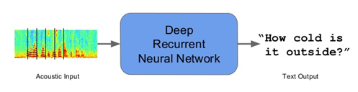

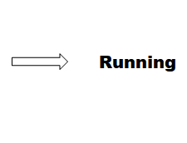
Sequence Modeling
Sequence models are the machine learning models that input or output sequences of data. Sequential data includes text streams, audio clips, video clips, time-series data and etc. Recurrent Neural Networks (RNNs) is a popular algorithm used in sequence models.
Applications of Sequence Models
1. Speech recognition: In speech recognition, an audio clip is given as an input and then the model has to generate its text transcript. Here both the input and output are sequences of data.
2. Video Activity Recognition: In video activity recognition, the model needs to identify the activity in a video clip. A video clip is a sequence of video frames, therefore in case of video activity recognition input is a sequence of data.
Ref. https://towardsdatascience.com/sequence-models-and-recurrent-neural-networks-rnns-62cadeb4f1e1/

Slide 5
Recurrent Neural Networks (RNNs)
Recurrent Neural Network (RNN) is a Deep learning algorithm and it is a type of Artificial Neural Network architecture that is specialized for processing sequential data.
RNNs are mostly used in the field of Natural Language Processing (NLP).
RNN maintains internal memory, due to this they are very efficient for machine learning problems that involve sequential data.
RNNs are also used in time series predictions as well.

Slide 6
Recurrent Neural Network (RNN)
Recurrent Neural Networks (RNNs) were introduced to address the limitations of traditional neural networks, such as FeedForward Neural Networks (FNNs), when it comes to processing sequential data. FNN takes inputs and process each input independently through a number of hidden layers without considering the order and context of other inputs.
Due to which it is unable to handle sequential data effectively and capture the dependencies between inputs. As a result, FNNs are not well-suited for sequential processing tasks such as, language modeling, machine translation, speech recognition, time series analysis, and many other applications that requires sequential processing.
To address the limitations posed by traditional neural networks, RNN comes into the picture.

Slide 7
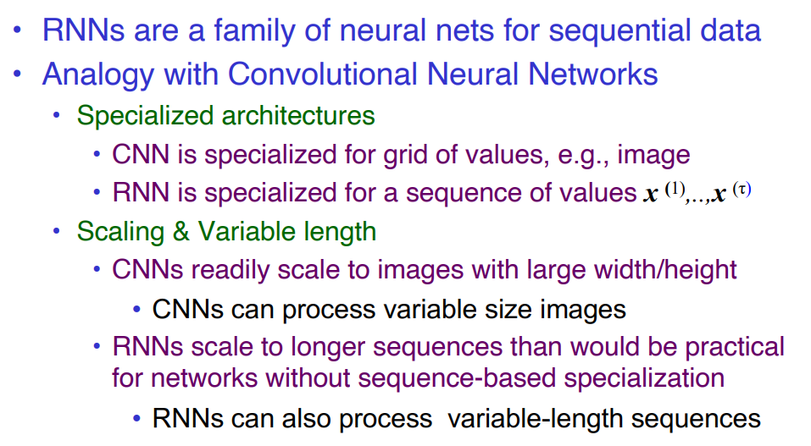
Recurrent Neural Networks process sequential data
Ref.: https://cedar.buffalo.edu/~srihari/CSE676/10.0%20SequenceModeling.pdf

Slide 8
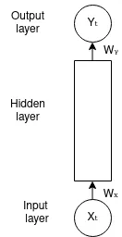
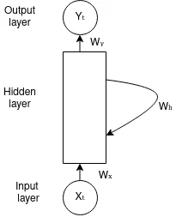
RNN: Recurrent connections
RNN overcome these limitations by introducing a recurrent connection that allow information to flow from one time-step to the next.
This recurrent connection enables RNNs to maintain internal memory, where the output of each step is fed back as an input to the next step, allowing the network to capture the information from previous steps and utilize it in the current step, enabling model to learn temporal dependencies and handle input of variable length.
FeedForward Neural Network (FNN)
Recurrent Neural Network (RNN)

Slide 9
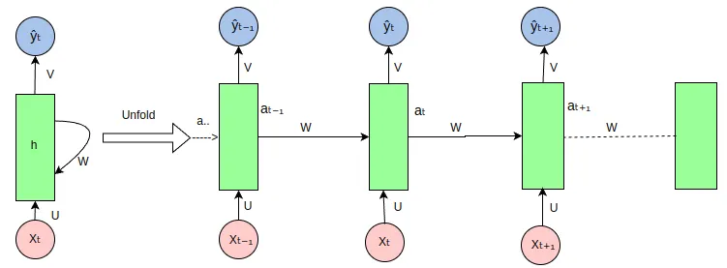
Architecture Of RNN
RNN: Unfolded
Notes:
https://medium.com/@poudelsushmita878/recurrent-neural-network-rnn-architecture-explained-1d69560541ef

Slide 10
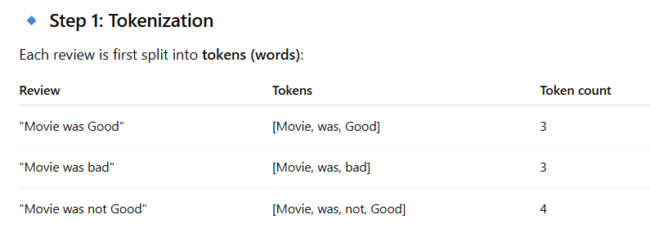
Example: Movie Reviews
"Movie was Good"
"Movie was bad"
"Movie was not Good"

Slide 11
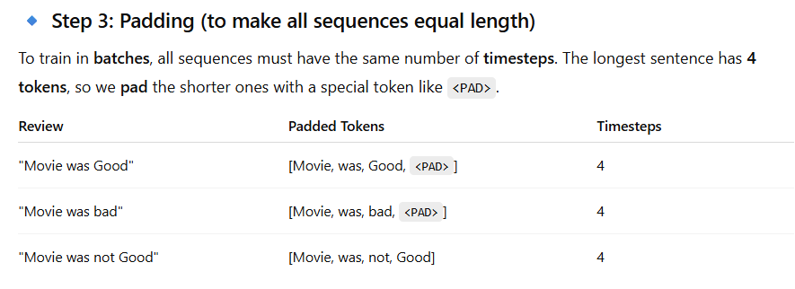
Example: Movie Reviews
Step-2: One hot Encoding
movie=[1,0,0,0,0] ; was=[0,1,0,0,0] ;
good=[0,0,1,0,0] ; bad=[0,0,0,1,0] ;
not=[0,0,0,0,1]

Slide 12
Example: Movie reviews
Final Input Representation
Now, we can construct a batch input tensor with:
batch size = 3 (number of reviews)
timesteps = 4 (after padding)
input features = 5 (embedding size)
So the input shape is: (3, 4, 5)
3 samples (reviews),
Each with 4 tokens (timesteps),
Each token is a 5-dimensional vector (features).

Slide 13
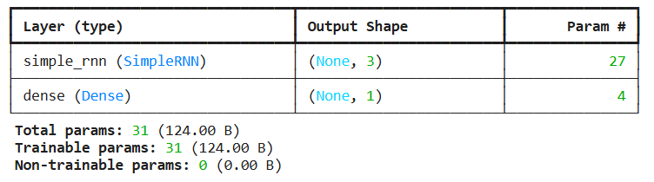
Number of Trainable Parameters
from keras import Sequential
from keras.layers import Dense, SimpleRNN
model=Sequential()
model.add(SimpleRNN(3, input_shape=(4,5)))
model.add(Dense(1, activation='sigmoid'))
model.summary()

Slide 14
Number of trainable parameters in a simple RNN
To calculate the number of trainable parameters in a simple RNN, we can derive the formula by considering the components involved in a vanilla RNN architecture with:
Input size = m
Hidden size = n (number of hidden units in the hidden layer)
Output size = 1 (single neuron in the output layer)
One hidden layer

Slide 15
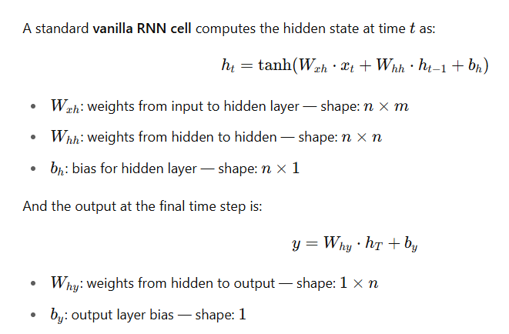
Number of trainable parameters in a simple RNN
Considering number of nodes in input layer as m, Number of hidden nodes as n
And number of nodes in output layer 1.

Slide 16
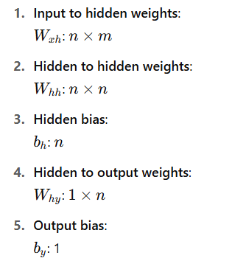
Number of trainable parameters in a simple RNN
Notes:
understand that you want to compute the number of parameters of a RNN, that is, the total count of parameter of a RNN.
In a recurrent neural network RNN we have to compute the number of parameters of the input layer, plus the number of parameters in the hidden layer.
In the input layer, the number of parameters comes from the size of the vocabulary, say ‘m’.
In the hidden layer, the number of parameters comes from the number of units of the layer, say ‘n’
Since the input is m and the hidden layer has n units, the W params of the input layer would be m * n.
Input weights: m*n
Since the network is recurrent, meaning it ‘calls’ itself over and over, then the W parameters in the hidden layer will be n * n.
Recurrent weight: n*n
If we add biases, then we would have ‘m’ biases for the input layer and ‘n’ biases for the hidden layer.
To compute the total number of parameters we add (m * n) + (n * n) + m + n

Slide 17
Number of trainable parameters in a simple RNN
If we consider number of nodes in output layer as k then
Total Parameters=m.n+n.n+n+n.k+k
Notes:
understand that you want to compute the number of parameters of a RNN, that is, the total count of parameter of a RNN.
In a recurrent neural network RNN we have to compute the number of parameters of the input layer, plus the number of parameters in the hidden layer.
In the input layer, the number of parameters comes from the size of the vocabulary, say ‘m’.
In the hidden layer, the number of parameters comes from the number of units of the layer, say ‘n’
Since the input is m and the hidden layer has n units, the W params of the input layer would be m * n.
Input weights: m*n
Since the network is recurrent, meaning it ‘calls’ itself over and over, then the W parameters in the hidden layer will be n * n.
Recurrent weight: n*n
If we add biases, then we would have ‘m’ biases for the input layer and ‘n’ biases for the hidden layer.
To compute the total number of parameters we add (m * n) + (n * n) + m + n

Slide 18
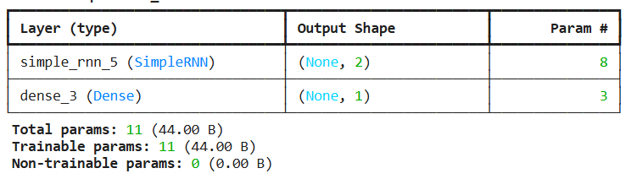
model=Sequential()
model.add(SimpleRNN(2, input_shape=(1,1)))
model.add(Dense(1,activation='sigmoid'))
model.summary()

Slide 19
Architecture Of RNN
RNN: Unfolded
Notes:
https://medium.com/@poudelsushmita878/recurrent-neural-network-rnn-architecture-explained-1d69560541ef

Slide 20
Architecture Of RNN
The RNN takes an input vector X and the network generates an output vector y by scanning the data sequentially from left to right, with each time step updating the hidden state and producing an output. It shares the same parameters across all time steps. This means that, the same set of parameters, represented by U, V, W is used consistently throughout the network. U represents the weight parameter governing the connection from input layer X to the hidden layer h , W represents the weight associated with the connection between hidden layers, and V for the connection from hidden layer h to output layer y. This sharing of parameters allows the RNN to effectively capture temporal dependencies and process sequential data more efficiently by retaining the information from previous input in its current hidden state.

Slide 21
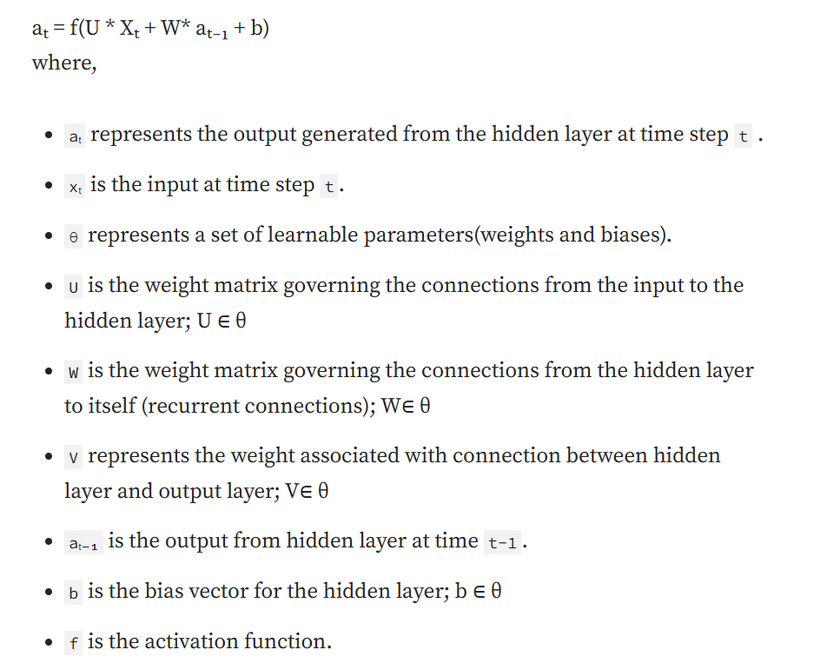
Forward Propagation in RNN
At each time step t, the hidden state aₜ is computed based on the current input xₜ , previous hidden state aₜ₋₁ and model parameters as illustrated by the following formula:
aₜ = f(aₜ₋₁, xₜ; θ) — — — — — (1)
It can also be written as,

Slide 22
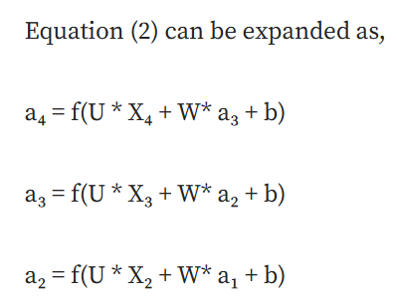
Forward Propagation in RNN
For a finite number of time steps T=4, we can expand the computation graph of a Recurrent Neural Network, illustrated in Figure 3, by applying the equation (1) T-1 times.

Slide 23
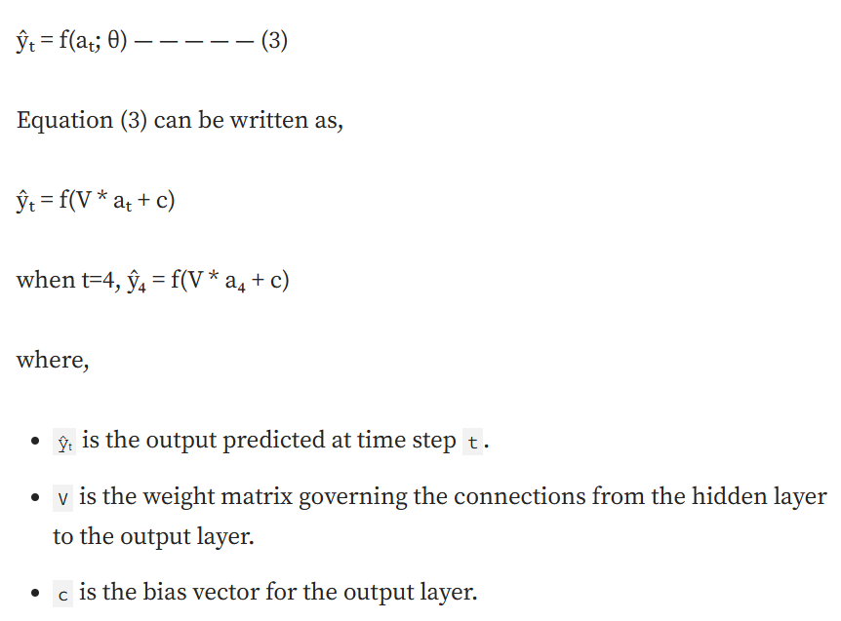
Forward Propagation in RNN
The output at each time step t, denoted as yₜ is computed based on the hidden state output aₜ using the following formula,

Slide 24
RNN: "Backpropagation Through Time" (BPTT) algorithm
For RNNs to learn sequential data, a variant of the backpropagation algorithm known as "Backpropagation Through Time" (BPTT) is used.
In RNNs, the data is processed step-by-step (one at a time). The term "time" is used in BPTT to highlight the fact that the network's computations are performed step by step, simulating the passage of time as the network processes each element of the sequence.
A time step in a Recurrent Neural Network (RNN) refers to a specific moment or instance in a sequence of data being processed by the network. In the context of sequential data, such as text, speech, or time series, the RNN processes one element of the sequence at each time step. This element could be a word in a sentence, a single data point in a time series, or a phoneme in speech.
Backpropagation is applied to each time step, starting from the last one and moving backward to the first. This process is known as Backpropagation Through Time.

Slide 25
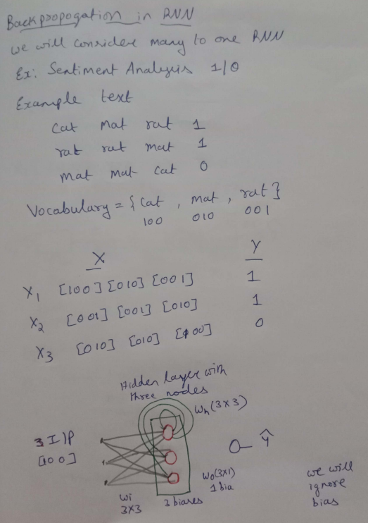
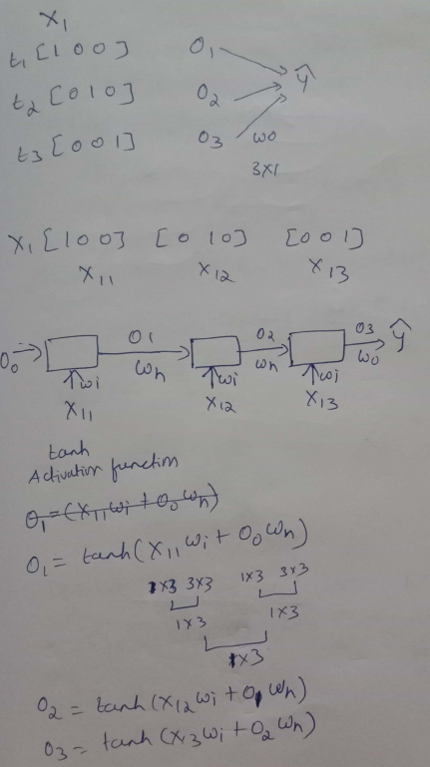
Backward Propagation in RNN

Slide 26
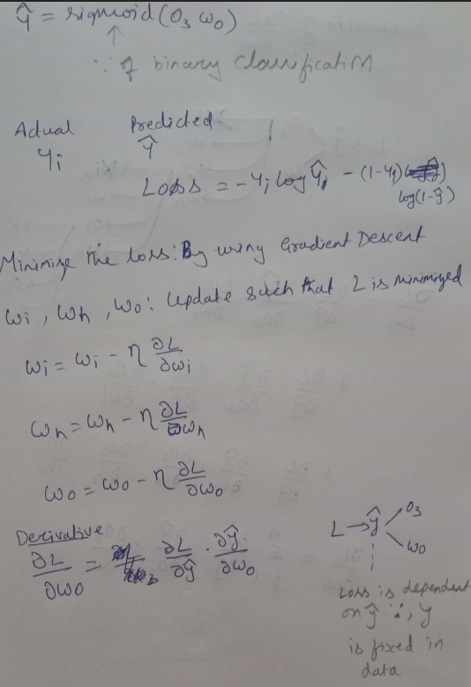
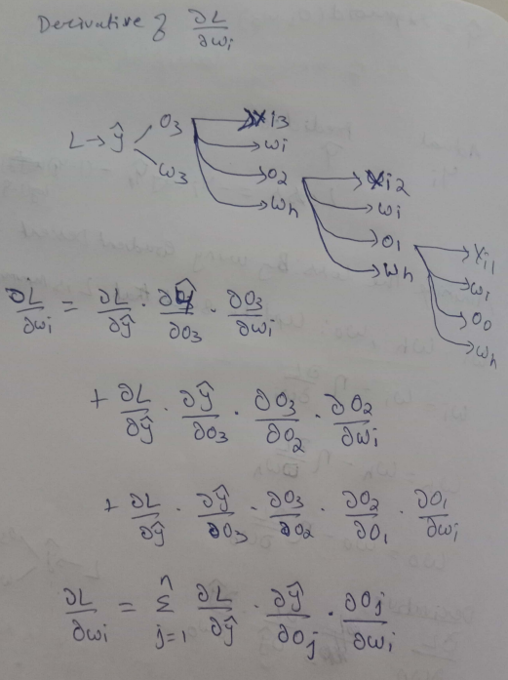
Backward Propagation in RNN

Slide 27
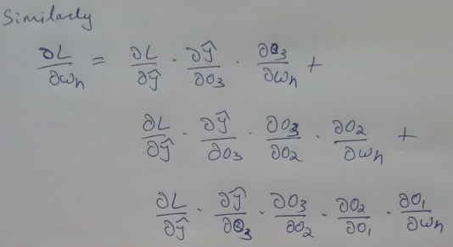
Backward Propagation in RNN

Slide 28
Regularization Techniques: Dropout, L1/L2 Regularization
L1 and L2 Regularization: L1 and L2 regularization are common techniques used to prevent overfitting by adding a penalty term to the loss function. L1 regularization adds the absolute value of the weights to the loss function, encouraging sparsity in the model by driving some weights to zero. L2 regularization, also known as weight decay, adds the squared value of the weights to the loss function, discouraging large weights and promoting a more evenly distributed set of weights. In the context of RNNs and LSTMs, L1 and L2 regularization can be applied to the weights of the network to prevent overfitting. These techniques help ensure that the model does not become too complex and that it generalizes well to new data. The choice between L1 and L2 regularization depends on the specific application and the desired properties of the model.

Slide 29
Regularization Techniques: Dropout, L1/L2 Regularization
Recurrent Dropout
Recurrent dropout is a variant of dropout specifically designed for RNNs and LSTMs. Unlike standard dropout, which is applied to the input and output connections, recurrent dropout is applied to the recurrent connections within the network. This technique helps prevent overfitting by ensuring that the network does not rely too heavily on any single recurrent connection. Recurrent dropout has been shown to be effective in various tasks, including language modeling and speech recognition. By applying dropout to the recurrent connections, the network is forced to learn more robust representations of the temporal dependencies in the data, leading to improved generalization performance

Slide 30

Applications of RNN
Sentiment Analysis

Slide 31
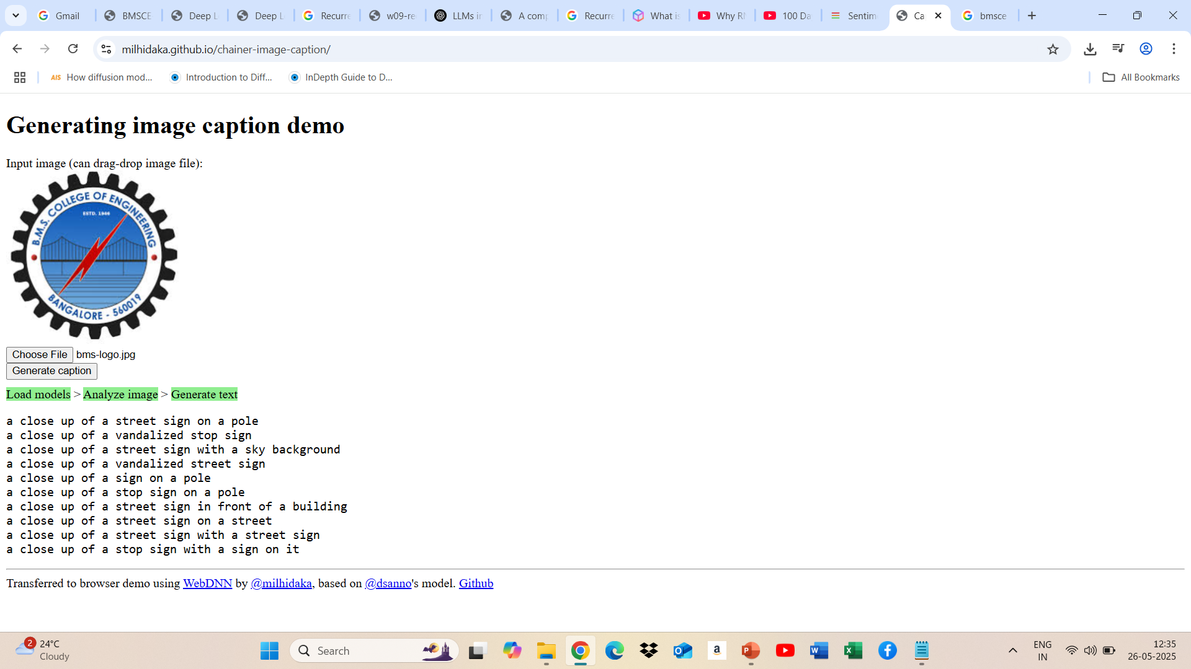
Applications of RNN
Image Caption Generation

Slide 32

Applications of RNN
Language Translation

Slide 33
Challenges with RNNs
One of the biggest challenges with RNNs is the problem of vanishing or exploding gradients. This occurs when the gradients of the loss function with respect to the parameters of the RNN become very small or very large as they propagate through time. This can make it difficult to train the RNN effectively, as the updates to the parameters will be very small or very large, and the network will not learn effectively.
Another challenge with RNNs is that they can be difficult to train. This is because RNNs are typically trained using backpropagation, which can be computationally expensive and time-consuming. Additionally, RNNs can be sensitive to the choice of hyperparameters, such as the learning rate and the number of layers.
Finally, RNNs can be limited in their ability to process long sequences. This is because the gradients of the loss function can become very small or very large as they propagate through time, making it difficult for the RNN to learn long-term dependencies.

Slide 34
Difference between RNN and LSTM
The main difference between RNN and LSTM (Long Short-Term Memory) lies in their ability to effectively handle long-range dependencies in sequential data.
While RNNs suffer from vanishing gradient problems, LSTMs employ a more sophisticated architecture with memory cells and gating mechanisms. This allows them to capture and retain important information over longer sequences. This key distinction makes LSTMs a preferred choice for various applications requiring sequential data analysis and prediction.
Notes:
The vanishing gradient is a phenomenon in which the gradients used to update the weights in neural networks become very small, tending closely towards zero

Slide 35
Why we need LSTM ?
Sentence Input: “Ravi went to the market. He bought apples, bananas, and oranges. When he came back, he was very tired.”
Now imagine we are trying to predict the word "tired" at the end of this sequence.
To predict “tired,” we need to understand who “he” refers to and what he did.
The information about “Ravi went to the market” is far back in the sequence.
Standard RNNs can "forget" this earlier context as the sequence grows longer — this is due to something called the vanishing gradient problem.

Slide 36
LSTM – Long Short-Term Memory
To address this, we use LSTM – a special kind of RNN that can learn to remember important information for longer durations and forget irrelevant data."

Slide 37
Key Concepts in LSTM
1. Short-Term Context
This refers to the recent memory, like remembering the last few words or phrases.
Example: In the sentence “He bought apples, bananas…”, remembering the word “bananas” to predict “oranges” needs short-term memory.
2. Long-Term Context
This is the important but older memory from earlier in the sequence.
Example: Remembering that “Ravi went to the market” to make sense of “he was tired” — this needs long-term memory.
RNNs fail here, but LSTMs learn what to retain for the long term using gates.

Slide 38
Key Concepts in LSTM
3. Short-Term Path (Hidden State)
This is the path that carries information from one step to the next via the hidden state (h_t).
It captures the current context (short-term), but it is vulnerable to vanishing gradients.
4. Long-Term Path (Cell State)
This is the special feature of LSTM, a separate memory stream (c_t), also called the cell state.
It allows information to flow across many time steps with minimal modification unless explicitly updated.
This path enables the network to retain information for longer durations (like remembering who "he" refers to after 20 words!).

Slide 39
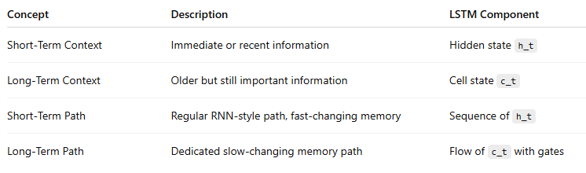
Key Concepts in LSTM
Summary table

Slide 40
Key Concepts in LSTM
Summary table
Wrap-Up Analogy: “Imagine your mind while reading a story: you retain local events (what happened just now), but you also remember the main character’s goal (from the beginning of the story). LSTM lets a neural network behave similarly — remembering what’s essential, forgetting what’s not.”

Slide 41
LSTM Networks
Long Short Term Memory networks – usually just called “LSTMs” – are a special kind of RNN, capable of learning long-term dependencies. They were introduced by Hochreiter & Schmidhuber (1997), and were refined and popularized by many people in following work.¹ They work tremendously well on a large variety of problems, and are now widely used.
LSTMs are explicitly designed to avoid the long-term dependency problem. Remembering information for long periods of time is practically their default behavior, not something they struggle to learn!
¹ Sepp Hochreiter, Jürgen Schmidhuber; Long Short-Term Memory. Neural Comput 1997; 9 (8): 1735–1780.
doi: https://doi.org/10.1162/neco.1997.9.8.1735

Slide 42
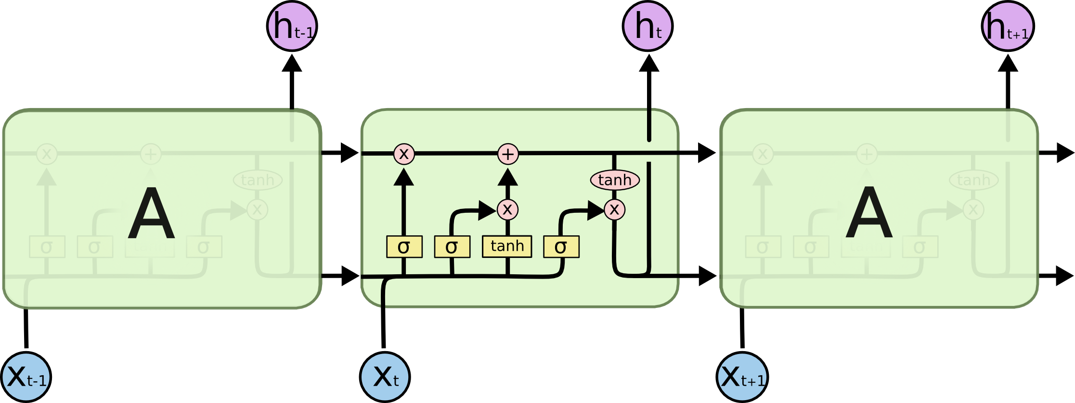
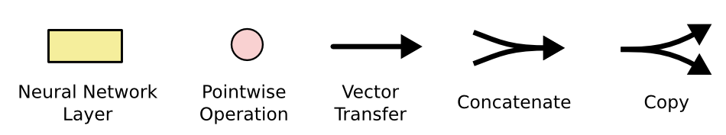
LSTM networks
LSTMs also have this chain like structure, but the repeating module has a different structure. Instead of having a single neural network layer, there are four, interacting in a very special way.

Slide 43
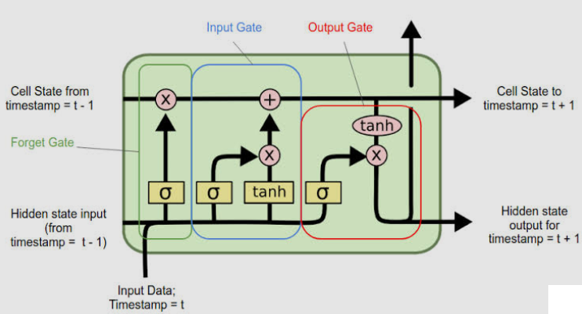
LSTM Gates
Forget gate: To remove something from cell state
Input gate: To add something to cell state
Output gate: To calculate hidden state

Slide 44
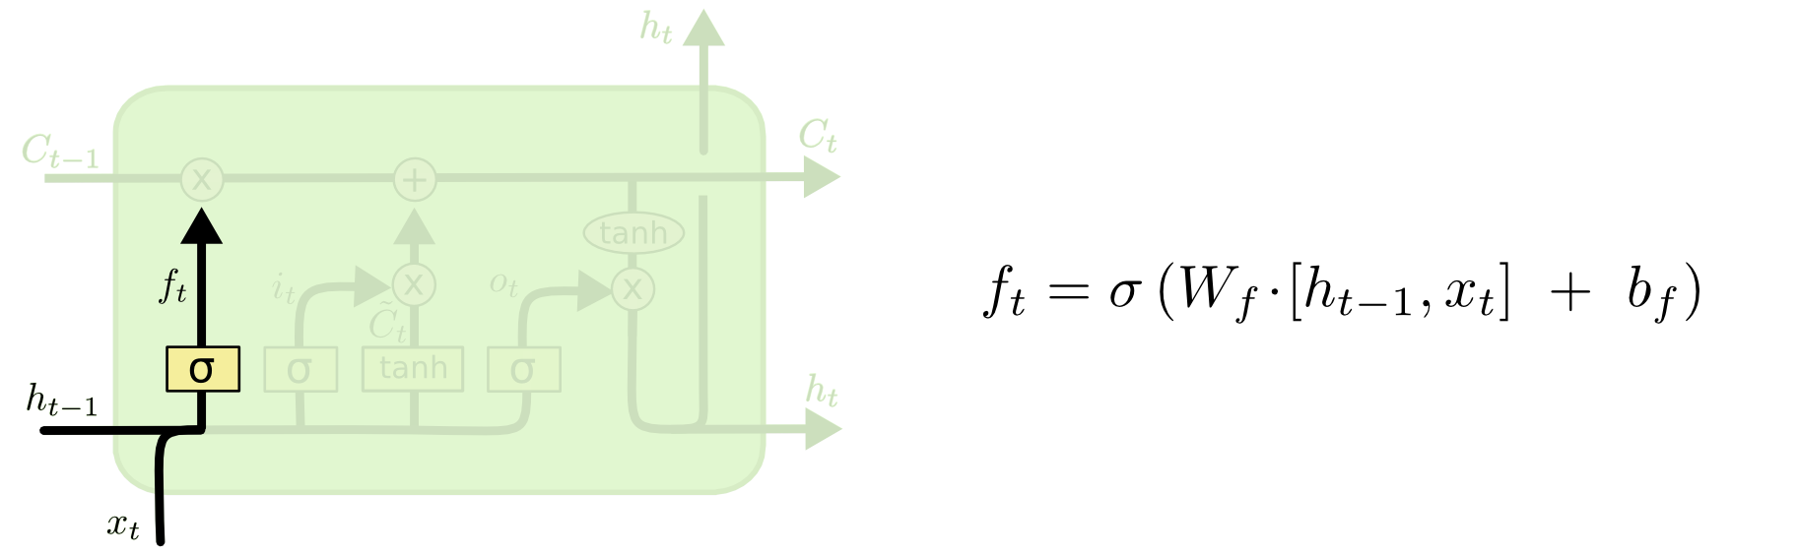
Forget gate
The first step in our LSTM is to decide what information we’re going to throw away from the cell state. This decision is made by a sigmoid layer called the “forget gate layer.” It looks at ht−1 and xt, and outputs a number between 0 and 1 for each number in the cell state Ct−1. A 1 represents “completely keep this” while a 0 represents “completely get rid of this.”

Slide 45
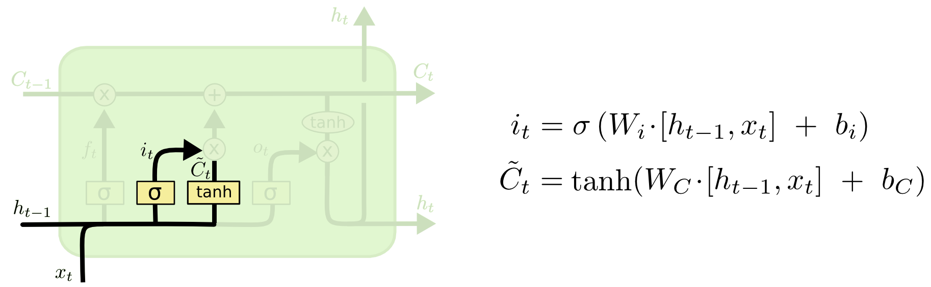
Input Gate
The next step is to decide what new information we’re going to store in the cell state. This has two parts. First, a sigmoid layer called the “input gate layer” decides which values we’ll update. Next, a tanh layer creates a vector of new candidate values, C~t, that could be added to the state. In the next step, we’ll combine these two to create an update to the state.

Slide 46
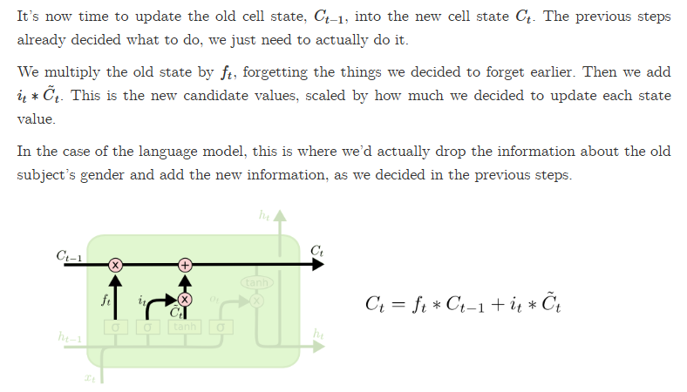
Input gate

Slide 47
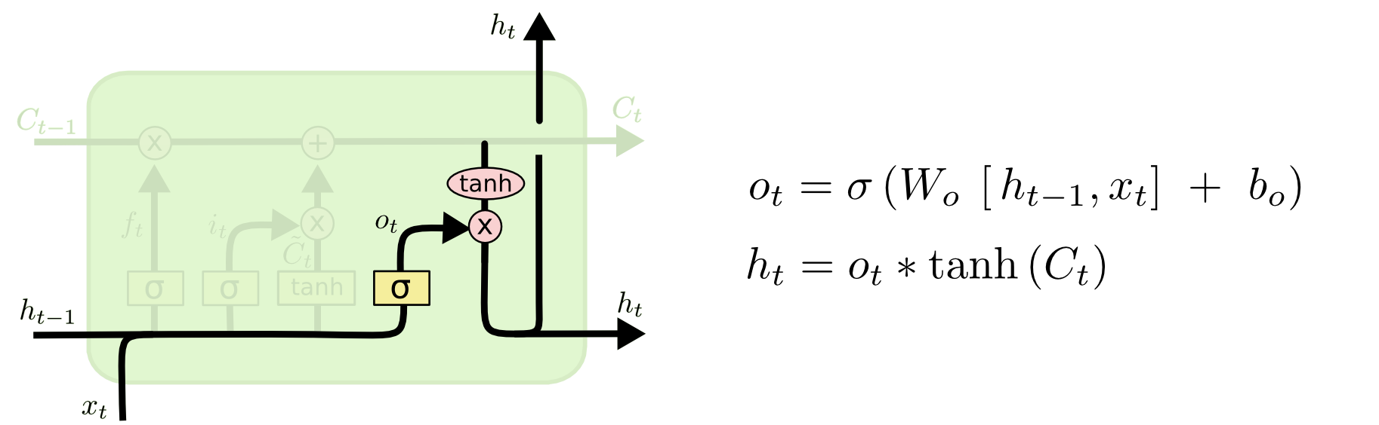
Output gate
Finally, we need to decide what we’re going to output. This output will be based on our cell state, but will be a filtered version. First, we run a sigmoid layer which decides what parts of the cell state we’re going to output. Then, we put the cell state through tanh (to push the values to be between −1 and 1) and multiply it by the output of the sigmoid gate, so that we only output the parts we decided to.

Slide 48
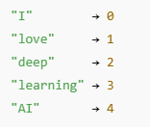
LSTM: For next word predictor
An Embedding layer is a trainable lookup table that maps integer indices (e.g., word IDs) to dense vectors of fixed size (real numbers).
Suppose you have a vocabulary of 5 words:
Without Embedding (Just Integers)
The sequence [0, 1, 4] is not meaningful to a neural network — it only sees these as arbitrary numbers.

Slide 49
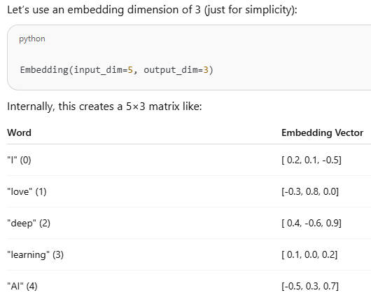
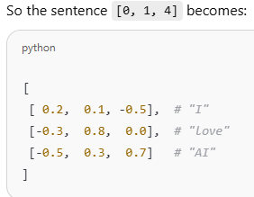
LSTM: For next word predictor

Slide 50
LSTM: For next word predictor
Embedding: Why Is This Useful?
It lets the model capture semantic similarity.
For example, words like “deep” and “AI” may end up with similar embeddings because they occur in similar contexts.
Embeddings are learned representations that improve performance in NLP tasks.
"Think of the embedding layer as a dictionary that translates word IDs into meaning — where each word is defined not by a definition but by a list of numbers representing what it means in the current language context."

Slide 51
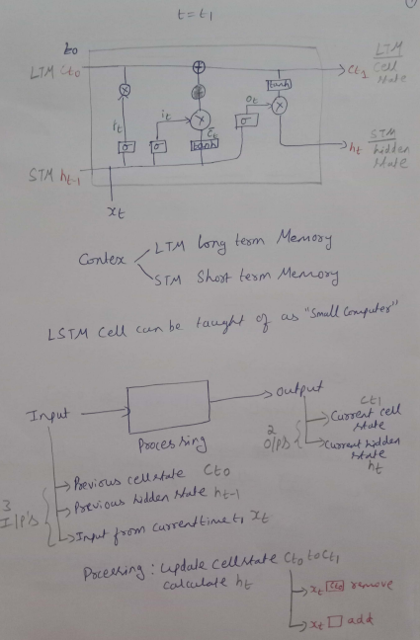
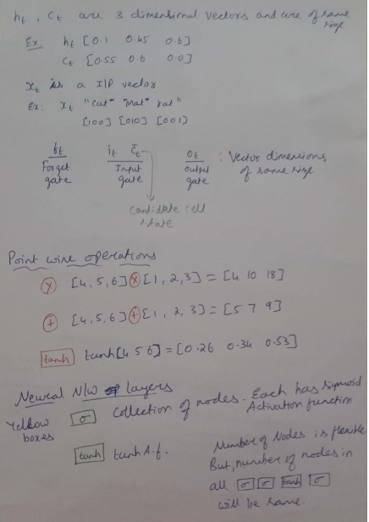

Slide 52
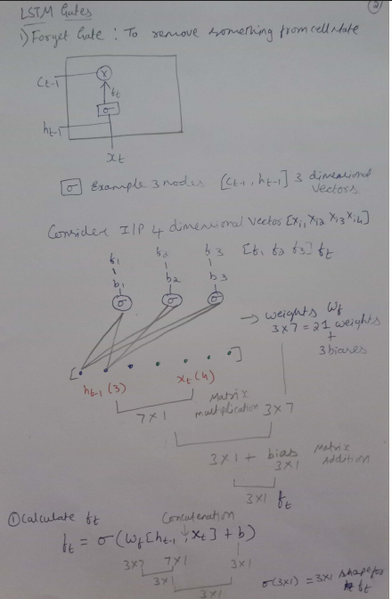
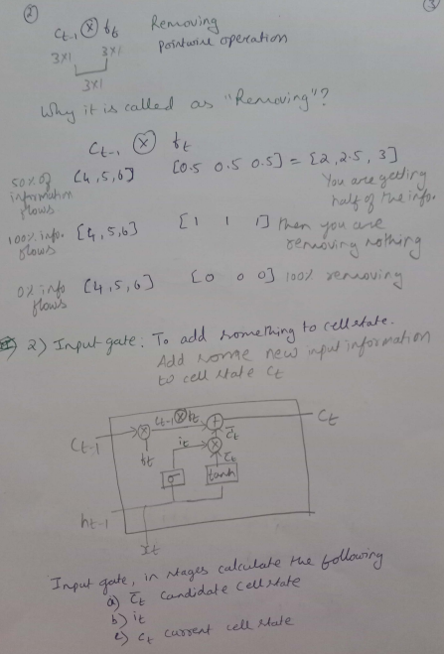

Slide 53
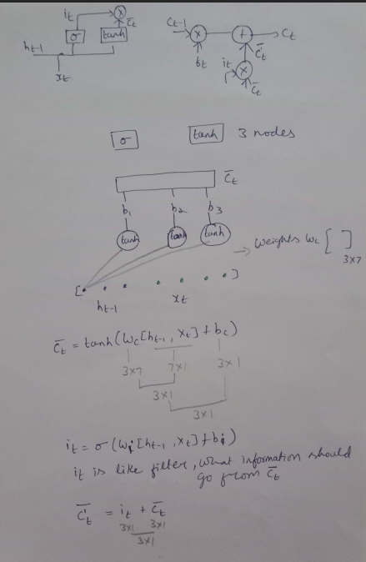
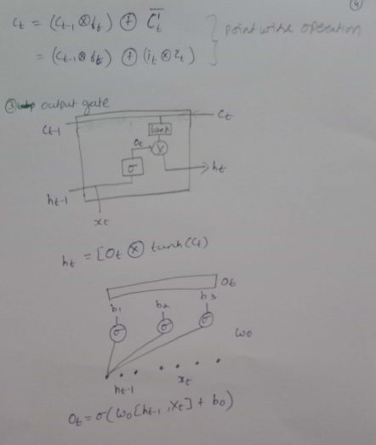

Slide 54
Thanks for Listening
Notes:
https://colab.research.google.com/github/ageron/handson-ml2/blob/master/02_end_to_end_machine_learning_project.ipynb#scrollTo=tLb7or7j1rMW

