Slide 1

Deep Learning and Generative AI MSCS202
Course Instructor
Dr. Umadevi V
Department of CSE, BMSCE

Slide 2
Unit-5
Generative Models for Text: Language Models Basics, Building blocks of Language models, Transformer Architecture, Encoder and Decoder, Attention mechanisms, Generation of Text: Models like BERT and GPT models, Exploring ChatGPT, Prompt Engineering: Designing Prompts, Issues of LLM like hallucination.

Slide 3
What are Large Language Models (LLMs)?
Large language models (LLMs) are advanced AI systems that excel at processing, understanding, and generating human language.
They are trained on massive amounts of text data and can be used for a wide range of tasks, including text generation, translation, summarization, and more.
LLMs are typically based on deep learning architectures, particularly the Transformer model, which was developed by Google

Slide 4
Language Model
Language models are artificial intelligence designed to understand, generate, and manipulate human language.
They are trained on vast amounts of text data and learn to predict the likelihood of sequences of words, enabling them to perform various tasks involving language, such as translation, summarization, text generation, and answering questions.
Objective: Predict the next word or fill in missing words given a context.
Examples:
"The cat sat on the ___" → mat (high probability), table (medium), rocket (low)
The important thing is that the model doesn’t focus on grammar, but rather on how words are used in a way that is similar to how people write.

Slide 5
Types of Language Models
There are three types of language models:
Statistical Language Models
Neural Network-based Models
Transformer based Models

Slide 6
Types of Language Models
1. Statistical Language Models (SLMs):
Earlier models, like n-grams, used probability distributions over word sequences. They calculate the likelihood of a word given its previous words but are limited by the size of the word sequences they can handle.
2. Neural Network-based Models: Modern language models use neural networks to understand more complex relationships in language. Examples include:
Recurrent Neural Networks (RNNs): Capture sequential data by remembering previous words in a sentence, though they struggle with long-term dependencies.
Long Short-Term Memory (LSTM): A type of RNN that helps manage long-range dependencies in language sequences.

Slide 7
Types of Language Models
3. Transformers: These are the foundation of state-of-the-art language models. Unlike RNNs, transformers can process words in parallel, improving speed and more effectively capturing long-term dependencies.
GPT (Generative Pretrained Transformer): A popular transformer-based model designed for text generation. GPT learns to predict the next word in a sentence, which enables it to generate coherent and contextually relevant text.
BERT (Bidirectional Encoder Representations from Transformers): BERT focuses on understanding context by simultaneously looking at words in both directions (left and right of a word), making it highly effective in tasks like question answering and text classification.

Slide 8
Core Building Blocks of Language Models
Core building blocks of language models are
Token’s
Embeddings
Transformer Architecture
These components work together to enable language models to process, understand, and generate human language

Slide 9
Core Building Blocks of Language Models
Tokens:
These are the fundamental units of data that language models operate on. They can be words, subwords, or even characters, depending on the model's design. For example, the sentence "The cat sat on the mat" might be tokenized into: ["The", "cat", "sat", "on", "the", "mat"].
Embeddings:
Embeddings are numerical representations of these tokens. Instead of treating words as discrete symbols, embeddings map them to a continuous vector space where words with similar meanings are located closer together. This allows the model to understand relationships between words and perform tasks like similarity comparisons or word analogies.
Transformer Architecture:
This is the neural network architecture that powers many modern language models. It utilizes self-attention mechanisms to weigh the importance of different parts of the input sequence, allowing the model to understand context and relationships between words effectively.

Slide 10
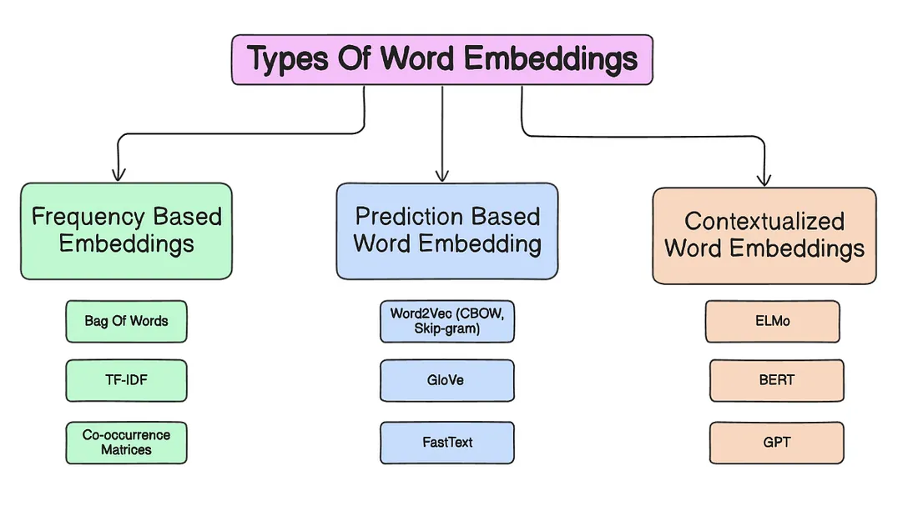
Tyes of Word Embeddings
In the realm of Natural Language Processing (NLP), converting words into vectors — commonly referred to as word embeddings — is fundamental. These embeddings serve as the foundation for numerous NLP applications, enabling computers to understand and interpret human language.
Notes:
With one sentence summary description and one example of “Frequency based Embeddings”, “Prediction based embedding” and “Contextualized word embedding”

Slide 11
Frequency-Based Embeddings | These embeddings represent words using co-occurrence statistics like word counts or term frequency from large corpora. | A co-occurrence matrix or TF-IDF vector where "apple" and "fruit" often appear together in similar contexts.
Prediction-Based Embeddings | These are learned by training a neural network to predict a word from its context (or vice versa) using shallow models. Single static vector per word, regardless of context. | Word2Vec predicts surrounding words of "king" and places "queen" nearby in vector space. The word “bank” has the same embedding in “river bank” and “money bank”. | Prediction-based embeddings are static (context-independent), while contextualized embeddings are dynamic (context-dependent).
Contextualized Word Embeddings | These embeddings dynamically change based on context within a sentence, capturing word meaning variations. Different vector for the same word depending on context. Generated by deep language models (like BERT) that understand sentence-level context during training and inference. | In BERT, the word “bank” will have different embeddings in “river bank” vs. “money bank”.

Slide 12
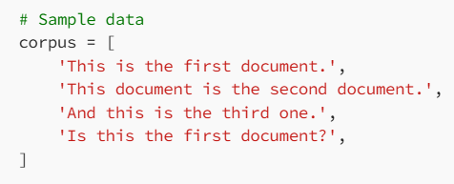
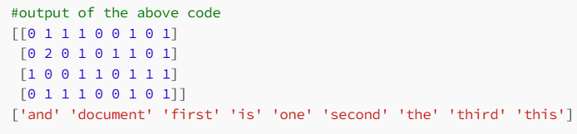
Frequency-based Embeddings
Frequency-based word embeddings are a category of techniques that represent words based on their frequency of occurrence and co-occurrence in a given corpus
Unlike prediction-based methods that learn embeddings through prediction tasks, frequency-based methods derive embeddings from the statistical properties of the text
1. Count Vectorization (Bag of Words)
Description: This method creates a vector for each document by counting the number of times each word appears
How Bag of Words Works
Tokenization: Split the text into individual words or tokens.
Vocabulary Creation: Create a list of all unique words (vocabulary) from the text corpus.
Vectorization: Convert each document into a vector of numbers where each number represents the count (or frequency) of a word in the document
Output

Slide 13
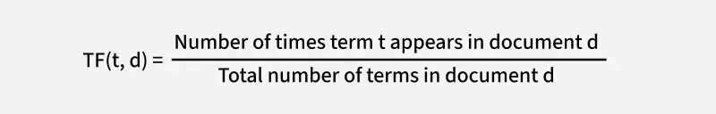
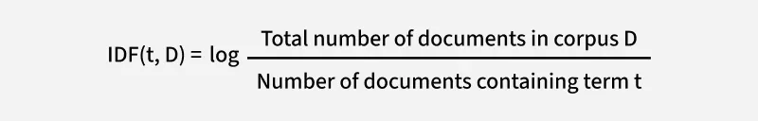
Frequency-based Embeddings
2. TF-IDF (Term Frequency-Inverse Document Frequency)
Description: TF-IDF adjusts the raw word count by considering the importance of words in the context of the entire corpus
Components:
Term Frequency (TF): Measures how frequently a word appears in a document
Inverse Document Frequency (IDF): Measures how important a word is by considering how often it appears across all documents
The TF-IDF of a term is calculated by multiplying TF and IDF scores.
TF-IDF=TF∗IDF

Slide 14
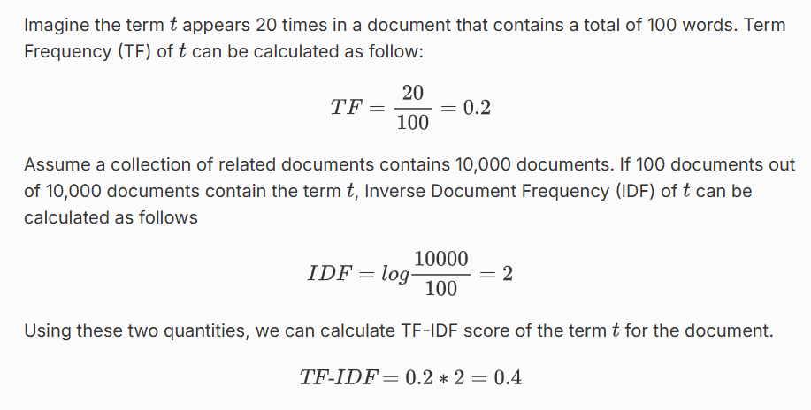
Numerical Example

Slide 15
Frequency-based Embeddings
3. Co-occurrence Matrix
Example:
Sentence 1: Apples are green and red.
Sentence 2: Red apples are sweet.
Sentence 3: Green oranges are sour.
We want to construct a co-occurrence matrix based on the words in these documents within a window size of 1. This means we consider the occurrence of each word with its immediate neighbouring words.
Next, we create a co-occurrence matrix where rows and columns represent words from the vocabulary. The value in each cell (i, j) of the matrix indicates the number of times the word i co-occurs with word j within the specified window size.

Slide 16
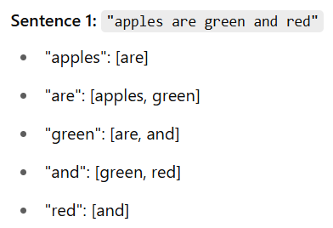
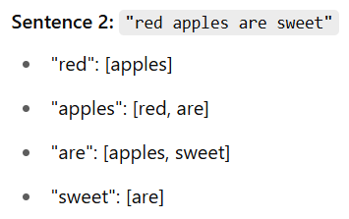
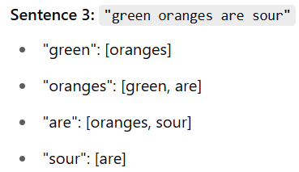
Co-occurrence Matrix
1. Apples are green and red. 2: Red apples are sweet.
3. Green oranges are sour
Vocabulary
Window size = 1): For each word, look at its left and right neighbors.

Slide 17
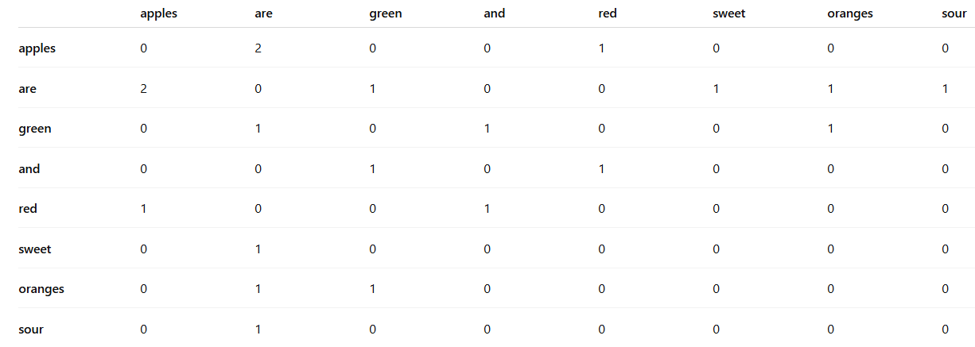
Co-occurrence Matrix

Slide 18
Prediction-based Embeddings
Prediction-based word embeddings are techniques that create word representations by predicting the context in which words appear
These methods use neural network models to learn word vectors that capture semantic relationships between words based on their usage patterns in large text corpora
Word2Vec
GloVe (Global Vectors for Word Representation)
FastText

Slide 19
Prediction-based Embeddings
Word2Vec is a neural network-based model that generates dense vector representations of words. The basic idea behind Word2Vec is to train a neural network to predict the context words given a target word, and then use the resulting vector representations to capture the semantic meaning of the words. It captures semantic relationships between words using two main approaches:
Continuous Bag of Words (CBOW)
Skip-gram
Continuous Bag of Words (CBOW): Predicts the target word based on its surrounding context words. For example, given the context words “the quick brown”, it predicts the target word “fox”
Skip-gram: Predicts the surrounding context words given the target word. For example, given the target word “fox”, it predicts context words like “the”, “quick”, “brown”

Slide 20
Prediction-based Embeddings
2-GloVe (Global Vectors for Word Representation)
GloVe, developed by researchers at Stanford, combines the benefits of both global matrix factorization (like LSA) and local context window methods (like Word2Vec).
Method: Constructs a word co-occurrence matrix from the corpus and then uses matrix factorization to learn word vectors. It captures the global statistical information of the corpus.
FastText
Developed by Facebook’s AI Research (FAIR) lab, FastText extends Word2Vec by taking subword information into account.
Method: Represents words as bags of character n-grams. For example, the word “where” could be represented by character trigrams like “whe”, “her”, “ere”.
Training: Similar to Word2Vec, but the model predicts the target word using the sum of its subword n-gram vectors.

Slide 21
Contextualized word embeddings
Contextualized word embeddings represent a significant advancement in NLP, enabling models to understand and generate language with greater nuance and accuracy.
By taking context into account, these embeddings provide more meaningful word representations, leading to superior performance across a wide range of NLP tasks.
ELMo
BERT
GPT

Slide 22
Contextualized word embeddings
1. ELMo (Embeddings from Language Models) is a deeply contextualized word representation that models both complex characteristics of word use (e.g., syntax and semantics) and how these uses vary across linguistic contexts (e.g., to model polysemy). ELMo generates context-sensitive embeddings using deep bi-directional LSTM models. It provides different embeddings for words based on their context. Key Features of ELMo: 1. Contextualized Representations: ELMo embeddings vary depending on the context in which a word appears. This is different from traditional embeddings like Word2Vec or GloVe, which provide a single representation for each word regardless of context. 2. Deep Representations: ELMo uses deep bidirectional LSTM networks to generate embeddings, capturing complex syntactic and semantic information. 3. Layer-wise Representations: ELMo combines representations from all the layers of the biLSTM, which allows it to capture different types of information at different layers.

Slide 23
Contextualized word embeddings
BERT (Bidirectional Encoder Representations from Transformers)
BERT is a transformer-based model that generates context-aware embeddings by considering the entire sentence bidirectionally (i.e., both left-to-right and right-to-left). Unlike traditional word embeddings like Word2Vec or GloVe, which generate a single representation for each word, BERT produces different embeddings for each word based on its context. Key Features of BERT:
Encoder: The encoder is the main component of the BERT architecture, consisting of multiple transformer encoder layers. Each encoder layer has a multi-head self-attention mechanism, which allows the model to attend to different positions in the input sequence when encoding a specific token. The self-attention mechanism is bidirectional, meaning that the encoding of a token can attend to both left and right context in the sequence. Each encoder layer also has a position-wise feed-forward network, which applies non-linear transformations to the output of the self-attention mechanism.
Pre-trained on Large Corpus: BERT is pre-trained on a large corpus of unlabeled text using two main objectives: a. Masked Language Modeling (MLM): In this task, some tokens in the input sequence are randomly masked (replaced with a [MASK] token), and the model is trained to predict the masked tokens based on the context. b. Next Sentence Prediction (NSP): In this task, the model is trained to predict whether two input sentences are consecutive in the original text or not.
Fine-tuning: After pre-training, BERT can be fine-tuned for specific NLP tasks by adding a task-specific output layer on top of the encoder. The parameters of the pre-trained BERT model are fine-tuned using labeled data for the target task, while the output layer is trained from scratch. This transfer learning approach allows BERT to leverage its pre-trained knowledge and adapt to new tasks with relatively small amounts of labeled data.

Slide 24
Contextualized word embeddings
GPT (Generative Pre-trained Transformer)
GPT is a transformer-based model that generates context-aware embeddings by processing text in a unidirectional manner (left-to-right). GPT uses the decoder part of the transformer, to process the input text. The model consists of multiple layers of self-attention mechanisms, which allow it to capture dependencies between words in a sentence. This allows GPT to excel in tasks that involve language generation, such as text completion, dialogue generation, and more. The model is pre-trained on a large corpus of text and can be fine-tuned for specific tasks.

Slide 25
Contextualized word embeddings: Summarizing
 | ELMo (Embeddings from Language Models) | BERT (Bidirectional Encoder Representations from Transformers) | GPT (Generative Pre-trained Transformer)
Architecture | BiLSTM (RNN-based) | Transformer Encoder | Transformer Decoder
Directionality | Bidirectional (but shallow – forward & backward LSTMs separately) | Deeply Bidirectional (full context both sides) | Unidirectional (left-to-right)
Training Objective | Language modeling: predict words forward and backward | Masked Language Modeling + Next Sentence Prediction | Causal Language Modeling (next word prediction)
Embedding Output | Contextualized embeddings (can be used as features) | Contextualized token representations (fine-tuned or pooled) | Contextualized token outputs (mainly for generation)
Best Suited For | Feature extraction for NLP tasks | Understanding tasks (QA, Sentiment Analysis classification) | Text generation (completion, story writing)

Slide 26
Attention Mechanisms
Self-Attention
Self-attention allows each token in a sequence to attend to all other tokens, capturing dependencies regardless of their position. This is crucial in transformer models for understanding context across the entire sentence.
Cross-Attention
Cross-attention is used in encoder-decoder models where the decoder focuses on relevant parts of the encoder's output. It enables the model to align generated words with input features, essential for tasks like translation and summarization.
Query-Key-Value (QKV)
Attention is computed using queries, keys, and values, where the query interacts with keys to produce attention weights that are applied to values. This mechanism enables the model to dynamically decide what to focus on.
Multi-Head Attention
Multi-head attention runs multiple self-attention operations in parallel with different learned projections, allowing the model to capture diverse types of relationships simultaneously. It enhances the expressiveness and depth of the attention mechanism.

Slide 27
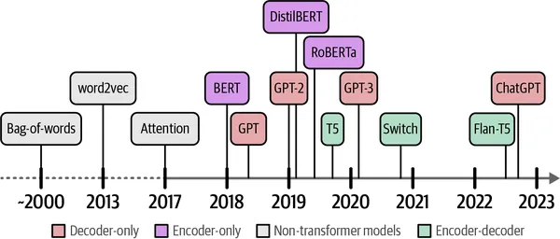
Language AI
Language AI is a subfield of AI that focuses on developing technologies capable of understanding, processing, and generating human language. Language AI can often be used interchangeably with natural language processing (NLP) as machine learning methods struggle to tackle language processing problems.
History of Language AI

Slide 28
Encode
Think of the encoder as a “translator” that takes raw input (like a sentence or piece of text) and turns it into something the machine can understand — like a condensed summary or code. The encoder doesn’t produce a final result (like a translation or answer) but instead creates a blueprint or map with which the system can work.
For example, in language translation:
The encoder reads a sentence in English, understands its meaning, and converts it into an internal format (a bunch of numbers) that the machine can manipulate.

Slide 29
Decoder
The decoder is like the “creator” that takes this encoded information and turns it into something useful — like an output sentence. So in our translation example:
The decoder takes the encoded English sentence and turns it into a French sentence. It generates the translation word by word.
The encoder is the brainy part that thinks, while the decoder is the hands-on part that does the actual talking (or writing).

Slide 30
Transformers
Transformers are a new, super-powerful way of handling language. Instead of working word by word (like older models), transformers look at everything simultaneously. This means they can understand the relationships between words much better, especially in longer sentences or paragraphs.
Transformers work using attention, which means they focus more on the essential parts of the text. If you’re reading a sentence like “I went to the store because I needed milk,” the transformer might focus on “store” and “milk” to understand the main idea. It doesn’t waste time on unimportant words like “I” and “to.”
There are two main types:
Encoder-Decoder Models: These use both an encoder and a decoder. The encoder figures out what’s going on in the input, and the decoder turns that understanding into something useful (like a translation or a summary). Examples include T5 and BART.
Decoder-only Models: These are mainly used for generating text. They don’t have a separate encoder; instead, the decoder does all the work, using previously generated words to predict the next ones. This is how GPT works and why it’s good at generating human-like text.

Slide 31
Non-Transformational Models
Before transformers, there were older models like Recurrent Neural Networks (RNNs) and LSTMs. These models processed language more step-by-step, handling each word in a sequence one at a time. The problem with these models is that they struggled to remember things when sentences got long.
RNNs: These models try to remember the previous words as they process each new word, but if the sentence is too long, they kind of “forget” important information.
LSTMs: A bit better at remembering, but still not as good as transformers.
The key difference is that transformers look at the entire sentence (or even the entire paragraph) at once, so they don’t forget things like RNNs and LSTMs tend to.

Slide 32
To Summarize
Encoder: Breaks down input into something the machine can understand.
Decoder: Takes that understanding and turns it into useful output (like a sentence or translation).
Transformers: Powerful models that handle language better by focusing on important words and processing everything at once.
Non-Transformational Models: Older models (like RNNs and LSTMs) that process text word by word, which can cause them to lose track of information in long sentences.
In layman’s terms-
Encoder: Like a chef who writes down a detailed recipe — organizing the ingredients and steps.
Decoder: Like the cook who follows the recipe and prepares the meal.
Transformer: A master chef who can see all the ingredients at once and quickly decide what’s most important

Slide 33
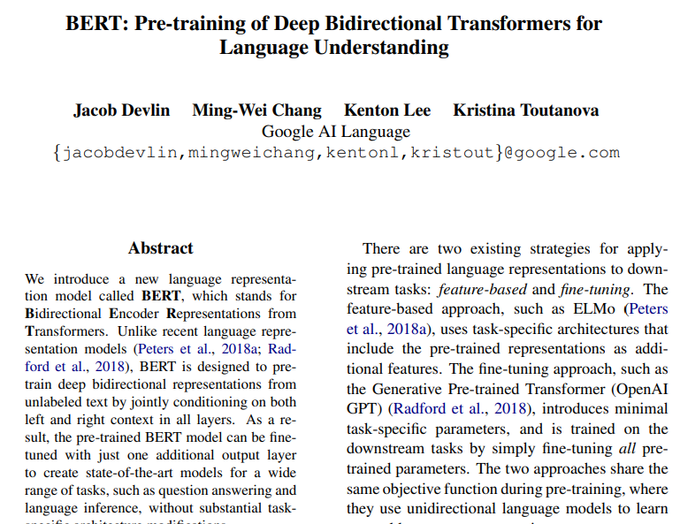
BERT (Bidirectional Encoder Representations from Transformers)
Devlin, J., Chang, M.W., Lee, K. and Toutanova, K., 2019, June. Bert: Pre-training of deep bidirectional transformers for language
understanding. In Proceedings of the 2019 conference of the North American chapter of the association for computational linguistics:
human language technologies, volume 1 (long and short papers) (pp. 4171-4186).

Slide 34
Traditional Language Models vs BERT in “Understanding Human Language”
Traditional LM:
Unidirectional Context: Traditional models like GPT and LSTM read left-to-right (or right-to-left), so they don’t see future words when predicting the current word. This leads to incomplete understanding of sentence context.
Static Word Embeddings: Earlier models used embeddings like Word2Vec, which give the same vector for a word regardless of context (e.g., "bank" in "river bank" vs "money bank").
BERT:
Bidirectional Contextual Understanding: BERT uses a deep bidirectional transformer encoder that considers both left and right context at once using Masked Language Modeling (MLM). This allows it to understand the full context of a word in a sentence.
Contextualized Word Embeddings: BERT generates different embeddings for the same word based on its sentence context, improving semantic understanding.
Example
Traditional LM: Predict "bank" in “He sat by the ___” → only sees left context.
BERT: Sees both sides (“He sat by the ___ of the river”) → learns correct meaning of “bank”.

Slide 35
BERT
BERT (Bidirectional Encoder Representations from Transformers) stands as an open-source machine learning framework designed for the natural language processing (NLP). Originating in 2018, this framework was crafted by researchers from Google AI Language.
BERT employs an encoder-only architecture.

Slide 36
Two step-process of BERT
The BERT model undergoes a two-step process:
Pre-training on Large amounts of unlabeled text to learn contextual embeddings.
Fine-tuning on labeled data for specific NLP tasks.

Slide 37
Two step-process of BERT
The BERT model undergoes a two-step process:
Pre-training on Large amounts of unlabeled text to learn contextual embeddings.
Fine-tuning on labeled data for specific NLP tasks.
Pre-Training on Large Data
BERT is pre-trained on large amount of unlabeled text data. The model learns contextual embeddings, which are the representations of words that take into account their surrounding context in a sentence.
BERT engages in various unsupervised pre-training tasks. For instance, it might learn to predict missing words in a sentence (Masked Language Model or MLM task), understand the relationship between two sentences, or predict the next sentence in a pair.

Slide 38
Two step-process of BERT
The BERT model undergoes a two-step process:
Pre-training on Large amounts of unlabeled text to learn contextual embeddings.
Fine-tuning on labeled data for specific NLP tasks.
Fine-Tuning on Labeled Data
After the pre-training phase, the BERT model, armed with its contextual embeddings, is then fine-tuned for specific natural language processing (NLP) tasks. This step tailors the model to more targeted applications by adapting its general language understanding to the nuances of the particular task.
BERT is fine-tuned using labeled data specific to the downstream tasks of interest. These tasks could include sentiment analysis, question-answering, named entity recognition, or any other NLP application. The model's parameters are adjusted to optimize its performance for the particular requirements of the task at hand.

Slide 39
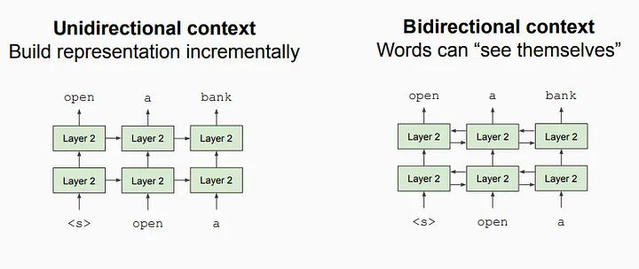
BERT: Bidirectional
Language models could only read text input sequentially — either left-to-right or right-to-left — but couldn’t do both at the same time. BERT is different because it is designed to read in both directions at once. This capability, enabled by the introduction of Transformers, is known as bi-directionality.

Slide 40
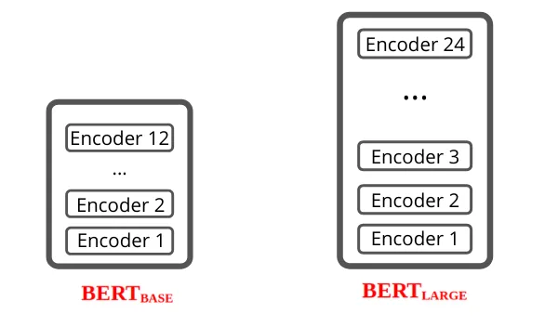
BERT Model Architecture
BERT is basically an Encoder stack of transformer architecture.
BERT is released in two versions of the pre-trained model, which is trained on a huge dataset.
BERT BASE Model — It has 12 layers in the Encoder stack, 12 Attention Heads, 110 million parameters, 768 Hidden Sizes
BERT LARGE Model — It has 24 layers in the Encoder stack, 16 Attention Heads, 340 million parameters, 1024 Hidden Sizes

Slide 41
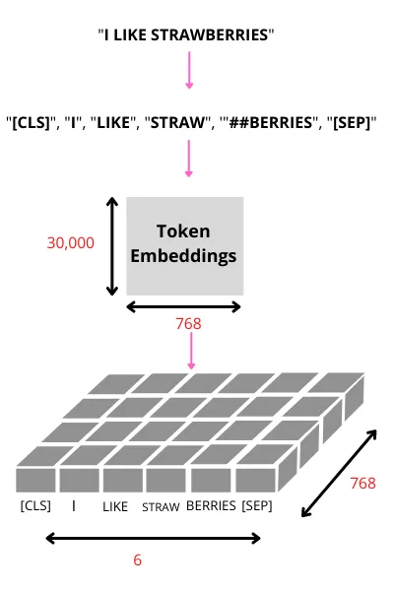
BERT: Model Input/Output Representation
When BERT is pre-trained, it builds a vocabulary of
around 30,000 unique tokens.
Each token maps to a 768-dimensional embedding
vector (for BERT-base).

Slide 42
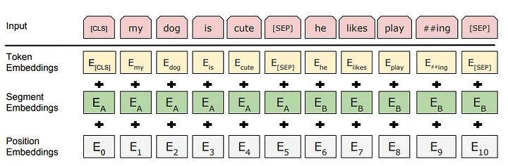
BERT: Model Input/Output Representation
BERT uses WordPiece embeddings with a 30,000 token vocabulary.
The first token of every sequence of input is always a[CLS], which means the classification token.
The final hidden state corresponding to this token is used as the aggregate sequence representation for classification tasks.
If the Sentence pairs are packed together into a single sequence, they will differentiate the sentence in two ways. First, using [SEP] token. Second, add a learned embedding to every token indicating whether it belongs to sentence A or sentence B.

Slide 43
How does BERT work?
The new model features an important improvement when it comes to context understanding. Especially with certain texts which are “context-heavy,” for which context understanding is so important for analytics purposes, BERT is a great solution.
Say we have two sentences like:
You were right.
Make a right turn at the light.
In the first sentence, the word “right” refers to a decision; in the second sentence, “right” refers to direction. We know that because of the context.
Another example:
My favorite flower is a rose.
He quickly rose from his seat.
In the first sentence, the word “rose” refers to a flower; in the second one, it’s referred to the past tense of rise. Again, we know that because of the context.
Because BERT practices to predict missing words in the text, and because it analyzes every sentence with no specific direction, it does a better job at understanding the meaning of homonyms than previous NLP methodologies, such as embedding methods.
To overcome this challenge, BERT is pre-trained on two different NLP tasks:
MLM (Masked Language Modeling)
Next Sentence Prediction (NSP)

Slide 44
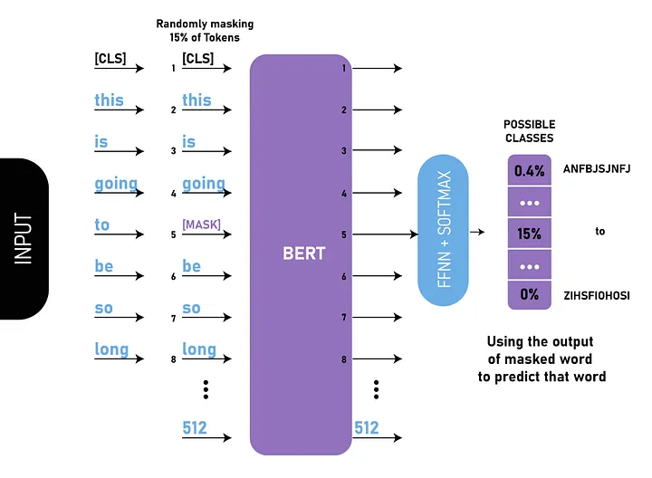
MLM (Masked Language Modeling)
Usually, Language Model can only be trained in one specific direction. BERT can handle this issue with MLM.
Masked Language Modeling(MLM) training is to hide a word in a sentence and have the program predict what word has hidden(masked) based on the context of the hidden words.
BERT does this by masking 15% of all WordPiece tokens in each sequence at random.
Note: [mask] token appear only in the pre-training and not during the fine-tuning.

Slide 45
MLM (Masked Language Modeling)
For every mask input sequence,
Randomly select 15% of tokens (not all masked in the same way) and don’t replace them with [MASK] 100% of the time
Example Sentence: This is going to be so long
For 80% of the time: Replace the word with the [MASK] token.
This is going to be so long → This is going [MASK] be so long
For 10% of the time: Replace the word with a random word
This is going to be so long → This is going the be so long
For 10% of the time: Keep the word unchanged
This is going to be so long → This is going to be so long

Slide 46
Next Sentence Prediction (NSP)
Most downstream tasks such as Question and Answer(QA) and Natural Language Inference (NLI) are based on understanding the relationship between two sentences. It is not directly captured by language modeling.
In the BERT training process, the model receives a pair of sentences as an input and it will be trained to predict whether the second sentence is subsequent to the first sentence.
It is Binary Classification, having two labels IsNext, NotNext.
When choosing the sentences A and B for each pre-training example, 50% of the time Sentence B is an actual sentence that follows Sentence A and it is labeled as IsNext. Next 50% of the time Sentence B will be random sentences from the corpus and it is labeled as NotNext.
Example:
Input: [CLS] the man went to [MASk] store [SEP] he bought a gallon [MASK] milk [SEP]
Output: IsNext
Another Example:
Input: [CLS] the man [MASk] to the store [SEP] penguin [MASK] are flight ##less birds [SEP]
Output: NotNext

Slide 47
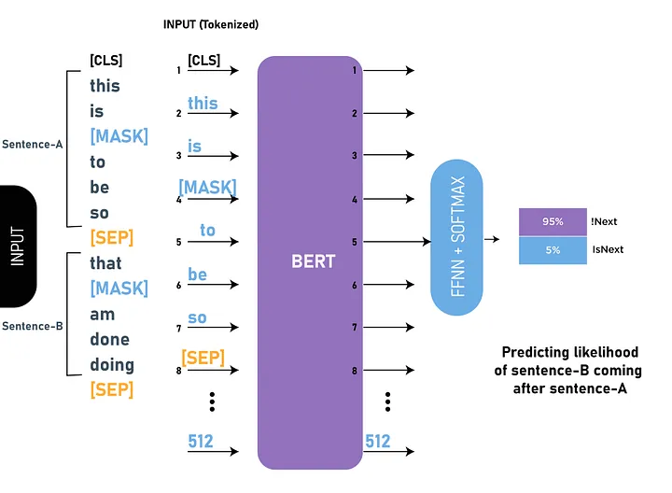
Next Sentence Prediction (NSP)

Slide 48
Fine-Tuning with BERT
Using BERT for a specific task is relatively straightforward:
BERT can be used for a wide variety of language tasks, while only adding a small layer to the core model:
For Classification Tasks(eg. Sentiment Analysis), add a classification (FFN) layer on top of the Transformer output for the [CLS] token.
For Question Answering Tasks (e.g. SQuAD v1.1), BERT train two extra vectors that are responsible for marking the beginning and the end of the answer.

Slide 49
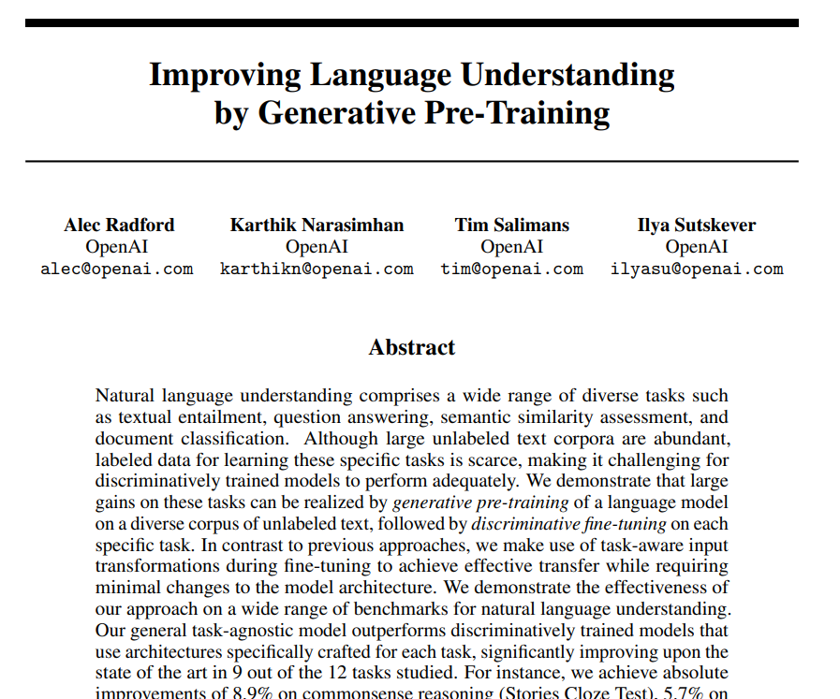
Generative Pre-trained Transformer (GPT)
Radford, A., Narasimhan, K., Salimans, T. and Sutskever, I., 2018. Improving language understanding by generative pre-training. Published at URL: https://www.mikecaptain.com/resources/pdf/GPT-1.pdf

Slide 50
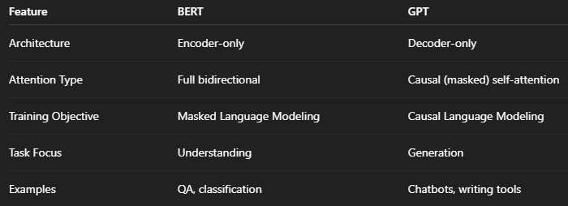
Difference between BERT and GPT
BERT (Encoder) is like a reader who has the whole sentence in front and tries to
understand what a missing word might be.
GPT (Decoder) is like a writer who completes a sentence word by word, only
seeing what they’ve already written.

Slide 51
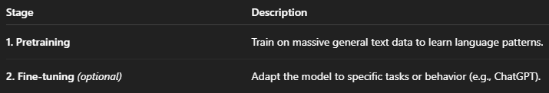
Training Process of Generative Pretrained Transformer (GPT)
GPT Training has two Main Stages

Slide 52
Training Process of Generative Pretrained Transformer (GPT)
1. Pre-training:
Objective: Learn to predict the next word in a sentence → Causal Language Modeling (CLM)
Training Data: Large, diverse corpus (e.g., Wikipedia, Common Crawl, books, code, web pages)
Text is tokenized.
How it works:
The model uses causal masking so that each token only attends to earlier tokens — not future ones.
Self-attention layers learn dependencies and relationships across tokens.
Example:
Input: "The sun rises in the" Target: "east"
GPT sees:
"The" → predicts "sun"
"The sun" → predicts "rises"
… and so on
Each token is predicted given only its left context.

Slide 53

Training Process of Generative Pretrained Transformer (GPT)
1. Pre-training:
Objective: Learn to predict the next word in a sentence → Causal Language Modeling (CLM)
Training Data: Large, diverse corpus (e.g., Wikipedia, Common Crawl, books, code, web pages)
Text is tokenized.
How it works:
The model uses causal masking so that each token only attends to earlier tokens — not future ones.
Self-attention layers learn dependencies and relationships across tokens.
Loss Function: GPT minimizes cross-entropy loss for predicting the next token:
Example:
Input: "The sun rises in the" Target: "east"
GPT sees:
"The" → predicts "sun"
"The sun" → predicts "rises"
… and so on
Each token is predicted given only its left context.

Slide 54
Training Process of Generative Pretrained Transformer (GPT)
1. Pre-training:
Objective: Learn to predict the next word in a sentence → Causal Language Modeling (CLM)
Training Data: Large, diverse corpus (e.g., Wikipedia, Common Crawl, books, code, web pages)
Text is tokenized.
How it works:
The model uses causal masking so that each token only attends to earlier tokens — not future ones.
Self-attention layers learn dependencies and relationships across tokens.
Loss Function: GPT minimizes cross-entropy loss for predicting the next token:
Example:
Input: "The sun rises in the" Target: "east"
GPT sees:
"The" → predicts "sun"
"The sun" → predicts "rises"
… and so on
Each token is predicted given only its left context.
Key Characteristics:
Causal masking in attention: Model can’t look ahead
GPT is auto-regressive: Each token prediction
depends on the previous ones.

Slide 55
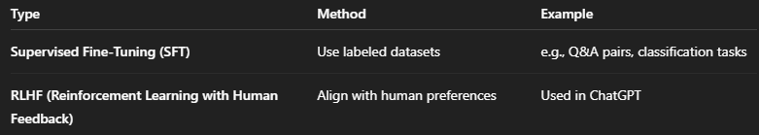
Training Process of Generative Pretrained Transformer (GPT)
2. Fine-tuning Phase (Optional)
Fine-tuning is task-specific adaptation or behavior tuning.
Use Cases: Code generation, medical Q&A, sentiment classification, chatbot personalities
Example

Slide 56
Causal Language Modeling (CLM)
Causal Language Modeling (CLM) is a type of language model that predicts the next word in a sequence based on the preceding words, without access to future context. This unidirectional approach mimics how humans process language, making it suitable for tasks like text generation and autocomplete.
Here's a more detailed explanation:
Unidirectional Prediction:
CLMs are trained to predict the next token in a sequence, moving from left to right (or right to left), and only considering the tokens that have already appeared.
Causality:
The "causal" aspect refers to the dependency of each predicted token on the tokens that precede it, establishing a cause-and-effect relationship in the language generation process.
Autoregressive Models:
CLMs are also known as autoregressive models, as they generate text by predicting one token at a time, using the previously generated tokens as input.
Examples:
Common examples of models using causal language modeling include the GPT (Generative Pre-trained Transformer) series of models.

Slide 57
Causal Language Modeling (CLM)
Applications:
CLMs are well-suited for tasks like:Text Generation: Generating coherent and contextually relevant text.
Chatbots: Creating conversational AI that responds to user input.
Autocomplete: Predicting the continuation of a partially written text.
Training:
CLMs are typically trained on large amounts of text data, where the model learns to predict the next token in a sequence given the preceding tokens.
Evaluation:
Metrics like cross-entropy and perplexity are used to evaluate the performance of CLMs, assessing how well the model predicts the distribution of text.
Key Difference from Masked Language Models (MLM):
Unlike CLMs, MLM models predict missing words in a sentence by looking at both preceding and succeeding words.

Slide 58
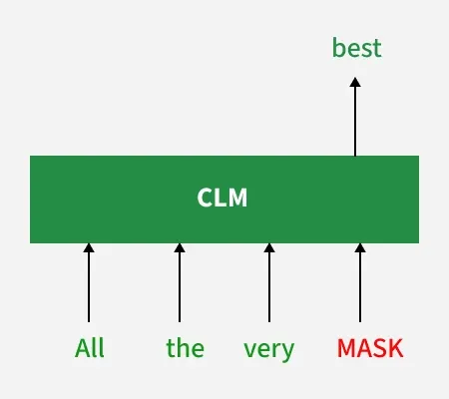
Causal Language Modeling (CLM)
These models are called "causal" because they rely on a causal relationship: each word depends only on the words that came before it not on any future words. This approach mimics how humans naturally process language as they read or speak.
The image explains how a Causal Language Model (CLM) predicts the next word using only previous words. The model takes "All," "the," "very," and "MASK" as input and predicts "best" for the masked word.

Slide 59
How Do Causal Language Models Work?
The training process for causal language models involves two key steps:
Step 1: Tokenization
The input text is broken down into smaller units called tokens, which can be words, subwords or even individual characters. For instance the sentence "The cat sleeps" might be tokenized into ["The", "cat", "sleeps"].

Slide 60
How Do Causal Language Models Work?
During training the model learns to predict the next token in a sequence based on the preceding tokens. It does this by analyzing patterns in large datasets of text. Over time, the model becomes adept at understanding grammar, syntax and context allowing it to generate fluent and meaningful sentences. Once trained causal language models can generate text by iteratively predicting one word at a time.
For example:
Input: "The weather is"
Prediction: "sunny"
The model analyzes the input and predicts the next word, resulting in:
New Input: "The weather is sunny"
Next Prediction: "today"
Finally the model completes the sentence: "The weather is sunny today."

Slide 61
Popular Causal Language Models
GPT (Generative Pre-trained Transformer): It is developed by OpenAI GPT is one of the most well-known causal language models. It has been used to generate human-like text, answer questions, and even write code. Versions like GPT-3 and GPT-4 have demonstrated remarkable capabilities in creative and technical writing.
PaLM (Pathways Language Model): Developed by Google, PaLM is a large-scale causal language model capable of performing a wide range of tasks, including reasoning and multi-language translation.
LLaMA (Large Language Model Meta AI): Created by Meta, LLaMA is another powerful causal language model designed for research purposes, with impressive text generation capabilities.

Slide 62
Applications of Causal Language Models
Causal language models have a wide range of practical applications across industries. Some common use cases include:
Content Creation : Writers and marketers use these models to generate blog posts, social media updates, and marketing copy.
Chatbots and Virtual Assistants : Causal models power conversational AI systems like Siri, Alexa, and customer service chatbots, enabling them to provide relevant responses in real time.
Code Generation : Tools like GitHub Copilot leverage causal language models to assist developers in writing code snippets and debugging programs.
Creative Writing : Authors and screenwriters use these models to brainstorm ideas, outline plots, or even draft entire stories.
Language Translation : While masked models are often preferred for translation tasks, causal models can also contribute by generating fluent translations in a sequential manner.
Education : Causal models can help students by providing explanations, summarizing texts, or generating practice questions.
Accessibility : These models can assist individuals with disabilities by transcribing speech, generating captions, or converting text into simpler language.

Slide 63
Architecture of Generative Pre-trained Transformer
The transformer architecture which is the foundation of GPT models is made up of feedforward neural networks and layers of self-attention processes. Important elements of this architecture consist of:
Self-Attention System: This enables the model to evaluate each word's significance within the context of the complete input sequence. It makes it possible for the model to comprehend word linkages and dependencies which is essential for producing content that is logical and suitable for its context.
Layer normalization and residual connections: By reducing problems such as disappearing and exploding gradients, these characteristics aid in training stabilization and enhance network convergence.
Feedforward Neural Networks: These networks process the output of the attention mechanism and add another layer of abstraction and learning capability. They are positioned between self-attention layers.

Slide 64
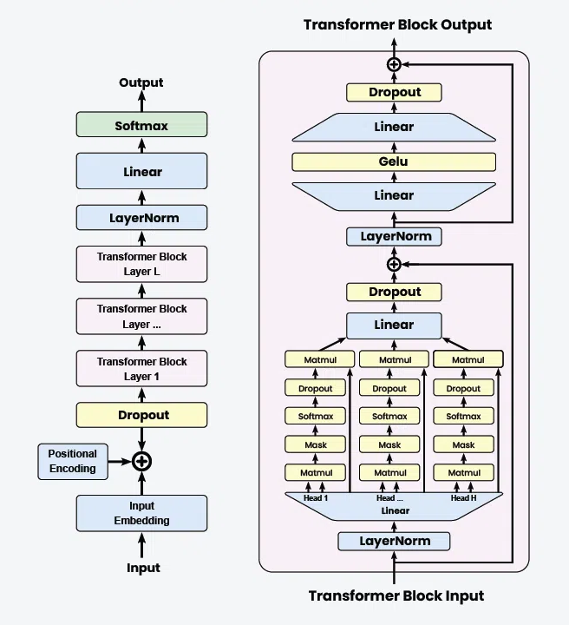
GPT Architecture

Slide 65
Detailed Explanation of the GPT Architecture
1. Input Embedding
Input: The raw text input is tokenized into individual tokens (words or subwords).
Embedding: Each token is converted into a dense vector representation using an embedding layer.
2. Positional Encoding: Since transformers do not inherently understand the order of tokens, positional encodings are added to the input embeddings to retain the sequence information.
3. Dropout Layer: A dropout layer is applied to the embeddings to prevent overfitting during training.
4. Transformer Blocks
LayerNorm: Each transformer block starts with a layer normalization.
Multi-Head Self-Attention: Multi-Head Self-Attention are core component, where the input passes through multiple attention heads.
Add & Norm: The output of the attention mechanism is added back to the input (residual connection) and normalized again.
Feed-Forward Network: A position-wise Feed-Forward Network is applied, typically consisting of two linear transformations with a GeLU activation in between.
Dropout: Dropout is applied to the feed-forward network output.
5. Layer Stack: The transformer blocks are stacked to form a deeper model, allowing the network to capture more complex patterns and dependencies in the input.
6. Final Layers
LayerNorm: LayerNorm is final layer normalization is applied.
Linear: The output is passed through a linear layer to map it to the vocabulary size.
Softmax: A Softmax:layer is applied to produce the final probabilities for each token in the vocabulary.

Slide 66
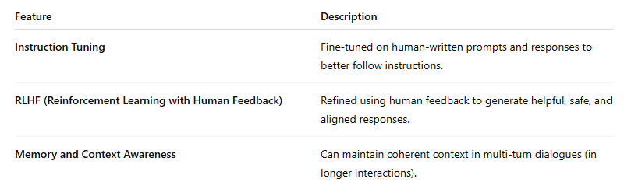
Exploring ChatGPT
What is ChatGPT?
ChatGPT is an AI chatbot developed by OpenAI, built on top of GPT-3.5 and GPT-4.
It uses transformer-based language models designed to understand and generate human-like text.
Model Architecture
Based on GPT (Generative Pre-trained Transformer) – a decoder-only transformer model.
Trained with causal language modeling: Predicts the next word given the previous context.
Enhancements Over GPT

Slide 67

Exploring ChatGPT
Training Pipeline of ChatGPT
Pre-training on massive internet text (like GPT-3).
Instruction tuning with supervised fine-tuning (SFT) on task-specific datasets.
RLHF:
Human annotators rank multiple responses.
A reward model is trained.
Final model is optimized using reinforcement learning
Core Capabilities

Slide 68
What is Prompt ?
A prompt is the text or instruction given to an AI/LLM model to perform a specific task. It serves as the starting point for interaction, providing context and direction for the AI to generate a response. A well-crafted prompt clearly communicates the task’s objective and expected outcome.
For example:
Task: Summarize an article.
Prompt: “Please summarize the following article in one paragraph.”
The AI/LLM model uses this prompt to understand that the response should be a concise summary of the article provided.
Prompts are central to interacting with AI models like GPT because they determine the quality and relevance of the output. Poorly designed prompts can lead to irrelevant or ambiguous responses, while clear and specific prompts can produce high-quality outputs.

Slide 69
What is Prompt Engineering?
Prompt engineering is the discipline of designing and refining prompts to guide AI/LLM models in generating desired outputs. It combines creativity, language skills, and technical knowledge to craft instructions that are both clear and effective.
Key aspects include:
Experimentation: Testing different phrasing and structures.
Iteration: Continuously improving prompts based on outputs.
Clarity: Avoiding ambiguity and misinterpretation.
Analogy: Imagine writing a recipe for baking a cake. The clearer and more detailed the recipe, the better the result. Similarly, in prompt engineering, the precision of the instruction affects the AI’s performance.
Prompt engineering has become crucial in AI applications since the introduction of generative models like ChatGPT, as it determines the quality of interaction and output.
Prompt engineering is a technique used to effectively communicate LLM like GPT-3 or GPT-4 and get the desired output.

Slide 70
Types of Prompts
There are 8 prompt engineering methods: (1) Zero-Shot Learning,
(2) One-Shot Learning,
(3) Few-Shot Learning, (4) Chain-of-Thought Prompting,
(5) Iterative Prompting, (6) Negative Prompting,
(7) Hybrid Prompting, and (8) Prompt Chaining

Slide 71
Zero-Shot Learning
This involves giving the AI a task without any prior examples. You describe what you want in detail, assuming the AI has no prior knowledge of the task.
Prompt: “Explain what a large language model is.”
Response: A Foundation Model in artificial intelligence refers to a large, powerful, and versatile machine learning model that has been trained on a vastamount of data and is capable of performing a wide range of tasks. It is called a foundation model because it serves as a base or starting point for various applications and can be fine-tuned or adapted for specific tasks. …….

Slide 72
One-Shot Learning
You provide one example along with your prompt. This helps the AI understand the context or format you’re expecting.
Prompt: “A Foundation Model in AI refers to a model like GPT-3, which is trained on a large dataset and can be adapted to various tasks. Explain what BERT is in this context.”
Response: BERT (Bidirectional Encoder Representations from Transformers) is a type of pre-trained deep learning model that uses the transformer architecture. It was developed by Google and is considered to be one of the most powerful language models in the field of natural language processing (NLP). BERT is trained on a large dataset of text,………

Slide 73
Few-Shot Learning
This involves providing a few examples (usually 2–5) to help the AI understand the pattern or style of the response you’re looking for.
Prompt: “Foundation Models such as GPT-3 are used for natural language processing, while models like DALL-E are used for image generation. How are Foundation Models used in the field of robotics?”
Response: Foundation Models such as GPT-3 and DALL-E are not typically used directly in robotics. Instead, they are often used to develop the underlying technologies that enable robots to perform various tasks. For example, natural language processing (NLP) is a field of AI that focuses on enabling machines to understand and generate human language. GPT-3 is a powerful NLP model that has been used to develop many natural language applications,………….

Slide 74
Chain-of-Thought Prompting
Here, you ask the AI to detail its thought process step-by-step. This is particularly useful for complex reasoning tasks.
Prompt: “Describe the process of developing a Foundation Model in AI, from data collection to model training.”
Response: Developing a foundation model in AI is a complex process that involves several steps, including data collection, preprocessing, labeling, and training. Here is an overview of the general process: 1. Data Collection: The first step in developing a foundation model is to collect large amounts of data. This data can come from various sources, such as text documents, images, videos, or audio recordings. The quality and quantity of the data collected will have a significant impact on the performance of the final model. 2. Data Preprocessing: Once the data has been collected, it needs to be preprocessed to make it suitable for use in a foundation model. This may involve cleaning the data (removing noise or irrelevant information), converting it into a specific format (such as text or images), and normalizing it to ensure that all the data is on the same scale……….
3. Labeling: ………………………
4. Model Training: …………..
5. Fine-tuning: ……………….
6. Deployment: ………………

Slide 75
Iterative Prompting
This is a process where you refine your prompt based on the outputs you get, slowly guiding the AI to the desired answer or style of answer.
Initial Prompt: “Tell me about the latest developments in Foundation Models in AI.”
Response: …………
Refined Prompt: “Can you provide more details about these improvements in multi-modal learning within Foundation Models?”
Refined Response:……….

Slide 76
Negative Prompting
In this method, you tell the AI what not to do. For instance, you might specify that you don’t want a certain type of content in the response.
Prompt: “Explain the concept of Foundation Models in AI without mentioning natural language processing or NLP.”
Response:………..

Slide 77
Hybrid Prompting
Combining different methods, like few-shot with chain-of-thought, to get more precise or creative outputs.
Prompt: “Like GPT-3, which is a versatile model used in various language tasks, explain how Foundation Models are applied in other domains of AI, such as computer vision.”
Response: ……..

Slide 78
Prompt Chaining
Breaking down a complex task into smaller prompts and then chaining the outputs together to form a final response.
First Prompt: “List some examples of Foundation Models in AI.”
Response:…………….
Second Prompt: “Choose one of these models and explain its foundational role in AI development.”
Response:………….

Slide 79
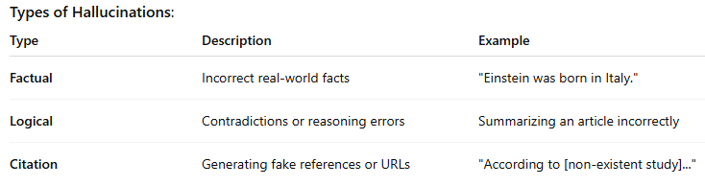
Issues in Large Language Models (LLMs): Hallucination and Bias
What Are Hallucinations in LLMs?
Hallucination refers to when an LLM confidently generates information that is factually incorrect or entirely fabricated.

Slide 80
Issues in Large Language Models (LLMs): Hallucination and Bias
What Is Bias in LLMs?
Definition: Bias in LLMs refers to the model generating outputs that reflect societal, cultural, political, or gender-based stereotypes.
Sources of Bias:
Biased training data (e.g., internet text)
Under representation of certain groups/languages
Reinforcement of harmful stereotypes
Examples:
Associating certain professions with one gender
Generating toxic or prejudiced language toward specific communities

Slide 81
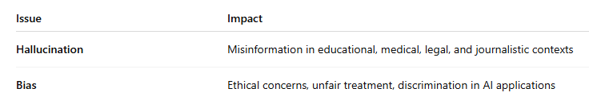
Issues in Large Language Models (LLMs): Hallucination and Bias
Best Practices for Students Using LLMs
Always verify facts from trusted sources.
Be aware of possible bias in outputs.
Use LLMs as assistive tools, not authoritative sources.
Summary
LLMs are powerful but not always reliable.
Hallucination = makes things up, Bias = reflects societal unfairness.
Awareness + careful usage = responsible AI adoption.

Slide 82
Thanks for Listening
Notes:
https://colab.research.google.com/github/ageron/handson-ml2/blob/master/02_end_to_end_machine_learning_project.ipynb#scrollTo=tLb7or7j1rMW

