Slide 1

Deep Learning and Generative AI MSCS202
Course Instructor
Dr. Umadevi V
Department of CSE, BMSCE

Slide 2
Disclaimer
Contents given in PPT are brief and for reference only. Should refer to text book/relevant materials for detailed description.

Slide 3
What Is Machine Learning?
Machine Learning is the science (and art) of programming computers so they can learn from data.
Machine Learning is the field of study that gives computers the ability to learn without being explicitly programmed.

Slide 4
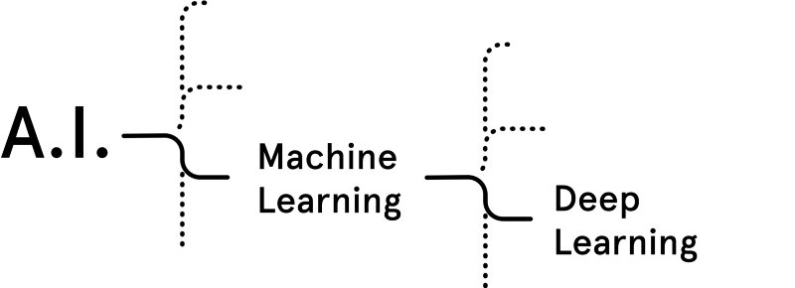
What is Deep Learning ?
(Artificial
Intelligence)
Deep Learning is a category of
machine learning models (=algorithms)
that use multi-layer neural networks.

Slide 5
Difference between
Traditional Machine Learning (ML)
And
Deep Learning (DL)

Slide 6
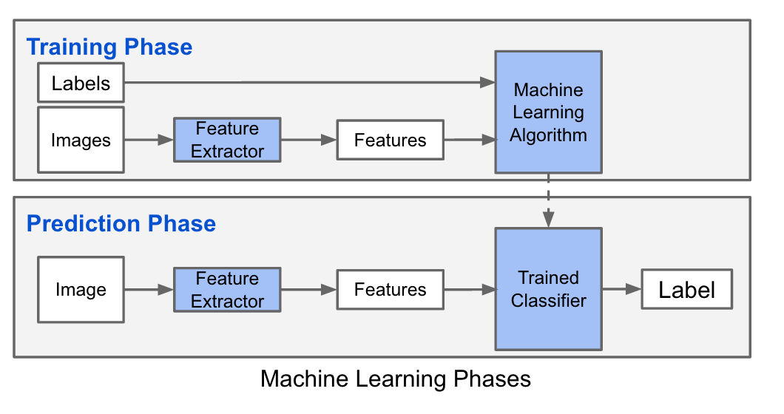
Traditional Machine Learning
Notes:
http://adilmoujahid.com/posts/2016/06/introduction-deep-learning-python-caffe/

Slide 7
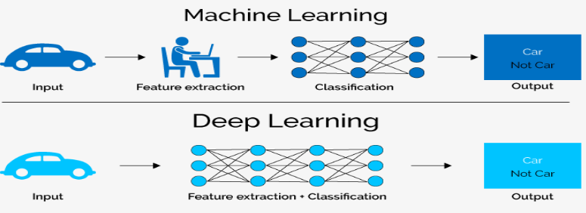
Difference between Traditional ML and DL
Traditional Machine Learning | Deep Learning
We need to hand-craft the features | Feature engineering is done automatically

Slide 8
Unit-1
Unit 1: Introduction: Neural Networks: Building Intelligent Systems, Limitations of Traditional Computer Programs, Mechanics of Machine Learning, Neuron, Expressing Linear Perceptrons as Neurons, Feed-Forward Neural Networks, Linear Neurons and Limitations, Sigmoid, Tanh and ReLU Neurons, Softmax Output Layers, Training Feed-Forward Neural Networks: Gradient Descent, Delta Rule and Learning Rates, Gradient Descent with Sigmoidal Neurons, Backpropagation Algorithm, Stochastic and Minibatch Gradient Descent, Overfitting, Preventing Overfitting in Deep Neural Networks

Slide 9
Building Intelligent Machines
Intelligent Machines: Example - Robotic assistants to clean our homes, cars that drive themselves, microscopes that automatically detect diseases etc.
Building artificially intelligent machines requires to solve the most complex computational problems.
Extremely active field of artificial computer intelligence often referred to as Deep Learning.

Slide 10
Limits of Traditional Computer Programs
Traditional computer programs are designed to be very good at two things: (1) Performing arithmetic really fast
(2) Explicitly following a list of instructions.

Slide 11
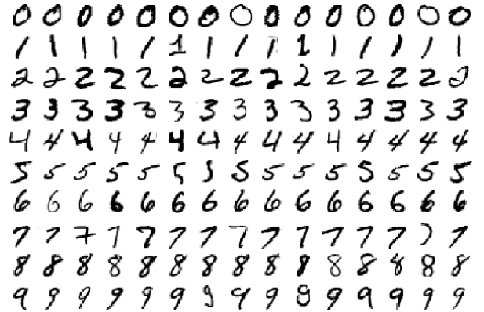
Limits of Traditional Computer Programs
Write a program to automatically read someone’s handwriting ?
Image from MNIST handwritten digit dataset

Slide 12
Mechanics of Machine Learning (ML)
Deep learning is a subset of a more general field of AI called machine learning, which is predicated on this idea of learning from example.
In machine learning, instead of teaching a computer a massive list of rules to solve the problem, we give it a model with which it can evaluate examples, and a small set of instructions to modify the model when it makes a mistake.

Slide 13
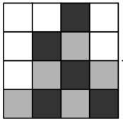
Mechanics of Machine Learning
Model: To be a function ℎ(x, θ). The input x is an example expressed in vector form.
For example, if x were a grayscale image, the vector’s components would be pixel intensities at each position.
The input θ is a vector of the parameters that our model uses. Our machine learning program tries to perfect the values of these parameters as it is exposed to more and more examples.

Slide 14
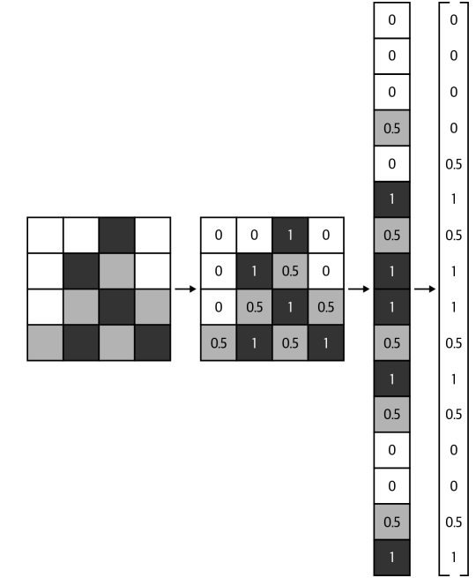
Mechanics of Machine Learning
Model: To be a function ℎ(x, θ). The input x is an example expressed in vector form.
For example, if x were a grayscale image, the vector’s components would be pixel intensities at each position.
The input θ is a vector of the parameters that our model uses. Our machine learning program tries to perfect the values of these parameters as it is exposed to more and more examples.
Process of vectorizing an image
for a machine learning algorithm

Slide 15
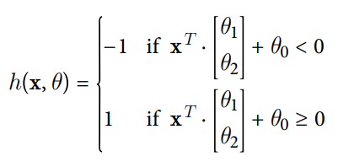
Mechanics of Machine Learning
Example:
To Predict: Performance of students.
−1 if we perform below average and
1 otherwise
Input: Number of hours of sleep (x₁) and the number of hours of study the previous day (x₂)
Each data point representation x = [x1 ,x2]^{T}
To learn a model ℎ(x, θ) with parameter vector θ = [θ₀ , θ₁ ,θ₂ ]^{T} such that:
To learn:
Parameter vector θ such that the
model makes the right predictions
This model is called a Linear Perceptron

Slide 16
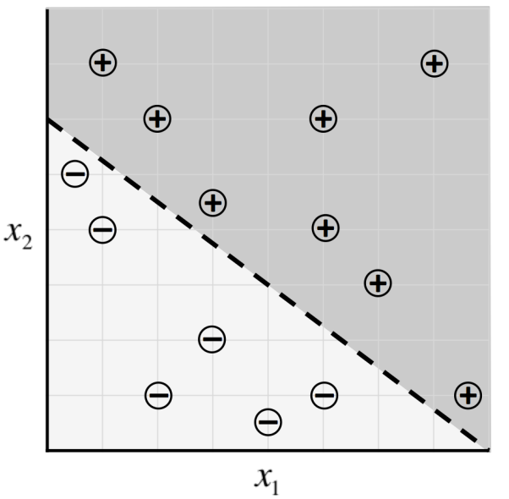
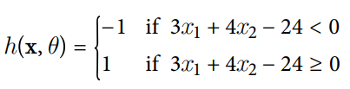
Mechanics of ML: Linear Perceptron
Sample data for our exam predictor algorithm and a potential classifier
7
6
5
4
3
2
1
Then it turns out that by selecting
θ =[−24, 3, 4]^{T} ,
our ML model makes the correct
prediction on every data point:
1 2 3 4 5 6 7

Slide 17
Mechanics of ML: Linear Perceptron
Optimization: An optimal value for the parameter vector θ
An optimizer aims to maximize the performance of a machine learning model by iteratively tweaking its parameters until the error is minimized.

Slide 18
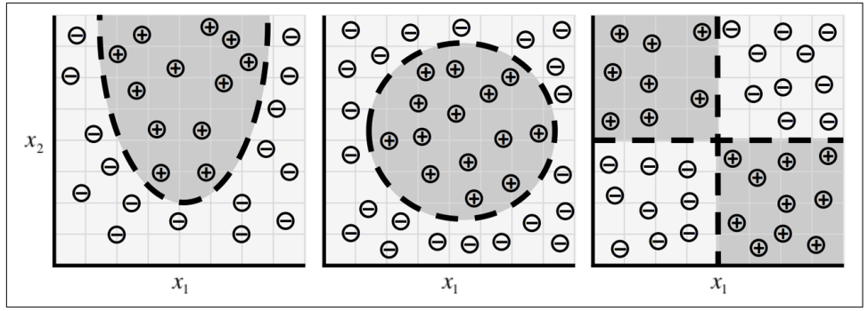
Mechanics of ML: Linear Perceptron
Linear perceptron model is quite limited in the relationships it can learn. For example, the distributions of data shown in Figure belo cannot be described well by a linear perceptron.
As our data takes on more complex forms, we need more complex models to describe them.

Slide 19
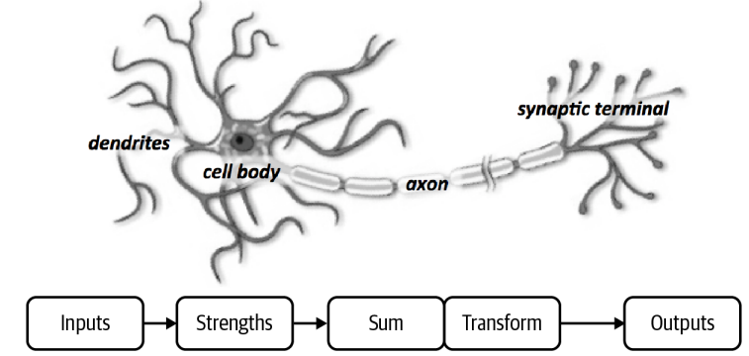
Neuron
Foundational unit of the human brain is the neuron. The human brain contains approximately 86 billion neurons. Each of the neuron forms an average of 6,000 connections with other neurons. Goal in this section is to use this natural structure to build machine learning models that solve problems in an analogous way,
Functional description of a biological neuron’s structure

Slide 20
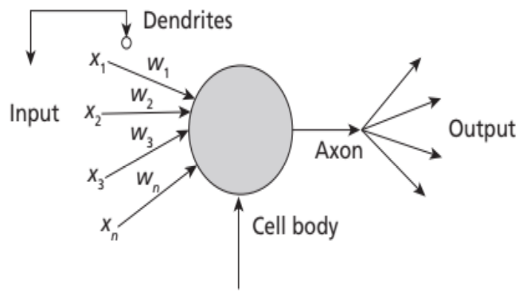
Neuron
Foundational unit of the human brain is the neuron. The human brain contains approximately 86 billion neurons. Each of the neuron forms an average of 6,000 connections with other neurons. Goal is to use this natural structure to build machine learning models that solve problems in an analogous way.
Functional description of a biological neuron’s structure
Schematic for a neuron in an
artificial neural net

Slide 21
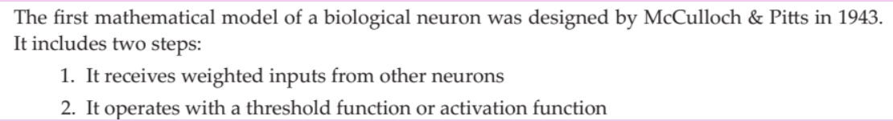
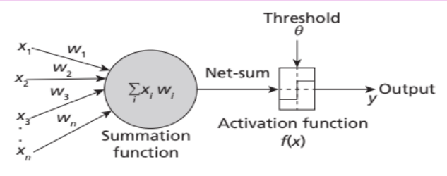
Simple Model of an Artificial Neuron

Slide 22
Perceptron Learning
The first network model 'Perceptron', designed in 1958
Perceptron is a linear binary classifier used for supervised learning.
Perceptron Learning model is a combination of two concepts, McColloch-Pitts model of an artificial neuron and Hebbian learning rule of adjusting weights

Slide 23
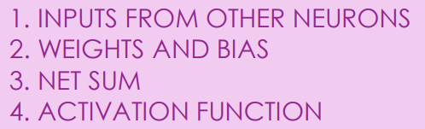

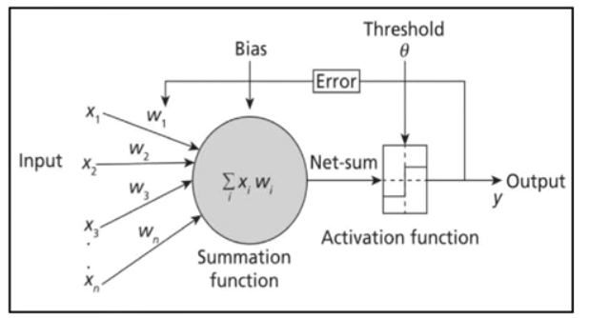
Perceptron Learning
The Perceptron Model consists of four steps
Y

Slide 24
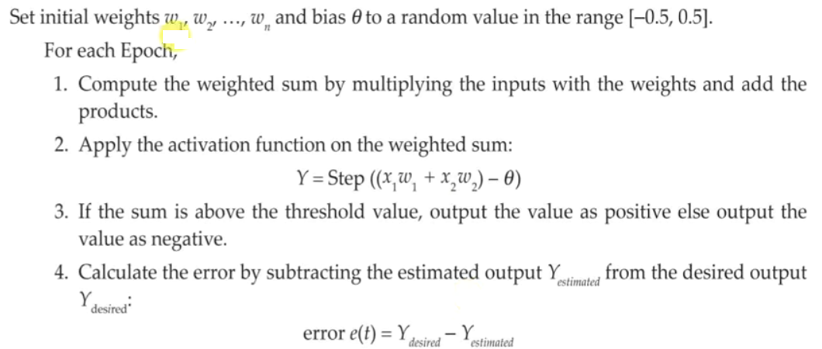
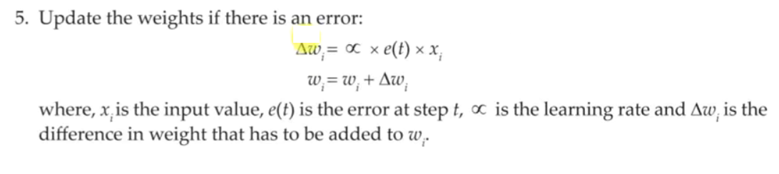
Perceptron Learning Algorithm

Slide 25
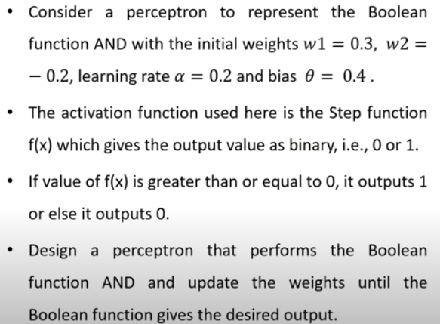
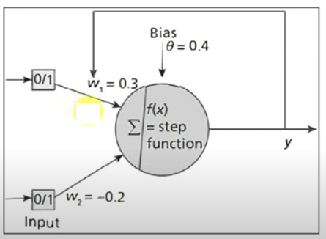
Perceptron Learning: To train Boolean AND function

Slide 26
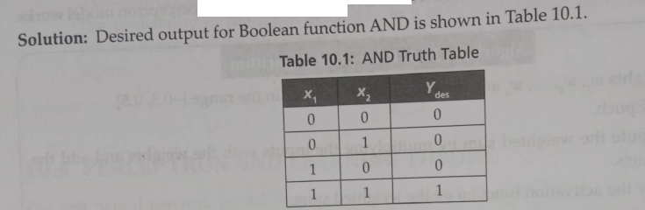
Perceptron Learning: To train Boolean AND function

Slide 27
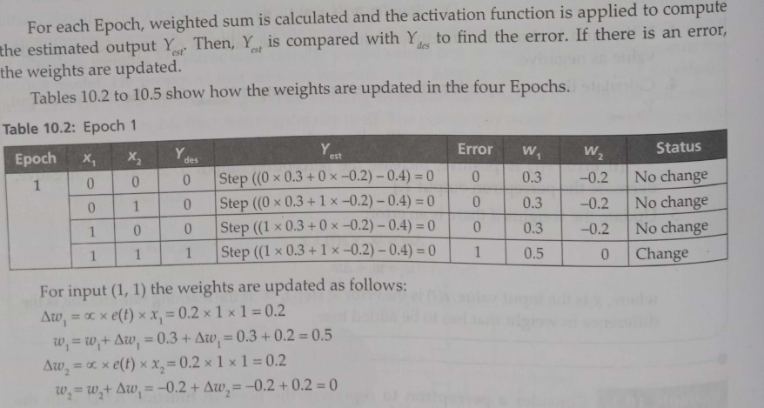
Perceptron Learning: To train Boolean AND function

Slide 28
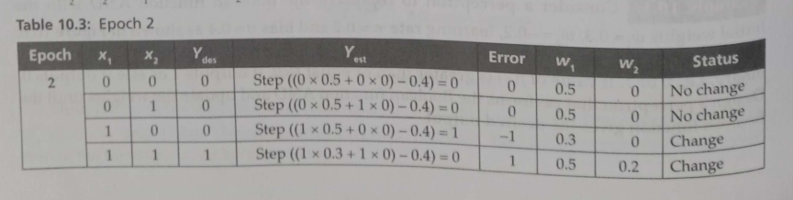
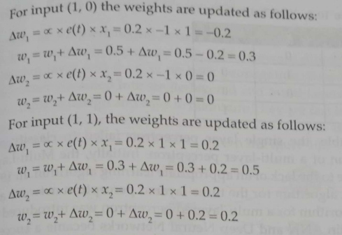
Perceptron Learning: To train Boolean AND function

Slide 29
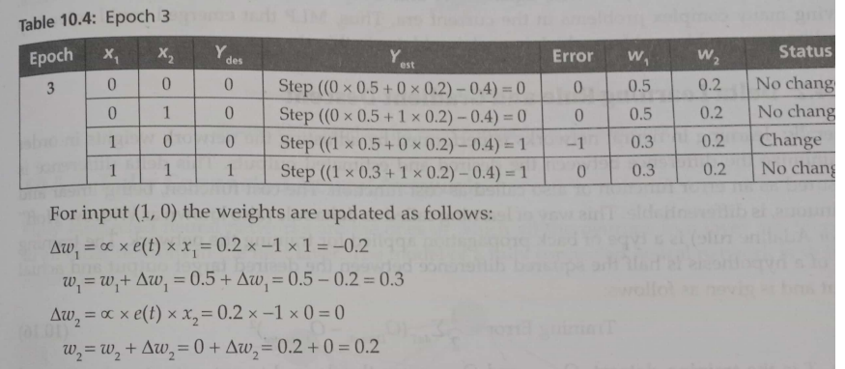
Perceptron Learning: To train Boolean AND function

Slide 30
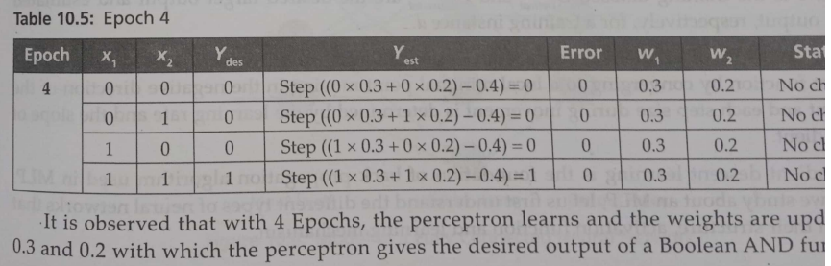
Perceptron Learning: To train Boolean AND function

Slide 31


Question
The signum function, often denoted as sgn(x) or sign(x), is an activation
function that returns the sign of a real number. It outputs 1 for positive
inputs, -1 for negative inputs, and 0 for zero inputs.

Slide 32

Question
The signum function, often denoted as sgn(x) or sign(x), is an activation function
that returns the sign of a real number. It outputs 1 for positive inputs, -1 for
negative inputs, and 0 for zero inputs.
Answer:

Slide 33
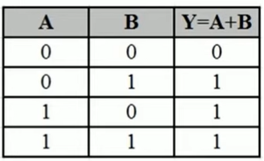
Problem
Consider a perceptron to represent the Boolean function OR with initial weights as w1=0.6, W2=0.6 and threshold as 1 and learning rate as 0.5. The activation function used is the Step function f(x) which gives the output value as binary, i.e. 0 or 1. If the values of f(x) is greater than or equal to threshold, it outputs 1 or else it outputs 0. Design a perceptron that performs the Boolean function OR and update the weights until the Boolean function gives the desired output.
Answer: Weights W1=1.1 , W2=1.1

Slide 34
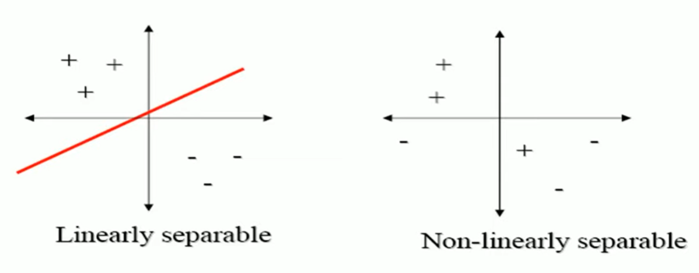
Linear Neurons and Limitations
The perceptron can only model linearly separable functions, − those functions which can be drawn in 2-dim graph and single straight line separates values in two part.
Boolean functions given below are linearly separable: − AND − OR − COMPLEMENT
It cannot model XOR function as it is non linearly separable. − When the two classes are not linearly separable, it may be desirable to obtain a linear separator that minimizes the mean squared error.

Slide 35
XOR – Non linearly separable function
A typical example of non-linearly separable function is the XOR that computes the logical exclusive or..
This function takes two input arguments with values in {0,1} and returns one output in {0,1},
Here 0 and 1 are encoding of the truth values false and true,
The output is true if and only if the two inputs have different truth values.
XOR is non linearly separable function which can not be modeled by perceptron.
For such functions we have to use multi layer feed-forward network.

Slide 36
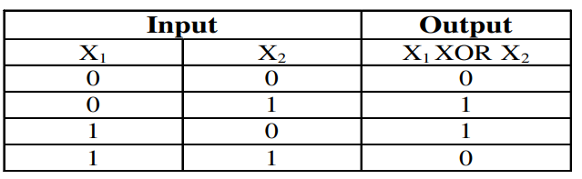
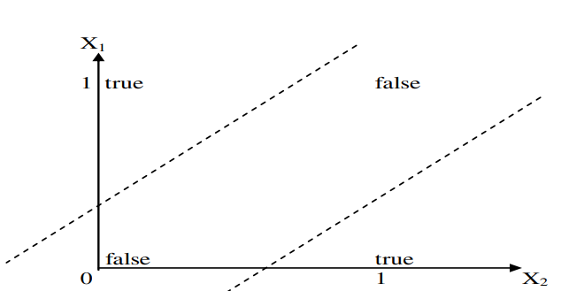
XOR – Non linearly separable function
These two classes (true and false) cannot be separated using a line. Hence XOR is non linearly separable.

Slide 37
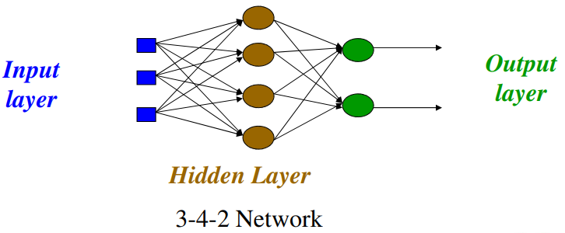
Multi layer feed-forward Neural Network (FFNN)
FFNN is a more general network architecture, where there are hidden layers between input and output layers.
Hidden nodes do not directly receive inputs nor send outputs to the external environment.
FFNNs overcome the limitation of single-layer NN.
They can handle non-linearly separable learning tasks.

Slide 38
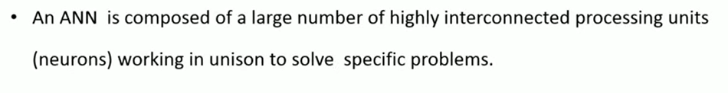
ANN Introduction

Slide 39
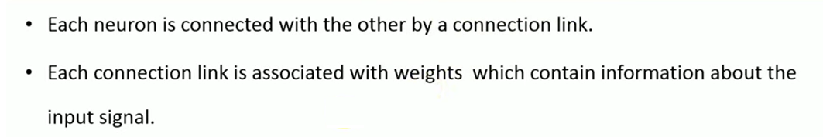
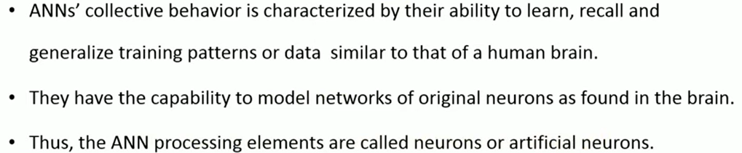
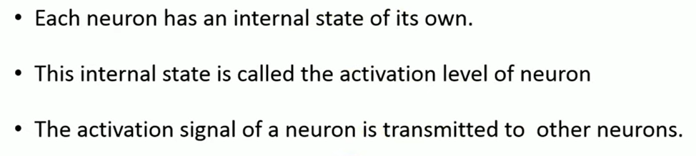
ANN Introduction

Slide 40
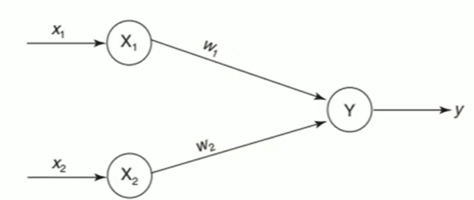
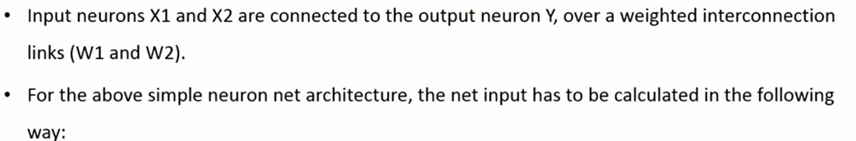


ANN Introduction

Slide 41
Bias Input
In our last example we set our threshold to 1, this means our weighted input needs to equal or exceed 1 to give us an output of 1.
This is okay when learning the AND function because we know we only need an output when both inputs will be set, allowing (with the correct weights) for the threshold to be reached or exceeded.
In the case of the NOR function however, the network should only output 1 if both inputs are off. This means if we have a threshold of 1 there isn't a combination of weights that will ever make the following true,
x₁ = 0 ; x₂ = 0 ; 1 <= x₁w₁ + x₂w₂
There's a simple fix to this though, a bias unit. A bias unit is simply a neuron with a constant output, typically of 1.
Bias units are weighted just like other units in the network, the only difference is that they will always output 1 regardless of the input from the previous layer, this is where they get their name! So why are they important? Bias inputs effectively allow the neuron to learn a threshold value. Consider our previous equation, with a bias input (x₀) added we can change it to, x₀ = 1; x₁ = 0 ; x₂ = 0 ; 1 <= x₀w₀ + x₁w₁ + x₂w₂
Output
w0
w1
w2
x0
Input1
x1
Input2
x2
Bias +1

Slide 42
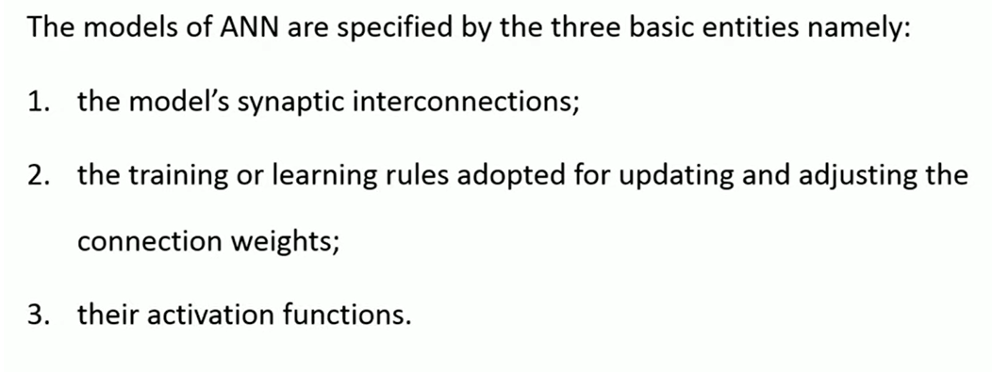
Three Basic components of ANN

Slide 43
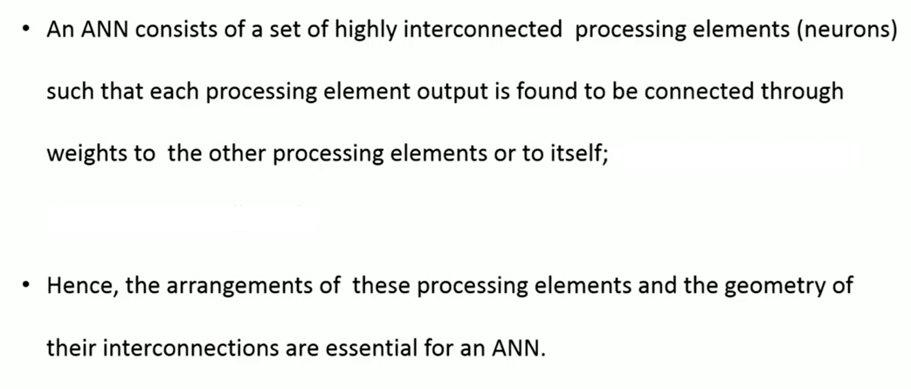
Connections

Slide 44
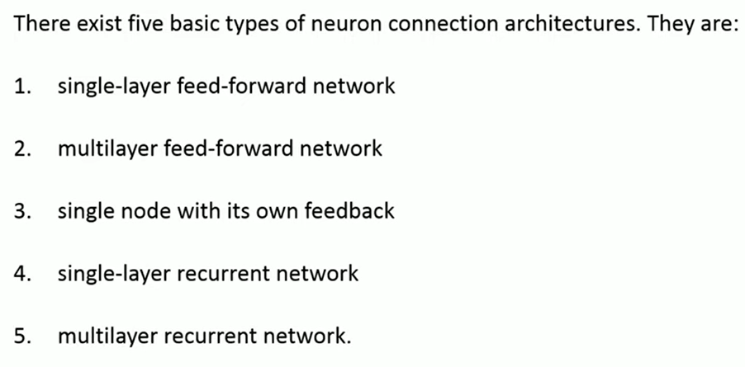
1. Connections
"feedforward" because the information flow is unidirectional, progressing forward from the input layer to the output layer, without any loops or feedback connections.
"recurrent" because they process sequential data by feeding back the output of a neuron at one time step as input to the network at the next time step.

Slide 45
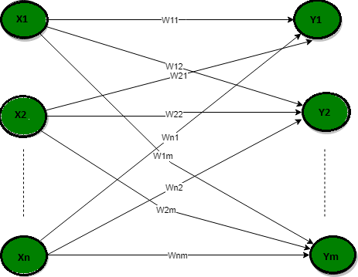
Single-layer feed-forward network

Slide 46
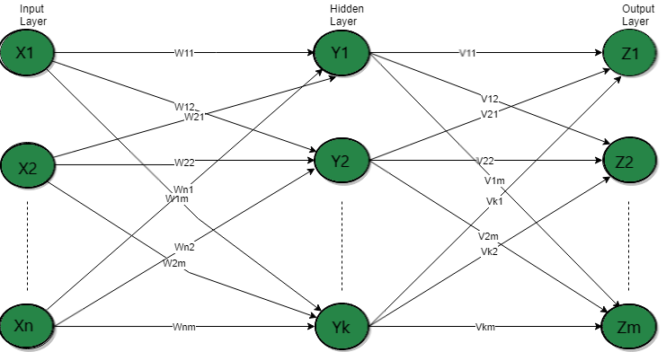
Multilayer feed-forward network

Slide 47
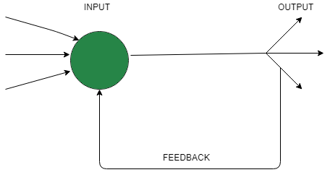
Single node with its own feedback

Slide 48
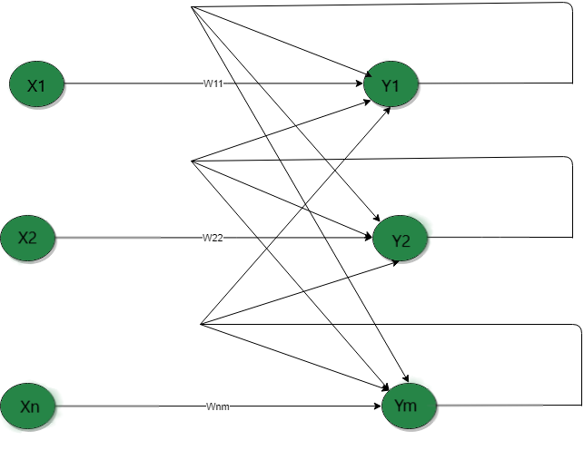
Single-layer recurrent network

Slide 49
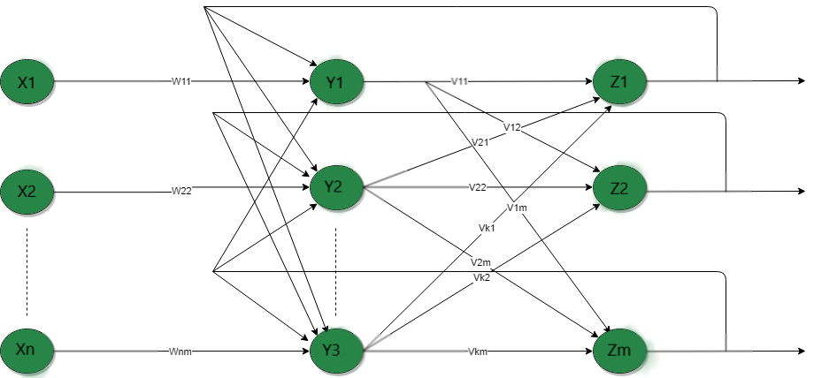
Multilayer recurrent network

Slide 50
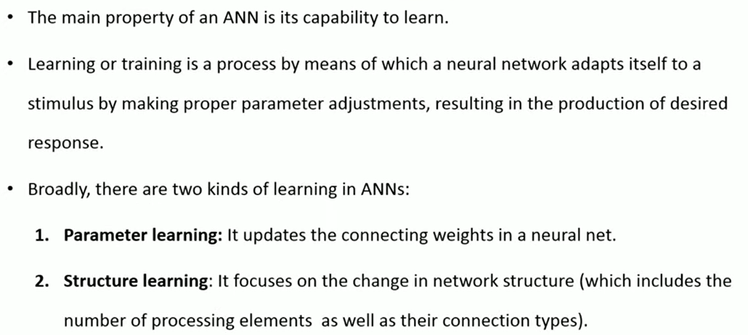
2. Learning

Slide 51
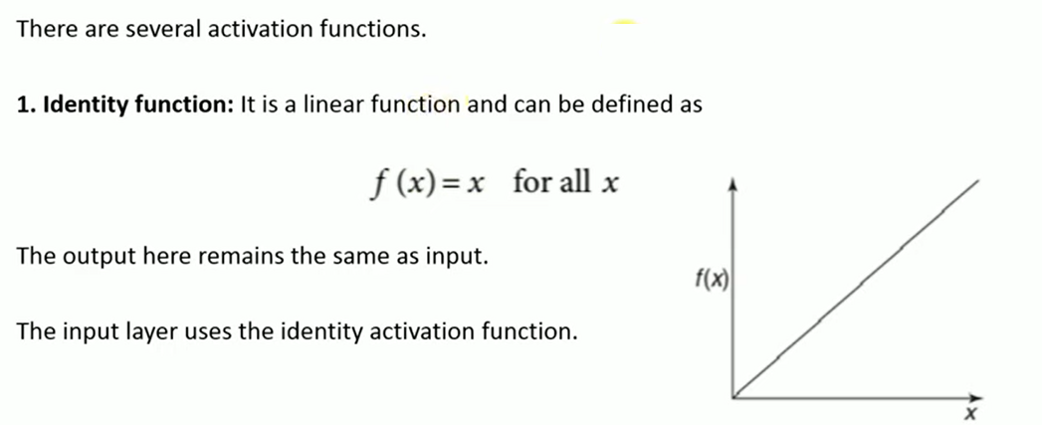
3. Activation functions

Slide 52
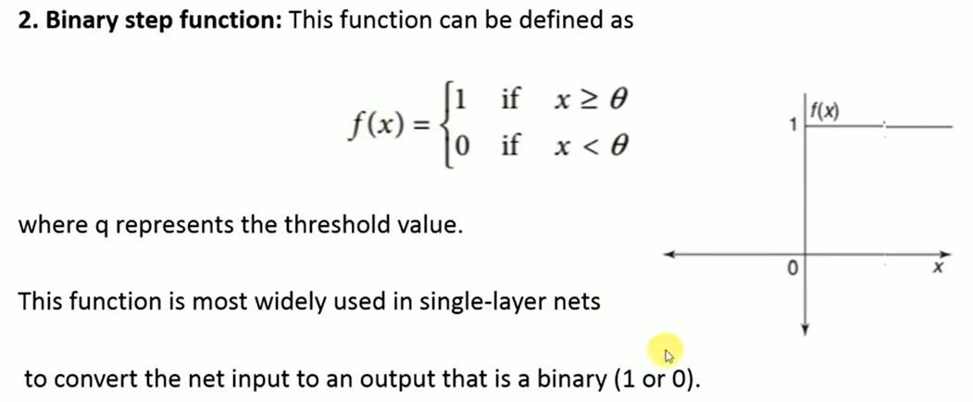
3. Activation function

Slide 53
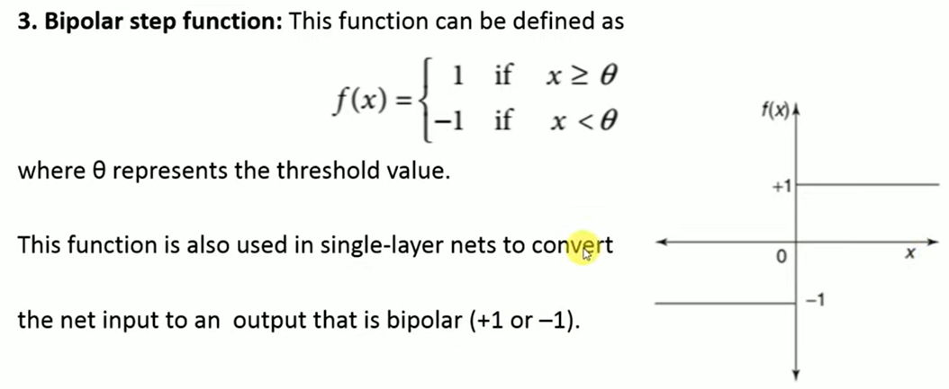
3. Activation function

Slide 54
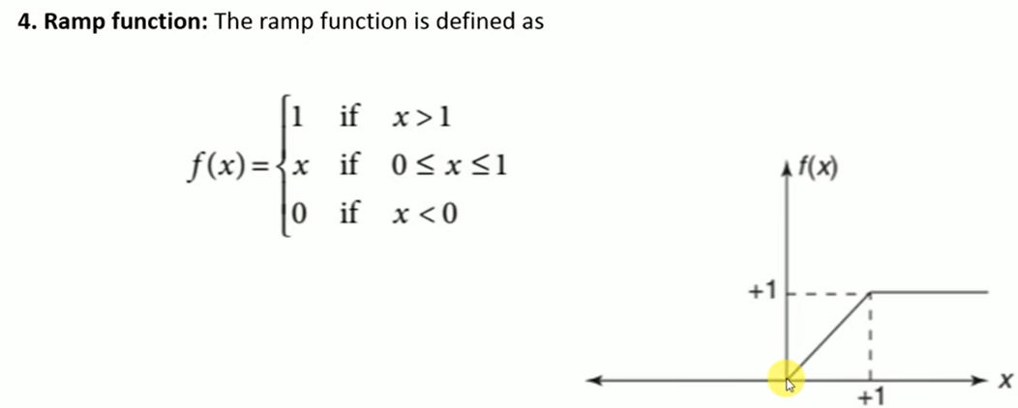
3. Activation function

Slide 55


3. Activation function
Sigmoid activation function: The sigmoid function is one of the earliest activation functions used in neural networks. It is defined as:

Slide 56

Activation function
Softmax is an activation function commonly used in neural networks for multi-classification problems.
Softmax performs the following transform on n numbers x1…xn​:
The outputs of the Softmax transform are always in the range [0,1][0,1] and add up to 1. Hence, they form a probability distribution.

Slide 57

Problem
Apply Sigmoid activation function by considering the following single-layer neural network and find its output.

Slide 58


Problem
Apply Sigmoid activation consider the following single-layer neural network and find its output.

Slide 59

Activation function
Softmax is an activation function commonly used in neural networks for multi-classification problems.
Softmax performs the following transform on n numbers x1…xn​:
The outputs of the Softmax transform are always in the range [0,1][0,1] and add up to 1. Hence, they form a probability distribution.

Slide 60

Activation function
Softmax is an activation function commonly used in neural networks for multi-classification problems.
Softmax performs the following transform on n numbers x1…xn​:
The outputs of the Softmax transform are always in the range [0,1][0,1] and add up to 1. Hence, they form a probability distribution.

Slide 61
Softmax
Example, N = 3 as we have 3 classes: {seal, panda, duck}, and the valid indices are 0, 1, and 2. Suppose you’re given the vector z = [0.25, 1.23, -0.8] of raw outputs from the neural network.
Let’s apply the softmax formula on the vector z, using the steps below:
Calculate the exponent of each entry.
Divide the result of step 1 by the sum of the exponents of all entries.

Slide 62

Softmax
Example, N = 3 as we have 3 classes: {seal, panda, duck}, and the valid indices are 0, 1, and 2. Suppose you’re given the vector z = [0.25, 1.23, -0.8] of raw outputs from the neural network.
Let’s apply the softmax formula on the vector z, using the steps below:
Calculate the exponent of each entry.
Divide the result of step 1 by the sum of the exponents of all entries.

Slide 63

Softmax
Example, N = 3 as we have 3 classes: {seal, panda, duck}, and the valid indices are 0, 1, and 2. Suppose you’re given the vector z = [0.25, 1.23, -0.8] of raw outputs from the neural network.
Let’s apply the softmax formula on the vector z, using the steps below:
Calculate the exponent of each entry.
Divide the result of step 1 by the sum of the exponents of all entries.
In the vector z of raw outputs,
the maximum value is 1.23,
which on applying softmax activation
maps to 0.664: the largest entry in the
softmax output vector. Likewise,
0.25 and -0.8 map to 0.249 and 0.087:
the second and the third largest entries
in the softmax output respectively.
Thus, applying softmax preserves the
relative ordering of scores.

Slide 64

Activation function
Tanh activation function: The hyperbolic tangent function is also sigmoidal ('S' shaped curve) in nature but the value ranges between -1 and +1.

Slide 65

Activation function
ReLu: Rectified Linear Units. Its some what similar to identity function for x greater than 0. Training of neural networks is considered to be faster with ReLUs.

Slide 66
Question
Which of the following functions can be used as an activation function in the output layer if we wish to predict the probabilities of n classes (p₁, p₂, …, p_{k}) such that sum of p over all n equals to 1?
a) Sigmoid
b) Rectified Linear Unit (ReLU)
c) Tanh
d) Softmax

Slide 67
Question
Which of the following functions can be used as an activation function in the output layer if we wish to predict the probabilities of n classes (p₁, p₂, …, p_{k}) such that sum of p over all n equals to 1?
a) Sigmoid
b) Rectified Linear Unit (ReLU)
c) Tanh
d) Softmax
Answer: (d) Softmax
The Softmax activation function is commonly used as an activation function in the case of multi-class classification problems in machine learning. The output of the Softmax is interpreted as the probability of getting each class.

Slide 68

Question
Formula: sigma(x) = 1 / (1 + e^{-x})
Compute the output of the sigmoid activation function for the input values: -1, 0, and 1.
Formula: ReLU(x) = max(0, x)
Calculate the output of the ReLU activation function for the input values: -3, 0, and 3.
Formula:
For the input vector [1, 2, 3], compute the output of the SoftMax activation function.

Slide 69
Gradient Descent Algorithm
An algorithm to minimize a function by optimizing the parameters.

Slide 70


Slide 71

Determine when the slope of the curve 𝑓(𝑥)=𝑥² is negative and positive.

Slide 72

Determine when the slope of the curve 𝑓(𝑥)=𝑥² is negative and positive.

Slide 73

Finding the minimum value of the function f(x)=𝑥² using gradient descent.

Slide 74

Finding the minimum value of the function f(x)=𝑥² using gradient descent.

Slide 75

Finding the minimum value of the function f(x)=𝑥² using gradient descent.

Slide 76


Finding the minimum value of the function f(x)=𝑥² using gradient descent.

Slide 77

Finding the minimum value of the function f(x)=𝑥² using gradient descent.

Slide 78



Slide 79

Finding the minimum value of the function f(x)=𝑥² using gradient descent.

Slide 80

Gradient Descent and Delta Rule

Slide 81


What is Gradient Descent ?
Gradient Descent: Gradient Descent is an optimization algorithm used to minimize the loss function (or error) in a neural network (or any ML model).
Intuition: Think of it like walking downhill on a landscape (the error surface), where the goal is to reach the lowest point (minimum error). At each step, you look at the slope (gradient) and take a step in the opposite direction—because you want to go downhill.

Slide 82
What is Delta Rule ?
The Delta Rule (also called the Widrow-Hoff Rule) is a special case of gradient descent used in single-layer neural networks (like the perceptron), where the update to the weights is:
Δw=η(t−o)x
Where:
η: learning rate (step size)
t: target output
o: actual output
x: input feature
This rule adjusts the weights in the direction that reduces the error between predicted output and actual output.

Slide 83

Gradient Descent Algorithm (for learning weights)

Slide 84
Basics of Neural Network
A neural network consists of interconnected nodes, called neurons, organized into layers.
Each neuron receives input signals, performs a computation on them using an activation function, and produces an output signal that may be passed to other neurons in the network.
An activation function determines the output of a neuron given its input. These functions introduce nonlinearity into the network, enabling it to learn complex patterns in data.
The network is typically organized into layers, starting with the input layer, where data is introduced. Followed by hidden layers where computations are performed and finally, the output layer where predictions or decisions are made.

Slide 85
Basics of Neural Network
Neurons in adjacent layers are connected by weighted connections, which transmit signals from one layer to the next. The strength of these connections, represented by weights, determines how much influence one neuron's output has on another neuron's input.
During the training process, the network learns to adjust its weights based on examples provided in a training dataset. Additionally, each neuron typically has an associated bias, which allows the neuron to adjust its output threshold.

Slide 86
Basics of Neural Network
Neural networks are trained using techniques called feedforward propagation and backpropagation.
During feedforward propagation, input data is passed through the network layer by layer, with each layer performing a computation based on the inputs it receives and passing the result to the next layer.

Slide 87
Basics of Neural Network
Backpropagation is an algorithm used to train neural networks by iteratively adjusting the network's weights and biases in order to minimize the loss function.
A loss function (also known as a cost function or objective function) is a measure of how well the model's predictions match the true target values in the training data.
The loss function quantifies the difference between the predicted output of the model and the actual output, providing a signal that guides the optimization process during training.
The goal of training a neural network is to minimize this loss function by adjusting the weights and biases. The adjustments are guided by an optimization algorithm, such as gradient descent.

Slide 88


Derivative of Sigmoid function

Slide 89

Neural Network: Training process
Forward Propagation
Backward Propagation
Why this formula ?

Slide 90

Formula for adjusting the weights
Why this formula?
First we want to make the adjustment proportional to the size of the error. Secondly, we multiply by the input, which is either a 0 or a 1. If the input is 0, the weight isn’t adjusted. Finally, we multiply by the gradient of the Sigmoid curve (Refer diagram).
To understand this last one, consider that:
We used the Sigmoid curve to calculate the output of the neuron.
If the output is a large positive or negative number, it signifies the neuron was quite confident one way or another.
From diagram, we can see that at large numbers, the Sigmoid curve has a shallow gradient.
If the neuron is confident that the existing weight is correct, it doesn’t want to adjust it very much. Multiplying by the Sigmoid curve gradient achieves this.
The gradient of the Sigmoid curve, can be found by taking the derivative:
So by substituting the second equation into the first equation, the final formula for adjusting the weights is:
Notes:
https://medium.com/technology-invention-and-more/how-to-build-a-simple-neural-network-in-9-lines-of-python-code-cc8f23647ca1

Slide 91

Maths behind Neural Network training Process
The objective of the training process is to find the weights (W) and biases (b) that
minimize the error. This minimization is achieved through the gradient
descent algorithm. To begin with, the weights are randomly initialized, and an iterative
process of a subtle weights change is performed until convergence.
Each iteration begins with a forward pass, that outputs the current prediction and evaluates the model’s error by a cost function J Next, a backward pass is conducted to compute the weights gradient.

Slide 92
Maths behind Neural Network training Process
To find the best parameters that minimize the error, we use the gradient descent algorithm. The goal is to find the minimum point of the cost function (J), where the gradient is close to zero.
The algorithm iteratively moves, step by step, in the direction of steepest descent, toward the minimum point. The step size is named the ‘learning rate‘, and it is a scalar that determines how much the weights change in each iteration, and therefore how quickly the NN converges.
The learning rate is a hyperparameter that has to be tuned. Smaller learning rates require more training time, whereas larger learning rates result in rapid training, but might suffer from compromised performances and instability.

Slide 93

Maths behind Neural Network training Process
To update the weights, the gradients are multiplied by the learning rate (alpha), and the new weights are calculated by the following formula:

Slide 94


Maths behind Neural Network training Process
Considering Two layered Neural Network Structure.
Forward Pass:

Slide 95

Maths behind Neural Network training Process
Backward pass
In order to update the weights and biases after each iteration, we need to compute the gradients. In our two layered net there are 4 parameters to be updated: W[2], b[2], W[1] and b[1], and therefore 4 gradients to be computed:

Slide 96


Maths behind Neural Network training Process
Backward Pass:
According to the ‘chain rule‘, we’ll construct the product of the derivatives along all paths connecting the variables. Let’s follow the weights of the second layer (W[2]) gradient:

Slide 97



Maths behind Neural Network training Process
Backward Pass:

Slide 98

Maths behind Neural Network training Process
Backward Pass:
Error

Slide 99


Maths behind Neural Network training Process
Backward Pass:
Next, we will compute the b[1] gradient in a similar way. Lets follow the gradient:

Slide 100


Maths behind Neural Network training Process
Backward Pass

Slide 101



Maths behind Neural Network training Process
Backward Pass:
At last, we finished computing the gradients for the second layer. The gradients for first layer are a bit longer, but we already computed parts of it. Lets follow the gradient for W[1] update:

Slide 102


Maths behind Neural Network training Process
Backward Pass

Slide 103

Maths behind Neural Network training Process
Weight Update

Slide 104


Problem

Slide 105

Solution

Slide 106

Solutions

Slide 107

Solution

Slide 108

Solution
target

Slide 109




Solution

Slide 110

Solution

Slide 111

Solution

Slide 112


Solution

Slide 113

Solution

Slide 114



Slide 115



Slide 116



Slide 117


Slide 118

Solve

Slide 119

Solution

Slide 120
Calculating Number of Weight updates required during Backpropagation in Neural Network
The number of weights to be updated is equal to the total number of connections (or edges) in the network.
Consider a neural network with:
Input Layer: 2 nodes
Hidden Layer: 3 nodes
Output Layer: 1 node
Calculations:
Input to Hidden: 2 nodes (input) * 3 nodes (hidden) = 6 weights
Hidden to Output: 3 nodes (hidden) * 1 node (output) = 3 weights
Total Weights: 6 weights + 3 weights = 9 weights
Important Considerations:
Bias: Each neuron (except input) also has a bias term, which is another parameter that needs to be updated. The number of biases is equal to the number of neurons in the hidden and output layers. In our example, we would have 3 biases in the hidden layer and 1 bias in the output layer.
Network Architecture: The number of hidden layers and nodes within each layer also affects the total number of weights. More complex networks with multiple hidden layers will have more weights.

Slide 121


Equation of the Gradient Descent Algorithm
Here θ is the parameter we wish to update, dJ/dθ is the partial derivative which tells us the rate of change of error on the cost function with respect to the parameter θ and α here is the Learning Rate.
J here represents the cost function and there are multiple ways to calculate this cost. Based on the way we are calculating this cost function there are different variants of Gradient Descent.

Slide 122

Batch Gradient Descent
Let’s say there are a total of ‘m’ observations in a data set and we use all these observations to calculate the cost function J, then this is known as Batch Gradient Descent.
So we take the entire training set, perform forward propagation and calculate the cost function. And then we update the parameters using the rate of change of this cost function with respect to the parameters. An epoch is when the entire training set is passed through the model, forward propagation and backward propagation are performed and the parameters are updated. In batch Gradient Descent since we are using the entire training set, the parameters will be updated only once per epoch.

Slide 123

Stochastic Gradient Descent(SGD)
If you use a single observation to calculate the cost function it is known as Stochastic Gradient Descent, commonly abbreviated as SGD. We pass a single observation at a time, calculate the cost and update the parameters.

Slide 124

Stochastic Gradient Descent(SGD)
Let’s say we have 5 observations and each observation has three features and the values taken are completely random.

Slide 125

Stochastic Gradient Descent(SGD)
Now if we use the SGD, will take the first observation, then pass it through the neural network, calculate the error and then update the parameters.

Slide 126

Stochastic Gradient Descent(SGD)
Then will take the second observation and perform similar steps with it. This step will be repeated until all observations have been passed through the network and the parameters have been updated.
Each time the parameter is updated, it is known as an Iteration. Here since we have 5 observations, the parameters will be updated 5 times or we can say that there will be 5 iterations. Had this been the Batch Gradient Descent we would have passed all the observations together and the parameters have been updated only once. In the case of SGD, there will be ‘m’ iterations per epoch, where ‘m’ is the number of observations in a dataset.

Slide 127

Mini-batch Gradient Descent
Another type of Gradient Descent is the Mini-batch Gradient Descent. It takes a subset of the entire dataset to calculate the cost function. So if there are ‘m’ observations then the number of observations in each subset or mini-batches will be more than 1 and less than ‘m’.

Slide 128

Mini-batch Gradient Descent
Again let’s take the same example. Assume that the batch size is 2. So we’ll take the first two observations, pass them through the neural network, calculate the error and then update the parameters.

Slide 129


Mini-batch Gradient Descent
Then we will take the next two observations and perform similar steps i.e will pass through the network, calculate the error and update the parameters.
Now since we’re left with the single observation in the final iteration, there will be only a single observation and will update the parameters using this observation.

Slide 130

Comparison between Batch GD, SGD, and Mini-batch GD

Slide 131

Comparison: Cost function
Now since we update the parameters using the entire data set in the case of the Batch GD, the cost function, in this case, reduces smoothly.
On the other hand, this updation in the case of SGD is not that smooth. Since we’re updating the parameters based on a single observation, there are a lot of iterations. It might also be possible that the model starts learning noise as well.
The updation of the cost function in the case of Mini-batch Gradient Descent is smoother as compared to that of the cost function in SGD. Since we’re not updating the parameters after every single observation but after every subset of the data.

Slide 132


Slide 133


Multilayer Neural Network for Email Spam Detection
Notes:
https://medium.com/emergent-future/spam-detection-using-neural-networks-in-python-9b2b2a062272

Slide 134

Multilayer Neural Network for Email Spam Detection
Three layer neural network for spam detection:
The first layer is the input layer which has 57 nodes, 1 node for each feature of the email
The second layer is the middle layer which has 4 node
The final layer is the output layer which has just 1 node
Input
layer
Hidden
layer
h1
Output
1
y
2
h2
….
h3
57
h4
Notes:
https://medium.com/emergent-future/spam-detection-using-neural-networks-in-python-9b2b2a062272

Slide 135
Multilayer Neural Network for Email Spam Detection: Program
from sklearn import preprocessing import numpy as np def derivative(x): return x * (1.0 - x) def sigmoid(x): return 1.0 / (1.0 + np.exp(-x)) X = [] Y = [] # read the training data with open('Train.csv') as f: for line in f: curr = line.split(',') new_curr = [1] for item in curr[:len(curr) - 1]: new_curr.append(float(item)) X.append(new_curr) Y.append([float(curr[-1])]) X = np.array(X) X = preprocessing.scale(X) # feature scaling Y = np.array(Y) # the first 2500 out of 3000 emails will serve as training data X_train = X[0:2500] Y_train = Y[0:2500] # the rest 500 emails will serve as testing data X_test = X[2500:] y_test = Y[2500:] X = X_train y = Y_train
Notes:
https://medium.com/emergent-future/spam-detection-using-neural-networks-in-python-9b2b2a062272

Slide 136

Multilayer Neural Network for Email Spam Detection: Program
# we have 3 layers: input layer, hidden layer and output layer # input layer has 57 nodes (1 for each feature) # hidden layer has 4 nodes , output layer has 1 node dim1 = len(X_train[0]) dim2 = 4 # randomly initialize the weight vectors np.random.seed(1) weight0 = 2 * np.random.random((dim1, dim2)) - 1 weight1 = 2 * np.random.random((dim2, 1)) - 1 # Number of iterations for j in range(5000): # first evaluate the output for each training email layer_0 = X_train layer_1 = sigmoid(np.dot(layer_0,weight0)) layer_2 = sigmoid(np.dot(layer_1,weight1)) # calculate the error layer_2_error = Y_train - layer_2 # perform back propagation layer_2_delta = layer_2_error * derivative(layer_2) layer_1_error = layer_2_delta.dot(weight1.T) layer_1_delta = layer_1_error * derivative(layer_1) # update the weight vectors weight1 += layer_1.T.dot(layer_2_delta) weight0 += layer_0.T.dot(layer_1_delta)
Notes:
https://medium.com/emergent-future/spam-detection-using-neural- networks-in-python-9b2b2a062272
np.random.random((dim1, dim2)) generates random values in [0,1)[0, 1)[0,1)
Multiplying by 2 and subtracting 1 maps them to [−1,1)[-1, 1)[−1,1)
So weight0 is a (dim1 × dim2) matrix.

Slide 137
Multilayer Neural Network for Email Spam Detection: Program
# evaluation on the testing data layer_0 = X_test layer_1 = sigmoid(np.dot(layer_0,weight0)) layer_2 = sigmoid(np.dot(layer_1,weight1)) correct = 0 # if the output is > 0.5, then label as spam else no spam print("layer_2",len(layer_2)) for i in range(len(layer_2)): if(layer_2[i][0] > 0.5): layer_2[i][0] = 1 else: layer_2[i][0] = 0 if(layer_2[i][0] == y_test[i][0]): correct += 1 # printing the output print("total = ", len(layer_2)) print("correct = ", correct) print("accuracy = ", correct * 100.0 / len(layer_2))
Output
2500 iterations total test emails = 500
correct = 437
accuracy = 87.4%
Notes:
https://medium.com/emergent-future/spam-detection-using-neural-networks-in-python-9b2b2a062272

Slide 138

Sigmoid vs Softmax Activation function
Sigmoid Function

Slide 139

Sigmoid vs Softmax Activation function
Softmax Function

Slide 140


Sigmoid vs Softmax Activation function

Slide 141

Sigmoid vs Softmax Activation function
Sigmoid: Used for binary classification. Maps a single logit to a probability.
Softmax: Used for multi-class classification. Maps a vector of logits to probabilities for all classes.

Slide 142
What is the Adam optimization algorithm?
Adam is an optimization algorithm that can be used instead of the classical stochastic gradient descent procedure to update network weights iterative based in training data.

Slide 143

What is One-Hot Encoding?
To handle categorical data
Creates binary columns for each category.

Slide 144

Categorical Cross-Entropy Loss
This loss function is used for multi-class classification (e.g., MNIST digits 0-9). It measures the difference between predicted probabilities and true labels.

Slide 145


Categorical Cross-Entropy Loss
This loss function is used for multi-class classification (e.g., MNIST digits 0-9). It measures the difference between predicted probabilities and true labels.
Why Use Categorical Cross-Entropy?
Penalizes incorrect classifications more heavily when the model is confident but wrong.
Works well with softmax activation (which converts logits to probabilities).

Slide 146

MNIST Dataset Introduction
The digits have been size-normalized and centered in a fixed-size image (28x28 pixels) with values from 0 to 1. For simplicity, each image has been flatten and converted to a 1-D numpy array of 784 features (28*28).
Notes:
https://codelabs.developers.google.com/codelabs/cloud-tensorflow-mnist/#3

Slide 147

One layer Neural Network to Classify handwritten digits
Notes:
https://codelabs.developers.google.com/codelabs/cloud-tensorflow-mnist/#3

Slide 148
We will Understand the concepts
W.r.t Machine Learning
Bias
Variance
Overfit
Underfit

Slide 149

Reference: https://www.youtube.com/watch?v=B01qMFMAgUQ

Slide 150
Reference: https://www.youtube.com/watch?v=B01qMFMAgUQ

Slide 151

Bias, Variance, Overfitting, Underfitting
Bias: Inability of machine Learning (ML) model to truly capture the relationship of the training data.
Ref.: https://analystprep.com/study-notes/cfa-level-2/quantitative-method/overfitting-methods-addressing/

Slide 152
Bias, Variance, Overfitting, Underfitting
High Bias
Low Bias
Bias: Inability of machine Learning (ML) model to truly capture the relationship of the training data.
Variance: Variance of ML model is high when the difference between Training error and Test error is High.
Ref.: https://analystprep.com/study-notes/cfa-level-2/quantitative-method/overfitting-methods-addressing/

Slide 153
Bias, Variance, Overfitting, Underfitting
High Bias
Low variance
Low Bias
High Variance
Bias: Inability of machine Learning (ML) model to truly capture the relationship of the training data.
Variance: Variance of ML model is high when the difference between Training error and Test error is High.
Overfitting: ML model of training data is performing well but on test data it is not doing well.
Underfitting: ML model is not capturing the relationship in the training data.
Ref.: https://analystprep.com/study-notes/cfa-level-2/quantitative-method/overfitting-methods-addressing/

Slide 154
Bias, Variance, Overfitting, Underfitting
High Bias
Low variance
Low Bias
Low variance
Low Bias
High Variance
Underfitting
Overfitting
Bias: Inability of machine Learning (ML) model to truly capture the relationship of the training data.
Variance: Variance of ML model is high when the difference between Training error and Test error is High.
Overfitting: ML model of training data is performing well but on test data it is not doing well.
Underfitting: ML model is not capturing the relationship in the training data.
Ref.: https://analystprep.com/study-notes/cfa-level-2/quantitative-method/overfitting-methods-addressing/

Slide 155
Bias, Variance, Overfitting, Underfitting
Bias: Inability of machine Learning (ML) model to truly capture the relationship of the training data.
Variance: Variance of ML model is high when the difference between Training error and Test error is High.
Overfitting: ML model of training data is performing well but on test data it is not doing well.
Underfitting: ML model is not capturing the relationship in the training data.

Slide 156

Overfitting

Slide 157

Overfitting and Underfitting

Slide 158
Why Overfitting occurs in Deep Neural Networks
Overfitting in deep neural networks occurs when a model learns the training data too well, including noise and irrelevant details, leading to poor generalization on new, unseen data.
This happens because the model's complexity (number of parameters, layers, etc.) is too high for the amount of training data, allowing it to memorize specific examples instead of learning the underlying patterns.

Slide 159

How to observe Overfitting ?
Overfitting can be observed by comparing a model's performance on the training data versus a validation or test set. If the model performs significantly better on the training data than on the validation/test data, it's a strong indicator of overfitting. This can be further confirmed by examining learning curves, where a large gap between training and validation error suggests overfitting

Slide 160
Loss and complexity
The only goal when training a ML model was to minimize loss;
that is: minimize(loss)
Models focused solely on minimizing loss tend to overfit. A better training optimization algorithm minimizes some combination of loss and complexity: mimimize(loss+complexity)
Unfortunately, loss and complexity are typically inversely related. As complexity increases, loss decreases. As complexity decreases, loss increases. You should find a reasonable middle ground where the model makes good predictions on both the training data and real-world data. That is, your model should find a reasonable compromise between loss and complexity.
Ref. https://developers.google.com/machine-learning/crash-course/overfitting/model-complexity

Slide 161
Methods to avoid Overfitting
Data Augmentation
L1 and L2 Regularization
Dropout
Early Stopping

Slide 162
Data Augmentation
The simplest way to eliminate overfitting is data augmentation. Data augmentation is the process of reproducing new training instances from existing ones. It is commonly used in computer vision to regenerate images for convolutional neural networks.
Image augmentation is a type of data augmentation technique in which we apply certain transformations to our images to produce multiple copies of the original image that are totally different in terms of size and colors from the original image.
Position and Color are the two most common transformation techniques that are used to reproduce data. Position augmentation changes the pixel position of an image. Some famous techniques to do so are — scaling, cropping, flipping, padding, rotation, and translation at different positional values.
Color Augmentation deals with altering the color properties of an image by changing its pixel values. Some of the most common techniques of it are changing brightness, contrast, saturation, hue, grayscale, dilation, etc.
Notes:
https://www.comet.com/site/blog/4-techniques-to-tackle-overfitting-in-deep-neural-networks/

Slide 163

Position Data Augmentation

Slide 164

Color Augmentation

Slide 165
Data Augmentation (Contd…)
One must be careful not to apply transformations that would change the correct class.
For example, optical character recognition tasks require recognizing the difference between ‘b’ and ‘d’ and the difference between ‘6’ and ‘9’, so horizontal flips and 180◦ rotations are not appropriate ways of augmenting datasets for these tasks.

Slide 166

Regularization
Regularization is a collection of strategies that can assist prevent overfitting in neural networks and improve their accuracy by modifying the learning procedure slightly such that the model generalizes more successfully. The model then performs better on the unobserved data as a result.
Notes:
When modeling the data, a low bias and high variance scenario is referred to as overfitting. To handle this, regularization techniques trade more bias for less variance. Effective regularization is one that strikes the optimal balance between bias and variation, with the final result being a notable decrease in variance at the least possible cost to bias. This would imply low variation without significantly raising the bias value, to put it another way.
‍
Additionally, Regularization orders possible models from weakest overfit to biggest and adds penalties to more complicated models. Regularization makes the assumption that the least weights could result in simpler models and help prevent overfitting.
‍

Slide 167

How can we do regularization?
Theoretically, we add the regularization term to the objective function and optimize the parameters based on it

Slide 168



L1 and L2 Regularization
L1 Regularization added to Loss
L2 Regularization added to Loss
L2 regularization shrinks weights continuously,
while L1 regularization pushes small weights exactly to zero, producing sparse models.
Notes:
https://medium.com/the-ml-intuition/l1-vs-l2-regularization-vs-weight-decay-key-differences-every-ml-engineer-must-know-5f13625301cf

Slide 169

Why does L1 create sparse weights, but L2 only makes weights small?

Slide 170

Why does L1 create sparse weights, but L2 only makes weights small?

Slide 171

Why does L1 create sparse weights, but L2 only makes weights small?

Slide 172

Difference between L1 and l2 Regularization
Notes:
https://medium.com/analytics-vidhya/regularization-understanding-l1-and-l2-regularization-for-deep-learning-a7b9e4a409bf

Slide 173
L1 and L2 Regularization
Regularization is a technique used in Machine Learning to penalize complex models. The reason why regularization is useful is because simple models generalize better and are less prone to overfitting.
In Deep Learning there are two well-known regularization techniques: L1 and L2 regularization. Both add a penalty to the cost based on the model complexity, so instead of calculating the cost by simply using a loss function, there will be an additional element (called “regularization term”) that will be added in order to penalize complex models.
L1 regularization, also known as LASSO, adds the absolute value of the weights as a penalty, promoting sparsity by forcing some weights to zero. L2 regularization, also known as Ridge, adds the squared value of the weights as a penalty, shrinking weights toward zero without making them exactly zero.

Slide 174
Dropout
Dropout is a regularization strategy that prevents deep neural networks from overfitting. While L1 & L2 regularization reduces overfitting by modifying the loss function, dropouts, on the other hand, deactivate a certain number of neurons at a layer from firing during training.
At each iteration different set of neurons are deactivated & this results in a different set of results. Many deep learning frameworks implement dropouts as a layer which receives inputs from the previous layer, the dropout layer randomly selects neurons which are not fired to the next layer. By deactivating certain neurons which might contribute to overfitting the performance of the network on test data improves.

Slide 175

Dropout

Slide 176

Early Stopping
While training a neural network using an optimization algorithm like Gradient Descent, the model parameters (weights) are updated to reduce the training error. At the end of each forward propagation, the network parameters are updated to reduce error in the next iteration.
Too much training can result in network overfitting on the training data. Early stopping provides guidance as to how many iterations can be run before the network begins to overfit.

Slide 177
Thanks for Listening
Notes:
https://colab.research.google.com/github/ageron/handson-ml2/blob/master/02_end_to_end_machine_learning_project.ipynb#scrollTo=tLb7or7j1rMW

Slide 178
Design single layer perceptron with two iteration. Consider the perceptron having with the initial weights w1=0.5, w2 = 0, learning rate α=0.2 and bias ᶿ =0.4 for AND Boolean function. The activation function is the Step function f(x) which gives the output either 0 or 1. If value of f(x) is greater than or equal to 0, it outputs 1 or else it outputs 0. 4 AP 10

Slide 179
Background: For Regularization
Bias, Variance, Overfitting, Underfitting

Slide 180
Bias, Variance, Overfitting, Underfitting
Bias: Inability of machine Learning (ML) model to truly capture the relationship of the training data.
Ref.: https://analystprep.com/study-notes/cfa-level-2/quantitative-method/overfitting-methods-addressing/

Slide 181
Bias, Variance, Overfitting, Underfitting
High Bias
Low Bias
Bias: Inability of machine Learning (ML) model to truly capture the relationship of the training data.
Variance: Variance of ML model is high when the difference between Training error and Test error is High.
Ref.: https://analystprep.com/study-notes/cfa-level-2/quantitative-method/overfitting-methods-addressing/

Slide 182
Bias, Variance, Overfitting, Underfitting
High Bias
Low variance
Low Bias
High Variance
Bias: Inability of machine Learning (ML) model to truly capture the relationship of the training data.
Variance: Variance of ML model is high when the difference between Training error and Test error is High.
Overfitting: ML model of training data is performing well but on test data it is not doing well.
Underfitting: ML model is not capturing the relationship in the training data.
Ref.: https://analystprep.com/study-notes/cfa-level-2/quantitative-method/overfitting-methods-addressing/

Slide 183
Bias, Variance, Overfitting, Underfitting
High Bias
Low variance
Low Bias
Low variance
Low Bias
High Variance
Underfitting
Overfitting
Bias: Inability of machine Learning (ML) model to truly capture the relationship of the training data.
Variance: Variance of ML model is high when the difference between Training error and Test error is High.
Overfitting: ML model of training data is performing well but on test data it is not doing well.
Underfitting: ML model is not capturing the relationship in the training data.
Ref.: https://analystprep.com/study-notes/cfa-level-2/quantitative-method/overfitting-methods-addressing/

Slide 184
Bias, Variance, Overfitting, Underfitting
Bias: Inability of machine Learning (ML) model to truly capture the relationship of the training data.
Variance: Variance of ML model is high when the difference between Training error and Test error is High.
Overfitting: ML model of training data is performing well but on test data it is not doing well.
Underfitting: ML model is not capturing the relationship in the training data.

Slide 185





Why Overfitting happens in Neural networks ?
Ref.: https://www.youtube.com/watch?v=4xRonrhtkzc

Slide 186




Background: For Regularization
Before Regularization
After Regularization
Training vs. Validation Loss curve
Training vs. Validation Loss curve
Ref.: https://colab.research.google.com/drive/1PObj5KrXLDDmHjoJ1x0bVmxAFbif5s7q?usp=sharing#scrollTo=njwsZuvWVyIT

