Slide 1

Edge Artificial Intelligence 22CS5PCAIN
Course Instructor
Dr. Umadevi V
Department of CSE, BMSCE

Slide 2
Unit-1 Syllabus
Foundations of Edge Artificial Intelligence: Cloud AI to Edge AI and Edge Intelligence. Edge, Fog and Cloud computing; Edge–Cloud continuum. Edge AI system architecture and AI workload placement. IoT/embedded sensing, data generation and intelligent edge analytics. Edge AI use cases: healthcare, agriculture, manufacturing, smart homes, transportation and surveillance. Compute, memory, storage, power, bandwidth, latency and thermal constraints. Edge AI design principles, performance metrics and hardware–software co-design.

Slide 3
Description of Unit-1
1
From Cloud AI to Edge AI
Edge intelligence, drivers, three compute tiers
2
Edge, Fog and Cloud
Comparison, advantages, limits, edge–cloud continuum
3
Edge AI Architecture
Pipeline, device hardware, CPU/GPU/NPU/TPU, inference
4
AI Workload Placement
On-device, gateway, fog, cloud and split inference
5
Sensing and Edge Analytics
IoT data generation, data rates, edge pipeline
6
Use Cases
Healthcare, agriculture, manufacturing, smart homes, transport, surveillance
7
Resource Constraints
Compute, memory, storage, power, bandwidth, latency, thermal
8
Design, Metrics, Co-design
Principles, performance metrics, HW–SW co-design, workflow
Notes:
Unit-1 runs for 8 hours. The eight blocks below map to roughly one hour each. The question bank at the end is mapped to CO1 and CO2.

Slide 4
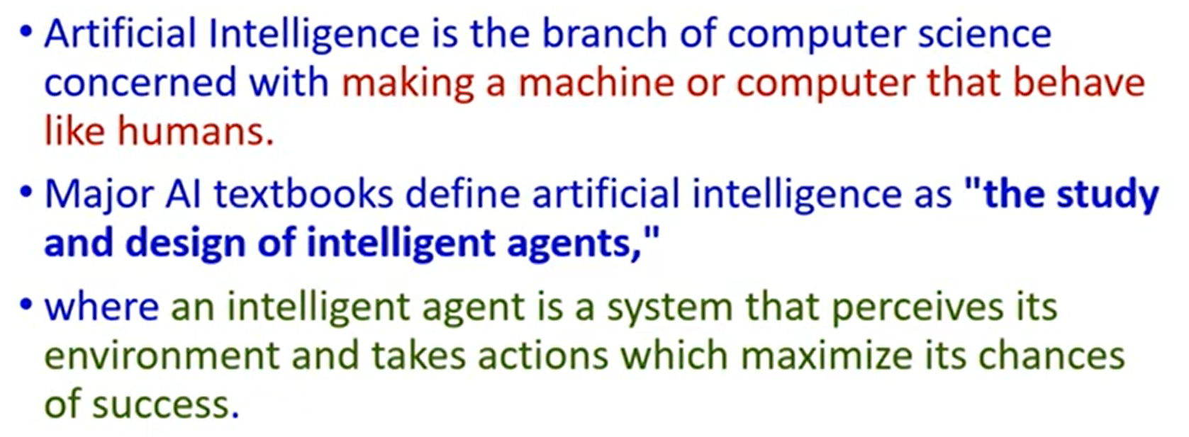
Artificial Intelligence

Slide 5
Edge Artificial Intelligence
Edge artificial intelligence (edge AI) deploys AI algorithms and AI models directly on local edge devices, such as sensors or Internet of Things (IoT) devices. This capability enables real-time data processing and analysis without constant reliance on cloud infrastructure.
In essence, edge AI (or “AI on the edge”) combines edge computing and artificial intelligence (AI) to perform machine learning (ML) tasks directly on interconnected edge devices.

Slide 6
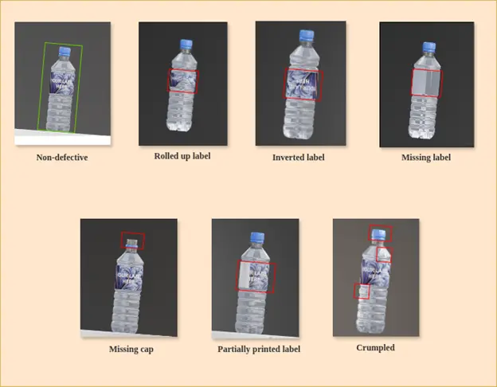
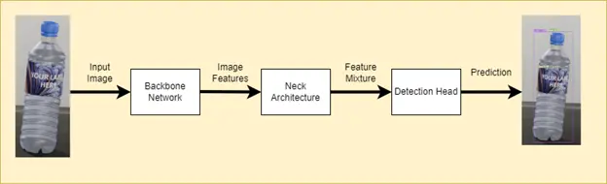
Intelligent Program
Dataset

Slide 7
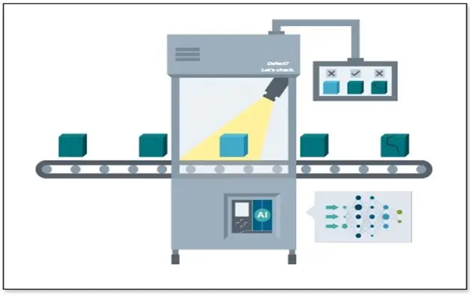
Detection System
Intelligent Program
Dataset

Slide 8
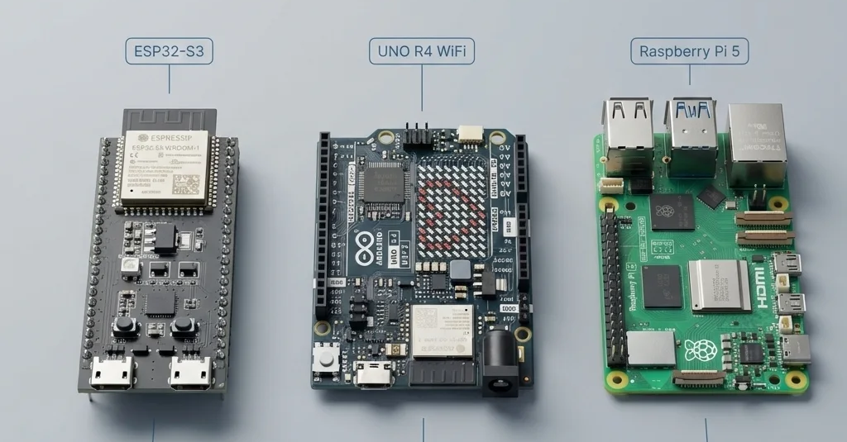
Edge Computing Devices

Slide 9
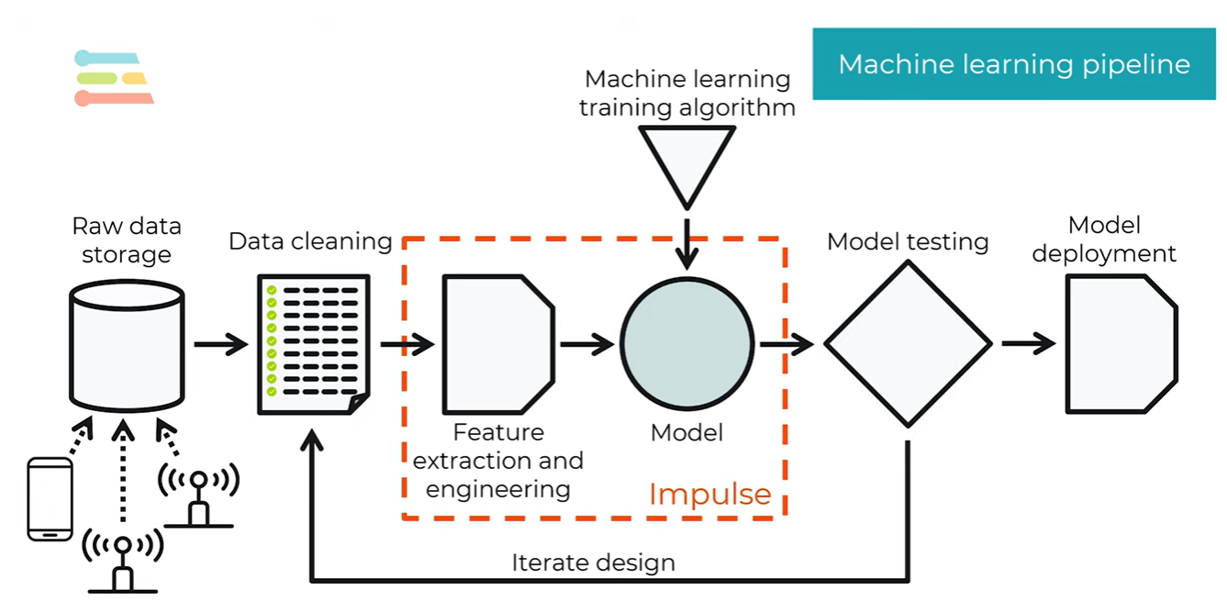

Slide 10
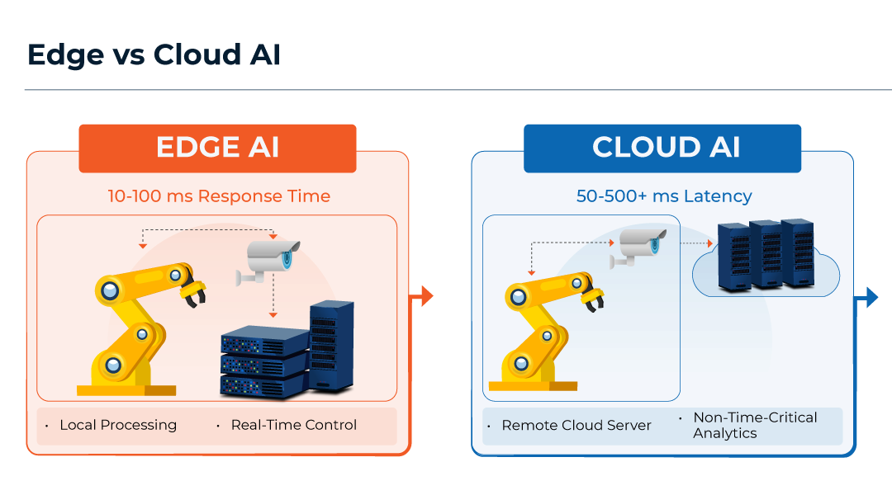

Slide 11
The AI Processing Revolution
For years, cloud AI was the logical choice. Training and executing AI models required enormous computing power, extensive storage, and robust networks. That scale was provided by centralised cloud systems. They still do. Cloud infrastructure is still critical for large-scale training, even if AI arrives at the edge on devices.
What has changed is the hardware. We are living in an age when devices are getting smarter. Chipmakers today embed AI acceleration into phones, microcontrollers, industrial systems and embedded devices when they build processors.

Slide 12
Cloud AI Limitations Driving the Edge Shift
The first is latency.
  There can be delays if data has to travel to a remote server and then back before a decision is made. That might be an acceptable thing for entertainment.
  That can be a headache for robotics, industrial automation or safety systems.
  Edge computing, which shortens the distance data has to travel for processing, thus reducing response time.

Slide 13
Cloud AI Limitations Driving the Edge Shift
The second limit is bandwidth.
  The need to constantly send massive streams of video, audio, or sensor data up to the cloud is costly and impractical.
  Local processing reduces that burden because it is only necessary to send on the most useful results.
  That can lead to less network traffic and increased efficiency of the system.

Slide 14
Cloud AI Limitations Driving the Edge Shift
The third limit is privacy.
Many AI applications involve personal or sensitive information.
Qualcomm says that on-device AI can enable more personal and relevant experiences and also help safeguard privacy and security because data can be kept local.
Google’s federated learning work is also repurposing what the world is moving toward, which is getting raw data to stay on devices rather than moving everything to centralised servers.

Slide 15
Cloud AI Limitations Driving the Edge Shift
The fourth limit is reliability.
  Cloud systems rely on stable connectivity.
  Edge AI can continue to function in weak, slow or lost networks. And that is particularly useful in remote, mobile or industrial environments.

Slide 16
Cloud AI Limitations Driving the Edge Shift
The cloud is great, but not without bounds.
The first is latency. There can be delays if data has to travel to a remote server and then back before a decision is made. That might be an acceptable thing for entertainment. That can be a headache for robotics, industrial automation or safety systems. Edge computing, which shortens the distance data has to travel for processing, thus reducing response time.
The second limit is bandwidth. The need to constantly send massive streams of video, audio, or sensor data up to the cloud is costly and impractical. Local processing reduces that burden because it is only necessary to send on the most useful results. That can lead to less network traffic and increased efficiency of the system.
The third limit is privacy. Many AI applications involve personal or sensitive information. Qualcomm says that on-device AI can enable more personal and relevant experiences and also help safeguard privacy and security because data can be kept local. Google’s federated learning work is also repurposing what the world is à la carte toward, which is getting raw data to stay on devices rather than moving everything to centralised servers.
The fourth limit is reliability. Cloud systems rely on stable connectivity. Edge AI can continue to function in weak, slow or lost networks. And that is particularly useful in remote, mobile or industrial environments.

Slide 17
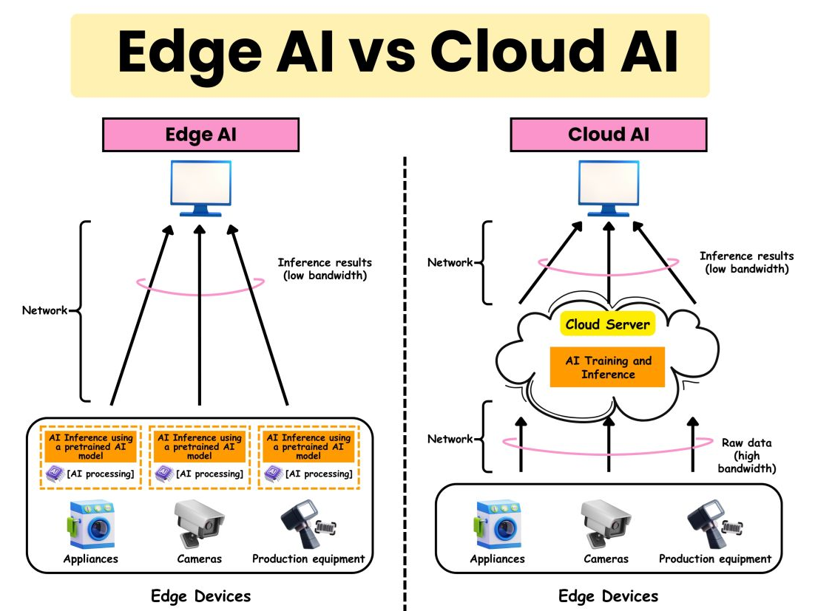

Slide 18
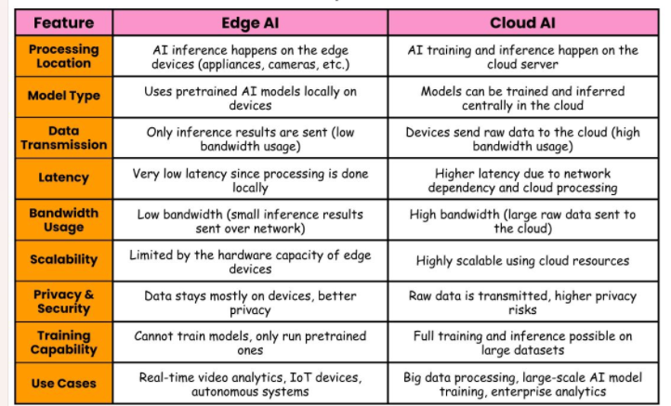
Edge AI vs Cloud AI

Slide 19
How Edge Computing Works?
Edge computing works by processing data near to the source of data generation, minimizing direct transfer of raw data to cloud servers. Here are the steps given below.
First, when devices such as IoT sensors, cameras, and machines generate vast amounts of data in real time.
Edge: instead of sending all data to a centralized cloud, edge devices (like gateways, routers, or local servers) process data locally. Which includes filtering, aggregating, or analyzing data to extract meaningful insights.

Slide 20
How Edge Computing Works?
Edge computing works by processing data near to the source of data generation, minimizing direct transfer of raw data to cloud servers. Here are the steps given below.
First, when devices such as IoT sensors, cameras, and machines generate vast amounts of data in real time.
Edge: instead of sending all data to a centralized cloud, edge devices (like gateways, routers, or local servers) process data locally. Which includes filtering, aggregating, or analyzing data to extract meaningful insights.
With the processed data at the edge, decisions can be made instantly. For example, in autonomous vehicles, immediate data from sensors can be analyzed to make driving decisions without delays.

Slide 21
How Edge Computing Works?
Edge computing works by processing data near to the source of data generation, minimizing direct transfer of raw data to cloud servers. Here are the steps given below.
First, when devices such as IoT sensors, cameras, and machines generate vast amounts of data in real time.
Edge: instead of sending all data to a centralized cloud, edge devices (like gateways, routers, or local servers) process data locally. Which includes filtering, aggregating, or analyzing data to extract meaningful insights.
With the processed data at the edge, decisions can be made instantly. For example, in autonomous vehicles, immediate data from sensors can be analyzed to make driving decisions without delays.
Now, only relevant or summarized data is sent to the cloud for further analysis, storage, or long-term processing. Which ultimately reduces bandwidth usage and minimizes latency.

Slide 22
How Edge Computing Works?
Edge computing works by processing data near to the source of data generation, minimizing direct transfer of raw data to cloud servers. Here are the steps given below.
First, when devices such as IoT sensors, cameras, and machines generate vast amounts of data in real time.
Edge: instead of sending all data to a centralized cloud, edge devices (like gateways, routers, or local servers) process data locally. Which includes filtering, aggregating, or analyzing data to extract meaningful insights.
With the processed data at the edge, decisions can be made instantly. For example, in autonomous vehicles, immediate data from sensors can be analyzed to make driving decisions without delays.
Now, only relevant or summarized data is sent to the cloud for further analysis, storage, or long-term processing. Which ultimately reduces bandwidth usage and minimizes latency.
Still, the edge devices may communicate with the cloud for tasks that require more extensive processing, historical data analysis, or centralized management, but they primarily operate independently for immediate needs.

Slide 23
Three Tiers of Compute for One System
Embedded processor
What it is
Small specialised chip built into the device to perform dedicated functions
Security-camera example
Manages camera settings and pre-processes the video
Notes:
Source: MathWorks Tech Talk on Edge AI. The same software system can be spread over all three tiers. The security-camera example shows how: pre-processing in the camera, motion detection on the edge computer, distribution from the cloud. The placement choice applies to inference with a trained model; where to train is a separate decision.

Slide 24
Three Tiers of Compute for One System
Embedded processor
Edge computer
Cloud computer
What it is
Small specialised chip built into the device to perform dedicated functions
Security-camera example
Manages camera settings and pre-processes the video
What it is
More powerful than the embedded chip; not inside the device but relatively close by
Security-camera example
Collects video from several local cameras, refines the images and runs motion detection
Notes:
Source: MathWorks Tech Talk on Edge AI. The same software system can be spread over all three tiers. The security-camera example shows how: pre-processing in the camera, motion detection on the edge computer, distribution from the cloud. The placement choice applies to inference with a trained model; where to train is a separate decision.

Slide 25
Three Tiers of Compute for One System
Embedded processor
Edge computer
Cloud computer
What it is
Small specialised chip built into the device to perform dedicated functions
Security-camera example
Manages camera settings and pre-processes the video
What it is
More powerful than the embedded chip; not inside the device but relatively close by
Security-camera example
Collects video from several local cameras, refines the images and runs motion detection
What it is
Remote servers reached over the internet to store data and run applications
Security-camera example
Receives the motion snippets and distributes them to end users
The same choice applies to AI inference: a trained model can run on the embedded processor, on an edge computer or in the cloud. Where to train is a separate decision.
Notes:
Source: MathWorks Tech Talk on Edge AI. The same software system can be spread over all three tiers. The security-camera example shows how: pre-processing in the camera, motion detection on the edge computer, distribution from the cloud. The placement choice applies to inference with a trained model; where to train is a separate decision.

Slide 26
Why Run AI Close to the Device
Reduced latency
No round trip to a cloud server; vital where the device must act quickly and safely
Less bandwidth
Most data stays local, for example continuous video from several cameras
Examples with the model on the device
Virtual sensor
A model estimates battery state of charge; the system acts in real time to prevent over-discharge.
Anomaly detection and predictive maintenance
A time-series model flags abnormal conditions and triggers a quick shut-off or a parameter change.
Robust to outages
Temporary internet loss has less impact because less data goes to the cloud
Data protection
Data is not sent over the internet or stored on third-party servers
Cordless drill
A model recognises that the bit may bind and cuts power before the torque jerks the drill from the user’s hands.
Notes:
Source: MathWorks Tech Talk. Four benefits on the left, three examples on the right. Ask students which benefit is decisive for each example. Answer: latency for the drill, robustness and latency for the battery estimator, bandwidth and latency for anomaly detection.

Slide 27
Edge Intelligence: Components and Scope
Edge intelligence: connected systems and devices that collect, cache, process and analyse data close to where it is captured, using AI, to improve processing and protect privacy and security.
Edge caching
Keep data or content near users so it can be served without a trip to the cloud
Edge training
Train or adapt models on edge nodes, for example with federated learning
Edge inference
Run a trained model near the data source to predict or classify
Edge offloading
Move computation between device, edge and cloud to meet latency and energy goals
Two related terms
Edge intelligence: deploying deep-learning services using edge computing.
Intelligent edge: using deep learning to manage and adapt the edge infrastructure itself.
Notes:
Xu et al. identify four fundamental components of edge intelligence: edge caching, edge training, edge inference and edge offloading. Wang et al. separate edge intelligence (deploying DL services with edge computing) from intelligent edge (using DL to manage and adapt the edge itself). In this course we focus on inference (Units 2-4); edge training and federated learning appear in Unit 5.

Slide 28
Critical edge AI components are
Edge devices/nodes: Industrial IoT machinery, IoT sensors and smart cameras that capture data.
Edge gateway: A router, server or other networking device that sits between edge devices and the cloud or centralized data center.
Edge servers: Specialized computers or clusters of computers located at the edge that handle processing, storage, networking, security and other computing resources.
Edge processors and AI accelerators: Specialized hardware includes neural processing units (NPUs) and graphics processing units (GPUs). These key AI infrastructure components optimize AI inferencing at the edge, providing high computation with low power consumption. AI accelerators use parallel-processing capabilities that allow them to perform billions of calculations at once. NVIDIA, IBM and other major technology companies offer edge AI solutions designed for local inferencing.
Machine learning models: Models that enable real-time decision-making at the edge, acting on data at its source. As a real-world example, AI algorithms (often pretrained in the cloud) can help detect a malfunction on a factory floor so repairs can be carried out right away.

Slide 29
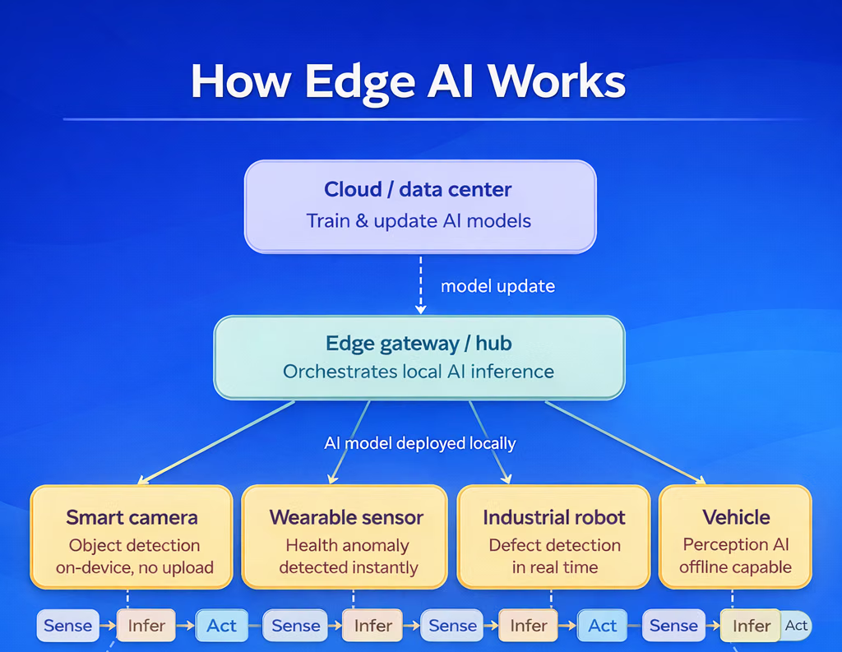
Notes:
https://www.simplilearn.com/what-is-edge-ai-article

Slide 30
Why Real-Time Data Processing Matters
Modern applications require immediate analysis and action. Delays of even a few milliseconds can lead to operational failures, safety risks, or poor customer experiences.
Real-time processing is especially critical in sectors such as:
Autonomous transportation
Healthcare monitoring systems
Smart manufacturing
Financial fraud detection
Retail analytics
Smart city infrastructure
Defense and cybersecurity
Traditional cloud architectures often struggle with latency due to network congestion and long-distance data transmission. Edge AI addresses this limitation by bringing intelligence closer to the source of data generation.

Slide 31
Key Ways Edge AI is Transforming Data Processing
Ultra-Low Latency Decision Making
One of the most important advantages of Edge AI is reduced latency. Since data processing occurs locally, systems can react almost instantly.
For instance, in autonomous driving systems, vehicles must detect pedestrians, traffic signals, and road hazards in real time. Cloud dependency would introduce delays that could compromise passenger safety.
Edge AI enables split-second decisions directly within the vehicle’s onboard systems.

Slide 32
Key Ways Edge AI is Transforming Data Processing
Ultra-Low Latency Decision Making
One of the most important advantages of Edge AI is reduced latency. Since data processing occurs locally, systems can react almost instantly.
For instance, in autonomous driving systems, vehicles must detect pedestrians, traffic signals, and road hazards in real time. Cloud dependency would introduce delays that could compromise passenger safety.
Edge AI enables split-second decisions directly within the vehicle’s onboard systems.
Reduced Bandwidth Consumption
IoT devices generate massive volumes of data daily. Sending all this information to centralized cloud servers is costly and inefficient.
Edge AI processes only relevant information locally and transmits filtered insights rather than raw datasets. This significantly reduces bandwidth usage and lowers operational costs for enterprises.
Industries operating remote assets, such as oil & gas, mining, and agriculture, particularly benefit from this approach.

Slide 33
Key Ways Edge AI is Transforming Data Processing
Improved Data Privacy and Security
Data privacy regulations are becoming stricter worldwide. Edge AI minimizes exposure risks by keeping sensitive information closer to local devices instead of transmitting it across networks.
Healthcare providers, for example, can process patient monitoring data on medical devices without constantly uploading confidential records to external servers.
This localized processing model strengthens cybersecurity while supporting regulatory compliance.

Slide 34
Key Ways Edge AI is Transforming Data Processing
Improved Data Privacy and Security
Data privacy regulations are becoming stricter worldwide. Edge AI minimizes exposure risks by keeping sensitive information closer to local devices instead of transmitting it across networks.
Healthcare providers, for example, can process patient monitoring data on medical devices without constantly uploading confidential records to external servers.
This localized processing model strengthens cybersecurity while supporting regulatory compliance.
Enhanced Reliability in Remote Locations
Many industrial environments have unstable or limited internet connectivity. Edge AI systems can continue functioning even when disconnected from cloud infrastructure.
Factories, offshore drilling sites, rural healthcare facilities, and military operations increasingly rely on edge-enabled AI systems for uninterrupted performance.
This independence from continuous internet access improves operational resilience.

Slide 35
Key Ways Edge AI is Transforming Data Processing
Faster Industrial Automation
Manufacturing companies are rapidly integrating Edge AI into production lines for predictive maintenance, robotic automation, and quality inspection.
AI-powered cameras can instantly detect defects during manufacturing, reducing waste and improving product consistency. Predictive maintenance systems analyze equipment behavior locally to identify potential failures before costly breakdowns occur.
As Industry 4.0 adoption accelerates, Edge AI is becoming a critical component of smart factory ecosystems.

Slide 36
Question
Analyze the role of Edge AI in transforming the data processing for the following industry sectors
Manufacturing
Healthcare
Autonomous driving

Slide 37
Edge Computing with Real-Life Example
Let’s consider an example: Imagine you have a car that integrates with your smartphone to manage various functions such as phone calls, navigation, entertainment, etc.

Slide 38
Edge Computing with Real-Life Example
Let’s consider an example: Imagine you have a car that integrates with your smartphone to manage various functions such as phone calls, navigation, entertainment, etc.
Now every five minutes, if every generated data is being directly sent or transferred to the cloud, it will create a few issues like increased latency; if the data is large or complex, it can slow down responsiveness; bandwidth overload; system overload; data privacy concerns; and complex data management. So keeping this in mind and to figure out this concern, edge computing has been introduced, which is built to address the issues related to frequent data transfers.

Slide 39
Edge Computing with Real-Life Example
Let’s consider an example: Imagine you have a car that integrates with your smartphone to manage various functions such as phone calls, navigation, entertainment, etc.
Now every five minutes, if every generated data is being directly sent or transferred to the cloud, it will create a few issues like increased latency; if the data is large or complex, it can slow down responsiveness; bandwidth overload; system overload; data privacy concerns; and complex data management. So keeping this in mind and to figure out this concern, edge computing has been introduced, which is built to address the issues related to frequent data transfers.
Now, instead of data directly sending to the cloud, it will transfer to the edge first, where the edge will process the data and only relevant or summarized information is sent to the cloud, which ultimately helps minimize volume or redundancy, immediate processing, optimized bandwidth usage, and scalable data management.
So now, before moving ahead with edge computing, let’s discuss and distinguish between a few terms—that’s edge, fog, and cloud computing.

Slide 40
Edge, Fog, Vs. Cloud Computing
Edge Computing: It is a distributed computing model that is used to process data near the source of data generation (e.g., IoT devices, sensors) to reduce latency, improve response times, and save bandwidth.

Slide 41
Edge, Fog, Vs. Cloud Computing
Edge Computing: It is a distributed computing model that is used to process data near the source of data generation (e.g., IoT devices, sensors) to reduce latency, improve response times, and save bandwidth.
Fog Computing: Fog computing is an extension of cloud computing that uses a distributed approach, processing data at various points between the edge and the cloud. Where it often involves multiple layers of computing resources, which provides more flexibility and scalability.

Slide 42
Edge, Fog, Vs. Cloud Computing
Edge Computing: It is a distributed computing model that is used to process data near the source of data generation (e.g., IoT devices, sensors) to reduce latency, improve response times, and save bandwidth.
Fog Computing: Fog computing is an extension of cloud computing that uses a distributed approach, processing data at various points between the edge and the cloud. Where it often involves multiple layers of computing resources, which provides more flexibility and scalability.
Cloud Computing: Whereas cloud computing is a centralized computing model where data processing and storage occur in cloud data centers. Users can access these data or resources over the internet, with vast on-demand scalability and extensive computational power, but it often experiences higher latency because of its distance from the data source.

Slide 43
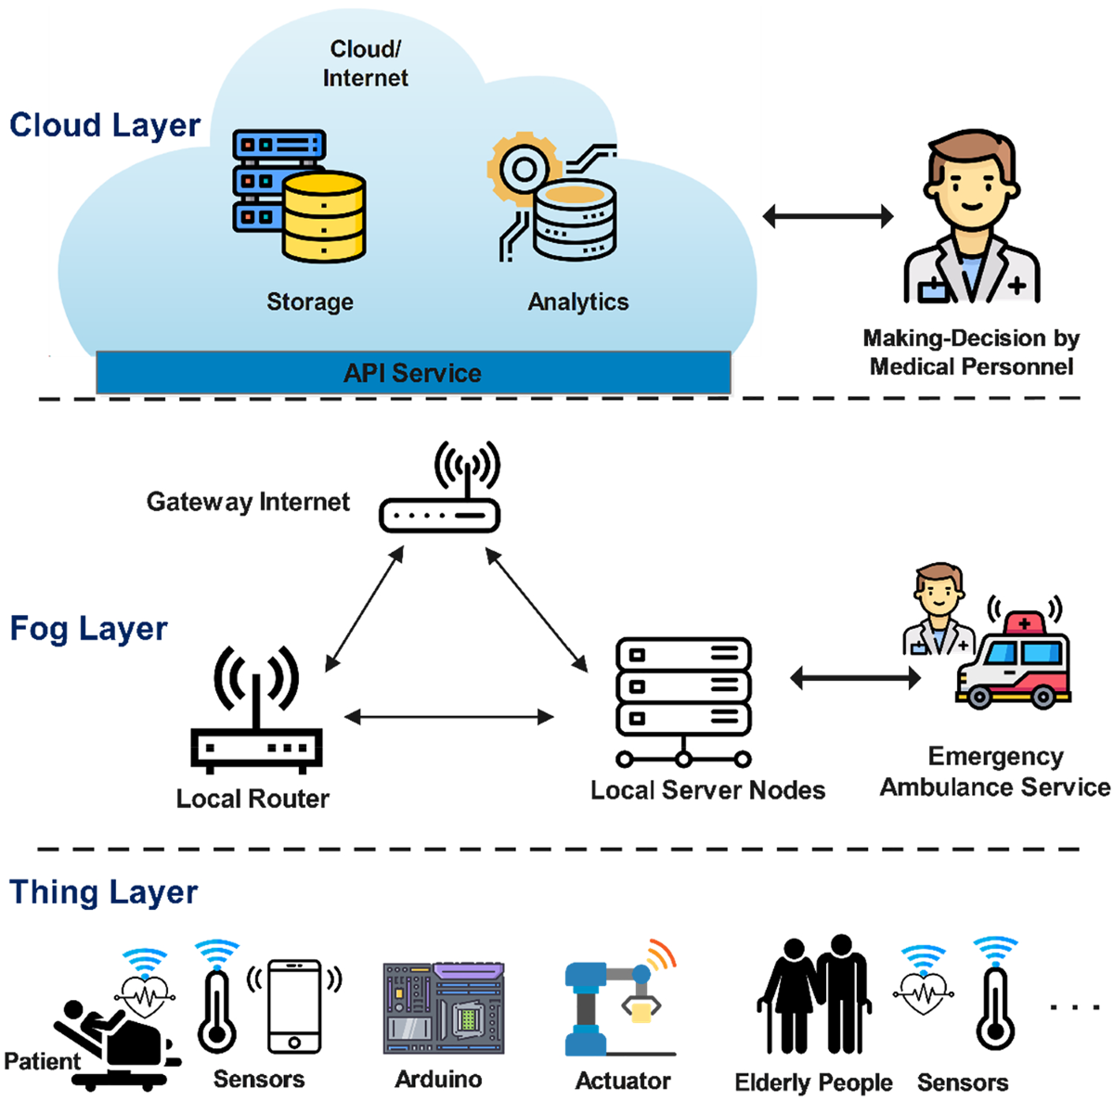
Edge, Fog, Vs. Cloud Computing
Cloud Computing
Fog Computing
Edge Computing

Slide 44
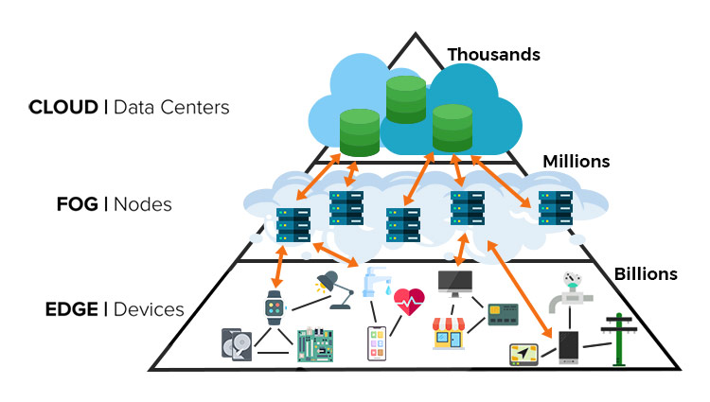
Edge, Fog, Vs. Cloud Computing

Slide 45
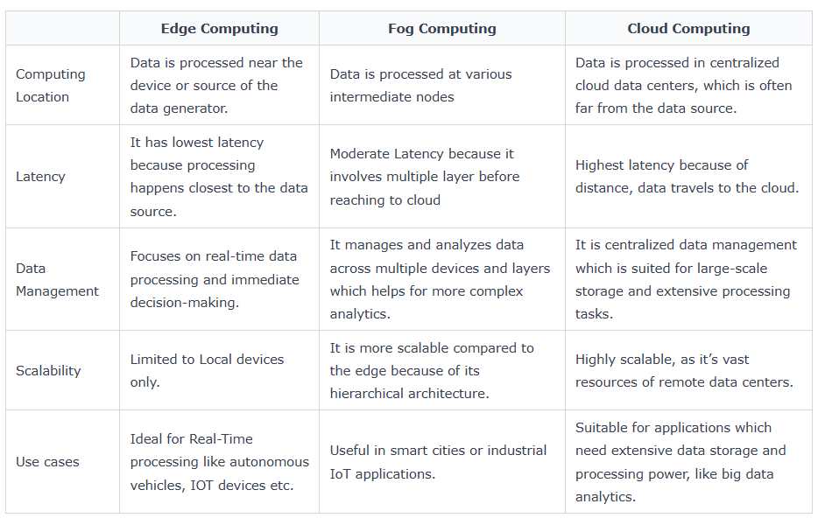
Edge, Fog, Vs. Cloud Computing

Slide 46
The Edge–Cloud Continuum
Device
Edge
Fog
Cloud
Sensors, MCUs, wearables
Gateways, on-premise servers
Regional nodes, aggregation
Data centres
Latency to the data source: lowest → highest
Compute and storage per node: smallest → largest
Number of nodes: billions → thousands (indicative)
Continuum: computation is orchestrated along the whole path from data producers to the cloud, moving processing closer to the data while keeping cloud-scale capacity.
Sources: Belcastro et al., arXiv:2506.02003 (2025); Khalyeyev et al., arXiv:2309.05416 (2022)
Notes:
The continuum treats device, edge, fog and cloud as one path along which computation can be placed. Moving right, latency to the data source and compute per node rise, while the number of nodes falls (billions of devices, millions of fog nodes, thousands of data centres: indicative figures from the course diagram). Khalyeyev et al. argue the continuum is still more a vision than a coherent paradigm and that edge and fog blur together.

Slide 47
Advantages of Edge Computing
Reduced Latency − Processing with data closer to the data source generation minimizes delays, which gives access to real-time decision-making, especially important for applications like autonomous vehicles and industrial automation.
Bandwidth Efficiency − By filtering and processing data locally, edge computing helps reduce the amount of data sent to the cloud, ultimately reducing network congestion and lowering bandwidth costs.
Real-Time Insights − At edge Immediate data analysis helps for quick responses to changing conditions, supporting applications that require rapid insights.
Improved Reliability − Local processing in Edge also allows systems to continue functioning even with no internet connectivity, which ultimately enhances overall system reliability.
Enhanced Security and Privacy − Edge computing will also process sensitive data locally, which reduces exposure during transmission and minimizes the risk of data breaches.

Slide 48
Advantages of Edge Computing
Scalability − Edge computing enables organizations to easily scale their operations by adding more edge devices without straining centralized resources.
Cost Savings − Reducing the volume of data transmitted to the cloud can lower data transfer and storage costs, which makes edge computing a more economical solution.
Optimized Performance − Edge Local processing also helps in improving application performance by reducing latency and allowing for quicker data retrieval and processing.
Better Resource Utilization − Edge computing enables efficient use of resources by balancing workloads across devices and reducing the load on central servers.

Slide 49
Limitations of Edge Computing
Though edge computing comes with numerous benefits, it still has a few limitations, which have been discussed below −
Challenges in Data Management − Data management challenges, where ensuring data consistency over distributed edge devices can be complex as a process in real time, may also have limited storage capacity, which makes it difficult to handle data of large volume.
Infrastructure and deployment costs − While setting up edge computing infrastructure, maintenance and updates may require a good amount of capital investment.
Security Risks − The number of edge devices can lead to more potential entry points for cyberattacks. Handling sensitive data locally leads to concerns about compliance with regulations and data privacy.
Management Complexity − Integrating and processing edge computing with already existing IT systems can be complex and require specialized knowledge. Scaling edge computing is also challenging across multiple locations because of its varying requirements and conditions.

Slide 50
Question
1. Differentiate between Edge, Fog, and Cloud Computing.
2. List and explain the advantages of Edge computing.
3. List and explain limitations of Edge computing.

Slide 51
Common edge use cases include
Gaming. Real-time responsiveness, wait times, matchmaking, and low latency are critical for competitive gaming. Edge computing improves these digital experiences by increasing proximity to players.
IoT networks. Edge computing solutions allow businesses to take advantage of the power of IoT networks to collect, analyze, and act on massive amounts of data in real time.
Autonomous vehicles. Self-driving cars produce massive amounts of data that must be aggregated and analyzed in real time, allowing the vehicle to make split-second decisions to deliver riders and cargo to the appropriate destination safely.
Telecommunications. Edge computing enables telecommunications service providers to modernize their networks and move workloads and services to the network’s edge for superior performance.

Slide 52
Common edge use cases include
Industrial manufacturing. Manufacturers rely on edge computing to monitor equipment, identify production errors, enable automation, manage robotics, and improve quality through real-time analytics and machine learning.
Energy. Businesses involved in energy exploration and production use edge computing to collect and store data on oil rigs and gas fields, providing real-time intelligence that can detect hazards, optimize production, improve efficiency, and keep personnel safe.
Safety applications. From real-time facial recognition at airports to on-site motion detectors and cameras, many safety and surveillance applications benefit from the ultra-fast response times available when data is processed at the edge of the network.
Healthcare. Edge computing is best able to collect and process the enormous volume of data produced by medical devices and sensors, allowing providers to respond quickly to changes in patient conditions.
Smart cities. Smart cities use edge computing to power real-time applications like smart traffic lights, smart power grids, smart streetlights, and smart surveillance systems that must be able to process data with split-second response times and superior accuracy.

Slide 53
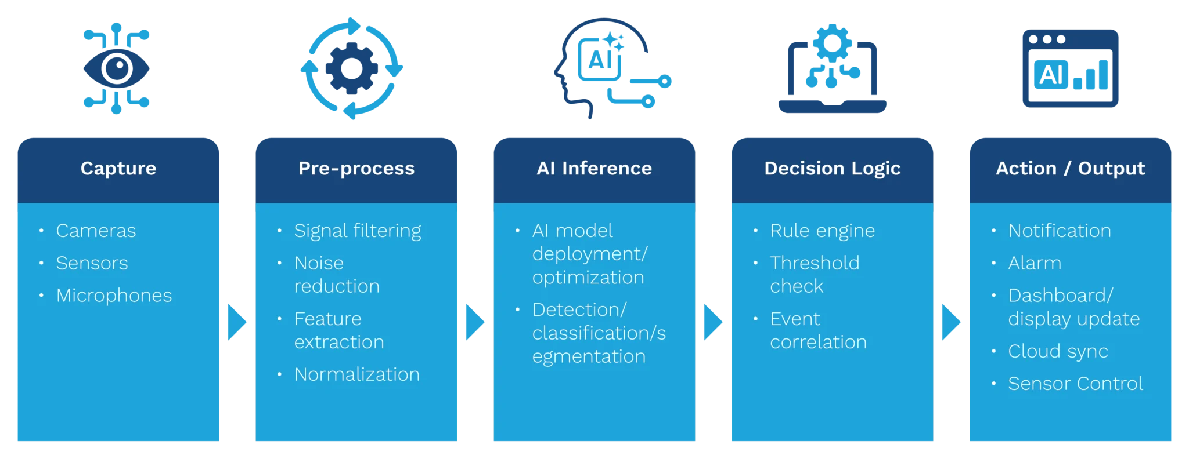
Edge AI Architecture
Capture: Sensor input and fusion (input to Micro-processor/Micro-controller )
Pre-process : On-device filtering and normalization (on CPU, GPU)
Infer: Light-weight AI models, event-based decision, TinyML/tensor framework execution (on NPU/CPU as necessary)
Decision/Action: An application layer shall interpret the AI outputs and make recommendations/take actions (which may include alarms, notifications, displays or shutting sensor off)

Slide 54
Question
With neat diagram describe the components involved in Edge AI Architecture.

Slide 55
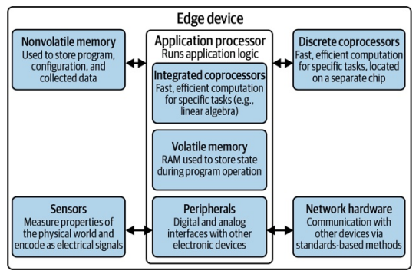
Edge AI Hardware Architecture
Architecture of an edge device

Slide 56
Edge AI Hardware Architecture
The beating heart of the device is the application processor. This is the general purpose processor that coordinates the application and, by default, runs all of the algorithms and logic that make up its program.
In many cases, the application processor will have integrated coprocessors: built-in additional hardware that is highly efficient at performing certain computations. For example, many processors have a built-in floating-point unit (FPU) designed to quickly perform floating-point calculations.
Medium- and high-end MCUs increasingly have integrated hardware that can accelerate functions relevant to edge AI, such as digital signal processing and linear algebra.
The application processor also integrates the volatile memory (such as RAM) that is used as working memory during program execution. That said, it’s also common to have additional RAM that is external to the processor itself and lives on a separate chip.
The application processor is connected to nonvolatile memory, commonly known as ROM (read-only memory) or flash. Nonvolatile memory is used to store things that don’t often change and need to be preserved when the system is shut down. This might include software programs, user configuration, and machine learning models. It’s slow to read and extremely slow to write.
Many designs have discrete coprocessors. Similar to integrated coprocessors, these exist to perform fast and efficient mathematics for specific purposes.

Slide 57
𝗗𝗶𝗳𝗳𝗲𝗿𝗲𝗻𝗰𝗲 𝗶𝗻 𝗔𝗜/𝗠𝗟: CPU, GPU, TPU, NPU and DPU
1. 𝗖𝗣𝗨 (𝗖𝗲𝗻𝘁𝗿𝗮𝗹 𝗣𝗿𝗼𝗰𝗲𝘀𝘀𝗶𝗻𝗴 𝗨𝗻𝗶𝘁)
The classic processor inside every computer.
𝗕𝗲𝘀𝘁 𝗳𝗼𝗿: Traditional ML (scikit-learn, XGBoost), prototypes, and general-purpose inference.
Great for flexibility, not raw deep learning speed.
2. 𝗚𝗣𝗨 (𝗚𝗿𝗮𝗽𝗵𝗶𝗰𝘀 𝗣𝗿𝗼𝗰𝗲𝘀𝘀𝗶𝗻𝗴 𝗨𝗻𝗶𝘁)
Built for massive parallelism. The heart of modern deep learning.
𝗕𝗲𝘀𝘁 𝗳𝗼𝗿: Training large neural networks (CNNs, RNNs, Transformers).
Powers models like GPT, BERT, and ResNet.
3. 𝗡𝗣𝗨 (𝗡𝗲𝘂𝗿𝗮𝗹 𝗣𝗿𝗼𝗰𝗲𝘀𝘀𝗶𝗻𝗴 𝗨𝗻𝗶𝘁)
AI-specific chips found in smartphones and IoT devices.
𝗕𝗲𝘀𝘁 𝗳𝗼𝗿: On-device, real-time AI (face unlock, language translation).
Optimized for efficiency and battery life.

Slide 58
𝗗𝗶𝗳𝗳𝗲𝗿𝗲𝗻𝗰𝗲 𝗶𝗻 𝗔𝗜/𝗠𝗟: CPU, GPU, TPU, NPU and DPU
4. 𝗧𝗣𝗨 (𝗧𝗲𝗻𝘀𝗼𝗿 𝗣𝗿𝗼𝗰𝗲𝘀𝘀𝗶𝗻𝗴 𝗨𝗻𝗶𝘁)
Google’s custom AI accelerator designed for TensorFlow.
𝗕𝗲𝘀𝘁 𝗳𝗼𝗿: Training large-scale models in Google Cloud.
Ideal for high-speed tensor computations.
5. 𝗗𝗣𝗨 (𝗗𝗮𝘁𝗮 𝗣𝗿𝗼𝗰𝗲𝘀𝘀𝗶𝗻𝗴 𝗨𝗻𝗶𝘁)
Not for running models — but vital for scaling AI infrastructure.
𝗕𝗲𝘀𝘁 𝗳𝗼𝗿: Offloading networking, storage, and data movement.
Frees CPUs & GPUs to focus on compute.
𝗜𝗻 𝘀𝗵𝗼𝗿𝘁:
CPUs = Versatile and general
GPUs = Powerful and flexible
NPUs = Efficient and mobile
TPUs = Scalable and cloud-optimized
DPUs = The silent infrastructure booster

Slide 59
Edge AI Inference
Edge AI inference runs trained models directly on local devices (sensors, cameras, vehicles, appliances) instead of sending data to a remote cloud server. The result: lower latency, reduced bandwidth consumption, and data that never leaves the device.
For teams building IoT, autonomous driving, or smart home products, edge inference determines whether your application can respond in milliseconds or has to wait for a round trip to the cloud. This guide covers how edge inference works, how it differs from cloud inference, and where each approach fits.

Slide 60
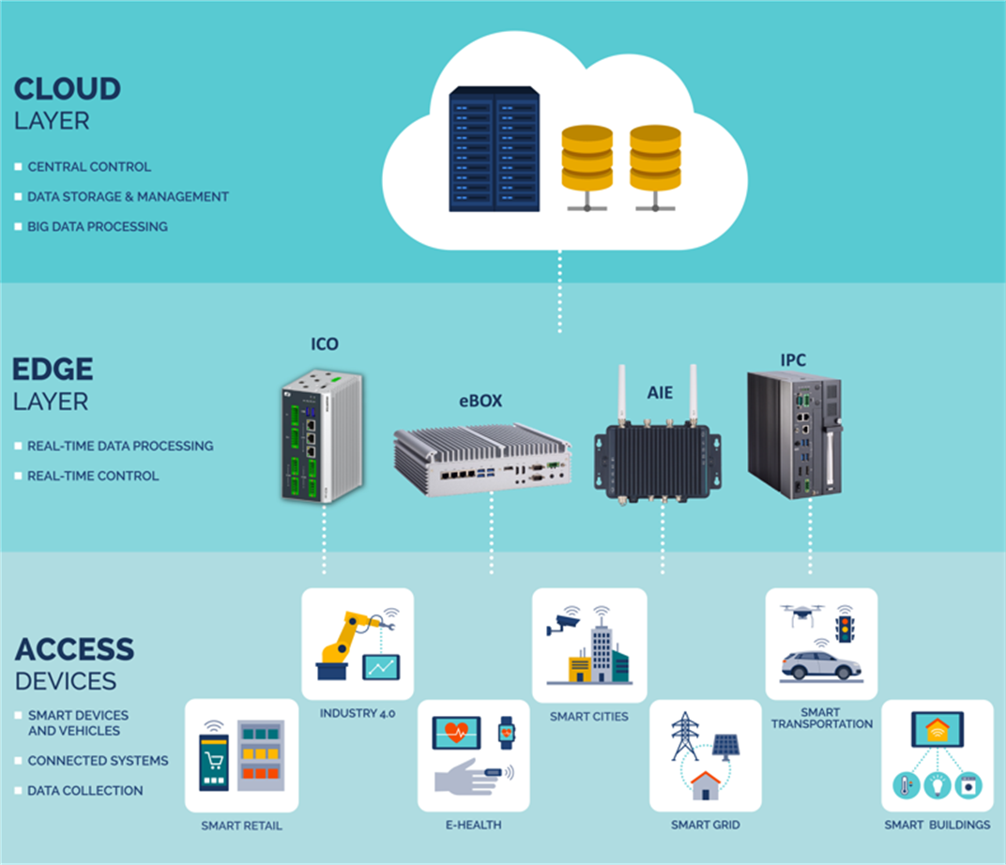
Notes:
https://us.axiomtek.com/Default.aspx?MenuId=Solutions&FunctionId=SolutionView&ItemId=2929&Title=Guide+to+Edge+Computing+and+Choosing+the+Right+Hardware

Slide 61
What is edge inference?
Edge inference is the process of a trained machine learning (ML) model taking an input and generating an output (inference), where that model is located very close to the end-user or data source.
Edge inference uses AI models in edge locations to help speed up the time-to-results for users.
Edge inferencing is important in time-sensitive applications such as healthcare, industrial operations, and autonomous driving.

Slide 62
What are the types of edge inference?
There are several different architectural patterns for edge AI inference, with each offering organizations different capabilities and performance constraints. Below are the main edge AI systems.
On-device inference
On-device inference is where processing occurs on an edge device, exactly where the data source lies, for instance, on a self-driving car. There is no dependence on cloud servers with this approach, making its ultra-low latency one of its key differences from other formats. Use cases that need instant data processing may opt for running artificial intelligence on a local device.
Gateway inference
Gateway inference is where an edge device forwards the necessary data to an edge computing node. That node hosts machine learning models and performs AI inference before then transmitting the data on. By moving the processing to this edge location, this mode does increase latency but also allows for more powerful AI processing. Also, organizations can consolidate many inputs from several different local devices, processing them in tandem to save energy.
Fog computing inference
Fog computing inference is a gateway approach in that it has multiple edge nodes and gateways that connect to regional cloud data centers. Fog computing offers edge AI models significantly more processing power while still benefiting from the relatively local data processing. It’s an effective choice for applications that need low latency but also need to deal with very high volumes of aggregated sensor data.

Slide 63
Edge vs. Cloud Inference
Where it runs
  Edge Inference: On the local device
  Cloud Inference: On remote GPU servers
Latency
  Edge Inference: Sub-10ms possible
  Cloud Inference: 50-500ms (network dependent)
Bandwidth
  Edge Inference: Minimal (data stays local)
  Cloud Inference: High (data sent to/from cloud)
Data privacy
- Edge Inference: Data never leaves device
- Cloud Inference: Data transits to provider
Model size
- Edge Inference: Limited by device memory (1-24 GB)
- Cloud Inference: Virtually unlimited (80-141+ GB)

Slide 64
Edge vs. Cloud Inference
Hardware
  Edge Inference: Edge GPUs, NPUs, mobile chips
  Cloud Inference: Data centers GPUs
Cost model
- Edge Inference: Upfront hardware + power
- Cloud Inference: Pay per request or per GPU-hour
Scaling
- Edge Inference: Add more devices
- Cloud Inference: Add more cloud capacity
The core trade-off:
Edge gives you speed and privacy but limits model size.
Cloud gives you powerful models and flexible scaling but depends on network connectivity.

Slide 65
Decision Framework: Edge vs. Cloud
1.Latency must be under 10ms
- Best Fit: Edge - Why: Network round trips add 50-500ms
2. Data cannot leave the device/premises
- Best Fit: Edge - Why: Data stays local by design
3. Network connectivity is unreliable
- Best Fit: Edge - Why: No cloud dependency
4. Model exceeds 24 GB
- Best Fit: Cloud - Why: Edge devices max out at ~24 GB
5. You need 70B+ parameter models
- Best Fit: Cloud - Why: Only data center GPUs have enough VRAM

Slide 66
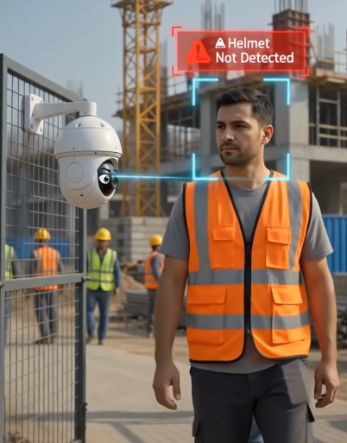
Case Study
Construction Site: Helmet Detection

Slide 67
Problem
A construction site has cameras at the entry gate. Each camera sends a 150 KB image to a cloud server, which runs a helmet-detection model (8 ms) and returns “helmet” or “no helmet”. The site’s uplink is 8 Mbps and the round-trip time to the server is 40 ms.
(a) Calculate the time to send one image.

Slide 68
Problem
A construction site has cameras at the entry gate. Each camera sends a 150 KB image to a cloud server, which runs a helmet-detection model (8 ms) and returns “helmet” or “no helmet”. The site’s uplink is 8 Mbps and the round-trip time to the server is 40 ms.
(a) Calculate the time to send one image.

Slide 69
Problem
A construction site has cameras at the entry gate. Each camera sends a 150 KB image to a cloud server, which runs a helmet-detection model (8 ms) and returns “helmet” or “no helmet”. The site’s uplink is 8 Mbps and the round-trip time to the server is 40 ms.
(b) Calculate the total latency of one cloud-only detection.
Latency = time to send the data + the round-trip wait for the reply + time to compute

Slide 70

Problem
A construction site has cameras at the entry gate. Each camera sends a 150 KB image to a cloud server, which runs a helmet-detection model (8 ms) and returns “helmet” or “no helmet”. The site’s uplink is 8 Mbps and the round-trip time to the server is 40 ms.
(b) Calculate the total latency of one cloud-only detection.
Latency = time to send the data + the round-trip wait for the reply + time to compute

Slide 71
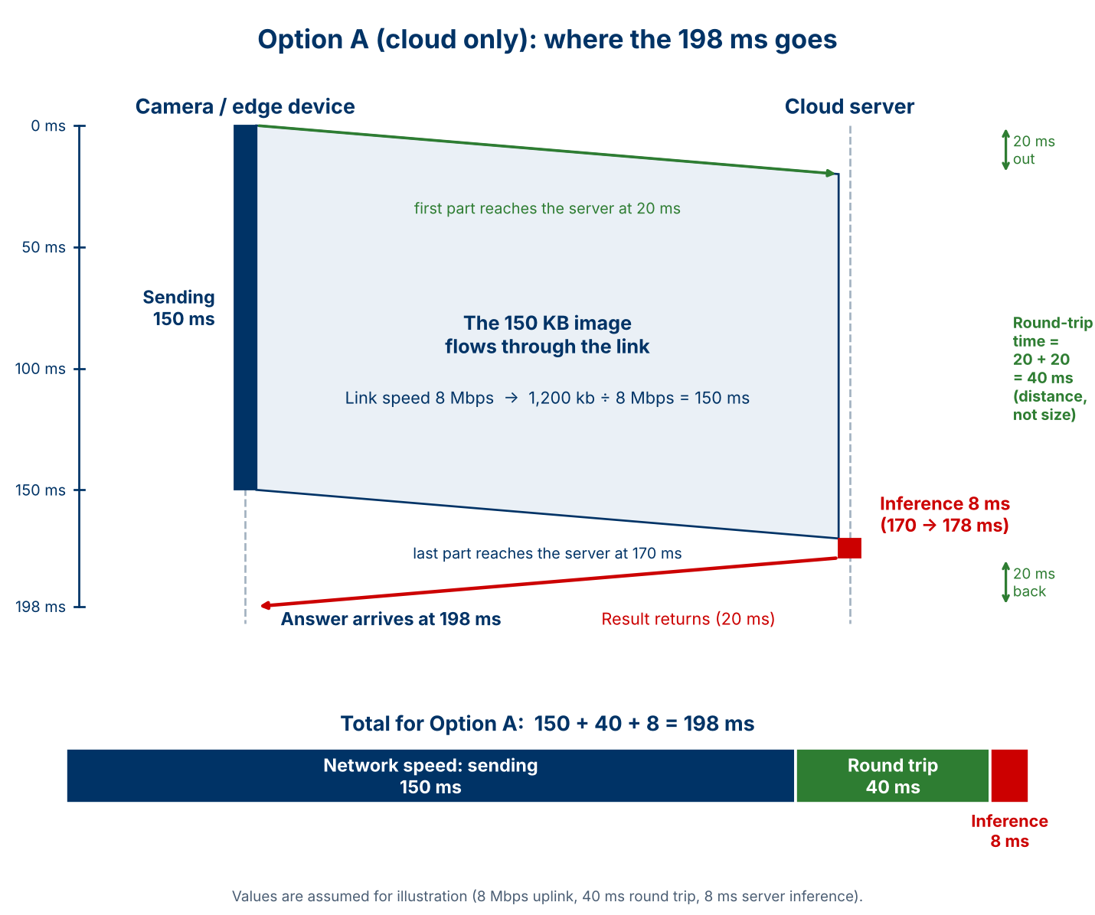
Problem
A construction site has cameras at the entry gate. Each camera sends a 150 KB image to a cloud server, which runs a helmet-detection model (8 ms) and returns “helmet” or “no helmet”. The site’s uplink is 8 Mbps and the round-trip time to the server is 40 ms. (b) Calculate the total latency of one cloud-only detection.
Latency = time to send the data + the round-trip wait for the reply + time to compute

Slide 72
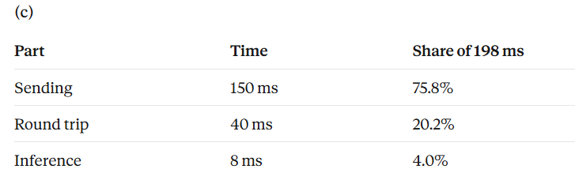
Problem
A construction site has cameras at the entry gate. Each camera sends a 150 KB image to a cloud server, which runs a helmet-detection model (8 ms) and returns “helmet” or “no helmet”. The site’s uplink is 8 Mbps and the round-trip time to the server is 40 ms.
(c) Find the percentage of the total taken by sending, round trip and inference. Which dominates?

Slide 73
Problem
A construction site has cameras at the entry gate. Each camera sends a 150 KB image to a cloud server, which runs a helmet-detection model (8 ms) and returns “helmet” or “no helmet”. The site’s uplink is 8 Mbps and the round-trip time to the server is 40 ms.
(d) The gate must warn a worker within 100 ms. Does the system meet this? If not, find the minimum uplink speed that is required..

Slide 74
Problem
A construction site has cameras at the entry gate. Each camera sends a 150 KB image to a cloud server, which runs a helmet-detection model (8 ms) and returns “helmet” or “no helmet”. The site’s uplink is 8 Mbps and the round-trip time to the server is 40 ms.
(d) The gate must warn a worker within 100 ms. Does the system meet this? If not, find the minimum uplink speed that is required..
(d)
198 ms is more than 100 ms, so it does not meet the limit. The sending time allowed = 100 − 40 − 8 = 52 ms.

Slide 75
Problem
A construction site has cameras at the entry gate. Each camera sends a 150 KB image to a cloud server, which runs a helmet-detection model (8 ms) and returns “helmet” or “no helmet”. The site’s uplink is 8 Mbps and the round-trip time to the server is 40 ms.
(d) The gate must warn a worker within 100 ms. Does the system meet this? If not, find the minimum uplink speed that is required..
(d)
198 ms is more than 100 ms, so it does not meet the limit. The sending time allowed = 100 − 40 − 8 = 52 ms.
time = size ÷ speed, so speed = size ÷ time
Minimum speed = 1,200 kb ÷ 52 ms ≈ 23.1 Mbps, nearly three times the current link.

Slide 76
Problem
A construction site has cameras at the entry gate. Each camera sends a 150 KB image to a cloud server, which runs a helmet-detection model (8 ms) and returns “helmet” or “no helmet”. The site’s uplink is 8 Mbps and the round-trip time to the server is 40 ms.
(e) Keeping the 8 Mbps link, find the largest image size that would meet the 100 ms limit.

Slide 77
Problem
A construction site has cameras at the entry gate. Each camera sends a 150 KB image to a cloud server, which runs a helmet-detection model (8 ms) and returns “helmet” or “no helmet”. The site’s uplink is 8 Mbps and the round-trip time to the server is 40 ms.
(e) Keeping the 8 Mbps link, find the largest image size that would meet the 100 ms limit.
time = size ÷ speed, so size= time x speed
(e)
At 8 Mbps, the allowed 52 ms carries 52 ms × 8 Mbps = 416 kb = 52 KB.
So the image must be reduced from 150 KB to about 52 KB, roughly a third, which means a lower resolution or stronger compression.

Slide 78
Problem
A construction site has cameras at the entry gate. Each camera sends a 150 KB image to a cloud server, which runs a helmet-detection model (8 ms) and returns “helmet” or “no helmet”. The site’s uplink is 8 Mbps and the round-trip time to the server is 40 ms.
(f) Each camera sends one image per second, all over the same 8 Mbps uplink. How many cameras can the link carry?
(f)
8 Mbps = 1 MB/s = 1,000 KB/s.
Each camera needs 150 KB/s.
1,000 ÷ 150 = 6.67, so the link carries 6 cameras (a seventh would exceed it). This shows that cloud-only also puts a limit on how many cameras a site can have.

Slide 79
Problem
A construction site has cameras at the entry gate. Each camera sends a 150 KB image to a cloud server, which runs a helmet-detection model (8 ms) and returns “helmet” or “no helmet”. The site’s uplink is 8 Mbps and the round-trip time to the server is 40 ms.
(a) Calculate the time to send one image.
(b) Calculate the total latency of one cloud-only detection.
(c) Find the percentage of the total taken by sending, round trip and inference. Which dominates?
(d) The gate must warn a worker within 100 ms. Does the system meet this? If not, find the minimum uplink speed that would.
(e) Keeping the 8 Mbps link, find the largest image size that would meet the 100 ms limit.
(f) Each camera sends one image per second, all over the same 8 Mbps uplink. How many cameras can the link carry?

Slide 80
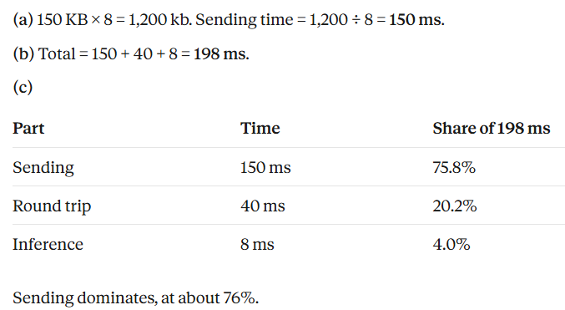
Solution

Slide 81
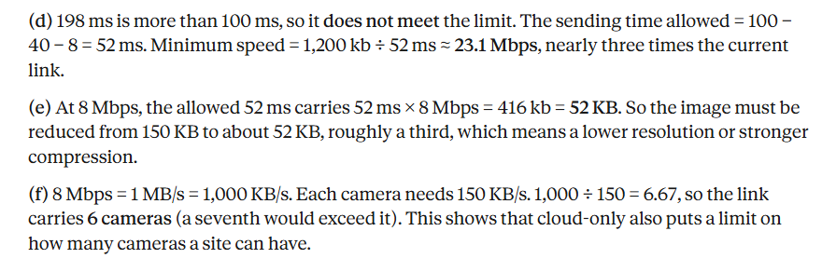
Solution

Slide 82
Question
The same construction-site gate camera now runs the helmet detector on the edge board next to the camera. The board uses an INT8 model, takes 60 ms to run inference on each image, and sends nothing to the cloud except an alert when a worker has no helmet. Before inference the board resizes and normalises the image (15 ms), and afterwards it applies the decision rule (5 ms). For comparison, cloud-only on this site took 198 ms per image, and the gate must warn a worker within 100 ms.
(a) Calculate the total latency of one edge-only detection.
(b) By how many milliseconds, and by what factor, is it faster than cloud-only? Does it meet the 100 ms limit, and with what margin?
(c) Each camera has its own edge board and sends one image per second to it. Each image takes 80 ms to process. (i) What is the maximum number of images per second one board can process? (ii) What percentage of the time is the board busy? (iii) What does this say about adding more cameras to the site?
(d) The helmet model has 2.5 million parameters, and the board has 4 MB of free flash memory. Find the model size in FP32 and in INT8, and say which fits.

Slide 83
The same construction-site gate camera now runs the helmet detector on the edge board next to the camera. The board uses an INT8 model, takes 60 ms to run inference on each image, and sends nothing to the cloud except an alert when a worker has no helmet. Before inference the board resizes and normalises the image (15 ms), and afterwards it applies the decision rule (5 ms). For comparison, cloud-only on this site took 198 ms per image, and the gate must warn a worker within 100 ms.
Calculate the total latency of one edge-only detection.

Slide 84
The same construction-site gate camera now runs the helmet detector on the edge board next to the camera. The board uses an INT8 model, takes 60 ms to run inference on each image, and sends nothing to the cloud except an alert when a worker has no helmet. Before inference the board resizes and normalises the image (15 ms), and afterwards it applies the decision rule (5 ms). For comparison, cloud-only on this site took 198 ms per image, and the gate must warn a worker within 100 ms.
Calculate the total latency of one edge-only detection.
(a) Total = 15 + 60 + 5 = 80 ms.

Slide 85
Question
The same construction-site gate camera now runs the helmet detector on the edge board next to the camera. The board uses an INT8 model, takes 60 ms to run inference on each image, and sends nothing to the cloud except an alert when a worker has no helmet. Before inference the board resizes and normalises the image (15 ms), and afterwards it applies the decision rule (5 ms). For comparison, cloud-only on this site took 198 ms per image, and the gate must warn a worker within 100 ms.
(b) By how many milliseconds, and by what factor, is it faster than cloud-only? Does it meet the 100 ms limit, and with what margin?
Faster by 198 − 80 = 118 ms, a factor of 198 ÷ 80 ≈ 2.5 times.
It meets the 100 ms limit, with a margin of 100 − 80 = 20 ms.

Slide 86
Question
The same construction-site gate camera now runs the helmet detector on the edge board next to the camera. The board uses an INT8 model, takes 60 ms to run inference on each image, and sends nothing to the cloud except an alert when a worker has no helmet. Before inference the board resizes and normalises the image (15 ms), and afterwards it applies the decision rule (5 ms). For comparison, cloud-only on this site took 198 ms per image, and the gate must warn a worker within 100 ms.
(c) Each camera has its own edge board and sends one image per second to it. Each image takes 80 ms to process.
(i) What is the maximum number of images per second one board can process?
(ii) What percentage of the time is the board busy?
(iii) What does this say about adding more cameras to the site?

Slide 87
Question
The same construction-site gate camera now runs the helmet detector on the edge board next to the camera. The board uses an INT8 model, takes 60 ms to run inference on each image, and sends nothing to the cloud except an alert when a worker has no helmet. Before inference the board resizes and normalises the image (15 ms), and afterwards it applies the decision rule (5 ms). For comparison, cloud-only on this site took 198 ms per image, and the gate must warn a worker within 100 ms.
(c) Each camera has its own edge board and sends one image per second to it. Each image takes 80 ms to process.
(i) What is the maximum number of images per second one board can process?
(ii) What percentage of the time is the board busy?
(iii) What does this say about adding more cameras to the site?
(i) 1,000 ms ÷ 80 ms = 12.5 images per second.
(ii) Each second, the board is busy for 80 ms out of 1,000 ms, which is 8%. It is idle for the other 92%.
(iii) Adding a camera means adding a board, so capacity grows with the number of cameras and does not depend on the uplink. This is different from cloud-only, where all cameras share one 8 Mbps link and the limit was 6 cameras. The cost is one board per camera.

Slide 88
Question
The same construction-site gate camera now runs the helmet detector on the edge board next to the camera. The board uses an INT8 model, takes 60 ms to run inference on each image, and sends nothing to the cloud except an alert when a worker has no helmet. Before inference the board resizes and normalises the image (15 ms), and afterwards it applies the decision rule (5 ms). For comparison, cloud-only on this site took 198 ms per image, and the gate must warn a worker within 100 ms.
(d) The helmet model has 2.5 million parameters, and the board has 4 MB of free flash memory. Find the model size in FP32 and in INT8, and say which fits.

Slide 89
Question
The same construction-site gate camera now runs the helmet detector on the edge board next to the camera. The board uses an INT8 model, takes 60 ms to run inference on each image, and sends nothing to the cloud except an alert when a worker has no helmet. Before inference the board resizes and normalises the image (15 ms), and afterwards it applies the decision rule (5 ms). For comparison, cloud-only on this site took 198 ms per image, and the gate must warn a worker within 100 ms.
(d) The helmet model has 2.5 million parameters, and the board has 4 MB of free flash memory. Find the model size in FP32 and in INT8, and say which fits.
FP32: 2.5 M × 4 bytes = 10 MB.
INT8: 2.5 M × 1 byte = 2.5 MB.
With 4 MB free, only the INT8 model fits.

Slide 90
Question: Edge pre-processing with cloud inference
The gate camera must warn a worker within 100 ms. The edge board shrinks each 150 KB image to 40 KB (10 ms), sends it to the cloud over an 8 Mbps uplink with a 40 ms round trip, and the cloud model detects helmet or no helmet in 8 ms. The decision returns to the gate.
(a) Calculate the sending time and the total latency.
(b) By how much is this faster than cloud-only (198 ms)? Does it meet the 100 ms limit, and with what margin?
(c) Keeping the 10 ms resizing time, find the largest reduced image size that still meets the limit.
(d) By what factor is the image reduced? How many cameras (one image per second each) can the 8 Mbps link carry now, compared with 6 for cloud-only?
(e) Give one risk of shrinking the image before sending it. How would you check it?

Slide 91
Solution
(a) Sending time = 40 KB × 8 = 320 kb, and 320 ÷ 8 = 40 ms. Total = 10 + 40 + 40 + 8 = 98 ms.
(b) 198 − 98 = 100 ms faster. It meets the 100 ms limit with a 2 ms margin.
(c) Time left for sending = 100 − 10 − 40 − 8 = 42 ms. Size = 42 ms × 8 Mbps = 336 kb = 42 KB.
(d) 150 ÷ 40 = 3.75 times smaller. The link carries 1,000 KB/s ÷ 40 KB = 25 cameras (against 6).
(e) A smaller image has less detail, so a helmet far from the camera may be missed, or the model (trained on larger images) may become less accurate. Check by testing the detector on a set of images reduced to 40 KB and comparing its accuracy with full-size images.

Slide 92
Question: Edge pre-processing with cloud inference
The gate camera must warn a worker within 100 ms. The edge board shrinks each 150 KB image to 40 KB (10 ms), sends it to the cloud over an 8 Mbps uplink with a 40 ms round trip, and the cloud model detects helmet or no helmet in 8 ms. The decision returns to the gate.
(a) Calculate the sending time and the total latency.
(a)
Sending time = 40 KB × 8 = 320 kb, and 320 ÷ 8 = 40 ms.
Total latency = 10 + 40 + 40 + 8 = 98 ms.

Slide 93
Question: Edge pre-processing with cloud inference
The gate camera must warn a worker within 100 ms. The edge board shrinks each 150 KB image to 40 KB (10 ms), sends it to the cloud over an 8 Mbps uplink with a 40 ms round trip, and the cloud model detects helmet or no helmet in 8 ms. The decision returns to the gate.
(b) By how much is this faster than cloud-only (198 ms)? Does it meet the 100 ms limit, and with what margin?
(b)
198 − 98 = 100 ms faster. It meets the 100 ms limit with a 2 ms margin.

Slide 94
Question: Edge pre-processing with cloud inference
The gate camera must warn a worker within 100 ms. The edge board shrinks each 150 KB image to 40 KB (10 ms), sends it to the cloud over an 8 Mbps uplink with a 40 ms round trip, and the cloud model detects helmet or no helmet in 8 ms. The decision returns to the gate.
(c) Keeping the 10 ms resizing time, find the largest reduced image size that still meets the limit.
(c) Time left for sending = 100 − 10 − 40 − 8 = 42 ms. Size = 42 ms × 8 Mbps = 336 kb = 42 KB.

Slide 95
Question: Edge pre-processing with cloud inference
The gate camera must warn a worker within 100 ms. The edge board shrinks each 150 KB image to 40 KB (10 ms), sends it to the cloud over an 8 Mbps uplink with a 40 ms round trip, and the cloud model detects helmet or no helmet in 8 ms. The decision returns to the gate.
(d) By what factor is the image reduced? How many cameras (one image per second each) can the 8 Mbps link carry now, compared with 6 for cloud-only?
(d)
150 ÷ 40 = 3.75 times smaller.
The link carries 1,000 KB/s ÷ 40 KB = 25 cameras (against 6).

Slide 96
Question: Edge pre-processing with cloud inference
The gate camera must warn a worker within 100 ms. The edge board shrinks each 150 KB image to 40 KB (10 ms), sends it to the cloud over an 8 Mbps uplink with a 40 ms round trip, and the cloud model detects helmet or no helmet in 8 ms. The decision returns to the gate.
(e) Give one risk of shrinking the image before sending it. How would you check it?
(e)
A smaller image has less detail, so a helmet far from the camera may be missed, or the model (trained on larger images) may become less accurate. Check by testing the detector on a set of images reduced to 40 KB and comparing its accuracy with full-size images.

Slide 97
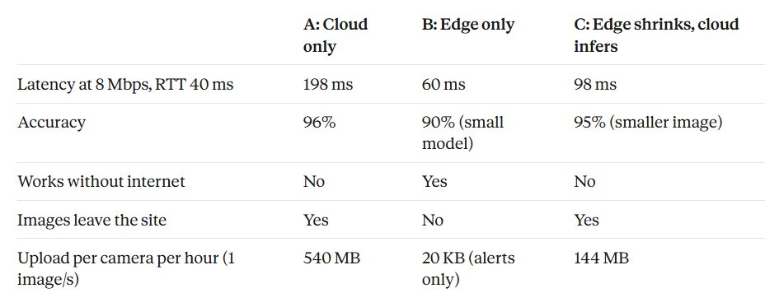
Question
A construction company has a helmet-detection system with three options. In the table, all values are assumed. Task: For each site, choose the best option and justify.

Slide 98
Question (Contd…)
A construction company has a helmet-detection system with three options. In the table, all values are assumed. Task: For each site, choose the best option and justify.
Site 1, entry gate. The warning must come within 100 ms, and the safety audit needs accuracy of at least 94%. The link is a stable 8 Mbps.
Site 2, tunnel project. The internet connection is unreliable, and the warning must come within 100 ms.
Site 3, secure facility. Rules say that no images may leave the premises, and warnings must come within 100 ms.

Slide 99
Site 1, entry gate. The warning must come within 100 ms, and the safety audit needs accuracy of at least 94%. The link is a stable 8 Mbps.
Solution:
Site 1: C.
A is 198 ms and fails the deadline. B is 60 ms but its 90% accuracy is below 94%. C takes 98 ms and has 95% accuracy, so it meets both.

Slide 100
Site 2, tunnel project. The internet connection is unreliable, and the warning must come within 100 ms.
Solution:
Site 2: B.
It is the only option that works without internet, and 60 ms meets the deadline. The cost is a lower accuracy (90%), so the site should accept that or add checks.

Slide 101
Site 3, secure facility. Rules say that no images may leave the premises, and warnings must come within 100 ms.
Solution:
Site 3: B.
It is the only option that keeps images on site.

Slide 102
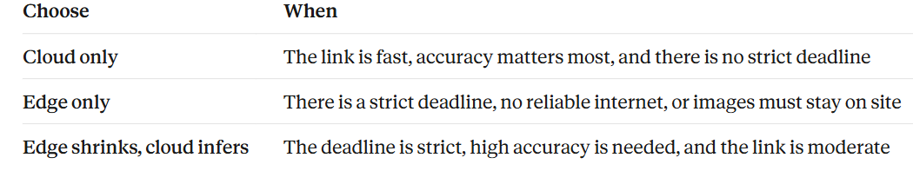
Choice of Inferencing System

Slide 103
AI Workload Placement Patterns
Pattern | Inference runs on | Latency | Privacy | Typical use
On-device | MCU or embedded processor in the device | Lowest | Data stays on the device | Wake word, gesture, sensor anomaly
Gateway / edge server | Edge computer near the devices | Low | Data stays on site | Multi-camera analytics, factory line
Fog / regional | Nodes between edge and cloud | Moderate | Data leaves the site | City-wide aggregation of sensor data
Cloud | Remote data-centre GPUs | Highest, network dependent | Data transits a provider | Very large models, fleet analytics
Split inference | Network cut: front part on device, rest on edge or cloud | Depends on cut point and link | Sends activations, not raw input | Mobile vision and speech
Decide with: latency budget, data volume and bandwidth, privacy rules, connectivity, device memory and power, model size and cost.
Hybrid: a small on-device model handles easy inputs; uncertain ones go to a larger edge or cloud model.
Notes:
Use this table with the existing slides on edge versus cloud inference. The new row is split (collaborative) inference, covered on the next slide. Hybrid cascades: a small on-device model handles easy inputs and escalates uncertain ones to a larger model on the edge or cloud.

Slide 104
Worked Example: Where Should Inference Run?
Option | What happens | Latency calculation | Total
A Cloud only | Send 150 KB image; server inference 8 ms | 150 ms (send) + 40 ms (RTT) + 8 ms | 198 ms
B Device only | INT8 model on an edge board | 60 ms (local inference) | 60 ms
C Split | Edge shrinks image to 40 KB (10 ms); cloud runs the model (8 ms) | 10 (resize) + 40 (send) + 40 (RTT) + 8 ms | 98 ms
Assumed link
8 Mbps uplink, 40 ms round-trip time
Reading the result
B is fastest, but only if the small model’s accuracy is acceptable.
If the task needs the large cloud model: C beats A by 100 ms. A and C tie at about 88 Mbps; faster links favour cloud-only, slower links favour shrinking the image first.
All values are assumed for illustration; re-measure on your own device and network.
Notes:
All numbers are assumed for teaching. Cloud-only: 150 KB x 8 / 8 Mbps = 150 ms, plus RTT 40 ms and 8 ms server time = 198 ms. Split (edge shrinks, cloud infers): resize 10 ms + 40 KB x 8 / 8 Mbps = 40 ms + RTT 40 ms + 8 ms = 98 ms. Device-only: 60 ms. C beats A by 198 - 98 = 100 ms. Tie between cloud-only and split: A = 1200/B + 48 and C = 320/B + 58 (B in Mbps), so 880/B = 10 and B = 88 Mbps. Above 88 Mbps cloud-only wins; below it, shrinking the image first wins. B is fastest here, but only if the small on-device model is accurate enough.

Slide 105
Worked Problem: Will the Model Fit in Flash memory?
Problem A machine learning model that classifies camera frames has 1.2 M parameters. Find its size in FP32, INT8 and 4-bit form. Which forms fit in 0.7 MB of flash memory.
Precision | Bytes per weight | Size = 1.2 M × bytes | Fits 0.7 MB?
FP32 | 4 | 4.8 MB | No
INT8 | 1 | 1.2 MB | No
4-bit | 0.5 | 0.6 MB | Yes
Method
Size = parameters × bytes per weight (1 byte = 8 bits, so 4-bit = 0.5 byte).
Compare each size with the free flash, 0.7 MB.
Also budget RAM for activations, and re-test accuracy after quantising.
Assumed model for teaching; 1 MB = 10⁶ bytes.
Notes:
Problem type (question bank Q12). Step 1: size = number of parameters x bytes per weight. FP32 = 4 bytes: 1.2 M x 4 = 4.8 MB. INT8 = 1 byte: 1.2 M x 1 = 1.2 MB. 4-bit = half a byte: 1.2 M x 0.5 = 0.6 MB. Step 2: compare each with the 0.7 MB of free flash. 4.8 and 1.2 MB are larger than 0.7 MB, so they do not fit; 0.6 MB fits with 0.1 MB spare. Step 3: remember that RAM is also needed for activations (the intermediate image data), so 'fits in flash' does not yet mean 'runs'. Quantising FP32 to INT8 gives 4 times smaller; to 4-bit gives 8 times smaller. Check accuracy after quantising. Camera link: the CNN classifies frames from the camera, for example helmet / no helmet.

Slide 106
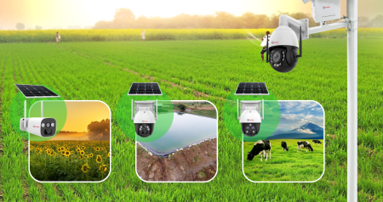
Question
A 40-hectare farm is monitored at night for animals or intruders entering the field. Eight cameras around the field each generate video at 30 frames per second. One frame is 1920 × 1080 pixels, RGB, 3 bytes per pixel. The edge board next to each camera runs a detection model and uploads a picture only when it detects an animal or an intruder. For the whole farm this gives 30 alert images per hour, each of 2 MB.
(a) Find the data generated per hour by one camera.
(b) Find the data generated per hour by all eight cameras.
(c) Find the data uploaded per hour when Edge AI is used.
(d) Find the reduction factor.
Notes:
Teaching points for this scenario
Without edge AI, a farm with patchy mobile coverage could not upload 5.37 TB per hour. With edge AI the upload is only 60 MB.
Each alert image is the evidence: it shows what was detected, and where and when, so the farmer can act.
Night cameras usually use infrared and give grey-level images. The problem keeps the RGB assumption of 3 bytes per pixel so the arithmetic stays the same.

Slide 107
Question
A 40-hectare farm is monitored at night for animals or intruders entering the field. Eight cameras around the field each generate video at 30 frames per second. One frame is 1920 × 1080 pixels, RGB, 3 bytes per pixel. The edge board next to each camera runs a detection model and uploads a picture only when it detects an animal or an intruder. For the whole farm this gives 30 alert images per hour, each of 2 MB.
Find the data generated per hour by one camera.
(a) 6,220,800 B per frame × 30 = 186.6 MB/s.
Notes:
Teaching points for this scenario
Without edge AI, a farm with patchy mobile coverage could not upload 5.37 TB per hour. With edge AI the upload is only 60 MB.
Each alert image is the evidence: it shows what was detected, and where and when, so the farmer can act.
Night cameras usually use infrared and give grey-level images. The problem keeps the RGB assumption of 3 bytes per pixel so the arithmetic stays the same.

Slide 108
Question
A 40-hectare farm is monitored at night for animals or intruders entering the field. Eight cameras around the field each generate video at 30 frames per second. One frame is 1920 × 1080 pixels, RGB, 3 bytes per pixel. The edge board next to each camera runs a detection model and uploads a picture only when it detects an animal or an intruder. For the whole farm this gives 30 alert images per hour, each of 2 MB.
(b) Find the data generated per hour by all eight cameras.
(b) 8 × 671.8 = 5,374.8 GB, about 5.37 TB per hour.
Notes:
Teaching points for this scenario
Without edge AI, a farm with patchy mobile coverage could not upload 5.37 TB per hour. With edge AI the upload is only 60 MB.
Each alert image is the evidence: it shows what was detected, and where and when, so the farmer can act.
Night cameras usually use infrared and give grey-level images. The problem keeps the RGB assumption of 3 bytes per pixel so the arithmetic stays the same.

Slide 109
Question
A 40-hectare farm is monitored at night for animals or intruders entering the field. Eight cameras around the field each generate video at 30 frames per second. One frame is 1920 × 1080 pixels, RGB, 3 bytes per pixel. The edge board next to each camera runs a detection model and uploads a picture only when it detects an animal or an intruder. For the whole farm this gives 30 alert images per hour, each of 2 MB.
(c) Find the data uploaded per hour when Edge AI is used.
(c) 30 × 2 MB = 60 MB per hour.
Notes:
Teaching points for this scenario
Without edge AI, a farm with patchy mobile coverage could not upload 5.37 TB per hour. With edge AI the upload is only 60 MB.
Each alert image is the evidence: it shows what was detected, and where and when, so the farmer can act.
Night cameras usually use infrared and give grey-level images. The problem keeps the RGB assumption of 3 bytes per pixel so the arithmetic stays the same.

Slide 110
Question
A 40-hectare farm is monitored at night for animals or intruders entering the field. Eight cameras around the field each generate video at 30 frames per second. One frame is 1920 × 1080 pixels, RGB, 3 bytes per pixel. The edge board next to each camera runs a detection model and uploads a picture only when it detects an animal or an intruder. For the whole farm this gives 30 alert images per hour, each of 2 MB.
(d) Find the reduction factor.
(d) 5,374,771 MB ÷ 60 MB ≈ 89,580. The upload is about 89,580 times smaller.
Notes:
Teaching points for this scenario
Without edge AI, a farm with patchy mobile coverage could not upload 5.37 TB per hour. With edge AI the upload is only 60 MB.
Each alert image is the evidence: it shows what was detected, and where and when, so the farmer can act.
Night cameras usually use infrared and give grey-level images. The problem keeps the RGB assumption of 3 bytes per pixel so the arithmetic stays the same.

Slide 111
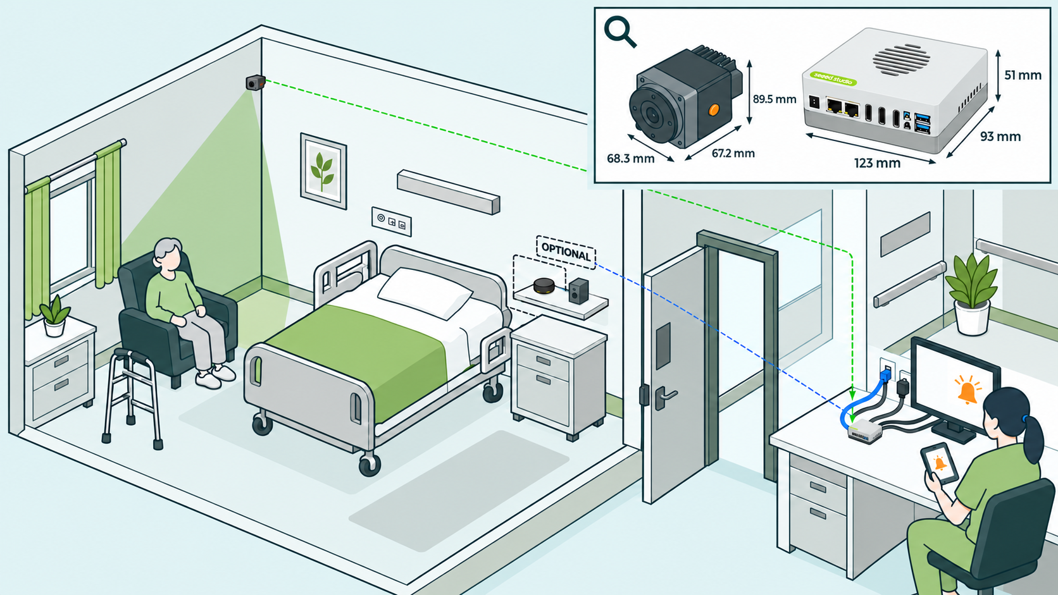
Question: Battery Life of a Camera Node
A hospital ward places a battery-powered camera node at each bed to detect patient falls. Each node has a 3.7 V, 1,000 mAh battery. Two designs are considered. Ignore sleep power.
Design A (edge): the node runs the fall-detection model locally and sends only an alert. It uses 15 mJ per second.
Design B (stream): the node streams raw images to the ward server, where the model runs. It uses 60 mJ per second.
(a) Find the battery energy in joules.
(b) Find the battery life of each design in hours and in days.
(c) The nursing staff want to recharge the nodes at most once a week. Which design meets this? What is the maximum average power a node may use to last 7 days?
(d) Name two reasons, apart from battery life, why a hospital would prefer Design A.

Slide 112
Question
A hospital ward places a battery-powered camera node at each bed to detect patient falls. Each node has a 3.7 V, 1,000 mAh battery. Two designs are considered. Ignore sleep power.
Design A (edge): the node runs the fall-detection model locally and sends only an alert. It uses 15 mJ per second.
Design B (stream): the node streams raw images to the ward server, where the model runs. It uses 60 mJ per second.
(a) Find the battery energy in joules.
(a)
Battery energy E = V × Ah × 3,600
Convert the capacity to Ah: 1,000 mAh ÷ 1,000 = 1 Ah.
Convert hours to seconds, because 1 Wh = 3,600 J (1 hour = 3,600 s)
Therefore battery Energy, E = 3.7 V × 1 Ah × 3,600 = 13,320 J.
Notes:
Multiply by the voltage: 3.7 V × 1 Ah = 3.7 Wh (watt-hours).
3.7 × 3,600 = 13,320 J.

Slide 113
Question
A hospital ward places a battery-powered camera node at each bed to detect patient falls. Each node has a 3.7 V, 1,000 mAh battery. Two designs are considered. Ignore sleep power.
Design A (edge): the node runs the fall-detection model locally and sends only an alert. It uses 15 mJ per second.
Design B (stream): the node streams raw images to the ward server, where the model runs. It uses 60 mJ per second.
(b) Find the battery life of each design in hours and in days.
1mJ per second = 1mW . Battery Life = Energy ÷ Power
Design A:
15 mJ/s = 15 mW. 1hr= 3600s
Life = 13,320 ÷ 0.015 = 888,000 s ÷ 3600= 246.7 h ≈ 10.3 days.
Design B:
60 mW. Life = 13,320 ÷ 0.06 = 222,000 s = 61.7 h ≈ 2.6 days.

Slide 114
Question
A hospital ward places a battery-powered camera node at each bed to detect patient falls. Each node has a 3.7 V, 1,000 mAh battery. Two designs are considered. Ignore sleep power.
Design A (edge): the node runs the fall-detection model locally and sends only an alert. It uses 15 mJ per second.
Design B (stream): the node streams raw images to the ward server, where the model runs. It uses 60 mJ per second.
(c) The nursing staff want to recharge the nodes at most once a week. Which design meets this? What is the maximum average power a node may use to last 7 days?

Slide 115
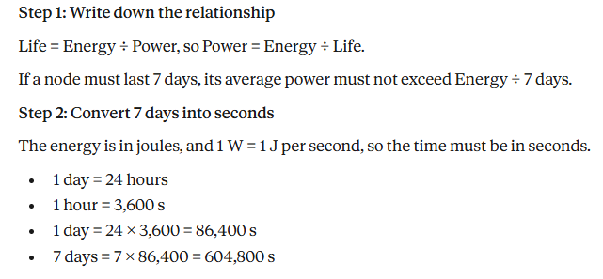
Question
A hospital ward places a battery-powered camera node at each bed to detect patient falls. Each node has a 3.7 V, 1,000 mAh battery. Two designs are considered. Ignore sleep power.
Design A (edge): the node runs the fall-detection model locally and sends only an alert. It uses 15 mJ per second.
Design B (stream): the node streams raw images to the ward server, where the model runs. It uses 60 mJ per second.
(c) The nursing staff want to recharge the nodes at most once a week. Which design meets this? What is the maximum average power a node may use to last 7 days?

Slide 116
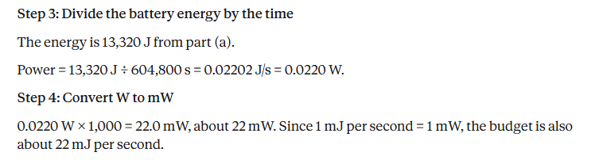
Question
(c) The nursing staff want to recharge the nodes at most once a week. Which design meets this? What is the maximum average power a node may use to last 7 days?

Slide 117
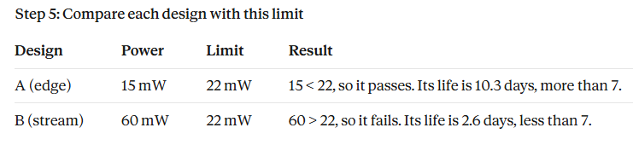
Question
(c) The nursing staff want to recharge the nodes at most once a week. Which design meets this? What is the maximum average power a node may use to last 7 days?

Slide 118
Question
A hospital ward places a battery-powered camera node at each bed to detect patient falls. Each node has a 3.7 V, 1,000 mAh battery. Two designs are considered. Ignore sleep power.
Design A (edge): the node runs the fall-detection model locally and sends only an alert. It uses 15 mJ per second.
Design B (stream): the node streams raw images to the ward server, where the model runs. It uses 60 mJ per second.
(d) Name two reasons, apart from battery life, why a hospital would prefer Design A.
Any two of these:
Patient video stays inside the node, so privacy is protected.
Only alerts travel over the hospital Wi-Fi, which saves bandwidth.
The decision is local, so the alert still works if the network is down.
Latency is lower than with a round trip to the server.

Slide 119
Analysing Trade-offs: Choosing a Model
Candidate | ML Model Accuracy | Model Size | Latency | Energy | Verdict
Requirement | ≥ 92% | ≤ 4 MB | ≤ 100 ms | lowest | —
Option A | 94.0% | 13.6 MB | 180 ms | 90 mJ | Fails size and latency
Option B | 93.2% | 3.4 MB | 55 ms | 28 mJ | Meets all constraints
Option C | 91.5% | 1.7 MB | 38 ms | 19 mJ | Fails accuracy
Illustrative numbers (assumed); not measurements.
Notes:
Illustrative numbers. Method: first filter by the hard constraints, then choose the option with the lowest energy. A fails size and latency; C fails accuracy; B meets all three and uses 28 mJ. Note the INT8 size is exactly one quarter of FP32 (13.6 to 3.4 MB) and the pruned model halves it again (1.7 MB). Always re-measure accuracy after every optimisation.

Slide 120
Common edge use cases include
Gaming. Real-time responsiveness, wait times, matchmaking, and low latency are critical for competitive gaming. Edge computing improves these digital experiences by increasing proximity to players.
IoT networks. Edge computing solutions allow businesses to take advantage of the power of IoT networks to collect, analyze, and act on massive amounts of data in real time.
Autonomous vehicles. Self-driving cars produce massive amounts of data that must be aggregated and analyzed in real time, allowing the vehicle to make split-second decisions to deliver riders and cargo to the appropriate destination safely.
Telecommunications. Edge computing enables telecommunications service providers to modernize their networks and move workloads and services to the network’s edge for superior performance.

Slide 121
Common edge use cases include
Industrial manufacturing. Manufacturers rely on edge computing to monitor equipment, identify production errors, enable automation, manage robotics, and improve quality through real-time analytics and machine learning.
Energy. Businesses involved in energy exploration and production use edge computing to collect and store data on oil rigs and gas fields, providing real-time intelligence that can detect hazards, optimize production, improve efficiency, and keep personnel safe.
Safety applications. From real-time facial recognition at airports to on-site motion detectors and cameras, many safety and surveillance applications benefit from the ultra-fast response times available when data is processed at the edge of the network.
Healthcare. Edge computing is best able to collect and process the enormous volume of data produced by medical devices and sensors, allowing providers to respond quickly to changes in patient conditions.
Smart cities. Smart cities use edge computing to power real-time applications like smart traffic lights, smart power grids, smart streetlights, and smart surveillance systems that must be able to process data with split-second response times and superior accuracy.

Slide 122
Edge AI Use Cases (1/2)
Healthcare
Sense: ECG, PPG and motion sensors on wearables; bedside monitors
Edge AI task: Arrhythmia and fall detection; vital-sign alerts
Why edge: Patient data stays local; alerts work offline
Main constraint: Battery life and false-alarm rate
Agriculture
Sense: Soil moisture, weather sensors, field cameras, drones
Edge AI task: Disease and pest detection; irrigation decisions
Why edge: Remote farms, weak connectivity, costly bandwidth
Main constraint: Solar or battery power; rugged hardware
Manufacturing
Sense: Vibration, current and acoustic sensors; inspection cameras
Edge AI task: Predictive maintenance; visual defect detection
Why edge: Millisecond control loops; huge raw data volumes
Main constraint: Real-time latency; harsh environment
Synthesis of Arm Newsroom, “Seven Edge AI Use Cases”, DataCamp and Ultralytics overviews, and MathWorks Tech Talk.
Notes:
Ask students to name the binding constraint before reading it off the slide, then link it to the constraint table later in the unit.

Slide 123
Edge AI Use Cases (2/2)
Smart homes
Sense: Microphone, PIR motion, camera, temperature
Edge AI task: Wake-word detection; occupancy and anomaly sensing
Why edge: Privacy, instant response, works without internet
Main constraint: Always-on low power; small memory on low-cost MCUs
Transportation
Sense: Cameras, radar or LiDAR, GPS, IMU
Edge AI task: Obstacle and pedestrian detection; traffic and parking monitoring
Why edge: Split-second safety decisions
Main constraint: Deterministic latency; heat; safety certification
Surveillance
Sense: IP cameras and microphones
Edge AI task: Person and vehicle detection; intrusion and anomaly alerts
Why edge: Streaming continuous video is too costly; privacy
Main constraint: Frames per second across many streams; 24/7 thermal load
Synthesis of Arm Newsroom, “Seven Edge AI Use Cases”, DataCamp and Ultralytics overviews.
Notes:
Contrast the smart-home MCU (memory-bound) with the surveillance gateway (throughput and thermal bound).

Slide 124
Edge AI Inference Performance Depends on Seven Key Factors
Edge AI inference performance isn't just about picking a powerful chip. It's the result of seven factors working together:
hardware acceleration,
model optimization,
latency requirements,
power constraints,
connectivity,
data quality, and
security.

Slide 125
Factor #1: Hardware Acceleration and Compute Power
Pick the wrong chip, and your model either won't run or won't hit the frame rate you need. Your edge deployment fails at the most basic level.
Edge devices don't have the processing headroom of a data center server. A general-purpose CPU can technically run inference, but it's far too slow for most production workloads. That's why specialized accelerators exist: GPUs, NPUs (Neural Processing Units), and dedicated AI chips designed to handle the math-heavy operations that inference demands.
The impact is direct. Using a GPU-based accelerator like NVIDIA Jetson gives you higher frames per second for computer vision and faster response times for robotics. A lightweight NPU like Google Coral handles simpler perception tasks at a fraction of the power draw.
How to choose? Match the hardware to your task. Vision-heavy workloads (object detection, video analytics) need GPU acceleration. Lightweight classification or sensor fusion tasks can run on NPUs. Don't over-spec for simple tasks, and don't under-spec for demanding ones.
But even the right hardware can't help if the model itself is too heavy for the device.

Slide 126
Factor #2: Model Complexity and Compression
A model that's too large for your device will choke inference, drain the battery, and deliver nothing useful. But compressing too aggressively kills accuracy. Either way, your product suffers.
Unoptimized models are the most common reason edge deployments underperform. A model trained in the cloud on high-end GPUs might work beautifully in a lab, but the moment you push it to a device with 2GB of RAM and a mobile processor, everything breaks down: memory overflows, inference slows to a crawl, and the battery drains in hours.
The fix is model compression. Three techniques matter most. Quantization reduces numerical precision (e.g., from FP32 to INT8), cutting model size and speeding up inference with minimal accuracy loss. Pruning removes unimportant weights, making the model smaller without changing its architecture. Knowledge distillation trains a smaller "student" model to mimic a larger "teacher" model, giving you most of the performance at a fraction of the size.
The goal isn't the smallest possible model. It's the best accuracy you can get within your device's hardware budget. Start with quantization (it's the easiest win), then layer in pruning or distillation if you need to go smaller.
With a compressed model on the right hardware, the next question is: is it fast enough?

Slide 127
Factor #3: Latency and Real-Time Processing
The whole point of edge AI is speed. If your latency is too high, you've lost the main reason for not running inference in the cloud.
Cloud AI requires data to travel from the device to a data center and back. That round trip adds latency, often hundreds of milliseconds. Edge AI eliminates that trip by processing data right where it's collected. But "on-device" doesn't automatically mean "fast." If the hardware can't keep up or the model is too heavy, latency stays high even without a network hop.
In many edge applications, latency requirements are strict. Autonomous vehicles need obstacle detection within 10 milliseconds. Industrial automation systems need real-time control loops that can't tolerate delays. Even a retail camera doing people-counting needs consistent sub-second response to be useful.
How to hit your latency target? Work backwards. Define your latency ceiling first (10ms? 100ms? 500ms?), then select hardware and model configurations that fit within that budget. If you can't meet the target, go back to Factor #2 and compress the model further, or go back to Factor #1 and upgrade the hardware.
Speed demands power. And power is exactly what edge devices don't have much of.

Slide 128
Factor #4: Energy Consumption and Power Constraints
Running inference at full speed is meaningless if the device overheats in twenty minutes or dies in two hours. On the edge, power is a hard constraint, not a nice-to-have.
Many edge devices run on batteries or operate under strict power budgets. A drone, a wearable sensor, a remote monitoring camera: none of these can be plugged into a wall outlet. Even powered devices in factories or vehicles often have thermal limits that restrict how hard the processor can run.
The real danger is thermal throttling. When a processor gets too hot, it automatically slows down to prevent damage. The result: your inference performance drops unpredictably, right when your application needs it most. You designed for 30 FPS, but in a hot environment under sustained load, you're getting 15.
How to manage this? Consider power draw (TDP) during hardware selection, not after. Pair your hardware choice with model compression techniques from Factor #2 to lower computational load. Use lower-precision inference (INT8 instead of FP32) to reduce energy per operation. For physically exposed devices, factor in cooling solutions or duty cycling (running inference in bursts rather than continuously).
With power under control, the next constraint is connectivity.

Slide 129
Factor #5: Bandwidth and Connectivity Limitations
Edge AI exists partly because you can't always count on a stable network. But if your architecture still depends on connectivity for critical functions, one dropped connection takes everything down.
Sending raw data to the cloud is expensive and slow. A single 4K camera generates gigabytes per hour. Multiply that across dozens of cameras in a warehouse or a fleet of vehicles, and the bandwidth costs alone become prohibitive. Add in environments where connectivity is unreliable, factories with thick walls, offshore rigs, remote agricultural sites, mining operations, and cloud-dependent AI simply isn't viable.
That's where edge processing earns its value. By running inference locally, only the results (a detection alert, a classification label, a summary metric) need to travel over the network. Raw data stays on the device. Bandwidth usage drops dramatically, and the system keeps working even when the network doesn't.
How to architect for this? Put core inference on the device. Send only processed outputs upstream. Design your system to function fully offline, with cloud sync as a bonus when connectivity is available, not a requirement for operation.
Processing data locally solves the network problem, but it raises another question: is the data any good?

Slide 130
Factor #6: Data Quality and Inference Accuracy
Your model is only as reliable as the data it receives. Feed it noisy, inconsistent, or degraded inputs, and the outputs will be wrong. In safety-critical applications, that's not just a performance issue. It's a liability.
Real-world data is messier than lab data. Cameras deal with changing light, rain, fog, and occlusion. Sensors drift over time. Vibration in industrial settings introduces noise. All of these degrade the inputs your model sees, and the model's accuracy degrades with them.
This is especially dangerous in high-stakes use cases. A predictive maintenance model that misreads sensor data might miss a failure warning. A security camera that can't handle low-light conditions becomes useless at night. An agricultural sensor that drifts out of calibration gives you false readings for weeks before anyone notices.
How to protect accuracy? Preprocess and filter data at the collection point before it reaches the model. Choose model architectures that are robust to noise and variation. For critical applications, add redundancy: cross-check outputs from multiple sensors, or flag low-confidence predictions for human review rather than acting on them automatically.
And if the data stays on the device, so does the responsibility for keeping it safe.

Slide 131
Factor #7: Security and Data Privacy
Edge AI keeps data local, which reduces the risk of interception during transmission. But edge devices are physically distributed and often exposed. Without proper security, they become attack surfaces instead of secure endpoints.
One of edge AI's selling points is privacy. Medical data stays on the hospital device. Factory data stays on the production floor. Customer data stays on the retail sensor. Nothing travels to a distant data center where it could be intercepted, leaked, or subpoenaed.
But local doesn't automatically mean secure. Edge devices are deployed in the field: on walls, in vehicles, on factory lines, in public spaces. They can be physically accessed, tampered with, or stolen. A compromised device could feed manipulated data to your system, extract your proprietary model, or serve as an entry point into your broader network.
How to secure edge deployments? Start with secure boot to ensure only verified software runs on the device. Use a silicon root of trust (hardware-level security) so the device's identity can't be spoofed. Encrypt stored data and model weights. For fleets of devices, implement remote attestation so you can verify device integrity from a central point.

Slide 132
Edge AI Design Principles
1
Process data where it is born
Send insights, not raw streams
2
Right-size the model
Best accuracy within the hardware budget, not the smallest model
3
Design backwards from the budget
Fix latency, power and memory ceilings first, then pick model and hardware
4
Offline first
Core inference works without a network; cloud sync is a bonus
5
Place work across the continuum
Put each task on the tier that meets its latency, privacy and cost needs
6
Be energy and thermal aware
Decide INT8, duty cycling and cooling at hardware selection
7
Fail safe
Detect out-of-distribution inputs and fall back to a rule-based controller
8
Co-design and verify on target
Iterate model and hardware together; test on the real device
Synthesised from the GMI Cloud edge inference guide and the MathWorks Tech Talk used in this unit.

Slide 133
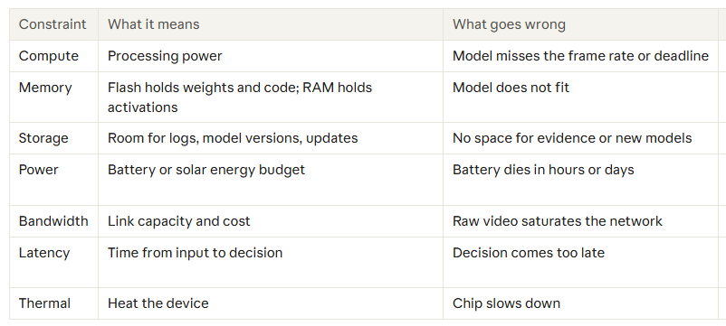
Resource constraints
An edge device has a small, fixed budget. A design works only if the model fits inside all seven limits at once, and fixing one limit often pushes the problem to another (a faster chip raises power and heat).

Slide 134
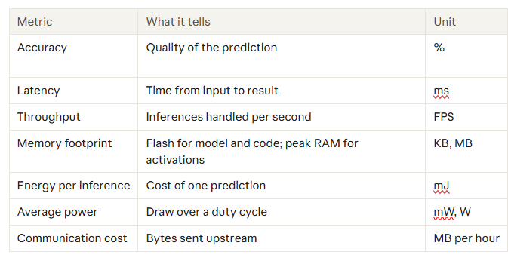
Performance metrics

Slide 135
Hardware–software co-design
Co-design means choosing the model and the hardware together, as one loop, instead of building the model first and hoping it fits. The hardware sets the limits (memory, compute, power); the model and software are shaped to fit them.
The loop: fix the budget (latency, power, memory) → pick a hardware class → shape the model for it (architecture, INT8) → convert to the device runtime → measure on the real device → go back and adjust.
Why it is needed
• A model trained on cloud GPUs is usually too big, too slow or too power-hungry for the edge board.
• A powerful chip alone does not help if the model is too heavy; a tiny model does not help if the chip cannot run its operations.

Slide 136
Thanks for Listening

