Slide 1
Gaussian Distribution, Probability: Intersection and Conditional, Bayes Theorem, Bayes Error, Variance, Covariance
Pre-requisite to understand the concepts for the topic “Relation between Perceptron and Bayes Classifier for a Gaussian Environment”

Slide 2
Gaussian Distribution

Slide 3
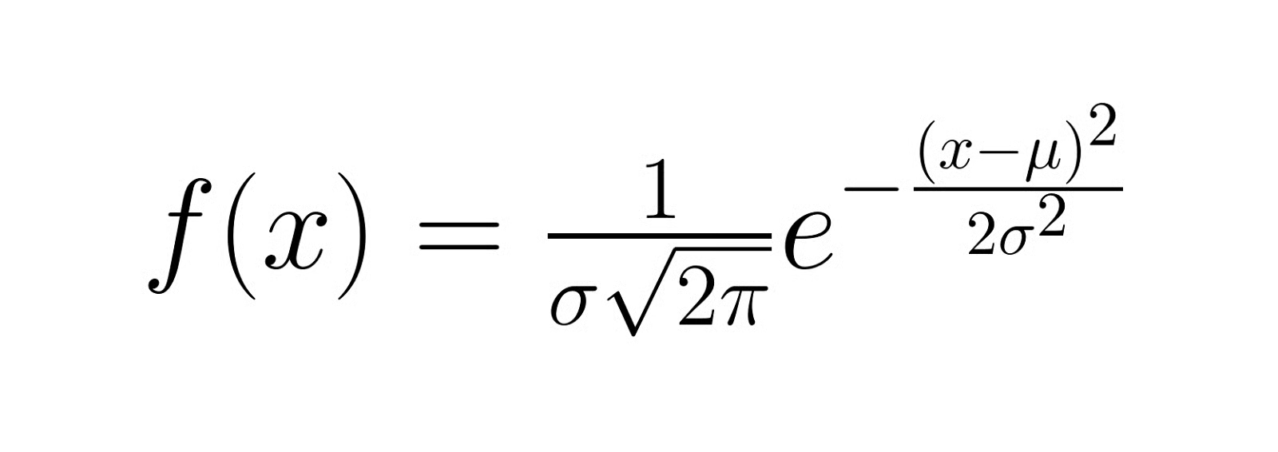
Gaussian Distribution
A Gaussian distribution, also known as a normal distribution, is a continuous probability distribution characterized by its bell-shaped curve. It is defined by two parameters:
μ (mu): The mean or expected value of the distribution
σ (sigma): The standard deviation, which measures the spread of the distribution
The probability density function (PDF) of a Gaussian distribution is given by:
Where:
x is the variable
e is Euler's number (approximately 2.71828)
π (pi) is the mathematical constant pi (approximately 3.14159)

Slide 4
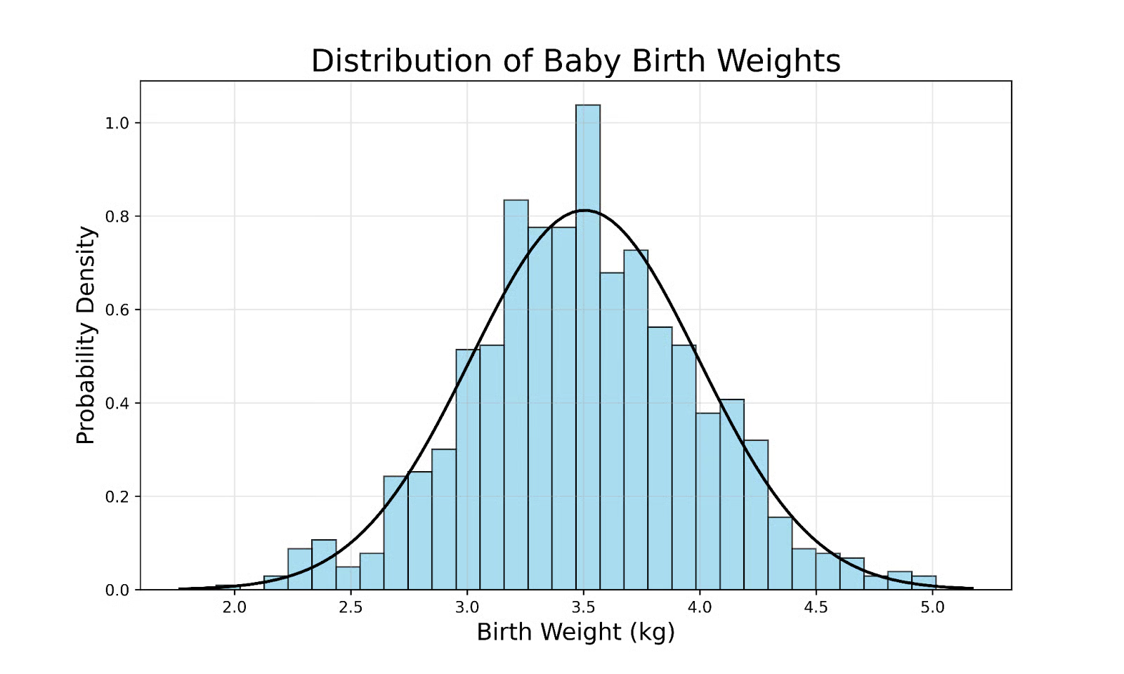
Visualizing the Gaussian distribution
To illustrate the concept of a Gaussian distribution, consider the distribution of birth weights for full-term babies in a large population:
Some key observations from this graph include:
- Most babies' birth weights cluster around an
average value (the peak of the curve).
- Fewer babies have birth weights that deviate
significantly from this average.
- Very few babies have extreme birth weights
(very high or very low).

Slide 5
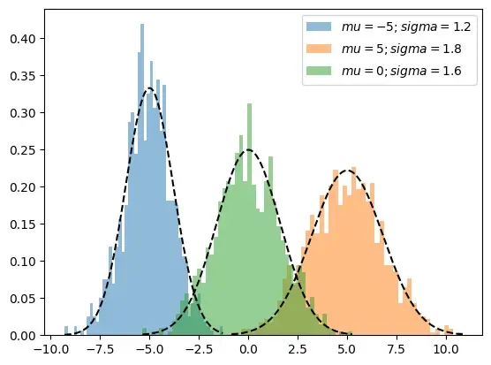
Visualizing the Gaussian distribution
Visualization of three distinct one-dimensional Gaussian distributions

Slide 6

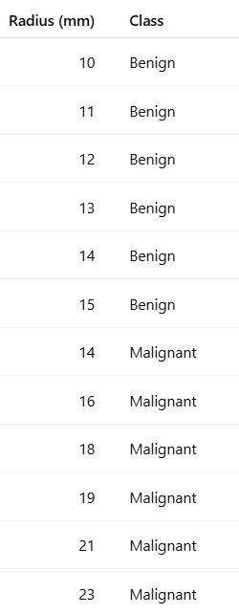
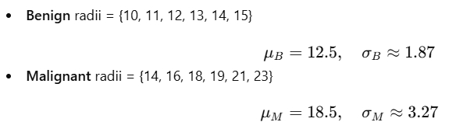



Probability Density Function
For x=14mm, Probability density if tumor is Benign
Notes:
These curves are nothing but $p\left(x∣Benign\right)$and $p\left(x∣Malignant\right)$— the class-conditional densities required for Bayes classifier

Slide 7
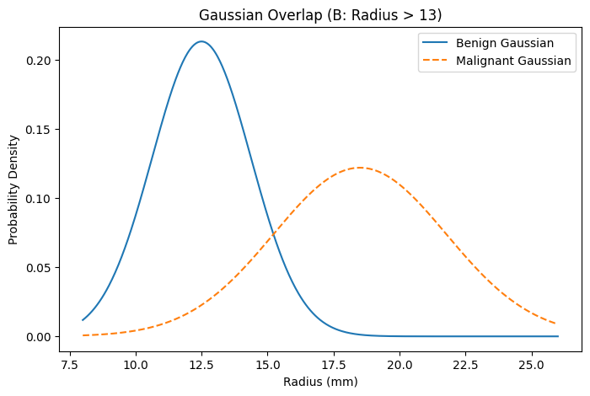
This is the height of the blue curve at 14.
Notes:
These curves are nothing but $p\left(x∣Benign\right)$and $p\left(x∣Malignant\right)$— the class-conditional densities required for Bayes classifier

Slide 8
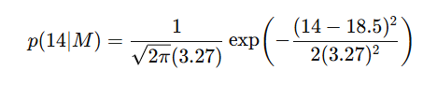

This is the height of dashed curve at 14.
Notes:
These curves are nothing but $p\left(x∣Benign\right)$and $p\left(x∣Malignant\right)$— the class-conditional densities required for Bayes classifier
In a Bayes classifier, the
likelihood probability ($P\left(\text{Data} | \text{Class}\right)$) represents the conditional probability of observing specific evidence, features, or data points, given that a particular class or hypothesis is true. It measures how likely the observed data is under a specific class,

Slide 9
Probability
Intersection
Conditional

Slide 10
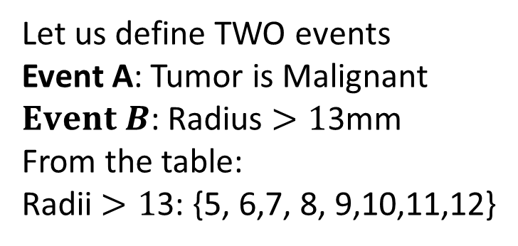
Let us define TWO events
Event A: Tumor is Malignant
$Event B$: Radius $>1$3mm
From the table:
Radii $>1$3: {5, 6,7, 8, 9,10,11,12}
Benign
{1,2,3, 4}
B (>13)
A
Malignant
{5,6}
{7,8,9,10,
11,12}

Slide 11
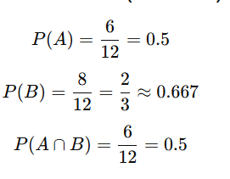
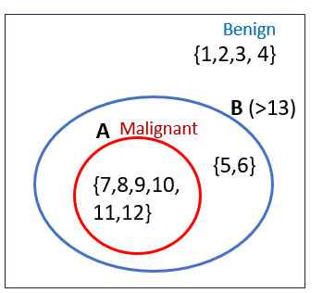
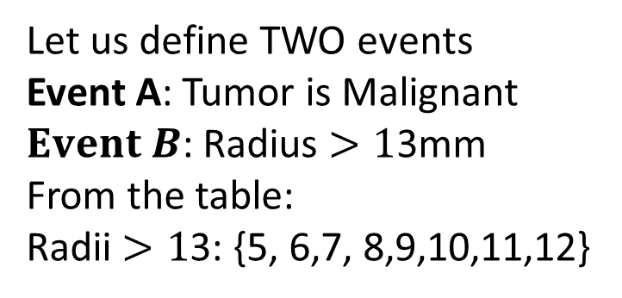
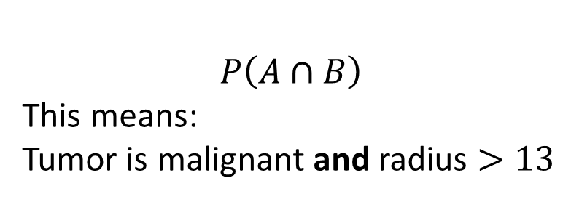
Let us define TWO events
Event A: Tumor is Malignant
$Event B$: Radius $>1$3mm
From the table:
Radii $>1$3: {5, 6,7, 8,9,10,11,12}
$$P\left(A∩B\right)$$
This means:
Tumor is malignant and radius $>13$

Slide 12

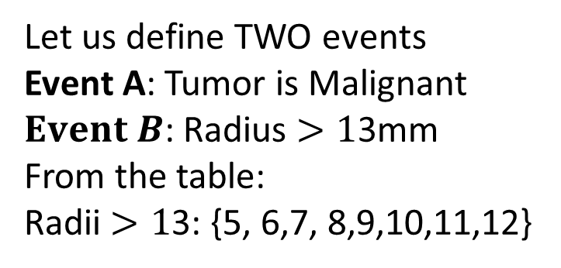
Let us define TWO events
Event A: Tumor is Malignant
$Event B$: Radius $>1$3mm
From the table:
Radii $>1$3: {5, 6,7, 8,9,10,11,12}
Conditional Probability
Notes:
“If radius is greater than 13 mm,
there is 75% chance the tumor is
malignant.”

Slide 13
Bayes Theorem

Slide 14
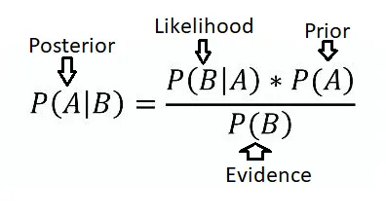
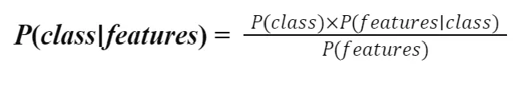
Bayes Theorem

Slide 15
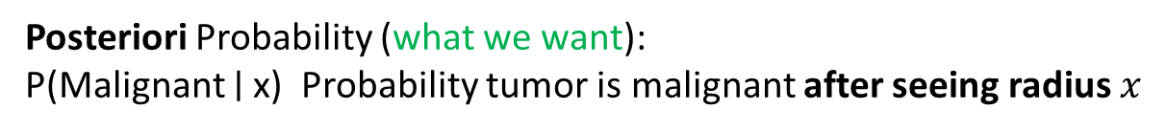
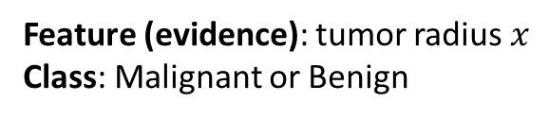
Bayes Theorem
Feature (evidence): tumor radius $x$
Class: Malignant or Benign
Posteriori Probability (what we want):
P(Malignant ∣ x) Probability tumor is malignant after seeing radius $x$
Likelihood:
𝑃(𝑥 ∣ Malignant) If tumor were malignant, how likely is this radius?
Prior:
P(Malignant) Before seeing radius, chance of malignancy
Evidence:
P (x) Overall probability of seeing this radius in the population

Slide 16

Bayes Theorem
Feature (evidence): tumor radius $x$
Class: Malignant or Benign
Notes:
Probability of class after seeing data must depend on both how well data fits the class and how common the class is.
How well data fits the class × How common the class is
We multiply by prior because a class that matches the data well but rarely occurs should not dominate the decision.
Probability of class after seeing data must depend on both how well data fits the class and how common the class is.

Slide 17
Bayes Classifier

Slide 18




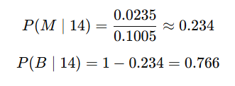
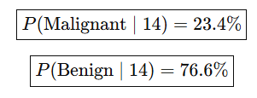
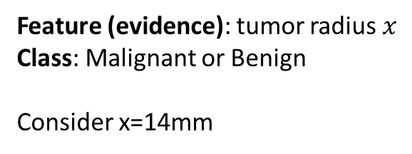
Bayes Classifier
Feature (evidence): tumor radius $x$
Class: Malignant or Benign
Consider x=14mm
Evidence P(x)
Notes:
“These numbers come directly from the heights of the curves at 14 mm, multiplied by how common each class is, and normalized.”
That is Bayes classifier in action on your dataset.

Slide 19



Bayes Decision Boundary
The Bayes decision boundary is the optimal
separating surface between classes that minimizes
the total probability of misclassification (expected loss).
It occurs where the posterior probabilities of two classes are equal
or where the ratio of their class-conditional densities matches
the ratio of their prior probabilities.
Solving this equation yield x=15.22mm

Slide 20
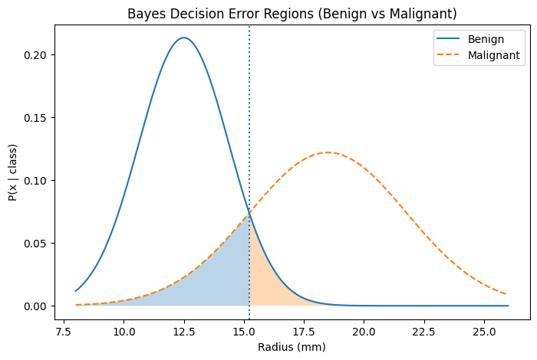
Decision Boundary x₀=15.2mm
c
X₀=15.22mm
x > 15.22 mm
decide Malignant
x < 15.22mm
decide Benign

Slide 21
X₀=15.22mm
Where Bayes error happens
Look at the shaded regions:
Left shaded under malignant curve
→ Malignant tumors misclassified as benign
Right shaded under benign curve
→ Benign tumors misclassified as malignant
These are unavoidable errors due to overlap.

Slide 22
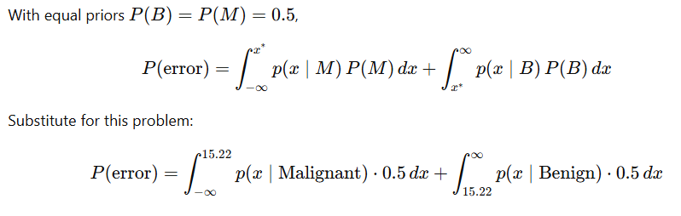
X₀=15.22mm
Bayes Error Rate
Notes:
This shaded area is the probability that even the best possible classifier will make a mistake.

Slide 23
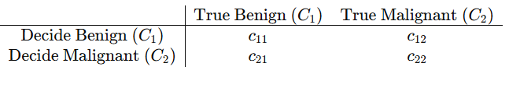
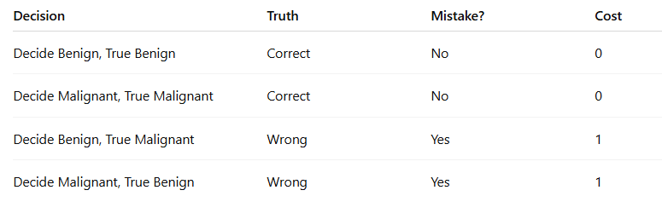
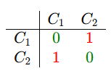
Cost Matrix
X₀=15.22mm

Slide 24
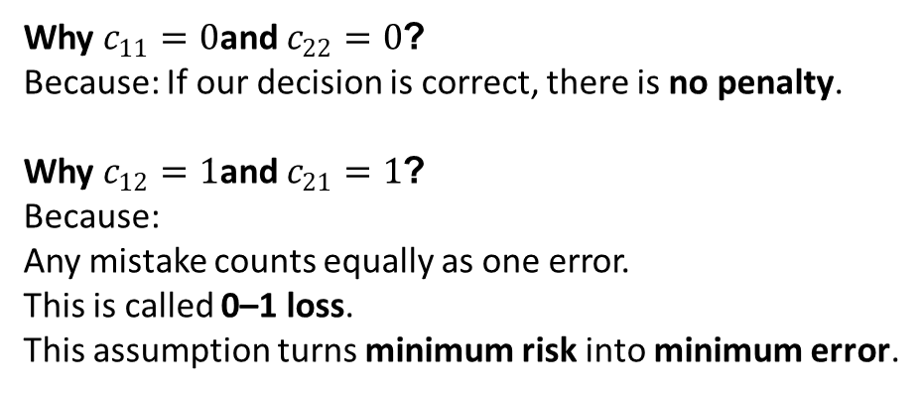
Cost Matrix
X₀=15.22mm
Why $c_{11}=0$and $c_{22}=0$?
Because: If our decision is correct, there is no penalty.
Why $c_{12}=1$and $c_{21}=1$?
Because:
Any mistake counts equally as one error.
This is called 0–1 loss.
This assumption turns minimum risk into minimum error.

Slide 25
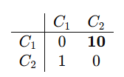
Cost Matrix
X₀=15.22mm
We are fine, if Benign Tumors are classified as Malignant Tumor.
But Malignant tumor should not be classified as Benign Tumor. "
Now missing a malignant tumor costs 10.
Notes:
This cost matrix tells Bayes: it is safer to over-diagnose than to miss a cancer.”

Slide 26
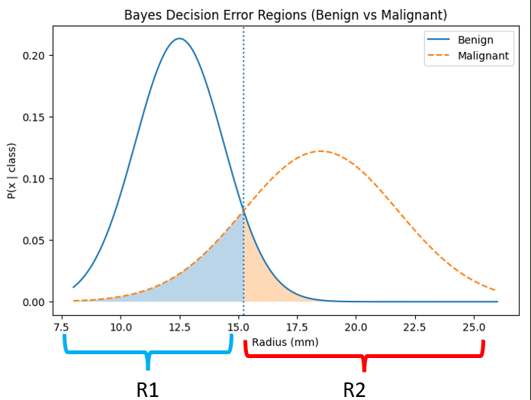
Bayes Risk
Bayes risk is the minimum expected loss of a decision rule, calculated by averaging the loss function over the posterior distribution of parameters, representing the best possible performance achievable in a Bayesian framework for a given problem and loss function.

Slide 27
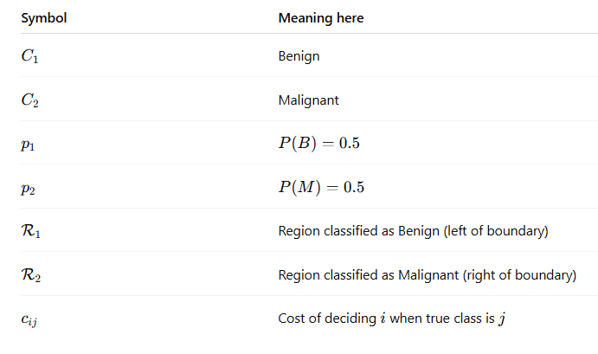


R1
R2
Risk
c11​=c22​=0, c21​=10, c12​=1

Slide 28
Relation between Perceptron and Bayes Classifier for a Gaussian Environment
Bayes Classifier
Bayes Classifier for a Gaussian Distribution
Covariance Matrix, Expectation,
Matrix: Diagonal vs Non-Diagonal
Singular vs Non-Singular

Slide 29
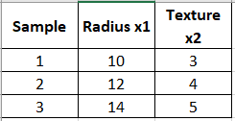

Take a 2-feature example (tumor)
Let features be:
$x_{1}$: Radius (mm)
$x_{2}$: Texture score
Suppose for Benign tumors we observed:

Slide 30

Mean

Slide 31
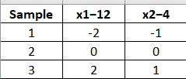

Mean
Compute deviations $\left(X−μ\right)$

Slide 32

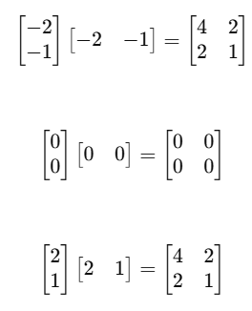



Mean
Compute deviations $\left(X−μ\right)$
Divide by number
of samples (3)
Covariance matrix

Slide 33


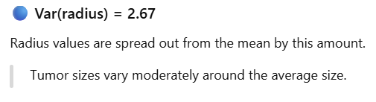
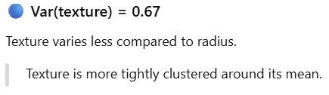
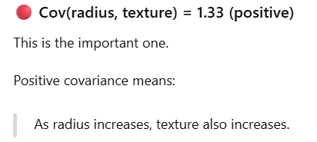

Slide 34
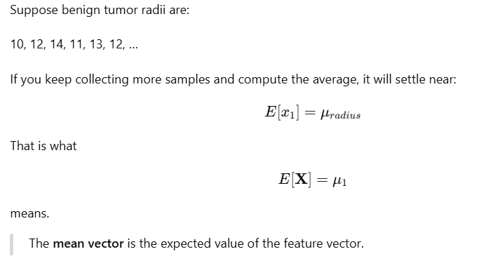
What is “Expectation”?
Expectation = long-run average value of a random quantity.
If you measure the same thing many, many times, the average you get is the expectation.

Slide 35
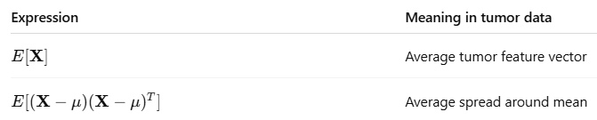
What is “Expectation”?
Expectation is the average value you would get if you observed infinitely many tumor samples.

Slide 36
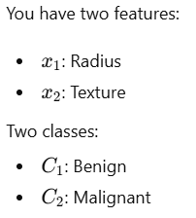

That means the covariance matrix is identical for both classes.

Slide 37
That means the covariance matrix is identical for both classes.
Covariance controls three things about a Gaussian cloud:
- How much it spreads in each direction (variance)
- How features move together (correlation)
- The orientation (tilt) of the ellipse

Slide 38
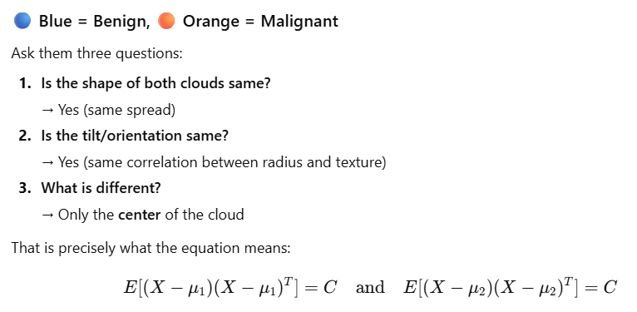
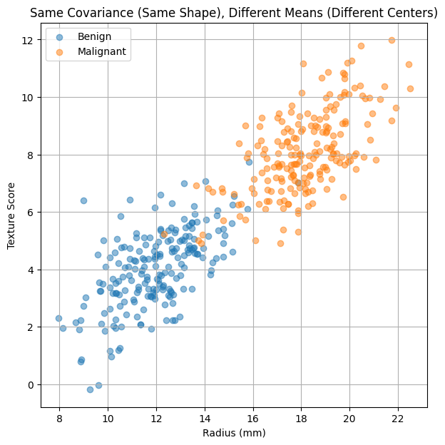

Slide 39
These two classes have identical shape and orientation.
Only their locations are different.
If shapes are same and only shifted, the best separator
must be a straight line.

Slide 40
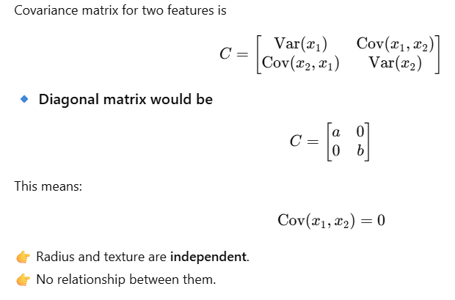
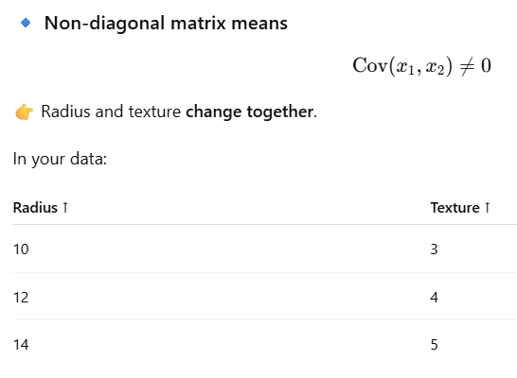
Covariance Matrix: Non-diagonal vs Diagonal

Slide 41
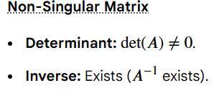
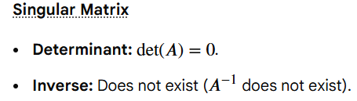


Singular vs Non-Singular matrix

Slide 42
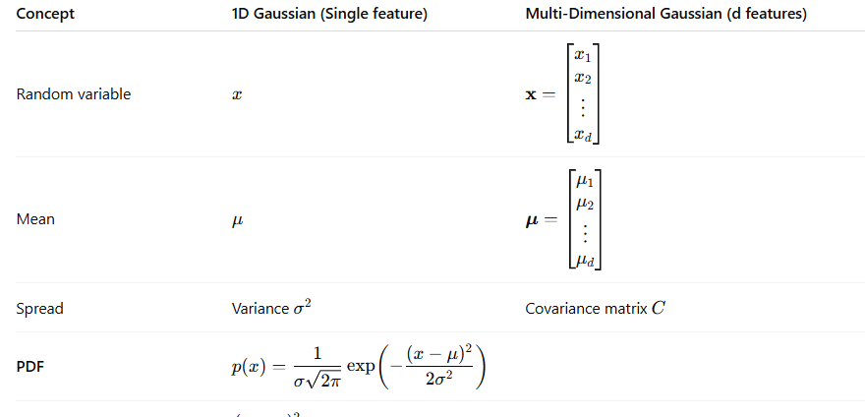

1D Gaussian PDF vs Multi-Dimensional Gaussian PDF
d: Number of features (dimension)

