Slide 1
Neural Network and Deep Learning 23CS8PENDL/23CS7PENDL

Slide 2
Unit-5
Sequence Modelling: Recurrent and Recursive Nets: Unfolding
Computational Graphs, Recurrent Neural Networks, Encoder-Decoder Sequence-to-Sequence Architectures, Deep Recurrent Networks, Recursive Neural Networks

Slide 3
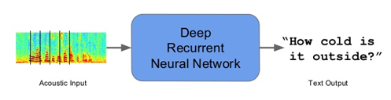

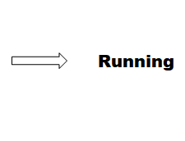
Sequence Modeling
Sequence models are the machine learning models that input or output sequences of data. Sequential data includes text streams, audio clips, video clips, time-series data and etc. Recurrent Neural Networks (RNNs) is a popular algorithm used in sequence models.
Applications of Sequence Models
1. Speech recognition: In speech recognition, an audio clip is given as an input and then the model has to generate its text transcript. Here both the input and output are sequences of data.
2. Video Activity Recognition: In video activity recognition, the model needs to identify the activity in a video clip. A video clip is a sequence of video frames, therefore in case of video activity recognition input is a sequence of data.
Ref. https://towardsdatascience.com/sequence-models-and-recurrent-neural-networks-rnns-62cadeb4f1e1/

Slide 4
Recurrent Neural Networks (RNNs)
Recurrent Neural Network (RNN) is a Deep learning algorithm and it is a type of Artificial Neural Network architecture that is specialized for processing sequential data.
RNNs are mostly used in the field of Natural Language Processing (NLP).
RNN maintains internal memory, due to this they are very efficient for machine learning problems that involve sequential data.
RNNs are also used in time series predictions as well.

Slide 5
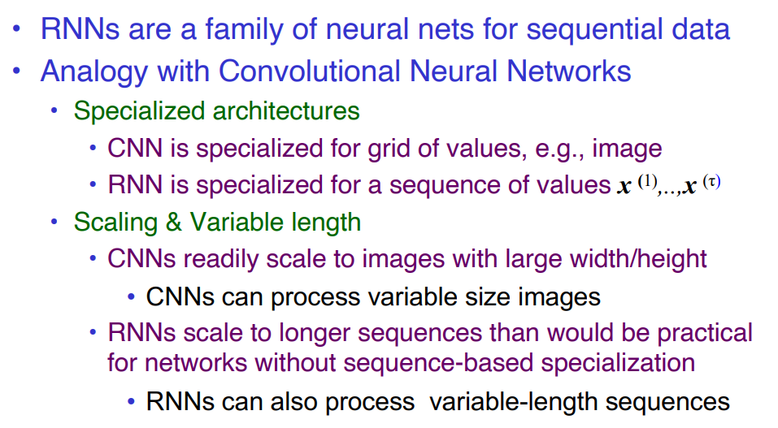
Recurrent Neural Networks process sequential data
Ref.: https://cedar.buffalo.edu/~srihari/CSE676/10.0%20SequenceModeling.pdf

Slide 6
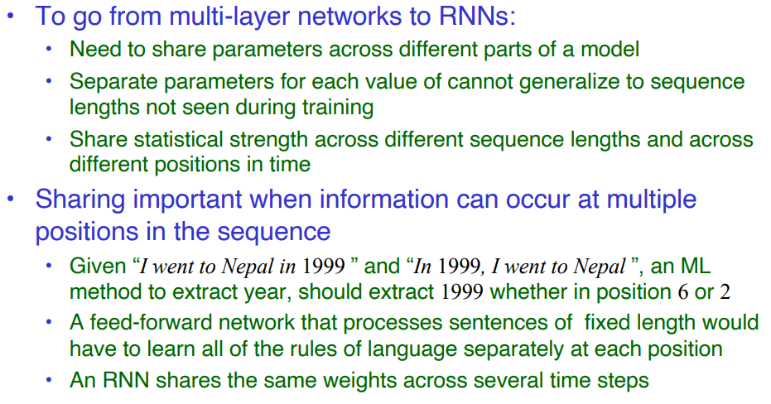
RNNs share same weights across Time Steps

Slide 7
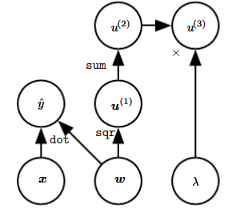
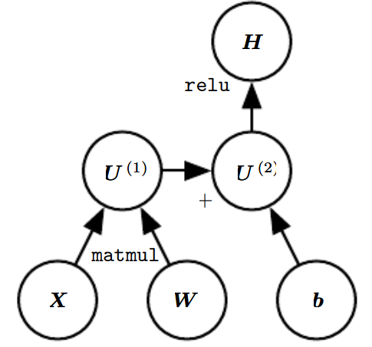
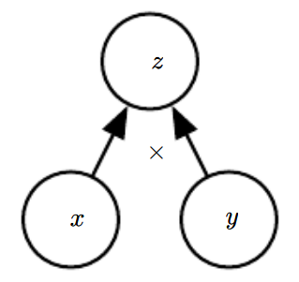
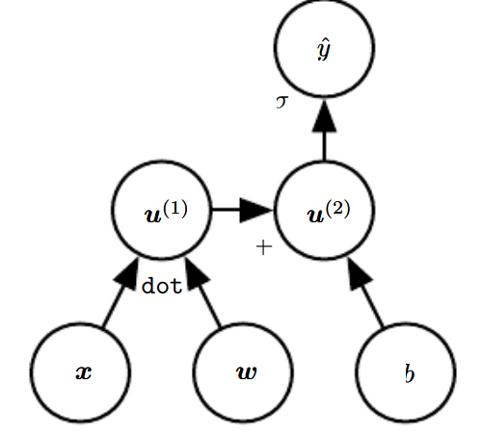
Computational Graphs
Computational Graphs: Formalizing computation as graphs.
Each node in the graph to indicate a variable. The variable may be a scalar, vector, matrix, tensor, or even a variable of another type.
An operation is a simple function of one or more variables. Graph language is accompanied by a set of allowable operations.
If a variable y is computed by applying an operation to a variable x, then we draw a directed edge from x to y.
Examples of computational graphs
The graph using the
× operation to compute z = xy
Example computation graph that
applies more than one operation
to the weights w

Slide 8


Unfolding Computational Graphs
To define recurrent neural networks, computational graphs are used.
We will discuss the idea of unfolding a recursive or recurrent computation into a computational graph that has a repetitive structure, typically corresponding to a chain of events.
This graph results in the sharing of parameters across a deep network structure.
For example, consider the classical form of a dynamical system:
where s^{(t)} is called the state of the system. This equation is recurrent because the definition of s at time t refers back to the same definition at time (t − 1)
For a finite number of time steps τ , the graph can be unfolded by applying the definition (τ − 1) times. For example, if we unfold equation for τ = 3 time steps, we obtain
Notes:
https://medium.com/@jianqiangma/all-about-recurrent-neural-networks-9e5ae2936f6e

Slide 9


Unfolding Computational Graphs
Unfolded computational graph
The classical dynamical system described by equation
, illustrated as an unfolded computational graph. Each node represents the state at some time t and the function f maps the state at t to the state at (t + 1). The same parameters (the same value of θ used to parametrize f) are used for all time steps.
As another example, let us consider a dynamical system driven by an external signal x(t),
where we see that the state now contains information about the whole past sequence.

Slide 10

Unfolding Computational Graphs
Recurrent Neural Networks:
Many recurrent neural networks use equation
or a similar equation to define the values of their hidden units.
When the recurrent network is trained to perform a task that requires predicting the future from the past, the network typically learns to use h(t) as a kind of lossy summary of the task-relevant aspects of the past sequence of inputs up to t. This summary is in general necessarily lossy, since it maps an arbitrary length sequence (x(t) , x(t−1), x(t−2), . . . , x(2), x(1)) to a fixed length vector h(t) .

Slide 11
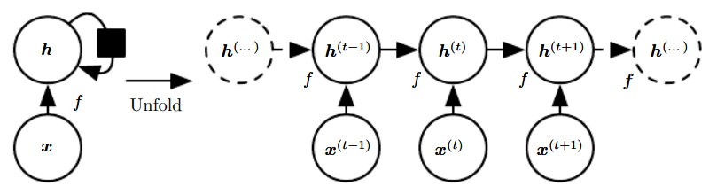
Unfolding Computational Graphs
Figure: A recurrent network with no outputs.
This recurrent network just processes information from the input x by incorporating it into the state h that is passed forward through time.
(Left) Circuit diagram. The black square indicates a delay of a single time step.
(Right) The same network seen as an unfolded computational graph, where each node is now associated with one particular time instance.
We use a black square in a circuit diagram to indicate that an interaction takes place with a delay of a single time step, from the state at time t to the state at time t + 1.
What we call unfolding is the operation that maps a circuit as in the left side of the figure to a computational graph with repeated pieces as in the right side. The unfolded graph now has a size that depends on the sequence length.

Slide 12
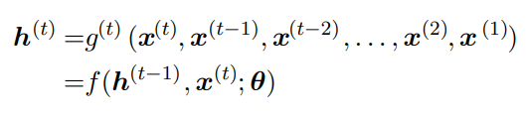
Unfolding Computational Graphs
We can represent the unfolded recurrence after t steps with a function g(t):
The function g(t) takes the whole past sequence (x(t) , x(t−1), x(t−2), . . . , x(2), x(1)) as input and produces the current state, but the unfolded recurrent structure allows us to factorize g(t) into repeated application of a function f .
The unfolding process thus introduces two major advantages:
1. Regardless of the sequence length, the learned model always has the same input size, because it is specified in terms of transition from one state to another state, rather than specified in terms of a variable-length history of states.
2. It is possible to use the same transition function f with the same parameters at every time step.
These two factors make it possible to learn a single model f that operates on all time steps and all sequence lengths, rather than needing to learn a separate model g(t) for all possible time steps.

Slide 13
Question
Examine the techniques for unfolding a computational graph with a repetitive structure within a dynamical system. Formulate this unfolding process using the external input signal x t and the hidden unit h. Mention the advantages of the unfolding process.
Illustrate unfolding computational graph with example.

Slide 14
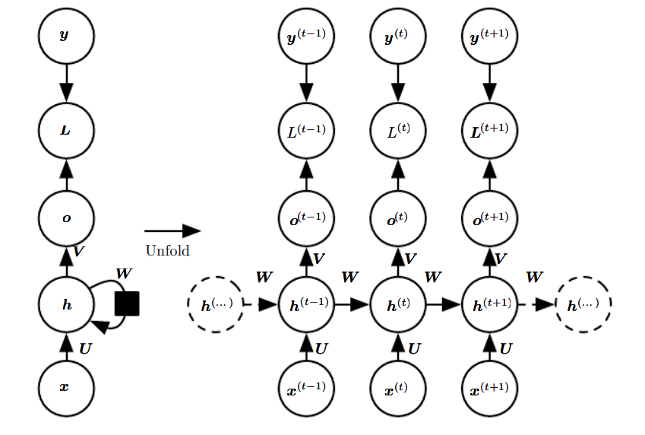
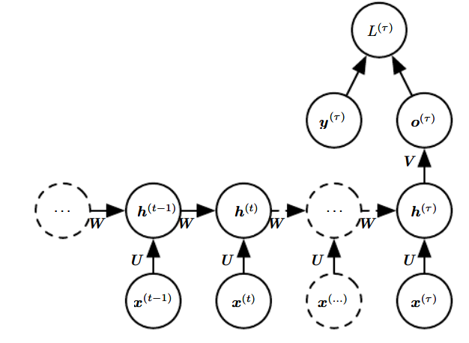
Recurrent Neural Networks
Variety of recurrent neural networks
Variation 1 of RNN (basic form): hidden2hidden connections, sequence output.
Variation 2 of RNN output2hidden, sequence output.
Variation 3 of RNN hidden2hidden, single output.
Variation 3
Variation 1
Variation 2

Slide 15
Recurrent Neural Networks
Variation 1 of RNN (basic form): hidden2hidden connections, sequence output.
Task: Given a sentence, predict the grammatical tag of each word.
Example
Input Sequence Output Sequence
"Students like deep learning" Noun Verb Adjective Noun
Variation 1
Notes:
RNN Flow
x(1),x(2),x(3),x(4)→o(1),o(2),o(3),o(4)
Explanation
Each word enters the network sequentially.
The hidden state captures context from previous words.
The model predicts a tag at every time step.
Other applications
Named Entity Recognition (NER)
Video frame labeling
Speech phoneme recognition

Slide 16
Recurrent Neural Networks
Variation 2 of RNN output2hidden, sequence output.
Task:
Predict the next word in a sentence.
Example
Input seed:
"Deep learning is"
RNN generates sequence:
Step Predicted Word
t1 powerful
t2 for
t3 many
t4 applications
Variation 2

Slide 17
Recurrent Neural Networks
Variation 3 of RNN hidden2hidden, single output.
Task: Classify sentiment of a sentence.
Example
Input sequence:
"This movie is very interesting"
Output:
Positive
Variation 3

Slide 18
Variation 1 of RNN (basic form): hidden2hidden connections, sequence output. Recurrent Hidden Units
The computational graph to compute the training loss of a recurrent network that maps an input sequence of x values to a corresponding sequence of output o values.
A loss L measures how far each o is from the corresponding training target y.
When using softmax outputs, we assume o is the unnormalized log probabilities. The loss L internally computes yˆ = softmax(o) and compares this to the target y.
The RNN has input to hidden connections parametrized by a weight matrix U, hidden-to-hidden recurrent connections parametrized by a weight matrix W , and hidden-to-output connections parametrized by a weight matrix V.
(Left) The RNN and its loss drawn with recurrent connections.
(Right) The same seen as an time unfolded computational graph, where each node is now associated with one particular time instance.

Slide 19
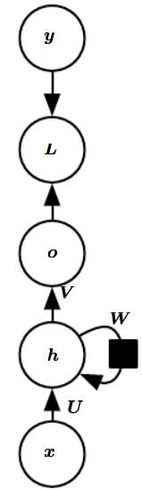
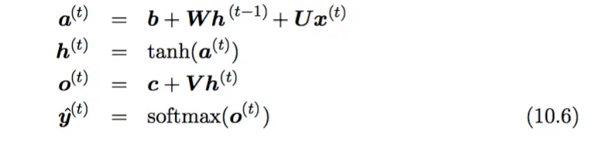
Variation 1 of RNN (basic form): hidden2hidden connections, sequence output.
The basic equations that defines the RNN (Variation 1) is shown in (10.6) below
where the parameters are the bias vectors b and c along with the weight matrices U, V and W , respectively for input-to-hidden, hidden-to-output and hidden-to-hidden connections. This is an example of a recurrent network that maps an input sequence to an output sequence of the same length.
Forward Pass: The runtime is O(τ) (t = 1 to t = τ) and cannot be reduced by parallelization because the forward propagation graph is inherently sequential; each time step may only be computed after the previous one.

Slide 20
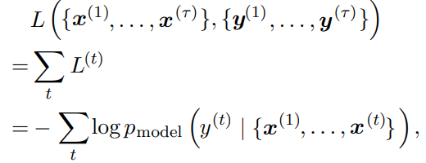
Variation 1 of RNN (basic form): hidden2hidden connections, sequence output.
The total loss for a given sequence of x values paired with a sequence of y values would then be just the sum of the losses over all the time steps. For example, if L(t) is the negative log-likelihood of y(t) given x(1), . . . , x(t) , then sum them up you get the loss for the sequence
where p_{model}(y(t) | {x(1) , . . . , x(t)}) is given by reading the entry for y(t) from the model’s output vector yˆ(t) . Computing the gradient of this loss function with respect to the parameters is an expensive operation. The gradient computation involves performing a forward propagation pass moving left to right through our illustration of the unrolled graph in figure, followed by a backward propagation pass moving right to left through the graph. The runtime is O(τ ) and cannot be reduced by parallelization because the forward propagation graph is inherently sequential; each time step may only be computed after the previous one. States computed in the forward pass must be stored until they are reused during the backward pass, so the memory cost is also O(τ). The back-propagation algorithm applied to the unrolled graph with O(τ) cost is called back-propagation through time or BPTT

Slide 21
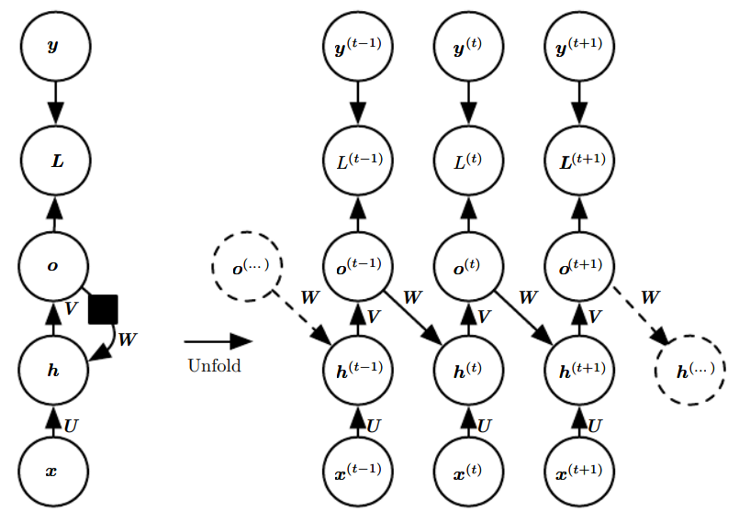
Variation 2 of RNN output2hidden, sequence output. Recurrence through only the Output
An RNN whose only recurrence is the feedback connection from the output to the hidden layer. At each time step t, the input is xt, the hidden layer activations are h(t) , the outputs are o(t) , the targets are y(t) and the loss is L(t) .
(Left) Circuit diagram.
(Right) Unfolded computational graph. Such an RNN is less powerful (can express a smaller set of functions) than those in the family represented by figure (Variation1). The RNN in figure (Variation1) can choose to put any information it wants about the past into its hidden representation h and transmit h to the future. The RNN in this figure (Variation 2) is trained to put a specific output value into o, and o is the only information it is allowed to send to the future. There are no direct connections from h going forward. The previous h is connected to the present only indirectly, via the predictions it was used to produce. Unless o is very high-dimensional and rich, it will usually lack important information from the past. This makes the RNN in this figure less powerful, but it may be easier to train because each time step can be trained in isolation from the others, allowing greater parallelization during training, x

Slide 22
Variation 3 of RNN hidden2hidden, single output. Sequence Input, Single Output
Time-unfolded recurrent neural network with a single output at the end of the sequence.
Such a network can be used to summarize a sequence and produce a fixed-size representation used as input for further processing.
There might be a target right at the end (as depicted here) or the gradient on the output o(t) can be obtained by back-propagating from further downstream modules.

Slide 23
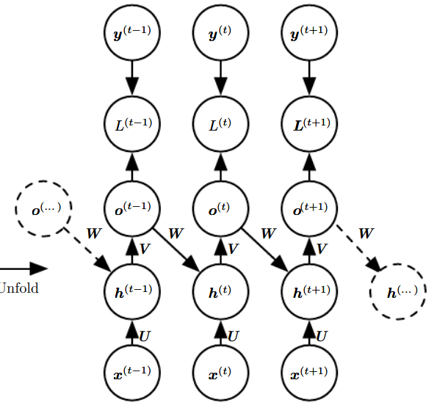
RNN: Teacher Forcing and Networks with Output Recurrence
Teacher forcing as a method for training recurrent neural networks.
Using Output as Input in Sequence Prediction
There are sequence prediction models that use the output from the last time step y(t-1) as input for the model at the current time step X(t).
This type of model is common in language models that output one word at a time and use the output word as input for generating the next word in the sequence.
For example, sequence-to-sequence generation problems such as: Machine Translation, Caption Generation, Text Summarization
After the model is trained, a “start-of-sequence” token can be used to start the process and the generated word in the output sequence is used as input on the subsequent time step.
This same recursive output-as-input process can be used when training the model, but it can result in problems such as: Slow convergence, Model instability, Poor skill.
Teacher forcing is an approach to improve model skill and stability when training these types of models.

Slide 24
RNN: Teacher Forcing
What is Teacher Forcing?
Teacher forcing is a strategy for training recurrent neural networks that uses ground truth as input, instead of model output from a prior time step as an input.
The approach was originally described and developed as an alternative technique to backpropagation through time for training a recurrent neural network.
Teacher forcing works by using the actual or expected output from the training dataset at the current time step y(t) as input in the next time step X(t+1), rather than the output generated by the network.
Notes:
Have you ever had math exam questions that consist of multiple parts, where the answer for part (a) is needed for the calculation in part (b), answer for part (b) is needed for part (c), and so on? I always pay extra attention to these questions because if we get part (a) wrong, then all the subsequent parts will most likely be wrong as well, even though the formulas and the calculations are correct. Teacher Forcing remedies this as follows: After we obtain an answer for part (a), a teacher will compare our answer with the correct one, record the score for part (a), and tell us the correct answer so that we can use it for part (b).

Slide 25
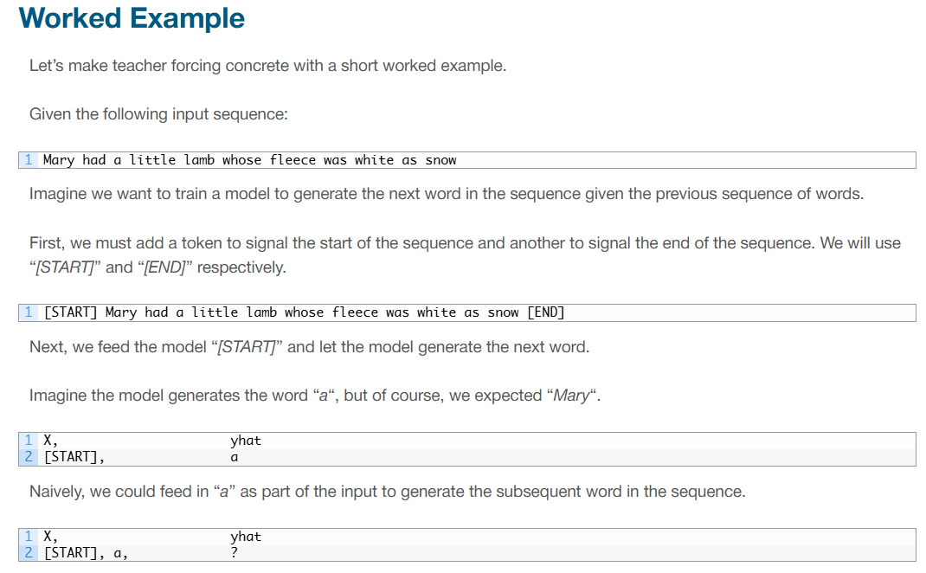
RNN: Teacher Forcing
Ref.: https://machinelearningmastery.com/teacher-forcing-for-recurrent-neural-networks/

Slide 26
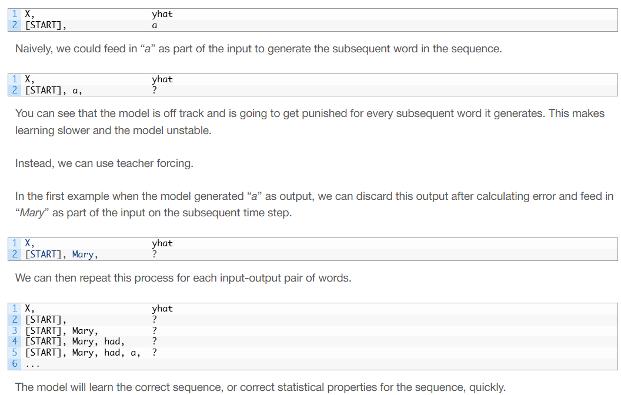
RNN: Teacher Forcing

Slide 27

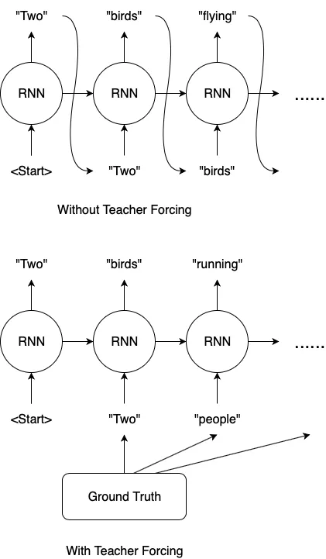
RNN: Teacher forcing
Another example
Let us assume we want to train an image captioning model, and the ground truth caption for the above image is “Two people reading a book”. Our model makes a mistake in predicting the 2nd word and we have “Two” and “birds” for the 1st and 2nd prediction respectively.
Without Teacher Forcing, we would feed “birds” back to our RNN to predict the 3rd word. Let’s say the 3rd prediction is “flying”. Even though it makes sense for our model to predict “flying” given the input is “birds”, it is different from the ground truth.
On the other hand, if we use Teacher Forcing, we would feed “people” to our RNN for the 3rd prediction, after computing and recording the loss for the 2nd prediction.
Notes:
Have you ever had math exam questions that consist of multiple parts, where the answer for part (a) is needed for the calculation in part (b), answer for part (b) is needed for part (c), and so on? I always pay extra attention to these questions because if we get part (a) wrong, then all the subsequent parts will most likely be wrong as well, even though the formulas and the calculations are correct. Teacher Forcing remedies this as follows: After we obtain an answer for part (a), a teacher will compare our answer with the correct one, record the score for part (a), and tell us the correct answer so that we can use it for part (b).

Slide 28
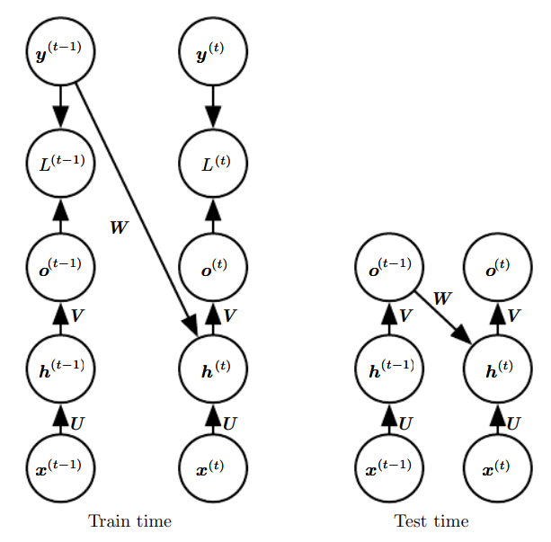
RNN: Teacher Forcing
Teacher forcing is a training technique that is applicable to RNNs that have connections from their output to their hidden states at the next time step.
(Left) At train time, we feed the correct output y(t) drawn from the train set as input to h(t+1) .
(Right) When the model is deployed, the true output is generally not known. In this case, we approximate the correct output y(t) with the model’s output o(t) , and feed the output back into the model.
Fig. Illustration of teacher forcing
Notes:
Train Time: We feed the correct output y(t) (from teacher) drawn from the training set as input to h(t+1)
Test time: True output is not known. We approximate the correct output y(t) with the model’s output o(t) and feed the output back to the model

Slide 29
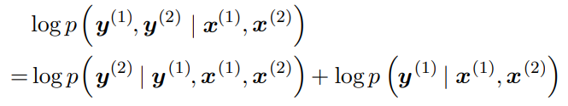
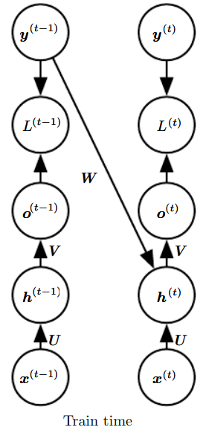
RNN: Teacher Forcing
Teacher forcing is a procedure that emerges from the maximum likelihood criterion, in which during training the model receives the ground truth output y(t) as input at time (t + 1). We can see this by examining a sequence with two time steps. The conditional maximum likelihood criterion is
In this example, we see that at time t = 2, the model is trained to maximize the conditional probability of y(2) given both the x sequence so far and the previous y value from the training set. Maximum likelihood thus specifies that during training, rather than feeding the model’s own output back into itself, these connections should be fed with the target values specifying what the correct output should be. This is illustrated in figure

Slide 30
RNN: Teacher Forcing
Advantages of Teacher-forcing method:
Faster convergence of model towards global optima
Stable model training
Lesser training time is required for model training
Disadvantage of the teacher forcing method:
During the training of the model with the teacher forcing method, we use ground-truth outputs from the dataset as input sequence but during the inference time, we won’t be having ground-truth outputs. Instead, the output generated at the previous time-step is passed as input at the current time-step. As separate approaches are used during the model training and inference part which may lead to model poor performance and instability.

Slide 31

RNN: Recurrent Networks as Directed Graphical Models
For RNNs to learn sequential data, a variant of the backpropagation algorithm known as "Backpropagation Through Time" (BPTT) is used.
In RNNs, the data is processed step-by-step (one at a time). The term "time" is used in BPTT to highlight the fact that the network's computations are performed step by step, simulating the passage of time as the network processes each element of the sequence.
A time step in a Recurrent Neural Network (RNN) refers to a specific moment or instance in a sequence of data being processed by the network. In the context of sequential data, such as text, speech, or time series, the RNN processes one element of the sequence at each time step. This element could be a word in a sentence, a single data point in a time series, or a phoneme in speech.
Backpropagation is applied to each time step, starting from the last one and moving backward to the first. This process is known as Backpropagation Through Time.
TimeStep(t-1)
TimeStep(t)

Slide 32
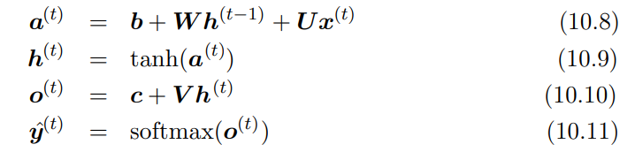
RNN: Computing the Gradient in a Recurrent Neural Network Backpropagation through time algorithm
Forward pass

Slide 33
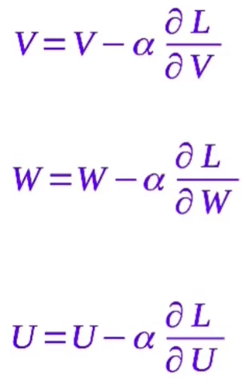
RNN: Computing the Gradient in a Recurrent Neural Network Backpropagation through time algorithm
Using Gradient descent to update the weights V, W, U
Ref.: https://www.youtube.com/watch?v=V5zzNYSTFD4

Slide 34
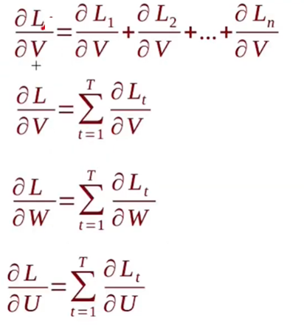
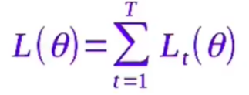
RNN: Computing the Gradient in a Recurrent Neural Network Backpropagation through time algorithm
Total derivative Loss L w.r.t V, is summation
of loss at TimeStep1, TimeStep2….
Total loss is simply the sum of loss
over all time steps, θ
is parameter vector of [V, W, U]

Slide 35
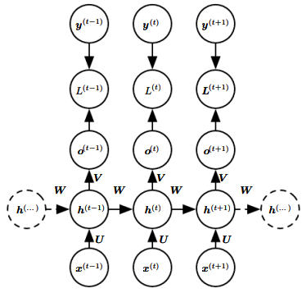
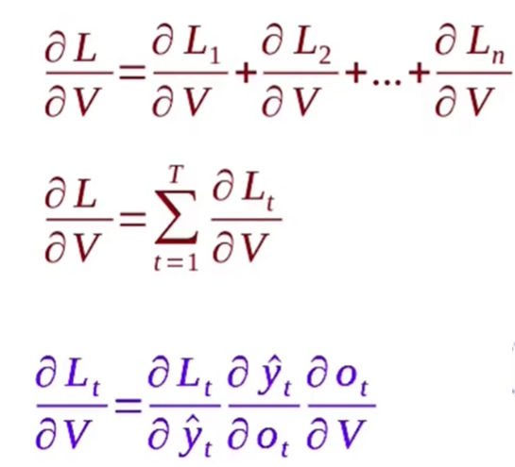
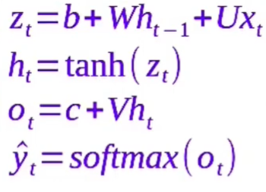
RNN: Computing the Gradient in a Recurrent Neural Network Backpropagation through time algorithm

Slide 36
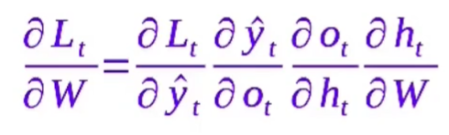
RNN: Computing the Gradient in a Recurrent Neural Network Backpropagation through time algorithm

Slide 37
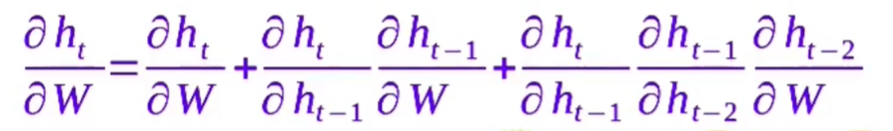
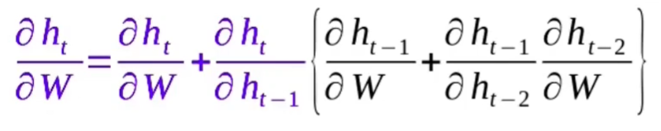
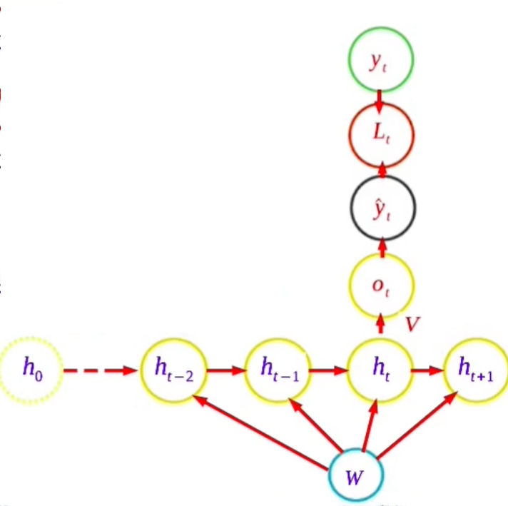
RNN: Computing the Gradient in a Recurrent Neural Network Backpropagation through time algorithm

Slide 38
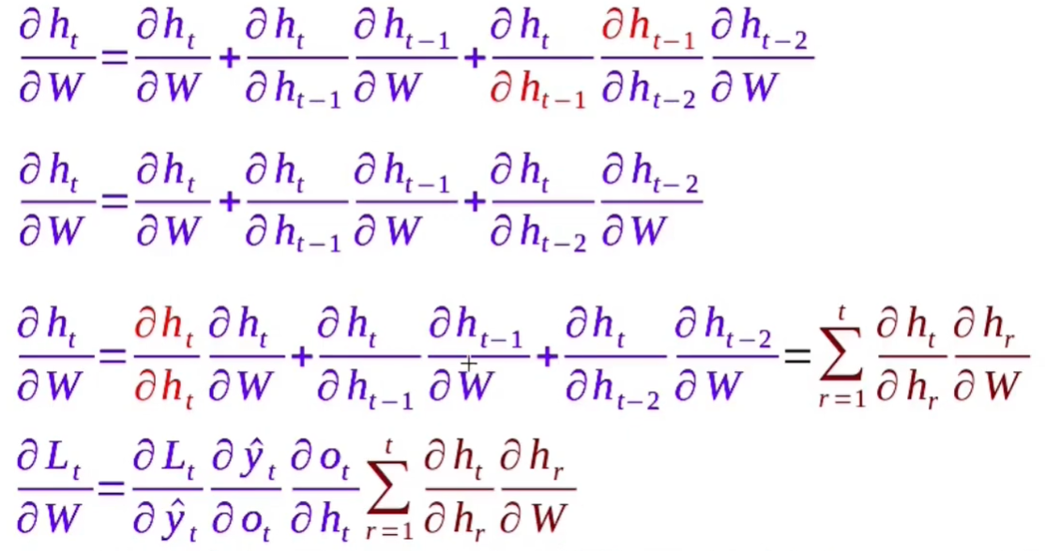
RNN: Computing the Gradient in a Recurrent Neural Network Backpropagation through time algorithm

Slide 39
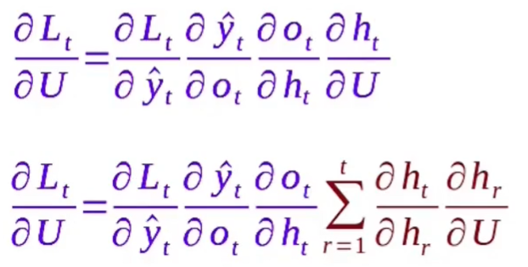
RNN: Computing the Gradient in a Recurrent Neural Network Backpropagation through time algorithm

Slide 40
Question
Design the gradient term for the weight parameters in the Recurrent Neural Network using the Back Propagation through time (BPTT) algorithm
With respect backpropagation through time, derive the gradients of the weight matrix U (input -to -hidden),V (hidden- to- output), W (hidden-to-hidden) of the computational graph.

Slide 41
The Vanishing Gradient Problem in RNNs
RNNs struggle with long-term dependencies because they process data sequentially. When training over long sequences, backpropagation through time (BPTT) calculates gradients by chaining derivatives over many time steps.
The Cause: As gradients are backpropagated through time, they are multiplied by the activation function derivative and the weights at each step. If these values are small (typically less than 1, such as with sigmoid or tanh functions), the gradient shrinks exponentially, leading to vanishing.
The Effect: Early layers of the network learn very slowly or not at all, resulting in poor performance on long-term dependencies (i.e., the RNN has a "short memory")

Slide 42
The Vanishing Gradient Problem in RNNs
Solutions to Vanishing Gradient
Long Short-Term Memory (LSTMs) & GRUs: These architectures are designed specifically to handle vanishing gradients by using gate mechanisms (input, forget, output gates) that allow gradients to flow without shrinking over long sequences.
Activation Functions: Switching from tanh or sigmoid to ReLU (Rectified Linear Unit) helps, as its derivative is 1 for all positive inputs, preventing the gradient from decaying as much.
Weight Initialization: Using techniques like He or Xavier initialization ensures weights are not too large or small at the start, preventing the gradient from vanishing early on.
Gradient Clipping: Limits the maximum value of gradients, which is particularly effective for dealing with exploding gradients (the opposite problem), but is generally used to maintain stability in RNN training.
Truncated BPTT: A strategy that breaks the sequence into shorter chunks, limiting how far back the gradients are propagated, thus reducing the opportunity for them to vanish.

Slide 43
Question
Discuss the vanishing gradient in RNN and how they can be solved.

Slide 44
RNN: Recurrent Networks as Directed Graphical Models
Conditional Probability in Sequence Modeling: In sequence modeling, the goal is to predict the next element of a sequence based on previous observations.
The conditional probability of the next element is written as
log⁡ p(y(t) ∣ x(1),...,x(t))
If the model includes dependencies on previous outputs, it becomes
log⁡ p(y(t) ∣ x(1),...,x(t),y(1),...,y(t−1))
This means the prediction of the current element depends on all past inputs and outputs.

Slide 45
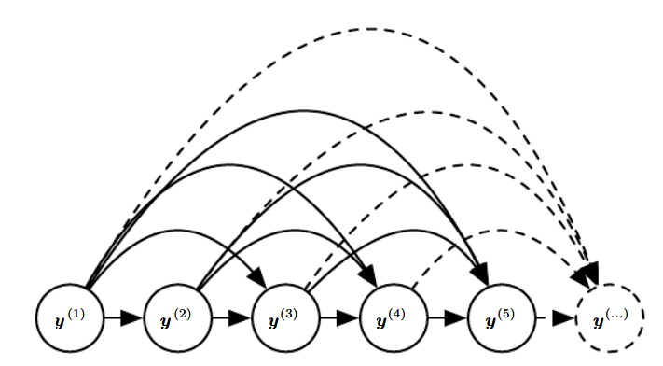
RNN: Recurrent Networks as Directed Graphical Models
Consider a sequence y(1),y(2),y(3),...,y(t) In the fully connected graphical model, every past observation can influence the future. This represents
P(y(t) ∣ y(1), y(2),...,y(t−1))
Thus every previous observation may influence the current prediction.
Limitation, This model becomes inefficient because:
The number of input connections grows with sequence length.
The number of parameters increases rapidly.
Computation becomes expensive for long sequences.
Fully connected graphical model for a sequence y(1), y (2), . . . , y(t) , . . .

Slide 46
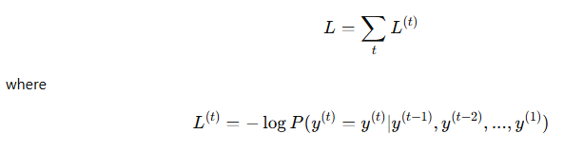
RNN: Recurrent Networks as Directed Graphical Models
The RNN is trained by maximizing the log-likelihood of the sequence.
The total loss is
Interpretation:
At each time step, the model predicts the next element.
The loss measures how well the predicted probability matches the true value.

Slide 47
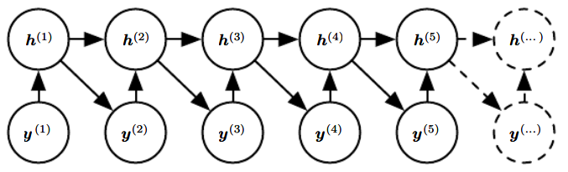
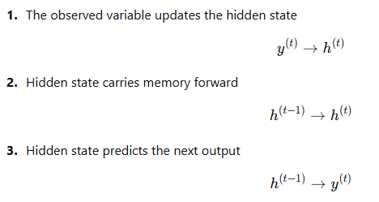
RNN: Recurrent Networks as Directed Graphical Models
To avoid the inefficiency of fully connected dependencies, RNN introduces a hidden state h(t).
The hidden state acts as a compact summary of all previous observations.
Dependencies at each time step
h(t) stores information about the past. Instead of connecting to all previous outputs, the model only uses the hidden state. This allows parameter sharing across time steps.
Introducing the state variable in the graphical model of the RNN
RNNs can be interpreted as Directed Graphical
Models where the hidden state summarizes past
information and enables efficient sequence prediction
while sharing parameters across time steps.

Slide 48
Question
With equations and neat diagrams, explain how Recurrent Neural Networks (RNNs) can be interpreted as Directed Graphical Models for sequence modeling.

Slide 49
RNN: Modeling Sequences Conditioned on Context with RNNs
Any model representing a variable P(y; θ) can be reinterpreted as a model representing a conditional distribution P(y|ω) with ω = θ.
We can extend such a model to represent a distribution P (y | x) by using the same P(y | ω) as before, but making ω a function of x.
In the case of an RNN, this can be achieved in different ways.

Slide 50
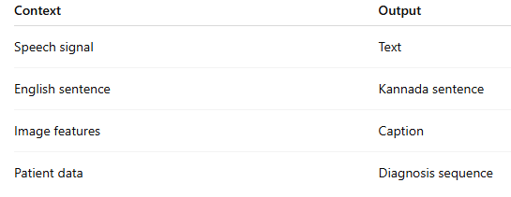

RNN: Modeling Sequences Conditioned on Context with RNNs
We want to model: P(y(1),y(2),...,y(T) | context)
Meaning: Generate or predict an output sequence y using some given context
Context can be: (A) Sequence context vector x(1),x(2),...,x(T) (B) Fixed context vector x
Examples
Basic RNN Model
(Without Output Dependency)
Assumption: Outputs are independent given inputs
Limitation: Does not capture relationships between outputs
Example (Wrong Behavior): Input: I like AI
Output: मुझे खेलना पसंद ❌

Slide 51

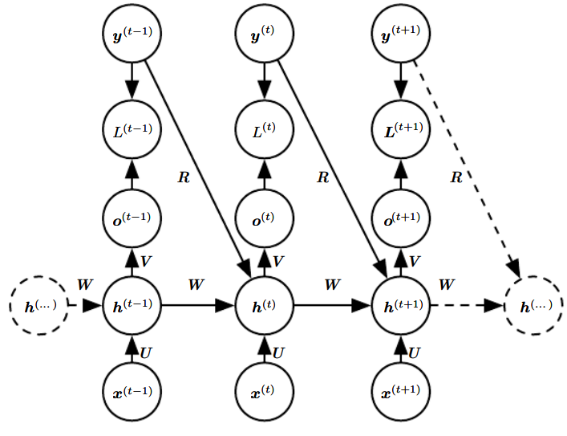
RNN: Modeling Sequences Conditioned on Context with RNNs
Case 1: Sequence Context
Improved Model: Add Output Feedback
We modify hidden state: h(t)=f(h(t−1), x(t), y(t−1))
New Probability Model
Now output depends on: past inputs and past outputs
Example: Language translation
Input: I like AI
Output: मुझे एआई पसंद
A conditional recurrent neural network mapping a variable-length sequence
of x values into a distribution over sequences of y values of the same length.

Slide 52
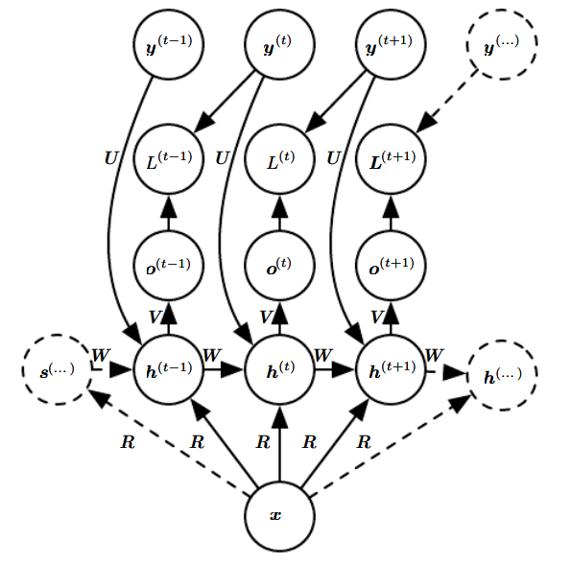
RNN: Modeling Sequences Conditioned on Context with RNNs
Case 2: Fixed Context Vector
Example: Image caption generation
The interaction between the input x and each hidden unit
vector h(t) is parametrized by a newly introduced
weight matrix R that was absent from
the model of only the sequence of y values.
This RNN is appropriate for tasks such as image captioning,
where a single image is used as input to a model that then
produces a sequence of words describing the image.
Each element y(t) of the observed output sequence serves
both as input (for the current time step) and, during training,
as target (for the previous time step).
Two people reading a book
An RNN that maps a fixed-length vector x
into a distribution over sequences Y

Slide 53
Encoder-Decoder (Sequence-to-Sequence) Architectures
We discuss how an RNN can be trained to map an input sequence to an output sequence which is not necessarily of the same length.
This comes up in many applications, such as speech recognition, machine translation or question answering,
where the input and output sequences in the training set are generally not of the same length (although their lengths might be related).
Notes:
The innovation of this kind of architecture over those presented in earlier sections of this chapter is that the lengths nx and ny can vary from each other, while previous architectures constrained nx = ny = τ.

Slide 54
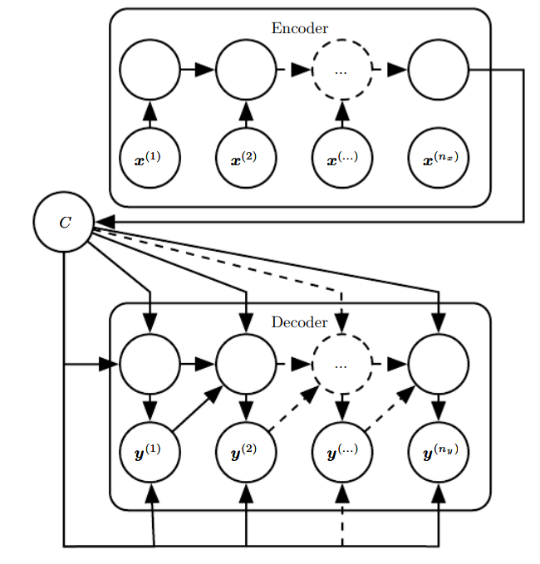

Encoder-Decoder (Sequence-to-Sequence) Architectures
We want to learn:
Convert an input sequence into an output sequence,
where lengths can differ.
Encoder–Decoder (Sequence-to-Sequence) Architecture
The architecture has two RNNs:
1. Encoder
Reads input sequence x(1),...,x(n_{x})
Compresses it into a context vector C
2. Decoder
Takes C as input
Generates output sequence y(1),...,y(n_{y})
An encoder-decoder or sequence-to-sequence RNN architecture
Think of:
Encoder = Reader
Decoder = Writer
C = Understanding of the sentence

Slide 55
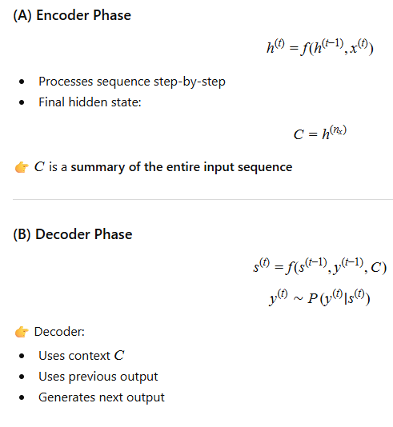
Encoder-Decoder (Sequence-to-Sequence) Architectures
How it works (Step-by-Step)

Slide 56
Encoder-Decoder (Sequence-to-Sequence) Architectures
The encoder–decoder architecture, also known as sequence-to-sequence learning, is used to map an input sequence to an output sequence of possibly different length.
It consists of two RNNs: an encoder that processes the input sequence and produces a fixed-length context vector, and a decoder that generates the output sequence conditioned on this context. The decoder predicts each output element using the context and previous outputs.
This architecture is widely used in applications such as machine translation and speech recognition.
One clear limitation of this architecture (Encoder-Decoder or Sequence-to-Sequence) is when the context C output by the encoder RNN has a dimension that is too small to properly summarize a long sequence.
To make C a variable-length sequence rather than a fixed-size vector. An attention mechanism that learns to associate elements of the sequence C to elements of the output can be introduced.
Attention Mechanism: Allows decoder to look at all encoder states.

Slide 57
Question
Design an encoder- decoder sequence architecture that can map the input sequence to an output sequence that are of different lengths. Also describe the process of the mapping using the architecture.
How the Sequence to Sequence Model works?

Slide 58
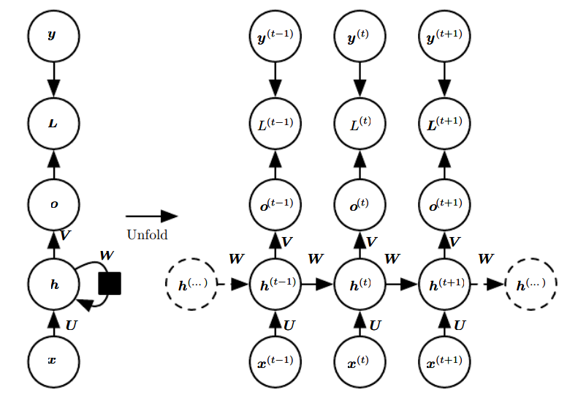
Deep Recurrent Networks
The computation in most RNNs can be decomposed into three blocks of parameters and associated transformations:
1. From the input to the hidden state,
2. From the previous hidden state to the next hidden state, and
3. From the hidden state to the output. With the RNN architecture of figure 10.3, each of these three blocks is associated with a single weight matrix (U, V, W). In other words, when the network is unfolded, each of these corresponds to a shallow transformation.
Why It is Called “Shallow”
Even though RNN looks deep across time:
h(1) → h(2) → h(3) → h(4)
At each time step: Input → Hidden → Output
(only one layer)
So:
Deep in time dimension
Not deep in representation

Slide 59
Deep Recurrent Networks
When the basic RNN is unfolded in time, these transformations are repeated but remain simple. This motivates deep recurrent networks, where multiple layers are introduced to increase model capacity.
A Deep Recurrent Network introduces multiple layers or deeper transformations either:
within each time step, or
across time, or
across state representations

Slide 60
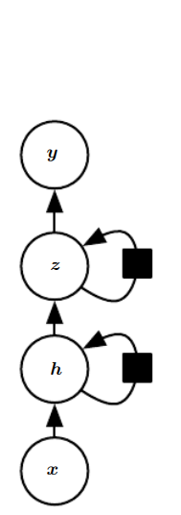
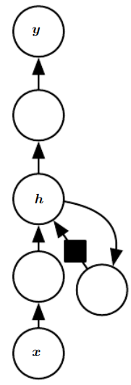
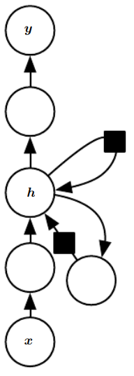
Deep Recurrent Networks
Different Types of Deep Recurrent Networks
1. Deep Hidden State (Hierarchical State): The hidden recurrent state can be broken down into groups organized hierarchically
2. Deep Transition Functions (MLP inside RNN): Deeper computation (e.g., an MLP) can be introduced in the input-to-hidden, hidden-to-hidden and hidden-to-output parts. This may lengthen the shortest path linking different time steps.
3. Skip Connections (Residual Connections): The path-lengthening effect can be mitigated by introducing skip connections.
1. Deep Hidden State
(Hierarchical State)
2. Deep Transition Functions
(MLP inside RNN)
3. Skip Connections
(Residual Connections):

Slide 61
Question
Discuss how the computation in most recurrent neural networks can be decomposed. Analyze how the blocks of parameters are treated as shallow transformations. How a deeper RNN can be implemented?

Slide 62
Deep Recurrent Networks
Deep recurrent networks extend standard RNNs by introducing depth in different ways, such as stacking multiple hidden layers, using deep nonlinear transformations within each time step, and adding skip connections to improve gradient flow. These approaches increase the representational capacity of the network, allowing it to learn complex temporal dependencies. However, deeper architectures also introduce challenges such as vanishing gradients, which can be mitigated using techniques like residual connections and gated units.

Slide 63
Recursive Neural Networks
Recursive Neural Networks are neural architectures designed to process hierarchical data structures using a tree-based computational graph.
Unlike recurrent networks that process sequences, recursive networks combine inputs recursively using shared weight matrices.
Each internal node computes a representation from its children, and the final root node represents the entire structure. This representation is used for prediction in supervised tasks.
Recursive networks are widely used in natural language processing tasks such as parsing and sentiment analysis.

Slide 64
Recursive Neural Networks (RecNN)
How Recursive Neural Networks Process Hierarchical Data?
Hierarchical data is structured in the form of layers, resembling a tree or graph. Each "parent" node has "child" nodes and the relationships between them define the meaning of the data.
Here are some of the examples of hierarchical data.
Syntax Trees in NLP: Sentences are divided into phrases, which are further broken into words.
Program Abstract Syntax Trees (ASTs): Code can be represented in the form of nested structures.
Scene Graphs in Vision: Objects in an image relate to one another hierarchically (e.g., "A bottle is on a table").
A recursive neural network processes hierarchical data in the following ways.
Tree Structure Input: Data is represented as a tree where each node represents a piece of information. (e.g., parse tree for a sentence)
Recursive Computation: Starting from the leaf nodes (base elements), RecNNs recursively join the information of child nodes to compute the representation for their parent nodes. This process repeats until reaching the root node.
Top-Level Output: The final output at the root node represents the complete structure.
Ref.: https://www.upgrad.com/blog/introduction-to-recursive-neural-network/

Slide 65
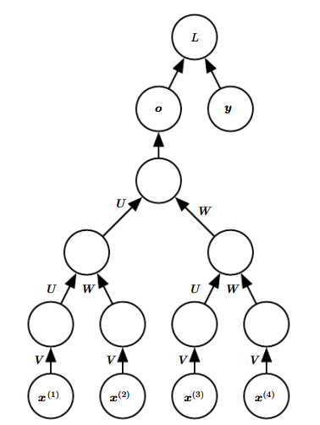
Recursive Neural Networks
A Recursive Neural Network is a neural architecture where the computational structure is a tree, not a sequence.
A recursive network has a computational graph that
generalizes that of the recurrent network from a chain
to a tree. A variable-size sequence x(1),x(2), . . . , x(t)
can be mapped to a fixed-size representation
(the output o), with a fixed set of parameters
(the weight matrices U, V , W ).
The figure illustrates a supervised learning case
in which some target y is provided which is
associated with the whole sequence.
Recursive neural network Computational graph

Slide 66

Difference between recurrent neural networks (RNN) and recursive neural networks (RecNN).
Ref.: https://www.upgrad.com/blog/introduction-to-recursive-neural-network/

Slide 67
Questions
Examine the techniques for unfolding a computational graph of a Recursive Network. List its advantages over Recurrent Nets. Also write the variants of Recursive Net idea.
Differentiate between recurrent neural networks and recursive neural networks.
Explain the need for recursive models in NLP.

Slide 68
Draw and explain the architecture of Recurrent Neural Network Architecture.
What is Gradient Clipping? Why is it essential in training RNNs?
Design a recurrent neural network that can map the input sequence to an output sequence that are of different lengths. Describe the process of the mapping using the architecture and mention the limitations of using the architecture.
Design the recurrent neural networks with different patterns that map an input sequence of x values to a corresponding sequence of output o values and the measure of loss L to calculate the difference of o from training target y and explain the same.
Any model representing a variable P (y; θ) can be reinterpreted as a model representing a conditional distribution P (y|ω) with ω = θ. We can extend such a model to represent a distribution P(y | x) by using the same P(y | ω) as before, Design the different types of RNNs that generates the y sequence by considering extra input.

Slide 69
Design an encoder- decoder sequence architecture that can map the input sequence to an output sequence that are of different lengths. Also describe the process of the mapping using the
architecture.
Explain the contribution of the process of unfolding the recurrence in the computational graph.
Design the recurrent neural networks with different patterns that map an input sequence of x values to a corresponding sequence of output o values and the measure of loss L to calculate the difference of o from training target y and explain the same
Illustrate the method of training an RNN to estimate the conditional distribution of the next sequence element y(t) to maximize the log- likelihood with an example.
Analyse the influence of teacher forcing in the training dynamics of recurrent networks, and what are the trade-offs between faster convergence during training and potential exposure bias during inference.

Slide 70
Thanks for Listening

