Slide 1
Neural Network and Deep Learning 23CS8PENDL/23CS7PENDL

Slide 2
Unit-3
Deep Learning: Introduction, Parameter Norm Penalties - L2 Parameter Regularization, Dataset Augmentation, Semi-Supervised Learning, Multi-Task Learning, Early Stopping, Parameter Tying and Parameter Sharing, Sparse Representations, Dropout

Slide 3
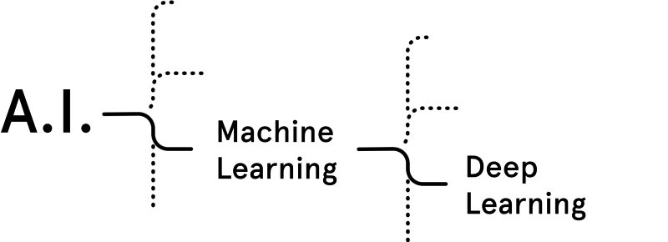
What is Deep Learning ?
(Artificial
Intelligence)
Deep Learning is a category of
machine learning models (=algorithms)
that use multi-layer neural networks.

Slide 4
Difference between
Traditional Machine Learning (ML)
And
Deep Learning (DL)

Slide 5
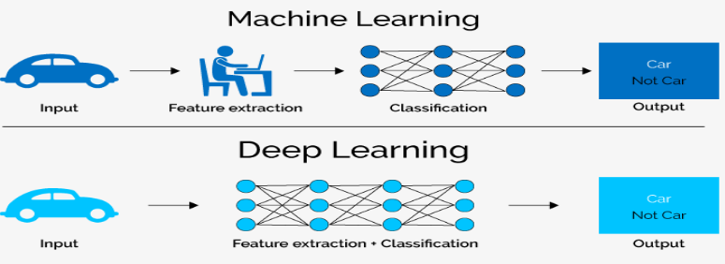
Difference between Traditional ML and DL
Traditional Machine Learning | Deep Learning
We need to hand-craft the features | Feature engineering is done automatically

Slide 6
Unit-3
Deep Learning: Introduction, Parameter Norm Penalties - L2 Parameter Regularization, Dataset Augmentation, Semi-Supervised Learning, Multi-Task Learning, Early Stopping, Parameter Tying and Parameter Sharing, Sparse Representations, Dropout

Slide 7
Background: For Regularization
Bias, Variance, Overfitting, Underfitting

Slide 8
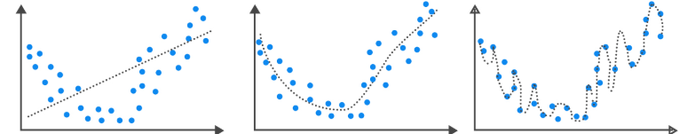
Bias, Variance, Overfitting, Underfitting
Bias: Inability of machine Learning (ML) model to truly capture the relationship of the training data.
Ref.: https://analystprep.com/study-notes/cfa-level-2/quantitative-method/overfitting-methods-addressing/

Slide 9
Bias, Variance, Overfitting, Underfitting
High Bias
Low Bias
Bias: Inability of machine Learning (ML) model to truly capture the relationship of the training data.
Variance: Variance of ML model is high when the difference between Training error and Test error is High.
Ref.: https://analystprep.com/study-notes/cfa-level-2/quantitative-method/overfitting-methods-addressing/

Slide 10
Bias, Variance, Overfitting, Underfitting
High Bias
Low variance
Low Bias
High Variance
Bias: Inability of machine Learning (ML) model to truly capture the relationship of the training data.
Variance: Variance of ML model is high when the difference between Training error and Test error is High.
Overfitting: ML model of training data is performing well but on test data it is not doing well.
Underfitting: ML model is not capturing the relationship in the training data.
Ref.: https://analystprep.com/study-notes/cfa-level-2/quantitative-method/overfitting-methods-addressing/

Slide 11
Bias, Variance, Overfitting, Underfitting
High Bias
Low variance
Low Bias
Low variance
Low Bias
High Variance
Underfitting
Overfitting
Bias: Inability of machine Learning (ML) model to truly capture the relationship of the training data.
Variance: Variance of ML model is high when the difference between Training error and Test error is High.
Overfitting: ML model of training data is performing well but on test data it is not doing well.
Underfitting: ML model is not capturing the relationship in the training data.
Ref.: https://analystprep.com/study-notes/cfa-level-2/quantitative-method/overfitting-methods-addressing/

Slide 12
Bias, Variance, Overfitting, Underfitting
Bias: Inability of machine Learning (ML) model to truly capture the relationship of the training data.
Variance: Variance of ML model is high when the difference between Training error and Test error is High.
Overfitting: ML model of training data is performing well but on test data it is not doing well.
Underfitting: ML model is not capturing the relationship in the training data.

Slide 13
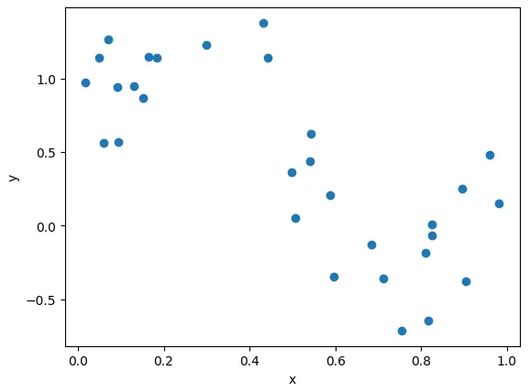
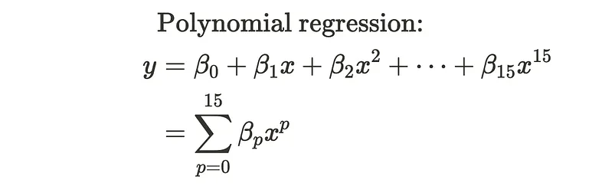
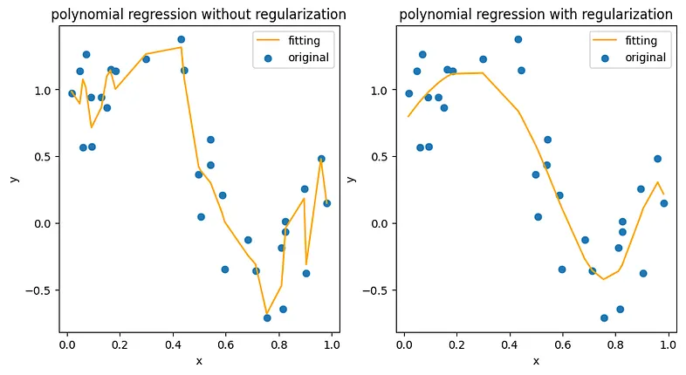
Background: For Regularization
We use regularization
like the to prevent the
model from overfitting.
Ref. https://medium.com/intuition/understanding-l1-and-l2-regularization-with-analytical-and-probabilistic-views-8386285210fc

Slide 14
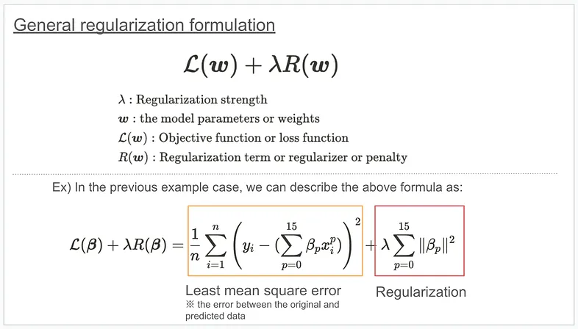
Background: For Regularization
How can we do regularization? Theoretically, we add the regularization term to the objective function and optimize the parameters based on it, as shown below.
Ref. https://medium.com/intuition/understanding-l1-and-l2-regularization-with-analytical-and-probabilistic-views-8386285210fc

Slide 15
Background: For Regularization
Generalization: Ability of the ML model to perform well on unseen data (or test data) is called Generalization.
Generalization or Test error should be less.

Slide 16
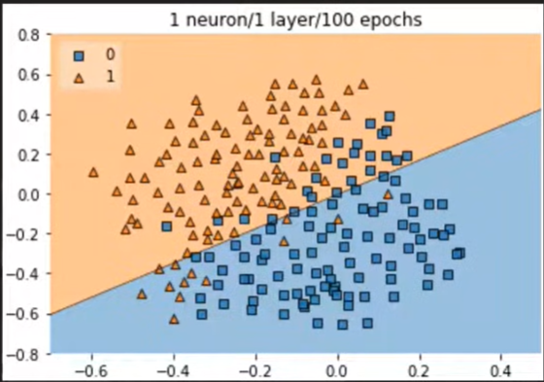
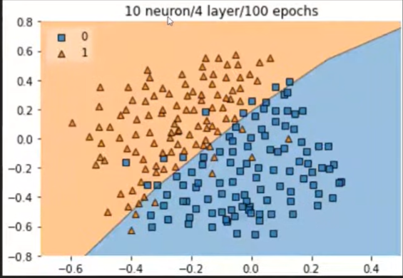
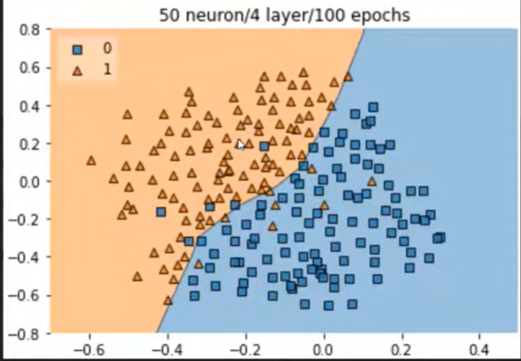
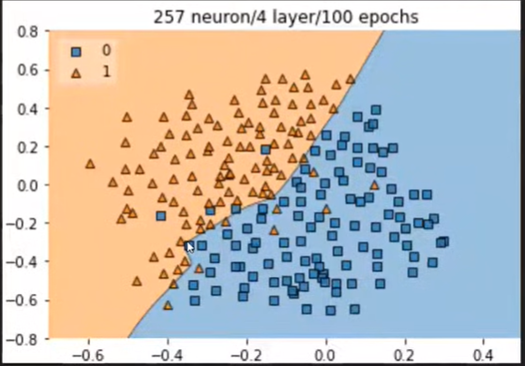
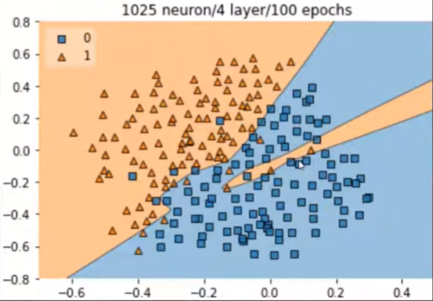
Why Overfitting happens in Neural networks ?
Ref.: https://www.youtube.com/watch?v=4xRonrhtkzc

Slide 17
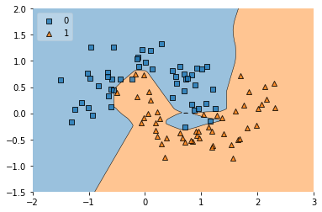
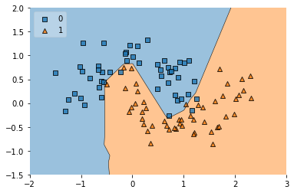
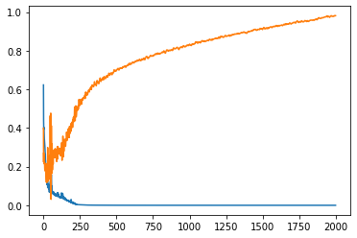
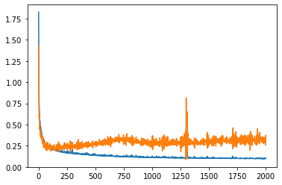
Background: For Regularization
Before Regularization
After Regularization
Training vs. Validation Loss curve
Training vs. Validation Loss curve
Ref.: https://colab.research.google.com/drive/1PObj5KrXLDDmHjoJ1x0bVmxAFbif5s7q?usp=sharing#scrollTo=njwsZuvWVyIT

Slide 18
Loss and complexity
The only goal when training a ML model was to minimize loss;
that is: minimize(loss)
Models focused solely on minimizing loss tend to overfit. A better training optimization algorithm minimizes some combination of loss and complexity: mimimize(loss+complexity)
Unfortunately, loss and complexity are typically inversely related. As complexity increases, loss decreases. As complexity decreases, loss increases. You should find a reasonable middle ground where the model makes good predictions on both the training data and real-world data. That is, your model should find a reasonable compromise between loss and complexity.
Ref. https://developers.google.com/machine-learning/crash-course/overfitting/model-complexity

Slide 19
Methods to avoid Overfitting
1. Adding More data: Data Augmentation
2. Reducing Complexity of the Model
2.1 Drop out
2.2 Early Stopping
2.3 Regularization
2.3.1. L1 Regularization
2.3.2. L2 Regularization
2.3.3. L1+L2 Regularization
2.4 Parameter tying and Parameter sharing

Slide 20
Question
Can over fitting happen in a neural network? If yes how to deal with over fitting in a neural network.

Slide 21
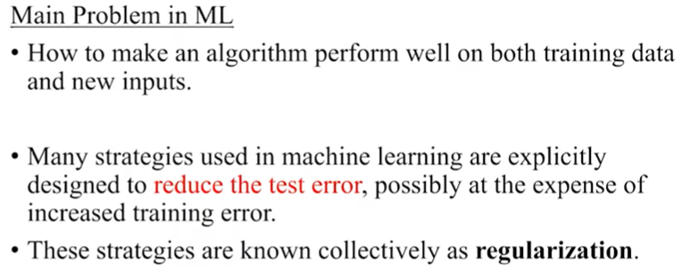
Regularization
Regularization is a collection of strategies that can assist prevent overfitting in neural networks and improve their accuracy by modifying the learning procedure slightly such that the model generalizes more successfully. The model then performs better on the unobserved data as a result.
Notes:
When modeling the data, a low bias and high variance scenario is referred to as overfitting. To handle this, regularization techniques trade more bias for less variance. Effective regularization is one that strikes the optimal balance between bias and variation, with the final result being a notable decrease in variance at the least possible cost to bias. This would imply low variation without significantly raising the bias value, to put it another way.
‍
Additionally, Regularization orders possible models from weakest overfit to biggest and adds penalties to more complicated models. Regularization makes the assumption that the least weights could result in simpler models and help prevent overfitting.
‍

Slide 22
Parameter Norm Penalties
Regularization is a set of techniques used in machine learning to prevent overfitting by adding a penalty term to the model's loss function, which discourages excessive model complexity. By penalizing large weight coefficients, regularization forces the model to learn smoother, more generalizable patterns rather than memorizing noise in the training data
Notes:
where
(lambda or alpha) controls the strength of the regularization.

Slide 23
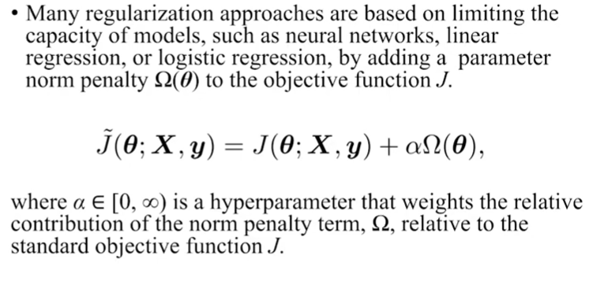
Parameter Norm Penalties

Slide 24
Primary Types of Regularization Penalty Terms
1. L2 Regularization (Ridge Regression)
2. L1 Regularization (Lasso Regression)

Slide 25

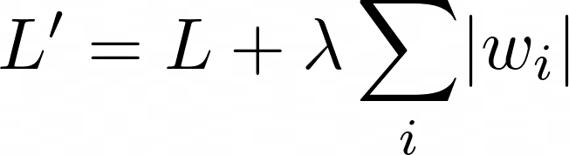
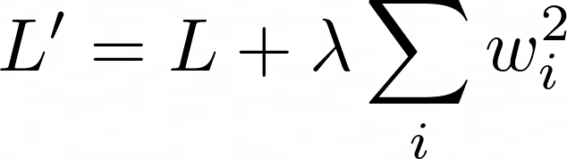
Parameter Norm Penalty
L2 Regularization
added to Loss
L1 Regularization
added to Loss
Norm penalty Ω penalizes only weights at each layer and leaves biases unregularized
W indicates all weights affected by norm penalty
θ denotes both w and biases.
Notes:
https://medium.com/the-ml-intuition/l1-vs-l2-regularization-vs-weight-decay-key-differences-every-ml-engineer-must-know-5f13625301cf

Slide 26
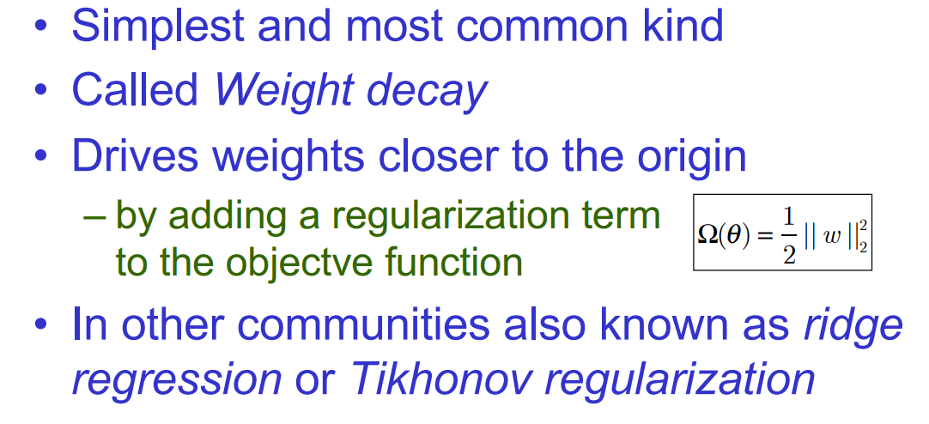
L2 Parameter Regularization

Slide 27

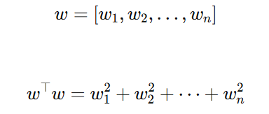

L2 Parameter Regularization
We can gain some insight into the behavior of weight decay regularization by studying the gradient of the regularized objective function. To simplify the presentation, we assume no bias parameter, so θ is just w. Such a model has the following total objective function:
L2 regularization always uses
squared weights

Slide 28
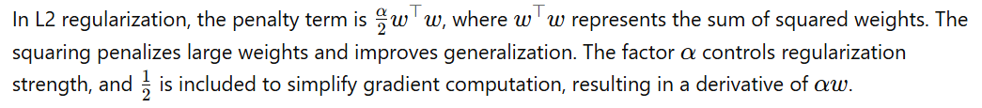
L2 Parameter Regularization

Slide 29



L2 Parameter Regularization
With the corresponding parameter gradient
To take a single gradient step to update the weights, we perform this update:
Written another way, the update is:

Slide 30

L2 Parameter Regularization
With the corresponding parameter gradient
To take a single gradient step to update the weights, we perform this update:
Written another way, the update is:
Notes:
We can see that the addition of the weight decay term has modified the learning rule to multiplicatively shrink the weight vector by a constant factor on each step, just before performing the usual gradient update. This describes what happens in a single step

Slide 31
L2 Parameter Regularization
With the corresponding parameter gradient
To take a single gradient step to update the weights, we perform this update:
Written another way, the update is:
We can see that the addition of the weight decay term has modified the learning rule to
multiplicatively shrink the weight vector by a constant factor on each step,
just before performing the usual gradient update. This describes what happens in a single step.

Slide 32


L2 Parameter Regularization
How weights are
updated ?
Next: How loss behaves near optimum
The best weight that
minimizes the original
(unregularized) loss
How does L2 regularization
change the final optimal weights

Slide 33
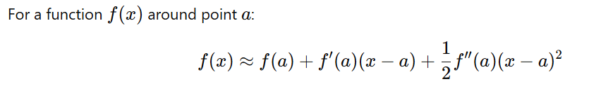
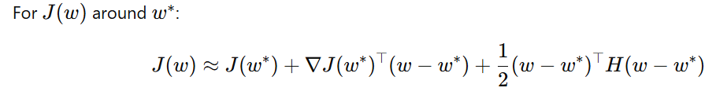
Background
1D Taylor Expansion
(w−w∗) means: How far current weights $w$ are from optimal weights $w^{∗}$
Notes:
w∗ → center (minimum point)
$\left(w−w^{∗}\right)$→ displacement vector
$w^{∗}$= center of a bowl
$w$= your current position

Slide 34
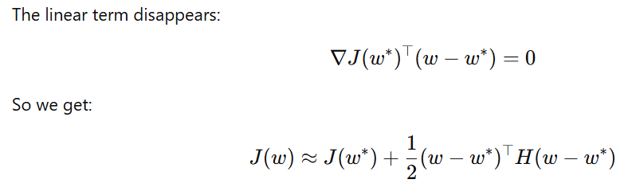
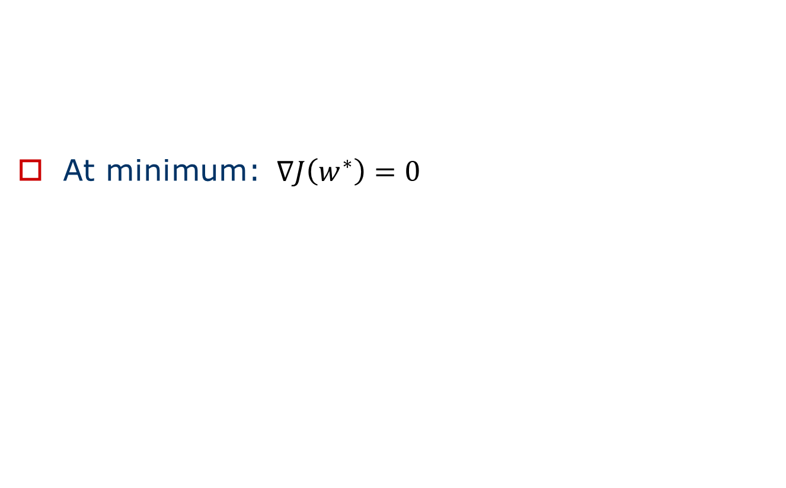
Background
At minimum: $∇J\left(w^{∗}\right)=0$
Notes:
At minimum: $∇J\left(w^{∗}\right)=0$

Slide 35

Background
At minimum: $∇J\left(w^{∗}\right)=0$
Notes:
At minimum: $∇J\left(w^{∗}\right)=0$

Slide 36


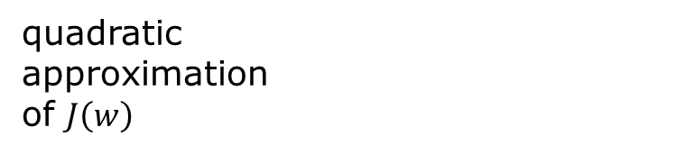
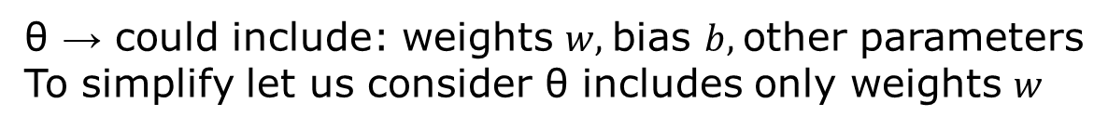
L2 Parameter Regularization (Contd…)
What the loss looks like near the minimum.
quadratic
approximation
of $J\left(w\right)$
θ → could include: weights $w,$bias $b,$other parameters
To simplify let us consider θ includes only weights $w$
Hessian matrix:
Contains second derivatives
Measures curvature
The best weight that
minimizes the original
(unregularized) loss

Slide 37



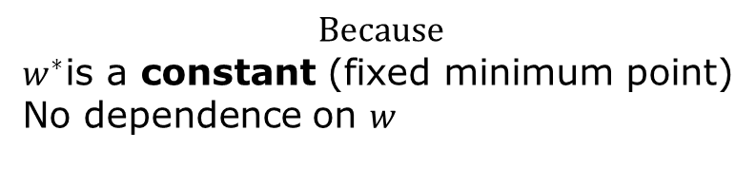
L2 Parameter Regularization (Contd…)
We compute
$$Because$$
$w^{∗}$is a constant (fixed minimum point)
No dependence on $w$

Slide 38
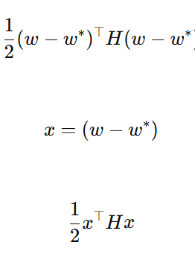
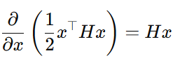


L2 Parameter Regularization (Contd…)
We compute

Slide 39

L2 Parameter Regularization (Contd…)
We compute
Therefore, finally

Slide 40


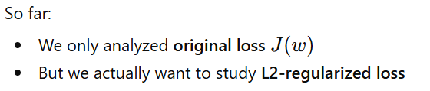
L2 Parameter Regularization (Contd…)
This is the gradient of the unregularized (approximated) loss.
At minimum:

Slide 41




L2 Parameter Regularization (Contd…)
Therefore
At Minimum:
So,

Slide 42

L2 Parameter Regularization (Contd…)
Therefore
At Minimum:
So,

Slide 43
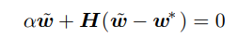




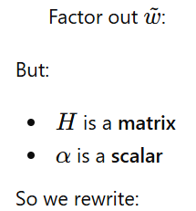



L2 Parameter Regularization (Contd…)
We want to combine

Slide 44


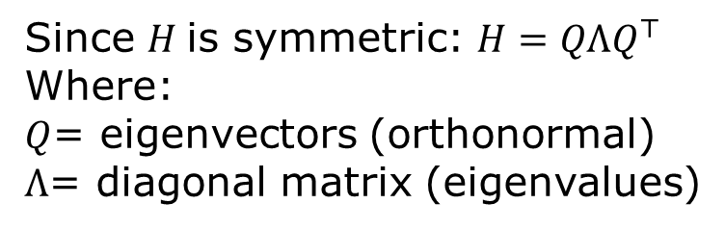
L2 Parameter Regularization (Contd…)
Since $H$is symmetric: $H=QΛQ^{⊤}$
Where:
$Q$= eigenvectors (orthonormal)
$Λ$= diagonal matrix (eigenvalues)
Why do we do eigen decomposition?
To understand how L2 regularization
affects each direction.

Slide 45

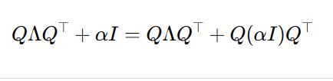




L2 Parameter Regularization (Contd…)
Because
Factor out $Q$and $Q^{⊤}$

Slide 46






L2 Parameter Regularization (Contd…)
Because $Q$is orthonormal

Slide 47





L2 Parameter Regularization (Contd…)
Since $Q$is orthonormal:
Remove identity matrix
Q⊤Q=I means:
Transform → inverse transform cancels out
Like:
rotate → rotate back = no change
QᵀQ = I → “they cancel each other”

Slide 48
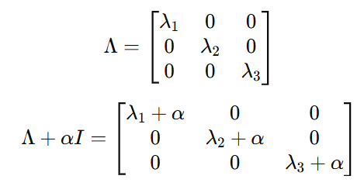
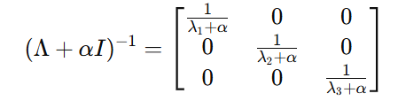
L2 Parameter Regularization (Contd…)
Understand the matrices
Take inverse

Slide 49

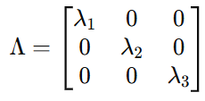
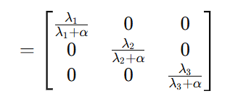
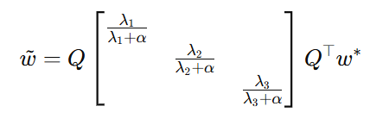

L2 Parameter Regularization (Contd…)
Now compute:
Each component is scaled by:

Slide 50
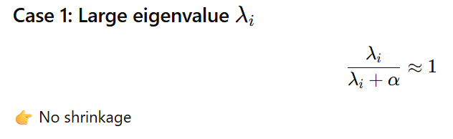
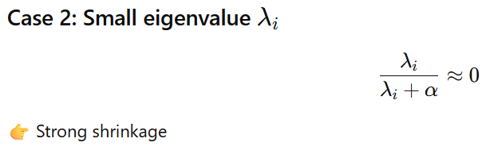
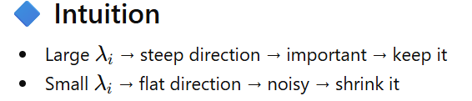
L2 Parameter Regularization (Contd…)
Each component is scaled by:
L2 regularization suppresses directions where the model is uncertain (flat regions) and
preserves directions where the data strongly supports the solution.

Slide 51
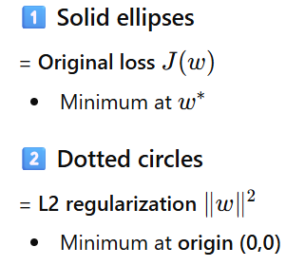
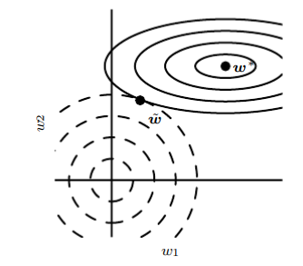


L2 Parameter Regularization (Contd…)
An illustration of the effect ofL2 (or weight decay) regularization on the value of the optimal w.
We are minimizing:
So:
One force → pulls toward $w^{∗}$
Another force → pulls toward origin
Final solution:$\tilde{w}$
= compromise point

Slide 52
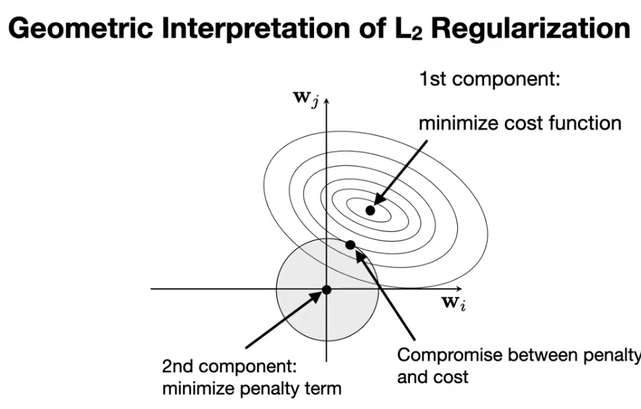
L2 Parameter Regularization

Slide 53


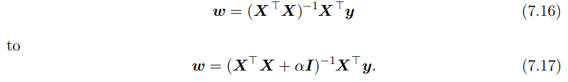

L2 Regularization: For Linear Regression
For linear regression, the cost function is the sum of squared errors:
When we add L2 regularization, the objective function changes to
This changes the normal equations for the solution from

Slide 54


Background: For L1 Regularization

Slide 55


L1 Regularization
Formally, L1 regularization on the model parameter w is defined as:
that is, as the sum of absolute values of the individual parameters.
L1 weight decay controls the strength of the regularization by scaling the penalty Ω using a positive hyperparameter α.
Thus, the regularized objective function ˜ J(w; X, y) is given by
with the corresponding gradient
where sign(w) is simply the sign of w applied element-wise.

Slide 56

Simple Numerical Example

Slide 57
Difference between L1 and L2 Regularization
L1 Regularization added to Loss
L2 Regularization added to Loss
Notes:
https://medium.com/the-ml-intuition/l1-vs-l2-regularization-vs-weight-decay-key-differences-every-ml-engineer-must-know-5f13625301cf

Slide 58

Difference between L1 and l2 Regularization
L2 regularization shrinks weights continuously,
while L1 regularization pushes small weights exactly to zero, producing sparse models.
Notes:
In $∥w∥_{2}^{2}$, the subscript 2 denotes the L2 norm, and the exponent 2 means squaring it, resulting in the sum of squared weights.

Slide 59

Difference between L1 and l2 Regularization
Notes:
https://medium.com/analytics-vidhya/regularization-understanding-l1-and-l2-regularization-for-deep-learning-a7b9e4a409bf

Slide 60
Questions on the topics: Introduction, Parameter Norm Penalties - L2 Parameter Regularization
Analyse the importance of regularization techniques that encourage sparsity and discuss the impact of the strategy on model parameters.
Which regularization method leads to weight sparsity? Explain why
Explain how parameter norm penalties act as a regularization technique. Derive the mathematical expression for L2 parameter regularization and its incorporation into the loss function.
How does the weight decay regularization technique, as described in L2 regularization, modify the gradient descent update rule, and what is the effect of this modification on the weight vector over the course of training?
How does penalizing the activations of units in a neural network lead to sparsity, and how is this different from the sparsity caused by L1 regularization on model parameters?

Slide 61
Data Augmentation
The simplest way to eliminate overfitting is data augmentation. Data augmentation is the process of reproducing new training instances from existing ones.
Dataset augmentation has been a particularly effective technique for a specific classification problem: object recognition. Dataset augmentation is effective for speech recognition tasks as well.
Image augmentation is a type of data augmentation technique in which we apply certain transformations to our images to produce multiple copies of the original image that are totally different in terms of size and colors from the original image.
Position and Color are the two most common transformation techniques that are used to reproduce data. Position augmentation changes the pixel position of an image. Some famous techniques to do so are — scaling, cropping, flipping, padding, rotation, and translation at different positional values.
Color Augmentation deals with altering the color properties of an image by changing its pixel values. Some of the most common techniques of it are changing brightness, contrast, saturation, hue, grayscale, dilation, etc.
Notes:
https://www.comet.com/site/blog/4-techniques-to-tackle-overfitting-in-deep-neural-networks/

Slide 62

Position Data Augmentation

Slide 63

Color Augmentation

Slide 64
Data Augmentation: Injecting Noise
Injecting noise in the input to a neural network can also be seen as a form of data augmentation.
For many classification and even some regression tasks, the task should still be possible to solve even if small random noise is added to the input.
Neural networks prove not to be very robust to noise, however. One way to improve the robustness of neural networks is simply to train them with random noise applied to their inputs.
Input noise injection is part of some unsupervised learning algorithms such as the denoising autoencoder.
Noise injection also works when the noise is applied to the hidden units, which can be seen as doing dataset augmentation at multiple levels of abstraction.

Slide 65
Data Augmentation: Comparing ML algorithms performance
When comparing machine learning benchmark results, it is important to take the effect of dataset augmentation into account.
Often, hand-designed dataset augmentation schemes can dramatically reduce the generalization error of a machine learning technique.
To compare the performance of one machine learning algorithm to another, it is necessary to perform controlled experiments.
When comparing machine learning algorithm A and machine learning algorithm B, it is necessary to make sure that both algorithms were evaluated using the same hand-designed dataset augmentation schemes.
Suppose that algorithm A performs poorly with no dataset augmentation and algorithm B performs well when combined with numerous synthetic transformations of the input. In such a case it is likely the synthetic transformations caused the improved performance, rather than the use of machine learning algorithm B.

Slide 66
Questions
Explain Data Augmentation Techniques.
Discuss how data augmentation techniques can vary across different applications.
Analyze the impact of applying aggressive data augmentation on the quality of the learned features.
In what ways does dataset augmentation enhance generalization for classification tasks, particularly in object recognition and speech recognition? How does noise injection contribute to the robustness of neural networks, and why is it crucial to account for dataset augmentation when comparing the performance of different machine learning algorithms?

Slide 67
Semi-Supervised Learning (SSL)
Semi-supervised learning is a machine learning paradigm that uses both labeled and unlabeled data during training. In many real-world applications, labeled data is scarce and expensive, while large amounts of unlabeled data are easily available. Example: Medical Image, Remote Sensing Images
Semi-supervised learning utilizes the information present in unlabeled data to improve the learning of predictive models.
In this framework:
Labeled data is drawn from the joint distribution P(x,y), where x is the input and y is the corresponding label.
Unlabeled data is drawn from the marginal distribution P(x).
The goal is to learn a function that predicts the label y from input x, i.e., to estimate the conditional probability: P(y∣x)

Slide 68
SSL: Combining Unsupervised and Supervised Components
Semi-supervised learning combines unsupervised learning and supervised learning components.
1. Unsupervised Component
The unsupervised component uses unlabeled data to learn the structure of the input distribution P(x).
This helps the model discover patterns, clusters, and the underlying manifold of the data.
In deep learning, this often involves learning a representation:
h=f(x) where x = input data , f(x) = neural network mapping , h = learned feature representation
The goal is to learn representations such that examples belonging to the same class have similar representations.
2. Supervised Component
The supervised component uses labeled data to learn the mapping from the representation to the output label.
y=g(h) or P(y∣x). This step trains a classifier using the learned representations.
Notes:
h=f(x)

Slide 69
SSL: Combining Unsupervised and Supervised Components (Contd…)
Step 1: Learn representation
h=f(x)
Data used: labeled + unlabeled
Step 2: Train classifier
y=g(h)
Data used: labeled only
Final model:
y = g(f(x))
The trained model predicts the label y for any new input x.

Slide 70


SSL: Shared Parameterization of Generative and Discriminative Models (Contd…)
Instead of training separate models, semi-supervised learning often uses a shared parameterization between:
Generative models that model P(x) or P(x,y)
Discriminative models that model P(y∣x)
Both models share the same neural network parameters.
The training objective combines both components:

Slide 71
SSL: Shared Parameterization of Generative and Discriminative Models (Contd…)
The shared parameterization allows the model to learn useful features from the input distribution P(x) using large amounts of unlabeled data. These learned features capture the underlying structure of the data, such as clusters and manifolds.
Because the generative and discriminative models share parameters:
the features learned from unlabeled data improve the representation h=f(x)
the classifier P(y∣x) can make better predictions even with limited labeled data.
Thus, modeling P(x) provides a useful prior belief about the solution to the supervised learning problem.
As a result, the model achieves better generalization compared to purely supervised or purely generative training.
Semi-supervised learning improves model performance by combining supervised learning from labeled data with unsupervised learning from unlabeled data. By sharing parameters between generative and discriminative models, the system learns meaningful representations of the data, leading to improved classification accuracy and better generalization.

Slide 72
Question
What is semi-supervised learning and how does it combine unsupervised and supervised components to improve representation learning? Additionally, how does the shared parameterization between generative and discriminative models enhance generalization.

Slide 73
Multi task Learning
Multi-Task Learning (MTL) is a type of machine learning technique where a model is trained to perform multiple tasks simultaneously. In deep learning, MTL refers to training a neural network to perform multiple tasks by sharing some of the network's layers and parameters across tasks.
A common example is a computer vision model for autonomous driving, which uses shared convolutional layers to process an image, then splits into separate "heads" to detect pedestrians, identify lane boundaries, and estimate distances concurrently.
In MTL, the goal is to improve the generalization performance of the model by leveraging the information shared across tasks. By sharing some of the network's parameters, the model can learn a more efficient and compact representation of the data, which can be beneficial when the tasks are related or have some commonalities.

Slide 74

Multi task Learning (Contd…)
Figure illustrates a very common form of multi-task learning, in which different supervised tasks (predicting y(i) given x) share the same input x, as well as some intermediate-level representation h(shared) capturing a common pool of factors. The model can generally be divided into two kinds of parts and associated parameters:
Task-specific parameters (which only benefit from the examples of their task to achieve good generalization). These are the upper layers of the neural network in figure.
Generic parameters, shared across all the tasks (which benefit from the pooled data of all the tasks). These are the lower layers of the neural network in figure .
1. Task-specific parameters (associated respectively with the weights into and from h(1)
and h(2)). Top-level hidden units h(1) and h(2) are specialized to each task (respectively
predicting y(1) and y(2))
2. Intermediate-level representation h(shared) is shared across all tasks.
3. In the unsupervised learning context, it makes sense for some of the top-level factors to
be associated with none of the output tasks (h(3)): these are the factors that explain some
of the input variations but are not relevant for predicting y(1) or y(2)
Figure: Multi task learning

Slide 75
Multi task learning (Contd…)
Improved generalization and generalization error bounds can be achieved because of the shared parameters, for which statistical strength can be greatly improved (in proportion with the increased number of examples for the shared parameters, compared to the scenario of single-task models).
Of course this will happen only if some assumptions about the statistical relationship between the different tasks are valid, meaning that there is something shared across some of the tasks.
From the point of view of deep learning, the underlying prior belief is the following: among the factors that explain the variations observed in the data associated with the different tasks, some are shared across two or more tasks.

Slide 76
Questions
Analyse how Multi-task learning improves generalization by pooling the examples arising out of several tasks
Analyze how multitask learning improves the generalization ability of models compared to single-task learning.

Slide 77

Early Stopping
Early stopping is one of the most commonly used strategies because it is very simple and quite effective. It refers to the process of stopping the training when the training error is no longer decreasing but the validation error is starting to rise.
This implies that we store the trainable parameters periodically and track the validation error. After the training stopped, we return the trainable parameters to the exact point where the validation error started to rise, instead of the last ones.
One way to think of early stopping is as a very efficient hyperparameter
selection algorithm. In this view, the number of training steps is just another
hyperparameter. We can see in figure that this hyperparameter has a
U-shaped validation set performance curve. Most hyperparameters that
control model capacity have such a U-shaped validation set performance curve,
as illustrated in figure. In the case of early stopping, we are controlling the
effective capacity of the model by determining how many steps it
can take to fit the training set.
Ref.: https://theaisummer.com/regularization/

Slide 78

Early stopping meta-algorithm
Algorithm 7.1: early stopping meta-algorithm for determining the best amount of time to train
The early stopping meta-algorithm for determining
the best amount of time to train.
This meta-algorithm is a general strategy
that works well with a variety of
training algorithms and ways of quantifying
error on the validation set.
This strategy is known as early stopping.
It is probably the most commonly used
form of regularization in deep learning.
Its popularity is due both to its
effectiveness and its simplicity.

Slide 79
Early Stopping (Contd…)
Early stopping requires a validation set, which means some training data is not fed to the model. To best exploit this extra data, one can perform extra training after the initial training with early stopping has completed. In the second, extra training step, all of the training data is included. There are two basic strategies one can use for this second training procedure.
First strategy: Algorithm 7.2
Second strategy: Algorithm 7.3

Slide 80

Early Stopping (Contd…)
First strategy: Algorithm 7.2
Initialize the model again and retrain on all of the data. In this second training pass, we train for the same number of steps as the early stopping procedure determined was optimal in the first pass. There are some subtleties associated with this procedure. For example, there is not a good way of knowing whether to retrain for the same number of parameter updates or the same number of passes through the dataset. On the second round of training, each pass through the dataset will require more parameter updates because the training set is bigger.

Slide 81

Early Stopping (Contd…)
Second strategy: Algorithm 7.3
Another strategy for using all of the data is to keep the parameters obtained from the first round of training and then continue training but now using all of the data. At this stage, we now no longer have a guide for when to stop in terms of a number of steps. Instead, we can monitor the average loss function on the validation set, and continue training until it falls below the value of the training set objective at which the early stopping procedure halted. This strategy avoids the high cost of retraining the model from scratch, but is not as well-behaved. For example, there is not any guarantee that the objective on the validation set will ever reach the target value, so this strategy is not even guaranteed to terminate.

Slide 82
Questions
Implement the meta-algorithm using early stopping to determine the best amount of time to train, how long to train and retrain the data, and determine a point at which overfitting begins during training and continue its training until the value is reached.
What is the early stopping meta-algorithm, and why is it considered an effective strategy for determining the optimal training duration across various training algorithms and error quantification methods on the validation set?

Slide 83
Parameter Tying and Parameter Sharing
One technique to reduce the number of parameters and improve the generalization of a model is
Parameter sharing
Parameter tying.

Slide 84


Parameter Tying
In some machine learning problems, we know that certain parameters should behave similarly.
Example: Two models performing similar classification tasks.
Let
Model A parameters → w(A)
Model B parameters → w(B)
Outputs:
If the tasks are similar, we expect

Slide 85


Parameter Tying (Contd…)
One way to enforce similarity between parameters is using a regularization penalty.
This forces the parameters to remain close to each other.
Interpretation: The training objective becomes
This method is called parameter tying using regularization.
Where λ controls how strongly the parameters should be tied.

Slide 86

Parameter Tying (Contd…)

Slide 87
Parameter Sharing
Parameter sharing refers to the idea of using the same set of parameters for multiple parts of a model.
For example, in convolutional neural networks (CNNs), the same set of weights is used to convolve over different patches of an image. By doing so, the model can learn features that are translation invariant, meaning they can recognize patterns regardless of their position in the input.

Slide 88
Parameter Sharing (Contd…)
Natural images have many statistical properties that are invariant to translation.
For example, a photo of a cat remains a photo of a cat if it is translated one pixel to the right. CNNs take this property into account by sharing parameters across multiple image locations.
The same feature (a hidden unit with the same weights) is computed over different locations in the input.
This means that we can find a cat with the same cat detector whether the cat appears at column i or column i + 1 in the image.
Same filter is applied across multiple locations in an image, reducing the number of parameters and improving generalization.

Slide 89
Parameter Tying and Sharing
Parameter Tying | Parameter Sharing
Parameters are encouraged to be similar but not necessarily equal | Parameters are forced to be exactly the same.
Achieved through regularization | Achieved through using the same parameter variable
Parameter tying is a soft constraint that encourages model parameters to be similar by adding a penalty such as ∣∣w(A)−w(B) ∣∣^2 to the loss function. | Parameter sharing is a stronger constraint where parameters are forced to be exactly equal and reused across multiple parts of a model. Parameter sharing is widely used in convolutional neural networks to reduce the number of parameters and improve generalization.

Slide 90
Questions
Discuss Parameter Sharing and Typing in Deep Learning.
Show how the parameters between two models performing the same/similar classification task are close to each other. Illustrate how parameter sharing occurs when processing images
Illustrate the imposing of soft constraints on parameters to improve generalization.

Slide 91
Sparse Representations
Sparse representation refers to a method of encoding information where only a few elements in a representation vector are non-zero, while the majority are zero.
This principle is highly useful in deep learning and machine learning as it leads to more efficient computation, and reduced memory usage, and can help in discovering the most important features of data.

Slide 92
Sparse Representations: Direct and Indirect Penalties
Direct Penalty
– Weight decay penalizes parameters directly
– L1 penalization induces sparse parameterization
Indirect Penalty
– Another strategy is to place penalty on the activations of the units in the neural network
• Encouraging their activations to be sparse
• It imposes a complicated penalty on model parameters
– Representational sparsity describes a representation where many of the elements of the representation are close to zero

Slide 93


Sparse Representations: Representational sparsity
Representational sparsity in the context of Linear Regression
Weight matrix A is sparse
Sparsely parametrized linear regression model
h vector is sparse B is not sparse
Linear regression with a sparse representation h of the data x.
That is, h is a function of x that, in some sense, represents
the information present in x, but does so with a sparse vector.

Slide 94

Sparse Representations: Representational Regularization
Representational regularization is accomplished by the same sorts of mechanisms that we have used in parameter regularization.
• Norm penalty regularization of representation: Performed by adding to the loss function J, a norm penalty on the representation.

Slide 95
Background: For Dropout
Bagging (short for bootstrap aggregating) is a technique for reducing generalization error by combining several models.
The idea is to train several different models separately, then have all of the models vote on the output for test examples.
This is an example of a general strategy in machine learning called model averaging.
Techniques employing this strategy are known as ensemble methods.

Slide 96

Dropout
Dropout — a regularization method that prevents overfitting by randomly “dropping” nodes in a neural network during training.
This prevents the network from becoming too dependent on certain nodes and encourages it to learn more generalized features, which helps it perform better on new data.
Drop hidden units from net, i.e.,
temporarily remove it from the network with
all input/output connections. Choice of units
to drop is random, determined by a
probability p
A standard neural
net with two hidden layers
(b) A thinned net produced by
applying dropout, crossed
units have been dropped

Slide 97

Dropout as an ensemble method
Notes:
In bagging we define k different models, construct k different data sets by sampling from the dataset with replacement, and train model i on dataset i
Dropout aims to approximate this process, but with an exponentially large no. of neural networks

Slide 98
Dropout as an ensemble method (Contd…)
Dropout trains an ensemble consisting of all sub-networks that can be constructed by removing non-output units from an underlying base network.
Here, we begin with a base network with two visible units and two hidden units. There are sixteen possible subsets of these four units.
We show all sixteen subnetworks that may be formed by dropping out different subsets of units from the original network.
In this small example, a large proportion of the resulting networks have no input units or no path connecting the input to the output. This problem becomes insignificant for networks with wider layers, where the probability of dropping all possible paths from inputs to outputs becomes smaller.

Slide 99
Dropout:Formal description of dropout
More formally, suppose that a mask vector µ specifies which units to include, and J(θ, µ) defines the cost of the model defined by parameters θ and mask µ.
Then dropout training consists in minimizing E_{µ}J(θ, µ).
The expectation contains exponentially many terms but we can obtain an unbiased estimate of its gradient by sampling values of µ

Slide 100


Dropout:Formal description of dropout

Slide 101

Dropout:Forward Propagation with dropout
An example of forward propagation through a feedforward network using
dropout.
In this example, we use a feedforward network with two input units,
one hidden layer with two hidden units, and one output unit.
To perform forward propagation with dropout, we randomly sample a
vector µ with one entry for each input or hidden unit in the network.
The entries of µ are binary and are sampled independently from each other.
The probability of each entry being 1 is a hyperparameter, usually 0.5
for the hidden layers and 0.8 for the input. Each unit in the network is
multiplied by the corresponding mask, and then forward propagation
continues through the rest of the network as usual. This is equivalent
to randomly selecting one of the sub-networks from figure (Ensemble of
Subnetworks) and running forward propagation through it.

Slide 102
Differences Between Bagging and Dropout in Neural Networks
Bagging (Bootstrap Aggregating) and Dropout are techniques used to improve the generalization performance of machine learning models by reducing overfitting. Although dropout is inspired by bagging, their mechanisms during training and prediction differ significantly.

Slide 103


Slide 104



Slide 105

Differences Between Bagging and Dropout in Neural Networks
Both bagging and dropout improve generalization by reducing overfitting.
However, bagging explicitly trains multiple independent models and averages their predictions,
while dropout implicitly trains an exponential number of subnetworks within a single neural
network through random neuron deactivation and parameter sharing.
This makes dropout a more efficient ensemble technique for deep neural networks.

Slide 106
Dropout
What is dropout in neural networks? Can it be compared with bagging or boosting in regular machine learning scenario?
Define dropout. Analyze the differences between bagging and dropout by examining their effects on training and prediction in neural networks
Illustrate how dropout trains an ensemble consisting of all subnetworks. Examine how dropout can help reduce overfitting in neural networks and explore its computational advantages.
Analyze the role of dropout in neural networks in mitigate overfitting. What are the computational trade-offs and the overall impact of dropout on model generalization
Explain how dropout create an ensemble of sub-networks from a base network, and why does the problem of sub-networks lacking input units or paths from input to output become less significant in networks with wider layers? Provide a suitable diagram to illustrate this concept.

Slide 107
Thanks for Listening

