Slide 1
THE HESSIAN AND ITS ROLE IN ON-LINE LEARNING
Background Informations
Non-Zero mean Inputs ; Eigen Values & Eigne Vector ; Hessian Matrix ;

Slide 2
Nonzero-mean inputs
"Nonzero-mean inputs" refer to data, signals, or forces whose average value over time or across a dataset is not zero.
Impact of Nonzero-Mean Inputs
Learning Dynamics: If inputs are not zero-centered, the inputs to deeper layers might become unbalanced, potentially causing slower learning or convergence issues.
Weight Updates: Nonzero-mean inputs can make the optimization landscape more complex, requiring more careful initialization of weights and learning rates.

Slide 3
Nonzero-mean inputs
Solutions and Best Practices
Data Normalization/Standardization: The most common solution is to preprocess the input data to have a mean of zero and a standard deviation of one (z-score normalization) or to scale it between -1 and 1.
Batch Normalization: This technique can be applied to hidden layers to actively maintain a mean activation closer to zero, mitigating the issues caused by non-zero inputs.
Zero-Centered Activations: Using activation functions that are zero-centered, such as tanh or specially designed functions (e.g., Ant), can improve the gradient flow and learning efficiency in deep networks.
Biases: Including bias terms in each neuron allows the network to shift the activation function, allowing it to adapt to data that is not centered around zero.

Slide 4
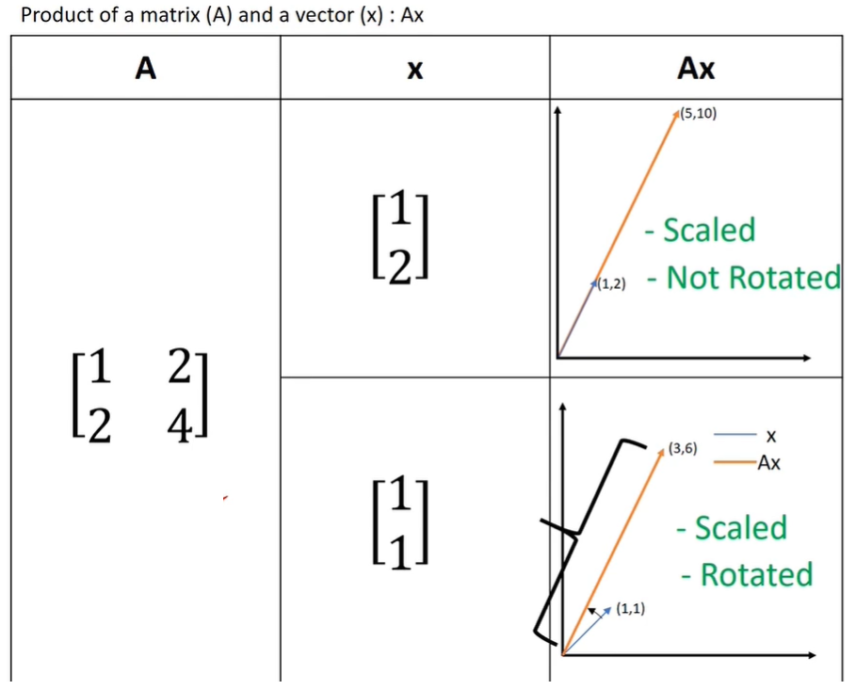
Eigen values and Eigen Vectors

Slide 5
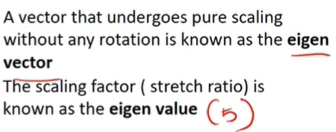
Eigen values and Eigen Vectors

Slide 6
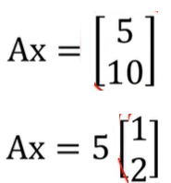
Eigen values and Eigen Vectors
Ax=5x
Ax=λx

Slide 7
The "Hessian matrix" of a multivariable function f(x, y, z, ....], organizes all second partial derivatives into a matrix:

Slide 8
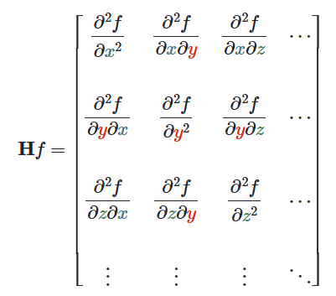
Computing a Hessian

Slide 9
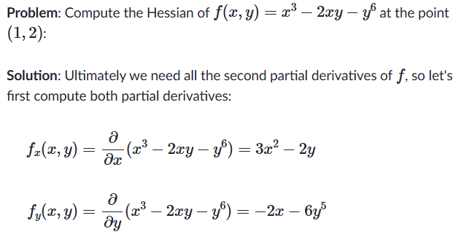
Example: Computing a Hessian

Slide 10
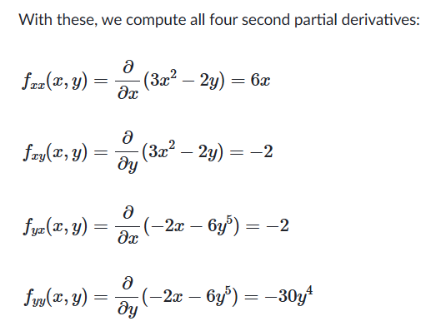
Example: Computing a Hessian

Slide 11
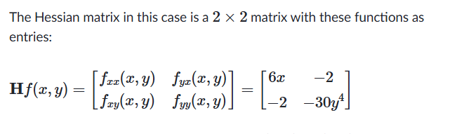
Example: Computing a Hessian

Slide 12
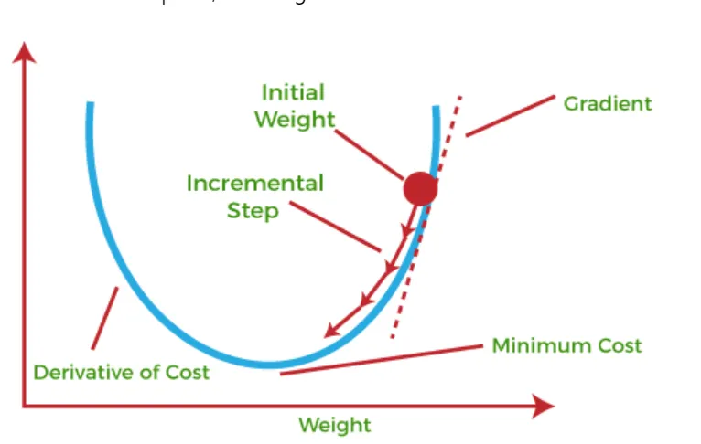

Slide 13
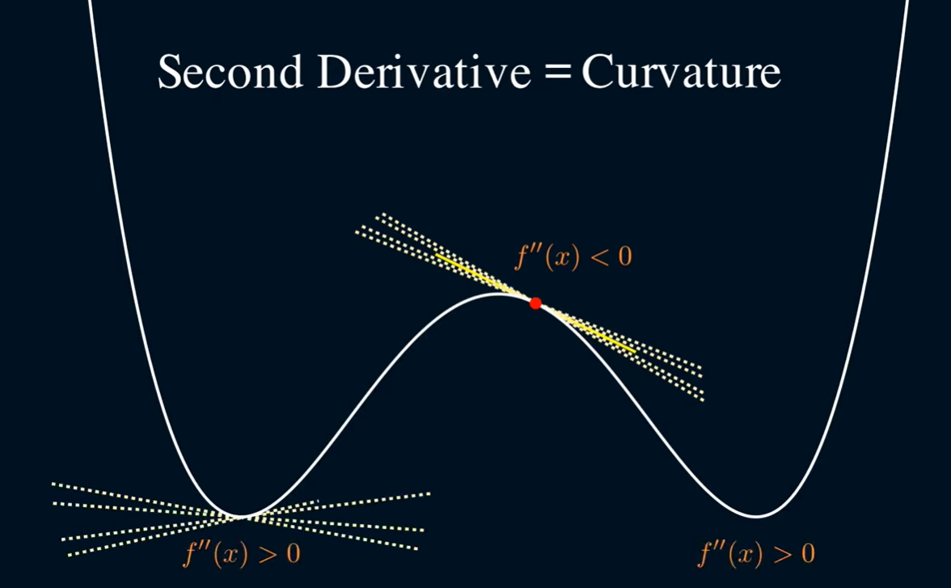

Slide 14
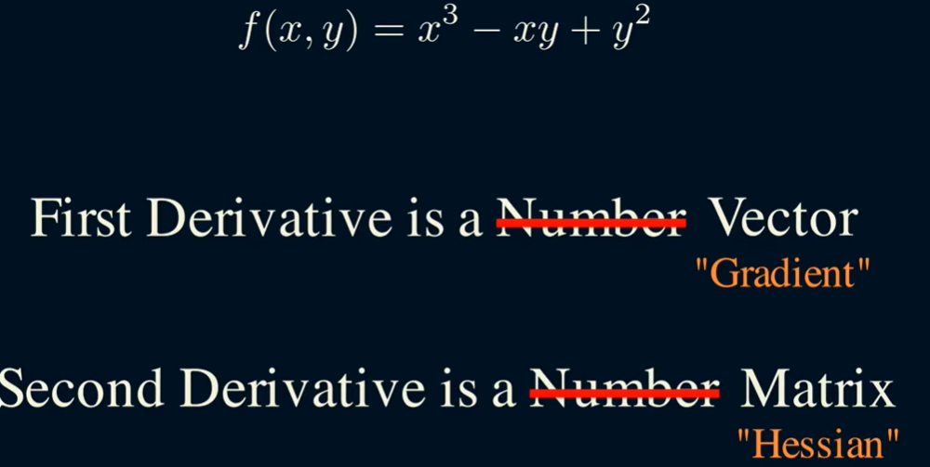

Slide 15
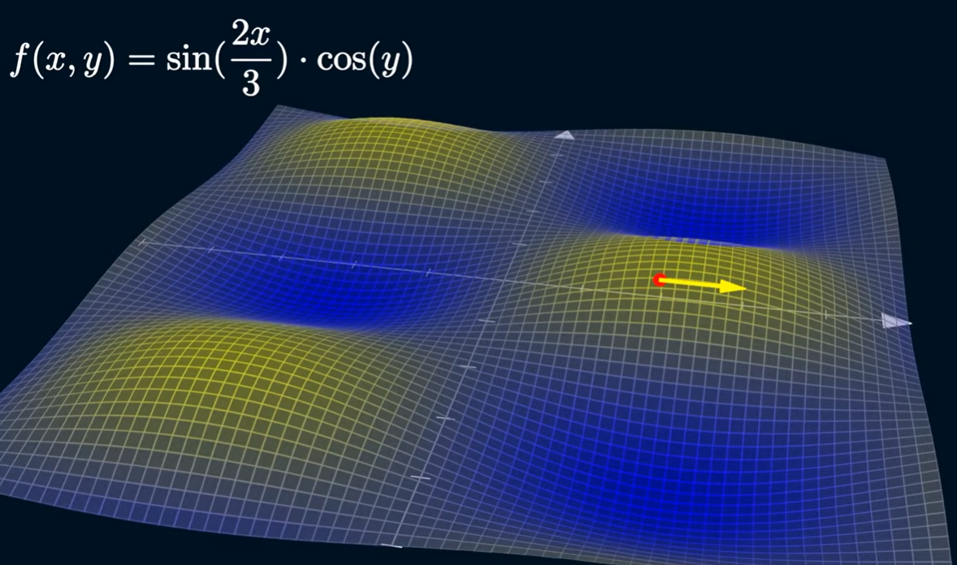

Slide 16
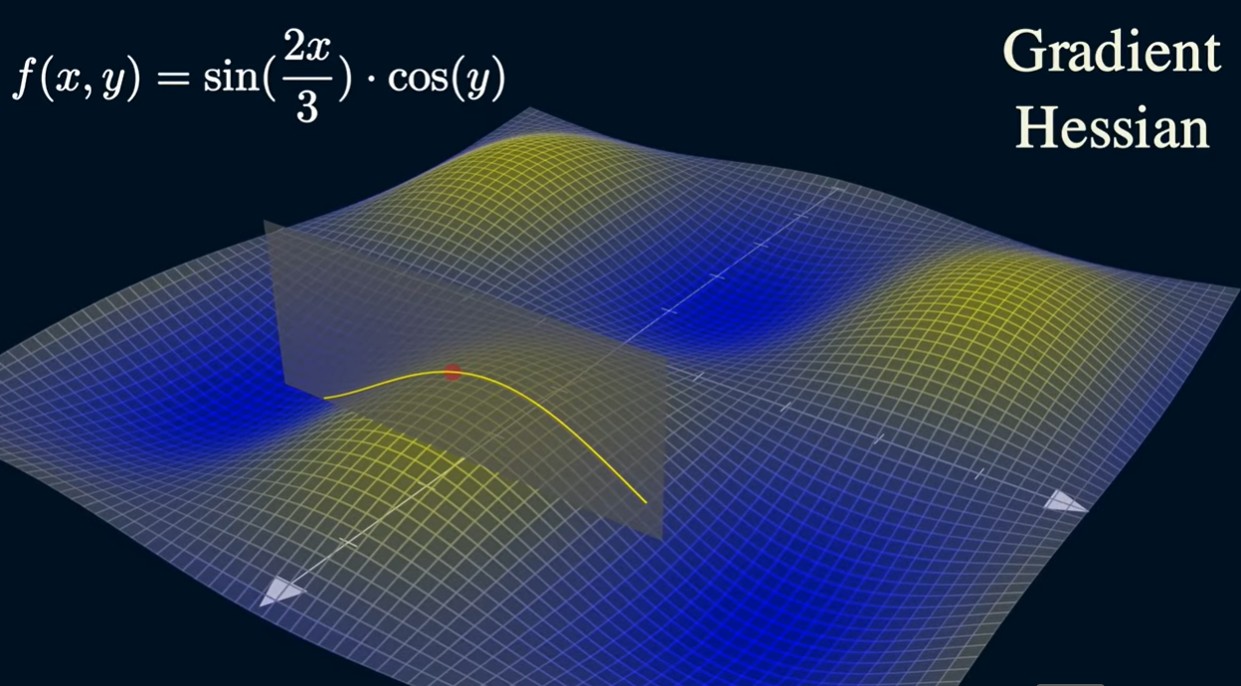

Slide 17
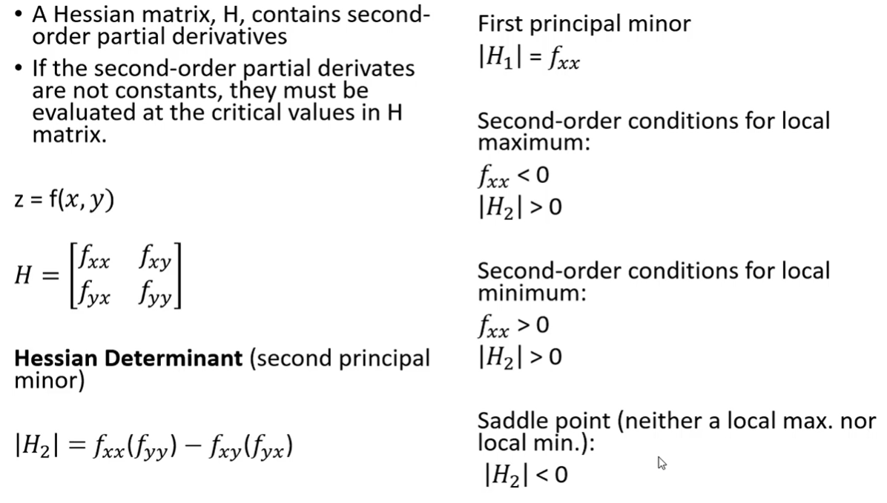

Slide 18
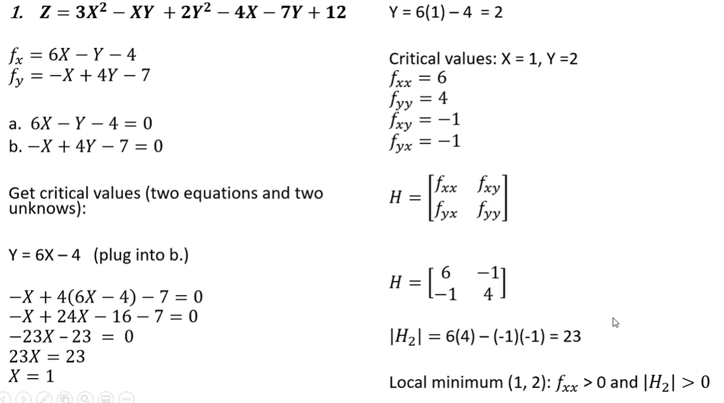

Slide 19
In neural networks, training involves minimizing an error function with respect to the network weights. The derivative of the error function w.r.t weights (gradient) dictates the direction to update weights to reduce error, while the eigenstructure of the Hessian matrix reveals the geometry (curvature) of the loss surface, guiding how quickly or slowly optimization converges.

Slide 20
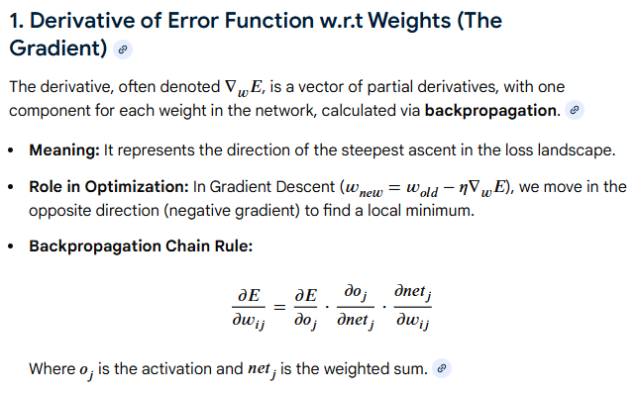
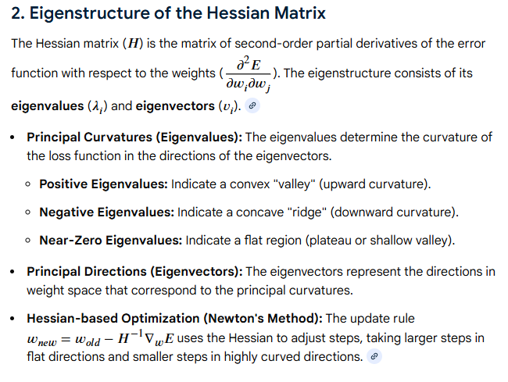

Slide 21
