Slide 1
Neural Network and Deep Learning 23CS8PENDL/23CS7PENDL

Slide 2
Unit-4
Convolution neural networks: The Convolution Operation, Pooling, Convolution and Pooling as an Infinitely Strong Prior, Variants of the Basic Convolution Function, Structured Outputs, Data Types, Efficient Convolution Algorithms

Slide 3
Convolutional Neural Networks (CNNs)
Convolutional networks, also known as convolutional neural networks or CNNs, are a specialized kind of neural network for processing data that has a known, grid-like topology.
Examples include time-series data, which can be thought of as a 1D grid taking samples at regular time intervals, and image data, which can be thought of as a 2D grid of pixels.
The name “convolutional neural network” indicates that the network employs a mathematical operation called convolution. Convolution is a specialized kind of linear operation.
Convolutional networks are simply neural networks that use convolution in place of general matrix multiplication in at least one of their layers.

Slide 4
Applications of CNNs
Image classification: CNNs are the state-of-the-art models for image classification. They can be used to classify images into different categories such as cats and dogs.
Object detection: It can be used to detect objects in images such as people, cars and buildings. They can also be used to localize objects in images which means that they can identify the location of an object in an image.
Image segmentation: It can be used to segment images which means that they can identify and label different objects in an image. This is useful for applications such as medical imaging and robotics.
Video analysis: It can be used to analyze videos such as tracking objects in a video or detecting events in a video. This is useful for applications such as video surveillance and traffic monitoring.
Ref. : https://www.geeksforgeeks.org/deep-learning/convolutional-neural-network-cnn-in-machine-learning/

Slide 5
CNNs: Why they are needed ?

Slide 6
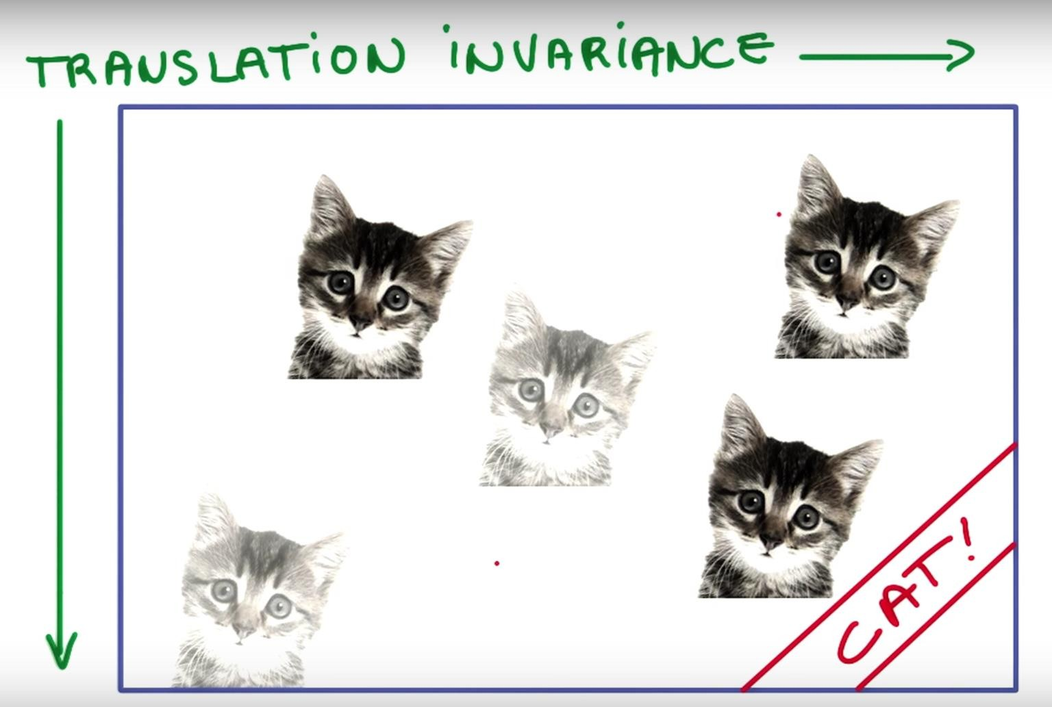
Advantage of Image data
Spatial Locality: Spatial locality is a fundamental advantage of image data, referring to the principle that pixels physically close to each other in an image are highly likely to be related or similar in value. Example: Pixels of cat are next to each other
Translation Invariance: Translation Invariance means that if an object occurs in any image it will be detected irrespective of its position. Example: Cat is cat , where ever it is.
Ref: https://aiplanet.com/learn/getting-started-with-deep-learning/convolutional-neural-networks/267/cnn-transfer-learning-data-augmentation

Slide 7
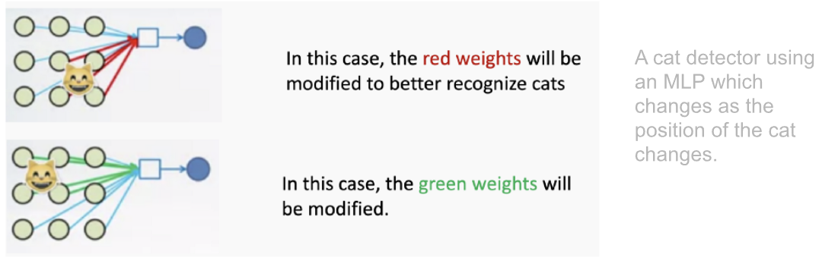
CNNs: Why they are needed ?
Disadvantages of Multi Layer Perceptron (MLP) or Artificial Neural Network (ANN)
Need to connect neurons in the hidden layer to ALL the neurons in the input layer
No spatial information: Since we reshape the image from 2D to 1D, it doesn't understand the spatial structure of the image, i.e., it is not spatially invariant. For example, if a picture of a cat appears in the top left of the image in one picture and the bottom right of another picture, the MLP will try to correct itself and assume that a cat will always appear in this section of the image.
And many, many parameters to be handled. MLPs use one perceptron for each input (e.g. pixel in an image, multiplied by 3 in RGB case). The amount of weights rapidly becomes unmanageable for large images. For a 224 x 224 pixel image with three color channels, there are around 150,000 weights that must be trained!
Ref: https://aiplanet.com/learn/getting-started-with-deep-learning/convolutional-neural-networks/267/cnn-transfer-learning-data-augmentation

Slide 8
CNNs: Why they are needed ?
Spatial Locality: CNNs leverage spatial structure by using convolutions. Convolution operations captures edges, textures and shapes.
https://setosa.io/ev/image-kernels/
Translation Invariance: CNNs use pooling layers and shared weights. Robust to image translation.

Slide 9
What is Convolution?
Image processing utilizes convolution, a mathematical operation where a matrix (or kernel or filter) traverses the image and performs a dot product with the overlapping region. A convolution operation involves the following steps:
Define a small matrix (filter or kernel).
This kernel moves across the input image.
At each location, the convolution operation computes the dot product of the kernel and the portion of the image it overlaps.
The result of each dot product forms a new matrix that represents transformed features of the original image.
The primary goal of using convolution in image processing is to extract important features from the image and discard the rest. This results in a condensed representation of an image.

Slide 10
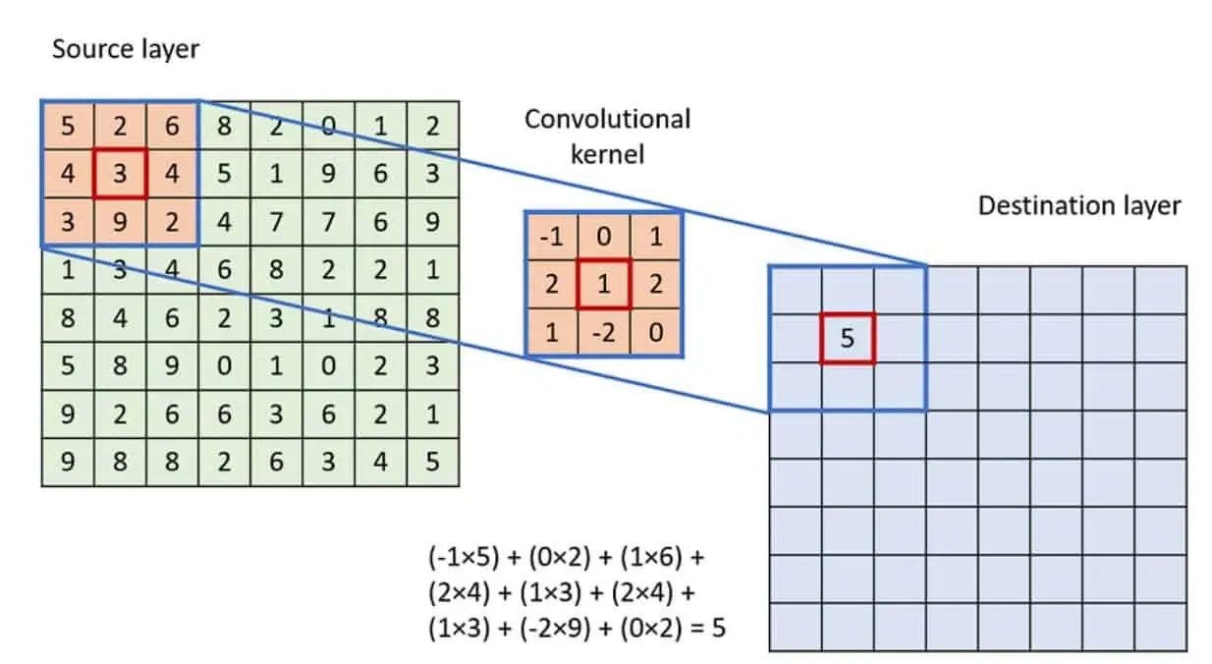
Convolution Operation
To apply the convolution:
Overlay the Kernel on the Image: Start from the top-left corner of the image and place the kernel so that its center aligns with the current image pixel.
Element-wise Multiplication: Multiply each element of the kernel with the corresponding element of the image it covers.
Summation: Sum up all the products obtained from the element-wise multiplication. This sum forms a single pixel in the output feature map.
Continue the Process: Slide the kernel over to the next pixel and repeat the process across the entire image.
Convolution
*
=
Ref.: https://viso.ai/deep-learning/convolution-operations/

Slide 11
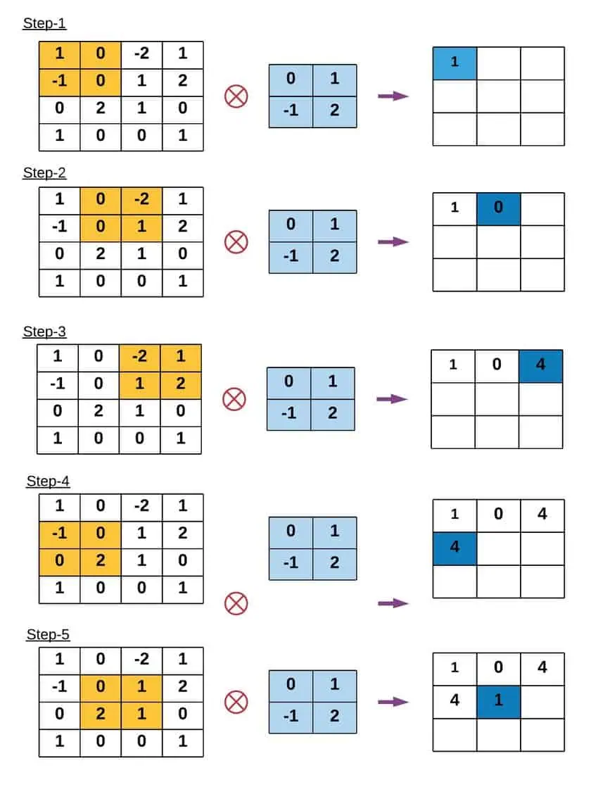
Example of Convolution Operation

Slide 12
Key Terms in Convolution Operation
Kernel Size: The convolution operation uses a filter, also known as a kernel, which is typically a square matrix. Common kernel sizes are 3×3, 5×5, or even larger. Larger kernels analyze more context within an image but come at the cost of reduced spatial resolution and increased computational demands.
Stride: Stride is the number of pixels by which the kernel moves as it slides over the image. A stride of 1 means the kernel moves one pixel at a time, leading to a high-resolution output of the convolution. Increasing the stride reduces the output dimensions, which can help decrease computational cost and control overfitting but at the loss of some image detail.
Padding: Padding involves adding an appropriate number of rows and columns (typically of zeros) to the input image borders. This ensures that the convolution kernel fits perfectly at the borders, allowing the output image to retain the same size as the input image.

Slide 13
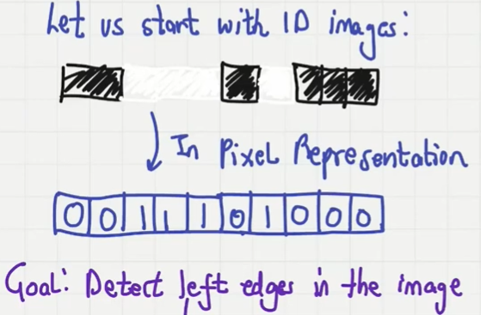

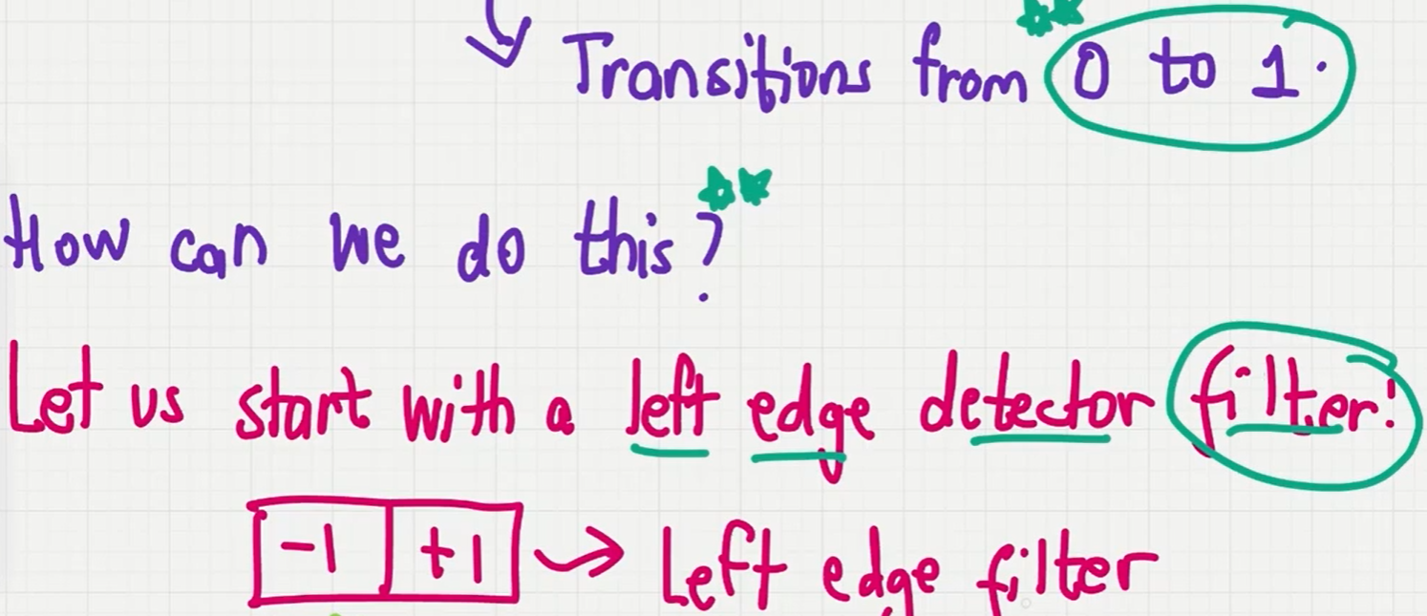
Filters or Kernels: Why do we care about them?
To detect left edge
Ref.: https://www.youtube.com/watch?v=P6d8NbTlEpU

Slide 14
Filters or Kernels: Why do we care about them?
1D image
Padding
0 | 0 | 1 | 1 | 1 | 0 | 1 | 0 | 0 | 0 | 0
Take the dot product
-1 | +1
Filter
0 | 1 | 0 | 0 | -1 | 1 | -1 | 0 | 0 | 0

Slide 15
Filters or Kernels: Why do we care about them?
1D image
Padding
0 | 0 | 1 | 1 | 1 | 0 | 1 | 0 | 0 | 0 | 0
Take the dot product
-1 | +1
Filter
0 | 1 | 0 | 0 | -1 | 1 | -1 | 0 | 0 | 0
Output: Ten data points
+1 is exactly at two locations
Pixel transitions from 0 to 1

Slide 16

Filters or Kernels: Why do we care about them?
Filters help us to detect features in images
-1 | +1
Left edge detector filter
+1 | -1
Right edge detector filter
-1 | +1 | -1
Isolated data pixel detector filter

Slide 17
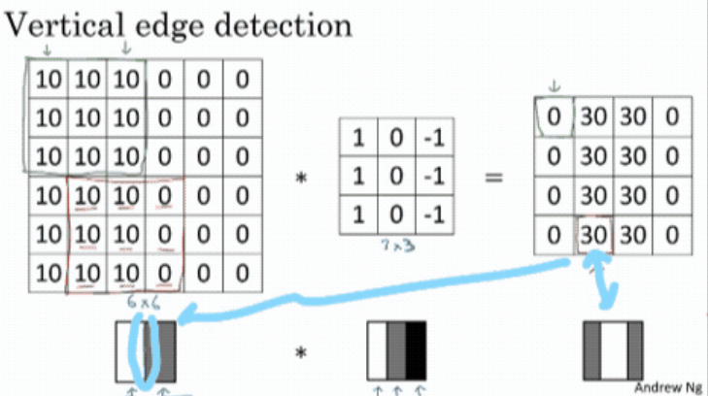
Image data: Example of Vertical Edge detection
Ref.: https://www.linkedin.com/pulse/deep-learning-cnn-edge-detection-chen-yang/

Slide 18
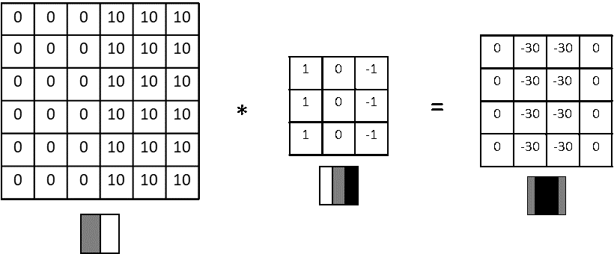
An example of vertical edge detection of dark to light transition

Slide 19
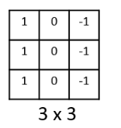
CNN: Vertical Edge Detection
Why This Filter Detects Vertical Edges:
Directional Sensitivity:
The kernel compares left-side pixels (1s) with right-side pixels (-1s).
The middle column (0s) ensures that center pixel values are ignored (don't bias the output).
When this kernel slides over the image, it gives high output values where there is a significant change from left to right—i.e., vertical edges.
Mathematical Operation:
At each location, the filter performs an element-wise multiplication (dot product) and sums the result.
If the left and right side of a region differ significantly (e.g., from dark to light), the result will be large → indicating a vertical edge.

Slide 20
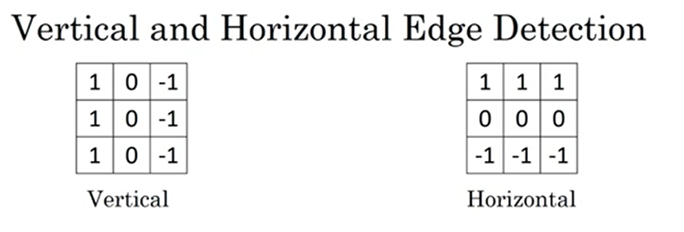
What About Horizontal Edges ?

Slide 21
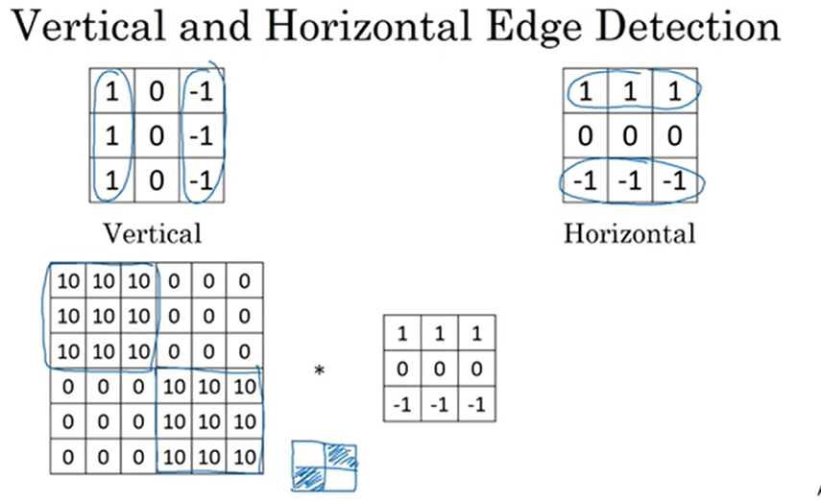
What About Horizontal Edges ?

Slide 22
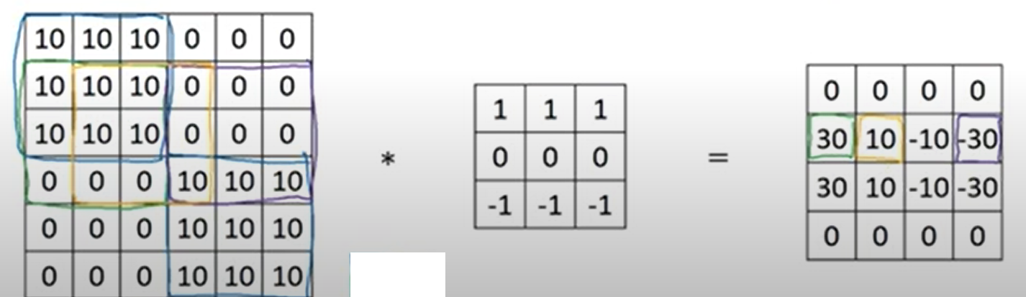

Slide 23
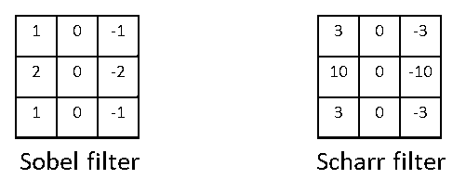
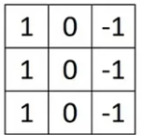
Learning to Detect Edges
It turns out that the 3×3 vertical edge detection filter we’ve used, is just one possible choice and
historically in the computer vision literature, there was a fair amount of debate about what is the best set
of numbers (coefficients) to use. So, here’s something else we could use which is called a Sobel filter.
The advantage of this is that it allows you to put a little bit more weight to the central row of the central pixel,
and this makes it maybe a little bit more robust, but computer vision researchers will use other excessive
numbers for instance, instead of a 1,2,1 it should be a 3,10,3 and also then −3,−10,−3. This is called a
Scharr filter and it has slightly different properties. This is just for vertical edge detection and
if we rotate it 90°, we get a horizontal edge detector.

Slide 24
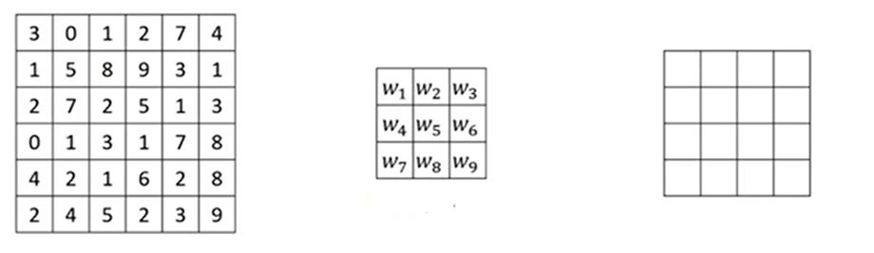
How to choose weights in the filter?
Convolution Operation
*
=
3x3
4x4
With the rise of deep learning one of the things we learned is that when we want to detect edges in some
complicated image, maybe we don’t need to have computer vision researchers handpick these 9 numbers.
It turns out that we can just learn them and treat the 9 numbers of this matrix as parameters, which we can
learn using backpropagation. The goal is to learn 9 parameters so that when we take the 6×6 image and
convolve it with our 3×3 filter, it should construct a good edge detector.
Notes:
https://datahacker.rs/edge-detection-extended/

Slide 25
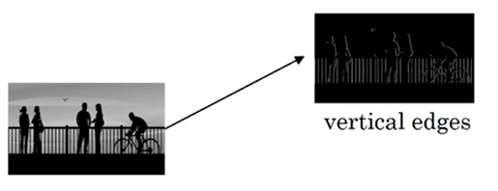
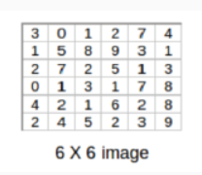
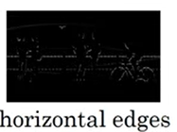
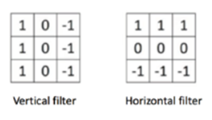
Question
Q1 - Consider the following gray scale image, we need to find the vertical and horizontal edges as following. Convolve the following 6x6 image (1 channel) with a vertical and horizontal filter and a stride of 1 to produce two 4X4 images that detect the edges

Slide 26
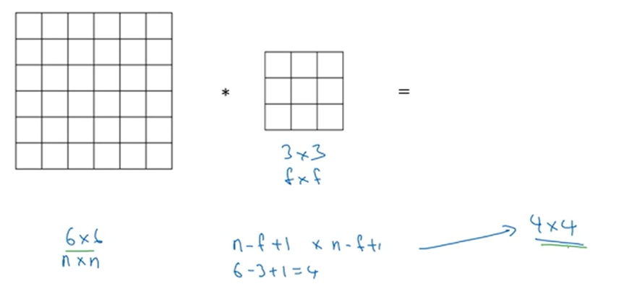
CNN: Padding

Slide 27
CNN: Padding
Why Padding is required ?
During convolution, the size of the output feature map is determined by the size of the input feature map, the size of the kernel, and the stride. If we simply apply the kernel on the input feature map, then the output feature map will be smaller than the input. This can result in the loss of information at the borders of the input feature map. In Order to preserve the border information we use padding.

Slide 28
CNN: Padding

Slide 29
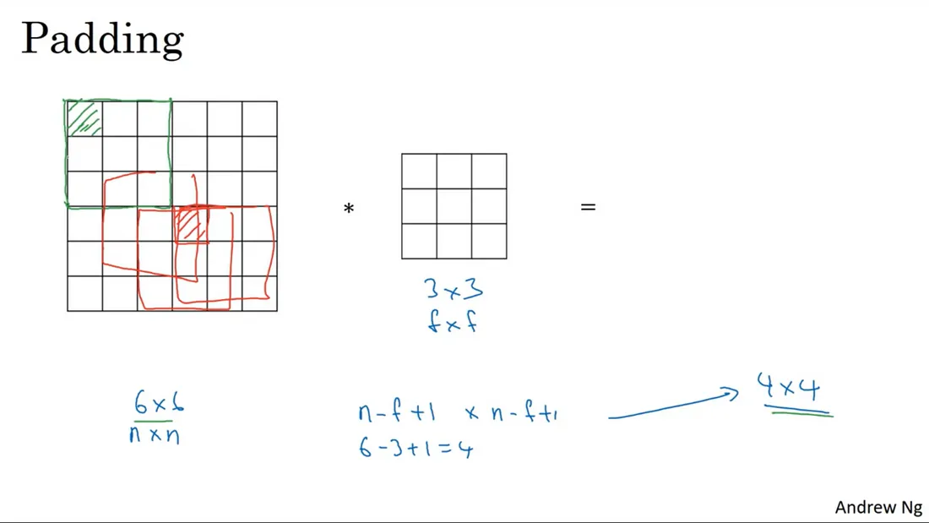
CNN: Padding
How information is lost on the edges. Note that the red-shaded center pixel overlaps with many (red) filters while the green-shaded pixel can only overlaps with just one (green) filter.

Slide 30
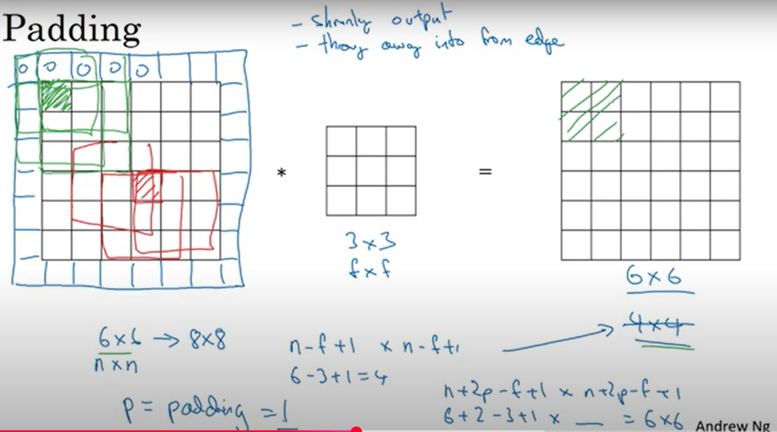
CNN: Padding

Slide 31
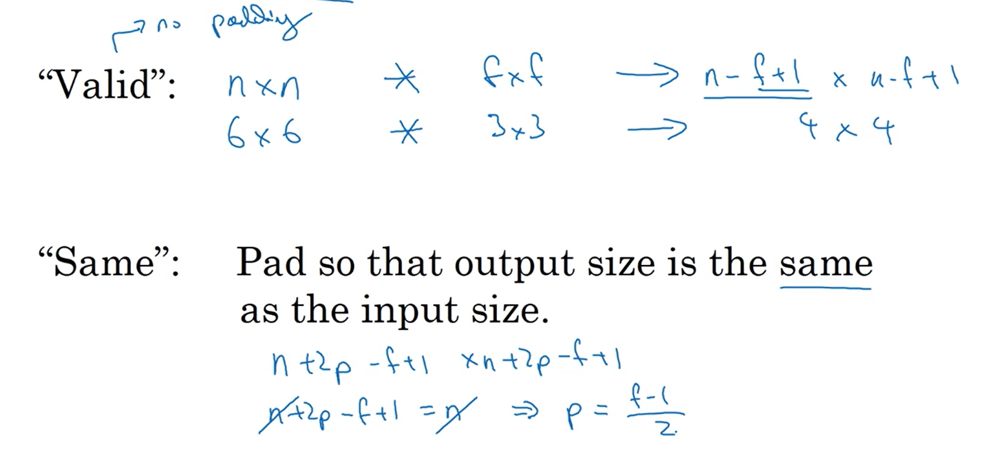
Valid and Same Padding

Slide 32
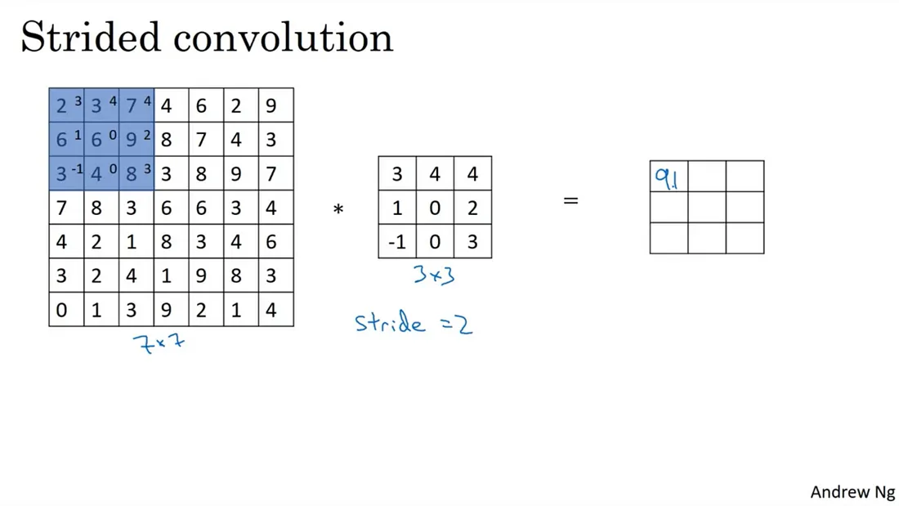
Striding
Notes:
If you want to convolve, let’s say, a7 by 7 image with this 3 by 3 filter with a stride of two, what that means is you take the element Y’s product as usual in this upper left 3 by 3region and then multiply and add (that gives you 91 as the first element of the output).

Slide 33
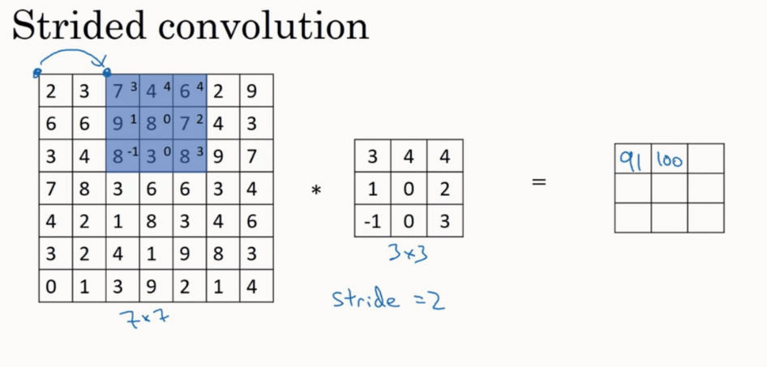
Striding
Notes:
But then instead of stepping the blue box over by one step, we are going to step over by two steps. So, we are going to make it hop over two steps like on GIF 2. Notice how the blue box jump over by two steps. And then you do the usual element Y’s product (summing it turns out 100)and now we are going to do they do that again, and make the blue box jump over by two steps (summing it up gives you 83).

Slide 34
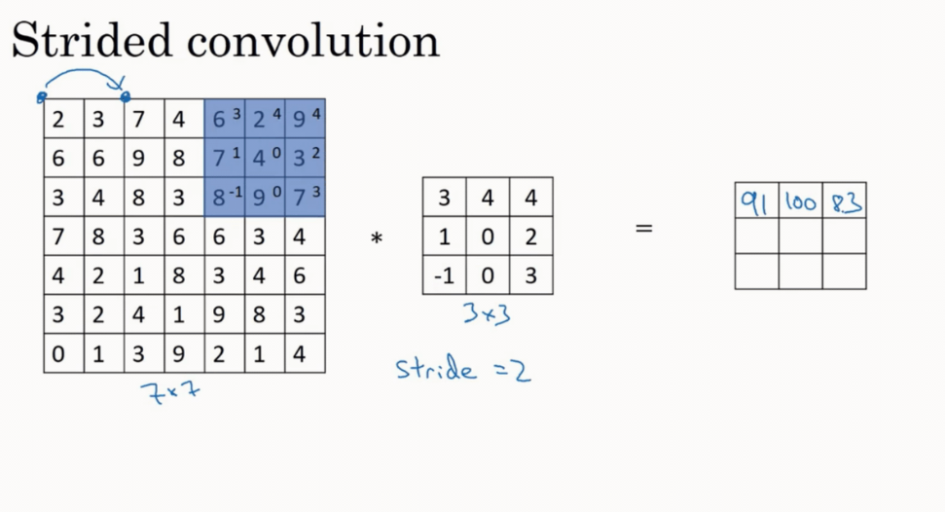

Slide 35
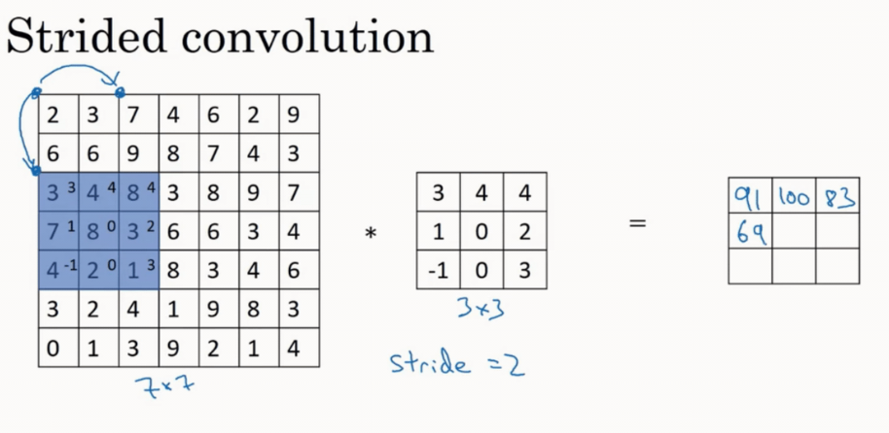

Slide 36
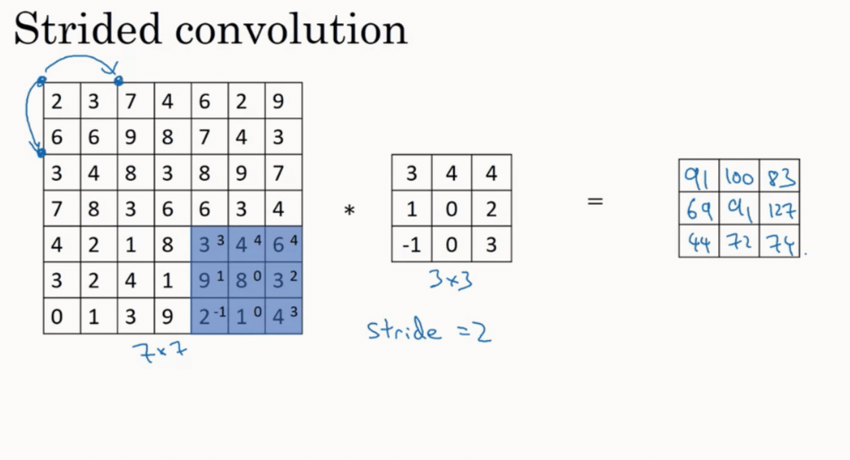

Slide 37
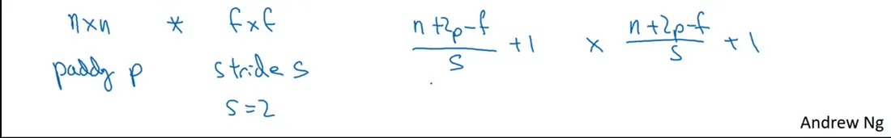
Strided Convolution
And if you use padding p and stride s. In this example, s = 2 then you end up with an output that is n+ 2 — f , and now because you’re stepping S steps of the time, you step just one step of the time, you now divide by S plus one and then can apply the same thing.

Slide 38
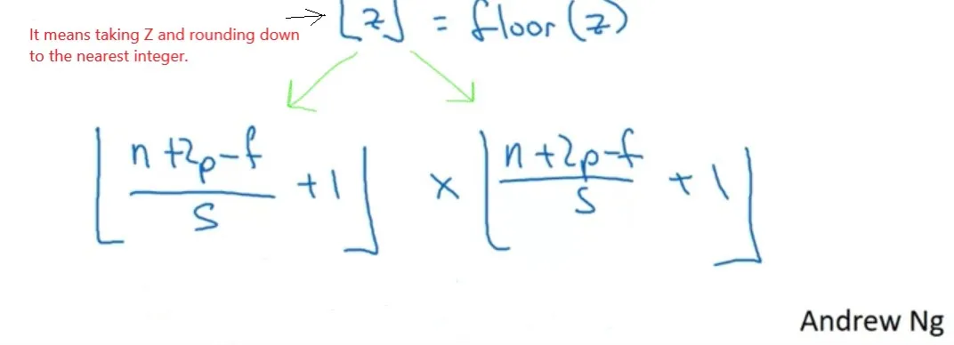
Strided Convolution
Now, just one last detail, what if this (n+2p — f) /s fraction is not an integer? In that case, we’re going to round the fraction down (i.e take the floor of the fraction).

Slide 39
Question
The input image has been converted into a matrix of size 12 x 12 and a kernel/filter of size 3 x 3 with a stride of 1. Determine the size of the convoluted matrix?
To calculate the size of the convoluted matrix, we use the generalized equation, given by:
C = ((n-f+2p)/s)+1
where,
C is the size of the convoluted matrix.
n is the size of the input matrix.
f is the size of the filter matrix.
p is the Padding amount.
s is the Stride applied.
Here n = 12, f = 3, p = 0, s = 1
Therefore the size of the convoluted matrix is 10 X 10.

Slide 40
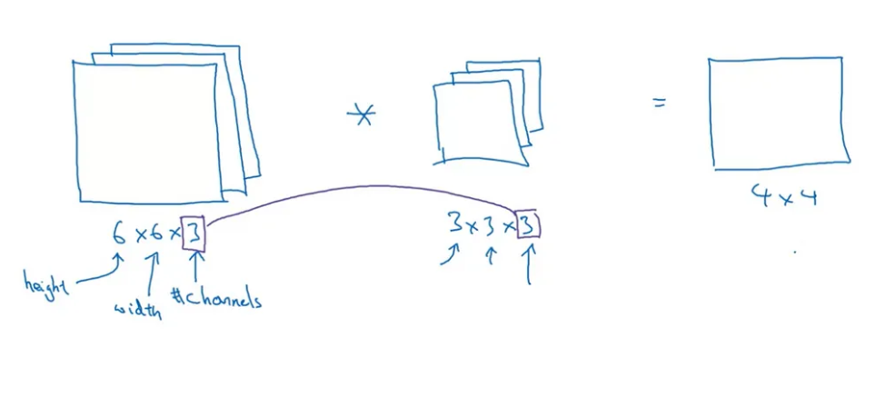
Convolutions Over Volume
Convolutions on RGB images

Slide 41
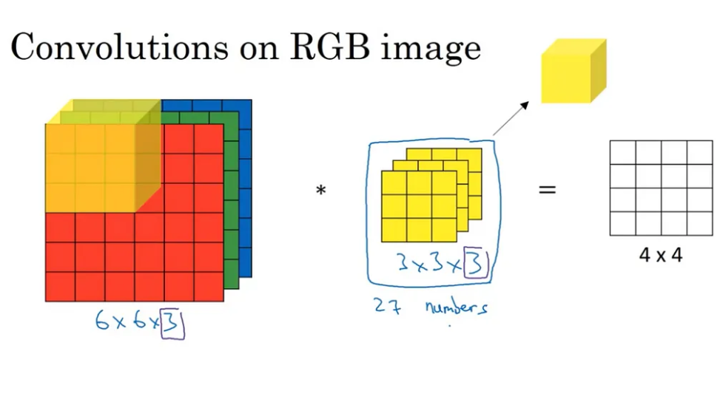
Convolutions Over Volume

Slide 42
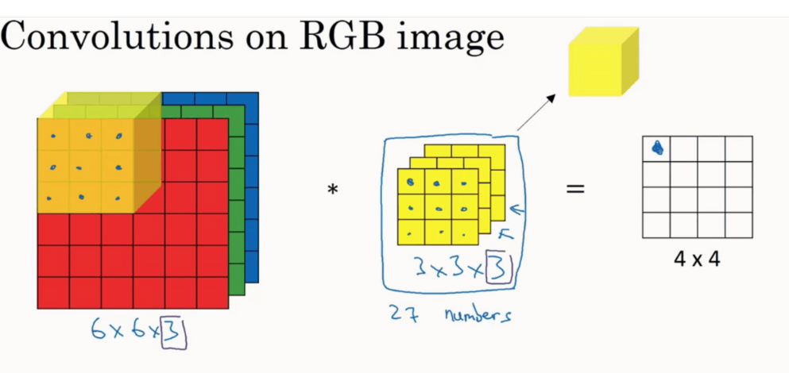
Add up all those 27 numbers and
this gives the first number in the output

Slide 43
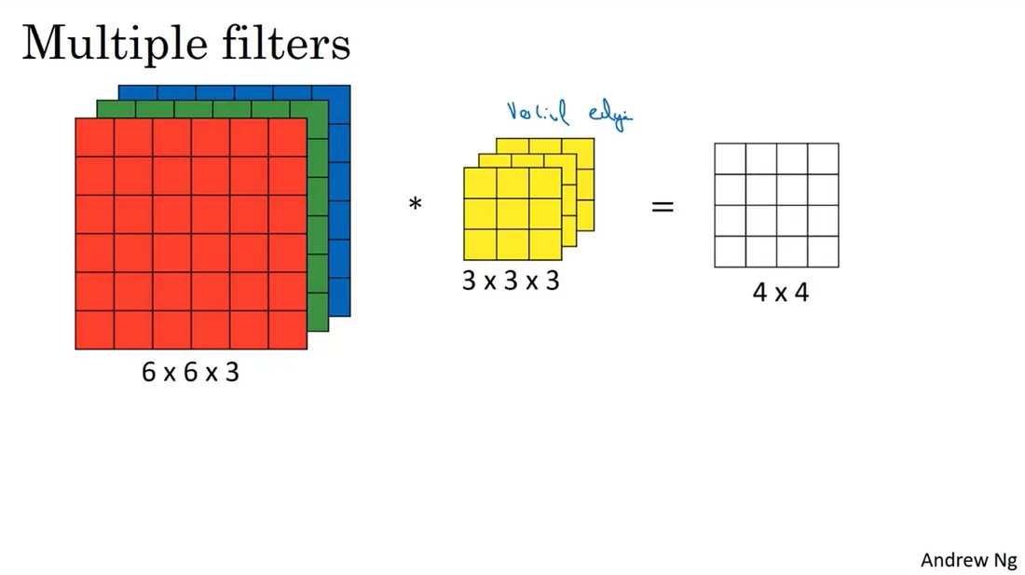
FIGURE : a representation of a 3D convolution that we have seen in the first section.
The yellow filter is now thought of to be a vertical edge filter.

Slide 44
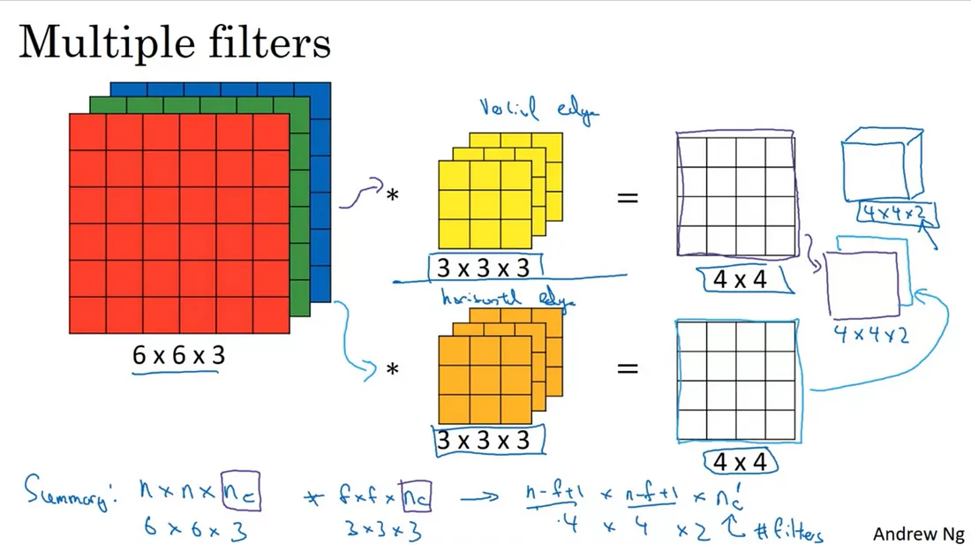
FIGURE : the orange filter at the bottom is thought to be a horizontal edge filter.

Slide 45
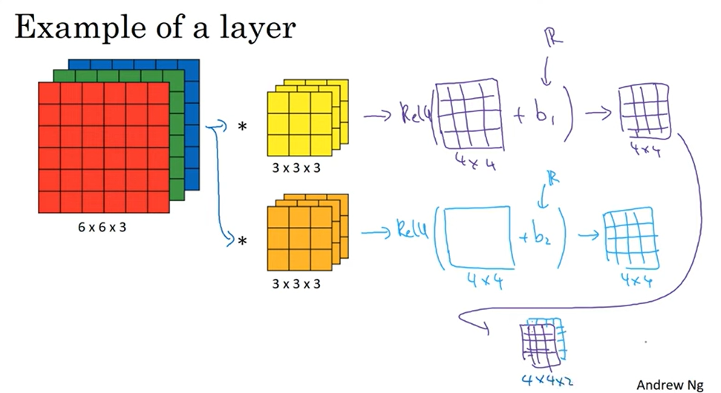
One Layer of CNN

Slide 46
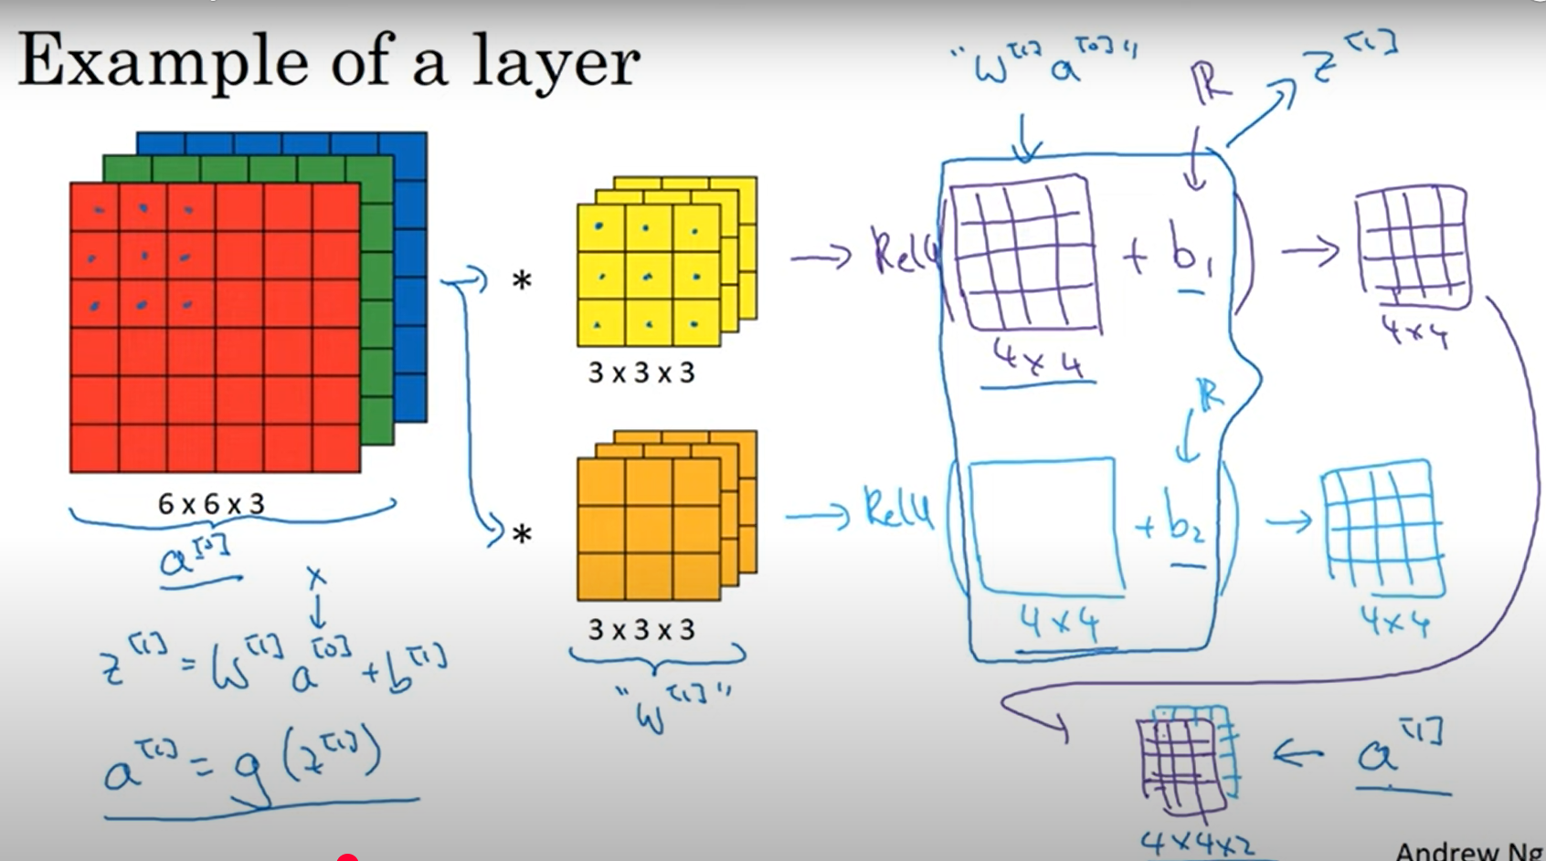
Forward Propagation in CNN
Notes:
The 4 by 4 matrix output matrix, the output of the convolution operation, plays a role similar to w^[1] a^[0]. and the output image plays a role similar to a^[1] = g(z^[1]), where g is the non-linearity function such as the ReLU and z^[1] = w^[1] a^[0] + b^[1]. So we are really just going from a^[0] to a^[1], where a^[0] is the 6 by 6 by 3 input image and a^[1] is the 4 by 4 by 2 output image.

Slide 47
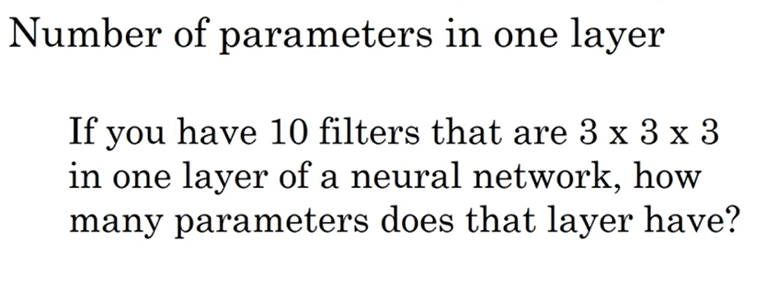
Consider one bias parameter for each 3x3x3 filter

Slide 48
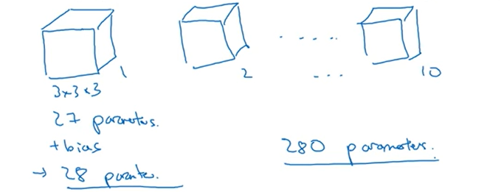
Consider one bias parameter for each 3x3x3 filter

Slide 49
Number of Parameter calculation
Parameters = (FxF * number of channels + bias-term) * D
The size of filter/kernel — > F (FxF)
Depth/Number of feature Maps/Kernels/Filters/Activation maps — > D (integer)

Slide 50
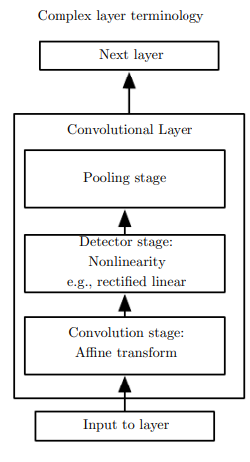
Three stages in Convolutional layer
Convolution stage
Detector stage
Pooling stage

Slide 51
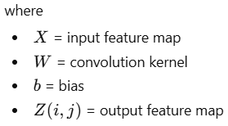

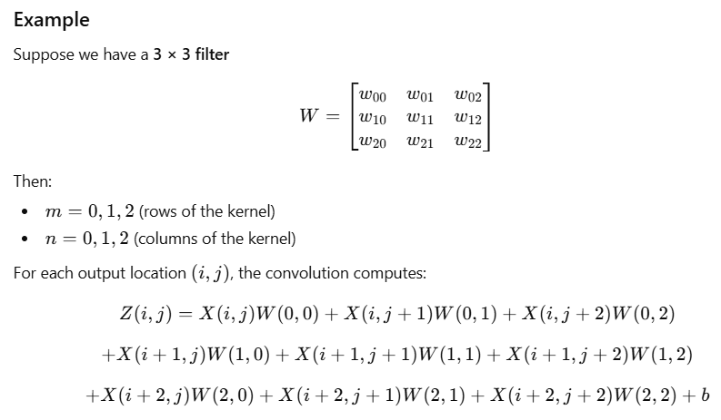
Three stages in Convolutional layer
1. Convolution Stage (Affine Transformation)
In this stage, the network performs a convolution operation between the input image (or feature map) and a set of learnable filters (kernels).
Mathematical Operation
For input X and kernel W:
m and n represent the indices (positions) of the convolution kernel/filter. m moves vertically inside the kernel n moves horizontally inside the kernel

Slide 52
Three stages in Convolutional layer
2. Detector Stage (Nonlinearity / Activation)
After convolution, the output is passed through a nonlinear activation function, typically ReLU (Rectified Linear Unit).
ReLU Function f(x)=max⁡(0,x)
Purpose
Introduces non-linearity into the model
Enables the network to learn complex patterns
Removes negative values, keeping only positive activations
The result is called the activated feature map.
3. Pooling Stage
Pooling performs downsampling on the activated feature map.
Common types: Max Pooling , Average Pooling
The pooling stage modifies the output layer by:
reducing the spatial size of feature maps,
decreasing computational complexity,
retaining dominant features,
providing translation invariance.
Thus, pooling produces a smaller and more robust representation of the features before passing them to the next layer.

Slide 53
Question
Discuss the three stages involved in the convolution network, how does the third stage of applying the pooling function modify the output layer.

Slide 54
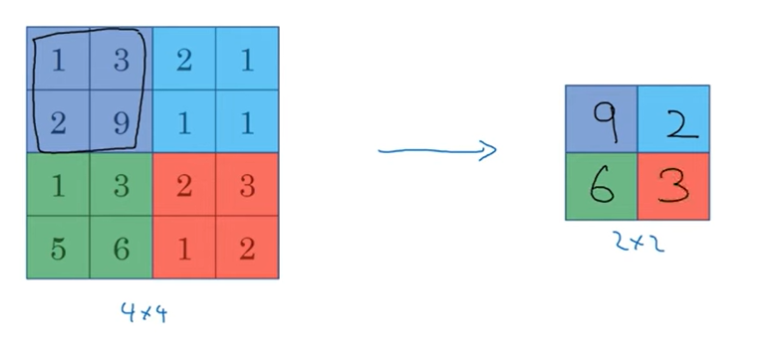
Pooling
Max Pooling
Intuition behind Max Pooling
By selecting the maximum value, it emphasizes the most salient feature within a
region and reduces the impact of less important or noisy activations.
Much bigger max number of a particular quadrant corresponds to a feature detected.

Slide 55
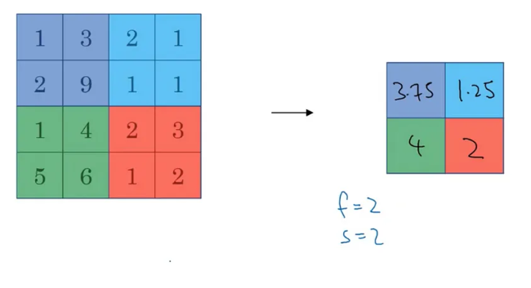
Pooling
Average Pooling

Slide 56
Calculating the output when an image passes through a Pooling (Max) layer
The input dimensions of the image — > I
For a pooling layer, one can specify only the filter/kernel size (F) and the strides (S).
Pooling Output dimension =
[(I - F) / S] + 1 x D
Notes:
Calculating the output when an image passes through a Pooling (Max) layer
The input dimensions of the image — > I
For a pooling layer, one can specify only the filter/kernel size (F) and the strides (S).
Pooling Output dimension =
[(I - F) / S] + 1 x D

Slide 57
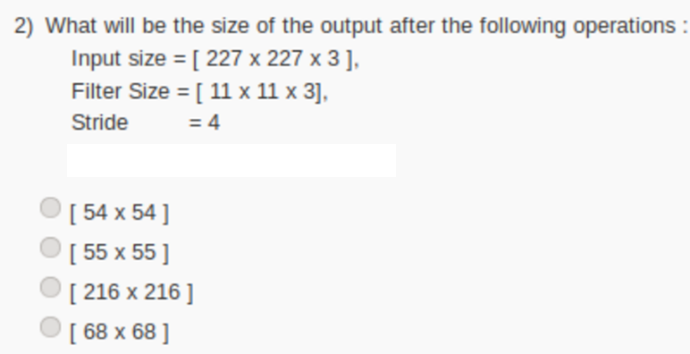

Slide 58

Notes:
[(I - F) / S] + 1 x D

Slide 59

Question
i. For the input matrix:
A. Perform max pooling with a 2×2 kernel and stride 2.
B. Perform average pooling with a 2×2 kernel and stride. Compare the two resulting matrices.

Slide 60
Unit-4
Convolution neural networks: The Convolution Operation, Pooling, Convolution and Pooling as an Infinitely Strong Prior, Variants of the Basic Convolution Function, Structured Outputs, Data Types, Efficient Convolution Algorithms

Slide 61
Convolution and Pooling as an Infinitely Strong Prior

Slide 62
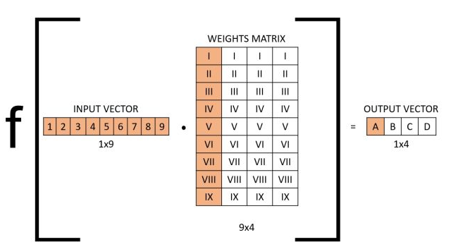
Full Connect Layer | Convolutional Layer
A fully connected layer is a type of neural network layer where each neuron is connected to every neuron in the previous layer, enabling global feature learning. | A convolutional layer, by contrast, uses filters that connect only to local regions of the input, allowing it to detect spatial patterns like edges or textures while using fewer parameters.
If we take a layer in a fully connected neural network with an input size of nine and an output size of four, the operation can be visualized as follows: The input is a 1x9 vector, the weights matrix is a 9x4 matrix. By taking the dot product and applying the non-linear transformation with the activation function we get the output vector (1x4).
Ref.: https://builtin.com/machine-learning/fully-connected-layer

Slide 63
Full Connect Layer | Convolutional Layer
A fully connected layer is a type of neural network layer where each neuron is connected to every neuron in the previous layer, enabling global feature learning. | A convolutional layer, by contrast, uses filters that connect only to local regions of the input, allowing it to detect spatial patterns like edges or textures while using fewer parameters.
If we take a layer in a fully connected neural network with an input size of nine and an output size of four, the operation can be visualized as follows The input is a 1x9 vector, the weights matrix is a 9x4 matrix. By taking the dot product and applying the non-linear transformation with the activation function we get the output vector (1x4). | Convolutions are not densely connected; not all input nodes affect all output nodes. This gives convolutional layers more flexibility in learning. Moreover, the number of weights per layer is a lot smaller, which helps with high-dimensional inputs such as image data. These advantages are what give CNNs their well-known characteristic of learning features in the data, such as shapes and textures in image data.

Slide 64
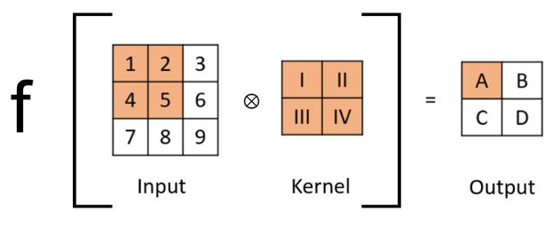
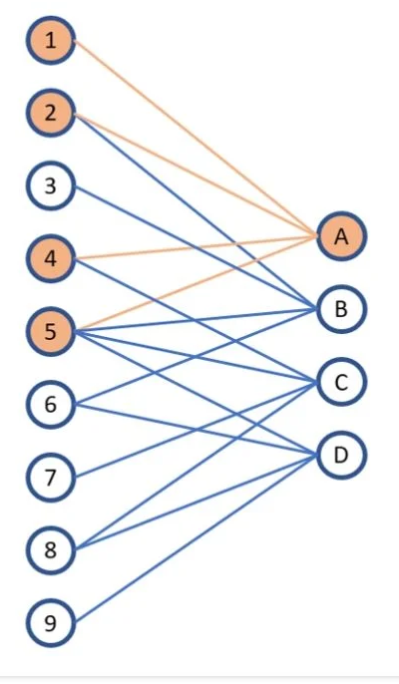
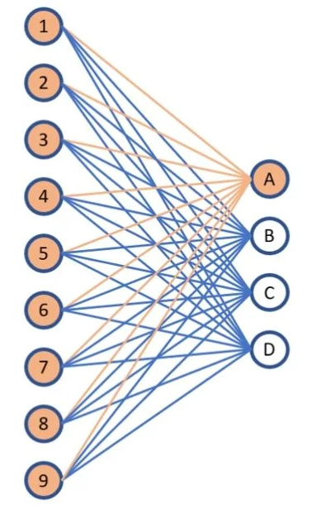
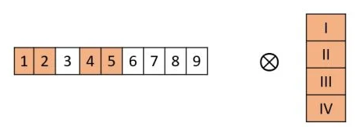
Full Connect Layer | Convolutional Layer
A fully connected layer is a type of neural network layer where each neuron is connected to every neuron in the previous layer, enabling global feature learning. | A convolutional layer, by contrast, uses filters that connect only to local regions of the input, allowing it to detect spatial patterns like edges or textures while using fewer parameters.
If we take a layer in a fully connected neural network with an input size of nine and an output size of four, the operation can be visualized as follows The input is a 1x9 vector, the weights matrix is a 9x4 matrix. By taking the dot product and applying the non-linear transformation with the activation function we get the output vector (1x4).

Slide 65
Convolution and Pooling as an Infinitely Strong Prior
What is a Prior in Machine Learning?
In machine learning, a prior represents assumptions about the structure of the data before learning begins.
Examples of priors:
Model Prior Assumption
Linear Regression: Relationship between variables is linear
Decision Trees: Data can be split hierarchically
CNN: Images contain local patterns that repeat across space

Slide 66
Convolution as a Prior
Key Assumption (Prior): Features detected in one location of an image are useful in other locations as well.
For example: An edge detector should work whether the edge appears top, bottom, or center of the image.
How CNN Enforces This Prior: Through weight sharing.
Instead of learning separate weights for every pixel location, CNN uses one filter applied everywhere.
Fully Connected Layer (No Prior): Each pixel has independent weights.
Example: For a 32×32 image: 32×32=1024 weights per neuron
Convolution Layer (Strong Prior): A 3×3 filter: 3×3=9 weights This same filter is applied across the whole image.
Thus CNN assumes: The same feature can appear anywhere in the image.

Slide 67
Convolution as a Prior
Why is it Called an "Infinitely Strong Prior"?
In CNNs:
The model cannot learn different weights for different spatial locations.
The same filter must be used everywhere.
Therefore:
The assumption of translation invariance is enforced strictly, not learned.
This is why convolution is called an infinitely strong prior.

Slide 68

Pooling as a Prior
Pooling introduces another strong assumption: Small changes in the position of features should not change the output significantly. This is called local translation invariance.

Slide 69
Convolution and Pooling as a Prior
Example: Object Detection in Images
Consider detecting a cat in an image.
Without Convolution Prior
The network must learn separately:
Cat at top-left
Cat at center
Cat at bottom-right
This requires huge number of parameters.
With Convolution Prior
The network learns one cat feature detector.
That filter works everywhere in the image.
With Pooling
Even if the cat shifts slightly:
left , right , up, down
The network still recognizes it.

Slide 70
Convolution and Pooling as a Prior
Convolution and pooling in CNN act as infinitely strong priors because they impose strict assumptions about image structure.
Convolution assumes that features learned in one location are useful across the entire image, implemented through weight sharing.
Pooling introduces local translation invariance, ensuring that small shifts in feature location do not affect detection.
These assumptions are built into the architecture and cannot be violated during training. As a result, CNNs require fewer parameters and generalize better for image data.

Slide 71
Convolution and Pooling as an Infinitely Strong Prior
Convolution and pooling are considered an "infinitely strong prior" in convolutional neural networks (CNNs) because they force the model to assume features are locally connected, spatially invariant, and hierarchical.
Convolution (Local Interaction & Translation Invariance): Convolution assumes that neighboring pixels are related and that features are shift-invariant. It enforces this by having adjacent units share the same weights (translated in space) and forcing non-local weights to be zero.
Pooling (Invariance to Small Translations): Pooling adds the assumption that the precise location of a feature is less important than its existence, making the network invariant to small input translations.

Slide 72
Question
Mention various priors and analyze the concept of viewing a convolutional network as a fully connected network with an infinitely strong prior. Examine how this perspective provides insights into convolutional networks' operation

Slide 73
Variants of the Basic Convolution Function
First, when we refer to convolution in the context of neural networks, we usually actually mean an operation that consists of many applications of convolution in parallel.
This is because convolution with a single kernel can only extract one kind of feature, although at many spatial locations.
Usually we want each layer of our network to extract many kinds of features, at many locations.

Slide 74

Variants of the Basic Convolution Function: Equation to compute output feature map
This equation describes how a convolution layer computes
the output feature map when multiple channels exist.
Unlike simple convolution (single filter on a single image),
CNN filters operate across all input channels.

Slide 75

(2D)

Slide 76


Slide 77



Slide 78









Input has 2 channels,
each 2×2
Kernel Tensor (4D)
Since we have two filters,
each filter must span
both input channels.
Filter-1: For input channel-1
and Channel-2
Input tensor V (3D): Channel-1
And Channel-2
Output Tensor (3D):
Since we have 2 filters,
we obtain 2 feature maps.
Filter-2: For input channel-1
and Channel-2

Slide 79
Variants of the Basic Convolution Function: Stride
Normally in convolution, the filter moves one pixel at a time across the image.
This is called: Stride = 1
But sometimes we intentionally skip some positions to reduce computation.
This skipping distance is called stride (s).
Example:
Stride Movement
s = 1 move 1 pixel
s = 2 move 2 pixels
s = 3 move 3 pixels

Slide 80

Variants of the Basic Convolution Function: Stride
Normally in convolution, the filter moves one pixel at a time across the image.
This is called: Stride = 1
But sometimes we intentionally skip some positions to reduce computation.
This skipping distance is called stride (s).
Example:
Stride Movement
s = 1 move 1 pixel
s = 2 move 2 pixels
s = 3 move 3 pixels
Ref.: https://medium.com/@akp83540/stride-of-a-convolution-operation-05bc7365d91c

Slide 81


Variants of the Basic Convolution Function: Stride
This equation describes how a convolution layer computes
the output feature map when multiple channels exist
considering a stride of s.
(j−1)s, (k−1)s
This shows the kernel jumps
by s pixels instead of moving by 1 pixel.

Slide 82


Variants of the Basic Convolution Function: Padding
Padding is a variant of the basic convolution function used to control the size of the output feature map during convolution. When the filter reaches the border of an image, it may not fully overlap with the input. To solve this, we add extra pixels (usually zeros) around the input image, which is called padding.
Why Padding is Needed
During convolution, the filter slides across the image. If no padding is used, the filter cannot move beyond the image boundary. Thus the output size becomes smaller after convolution.
General output size formula:

Slide 83
Variants of the Basic Convolution Function: Padding
Zero padding is a technique in convolutional neural networks (CNNs) that adds a border of zeros around the edge of an input matrix (image) before convolution.
Different types of Zero-padding: Valid, Same, Full

Slide 84


Variants of the Basic Convolution Function: Padding
Valid Zero padding: Valid padding (No padding) means no extra pixels are added.
Input
Output
With padding P=0,
Stride S=1
Filter

Slide 85



Variants of the Basic Convolution Function: Padding
Same Zero padding: Same padding adds zeros around the image so that
Output size = Input size
Input
Padded Input
Output
With padding P=1,
Stride S=1
Filter
Padding Value

Slide 86





Variants of the Basic Convolution Function: Padding
Full Zero padding: Full padding adds more zeros around the image, allowing the filter to slide even beyond the borders. This produces a larger output feature map.
Padded Input
Since P=2, we add two rows
and columns of zeros around the input.
Input
Output
With padding P=2,
Stride S=1
Padding Value
New input size
Output size

Slide 87

Variants of the Basic Convolution Function: Fully connected, Locally connected, Standard convolution, Tiled convolution
Figure shows Comparison of local connections, convolution, and full connections.
(Top)A locally connected layer with a patch size of two pixels. Each edge is labeled with a unique letter to show that each edge is associated with its own weight parameter.
(Center)A convolutional layer with a kernel width of two pixels. This model has exactly the same connectivity as the locally connected layer. The difference lies not in which units interact with each other, but in how the parameters are shared. The locally connected layer has no parameter sharing. The convolutional layer uses the same two weights repeatedly
across the entire input, as indicated by the repetition of the letters labeling each edge.
(Bottom)A fully connected layer resembles a locally connected layer in the sense that each edge has its own parameter (there are too many to label explicitly with letters in this diagram). However, it does not have the restricted connectivity of the locally connected layer.

Slide 88




Variants of the Basic Convolution Function: Fully connected, Locally connected, Standard convolution, Tiled convolution
Locally Connected Layer (Top Diagram)
In the top figure, each output neuron si​ connects only to a small local region of inputs.
Example connections shown:
Top
Center
Bottom

Slide 89


Variants of the Basic Convolution Function: Fully connected, Locally connected, Standard convolution, Tiled convolution
Convolutional Layer (Center Diagram)
The middle figure has exactly the same connectivity as the
locally connected layer.
Each output still depends on two nearby inputs.
Example
The same weights a and b repeat everywhere.
This means the same filter slides across the input.
Top
Center
Bottom

Slide 90


Variants of the Basic Convolution Function: Fully connected, Locally connected, Standard convolution, Tiled convolution
Fully Connected Layer (Bottom Diagram)
In the bottom figure, each output neuron connects to every input neuron.
Example:
So every node interacts with every input.
Top
Center
Bottom

Slide 91
Variants of the Basic Convolution Function: Fully connected, Locally connected, Standard convolution, Tiled convolution
Standard Convolution
Standard convolution = the convolutional layer shown in the middle figure.
Characteristics:
Local connections
Weight sharing
Same filter everywhere
Top
Center
Bottom

Slide 92



Variants of the Basic Convolution Function: Fully connected, Locally connected, Standard convolution, Tiled convolution
Tiled Convolution:
Tiled convolution is between locally connected and standard convolution.
Instead of one filter everywhere, we use a small set of filters that repeat.
Example with two kernels
So weights repeat periodically.
Top
Center
Bottom

Slide 93

Variants of the Basic Convolution Function: Fully connected, Locally connected, Standard convolution, Tiled convolution
Imagine detecting edges in an image.
Fully connected: Every pixel interacts with every neuron.
Locally connected: Each location learns its own edge detector.
Standard convolution: One universal edge detector works everywhere.
Tiled convolution: A few edge detectors repeat across the image.

Slide 94
Question
Show the different variants of the convolution in terms of convolution with a stride and the effect of zero padding with appropriate examples
With a neat diagram, demonstrate the convolution variations for the locally connected layers, tiled convolution and standard convolution.
Explain the three special cases of zero padding settings in terms of width of the image and the width of the kernel.
List different types of priors and analyze the idea of treating a convolutional network as a fully connected network with an infinitely strong prior. Discuss how this perspective enhances the understanding of convolutional networks functionality and benefits

Slide 95


Properties of Convolution
Convolution Operation: Commutative
If we use a two-dimensional image I as our input, we probably also want to use a two-dimensional kernel K:
Convolution is commutative, meaning we can equivalently write:

Slide 96

Example of architecture for classification with convolutional networks

Slide 97
Question
Describe the architecture of a typical Convolutional Neural Network (CNN)?

Slide 98
Unit-4
Convolution neural networks: The Convolution Operation, Pooling, Convolution and Pooling as an Infinitely Strong Prior, Variants of the Basic Convolution Function, Structured Outputs, Data Types, Efficient Convolution Algorithms

Slide 99
Structured Outputs
1. Introduction
Traditional neural networks usually produce simple outputs, such as:
Classification: one class label
Regression: one numeric value
However, many real-world problems require predicting complex outputs that have structure.
A structured output means the model produces multiple related predictions that depend on each other.
In CNNs, this output is typically represented as a tensor rather than a single value.

Slide 100


Structured Output
Structured Output in CNNs
A convolutional network can output a high-dimensional tensor S instead of a single class label.
S_{i,j,k} represents: probability that pixel (𝑗,𝑘) belongs to class 𝑖.
Thus the model predicts a label for every pixel in the image.
Example: If an image contains: road, car, pedestrian, background
The network produces a probability map for each class.
Input:
Satellite Image
Output:
Labelled Image

Slide 101

Structured Output
Pixel-wise Labeling
Structured outputs allow the model to assign labels to each pixel in an image. The output becomes a label map or segmentation mask which is referred as Pixel-wise labeling. Pixel-wise labeling means assigning a class label to every pixel in the image.
Pixel-wise labeling is used in tasks such as:

Slide 102
Structured Output
Pixel-wise Labeling
Challenge: Output Size Reduction
In typical CNN architectures:
pooling layers
strided convolutions
reduce the spatial size of feature maps.
Thus the output map becomes smaller than the input image.
Strategies to Handle Size Reduction
Several approaches are used.
1. Avoid pooling: Remove pooling layers so that spatial size remains unchanged.
2. Predict lower-resolution labels: Example: 64 × 64 label map instead of 256 × 256 pixels
3. Use pooling with stride 1: Pooling without reducing spatial dimensions.

Slide 103
Structured Output
Another Challenge in Pixel-wise Labeling: Even if we predict labels for each pixel, predictions may be noisy.
Neighboring pixels are usually related.
Example:
car car car
car car car
If one pixel is car, nearby pixels are likely also car.
Thus predictions must consider pixel interactions.
However, a simple CNN may produce noisy predictions.
Example initial prediction:
car car road
car road car
car car car

Slide 104
Structured Output
Instead of predicting labels in one step, the network can:
Make an initial guess
Improve it using neighboring pixel interactions
Repeat the refinement multiple times
Example:
Step Prediction
Initial rough segmentation
Step 2 improved boundaries
Step 3 refined segmentation
This repeated refinement process can be modeled as a recurrent convolutional network.

Slide 105




Structured Output
Input: $X$Image tensor
Hidden representations
Label predictions
Fig. Recurrent convolutional network for pixel labeling

Slide 106





Structured Output
Three convolution kernels are used. U: extract image features,
V: produce label predictions, W: refine predictions using previous labels
Step 1: Initial Prediction
Image features are computed.
Then label prediction:
Step 2: First Refinement
Now the network uses image features
and previous prediction
Step 3: Further Refinement
Why This is Called a Recurrent Network
The same parameters are reused at every step:
kernel U , kernel V , kernel W
Thus the computation repeats over time.

Slide 107
Question
Illustrate how Convolutional Networks produce high dimensional, structured outputs, and how can a recurrent convolutional network be applied for pixel labeling? What strategies can be used to address the disadvantage when the output plane is smaller than the input plane?

Slide 108

Data Types
The data used with a convolutional network usually consists of several channels, each channel being the observation of a different quantity at some point in space or time.
Table: Examples of different formats of data that can be used with convolutional networks.

Slide 109

Data Types
Table: Examples of different formats of data that can be used with convolutional networks.

Slide 110
Question
Illustrate the different formats of data that can be used with convolutional networks.
Describe the various data formats that can be used with convolutional networks, and how do they influence the network’s performance and application?

Slide 111

Efficient Convolution Algorithms
Modern convolutional neural networks often contain millions of parameters and computations. Therefore, efficient algorithms are required to reduce computational cost and improve speed, especially during large-scale deployment.
Two important techniques used to speed up convolution operations are FFT-based convolution and separable convolution.
1. Fourier Transform Based Convolution (FFT Convolution)
Convolution can be computed efficiently in the frequency domain using the Fourier Transform.
Principle: According to the convolution theorem:
$$\text{Convolution} \text{in} \text{time} \text{domain}=\text{Multiplication} \text{in} \text{frequency} \text{domain}$$
Steps involved:
Convert the input signal/image and kernel into the frequency domain using Fourier Transform.
Perform point-wise multiplication of the transformed signals.
Apply the inverse Fourier Transform to obtain the convolution result.
Advantage: For large inputs or kernels, this method can be faster than the direct convolution implementation.

Slide 112
Efficient Convolution Algorithms
2. Separable Convolution: A convolution kernel is called separable when it can be expressed as the outer product of lower-dimensional vectors.
Example: A 2D kernel can be separated into two 1D kernels.
Instead of performing a 2D convolution, we perform:
One horizontal convolution
One vertical convolution
Computational Advantage: If the kernel width is w and the convolution is d-dimensional:
Naive convolution complexity O(w^{d}) Separable convolution complexity O(w×d)

Slide 113
Efficient Convolution Algorithms
Efficient convolution algorithms are important because:
CNNs may contain millions of units
Convolution operations dominate computational cost
Faster algorithms improve training and inference speed
Improving convolution efficiency is an active area of research, particularly for large-scale deployment of deep learning models.

Slide 114
Thanks for Listening

