Slide 1
Neural Network and Deep Learning 23CS8PENDL/23CS7PENDL

Slide 2
Unit-2
Multilayer Perceptron: Introduction, Batch Learning and on-line Learning, The Back- Propagation Algorithm, The Hessian and its Role in On-Line Learning, Generalization, Approximation of Functions, Cross-Validation, Complexity Regularization and Network Pruning, Supervised Learning viewed as an Optimization, Non-Linear Filtering

Slide 3
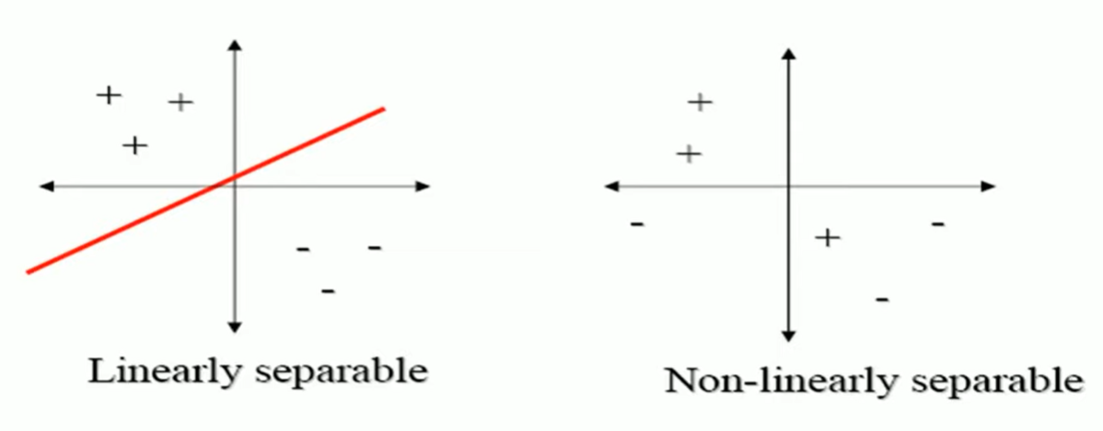
Linear Neurons and Limitations
The perceptron can only model linearly separable functions, − those functions which can be drawn in 2-dim graph and single straight line separates values in two part.
Boolean functions given below are linearly separable: − AND − OR − COMPLEMENT
It cannot model XOR function as it is non linearly separable. − When the two classes are not linearly separable, it may be desirable to obtain a linear separator that minimizes the mean squared error.

Slide 4
XOR – Non linearly separable function
A typical example of non-linearly separable function is the XOR that computes the logical exclusive or..
This function takes two input arguments with values in {0,1} and returns one output in {0,1},
Here 0 and 1 are encoding of the truth values false and true,
The output is true if and only if the two inputs have different truth values.
XOR is non linearly separable function which can not be modeled by perceptron.
For such functions we have to use multilayer perceptron.

Slide 5
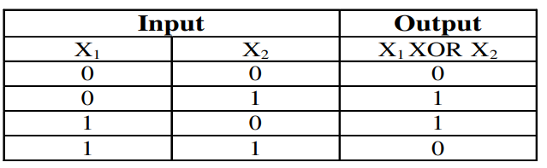
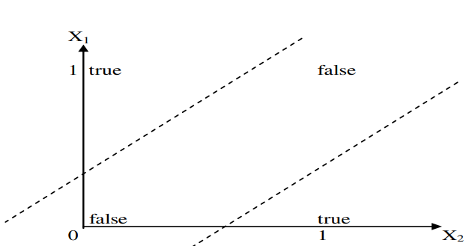
XOR – Non linearly separable function
These two classes (true and false) cannot be separated using a line. Hence XOR is non linearly separable.

Slide 6
Multilayer Perceptron
To overcome the practical limitations of the perceptron and the LMS algorithm, we look to a neural network structure known as the multilayer perceptron.
The following three points highlight the basic features of multilayer perceptrons:
• The model of each neuron in the network includes a nonlinear activation function that is differentiable.
• The network contains one or more layers that are hidden from both the input and output nodes.
• The network exhibits a high degree of connectivity, the extent of which is determined by synaptic weights of the network.

Slide 7
Question: Multilayer Perceptron
Explain the three basic features of the multilayer perceptron and the two phases of training by back-propagation algorithm with LMS as a special case.

Slide 8
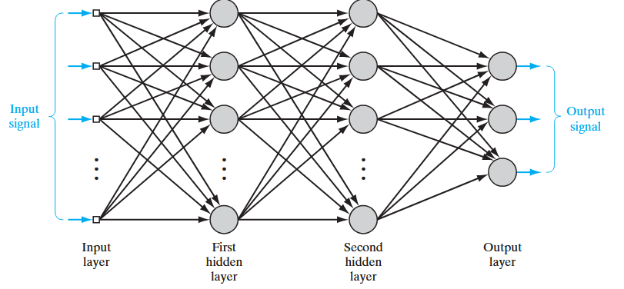
Architectural graph of a multilayer perceptron
Architectural graph of a multilayer perceptron with two hidden layers
Notes:
To set the stage for a description of the multilayer percep-tron in its general form, the network shown here is fully connected. This means that a neu-
ron in any layer of the network is connected to all the neurons (nodes) in the previous layer. Signal flow through the network progresses in a forward direction, from left to right
and on a layer-by-layer basis.

Slide 9
Architectural graph of a multilayer perceptron (MLP)
A multilayer perceptron (MLP) is a perceptron that teams up with additional perceptron stacked in several layers, to solve complex problems.
Each perceptron sends multiple signals, one signal going to each perceptron in the next layer.
For each signal, the perceptron uses different weights.
The multilayer perceptron has another, more common name—a neural network.
• A three-layer MLP is called a Non-Deep or Shallow Neural Network.
• An MLP with four or more layers is called a Deep Neural Network.
Classic Perceptron Vs. A Neural Network:
• In a classic perceptron, the decision function is a step function and the output is binary.
• In neural networks that evolved from MLPs, other activation functions can be used, usually between 0 and 1 or between -1 and 1.
• This allows for probability-based predictions or classification of items into multiple labels.
A Multilayer Perceptron (MLP) is a feedforward artificial neural network consisting of multiple layers of interconnected neurons.
Input Layer: Each neuron or node in this layer corresponds to an input feature. For instance, if you have three input features the input layer will have three neurons.
Hidden Layers: MLP can have any number of hidden layers with each layer containing any number of nodes. These layers process the information received from the input layer.
Output Layer: The output layer generates the final prediction or result. If there are multiple outputs, the output layer will have a corresponding number of neurons.
A binary classification problem may have a single output neuron and use a sigmoid activation function to output a value between 0 and 1
A multi-class classification problem may have multiple neurons in the output layer, one for each class

Slide 10
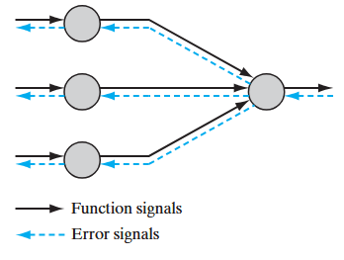
Multilayer Perceptron: Two kinds of Signal
Two kinds of signals are identified in Multilayer Perceptron network:
1. Function Signals. A function signal is an input signal (stimulus) that comes in at the input end of the network, propagates forward (neuron by neuron) through the network, and emerges at the output end of the network as an output signal. We refer to such a signal as a “function signal” for two reasons. First, it is presumed to perform a useful function at the output of the network. Second, at each neuron of the network through which a function signal passes, the signal is calculated as a
function of the inputs and associated weights applied to that neuron. The function signal is also referred to as the input signal.
2. Error Signals. An error signal originates at an output neuron of the network and propagates backward (layer by layer) through the network. We refer to it as an “error signal” because its computation by every neuron of the network involves an error-dependent function in one form or another

Slide 11


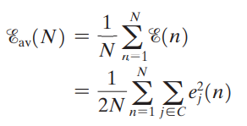

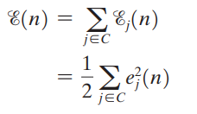
Batch learning and Online Learning: Background Information
Consider a multilayer perceptron with an input layer of source nodes, one or more hidden layers, and an output layer consisting of one or more neurons
Training Samples:
Let yj (n) denote the function signal produced at
the output of neuron j in the output layer by the
stimulus x(n) applied to the input layer.
Correspondingly, the error signal produced
at the output of neuron j is defined by
where dj (n) is the ith element of the desired-response vector d(n)
With the training sample consisting
of N examples, the error energy
averaged over the training sample,
is defined by
Summing the error-energy contributions of
all the neurons in the output layer,
we express the total instantaneous error
energy of the whole network as
Instantaneous error energy
of neuron j is defined by
set C includes all
the neurons in the
output layer.

Slide 12
Batch learning: How weights are updated
In the batch method of supervised learning, adjustments to the synaptic weights of the multilayer perceptron are performed after the presentation of all the N examples in the training sample t that constitute one epoch of training.
In other words, the cost function for batch learning is defined by the average error energy E_{av}. Adjustments to the synaptic weights of the multilayer perceptron are made on an epoch-by-epoch basis.

Slide 13
Batch learning: Advantages and Disadvantages
Advantages: With the method of gradient descent used to perform the training, the advantages of batch learning include the following:
• Accurate estimation of the gradient vector (i.e., the derivative of the cost function E_{av} with respect to the weight vector w), thereby guaranteeing, under simple conditions, convergence of the method of steepest descent to a local minimum;
• parallelization of the learning process.
Disadvantages:
However, from a practical perspective, batch learning is rather demanding in terms of storage requirements

Slide 14
Online learning: How weights are updated
In the on-line method of supervised learning, adjustments to the synaptic weights of the multilayer perceptron are performed on an example-by-example basis.The cost function to be minimized is therefore the total instantaneous error energy e(n).
Consider an epoch of N training examples arranged in the order {x(1), d(1)}, {x(2), d(2)}, {x(N), d(N)}.The first example pair {x(1), d(1)} in the epoch is presented to the network, and the weight adjustments are performed using the method of gradient descent.
Then the second example {x(2), d(2)} in the epoch is presented to the network, which leads to further adjustments to weights in the network. This procedure is continued until the last example {x(N), d(N)} is accounted for.

Slide 15
Online learning: Advantages and Disadvantages
Advantage:
On-line learning is the fact that it requires much less storage than batch learning.
Given that the training examples are presented to the network in a random manner, the use of on-line learning makes the search in the multidimensional weight space stochastic in nature; it is for this reason that the method of on-line learning is sometimes referred to as a stochastic method. This stochasticity has the desirable effect of making it less likely for the learning process to be trapped in a local minimum.
On-line learning is popular for solving pattern-classification problems because it is simple to implement.
Disadvantages:
Parallalization cannot be achieved in on-line learning.

Slide 16
Question: Batch and Online learning
Evaluate how batch and online learning impact convergence rate, generalization capability, and computational performance
How do batch learning and on-line learning differ in terms of synaptic weight adjustments in a multilayer perceptron, and what are the advantages associated with each method?

Slide 17
MLP or Neural Network: Training process
The neural network needs to be trained in order to work. Its training process is in the context of supervised machine learning, where each data sample has a label informing to which class it belongs to. Thus, the general idea is to make the network able to learn the patterns relative to each class of objects we have, so when a new unknown sample of data is given to the network, it will be able to predict to which class that sample belongs to. How can this be done?
The idea of the backpropagation algorithm is, based on error (or loss) calculation, to recalculate the weights array w in the last neuron layer, and proceed this way towards the previous layers, from back to front, that is, to update all the weights w in each layer, from the last one until reaching the input layer of the network, for this doing the backpropagation of the error obtained by the network. In other words, we calculate the error between what the network predicted to be and what it was indeed, then we recalculate all the weights values, from the last layer to the very first one, always intending to decrease the neural network error.

Slide 18
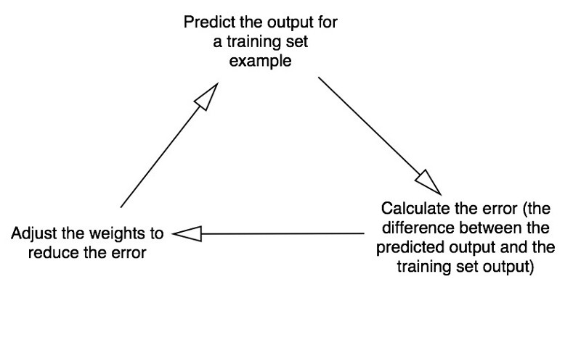
MLP or Neural Network: Training process
Forward Propagation
Backward Propagation

Slide 19
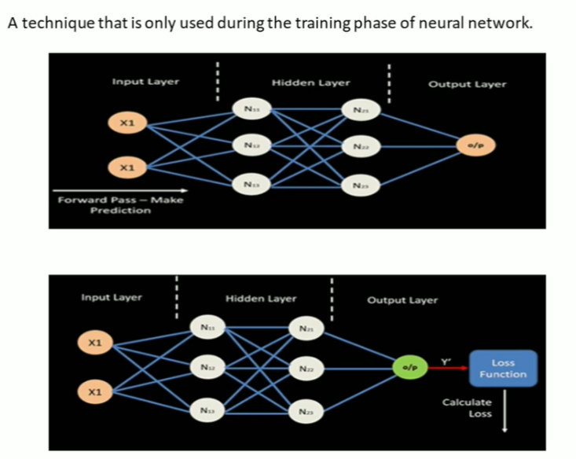
Backpropagation
Notes:
A technique that is only used during training phase of neural network.

Slide 20
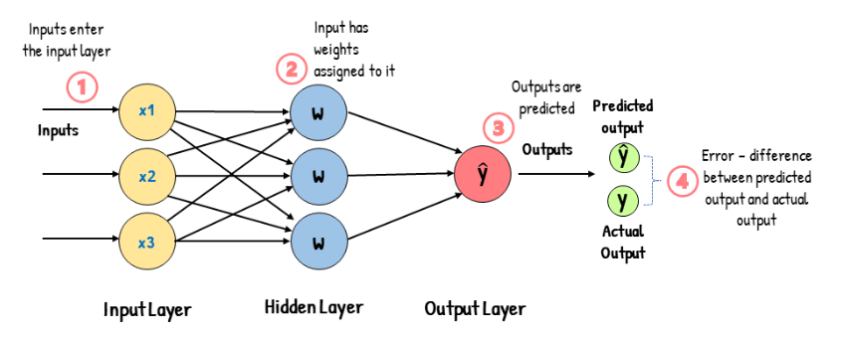
How Backpropagation works?
Backpropagation: A technique that is only used during training phase of neural network.

Slide 21
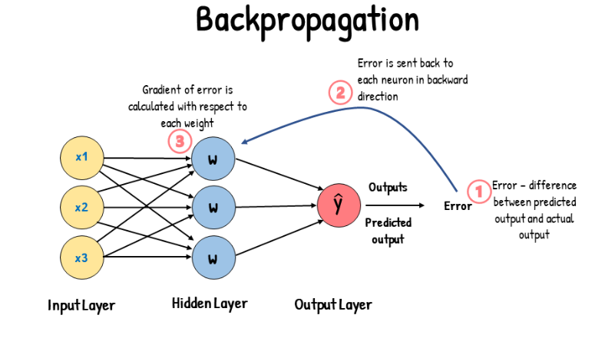

Slide 22
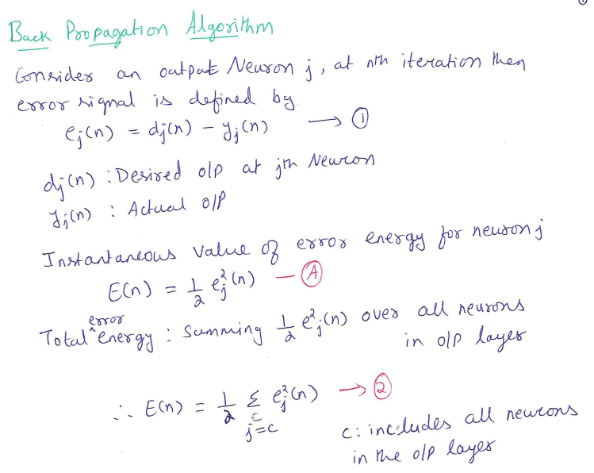

Slide 23
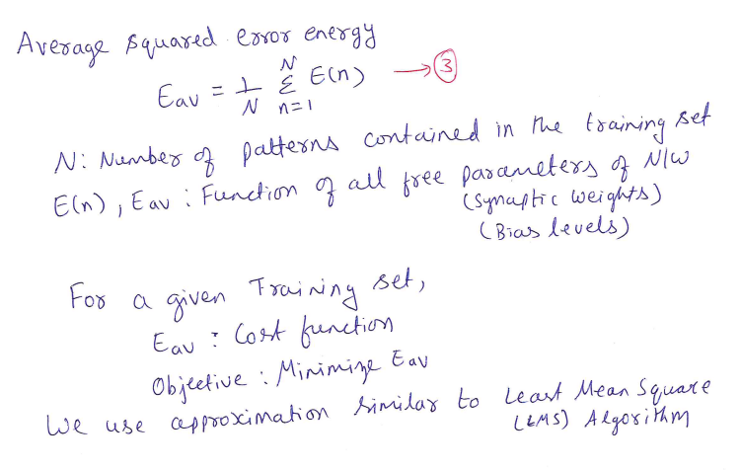
Back Propagation Algorithm

Slide 24
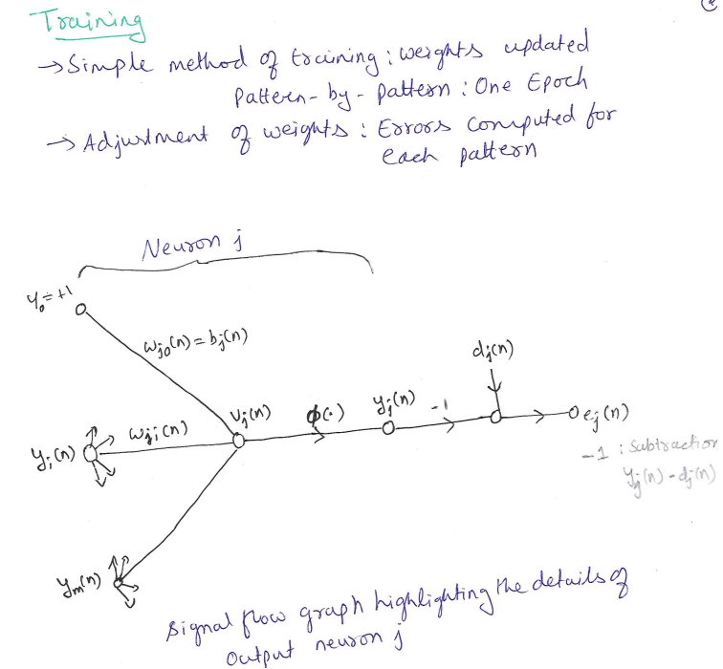
Back Propagation Algorithm

Slide 25
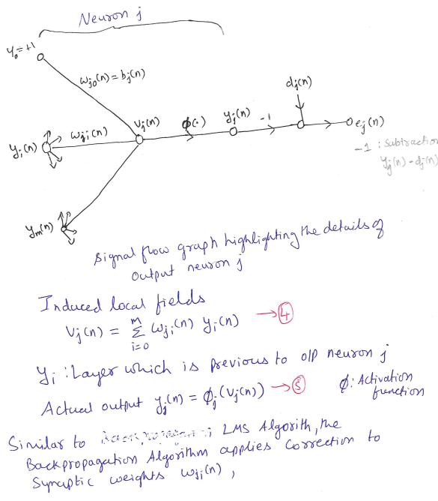
Back Propagation Algorithm

Slide 26
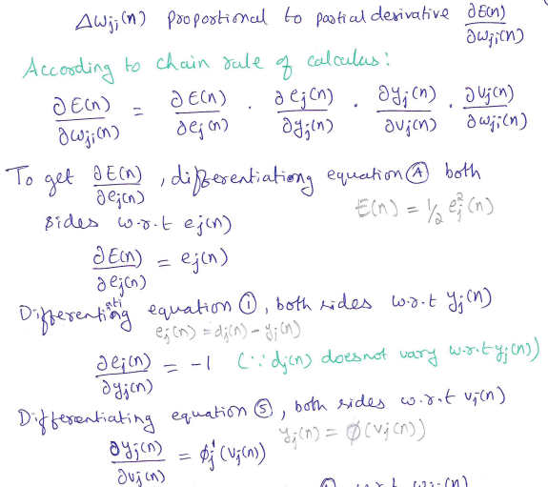
Back Propagation Algorithm

Slide 27
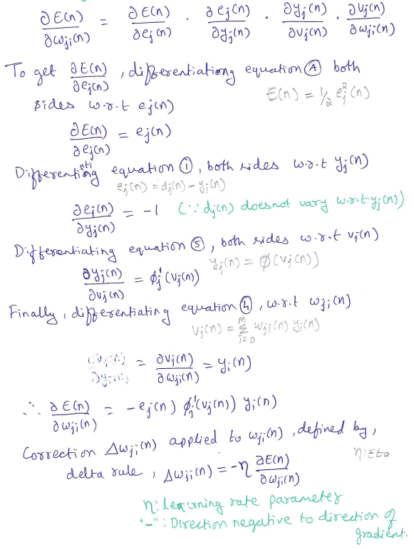
Back Propagation Algorithm

Slide 28
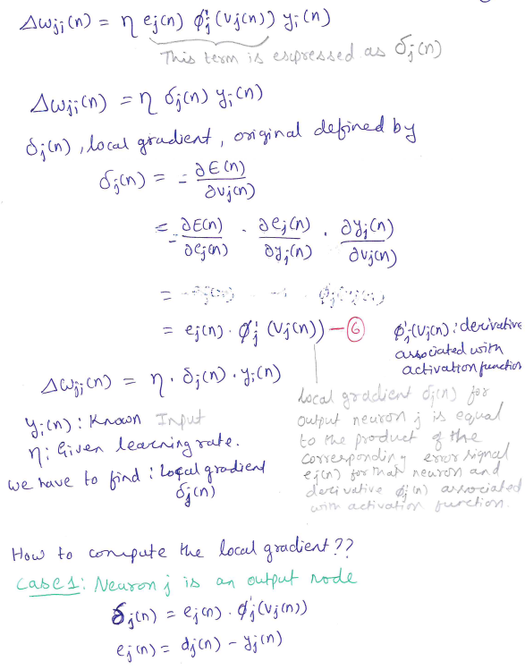
Back Propagation Algorithm

Slide 29
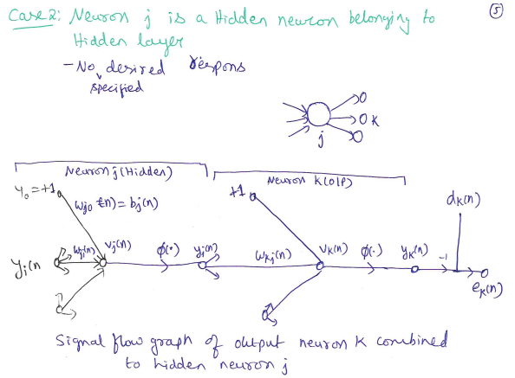
Back Propagation Algorithm

Slide 30
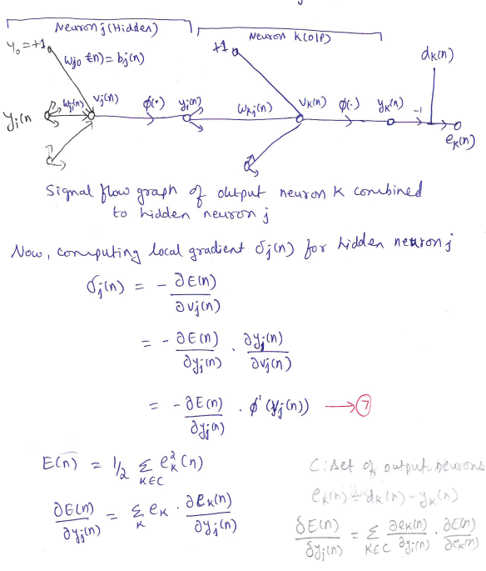
Back Propagation Algorithm

Slide 31
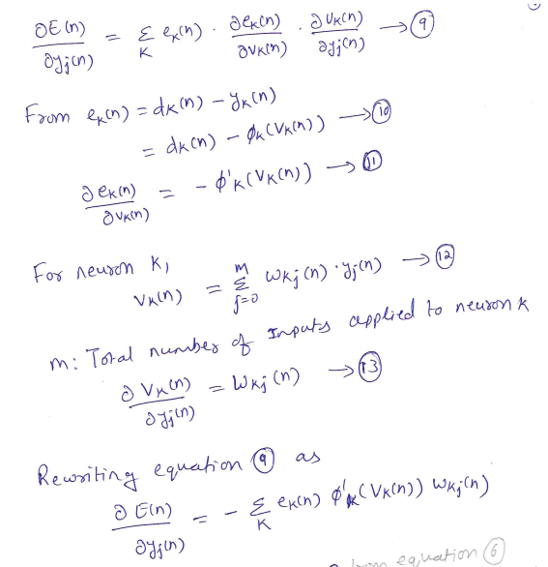
Back Propagation Algorithm

Slide 32
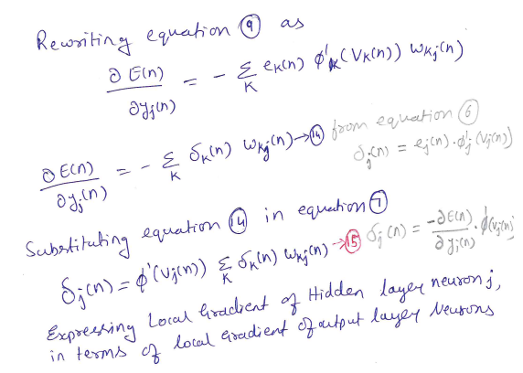
Back Propagation Algorithm

Slide 33
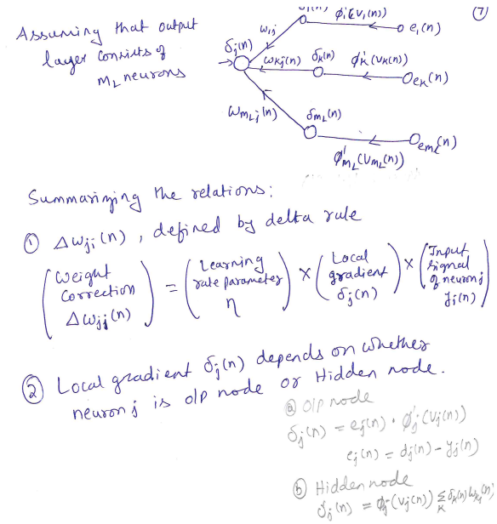
Back Propagation Algorithm

Slide 34
Question: Back Propagation algorithm
Derive the expression for the local gradient δj(n) used to change the synaptic weights in the backpropagation algorithm.
Derive the local gradient expressions for Neuron j as an output node and as a hidden node, detailing the differences in their calculations

Slide 35
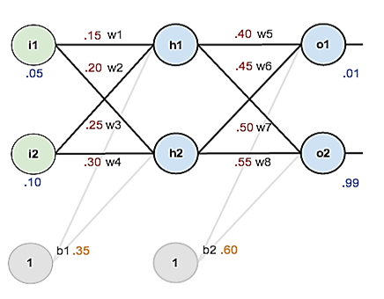
Question: Back Propagation algorithm
Consider the network given below apply the backpropagation algorithm to update the weights w1- w8 to obtain the output expected output with the learning rate 0.5. Use sigmoid activation function to train the network.
Neural Network: 2 inputs, 2 hidden neurons,
2 output Neurons

Slide 36
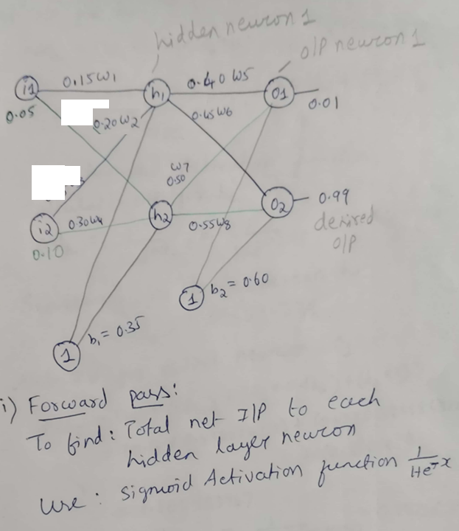
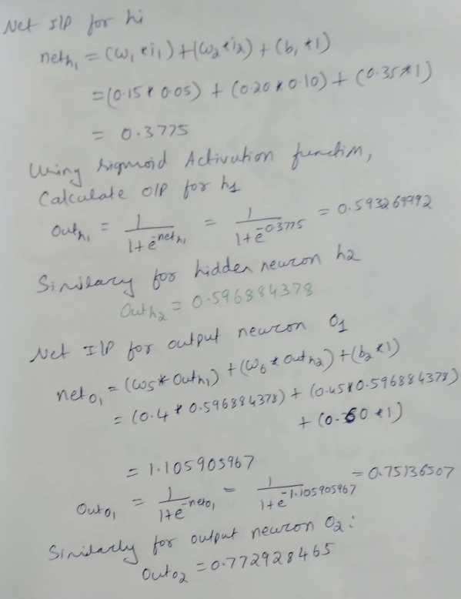
0.25 W3

Slide 37
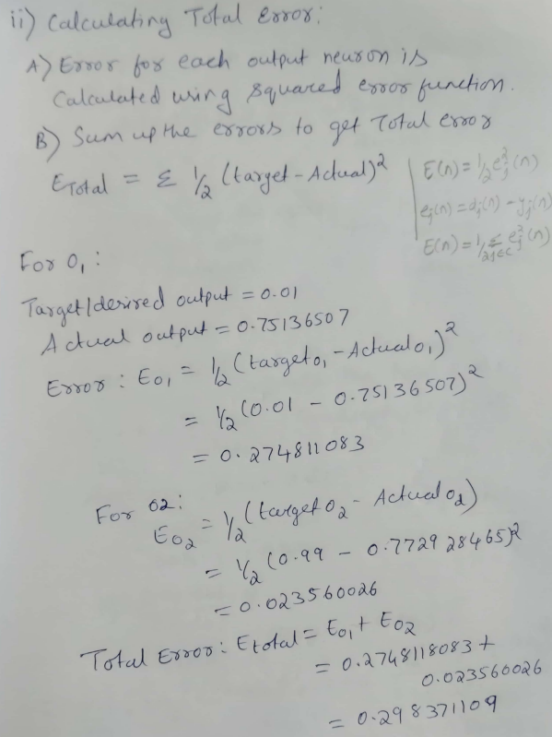
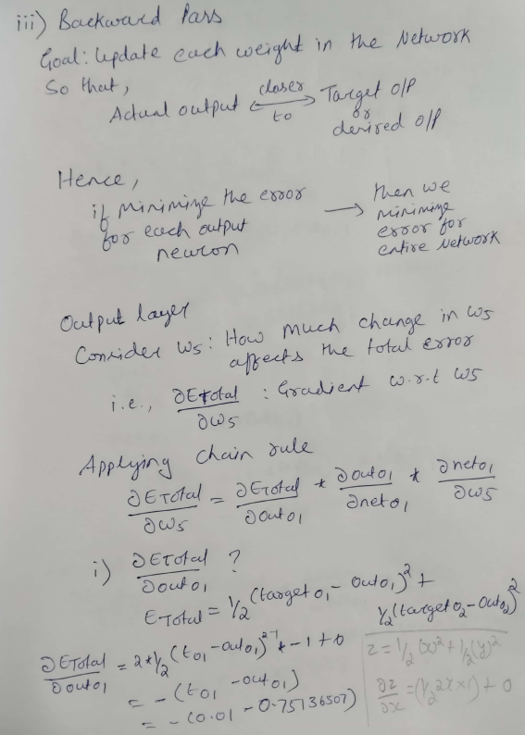

Slide 38
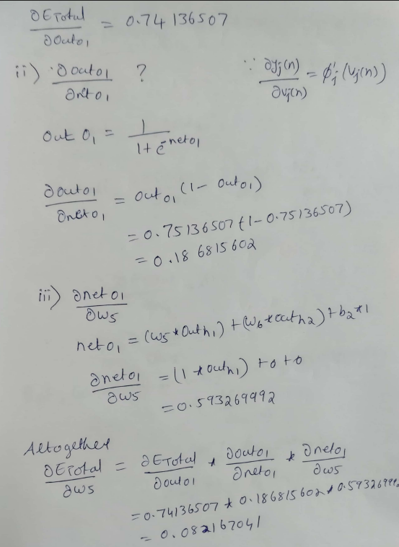
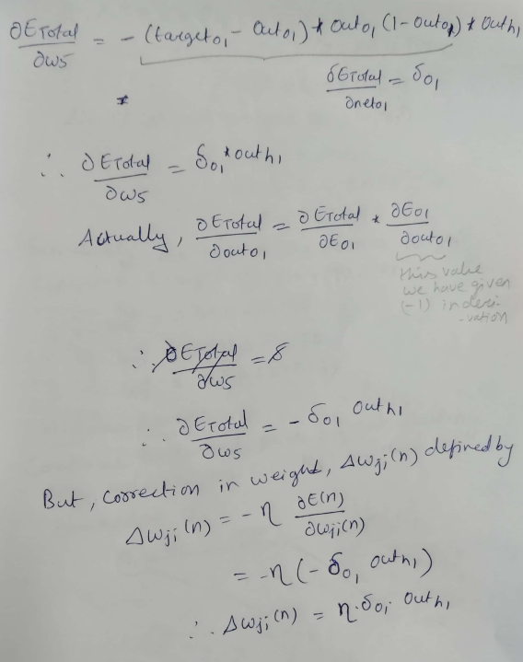

Slide 39
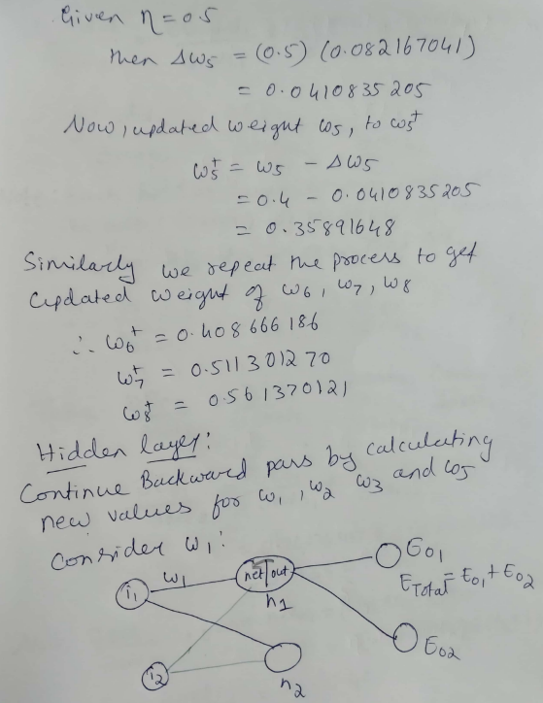
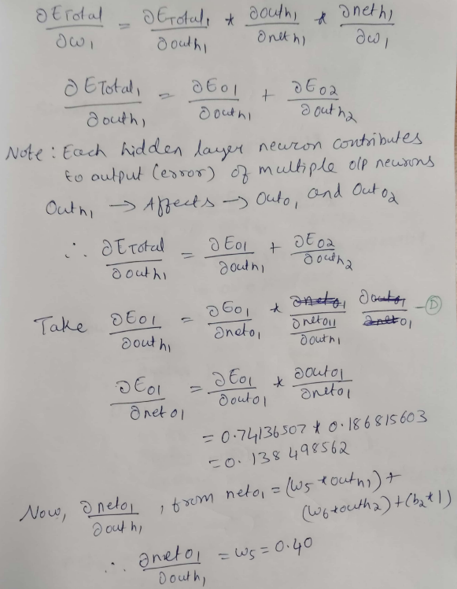

Slide 40
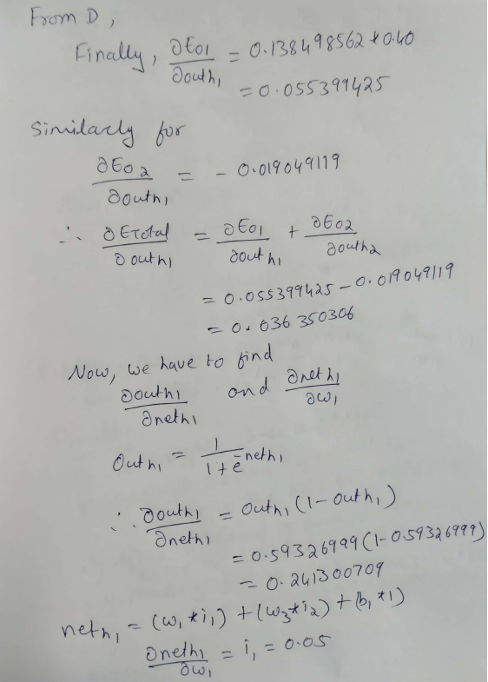
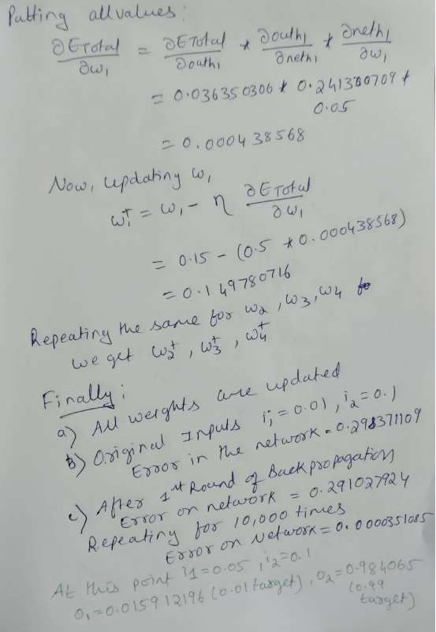

Slide 41
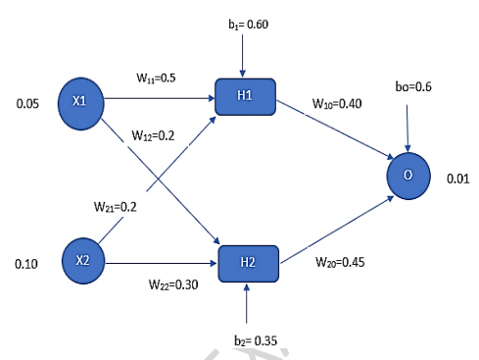
Question: Back Propagation algorithm
Consider a multilayer feed-forward neural network given below. Let the learning rate be 0.5. Assume initial values of weights and biases as given in the figure below. Show weight and bias updates by using back-propagation algorithm. Assume that sigmoid activation function is used in the network.

Slide 42
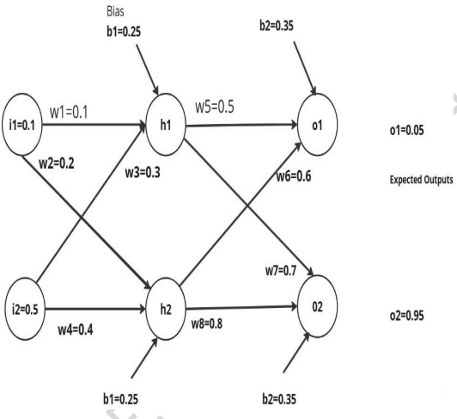
Question: Back Propagation algorithm
Apply the backpropagation algorithm for the network given below to update the weights w1- w8 to obtain the expected output with the learning rate 0.6. Use sigmoid activation function to train the network. In the network, i1, i2 are input layer neurons, h1 and h2 in hidden layer neurons and o1 and o2 are output layer neurons.

Slide 43
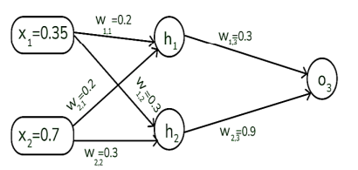
Question: Back Propagation algorithm
Assume that the neurons have the sigmoid activation function to perform forward and backward pass on the network. And also assume that the actual output of y is 0.5 and the learning rate is 1. Show weight updates by using back-propagation algorithm.

Slide 44
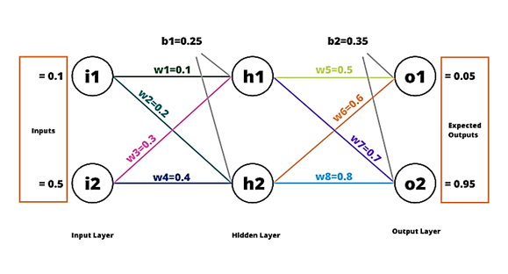
Question:Back Propagation algorithm
Consider the network given below apply the backpropagation algorithm to update the weights w1- w8 to obtain the output expected output with the learning rate 0.6. Use sigmoid activation function to train the network.

Slide 45
Hessian and its role in online learning

Slide 46
Why Do We Need the Hessian?
So far, in backpropagation learning, we have focused on:
First-order derivative → Gradient of the error surface
Used to decide the direction of weight update
However, we often observe that:
Learning is fast in some cases and very slow in others
Learning may oscillate or become unstable
Lower layers learn slowly compared to upper layers
These behaviors cannot be explained by gradients alone. To understand them, we must study the second-order structure of the error surface — the Hessian matrix.

Slide 47
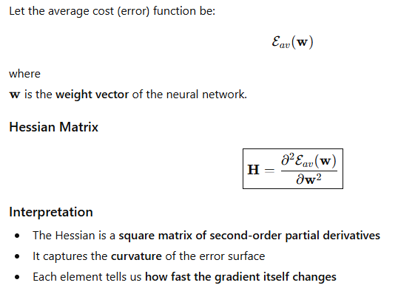
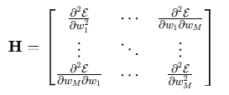
Definition of the Hessian Matrix
Gradient tells us where to go; Hessian tells us how the surface bends.

Slide 48
Role of the Hessian in Neural Network Learning
The Hessian plays an important role in neural networks, especially in:
Backpropagation learning dynamics
Stability of learning
Speed of convergence
The eigenstructure of the Hessian strongly influences learning behavior in backpropagation.

Slide 49
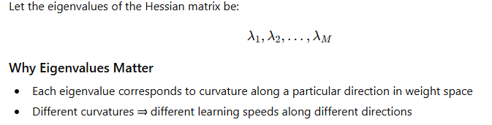
Eigenvalues of the Hessian

Slide 50
Typical Eigenvalue Composition in MLPs
For a multilayer perceptron trained using backpropagation, experiments show that the Hessian has:
a small number of small eigenvalues
a large number of medium-sized eigenvalues
a small number of large eigenvalues

Slide 51
Factors Affecting Hessian Eigenvalues
(i) Nonzero-Mean Input or Output Signals
If inputs or induced neural outputs have nonzero mean:
Hessian eigenvalue spread increases
Learning becomes slower and more unstable
Design Principle: Avoid nonzero-mean input signals whenever possible.
(ii) Correlation Between Inputs and Outputs
High correlation between input vector elements
High correlation between neuron outputs
Leads to: Ill-conditioned Hessian and Slow convergence
(iii)Layer-Wise Variations in Second-Order Derivatives
Second derivatives are:
Smaller in lower layers
Larger in higher layers
Important Insight
Weights in the first hidden layer learning slowly
Weights in the last layers learn faster
Notes:
x1x_1x1​ = temperature in Celsius
x2x_2x2​ = temperature in Fahrenheit
Relation:
x2=1.8x1+32x_2 = 1.8x_1 + 32x2​=1.8x1​+32 Why This Is Correlated
Both inputs represent the same physical quantity
When x1x_1x1​ increases, x2x_2x2​ also increases
One input can be predicted from the other
📌 Conclusion Inputs are highly correlated.
Correlated Input Example:
Temperature in °C and °F
Correlated Output Example:
Two hidden neurons learning the same feature
Correlated input: Inputs that carry redundant information, such as temperature in Celsius and Fahrenheit.
Correlated output: Hidden neurons producing similar activations due to similar weights or inputs.
“Do we learn faster if we repeat the same information twice?”
Then connect:
“Neural networks also learn slower with repeated (correlated) information.”

Slide 52
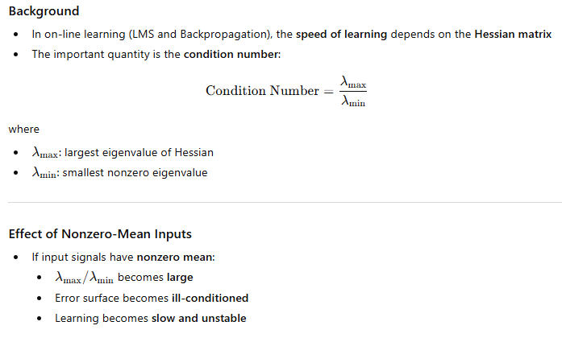

Avoidance of Nonzero-mean Inputs

Slide 53
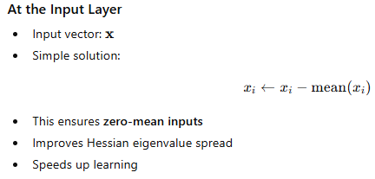

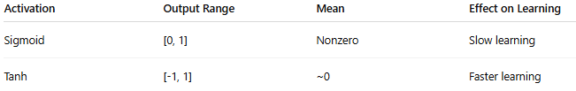
How to Avoid Nonzero-Mean Signals in Neural Networks
Zero-mean signals → better Hessian → faster learning
Nonzero-mean signals → poor Hessian → slow learning

Slide 54
Asymptotic Behavior of On-line Learning
Asymptotic behavior refers to:
The behavior of the learning process after a very large number of iterations (i.e., as n→∞)
In simple terms:
What happens to the weights after long training?
Do they converge?
Do they fluctuate?
How stable is the learning?
In on-line learning:
Network weights are updated one sample at a time
Learning is stochastic (contains randomness)
Error does not decrease smoothly
To understand such learning, we study how the average learning curve behaves over a long period of time.

Slide 55
Asymptotic Behavior of On-line Learning
In on-line learning, weights are updated one sample at a time, so learning is stochastic. Because of this randomness, even after a very long time, the weights do not settle exactly at the minimum — they fluctuate around it.
“This long-term behavior of weights is what we call asymptotic behavior.”
“If the weights are fluctuating, what controls how large these fluctuations are?”
The answer is — the learning rate.

Slide 56

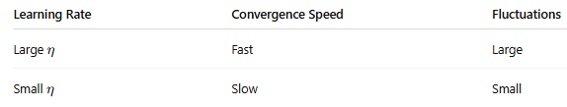
Asymptotic Behavior of On-line Learning
To ensure stable learning, the learning rate must satisfy:
where: λ_{max}​ = largest eigenvalue of the Hessian
If η is too large:
Learning becomes unstable
Weights may diverge

Slide 57
Question: Hessian and its role in online learning
What is the role of the Hessian in study of neural networks, how does avoiding nonzero-mean inputs impact the learning process, and what is the importance of asymptotic behavior of assuming a fixed learning-rate parameter?

Slide 58
Generalization

Slide 59
Generalization
In back-propagation learning, we typically start with a training sample and use the backpropagation algorithm to compute the synaptic weights of a multilayer perceptron by loading as many of the training examples as possible into the network. The hope is that the neural network so designed will generalize well.
A network is said to generalize well when the input–output mapping computed by the network is correct for test data.
The learning process (i.e., training of a neural network) may be viewed as a “curvefitting” problem. The network itself may be considered simply as a nonlinear input–output mapping.
Such a viewpoint then permits us to look at generalization not as a mystical property of neural networks, but rather simply as the effect of a nonlinear interpolation of the input data.
Nonlinear interpolation is the process of estimating unknown data points within a known range by fitting a nonlinear function to the existing data, such that the interpolated points form a curve rather than a straight line.

Slide 60
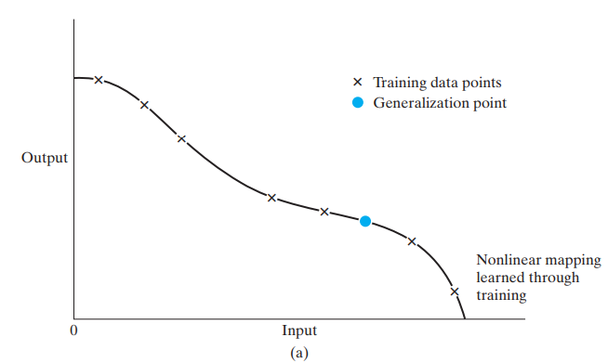
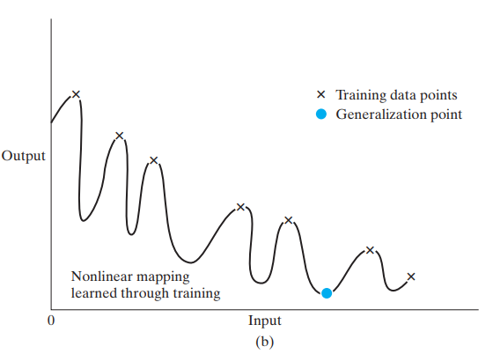
Generalization
Figure illustrates how generalization may occur in a hypothetical network. The nonlinear input–output mapping represented by the curve depicted in this figure is computed by the network as a result of learning the points labeled as “training data.” The point marked in blue on the curve as “generalization” is thus seen as the result of interpolation performed by the network.
When, however, a neural network learns too many input–output examples, the network may end up memorizing the training data. It may do so by finding a feature (due to noise, for example) that is present in the training data, but not true of the underlying function that is to be modeled. Such a phenomenon is referred to as overfitting or overtraining. When the network is overtrained, it loses the ability to generalize between similar input–output patterns.
Properly fitted nonlinear mapping with good generalization. (b) Overfitted nonlinear mapping with poor generalization.

Slide 61
Unit-2
Multilayer Perceptron: Introduction, Batch Learning and on-line Learning, The Back- Propagation Algorithm, The Hessian and its Role in On-Line Learning, Generalization, Approximation of Functions, Cross-Validation, Complexity Regularization and Network Pruning, Supervised Learning viewed as an Optimization, Non-Linear Filtering

Slide 62
APPROXIMATIONS OF FUNCTIONS
A multilayer perceptron trained with the back-propagation algorithm may be viewed as a practical vehicle for performing a nonlinear input–output mapping of a general nature.
To be specific, let m0 denote the number of input (source) nodes of a multilayer perceptron, and let M = m_{L} denote the number of neurons in the output layer of the network.
The input–output relationship of the network defines a mapping from an m0-dimensional Euclidean input space to an M-dimensional Euclidean output space, which is infinitely continuously differentiable when the activation function is likewise.
In assessing the capability of the multilayer perceptron from this viewpoint of input–output mapping, the following fundamental question arises:

Slide 63
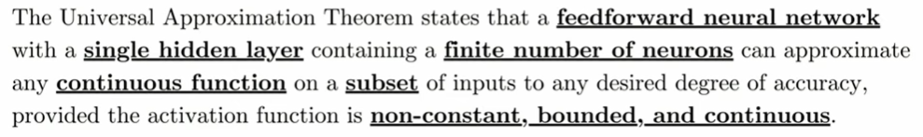
Universal Approximation Theorem

Slide 64
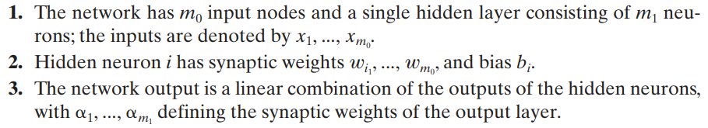
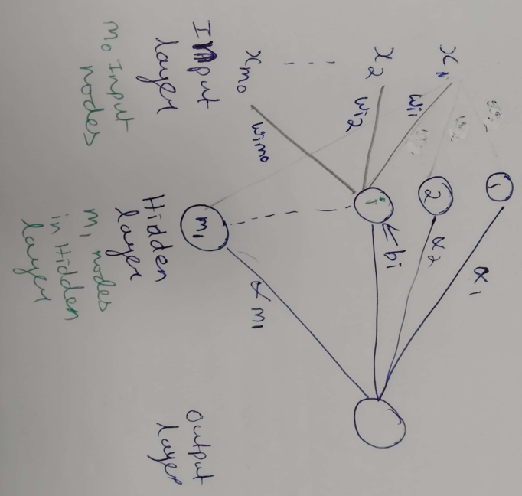
Consider a Neural Network

Slide 65

Consider a Neural Network

Slide 66

Universal Approximation Theorem

Slide 67
Theoretical Insights of the Theorem
The Universal Approximation Theorem provides theoretical assurance that neural networks are capable of learning almost any function. Specifically, a single hidden layer neural network can approximate any continuous function on a compact subset of real numbers, given enough neurons and an appropriate activation function.
This highlights the strength of neural networks:
Expressiveness: Neural networks can model functions of varying complexity.
Scalability: Larger networks (more neurons and layers) can approximate more complex functions with greater precision.

Slide 68
Practical Limitations of UAT
While the Universal Approximation Theorem is mathematically elegant, it comes with certain practical limitations:
1. Network Size and Efficiency
The theorem guarantees that a neural network can approximate any continuous function, but it doesn’t specify the size of the network required. In some cases, the number of neurons required to achieve a high degree of accuracy may be impractically large.
2. Overfitting
The network may fit the training data perfectly, but it can also overfit, meaning it performs poorly on unseen data. Regularization techniques like dropout or early stopping are needed to mitigate this risk.
3. Generalization
The theorem applies to the function approximation on the given training set, but it doesn’t guarantee how well the network will generalize to new, unseen data. Techniques such as cross-validation help ensure good generalization.
4. Training Difficulties
While the theorem assures that such an approximation exists, it doesn't provide insights on how to efficiently train the network. Gradient-based optimization methods can get stuck in local minima or saddle points, making it challenging to find the optimal solution.

Slide 69
Question: Approximation functions
Write an expression for the Universal approximation theorem (UAT) for a nonlinear input -output mapping and explain the intuition behind UAT.

Slide 70
Cross-validation
Cross-validation is a technique used to check how well a machine learning model performs on unseen data while preventing overfitting. It works by:
Splitting the dataset into several parts.
Training the model on some parts and testing it on the remaining part.
Repeating this resampling process multiple times by choosing different parts of the dataset.
Averaging the results from each validation step to get the final performance.

Slide 71
Cross Validation
The use of cross-validation is appealing particularly when we have to design a large neural network with good generalization as the goal.
We can use cross-validation to determine the –
multilayer perceptron with the best number of hidden neurons (Model Selection)
to figure out when it is best to stop training (Early Stopping Method for Training)

Slide 72
Cross-Validation for Model Selection
Problem
Too few hidden neurons → Underfitting
Too many hidden neurons → Overfitting
Procedure
Fix learning algorithm and activation functions
Choose different candidate architectures:
MLP with 5, 10, 15, 20 hidden neurons
For each architecture:
Train on training set
Measure error on validation set
Select the architecture with minimum validation error

Slide 73

Cross Validation: Early Stopping Method for Training
X-axis: Number of epochs Y-axis: Mean Square Error (MSE)
Training error (black curve):
Decreases continuously
Validation error (blue curve):
Decreases initially
Starts increasing after a point
Early Stopping Rule
Stop training at the epoch where validation error is minimum
This point is called the early stopping point.
Why It Works
Acts as a regularization technique
Prevents the network from memorizing training data
Illustration of the early-stopping rule
based on cross-validation.

Slide 74

Variants of Cross-Validation
The hold-out method involves splitting the data into multiple parts and using one part for training the model and the rest for validating and testing it.
Multifold cross-validation by dividing the available set of N examples into K subsets, where K 1; this procedure assumes that K is divisible into N. The model is trained on all the subsets except for one, and the validation error is measured by testing it on the subset that is left out. This procedure is repeated for a total of K trials, each time using a different subset for validation. The performance of the model is assessed by averaging the squared error under validation over all the trials of the experiment. There is a disadvantage to multifold cross-validation: It may require an excessive amount of computation, since the model has to be trained K times, where 1 < K <= N
Illustration of the multifold method (K=4) of crossvalidation.
For a given trial, the subset of data shaded in blue is
used to validate the model trained on the remaining data.

Slide 75
Variants of Cross-Validation
Leave-one-out method:
In this case, N - 1 examples are used to train the model, and the model is validated by testing it on the example that is left out.
The experiment is repeated for a total of N times, each time leaving out a different example for validation.
The squared error under validation is then averaged over the N trials of the experiment.

Slide 76


Variants of Cross-Validation
Leave-one-out method:
In this case, N - 1 examples are used to train the model, and the model is validated by testing it on the example that is left out.
The experiment is repeated for a total of N times, each time leaving out a different example for validation.
The squared error under validation is then averaged over the N trials of the experiment.
Multifold Cross validation, k=3
Leave-one-out- Cross validation

Slide 77
COMPLEXITY REGULARIZATION AND NETWORK PRUNING
Why Do We Need Regularization?
When training a neural network:
If the network is too flexible, it may memorize training data → overfitting
If the network is too simple, it may not learn enough → underfitting
We need a balance between:
Accuracy on training data
Simplicity (complexity control) of the network
This balance is achieved using regularization.

Slide 78



COMPLEXITY REGULARIZATION AND NETWORK PRUNING
The learning problem is formulated as minimizing the total risk:

Slide 79


COMPLEXITY REGULARIZATION AND NETWORK PRUNING
The learning problem is formulated as minimizing the total risk:

Slide 80


COMPLEXITY REGULARIZATION AND NETWORK PRUNING
The learning problem is formulated as minimizing the total risk:

Slide 81



COMPLEXITY REGULARIZATION AND NETWORK PRUNING
The learning problem is formulated as minimizing the total risk:
Role of Regularization Parameter $λ$
Case 1: $λ=0$
No regularization
Network determined only by training data
High risk of overfitting

Slide 82


COMPLEXITY REGULARIZATION AND NETWORK PRUNING
The learning problem is formulated as minimizing the total risk:
Role of Regularization Parameter $λ$
Case 2: $λ→∞$
Complexity penalty dominates
Training data becomes unreliable
Network weights forced to be very small
Model becomes overly simple (underfitting)

Slide 83

COMPLEXITY REGULARIZATION AND NETWORK PRUNING
The learning problem is formulated as minimizing the total risk:
Role of Regularization Parameter $λ$
Case 3: 0<λ<∞
Balanced learning
Good generalization
Best compromise between:
Accuracy
Simplicity
Choosing $λ$ is crucial (often done using validation data).

Slide 84

COMPLEXITY REGULARIZATION AND NETWORK PRUNING
The learning problem is formulated as minimizing the total risk:
Total risk = training error + complexity penalty
$ℰ_{av}$→ depends on data + network
$ℰ_{c}$→ depends only on weights
$λ$ controls tradeoff between:
Overfitting
Underfitting

Slide 85
COMPLEXITY REGULARIZATION AND NETWORK PRUNING
Why Do Neural Networks Need Regularization and Pruning?
Think of a neural network as a very flexible curve-fitting machine.
More weights → more flexibility
Too much flexibility → memorization → poor performance on new data
So we need techniques that:
Control complexity while learning
Remove unnecessary parts after learning
This leads to:
Weight Decay → controls complexity during training
Network Pruning → removes redundancy after training

Slide 86
COMPLEXITY REGULARIZATION AND NETWORK PRUNING
Intuition Behind Weight Decay
Simple Analogy: Imagine tuning a radio:
Turning volume too high → noise
Turning volume too low → cannot hear
Best sound → moderate volume
Weights in a neural network behave like volume knobs
Large weights → network reacts strongly → overfitting
Small weights → smoother, more stable behaviour
Weight decay gently pulls weights toward smaller values.
Notes:
Smaller weights mean:
Smoother input–output mapping
Small change in input → small change in output
Less sensitivity to noise
Better generalization
Works well on unseen data
📌 Weight decay does not remove weights, it only shrinks them.

Slide 87
COMPLEXITY REGULARIZATION AND NETWORK PRUNING
Why Prune a Network?
After training:
Many weights exist
Some are important
Some are barely used
Just because a weight exists does not mean it matters
Pruning removes:
Redundant connections
Ineffective neurons
Simple Analogy for Pruning
Analogy: Team Project
A team has 10 members
Only 6 are doing real work
Removing the other 4 does not affect output
Pruning removes non-contributing members.

Slide 88
COMPLEXITY REGULARIZATION AND NETWORK PRUNING
Weight decay prevents a neural network from becoming too complex by discouraging large weights during learning.
Network pruning, goes a step further by carefully removing unnecessary connections after training while preserving performance.
Together (Weight Decay and Network Pruning), they help build models that are accurate, efficient, and generalize well.

Slide 89
Unit-2
Multilayer Perceptron: Introduction, Batch Learning and on-line Learning, The Back- Propagation Algorithm, The Hessian and its Role in On-Line Learning, Generalization, Approximation of Functions, Cross-Validation, Complexity Regularization and Network Pruning, Supervised Learning viewed as an Optimization, Non-Linear Filtering

Slide 90
What is machine learning optimization?
A major goal of training a machine learning algorithm is to minimize the degree of error between the predicted output and the true output.
Optimization is measured through a loss or cost function, which is typically a way of defining the difference between the predicted and actual value of data. Machine learning models aim to minimize this loss function, or lower the gap between prediction and reality of output data. Iterative optimization will mean that the machine learning model becomes more accurate at predicting an outcome or classifying data.

Slide 91

SUPERVISED LEARNING VIEWED AS AN OPTIMIZATION PROBLEM
Supervised learning is not just weight updating — it is a structured optimization problem on a nonlinear error surface.
What Makes the Error Surface Nonlinear in Neural Networks: Neural networks include: Nonlinear activation functions (ReLU, sigmoid, tanh) and Multiple layers
Error Surface Shape, (a) linear transfer function and (b) nonlinear
Notes:
A nonlinear error surface:
Is curved
Has: Valleys , Ridges, Flat regions, Multiple local minima
Why the Statement Is Powerful
“Supervised learning is not just weight updating…”
This means:
We are not blindly adjusting weights
We are solving a difficult optimization problem
The difficulty comes from nonlinearity
📌 Hence we need:
Conjugate Gradient
Newton
Quasi-Newton methods
In supervised learning, the error surface is nonlinear because the network output depends on weights through nonlinear activation functions and layered compositions, resulting in a complex, curved error landscape rather than a simple linear surface.

Slide 92
SUPERVISED LEARNING VIEWED AS AN OPTIMIZATION PROBLEM
Up to now, supervised learning may have been explained as:
adjusting weights using backpropagation,
reducing error epoch by epoch.
Here, the viewpoint changes:
Training a neural network is treated as a numerical optimization problem.
That is:
The neural network is a function
The weights are variables
The error is a surface
Learning is searching for the minimum of that surface

Slide 93
SUPERVISED LEARNING VIEWED AS AN OPTIMIZATION PROBLEM
What Is Being Optimized?
The quantity being minimized is the average error (cost) over training data:
This error depends on all weights together
Because of nonlinear activation functions, the error surface is:
Nonlinear
High-dimensional
Not a simple bowl
This is why advanced optimization methods are needed.

Slide 94
Optimization Method
Gradient Descent
Conjugate Gradient
Quasi-Newton

Slide 95


Gradient descent
Gradient descent (GD) is a central building block for lots of gradient-based optimization algorithms, including conjugate gradient descent.
Basic idea behind GD is to take a step in the direction of the negative gradient at each iteration.
Let f(x):R^{d} → R be our loss function that we wish to minimize. Given a current estimate x_{t} on the t^{th} iteration, GD takes the following update:
A common way of assessing convergence is to track the reduction in the loss between iterations, and to stop when this reduction falls below some threshold:
where α_{t} is a learning rate parameter

Slide 96

Conjugate gradient descent
Conjugate Gradient Descent (CGD) is an optimization algorithm that finds the minimum of a function more efficiently than standard gradient descent. It's especially powerful for solving large systems of linear equations.
Why Gradient Descent Is Slow
Because it ignores curvature.
If error surface is elongated (elliptical valley):
It zig-zags
Converges slowly
Notes:
Conjugate gradient descent (CGD) adapts the idea of GD to better accommodate the geometry of the objective function. Rather than taking a step in the direction of the negative gradient locally, CGD constrains each step to be orthogonal to the previous ones.

Slide 97
Taylor Series
A Taylor series is a series expansion of a function about a point.
A one-dimensional Taylor series is an expansion of a real function f(x) about a point x=a is given by

Slide 98


Taylor Series of Error Function
Now expand error around current weight vector w(n).
Let E_{av}(w)denote the cost function, averaged over the training sample. Using the Taylor series, we may expand E_{av}(w) about the current operating point on the error surface
The matrix H(n) is the local Hessian representing “curvature” of the error performance surface, defined by
Notes:
In the steepest-descent method, exemplified by the back-propagation algorithm, the adjustment !w(n) applied to the synaptic weight vector w(n) is defined by

Slide 99

Taylor Series of Error Function
Now expand error around current weight vector w(n).
Let E_{av}(w)denote the cost function, averaged over the training sample. Using the Taylor series, we may expand E_{av}(w) about the current operating point on the error surface
The matrix H(n) is the local Hessian representing “curvature” of the error performance surface, defined by
In the steepest-descent method, exemplified by the back-propagation algorithm,
the adjustment Δw(n) applied to the synaptic weight vector w(n) is defined by
Notes:
In the steepest-descent method, exemplified by the back-propagation algorithm, the adjustment !w(n) applied to the synaptic weight vector w(n) is defined by

Slide 100
Taylor Series of Error Function
Now expand error around current weight vector w(n).
Let E_{av}(w)denote the cost function, averaged over the training sample. Using the Taylor series, we may expand E_{av}(w) about the current operating point on the error surface
The matrix H(n) is the local Hessian representing “curvature” of the error performance surface, defined by
In order to produce a significant improvement in the convergence performance of a
multilayer perceptron (compared with back-propagation learning), we have to use
higher-order information in the training process. We may do so by invoking a quadratic
approximation of the error surface around the current point w(n).

Slide 101

Conjugate Gradient Method
Suppose we want to solve the system of linear equations
Ax=b
for the vector x,
where the known n×n matrix A is symmetric (i.e., A^{T}=A), positive definite (i.e. x^{T}Ax>0 for all non-zero vectors x in R^{n}), and real, and b is known as well.
Then the equation has a solution x∗

Slide 102


Conjugate Gradient Method
Solve Ax=b
is equivalent to
$$\text{Minimize} f\left(x\right)=\frac{1}{2}x^{T}Ax−b^{T}x$$

Slide 103



Conjugate Gradient Method
$$\text{Minimize} f\left(x\right)=\frac{1}{2}x^{T}Ax−b^{T}x$$
To minimize $f\left(x\right)$, we compute its gradient and set it to zero.
Gradient of $f\left(x\right)$
Using matrix calculus:
$$∇f\left(x\right)=Ax−b$$
Explanation:

Slide 104

Conjugate Gradient Method
$$\text{Minimize} f\left(x\right)=\frac{1}{2}x^{T}Ax−b^{T}x$$
To minimize $f\left(x\right)$, we compute its gradient and set it to zero.
Gradient of $f\left(x\right)$
Using matrix calculus:
$$∇f\left(x\right)=Ax−b$$
Explanation:

Slide 105


Conjugate Gradient Method
$$\text{Minimize} f\left(x\right)=\frac{1}{2}x^{T}Ax−b^{T}x$$
Thus,
The point where the quadratic function reaches its minimum is exactly the solution of the linear system.

Slide 106

Conjugate Gradient Method
Directly solving
$$Ax=b$$
using matrix inversion is expensive for large systems.
Instead, we convert the problem into an optimization problem:
$$\min{f}\left(x\right)=\frac{1}{2}x^{T}Ax−b^{T}x$$
Then use iterative optimization methods such as:
Conjugate Gradient
Quasi-Newton methods
These methods move toward the minimum of the quadratic function, which automatically gives the solution of $Ax=b$.

Slide 107

Conjugate Gradient Method

Slide 108

Conjugate Gradient Method
Contour diagram of the quadratic function (paraboloid) with two optimization paths:
Gradient Descent → zig-zag path
Conjugate Gradient → faster path to the minimum ⭐
Notes:
Gradient descent always moves in the steepest descent direction.
But in an elongated valley (like this ellipse):
direction keeps changing
algorithm overshoots
it oscillates between sides
Conjugate Gradient chooses special directions called conjugate directions.
Properties:
directions are A-orthogonal
avoids undoing previous progress
moves across the valley efficiently

Slide 109

Recap: Supervised learning Viewed as Optimization
Optimization Methods
Gradient Descent
Conjugate Gradient
Quasi-Newton
$$f\left(x\right)=\frac{1}{2}x^{T}Ax−b^{T}x$$

Slide 110

Back Ground for “Summary of the Nonlinear Conjugate-Gradient Algorithm”

Slide 111


Back Ground for “Summary of the Nonlinear Conjugate-Gradient Algorithm”
A is an nxn matrix, and x and b are vectors — that is, nx1 matrices
Notes:
https://jonathan-hui.medium.com/rl-conjugate-gradient-5a644459137a
https://www.cs.cmu.edu/~quake-papers/painless-conjugate-gradient.pdf

Slide 112


Back Ground for “Summary of the Nonlinear Conjugate-Gradient Algorithm”
A is an nxn matrix, and x and b are vectors — that is, nx1 matrices
Notes:
https://jonathan-hui.medium.com/rl-conjugate-gradient-5a644459137a
https://www.cs.cmu.edu/~quake-papers/painless-conjugate-gradient.pdf

Slide 113

Summary of the Nonlinear (Nonquadratic) Conjugate-Gradient Algorithm for the Supervised Training of a Multilayer Perceptron

Slide 114

Summary of the Nonlinear (Nonquadratic) Conjugate-Gradient Algorithm for the Supervised Training of a Multilayer Perceptron (Contd…)
Notes:
Polak Ribiere

Slide 115


Summary of the Nonlinear (Nonquadratic) Conjugate-Gradient Algorithm for the Supervised Training of a Multilayer Perceptron
Conjugate search direction can by either
Fletcher-reeves or Polak-ribière-polyak

Slide 116


Problem
Apply conjugate gradient (CG)algorithm to minimize function
Given
Starting from x(0)=[0,0]^{T}
Solve for two iterations of CG and show the final value of x vector.

Slide 117

Solution
Minimize

Slide 118



Slide 119



Slide 120


Slide 121
Optimization Method
Gradient Descent
Conjugate Gradient
Quasi-Newton

Slide 122
Quasi Newton Method
In the context of supervised learning, we view training as the process of minimizing a cost E_{av}(w). While Gradient Descent uses only first-order information (the gradient), the Quasi-Newton method uses an approximation of second-order information (the Hessian) to navigate the error landscape more efficiently.
Taylor Series of Error Function

Slide 123


Quasi Newton Method
In the context of supervised learning, we view training as the process of minimizing a cost E_{av}(w). While Gradient Descent uses only first-order information (the gradient), the Quasi-Newton method uses an approximation of second-order information (the Hessian) to navigate the error landscape more efficiently.
1. The Newton Foundation
Newton’s method uses the Hessian matrix H (the square matrix of second-order partial derivatives of the error with respect to weights) to find the search direction. The weight update rule is:
The Problem: Calculating the exact Hessian H and its inverse H⁻¹ is computationally expensive—order of O(N³), where N is the number of weights. This is impractical for deep networks with millions of parameters.

Slide 124
Quasi Newton Method
2. The Quasi-Newton Solution
Instead of calculating the exact Hessian at every step, Quasi-Newton methods build an approximation of the inverse Hessian using only the gradient information obtained from successive backpropagation steps.
Let B(n) be the approximation of the inverse Hessian matrix H⁻¹(n) at time-step n.
3. The BFGS Algorithm for Weight Updates
The most popular Quasi-Newton implementation is the BFGS (Broyden–Fletcher–Goldfarb–Shanno) algorithm. It updates the estimate of the inverse Hessian B at each step n based on the change in gradients.

Slide 125



Quasi Newton Method
Illustration of the line search.
We initiate the search procedure by searching along the line
until we find three points n₁, n₂, and n₃ such that the following
condition is satisfied, as illustrated in Figure
Let E_{av}(n) denote
the cost function
of the multilayer
perceptron,
expressed as a
function of n
Since E_{av}(n) is a continuous function of n , the choice
described in Equation ensures that the bracket [n₁, n₃]
contains a minimum of the function .

Slide 126
Quasi Newton Method

Slide 127

Comparison between Conjugate Gradient and Quasi Newton
approx.

Slide 128
Question: Supervised Learning viewed as an Optimization
Derive the steps in applying the Conjugate Gradient Method and Quasi Newton method for the supervised training of a multilayer perceptron.
Show that the supervised learning can be viewed as an optimization problem by summarizing the steps involved in the Nonlinear Conjugate gradient method and Quasi-Newton Method.

Slide 129
Non-linear filtering
Until now in neural networks we studied structural pattern recognition, where the network processes a static input pattern.
Example: Image classification, Handwritten digit recognition
However, many real-world problems involve signals that change over time.
Examples: Speech recognition, Stock price prediction, ECG signal analysis, Weather forecasting
These are called temporal pattern recognition problems.
In such problems:
The current output depends not only on the present input
It also depends on previous inputs
Therefore the neural network must remember past inputs.
This leads to the concept of Nonlinear Filtering or temporal pattern recognition.

Slide 130

Non-linear filtering

Slide 131
Non-linear filtering
A nonlinear filter is a system that processes time-varying signals where the output depends on:
Current input
Past inputs
Nonlinear transformations
In neural networks:
Memory handles time information
Neural network handles nonlinear mapping
Thus,
Nonlinear Filter = Memory + Nonlinear Neural Network

Slide 132
Non-linear filtering
A standard multilayer perceptron (MLP) is:
Static
Has no memory
To process time signals, we must add memory to the network.
Time in Neural Networks:
Time can be incorporated in two basic ways.
1. Implicit representation.
2. Explicit representation.

Slide 133
Implicit Representation of Time
In this method: Time is represented through delayed input samples
Instead of giving only the present input:
x(n) we provide
x(n), x(n−1), x(n−2),... These delayed samples become separate inputs to the network.
Thus the temporal structure of the signal is converted into spatial structure.

Slide 134



Implicit Representation of Time
In this method: Time is represented through delayed input samples
Instead of giving only the present input:
x(n) we provide
x(n), x(n−1), x(n−2),... These delayed samples become separate inputs to the network.
Thus the temporal structure of the signal is converted into spatial structure.
Structure

Slide 135
Implicit Representation of Time
In this method: Time is represented through delayed input samples
Instead of giving only the present input:
x(n) we provide
x(n), x(n−1), x(n−2),... These delayed samples become separate inputs to the network.
Thus the temporal structure of the signal is converted into spatial structure.
Example
Speech recognition: Instead of processing only the current sound frame, we input several frames:
Current frame
Previous frame
Frame before that
This allows the network to capture temporal patterns.

Slide 136
Explicit Representation of Time
In explicit representation, time is represented inside the neural network itself.
The network stores past information in internal states
The current output depends on the current input and previous internal state
This is different from implicit representation where we explicitly supply delayed inputs.
Examples of explicit representation systems: Recurrent Neural Networks (RNN), Long Short Term memory (LSTM)networks
Here the network stores information internally.
Notes:
Feedback neural networks

Slide 137



Explicit Representation of Time
In explicit representation, time is represented inside the neural network itself.
The network stores past information in internal states
The current output depends on the current input and previous internal state
This is different from implicit representation where we explicitly supply delayed inputs.
Examples of explicit representation systems: Recurrent Neural Networks (RNN), Long Short Term memory (LSTM)networks
Here the network stores information internally.
Structure
Notes:
Feedback neural networks

Slide 138
Explicit Representation of Time
In explicit representation, time is represented inside the neural network itself.
The network stores past information in internal states
The current output depends on the current input and previous internal state
This is different from implicit representation where we explicitly supply delayed inputs.
Examples of explicit representation systems: Recurrent Neural Networks (RNN), Long Short Term memory (LSTM)networks
Here the network stores information internally.
Example: Stock Market Prediction
Suppose a neural network predicts the next stock price.
At time t:
Input: Current price Memory: Previous market trends Output: Next price prediction
Here the network internally stores patterns like:
Rising trend, Falling trend, Market volatility
Thus the prediction depends on: Current input + internal state (memory)
This internal state represents time explicitly.
Notes:
Feedback neural networks

Slide 139

Difference between Implicit and Explicit Representation
Implicit representation of time: In this approach, time information is incorporated by providing delayed versions of the input signal to a static neural network. A tapped delay line memory generates inputs such as x(n),x(n−1),x(n−2), which are processed by the network. Thus, temporal information is represented indirectly through the input vector.
Explicit representation of time: In this approach, time is represented within the neural network structure itself using feedback connections or internal states. The output depends on both the current input and previous internal state, as seen in recurrent neural networks (RNNs).
Difference: Implicit representation uses external memory (delays), while explicit representation uses internal network memory (feedback/state).

Slide 140
Nonlinear filter built on a static neural network
A nonlinear filter can be built using two subsystems.
Short-Term Memory
Static Neural Network
Figure shows the block diagram of a nonlinear filter consisting of the cascade connection of two subsystems: Short-Term Memory and Static Neural Network. The static network accounts for nonlinearity, and the memory accounts for time. To be specific, suppose we are given a multilayer perceptron with an input layer of size m. Then, in a corresponding way, the memory is a single-input, multiple-output (SIMO) structure providing m differently delayed versions of the input signal for
stimulating the neural network.
Input
x(n)
Short-term Memory
Static Neural Network
Output
y(n)
-
Error Signal
e(n)
d(n) Desired Signal

Slide 141
Nonlinear filter built on a static neural network
Role of the Two Subsystems
1. Short-Term Memory
Purpose: Stores past input values, Provides time information
Output of memory block: x(n),x(n−1),x(n−2),...,x(n−p)
Thus it produces multiple delayed versions of the input signal.
Example: Suppose we are predicting the next temperature value.
Input signal
x(n) = today's temperature , Memory generates: x(n) → today, x(n-1) → yesterday, x(n-2) → two days ago, x(n-3) → three days ago
So: p = 3 , m = 4 i.e. m=p+1
2. Static Neural Network
Purpose: Performs nonlinear mapping, Combines delayed inputs, Produces prediction or classification
Example: Speech phoneme classification, Time-series prediction
The network learns a nonlinear function:
y(n) = f[x(n), x(n-1), x(n-2), x(n-3)]
Output: y(n) = predicted temperature tomorrow
Notes:
The network learns a nonlinear function:
y(n) = f[x(n), x(n-1), x(n-2), x(n-3)]
Output:
y(n) = predicted temperature tomorrow

Slide 142

Short-Term Memory Structures
Figure shows the block diagram of a discrete-time memory structure consisting of p identical sections connected in cascade. Each section is characterized by an impulse response, denoted by h(n), where n denotes discrete time. The number of sections, p, is called the order of the memory. Correspondingly, the number of output terminals (i.e.,
taps) provided by the memory is (p + 1), which includes the direct connection from the input to the output. Thus, with m denoting the size of the input layer of the static neural network, we may set m=p+1.
Generalized tapped-delay-line memory of order p

Slide 143


Short-Term Memory Structures (Contd…)
The units are connected sequentially because:
Each delay uses the output of the previous delay.
Think of it like a shift register or queue memory.
Notes:
Tap0, Tap1 … Tapp → provide delayed input signals • p → number of delay units (memory order) • h(n) → impulse response of each delay element • Sequential connection → creates progressive delays • Delayed signals generated
x(n), x(n-1), x(n-2), … , x(n-p)
• These become inputs to the neural network.

Slide 144
Short-Term Memory (Contd…)
In nonlinear filtering using neural networks, a short-term memory block stores past values of the input signal.
Each delay unit in the memory structure has an impulse response denoted by h(n) where n represents discrete time.
The impulse response describes how the memory unit reacts to an input signal.
1. Properties of Impulse Response h(n) : Causality and Normalization

Slide 145
Short-Term Memory (Contd…)
In nonlinear filtering using neural networks, a short-term memory block stores past values of the input signal.
Each delay unit in the memory structure has an impulse response denoted by h(n) where n represents discrete time.
The impulse response describes how the memory unit reacts to an input signal.
1. Properties of Impulse Response h(n) : Causality and Normalization
The impulse response of each delay section must satisfy two properties.
1.1 Causality
Definition A system is causal if its output depends only on: present input, past input and not on future input.
Mathematically: h(n)=0 , n<0
A real system cannot know the future.
Example: Suppose we predict tomorrow’s temperature.
The prediction can depend on: today's temperature, yesterday’s temperature, last week’s temperature
But it cannot depend on tomorrow’s temperature.
Why h(n)=0 ? Example: Echo in a room
You clap your hands at time t = 0. Echo appears at: t = 0.2s , t = 0.4s . But there cannot be an echo at t = -0.2s because the clap has not occurred yet. Thus the system response before the input is zero.

Slide 146

Short-Term Memory (Contd…)
1.2 Normalization: Normalization ensures the total response of the memory unit is limited and stable.
Mathematically:
This condition ensures that the memory does not amplify signals infinitely.
It keeps the memory system stable.
Example
Suppose
h(0) = 0.5 h(1) = 0.3 h(2) = 0.2
Then
0.5 + 0.3 + 0.2 = 1

Slide 147

Short-Term Memory (Contd…)
2. Generating Kernel
Because the impulse response generates the memory behavior, we call h(n) the generating kernel of the discrete-time memory.
The generating kernel defines: how strongly past inputs influence the present output
Example: Delay Influence x(n): strong ; x(n−1): medium ; x(n−2): weak
3. Overall Impulse Response h_{overall}(n)
When there are p memory sections, the overall impulse response becomes h_{overall}(n). This represents the combined effect of all delay units.
The overall response is obtained by successive convolution of h(n).

Slide 148

Short-Term Memory (Contd…)
4. Memory Depth D
Memory depth tells: How far into the past the system remembers information.
A memory of low depth D holds information content for a relatively short time interval, whereas a high-depth memory holds it much further into the past.
We multiply
time delay
importance of that delay

Slide 149

Short-Term Memory (Contd…)
4. Memory Depth D
Memory depth tells: How far into the past the system remembers information.
A memory of low depth D holds information content for a relatively short time interval, whereas a high-depth memory holds it much further into the past.
We multiply
time delay
importance of that delay

Slide 150

Short-Term Memory (Contd…)
4. Memory Depth D
Memory depth tells: How far into the past the system remembers information.
A memory of low depth D holds information content for a relatively short time interval, whereas a high-depth memory holds it much further into the past.
We multiply
time delay
importance of that delay

Slide 151
Short-Term Memory (Contd…)
5. Memory Resolution R
Resolution tells: How finely the past is sampled.
Definition: Memory resolution = number of taps per unit time.
For a fixed memory order p:
D×R=p
Meaning: Memory capacity is fixed.
You can either:
remember far into the past (high D) or
remember with fine detail (high R)
but not both.

Slide 152
Short-Term Memory
5. Memory Resolution R
Resolution tells: How finely the past is sampled.
Definition: Memory resolution = number of taps per unit time.
For a fixed memory order p:
D×R=p
Meaning: Memory capacity is fixed.
You can either:
remember far into the past (high D) or
remember with fine detail (high R)
but not both.
Example: Imagine a security camera.
Camera memory capacity = fixed.
Option 1
Store every second for 1 minute.
High resolution Small depth.
Option 2
Store every 1 minute for 1 hour.
Low resolution Large depth.

Slide 153

Short-Term Memory (Contd…)
h_{overall}​(n) describes how much influence each past input has.
Memory depth D measures how far into the past the system effectively remembers.
Memory resolution R measures how finely the past inputs are sampled.

Slide 154
Question: Non-linear filtering
What is nonlinear filtering? Illustrate the two basic ways where time may be built into the operation of a neural network. With a neat block diagram, describe the cascade connection of two subsystems: short-term memory and a static neural network.
Analyze how time can be incorporated into the operation of a neural network to enable temporal pattern recognition and what are the two basic ways this can be achieved. With the block diagram of a discrete-time memory structure consisting of p identical sections connected in cascade, derive an equation for memory depth D.

Slide 155
Question: Multilayer Perceptron
Derive the steps in applying the Conjugate Gradient Method and Quasi Newton method for the supervised training of a multilayer perceptron.
Explain the three basic features of the multilayer perceptron and the two phases of training by back-propagation algorithm with LMS as a special case.

Slide 156
Thanks for Listening

