Slide 1
Background Information
For Unit-2 topic “Approximate Functions”

Slide 2
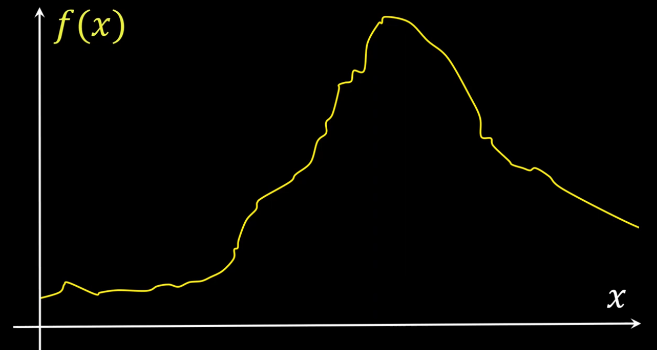
Background for Universal Approximation Theorem

Slide 3
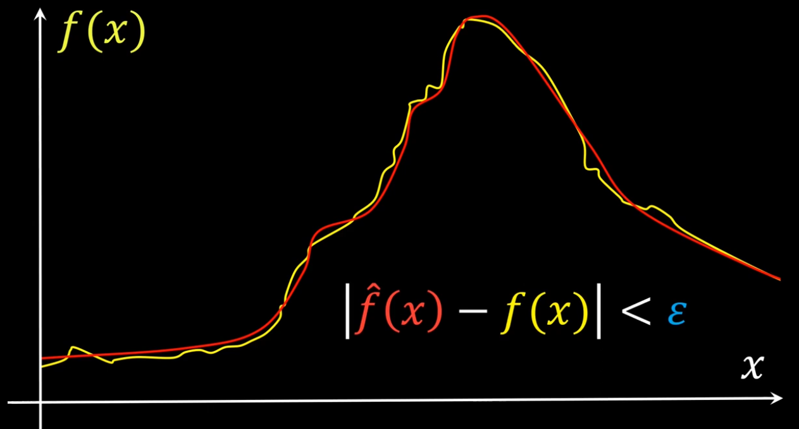
Background for Universal Approximation Theorem

Slide 4
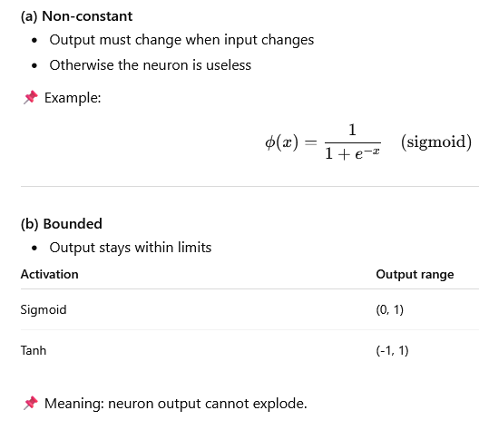
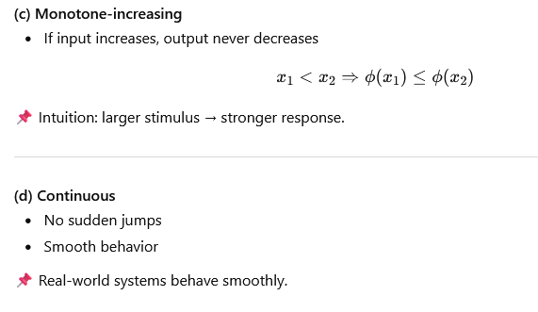
Background for Universal Approximation Theorem

Slide 5
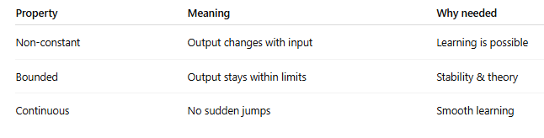
Background for Universal Approximation Theorem
Activation Function: Non constant, Bounded, and Continuous

Slide 6
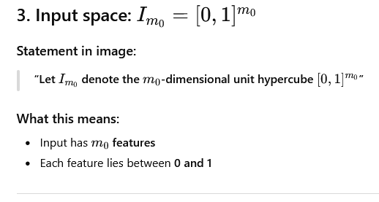
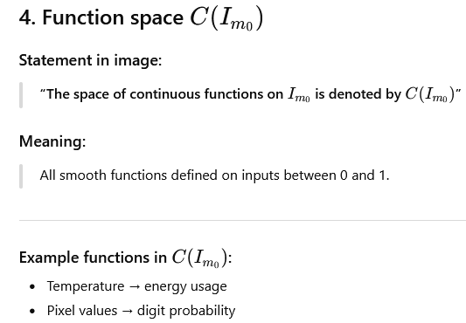
Background for Universal Approximation Theorem
These are unknown target functions neural networks try to learn.

Slide 7
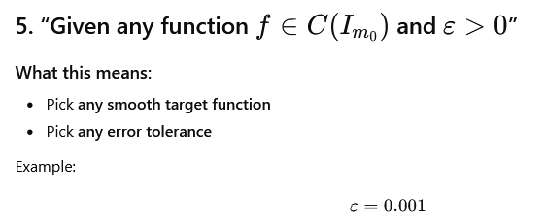
Background for Universal Approximation Theorem

