Slide 1
Neural Network and Deep Learning 23CS8PENDL/23CS7PENDL

Slide 2
Unit-3
Deep Learning: Introduction, Parameter Norm Penalties - L2 Parameter Regularization, Dataset Augmentation, Semi-Supervised Learning, Multi-Task Learning, Early Stopping, Parameter Tying and Parameter Sharing, Sparse Representations, Dropout

Slide 3
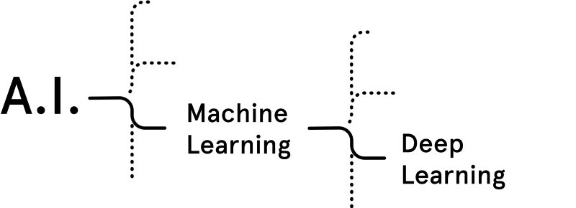
What is Deep Learning ?
(Artificial
Intelligence)
Deep Learning is a category of
machine learning models (=algorithms)
that use multi-layer neural networks.

Slide 4
Difference between
Traditional Machine Learning (ML)
And
Deep Learning (DL)

Slide 5
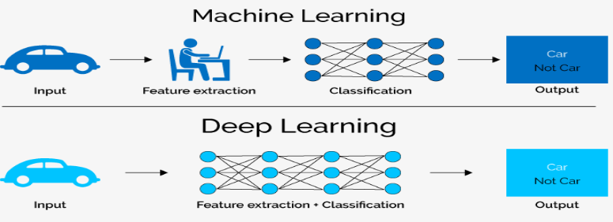
Difference between Traditional ML and DL
Traditional Machine Learning | Deep Learning
We need to hand-craft the features | Feature engineering is done automatically

Slide 6
Unit-3
Deep Learning: Introduction, Parameter Norm Penalties - L2 Parameter Regularization, Dataset Augmentation, Semi-Supervised Learning, Multi-Task Learning, Early Stopping, Parameter Tying and Parameter Sharing, Sparse Representations, Dropout

Slide 7
Background: For Regularization
Bias, Variance, Overfitting, Underfitting

Slide 8
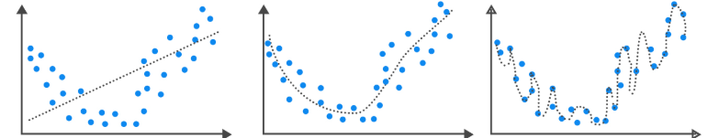
Bias, Variance, Overfitting, Underfitting
Bias: Inability of machine Learning (ML) model to truly capture the relationship of the training data.
Ref.: https://analystprep.com/study-notes/cfa-level-2/quantitative-method/overfitting-methods-addressing/

Slide 9
Bias, Variance, Overfitting, Underfitting
High Bias
Low Bias
Bias: Inability of machine Learning (ML) model to truly capture the relationship of the training data.
Variance: Variance of ML model is high when the difference between Training error and Test error is High.
Ref.: https://analystprep.com/study-notes/cfa-level-2/quantitative-method/overfitting-methods-addressing/

Slide 10
Bias, Variance, Overfitting, Underfitting
High Bias
Low variance
Low Bias
High Variance
Bias: Inability of machine Learning (ML) model to truly capture the relationship of the training data.
Variance: Variance of ML model is high when the difference between Training error and Test error is High.
Overfitting: ML model of training data is performing well but on test data it is not doing well.
Underfitting: ML model is not capturing the relationship in the training data.
Ref.: https://analystprep.com/study-notes/cfa-level-2/quantitative-method/overfitting-methods-addressing/

Slide 11
Bias, Variance, Overfitting, Underfitting
High Bias
Low variance
Low Bias
Low variance
Low Bias
High Variance
Underfitting
Overfitting
Bias: Inability of machine Learning (ML) model to truly capture the relationship of the training data.
Variance: Variance of ML model is high when the difference between Training error and Test error is High.
Overfitting: ML model of training data is performing well but on test data it is not doing well.
Underfitting: ML model is not capturing the relationship in the training data.
Ref.: https://analystprep.com/study-notes/cfa-level-2/quantitative-method/overfitting-methods-addressing/

Slide 12
Bias, Variance, Overfitting, Underfitting
Bias: Inability of machine Learning (ML) model to truly capture the relationship of the training data.
Variance: Variance of ML model is high when the difference between Training error and Test error is High.
Overfitting: ML model of training data is performing well but on test data it is not doing well.
Underfitting: ML model is not capturing the relationship in the training data.

Slide 13
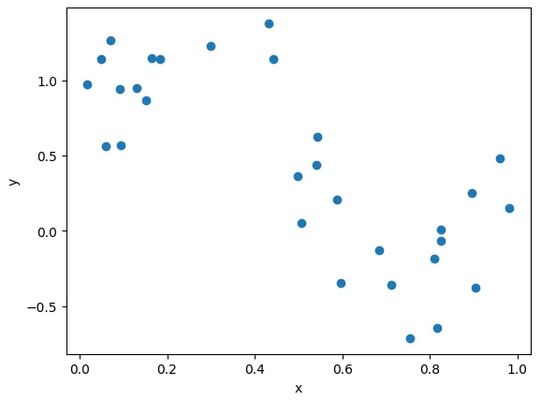
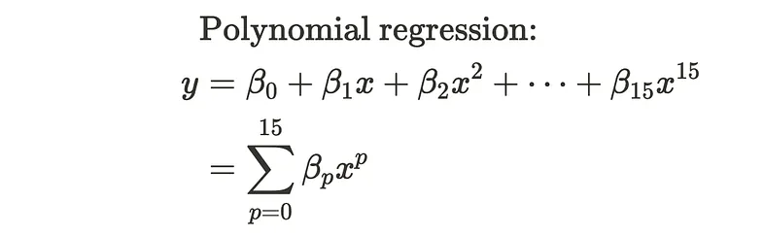
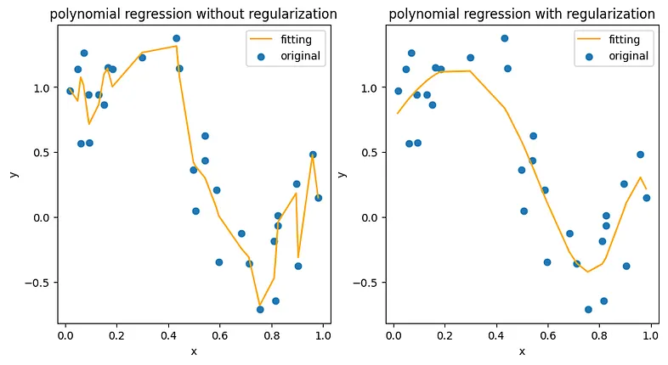
Background: For Regularization
We use regularization
like the to prevent the
model from overfitting.
Ref. https://medium.com/intuition/understanding-l1-and-l2-regularization-with-analytical-and-probabilistic-views-8386285210fc

Slide 14
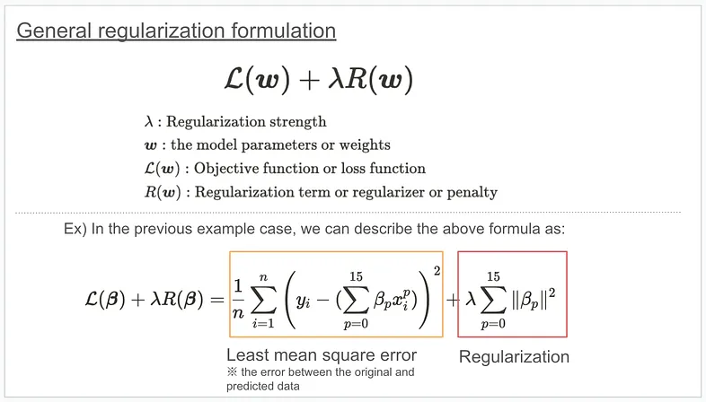
Background: For Regularization
How can we do regularization? Theoretically, we add the regularization term to the objective function and optimize the parameters based on it, as shown below.
Ref. https://medium.com/intuition/understanding-l1-and-l2-regularization-with-analytical-and-probabilistic-views-8386285210fc

Slide 15
Background: For Regularization
Generalization: Ability of the ML model to perform well on unseen data (or test data) is called Generalization.
Generalization or Test error should be less.

Slide 16
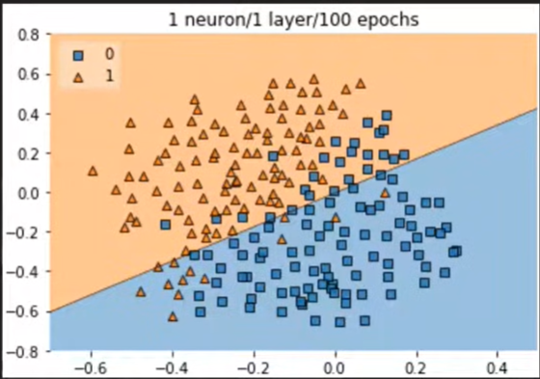
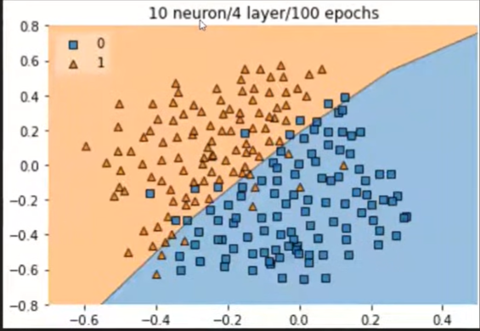
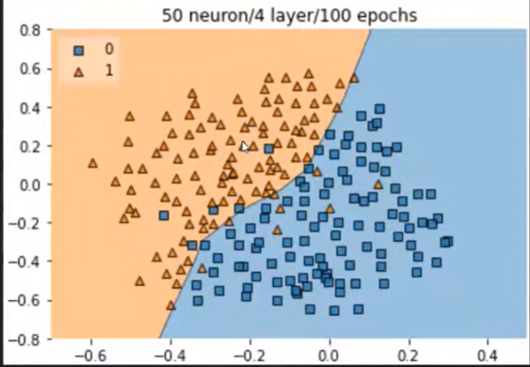
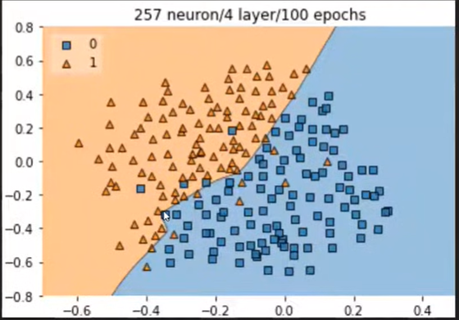
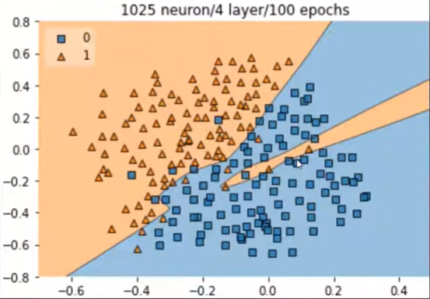
Why Overfitting happens in Neural networks ?
Ref.: https://www.youtube.com/watch?v=4xRonrhtkzc

Slide 17
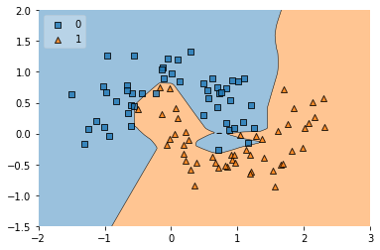
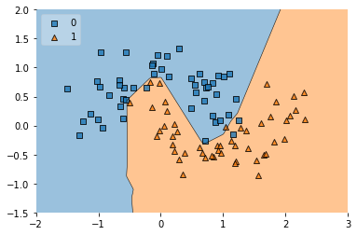
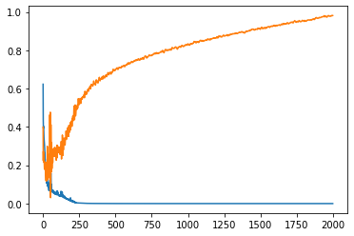
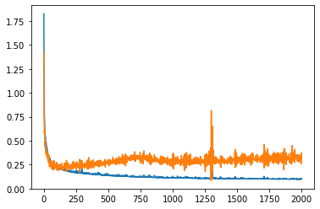
Background: For Regularization
Before Regularization
After Regularization
Training vs. Validation Loss curve
Training vs. Validation Loss curve
Ref.: https://colab.research.google.com/drive/1PObj5KrXLDDmHjoJ1x0bVmxAFbif5s7q?usp=sharing#scrollTo=njwsZuvWVyIT

Slide 18
Methods to avoid Overfitting
1. Adding More data: Data Augmentation
2. Reducing Complexity of the Model
2.1: Drop out
2.2. Early Stopping
2.2.1. L1 Regularization
2.2.2. L2 Regularization
2.2.3. L1+L2 Regularization

Slide 19
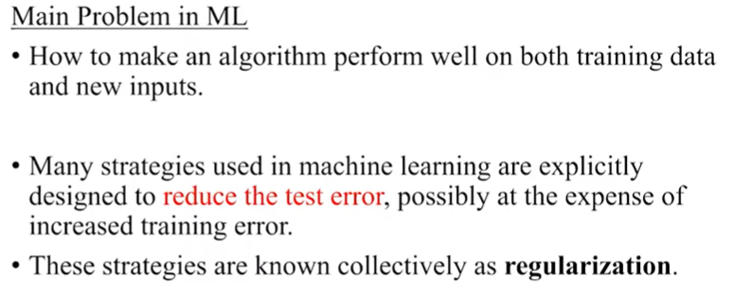
Regularization
Regularization is a collection of strategies that can assist prevent overfitting in neural networks and improve their accuracy by modifying the learning procedure slightly such that the model generalizes more successfully. The model then performs better on the unobserved data as a result.
Notes:
When modeling the data, a low bias and high variance scenario is referred to as overfitting. To handle this, regularization techniques trade more bias for less variance. Effective regularization is one that strikes the optimal balance between bias and variation, with the final result being a notable decrease in variance at the least possible cost to bias. This would imply low variation without significantly raising the bias value, to put it another way.
‍
Additionally, Regularization orders possible models from weakest overfit to biggest and adds penalties to more complicated models. Regularization makes the assumption that the least weights could result in simpler models and help prevent overfitting.
‍

Slide 20
Parameter Norm Penalties
Regularization is a set of techniques used in machine learning to prevent overfitting by adding a penalty term to the model's loss function, which discourages excessive model complexity. By penalizing large weight coefficients, regularization forces the model to learn smoother, more generalizable patterns rather than memorizing noise in the training data
Notes:
where
(lambda or alpha) controls the strength of the regularization.

Slide 21
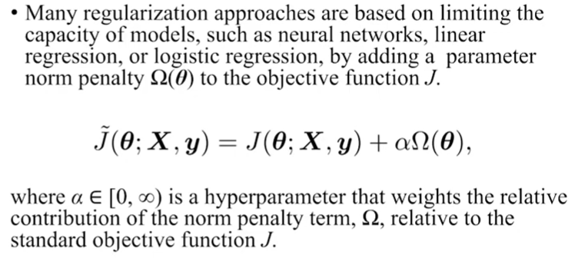
Parameter Norm Penalties

Slide 22
Primary Types of Regularization Penalty Terms
1. L2 Regularization (Ridge Regression)
2. L1 Regularization (Lasso Regression)

Slide 23

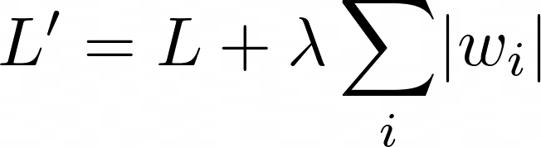
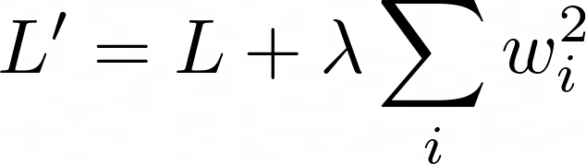
Parameter Norm Penalty
L2 Regularization
added to Loss
L1 Regularization
added to Loss
Norm penalty Ω penalizes only weights at each layer and leaves biases unregularized
W indicates all weights affected by norm penalty
θ denotes both w and biases.
Notes:
https://medium.com/the-ml-intuition/l1-vs-l2-regularization-vs-weight-decay-key-differences-every-ml-engineer-must-know-5f13625301cf

Slide 24
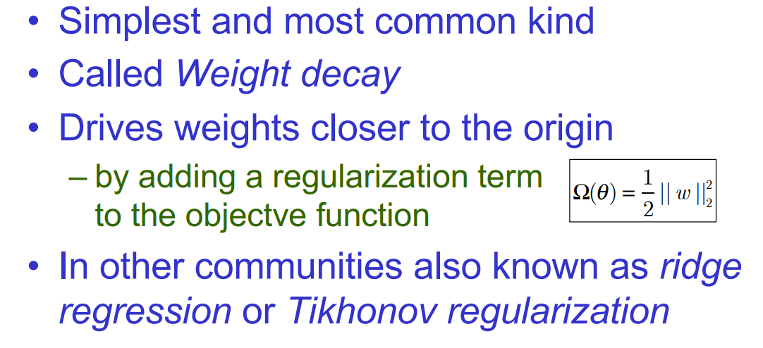
L2 Parameter Regularization

Slide 25

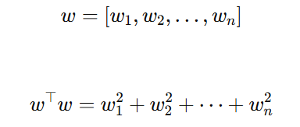

L2 Parameter Regularization
We can gain some insight into the behavior of weight decay regularization by studying the gradient of the regularized objective function. To simplify the presentation, we assume no bias parameter, so θ is just w. Such a model has the following total objective function:
L2 regularization always uses
squared weights

Slide 26
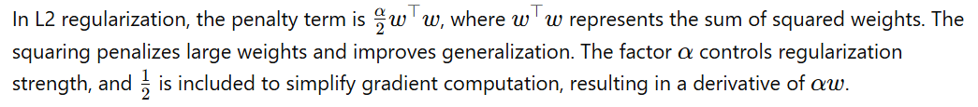
L2 Parameter Regularization

Slide 27



L2 Parameter Regularization
With the corresponding parameter gradient
To take a single gradient step to update the weights, we perform this update:
Written another way, the update is:

Slide 28

L2 Parameter Regularization
With the corresponding parameter gradient
To take a single gradient step to update the weights, we perform this update:
Written another way, the update is:
Notes:
We can see that the addition of the weight decay term has modified the learning rule to multiplicatively shrink the weight vector by a constant factor on each step, just before performing the usual gradient update. This describes what happens in a single step

Slide 29
L2 Parameter Regularization
With the corresponding parameter gradient
To take a single gradient step to update the weights, we perform this update:
Written another way, the update is:
We can see that the addition of the weight decay term has modified the learning rule to
multiplicatively shrink the weight vector by a constant factor on each step,
just before performing the usual gradient update. This describes what happens in a single step.

Slide 30


L2 Parameter Regularization
How weights are
updated ?
Next: How loss behaves near optimum
The best weight that
minimizes the original
(unregularized) loss
How does L2 regularization
change the final optimal weights

Slide 31
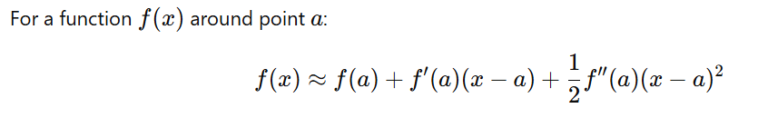
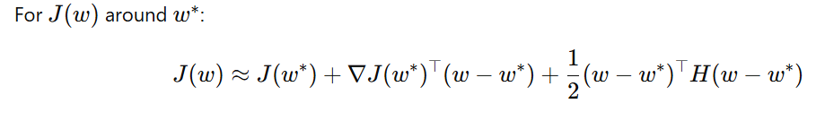
Background
1D Taylor Expansion
(w−w∗) means: How far current weights $w$ are from optimal weights $w^{∗}$
Notes:
w∗ → center (minimum point)
$\left(w−w^{∗}\right)$→ displacement vector
$w^{∗}$= center of a bowl
$w$= your current position

Slide 32
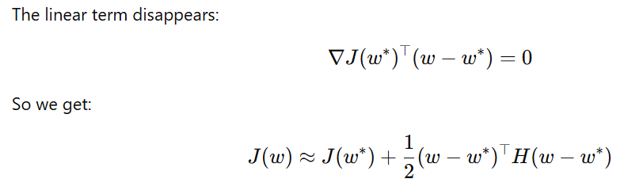
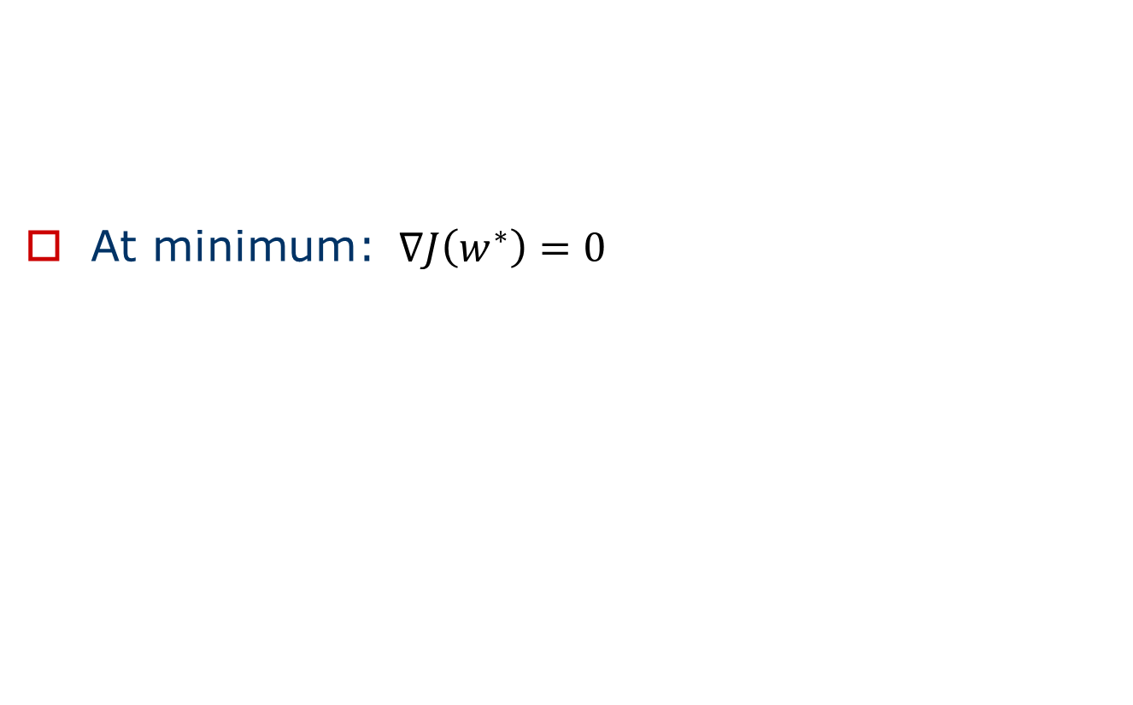
Background
At minimum: $∇J\left(w^{∗}\right)=0$
Notes:
At minimum: $∇J\left(w^{∗}\right)=0$

Slide 33

Background
At minimum: $∇J\left(w^{∗}\right)=0$
Notes:
At minimum: $∇J\left(w^{∗}\right)=0$

Slide 34


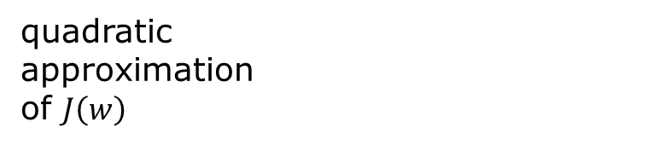
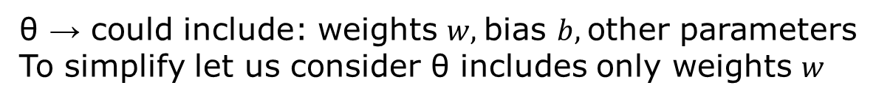
L2 Parameter Regularization (Contd…)
What the loss looks like near the minimum.
quadratic
approximation
of $J\left(w\right)$
θ → could include: weights $w,$bias $b,$other parameters
To simplify let us consider θ includes only weights $w$
Hessian matrix:
Contains second derivatives
Measures curvature
The best weight that
minimizes the original
(unregularized) loss

Slide 35



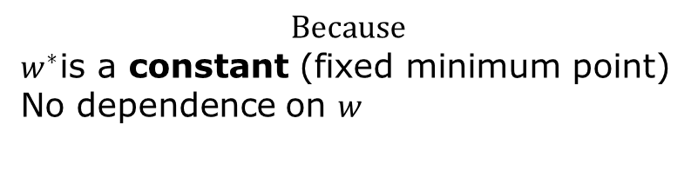
L2 Parameter Regularization (Contd…)
We compute
$$Because$$
$w^{∗}$is a constant (fixed minimum point)
No dependence on $w$

Slide 36
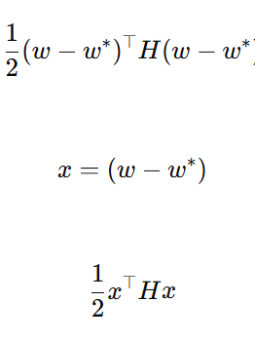
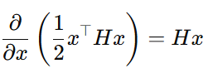


L2 Parameter Regularization (Contd…)
We compute

Slide 37

L2 Parameter Regularization (Contd…)
We compute
Therefore, finally

Slide 38


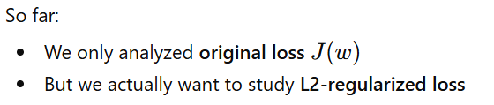
L2 Parameter Regularization (Contd…)
This is the gradient of the unregularized (approximated) loss.
At minimum:

Slide 39




L2 Parameter Regularization (Contd…)
Therefore
At Minimum:
So,

Slide 40

L2 Parameter Regularization (Contd…)
Therefore
At Minimum:
So,

Slide 41
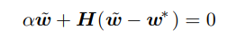




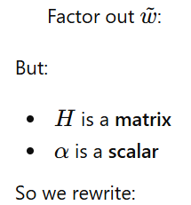



L2 Parameter Regularization (Contd…)
We want to combine

Slide 42


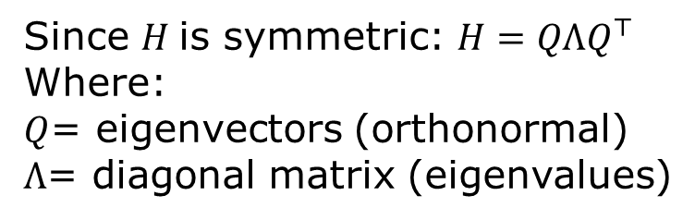
L2 Parameter Regularization (Contd…)
Since $H$is symmetric: $H=QΛQ^{⊤}$
Where:
$Q$= eigenvectors (orthonormal)
$Λ$= diagonal matrix (eigenvalues)
Why do we do eigen decomposition?
To understand how L2 regularization
affects each direction.

Slide 43

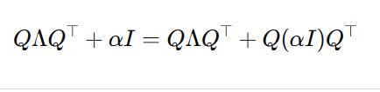




L2 Parameter Regularization (Contd…)
Because
Factor out $Q$and $Q^{⊤}$

Slide 44






L2 Parameter Regularization (Contd…)
Because $Q$is orthonormal

Slide 45





L2 Parameter Regularization (Contd…)
Since $Q$is orthonormal:
Remove identity matrix
Q⊤Q=I means:
Transform → inverse transform cancels out
Like:
rotate → rotate back = no change
QᵀQ = I → “they cancel each other”

Slide 46
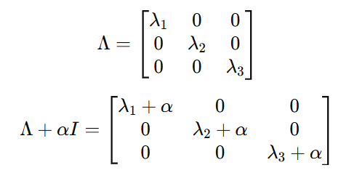
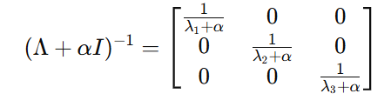
L2 Parameter Regularization (Contd…)
Understand the matrices
Take inverse

Slide 47

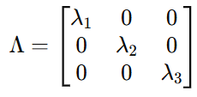
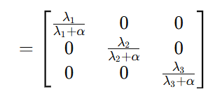
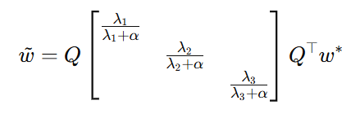

L2 Parameter Regularization (Contd…)
Now compute:
Each component is scaled by:

Slide 48
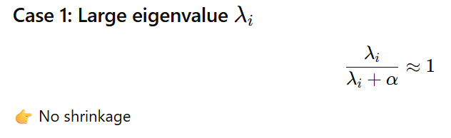
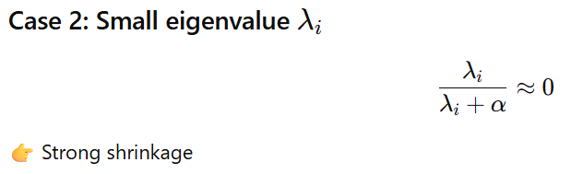
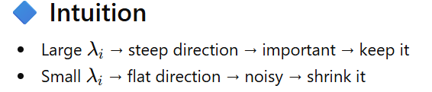
L2 Parameter Regularization (Contd…)
Each component is scaled by:
L2 regularization suppresses directions where the model is uncertain (flat regions) and
preserves directions where the data strongly supports the solution.

Slide 49
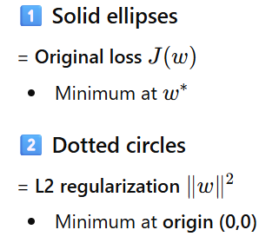
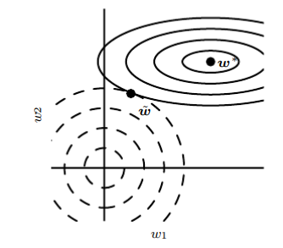


L2 Parameter Regularization (Contd…)
An illustration of the effect ofL2 (or weight decay) regularization on the value of the optimal w.
We are minimizing:
So:
One force → pulls toward $w^{∗}$
Another force → pulls toward origin
Final solution:$\tilde{w}$
= compromise point

Slide 50
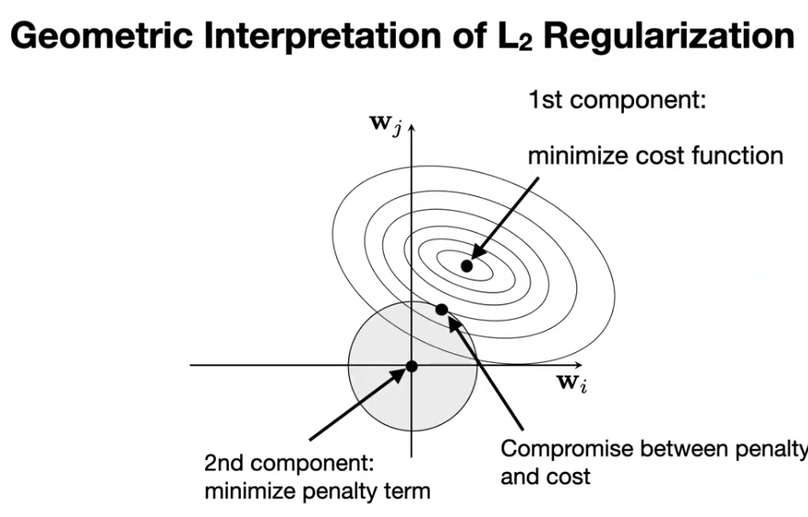
L2 Parameter Regularization

Slide 51
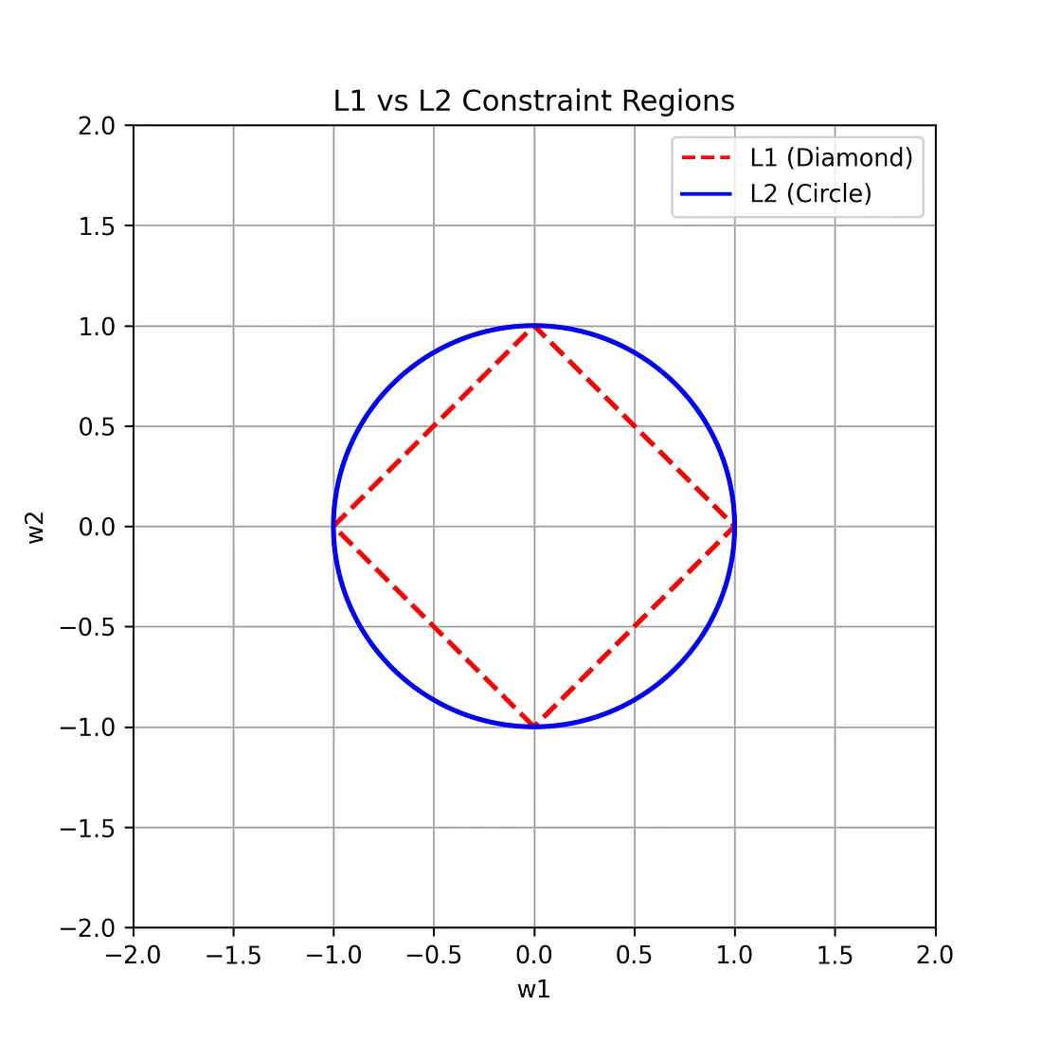
L1 Regularization added to Loss
L2 Regularization added to Loss
Notes:
https://medium.com/the-ml-intuition/l1-vs-l2-regularization-vs-weight-decay-key-differences-every-ml-engineer-must-know-5f13625301cf

Slide 52

Notes:
https://www.youtube.com/watch?v=aBgMRXSqd04

Slide 53

Notes:
In $∥w∥_{2}^{2}$, the subscript 2 denotes the L2 norm, and the exponent 2 means squaring it, resulting in the sum of squared weights.

Slide 54

Notes:
https://medium.com/analytics-vidhya/regularization-understanding-l1-and-l2-regularization-for-deep-learning-a7b9e4a409bf

Slide 55
Introduction, Parameter Norm Penalties - L2 Parameter Regularization,
Analyse the importance of regularization techniques that encourage sparsity and discuss the impact of the strategy on model parameters.
Which regularization method leads to weight sparsity? Explain why
Explain how parameter norm penalties act as a regularization technique. Derive the mathematical expression for L2 parameter regularization and its incorporation into the loss function.
How does the weight decay regularization technique, as described in L 2 regularization, modify the gradient descent update rule, and what is the effect of this modification on the weight vector over the course of training?
How does penalizing the activations of units in a neural network lead to sparsity, and how is this different from the sparsity caused by L1 regularization on model parameters?
Illustrate the imposing of soft constraints on parameters to improve generalization.

Slide 56
Dataset Augmentation
Explain Data Augmentation Techniques.
Discuss how data augmentation techniques can vary across different applications.
Analyze the impact of applying aggressive data augmentation on the quality of the learned features.
In what ways does dataset augmentation enhance generalization for classification tasks, particularly in object recognition and speech recognition? How does noise injection contribute to the robustness of neural networks, and why is it crucial to account for dataset augmentation when comparing the performance of different machine learning algorithms?

Slide 57
Semi-Supervised Learning
What is semi-supervised learning and how does it combine unsupervised and supervised components to improve representation learning? Additionally, how does the shared parameterization between generative and discriminative models enhance generalization, and what role does this play in methods like kernel machines for regression?

Slide 58
Multi-Task Learning
Analyse how Multi-task learning improves generalization by pooling the examples arising out of several tasks
Analyze how multitask learning improves the generalization ability of models compared to single-task learning.

Slide 59
Early Stopping, Parameter Tying and Parameter Sharing
Discuss Parameter Sharing and Typing in Deep Learning.
Implement the meta-algorithm using early stopping to determine the best amount of time to train, how long to train and retrain the data, and determine a point at which overfitting begins during training and continue its training until the value is reached.
Show how the parameters between two models performing the same/similar classification task are close to each other. Illustrate how parameter sharing occurs when processing images
Apply parameter tying and sharing on the optimization landscape and model convergence.
What is the early stopping meta-algorithm, and why is it considered an effective strategy for determining the optimal training duration across various training algorithms and error quantification methods on the validation set?

Slide 60
Sparse Representations

Slide 61
Dropout
What is dropout in neural networks? Can it be compared with bagging or boosting in regular machine learning scenario?
Define dropout. Analyze the differences between bagging and dropout by examining their effects on training and prediction in neural networks
Illustrate how dropout trains an ensemble consisting of all subnetworks. Examine how dropout can help reduce overfitting in neural networks and explore its computational advantages.
Analyze the role of dropout in neural networks in mitigate overfitting. What are the computational trade-offs and the overall impact of dropout on model generalization
Explain how dropout create an ensemble of sub-networks from a base network, and why does the problem of sub-networks lacking input units or paths from input to output become less significant in networks with wider layers? Provide a suitable diagram to illustrate this concept.
Analyze how incorporating dropout in the neural network model can mitigate overfitting. Discuss the computational trade-offs and the overall impact on model generalization.

Slide 62
Can over fitting happen in a neural network? If yes how to deal with over fitting in a neural network

Slide 63
Analyze the influence of non-linear filtering in the effectiveness of short-term memory structures in time-series prediction tasks. How does different choices of the generating kernel h(n) result in different values for the depth D and memory resolution R illustrated by two memory structures.

Slide 64
Thanks for Listening

