Slide 1


Slide 2

Rice Plant Disease Detection

Slide 3
Group Members Introduction
Group ID: S25PROJECTD5623
Student Name: Umed Ali
Student ID: BC220207743

Slide 4

INTRODUCTION OF PROJECT
Rice is one of the world’s most widely consumed staple foods, feeding over half the global population.
Ensuring healthy rice crop production is essential for food security and the economy, especially in agricultural countries.
However, rice plants are highly vulnerable to various leaf diseases, including:
  Leaf Smut
  Brown Spot
  Bacterial Leaf Blight
These diseases significantly impact plant health, reduce crop yield, and cause major financial losses to farmers.
Traditionally, detecting such diseases relies on manual inspection by agricultural experts.
This method is time-consuming, error-prone, and often inaccessible for small-scale farmers.

Slide 5
Motivation & Purpose
Our project aims to provide a smart, automated system to identify rice plant leaf diseases using deep learning.
The core of the system is a CNN-based classifier, trained to recognize patterns in diseased rice leaves.
Users (e.g., farmers or agricultural officers) can upload images via a simple web interface.
The system will analyze the image and provide an instant diagnosis of the disease.
This solution will help:
Farmers take timely action to protect their crops.
Reduce dependency on experts for basic disease identification.
Enable scalable, accessible, and cost-effective plant health monitoring.
The final deliverable is a fully functional web application that integrates AI-powered prediction with a user-friendly interface.

Slide 6
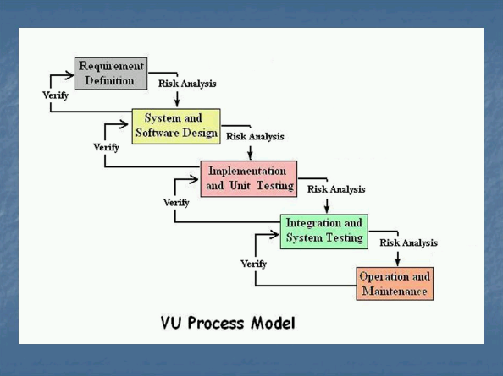
Diagram of Process Model.

Slide 7
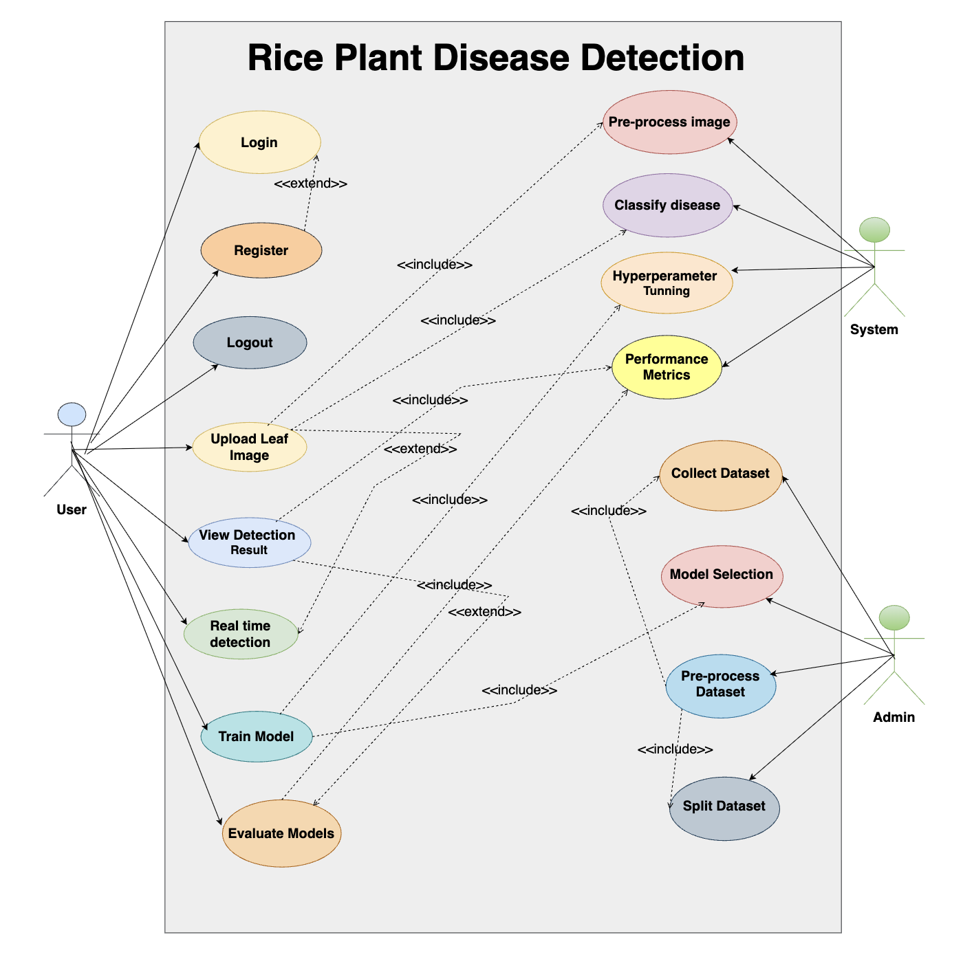
Use Case Diagram

Slide 8
Business Rules Catalog
Dataset Collection:
The dataset should be collected from free online sources. Students are responsible for finding and using a suitable image dataset of rice plant leaves.
Preprocessing:
Basic image processing techniques must be applied to standardize the dataset. This includes resizing, normalization, and possibly data augmentation to improve model performance.
Model Selection:
Deep learning models (especially CNNs) should be evaluated, and the best one should be selected for final classification.
Dataset Splitting:
The collected dataset must be divided into training and testing sets to allow proper evaluation of model accuracy.
Model Training:
The selected model should be trained using Python tools (e.g., Google Colab, Jupyter Notebook) to recognize rice leaf diseases.
Validation and Hyperparameter Tuning:
Model performance should be validated on a separate dataset, and parameters like learning rate and batch size should be adjusted for better accuracy.
Model Evaluation:
After training, the model must be tested and evaluated using accuracy, precision, and other relevant performance metrics.
Real-time Detection:
A real-time image upload and prediction feature must be developed using OpenCV or similar tools. Users will upload an image and receive instant feedback.
User Interface:
A simple and user-friendly web interface must be developed where users can upload images and view the results with visual feedback.

Slide 9
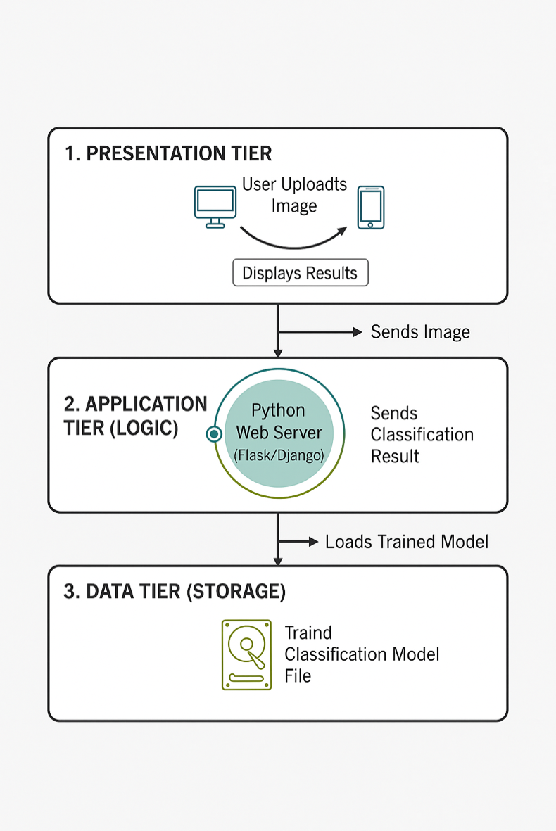
Architectural Design

Slide 10
Team Structure
VUID: BC220207743
Name: Umed Ali

Slide 11
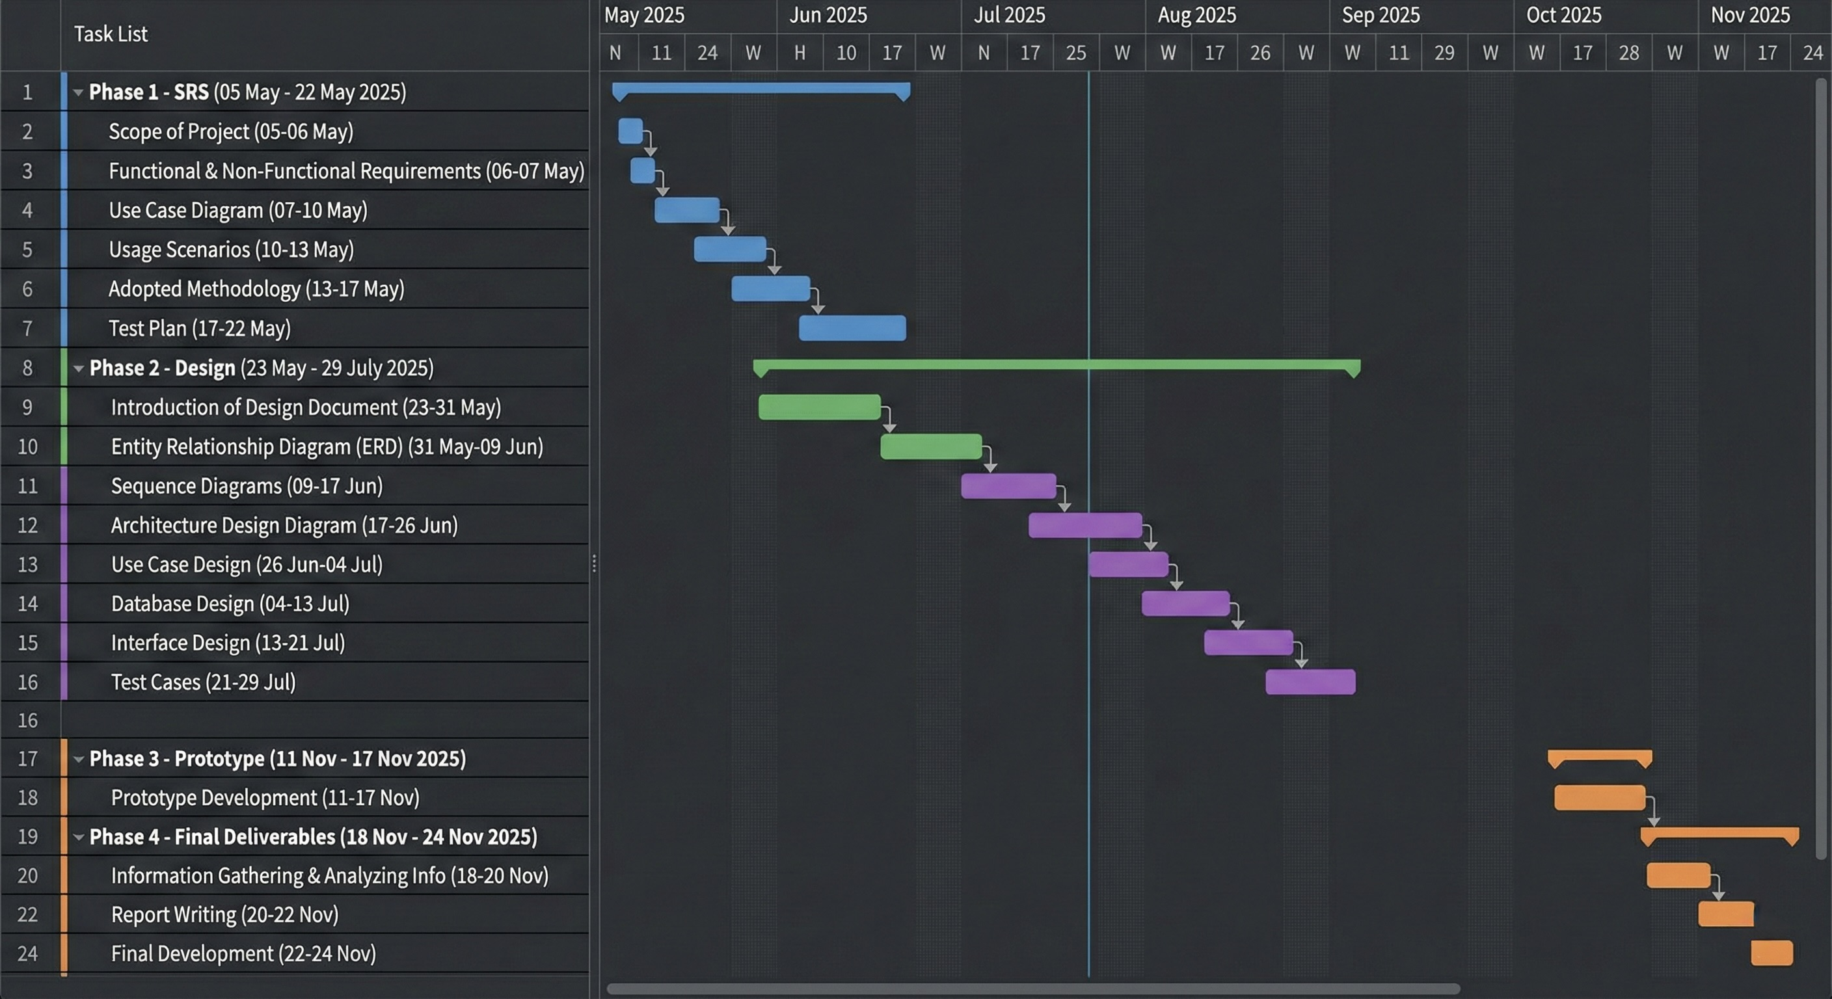
Project Schedule

Slide 12
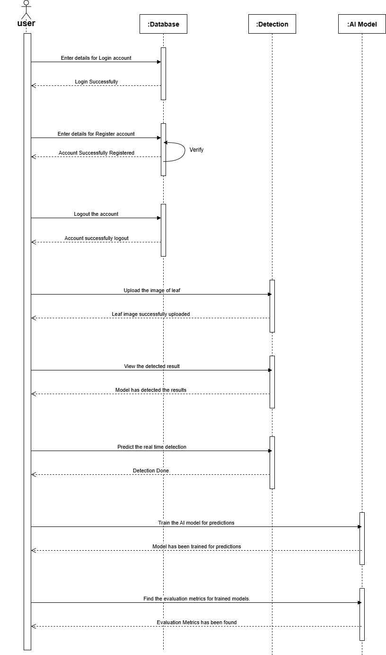
Sequence Diagrams
For User to register, login, logout, detect images, train mode and evaluate the models.

Slide 13
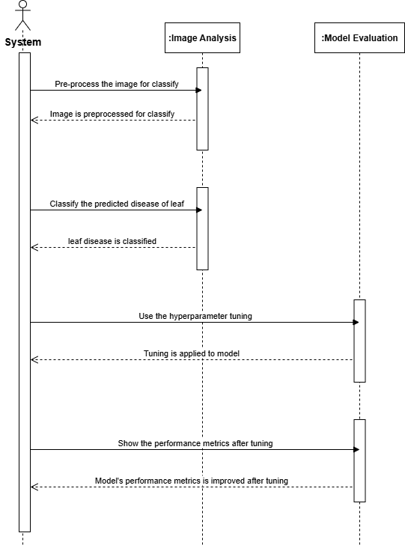
For System to preprocess images, hyperperameter tunning, classify disease, performance metrics.

Slide 14
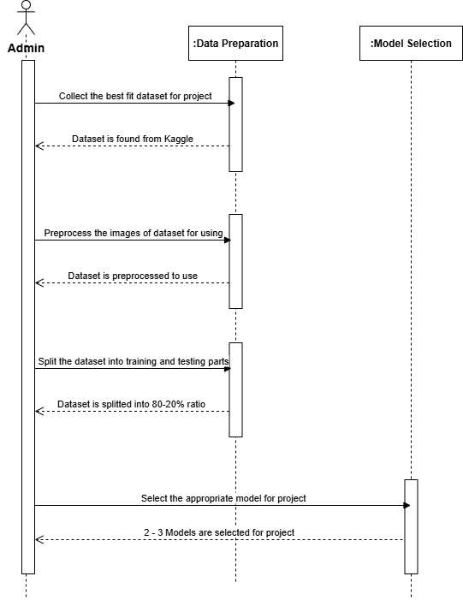
For Admin to Pre-process, split dataset, collect the dataset and model selection.

Slide 15
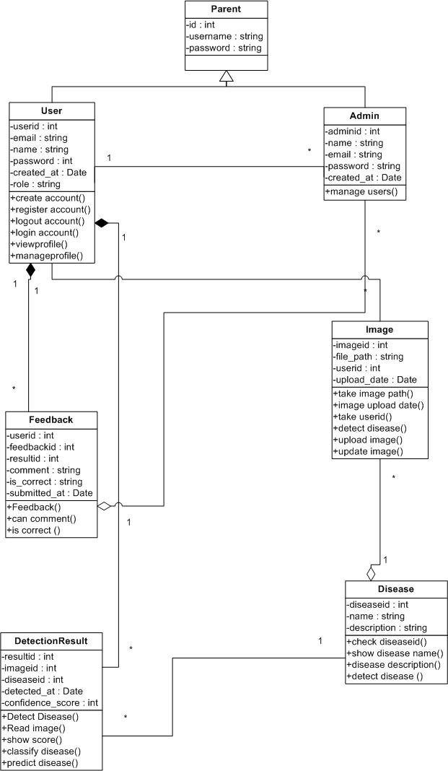
Logical Model/Class Diagram

Slide 16
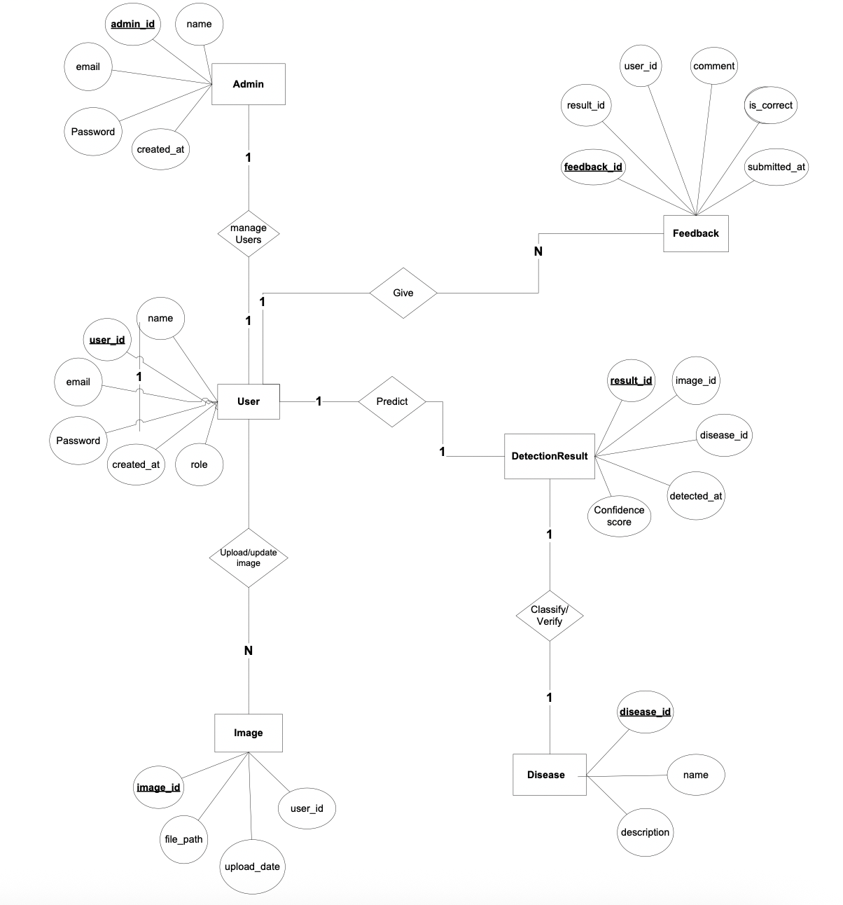
Entity-Relationship Diagram

Slide 17
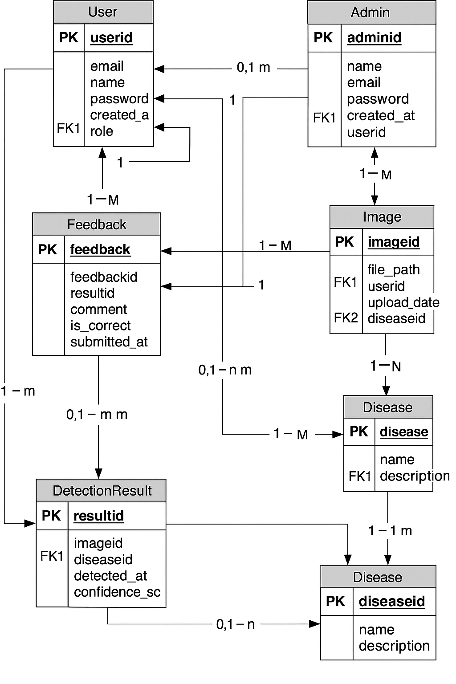
Database Diagram

Slide 18
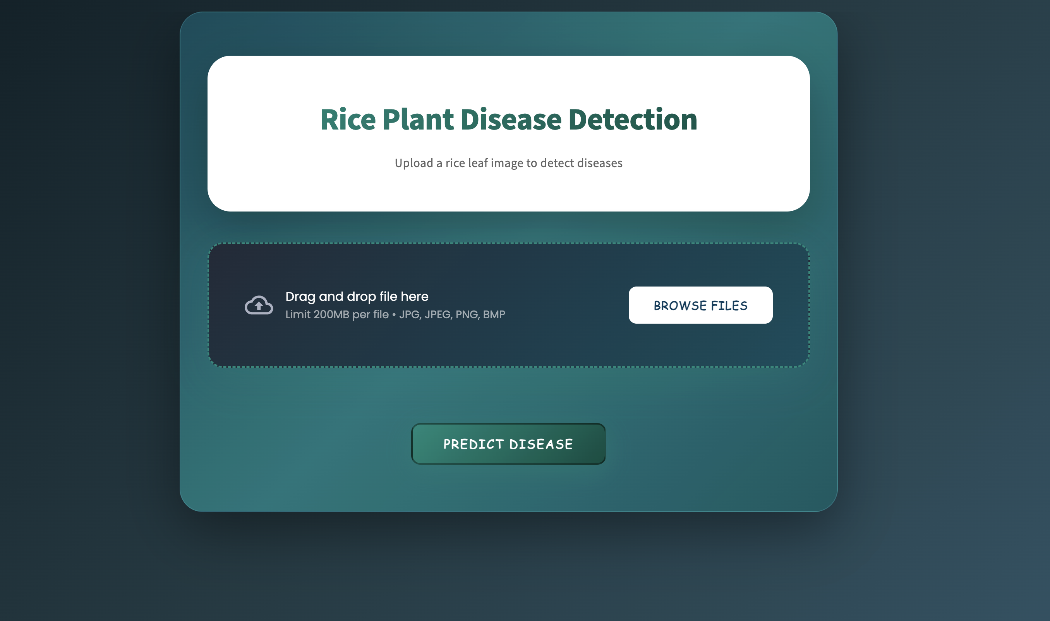
User Interfaces

Slide 19
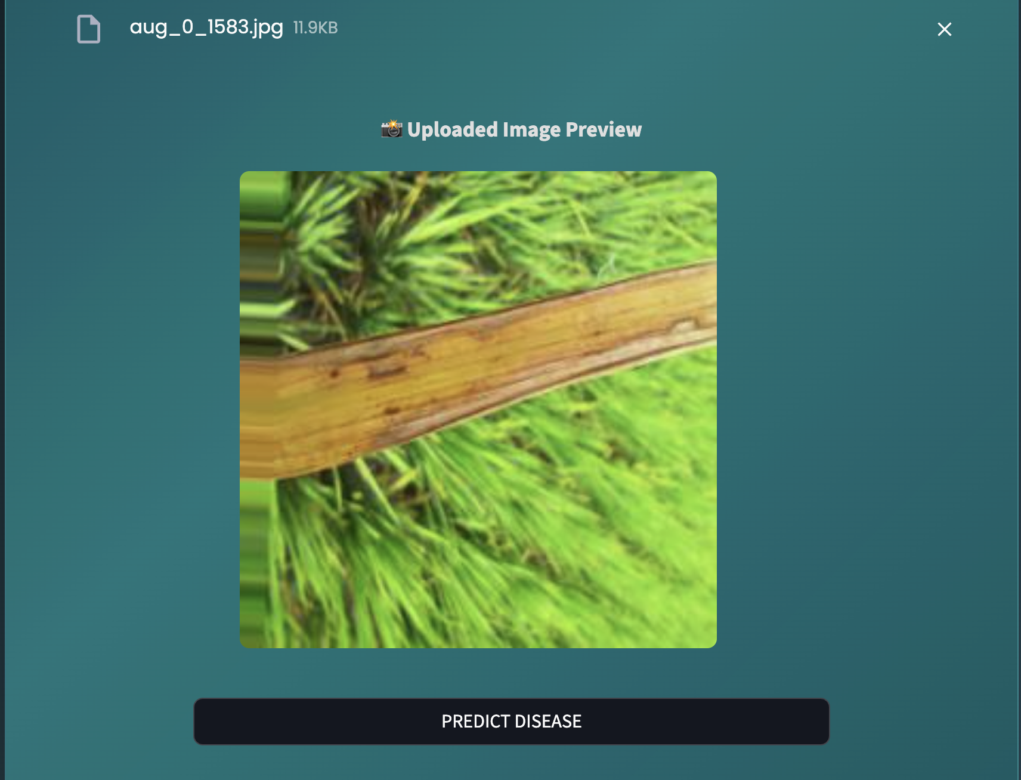
User Interfaces

Slide 20
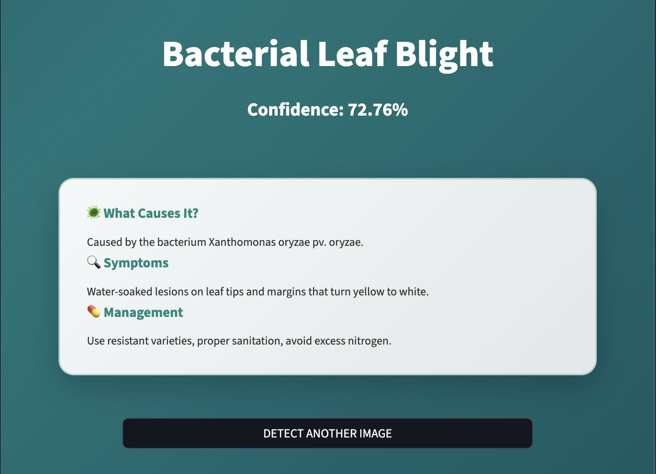
User Interfaces

Slide 21
Tools
Python
Google Colab
Jupyter Notebook
OpenCV
Flask
Streamlit
HTML/CSS + Bootstrap
VS Code
MS Word
MS PowerPoint
MS Visio

