Slide 1

H
HallMate
SMART VENUE BOOKING
HACKATHON · PRODUCT PITCH
HALLMATE
Smart Venue Booking System
Discover. Check. Book.
TEAM BUG SLAYERS
COLLEGE · KITSW
HACKATHON · NN HACKATHON
01

Slide 2

H
HallMate
02 / HALLMATE
SMART VENUE BOOKING
The Problem
Venue booking is still fragmented, slow and difficult to track.
MANUAL & SCATTERED
☎
Phone calls
▤
Paper records
↔
Scattered messages
↻
Repeated enquiries
?
Unclear availability
!
Double-booking risk
CUSTOMERS
HALL OWNERS
Limited visibility.
Time-consuming enquiries.
Manual records.
Difficult booking control.
The result: more effort, less confidence.
HALLMATE · SMART VENUE BOOKING SYSTEM
02

Slide 3
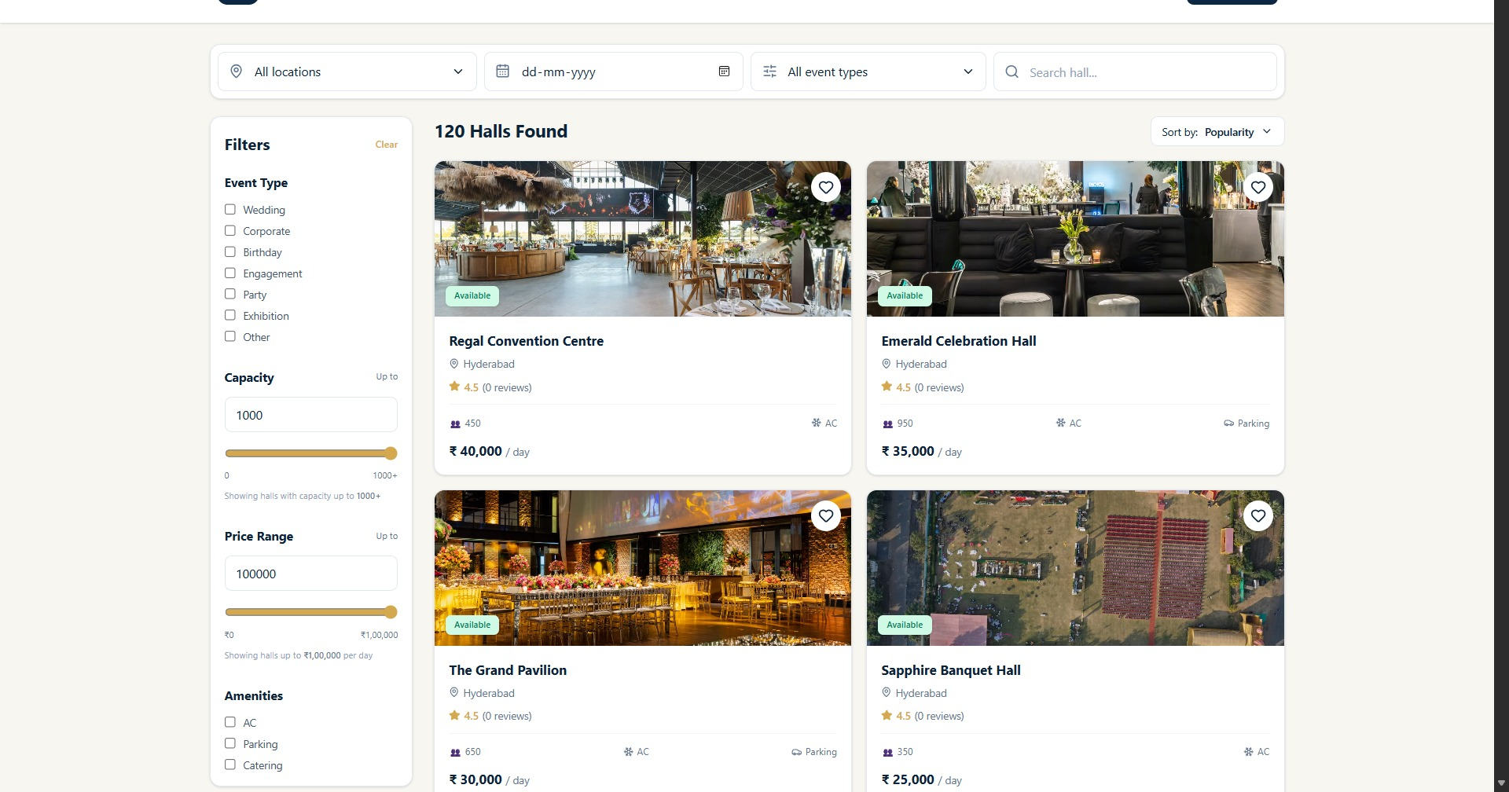
H
HallMate
03 / HALLMATE
SMART VENUE BOOKING
Introducing HallMate
One focused platform for venue discovery, availability and booking.
THE PROMISE
A centralized
venue booking
experience.
Customers discover.
Owners manage.
Administrators oversee.
1
2
3
4
CUSTOMER
OWNER
ADMIN
DISCOVER
CHECK
AVAILABILITY
BOOK
GET UPDATES
HALLMATE · SMART VENUE BOOKING SYSTEM
03

Slide 4
H
HallMate
04 / HALLMATE
SMART VENUE BOOKING
A Simpler Way to Book
A clear journey from search to confirmation.
CUSTOMER JOURNEY
1
2
3
Search halls
Apply filters
View details
4
5
6
Check availability
Enter event details
Review booking
7
8
9
Sign in / register
Confirm booking
Receive notification
KEY FEATURES
Location & event type
Capacity & price
Amenities
Gallery & details
Favorites
Profile & settings
HALLMATE · SMART VENUE BOOKING SYSTEM
04

Slide 5
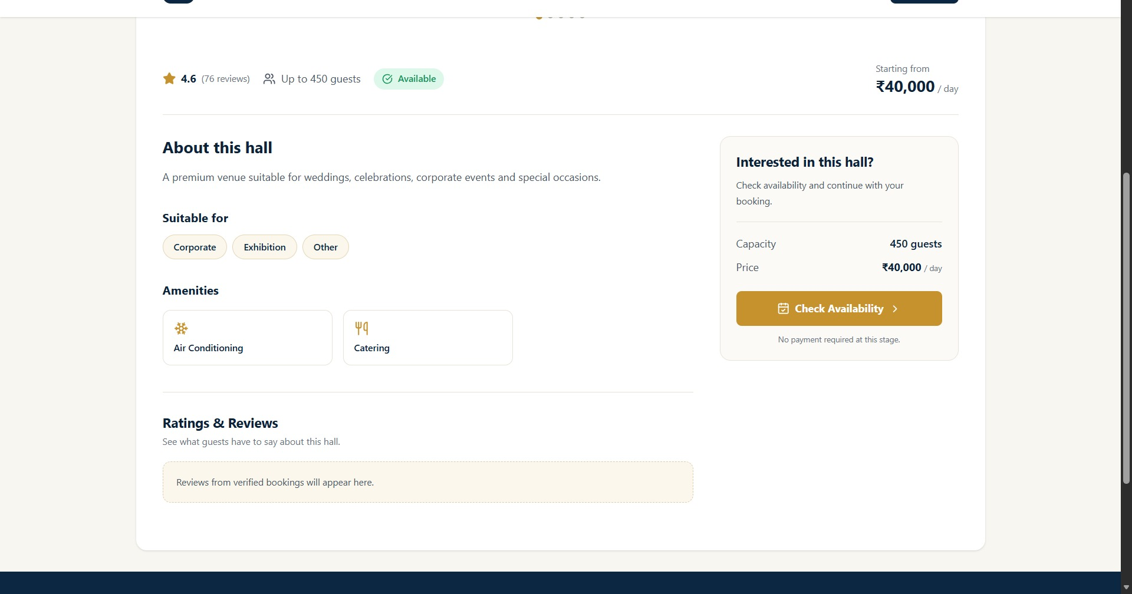
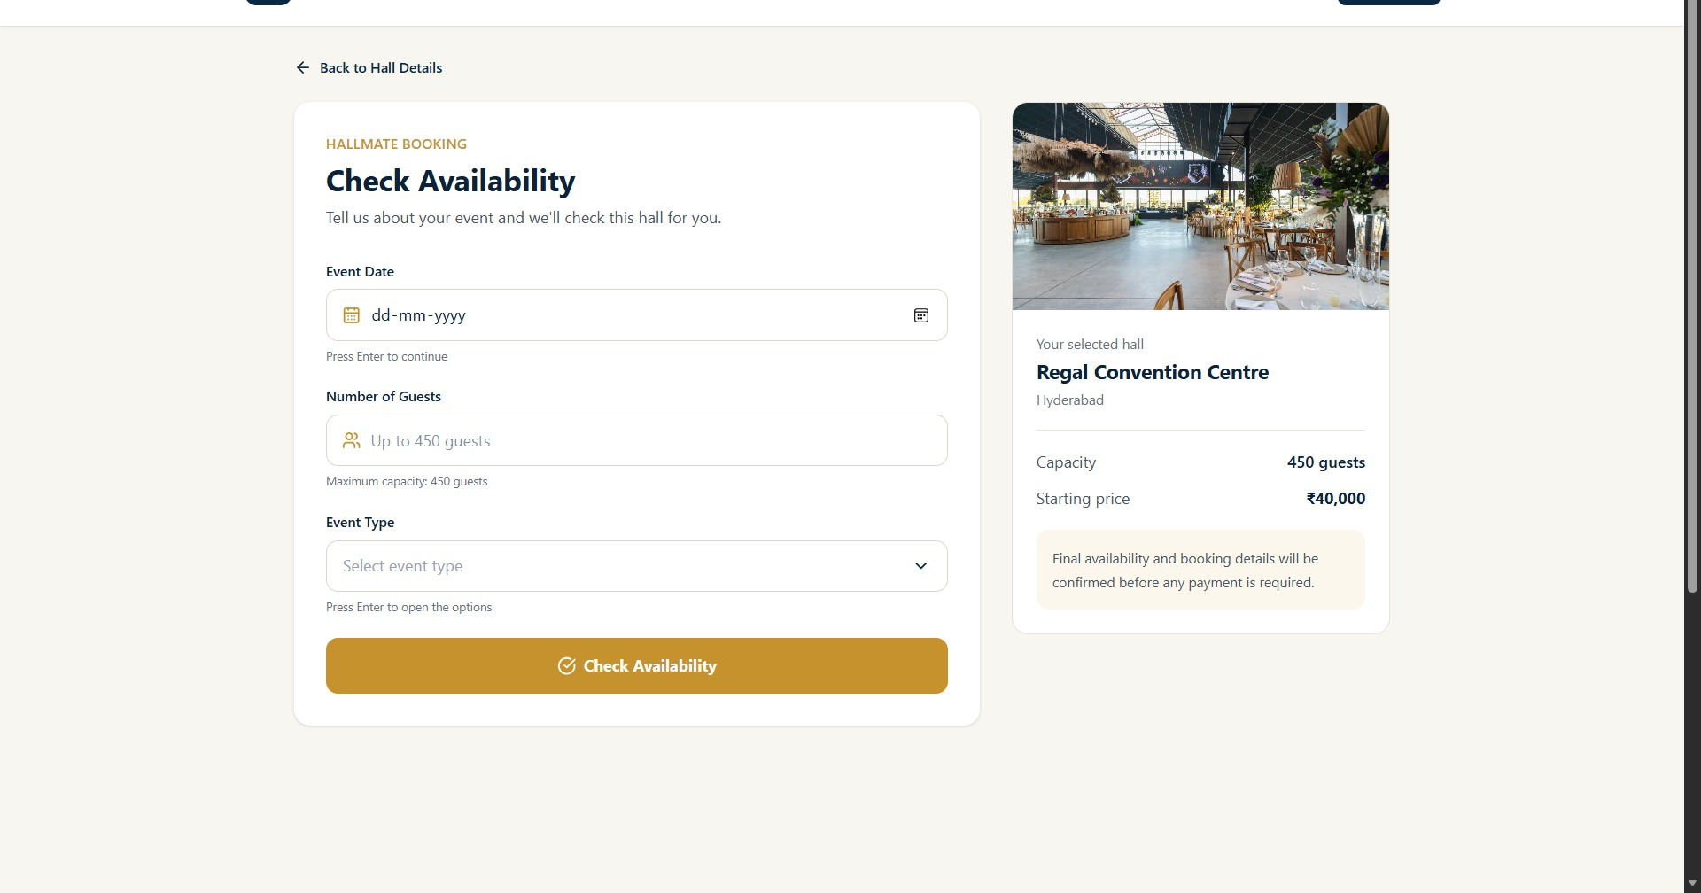
H
HallMate
05 / HALLMATE
SMART VENUE BOOKING
From Hall Discovery to Booking
Every decision point stays visible and structured.
Name + location
Gallery
Capacity + price
Amenities
Date
Guests
Event type
Requirements
1
2
3
4
5
6
HALL DETAILS
CHECK AVAILABILITY
BOOKING DETAILS
RESULT
REVIEW
CONFIRM
HALLMATE · SMART VENUE BOOKING SYSTEM
05

Slide 6
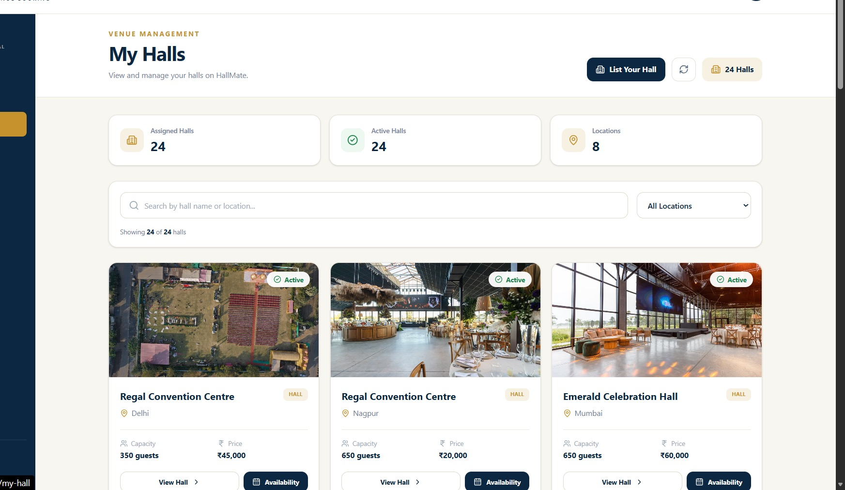
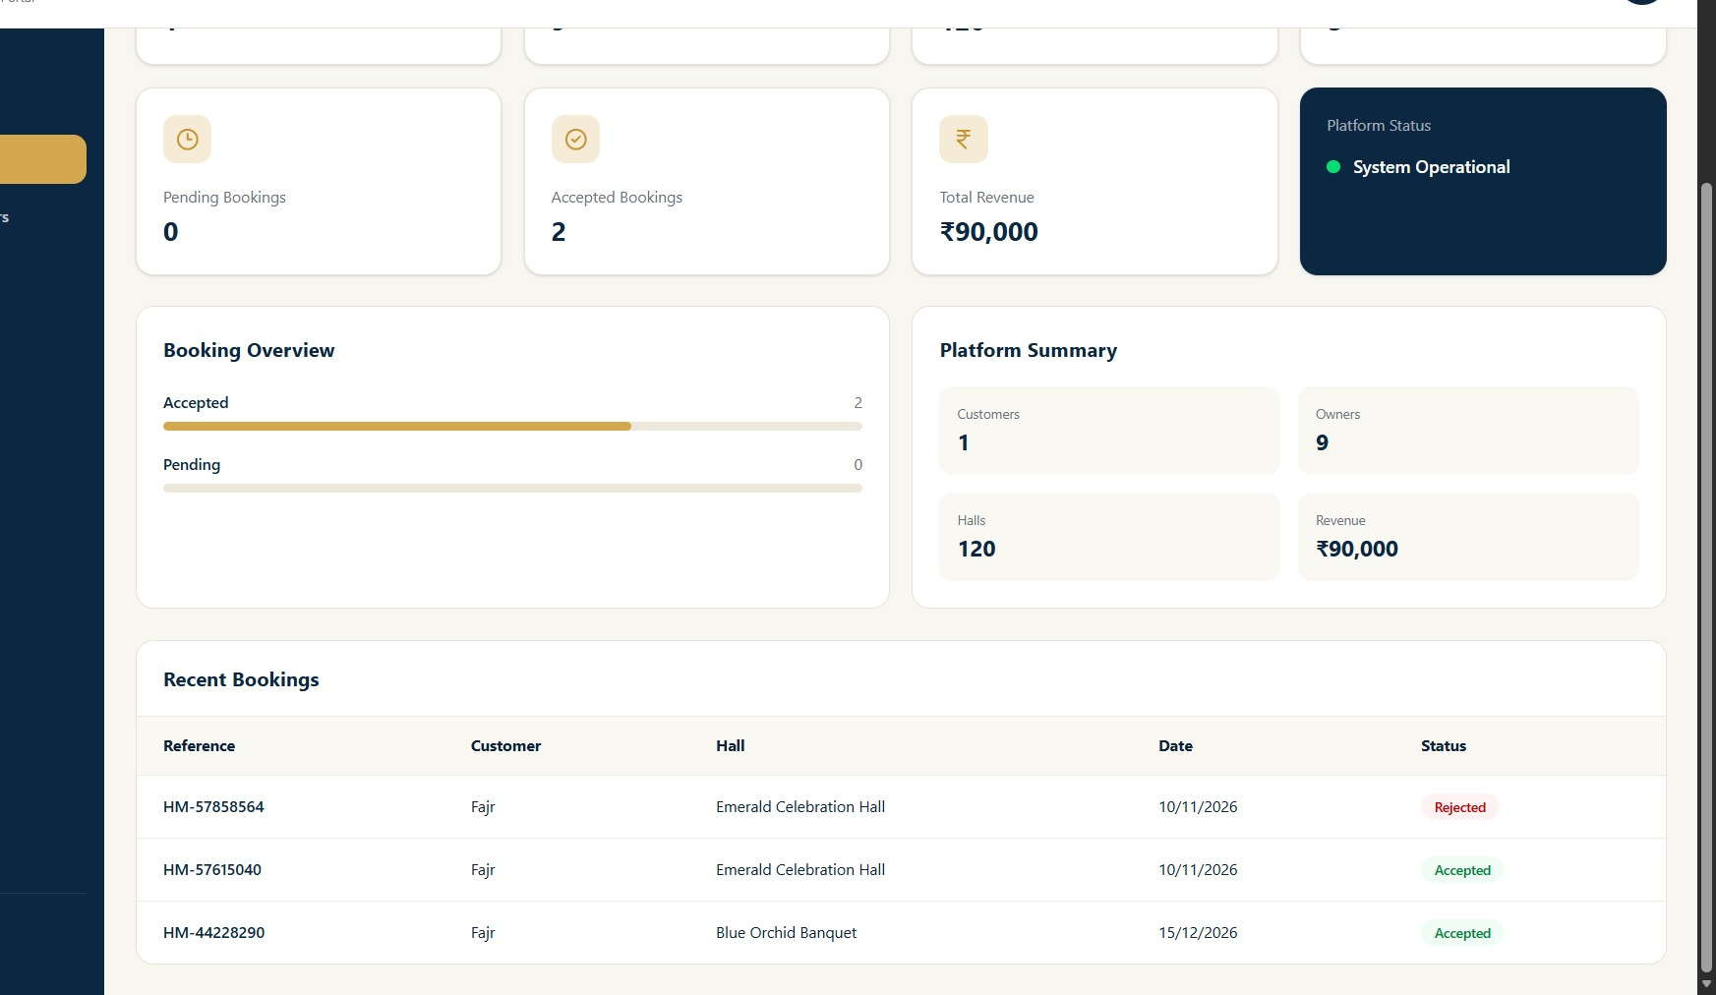
H
HallMate
06 / HALLMATE
SMART VENUE BOOKING
Powerful Management, Kept Simple
Purpose-built views for hall owners and platform administrators.
HALL OWNER
ADMIN
List hall · Manage details & availability · Review requests · Accept / reject · Track bookings
Overview · Users · Halls · Bookings · Basic reports & statistics
HALLMATE · SMART VENUE BOOKING SYSTEM
06

Slide 7
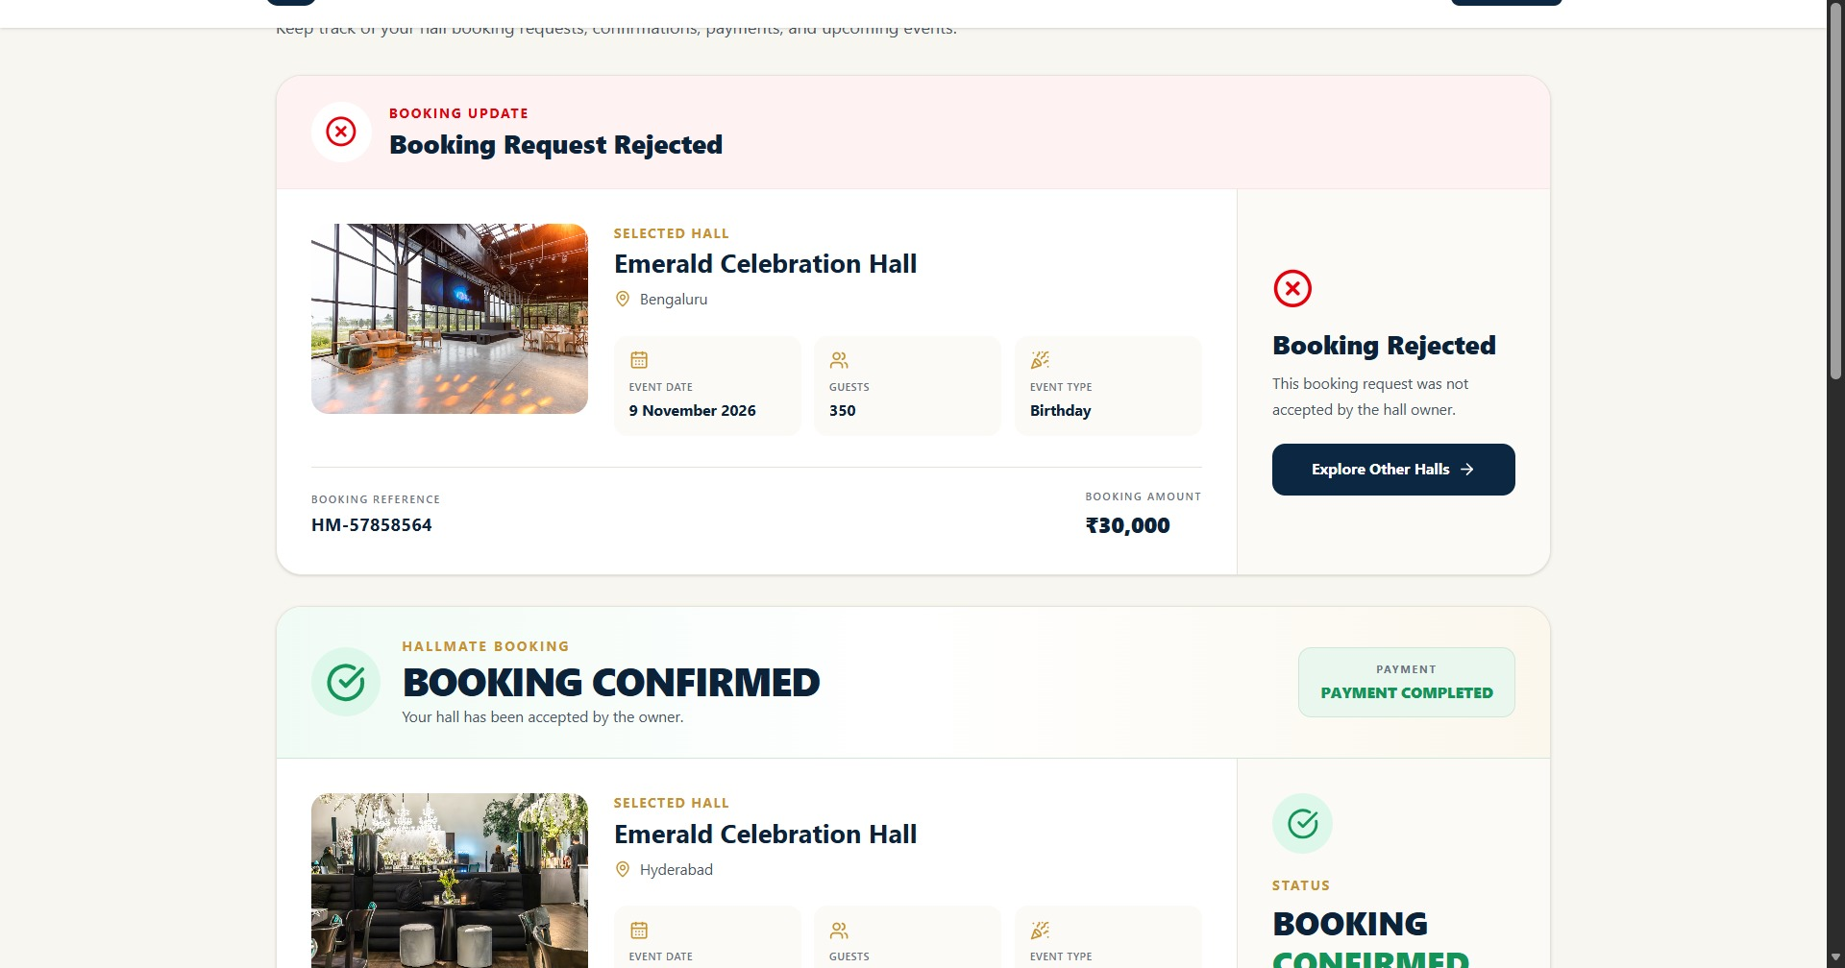
H
HallMate
07 / HALLMATE
SMART VENUE BOOKING
Stay Connected After Booking
A transparent request cycle keeps customers and hall owners aligned.
CUSTOMER
HALL OWNER
DECISION
CUSTOMER
SUBMITS REQUEST
REVIEWS
ACCEPT / REJECT
GETS NOTIFIED
LIVE BOOKING STATES
✓
✓
×
Booking Request Submitted
Booking Accepted
Booking Rejected
Your request is waiting for owner review.
Your venue request has been approved.
Explore other halls for your event.
Discovery
Search & filters
Details & gallery
Availability
Requests
Owner tools
Admin tools
Notifications
Favorites
Profile
HALLMATE · SMART VENUE BOOKING SYSTEM
07

Slide 8
H
HallMate
08 / HALLMATE
SMART VENUE BOOKING
How HallMate Is Built
A focused, practical stack for a clear three-role platform.
SYSTEM ARCHITECTURE
TECHNOLOGY STACK
RESPONSIBILITIES
CUSTOMER / OWNER / ADMIN
People using HallMate
FRONTEND
React + Vite · Tailwind CSS · Lucide React
01
Frontend
↓
Handles every customer, owner and admin interface.
REACT + VITE + TAILWIND
Interface & experience
BACKEND
Node.js · Express.js
02
Backend
↓
Manages APIs and application logic.
NODE.JS + EXPRESS
APIs & application logic
DATABASE
PostgreSQL
↓
03
Database
POSTGRESQL
Platform data
Stores platform and booking data.
TOOLS
VS Code · Git / GitHub
HALLMATE · SMART VENUE BOOKING SYSTEM
08

Slide 9
H
HallMate
09 / HALLMATE
SMART VENUE BOOKING
Impact & Future Scope
Immediate value today — with a practical roadmap for tomorrow.
CUSTOMERS
HALL OWNERS
ADMIN
FUTURE IMPROVEMENTS
Saves time
Easier discovery
Clearer availability
Simpler booking
Organized requests
Availability control
Centralized hall info
Central management
Booking visibility
Organized records
A practical roadmap
Online payments
Calendar sync
Maps & location
Automated reminders
Multi-language
Advanced analytics
VALUE CREATED
Mobile application
Less friction. Better visibility. More organized venue operations.
Verified reviews
HALLMATE · SMART VENUE BOOKING SYSTEM
09

Slide 10
H
HallMate
SMART VENUE BOOKING
READY FOR THE DEMO
Thank You
HALLMATE
Smart Venue Booking System
Discover. Check. Book.
TEAM BUG SLAYERS
KITSW | NN HACKATHON
10

