Slide 1
SE Student Help Desk
Project Title:

Slide 2
Group Members
Laraib Ishtiaq (FA17-BSE-096)
Umair Ansar (FA17-BSE-069)
Abdul Rafay (FA17-BSE-092)
Zunaira Ali (FA17-BSE-076)

Slide 3
The main purpose of the system Student Help Desk is to automate the management of student’s daily needs efficiently. To build a system that can guide freshers and any other student for their upcoming courses and to view many needed documents i.e. assignments, refences books in easy way and short time.
Introduction

Slide 4
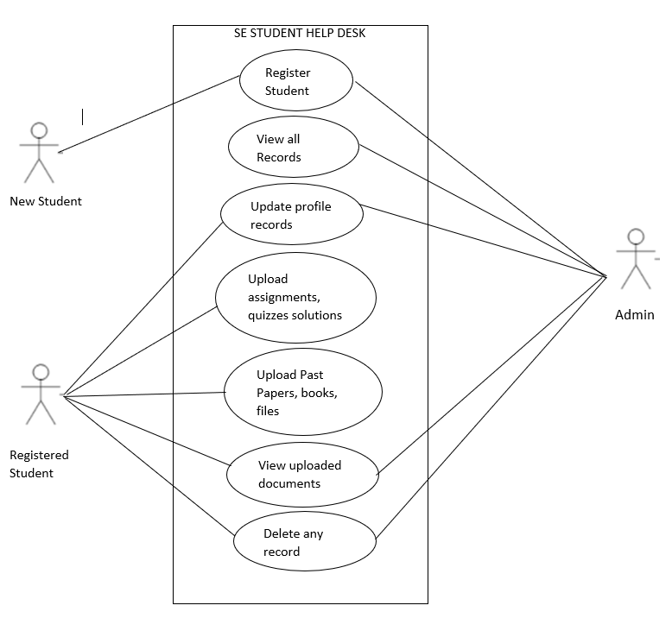
Use Case Diagram

Slide 5
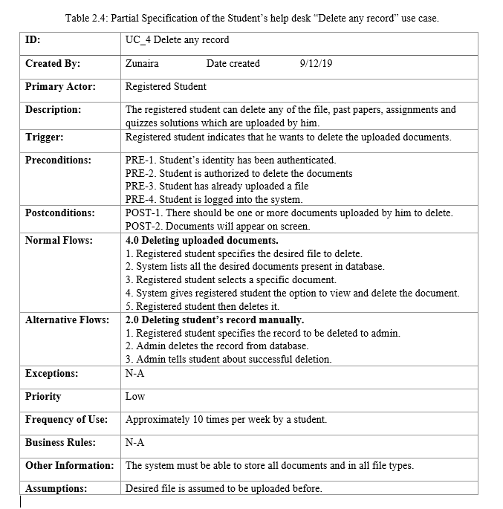
Use Case Specification
1
4

Slide 6
Functional Requirements
FR1: Registered student can upload and view past papers.
FR2: Registered student can upload and view assignments.
FR3: Registered student can upload and view quizzes.
FR4: Registered student can upload and view notes.
FR5: Registered student can update his files.
FR6: Registered student can delete his files.
FR7: Admin can register new students.
FR8: Admin can maintain student records.
FR9: Admin can update student’s records.
FR10: Admin can delete any students record.
Functional Requirements

