Slide 1
Ride Analytics & Revenue Intelligence Platform
Final Business Intelligence Presentation
ZYROO Data Analytics Internship | Weeks 2-6 | Power BI, Python, SQL
Notes:
Introduce the project: ride-level data turned into a validated dashboard, advanced analysis, scenarios and recommendations.

Slide 2
The business problem
How many rides happen and how much revenue do they generate?
When is demand highest?
Which vehicle types and payment methods earn the most?
How do drivers compare with a benchmark?
Where does service quality fall short?
What would a fare or volume change do to revenue?
Goal
Explain not only what happened, but why it matters and what the business should investigate next.
Notes:
Frame the problem as six management questions. The goal is evidence-based decision support.

Slide 3
Data and preparation
Preparation steps
50
50
2022-24
USD
Removed fully blank rows so counts reflect real rides
Repaired the driver file headers (extra commas had shifted the data)
Derived weekday and hour from Request Time
Ride status is a proxy: fare > $0 = Completed
No rows excluded for invalid values
Rides
Drivers
Date range
Currency
Source: Ride_Sharing_Dataset.csv (17 columns, one row per ride) plus a driver performance file built from it.
Notes:
Explain the dataset and the cleaning rules. Stress that status is a proxy because there is no status column.

Slide 4
Data quality audit
Check | Result | Status
Missing values, duplicate rows, duplicate Ride / Driver IDs | 0 | Pass
Invalid dates, zero or negative fares, invalid ratings | 0 | Pass
Ride distances | All 50 rides over 500 miles (525 to 12,132) | Flag
Stored Day of Week vs Request Time | Matches on only 18% of rows | Fixed
Pickup locations | 50 unique worldwide coordinates | Limit
Ride status | No status column; proxy from fare | Limit
Distance-based findings are treated as unreliable; weekday is taken from the timestamp.
Notes:
Show the audit honestly: two real problems were found and handled, and the rest is documented as limits.

Slide 5
Data model and methodology
FactRides
DimDriver
DimDate
Ride-level facts
Driver scores
Calendar table
One-to-many, single-direction relationships; all measures in one measures table.
KPIs built as DAX measures and checked in pandas and SQL
Segments compared on rides, revenue, average fare and rating
Low-rated share (rides rated 1-2) used as the attention signal, since there are no cancellations
Driver score = 30% revenue, 25% volume, 25% rating, 20% completion
Scenarios use revenue = completed rides x average fare (estimates)
Associations are shown, not causes
Notes:
Three-table model, then the five analytical ideas in simple terms.

Slide 6
KPIs and validation
50
50
0
$31,788.97
$635.78
2.80
Total rides
Completed
Cancelled
Revenue
Average fare
Average rating
Definitions
Validation
Completed = fare greater than $0
Average fare = revenue / completed rides
Completion rate = completed / total rides (100%)
Cancellation rate = 0% (none recorded)
Source | Rides | Revenue
Power BI / pandas | 50 | $31,788.97
SQL (SQLite) | 50 | $31,788.97
Driver file | 50 | $31,788.97
Average fare ($635.78) and rating (2.80) also match across sources.
Notes:
Explain each KPI calculation and the three-way validation.

Slide 7
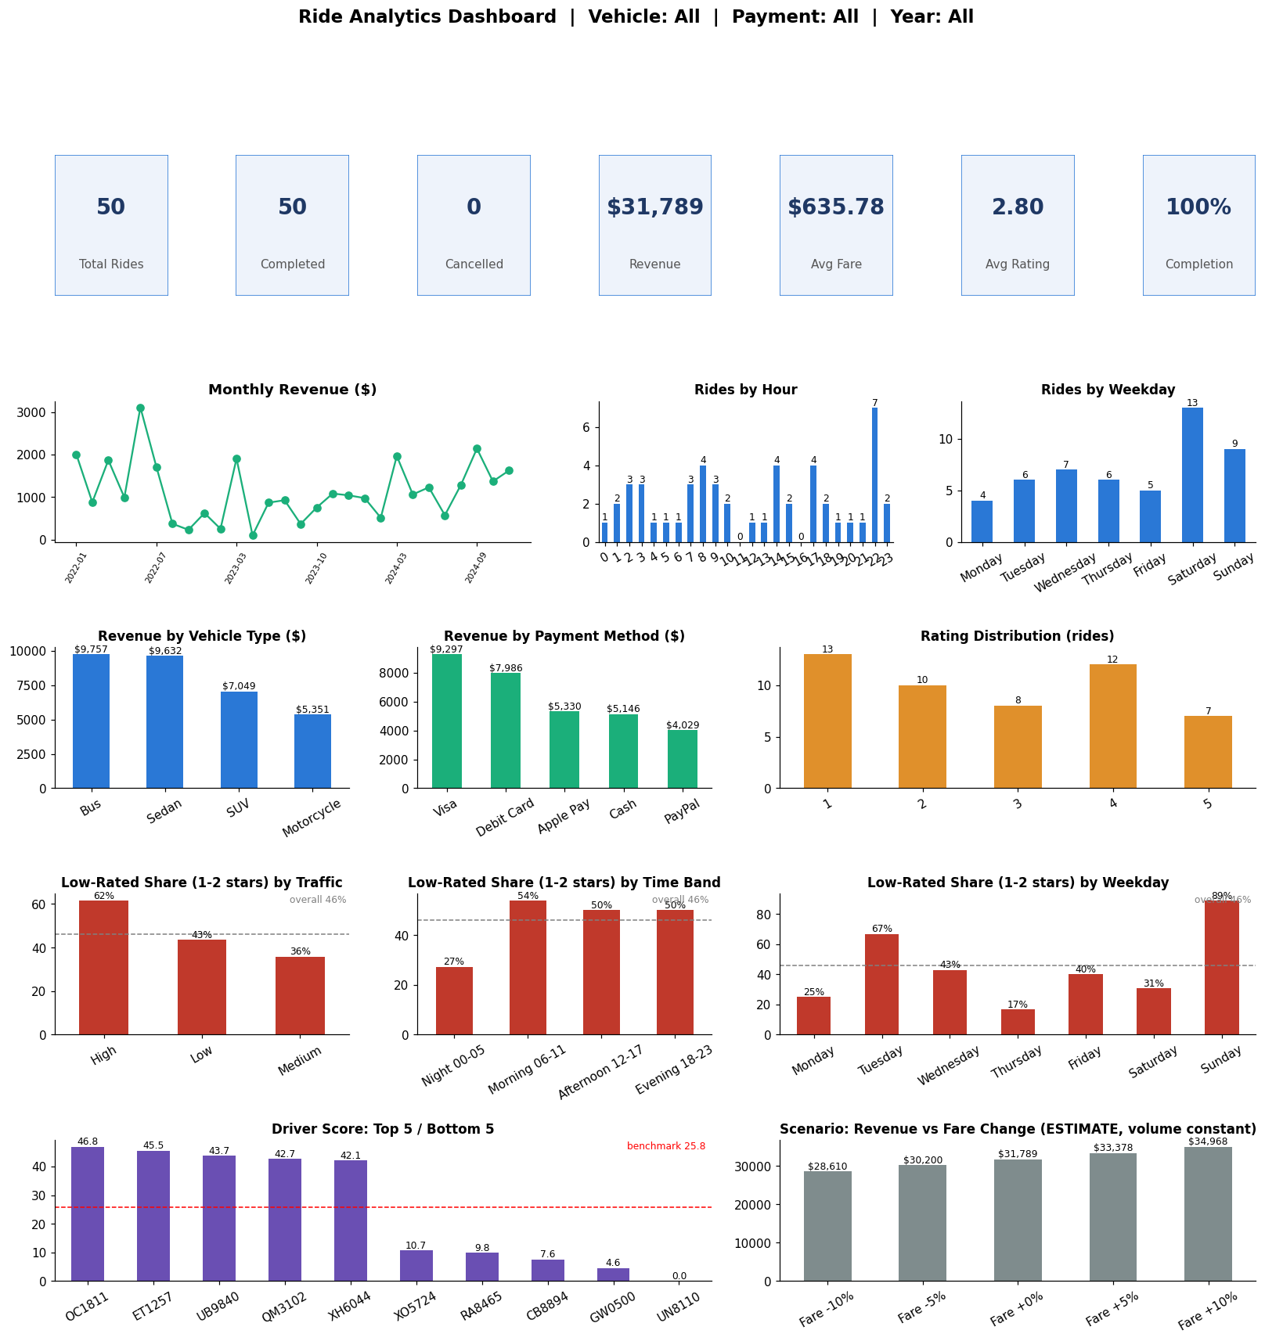
The interactive dashboard
KPI cards, demand, revenue, ratings, operations and driver views on one page
Filters: vehicle type, payment method, year
Power BI pages: Executive Overview, Demand, Revenue, Customers, Drivers, Operations
Drill-through to driver and segment detail; report tooltip
Live demo: filter to Sedan, click a Visa bar, move the scenario slider
Notes:
Switch to the live dashboard here. Demo: Sedan slicer (17 rides, $9,631.78), cross-filter on Visa, driver drill-through, scenario slider.

Slide 8
Demand: when do rides happen?
Saturday is the busiest day (13 of 50 rides); Monday is the lightest (4)
Weekday is derived from Request Time, not the stored column
Monthly revenue is volatile: 28 of 36 months have rides, from $96 to $3,110 (peak June 2022)
Peak-hours flag splits evenly (25 / 25), so it adds little signal
Notes:
Demand findings from corrected weekday logic. Read the busiest hour off the dashboard's hour chart during the demo.

Slide 9
Revenue: where does it come from?
Bus + Sedan = 61% of revenue. Visa + Debit Card = 54%. Rides over $700 are 46% of rides but 66.2% of revenue.
Notes:
Revenue is concentrated in a few vehicle types and card payments. PayPal is the lowest earner.

Slide 10
Customer experience: ratings
Average rating is 2.80 out of 5
46% of rides are rated 1-2 stars, worth $14,780.67 (46.5% of revenue)
Satisfaction is similar across fare levels, so low ratings are not just a cheap-ride issue
No Customer ID exists: segments are groups of rides, not customers
Notes:
Completion is 100% but satisfaction is weak. Be clear that customer segmentation was not possible.

Slide 11
Advanced analysis: where do low ratings concentrate?
Driver benchmark
Average score 25.81; 25 of 50 drivers below it
Top: OC1811 (46.8). Bottom: UN8110 (0.0)
Revenue and rating are unrelated (correlation near zero)
Each driver has one ride, so scores are single-trip snapshots
Associations, not causes. Segments are small (Sunday = 9 rides).
Notes:
Low-rated share is the attention signal. Say explicitly that this shows where, not why, and that samples are small.

Slide 12
Scenario analysis (estimates)
Scenario | Assumption | Estimate | Change
Baseline | Current | $31,788.97 | -
Fare +5% | Volume unchanged | $33,378.42 | +$1,589.45
Fare +10% | Volume unchanged | $34,967.87 | +$3,178.90
Fare +10%, volume -9% | Some riders leave | $31,820.76 | +$31.79
Fare +10%, volume -15% | Strong price sensitivity | $29,722.69 | -$2,066.28
Cancellations 5% (stress test) | Cancelled rides earn $0 | $30,199.52 | -$1,589.45
Break-even rule: a +5% fare pays off only if volume falls by less than 4.8% (+10%: less than 9.1%).
Revenue only, no costs or demand data. The cancellation case is hypothetical: no cancellations were recorded.
Notes:
Explain baseline, assumption, estimate and difference. Everything here is an estimate.

Slide 13
Findings and recommendations
Key findings
Recommendations
$31.8K revenue from 50 rides at $635.78 each
Bus and Sedan earn 61%; Visa and Debit Card 54%
46% of rides are rated 1-2 stars
Low ratings peak in high traffic, on Sundays, mornings and Sedan
Saturday is busiest; evening (18-23) earns the most
No cancellations recorded
Investigate causes of low ratings first (needs rider feedback data)
Capture Customer ID, ride status, cancellation reason, valid distance and cost
A/B test any fare change using the break-even rule
Review driver availability on Saturdays and evenings
Hold driver incentives until drivers have several rides
Track cancellations and retention once the data exists
Notes:
Prioritise recommendation 1 and 2. Several need extra data, which is itself a finding.

Slide 14
Limitations and future improvements
Limitations
Future improvements
No Customer ID: no segmentation or retention
No cancellations; status is a fare-based proxy
Distances implausible (all over 500 miles)
One ride per driver: rankings are single trips
Small sample (50 rides); no cost data
Collect Customer ID, status with reason, wait time, driver supply and trip cost
Use a larger dataset with many rides per driver and customer
Replace raw coordinates with area names
Rebuild the driver score with volume and completion history
Run an A/B pricing test
Notes:
State limitations plainly; they show the analysis was validated, not forced.

Slide 15
Final product
Power BI dashboard: six analytical pages with filters, drill-through and a what-if slider
Jupyter dashboard and full analysis code
Validated KPIs (Power BI, pandas, SQL)
Final report, README and organised GitHub repository
Questions?
Notes:
Close, summarise the final product, and invite questions.

