Slide 1
Large Spatial Datasets Visualizations
Kepler GL, Deck GL, Mapbox, React-Map GL, Luma GL, Loader GL

Slide 2
DECK.GL
A Layered Approach to Data Visualization
High-Precision Computations in the GPU
React and Mapbox GL Integrations
Show Case https://deck.gl/showcase [viv, flowmap.blue, The bad bet, Sand Dance, Flight Mapper, Kepler.gl]
Kepler.GL [Kepler.gl is a powerful web-based geospatial data analysis tool. Built on a high performance rendering engine and designed for large-scale data sets.]

Slide 3
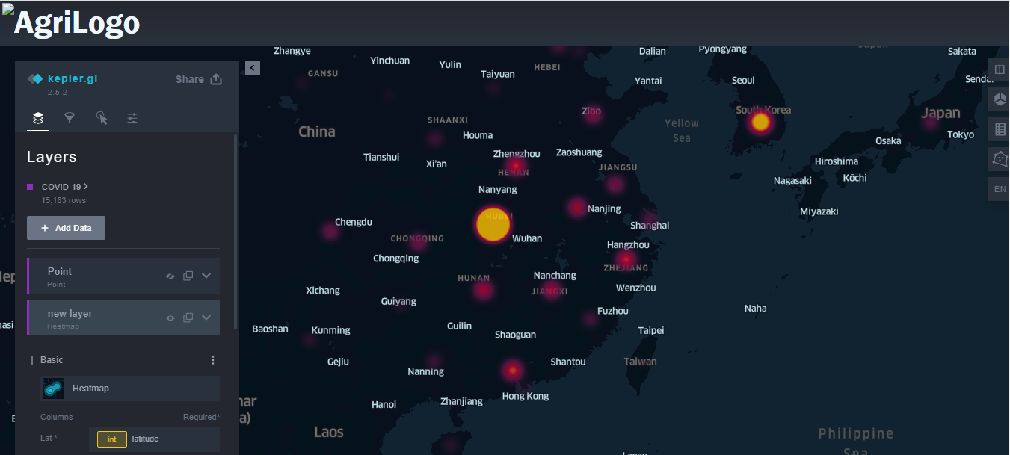
Implementation Approach – Customize Kepler.GL Dashboard

Slide 4
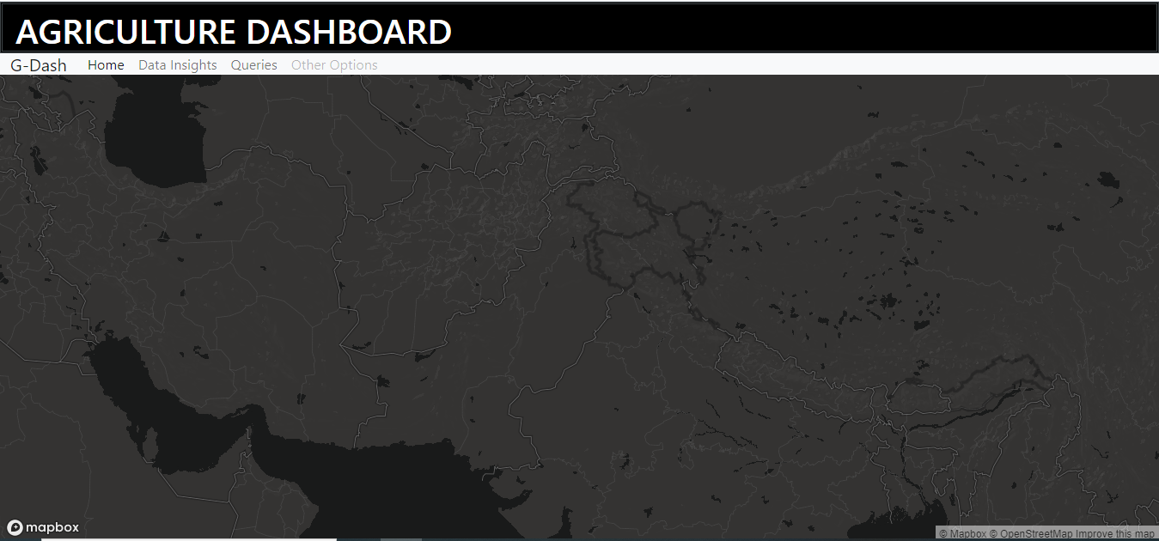
Built Dashboard in React and Mapbox.GL from Scratch and integrate Deck.GL

Slide 5
https://www.gislounge.com/ubers-open-source-mapping-tool/
In kepler.gl, visualization in different maps can be quickly achieved by simply dragging and dropping data, such as from a .csv file, and then trying different forms of data visualization. Geometry calculations are GPU-acellerated, allowing faster processing of visual and large amounts of data.

