Slide 1
CpG markers for melanoma stage prediction
320 patients
197 CpGs
AGE + SEX
From exploratory data analysis to locked-model evaluation
Goal
Low-stage vs high-stage classification
Output
Interpretable 20-CpG panel + model evaluation
1
Notes:
Introduce the question: can supplied CpG methylation features help classify melanoma stage? Do not present this as a validated clinical tool.

Slide 2
Research aim and classification task
What the analysis is trying to predict
Binary target
Main analysis question
Stage 1
Low stage
157 patients
Stage 2
High stage
163 patients
Can CpG methylation features and simple clinical variables distinguish high-stage from low-stage melanoma patients?
Modeling goal
Compare broad feature sets, then lock an interpretable compact CpG panel for a single final held-out evaluation.
Output focus
Prediction performance, selected markers, coefficient direction, and uncertainty around the held-out test estimates.
2
Notes:
Put locally: one sentence explaining the biological context of melanoma methylation markers, if required by your course.

Slide 3
Dataset structure
What the input table contains
Component
Value
Use
Important interpretation limits
AGE units, SEX code mapping, CpG platform, and CpG preprocessing are not documented in the supplied files. Add these locally if available.
Patients
320 rows
Classification samples
Variables
200 columns
Target + predictors
Study type
CpG markers
197 cg... columns
Main molecular features
This is stage classification. The supplied CSV does not include survival time or event-status columns.
Clinical variables
AGE and SEX
Simple comparators
Positive class
High stage is recoded internally as the positive class for model evaluation.
Target
Stage 1/2
Low vs high stage
3

Slide 4
End-to-end workflow
Three notebooks with locked handoffs
Member 1
Data audit
Split
EDA
Member 2
Nested CV
Panel selection
Model locking
development.joblib
test_holdout.joblib
locked_models.joblib
Why joblib handoffs matter
What to emphasize
They freeze the split, selected features, model parameters, and fitted models. Member 3 evaluates without refitting.
The workflow separates exploration, model selection, and final testing. This reduces accidental reuse of the test set.
4
Notes:
Place the repository flow here if you create your own icons locally.

Slide 5
EDA methods
Exploration was done after reserving the test set
Audit missing values, constant columns, class balance, and feature ranges.
Create a stratified 80:20 development-test split.
Explore AGE, SEX, and CpG distributions within development data only.
Check CpG-CpG correlations to identify near-duplicate predictors.
Use PCA only as visualization, not as classifier input.
EDA rule
Do not learn from the test set
Why this matters
If feature exploration or selection uses the test set, the final evaluation can look better than it really is.
Where to put local data
Add one screenshot/table from Member 1 showing data audit or class counts if your teacher wants raw evidence.
5

Slide 6
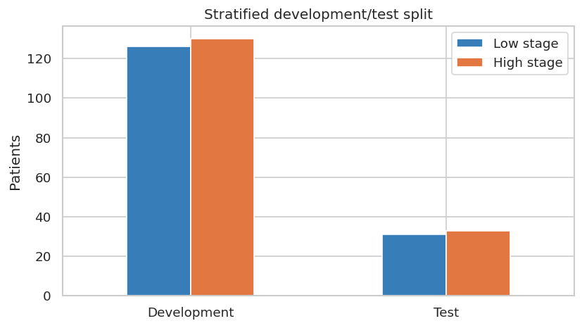
EDA result: data audit and split
Clean input and preserved class balance
Check
Result
Rows
320
Variables
200
CpGs
197
Missing values
0
Constant columns
0
AGE range
1 to 69
CpG range
-1.39 to 1.38
6
Notes:
Explain that stratification keeps low/high-stage proportions similar in development and test.

Slide 7
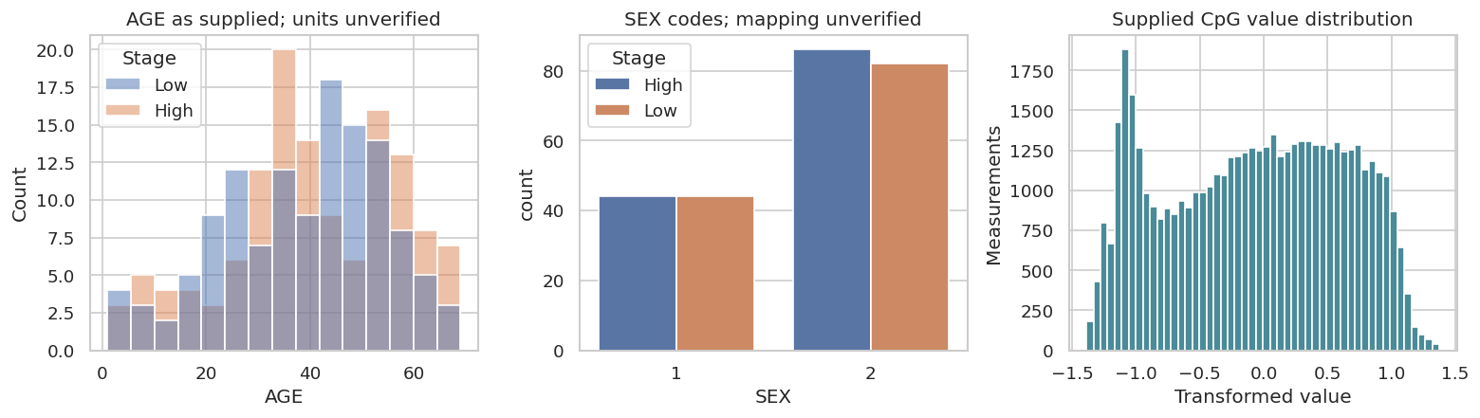
EDA result: clinical and CpG distributions
Distribution checks before modeling
AGE was inspected by stage to detect broad clinical differences.
SEX distribution was checked by stage, but code mapping needs confirmation.
CpG distributions were checked to confirm transformed, comparable feature ranges.
No major missing-data issue was found in the supplied table.
How to present
Say this EDA supports using the dataset for modeling, but it does not prove strong separation between stage groups.
7

Slide 8
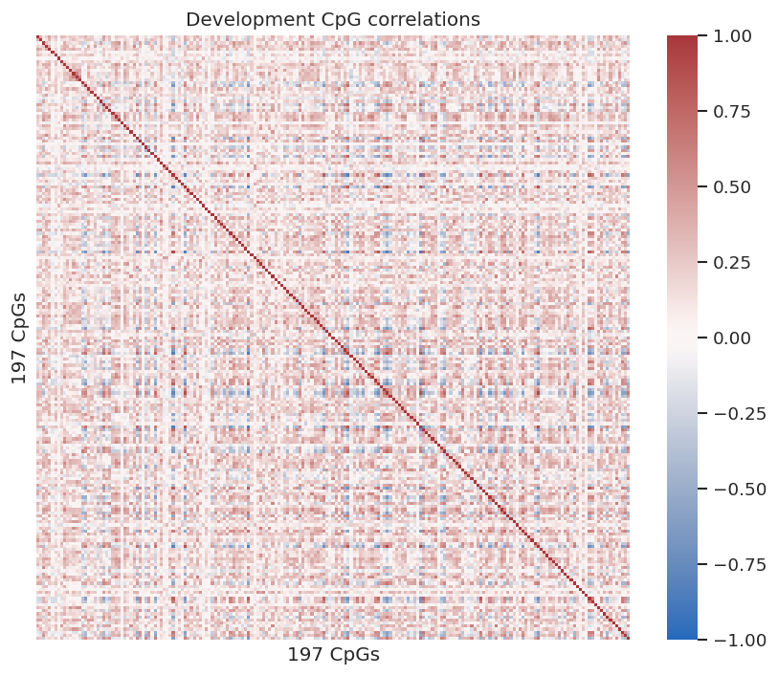
EDA result: CpG correlation structure
Checking redundancy among methylation features
Highly correlated pair
Pearson r
cg25671438 / cg02210967
0.913
cg14649566 / cg11496569
0.916
Interpretation
Only two CpG pairs had |r| > 0.9 in the development set, so widespread duplicate predictors were not evident.
Why it matters
Strongly correlated features can make coefficients unstable. Penalized models and compact panels help manage this.
8

Slide 9
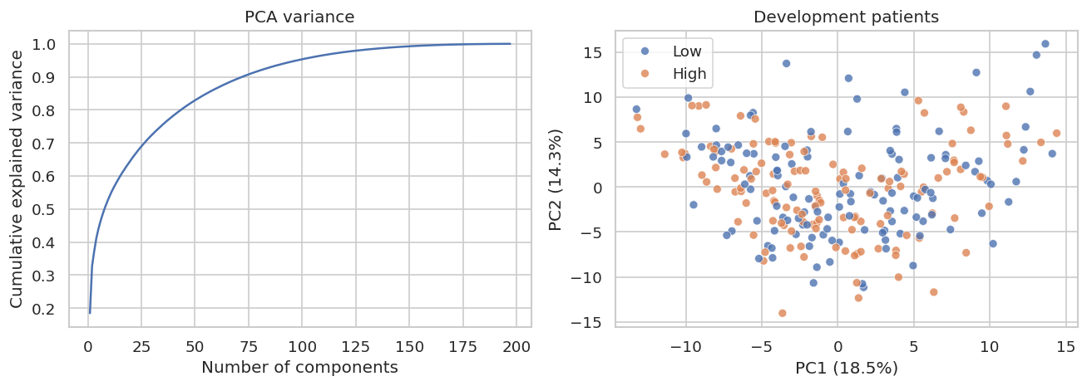
EDA result: PCA visualization
Exploratory view of stage separation
PCA summarizes high-dimensional CpG variation into principal components.
It was used only for visualization.
No clear visual separation means stage prediction may be difficult.
The classifiers still use original features, not PCA scores.
Talk track
Use PCA as exploratory evidence: useful for seeing broad structure, but not enough to judge model performance.
9

Slide 10
Model candidates
Nine configurations across three modeling strategies
Strategy
Configurations
Purpose
Clinical baseline
Clinical elastic-net, clinical forest
Tests AGE + SEX only
Full CpG models
CpG elastic-net, CpG forest
Uses all 197 CpGs
Combined models
Combined elastic-net, combined forest
AGE + SEX + CpGs
Compact panels
Panel 5, Panel 10, Panel 20
Interpretable CpG subsets
Key message
Why compare multiple feature sets
There are nine model configurations, but three main ML ideas: penalized logistic regression, random forest, and selected-CpG logistic panels.
This shows whether CpGs add signal beyond AGE and SEX and whether a smaller marker panel performs similarly to larger models.
10

Slide 11
Why these model families were selected
Practical choices for small data and many CpGs
Elastic-net logistic regression
Handles many predictors
Produces sparse coefficients
Random Forest
Captures nonlinear patterns
Useful comparator
CpG panels
Small marker sets
Easier to explain
Reason for not using more complex models
Reporting phrase
With 320 patients and 197 CpGs, highly flexible models such as deep learning would have high overfitting risk and low interpretability.
Describe the analysis as a comparison of penalized linear models, tree-based ensembles, and parsimonious CpG-panel models.
11

Slide 12
Evaluation strategy
Development selection first, final test once
Development
256 patients
Nested CV
Lock models
Features + parameters
Held-out test
64 patients
Evaluate once
Full data
320 patients
Why stratified split
Why test once
Stage classes are balanced but not identical. Stratification preserves class proportions in development and test.
Repeatedly checking the test set during model choice would overfit the evaluation itself.
12

Slide 13
Nested cross-validation and leakage control
How model selection was made fairer
Outer CV
5 folds
Performance estimate
Inner CV
3 folds
Tune parameters
Pipelines
Scale + select features
inside CV only
Inner folds select hyperparameters.
Outer folds estimate the selected procedure.
Feature selection for panel models is repeated within training folds.
StandardScaler is fitted only on training data within each fold.
Why nested CV
It reduces optimistic bias when several models and hyperparameters are compared on a small dataset.
13

Slide 14
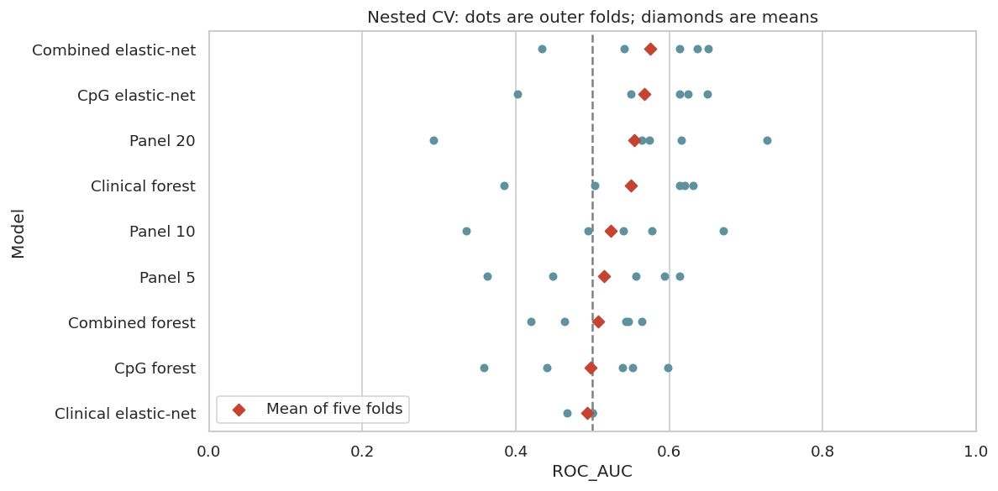
Model-selection result
Nested CV shows weak-to-moderate internal discrimination
Model
Mean ROC-AUC
Combined elastic-net
0.575
CpG elastic-net
0.568
Panel 20
0.555
Clinical forest
0.550
Selection result
The overall development winner was combined elastic-net, but the compact Panel 20 was retained for interpretability.
How to explain dots
Dots are outer-fold test scores. Diamonds show fold means. Wide spread means performance is unstable across folds.
14

Slide 15
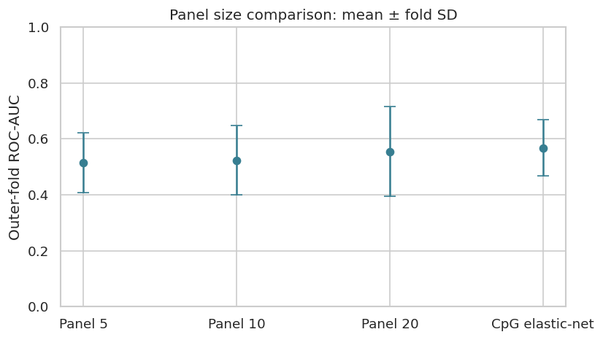
CpG-panel selection
Reason for selecting the 20-CpG panel
Panel sizes compared: 5, 10, and 20 CpGs.
Feature selection used ANOVA F score within training folds.
Panel 20 gave the strongest compact-panel mean ROC-AUC.
The selection rule favored a small interpretable panel close to the best compact result.
Important wording
This is a practical marker-selection rule. It is not proof that 20 CpGs are biologically sufficient or externally validated.
15

Slide 16
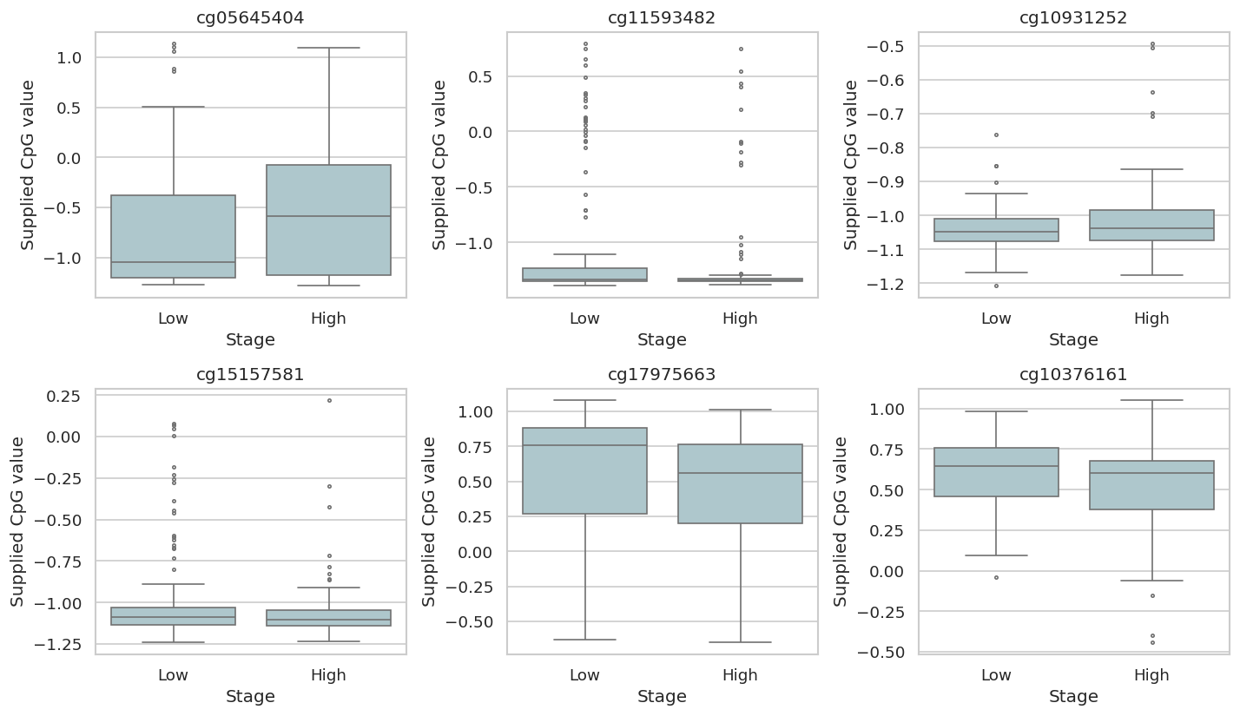
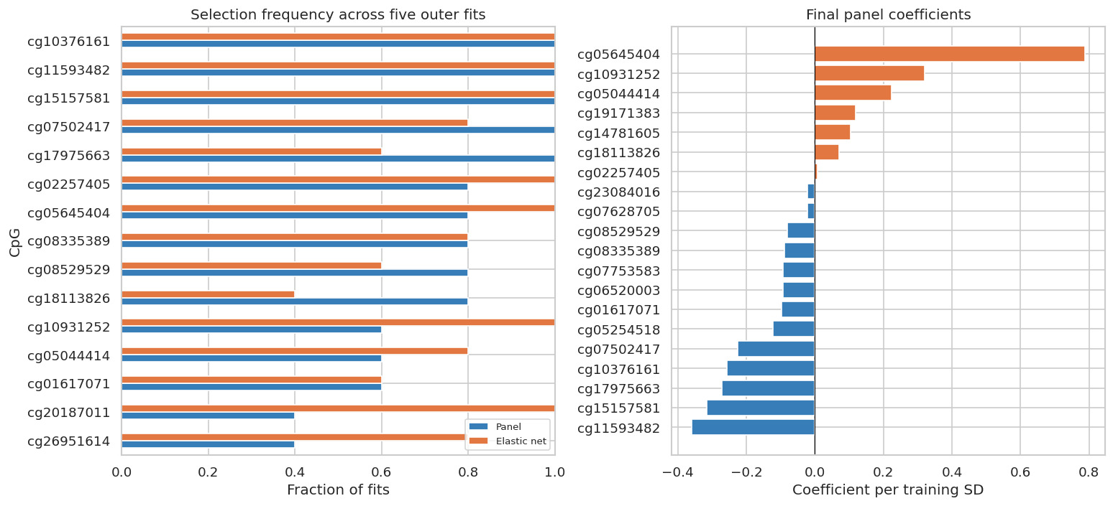
Marker stability and coefficients
What the selected CpGs show
Interpretation
Selection frequency shows how often a CpG was chosen across outer-fold training sets. Coefficient sign shows direction in the fitted panel.
16

Slide 17
Held-out evaluation methods
Locked models tested once on unseen patients
Member 3 loads development, test, and locked-model checkpoint files.
No refitting, no new feature selection, no threshold tuning on the test set.
Fixed probability threshold: 0.5 for class labels.
Primary metric: ROC-AUC.
Secondary metrics: average precision, balanced accuracy, sensitivity, specificity, Brier score.
Why ROC-AUC
ROC-AUC compares ranking performance across thresholds, so it is useful before choosing a clinical decision threshold.
Why balanced accuracy
Balanced accuracy gives equal weight to low-stage and high-stage classes.
Why Brier score
Brier score checks probability error, not only class ranking.
Why bootstrap
The test set has 64 patients, so confidence intervals communicate sampling uncertainty.
17

Slide 18
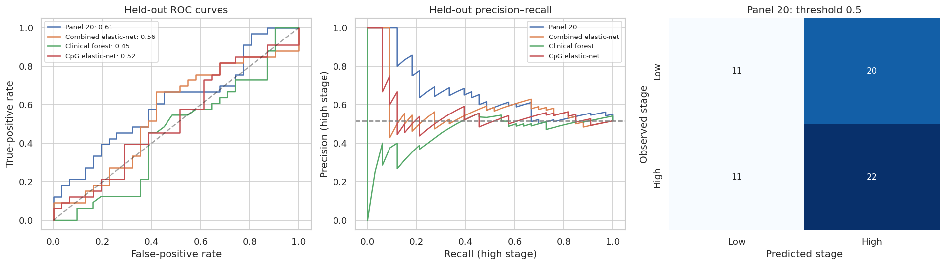
Held-out evaluation plots
ROC, precision-recall, and confusion matrix
Locked model
ROC-AUC
Balanced acc.
Panel 20
0.609
0.511
Combined elastic-net
0.555
0.575
Clinical forest
0.451
0.531
CpG elastic-net
0.522
0.481
Main result
Panel 20 had the highest held-out ROC-AUC among locked models, but classification at threshold 0.5 remained weak.
How to present confusion matrix
Mention the threshold is fixed at 0.5. Do not optimize it after seeing the test labels.
18

Slide 19
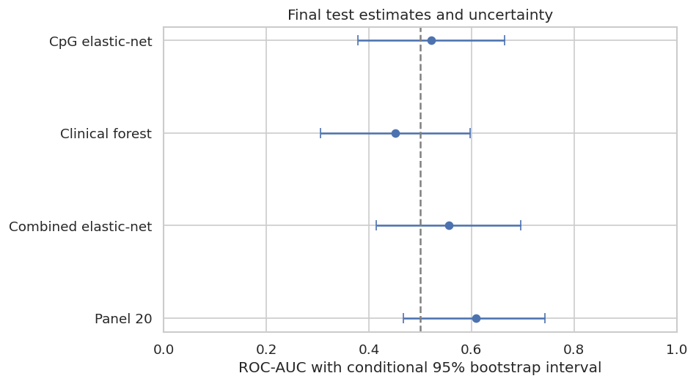
Uncertainty and final interpretation
Final estimates need cautious wording
Metric for Panel 20
Value
Held-out ROC-AUC
0.609
95% bootstrap interval
0.467 to 0.743
Test patients
64
Conclusion
Exploratory signal only
Reason for caution
The interval includes 0.5, so the held-out result does not establish reliable stage prediction.
What is still needed
Independent external validation, verified CpG annotation, clinical variable code mapping, and platform/preprocessing details.
19

Slide 20
What to add locally before presenting
Items that need your local confirmation
Add locally
Where to add it
Assay platform and CpG annotation source
Slides 3, 16, 19
SEX code mapping
Slides 3 and 7
AGE units and source
Slides 3 and 7
Original dataset/preprocessing notes
Slides 2 or 3
Course-specific requirement or rubric
Final slide or appendix
Biological interpretation of top CpGs
After Slide 16 or as appendix
Recommended closing statement
The workflow identifies an exploratory 20-CpG marker panel and evaluates it with leakage-controlled internal validation. External validation is required before biological or clinical claims.
20

