Slide 1
Weather and Covid-19 Transmission Rates
By: Umair Usmani

Slide 2
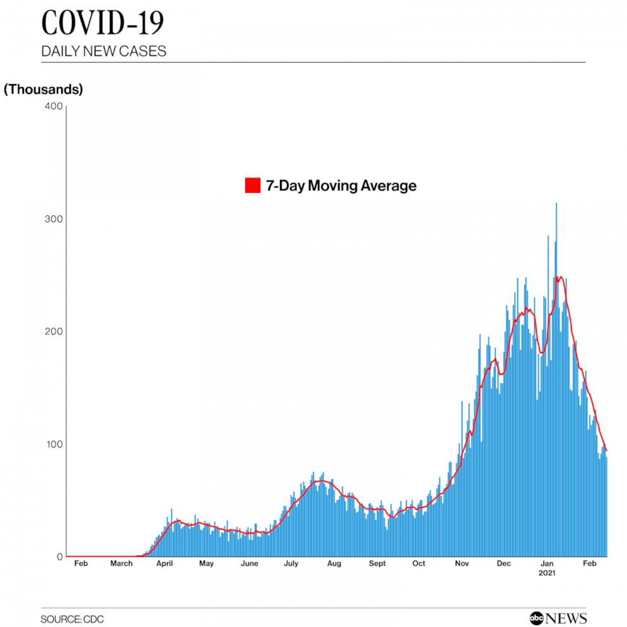
Goal of Project
Intro:
Effect of weather/temperature on virus never discussed after initial outbreak
See if Covid-19 has a faster spread in certain environments
Hypothesis:
Colder weather should show an increased Covid-19 cases spread
Goal:
Find if temperature has an effect on Covid-19 spread
Use different machine learning methods to predict accuracy of future data

Slide 3

Literature Review
Previous Work:
Not much previous work being done on this specific topic
IRS using this data to re-integrate federal employees with CDC help
Where Previous Work Fell Short in Answering Question:
Data does not predict future waves
Previously being very difficult to find an archive of historical data
Most sources allow user to enter date for provided weather
I had to manually pull and enter the historical monthly temps in county's

Slide 4
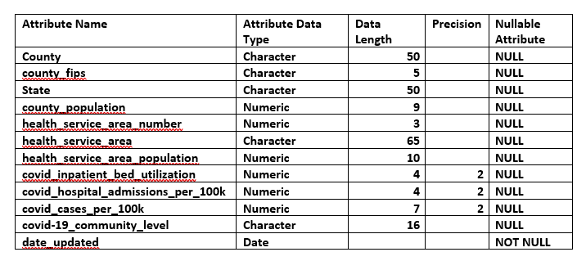
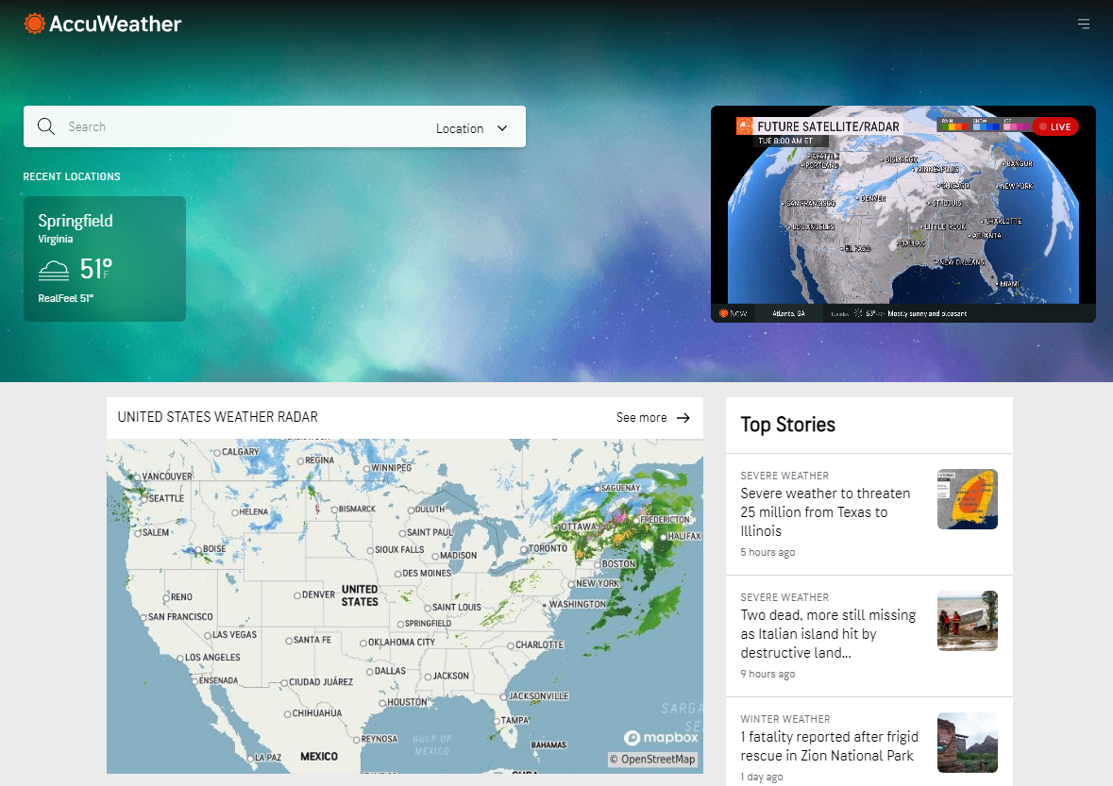
Data Description
Covid-19/Area Related Data:
Meta data shown on right ->
Used mainly Covid Cases, County, and FIPS
FIPS: 2 digit State Code + 3 digit County Code
Date_Updated and County Fips attributes form the Primary
Key of the data.
Weather Related Data:
Format of website shown on right ->
Data provided had to be manually searched for
Data shown had to be summarized and manually
entered/merged into the initial dataset

Slide 5
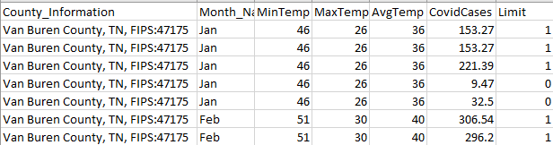
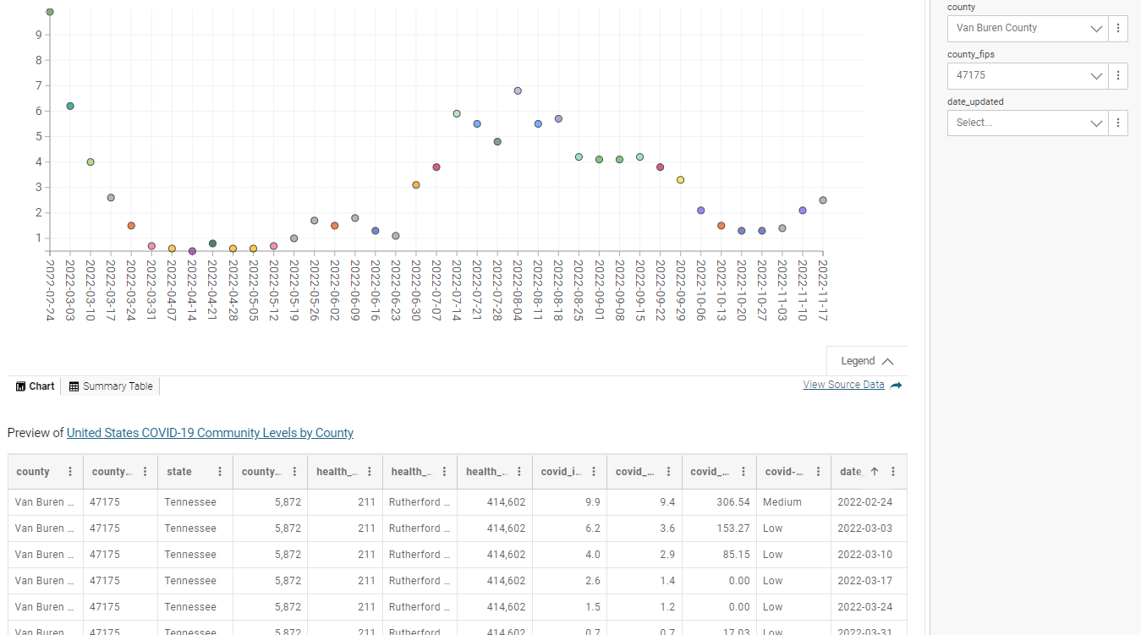
Data Description pt.2
How I modified Data:
Weather data averaged
Manually merged with CDC data
Added a “limit” column
If cases >70 then = 1, else 0
Potential of Modified Data:
Now we can compare and train the data
Adding the “limit” column allows for classifying
ML algorithms to be done

Slide 6
Data Description References
Anon. n.d. “United States Covid-19 Community Levels by County.” Centers for Disease Control and Prevention. Retrieved October 17, 2022 (https://data.cdc.gov/Public-Health-Surveillance/United-States-COVID-19-Community-Levels-by-County/3nnm-4jni).
https://data.cdc.gov/Public-Health-Surveillance/United-States-COVID-19-Community-Levels-by-County/3nnm-4jni
US Department of Commerce, N. OA A. 2015. “Temperature Breakdown by Decade.” National Weather Service. Retrieved October 17, 2022 (https://www.weather.gov/dtx/fnttemp1920-1940).
https://www.weather.gov/dtx/fnttemp1920-1940
Paducah, Ky Today, Tonight & Tomorrow's weather forecast. AccuWeatherAvailable at https://www.accuweather.com/en/us/paducah/42003/weather-forecast/328977 (verified 28 November 2022).
https://accuweather.com

Slide 7
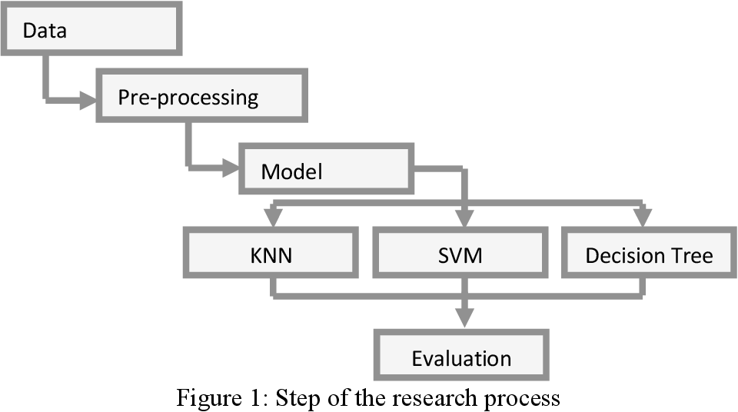
Methods Description
First Method Used:
First ML used was KNN
Uses proximity to make predictions about grouping individual data points
Second Method Used:
Second ML used was Decision Tree Predictions
Then to make a Confusion Matrix
Shows map of possible outcomes in a series of related choices

Slide 8
Methods Description pt.2
Potential of Previous Methods in this project:
The KNN method can show individual future predictions
Makes predictions of possible future inputted data compared to current data
The Decision tree can show a larger scale of predictions encompassing multiple county’s
Makes predictions using previous data to create new potential outcomes
Potential Future Methods (more on another potential ML algorithm on later slide):
Other variables being a factor
Collecting more data (probably will involve much manual data entry)
Incorporating data into ML algorithms to see individual effects of different variables

Slide 9
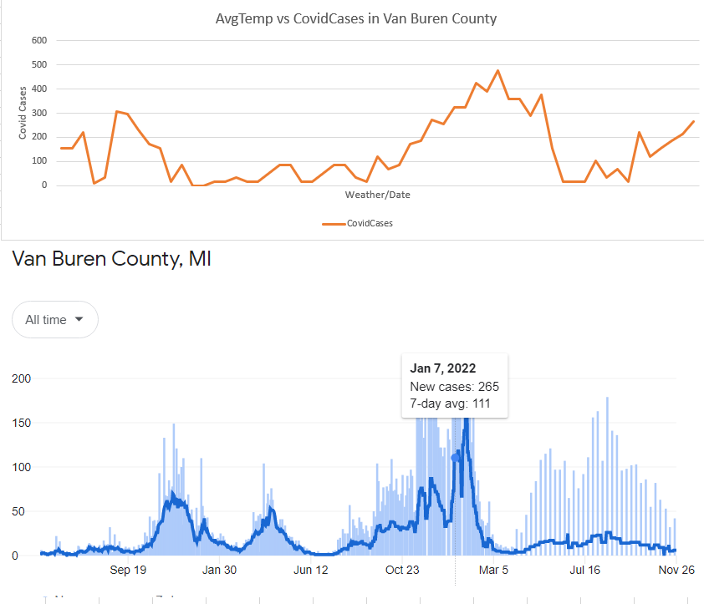
Results/Visualizations
Initial Results from Initial Data (Basic Visualization Graphs):
These are the initial base graphs that can be referred back to
The bottom graph is of covid-19 rates in Van Buren County
Top graph is Merged data shown in previous slide with Covid cases and weather

Slide 10
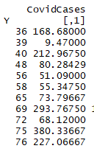
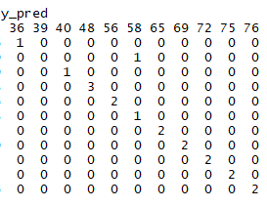

Results/Visualizations pt.2
Results from ML Methods:
KNN shows the predicted points and their correlation between the weather/covid cases
As more data is added the accuracy will start to even out (a little high right now)
Decision tree method shows the predicted values given the temperature
Comparable to the previous charts

Slide 11
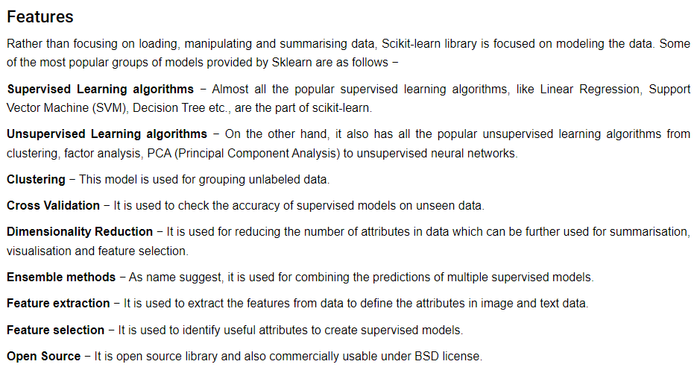
Results/Visualizations pt.3
Potential Future Experimenting Results/Visualizations:
Using Scikit-learn ML algorithm in Python
Includes multiple ML algorithms within one library
Potential Future Results:
Scikit-learn rather than needing to load data, the library focuses on modeling

Slide 12
Sources
Anon. n.d. “United States Covid-19 Community Levels by County.” Centers for Disease Control and Prevention. Retrieved October 17, 2022 (https://data.cdc.gov/Public-Health-Surveillance/United-States-COVID-19-Community-Levels-by-County/3nnm-4jni).
Horizon Blue Cross Blue Shield of New Jersey. (2022, January 25). Why do viruses spread more in winter? Cold temps are key. Retrieved November 27, 2022, (https://www.horizonhealthnews.com/why-do-viruses-spread-more-in-winter-cold-temps-are-key/)
Paducah, Ky Today, Tonight & Tomorrow's weather forecast. AccuWeatherAvailable at https://www.accuweather.com/en/us/paducah/42003/weather-forecast/328977 (verified 28 November 2022).
US Department of Commerce, N. OA A. 2015. “Temperature Breakdown by Decade.” National Weather Service. Retrieved October 17, 2022 (https://www.weather.gov/dtx/fnttemp1920-1940).

