Slide 1
Merge-Based Parallel
Sparse Matrix-Vector
Multiplication
CS-3006 · Parallel & Distributed Computing · Spring 2026
Muhammad Umair (23i-0662) · Awais Basheer (23i-0506)
Base Paper: Merrill & Garland, SC'16

Slide 2
Presentation Outline
1
The SpMV Problem & Motivation
2
How Merge-Path Works — Step by Step
3
Our Five Implementations
4
Results: thermomech_dK (Regular Matrix)
5
Results: ASIC_320k (Irregular Matrix)
6
Hardware-Level Analysis (Roofline)
7
Key Takeaways & Conclusions

Slide 3
The SpMV Problem & Why Balance Matters
y = A · x
— core of iterative solvers, graph analytics, ML
Traditional Row-Based Approach
• Assign one thread per row
• Long rows → one thread works forever
• Short / empty rows → threads idle
• Performance varies up to 100× for similar nnz
Our Goal
• Guarantee equal work per thread
• No reformatting of CSR needed
• Works for any sparsity pattern
Row-Based Imbalance
Row 0 (empty)
0 nnz
Row 1 (short)
1 nnz
Row 2 (medium)
4 nnz
Row 3 (very long)
14 nnz
Thread 3 does 14× more work than Thread 0!

Slide 4
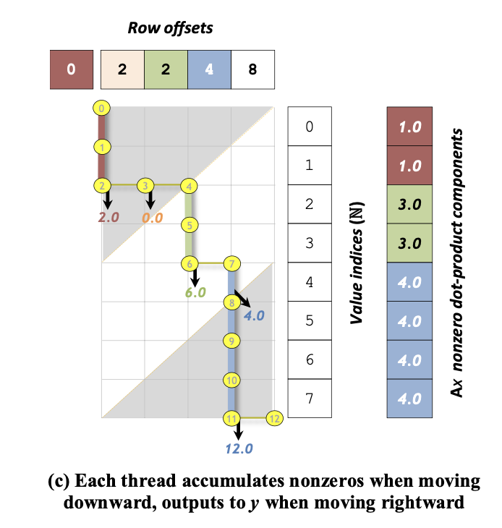
The Merge-Path Idea — Logical 2D Grid
Key insight: frame SpMV as merging two lists — row-offsets (List A) and nonzero indices (List B). The merge path traverses a 2D grid top-left → bottom-right. Each diagonal segment is equal-length → equal work per thread.
How each thread works:
1
Each thread gets diagonal range of size (rows + nnz) / threads
2
Binary search along starting diagonal → finds (row_idx, nz_idx)
3
Thread walks forward: moving DOWN = consume a nonzero, multiply & add
4
Moving RIGHT = finished a row → write y[row], reset accumulator
5
Partial rows fixed up after parallel section

Slide 5
Worked Example — 3 Threads on a 4-Row Matrix
Matrix A: 4 rows, 8 nonzeros row_offsets = [0, 2, 2, 4, 8] Total merge path = 4 + 8 = 12 steps → 4 steps/thread
Step 1: Binary Search
Step 2: Each Thread Consumes
Step 3: Fix-Up Pass
Diagonal 0 → Thread 0 starts at (row=0, nz=0)
Diagonal 4 → Thread 1 starts at (row=2, nz=2)
Diagonal 8 → Thread 2 starts at (row=3, nz=5)
Each binary search = O(log(rows+nnz))
T0: rows 0-1 → y[0]=1+1=2, y[1]=0
(empty row)
T1: partial row 2 → accumulates y[2]
partial
T2: completes row 2 + does row 3 fully
All threads work on exactly 4 items each
Row 2 spans T1 and T2 → carry-out
fix-up
y[2] += carry from Thread 1
Single sequential pass over
num_threads-1 values
Overhead is negligible (O(threads) not O(nnz))
Key guarantee: No thread ever gets more than ⌈(rows + nnz) / threads⌉ items — regardless of matrix structure.

Slide 6
Our Five Implementations
Sequential Baseline
CSR loop
1
Standard row-loop. Single thread. Reference for correctness & speedup baseline.
OMP Merge-Path Scalar
OpenMP
2
Algorithm 2 from paper. Each OpenMP thread binary-searches its diagonal, then walks path sequentially.
OMP Merge-Path AVX2
AVX2 FMA
3
Inner loop vectorized with 256-bit AVX2. 4× double FMA per instruction. _mm256_i32gather_pd for x[] reads.
OMP AVX2 Unrolled ×2
AVX2 + Unroll
4
Two independent FMA accumulator chains (vs0, vs1). Breaks 4-cycle FMA latency dependency → 2× FMA throughput.
OMP AVX2 + Prefetch
+ SW Prefetch
5
Adds __builtin_prefetch ahead by pf_dist nonzeros. Hides DRAM latency for x[col[i]] gather accesses.

Slide 7
Results: thermomech_dK (Regular Matrix, CV ≈ 0.10)
2,846,228 nonzeros · uniform row lengths · data fits mostly in L3 cache
Speedup vs. Sequential Baseline (avg. of 4 runs)
Key Observations
1
OMP Scalar (×2.84) — thread parallelism alone gives biggest boost for regular matrices
2
AVX2 vectorization adds modest gain; regular matrices already stress the memory bus
3
Unroll ×2 inconsistent — sometimes slower due to register pressure
4
Prefetch helps when rows are long enough (pf_dist=32 works well here)
5
All 5 approaches pass correctness check
1.67 GFLOPs
4.09 GFLOPs
×3.43
Baseline
Best
Best Speedup

Slide 8
Results: ASIC_320k (Irregular Matrix, CV ≈ 61)
2,635,364 nonzeros · extreme row-length variation (circuit simulation) · x[] accesses highly random
Speedup vs. Sequential Baseline (avg. of 3 runs)
Key Observations
Merge-path shines here — row imbalance eliminated, scalar OMP still ×3.0
1
Row-based OpenMP would have failed badly on this matrix (CV=61!)
2
AVX2 gathers hit cache misses on random col[] → less benefit than expected
3
Prefetch (d=32) slightly hurt — cache pollution on short-row matrices
4
Unrolled ×2 also regresses slightly vs AVX2
1.55 GFLOPs
3.45 GFLOPs
×3.44
5
Baseline
Best
Best Speedup

Slide 9
Head-to-Head: Regular vs. Irregular Matrix
Regular matrix (thermomech)
OMP Scalar wins because rows are uniform — all threads finish together. AVX2 gains are modest since the bottleneck is memory bandwidth, not compute.
Irregular matrix (ASIC_320k)
OMP Scalar performs slightly better here too — merge-path eliminates the imbalance that would cripple a row-based approach. AVX2 gathers hit L3/DRAM misses on random column indices.

Slide 10
Hardware-Level Analysis — Roofline Model
Roofline Model for SpMV
Binding Regime Analysis
Arithmetic Intensity (AI) = FLOPs / Bytes
SpMV: 2·nnz FLOPs
Bytes ≈ nnz×(8+4+8) + rows×(4+8)
= nnz×20 + rows×12
For our matrices:
thermomech: AI ≈ 0.095 FLOP/byte
ASIC_320k: AI ≈ 0.091 FLOP/byte
Both are deeply memory-bound.
Roofline ridge ≈ 100+ FLOP/byte on modern CPUs.
We are 1000× below the ridge.
→ Adding more SIMD/FMAs won’t help.
→ Reducing memory traffic is the only lever.
Memory-Bound
◀ US
BW saturated, threads don't scale above ~×3
Compute-Bound
GFLOPs near peak; perfect thread scaling
Sync Overhead
Efficiency drops at high thread count
Poor Locality
◀ US
Low BW even at low thread count

Slide 11
Why AVX2 Didn’t Outperform Scalar — Memory Bottleneck
Expected (Compute View)
Actual (Memory-Bound Reality)
✓ AVX2 FMA processes 4 doubles simultaneously → 4× compute
✗ Actual gain: AVX2 ≈ 5–15% faster at best, sometimes slower
✗ Root cause: x[col[i]] gather — every access is a potential cache miss
✓ Unroll ×2 breaks FMA latency chain → another 2× compute
✗ Memory latency (L3: ~30 cycles, DRAM: ~200 cycles) hides all FMA gains
✓ Total expected: up to 8× improvement in inner loop
✗ AVX2 gather doesn't prefetch — hardware prefetcher can't predict random col[]
Lesson: For SpMV, software prefetch (Approach 5) is more valuable than extra FMA lanes — hide latency, not compute.

Slide 12
Scalability Analysis — Thread Count vs. Speedup
Efficiency Analysis
Scalar (8T)
1.86×
eff: 23%
AVX2 (8T)
2.61×
eff: 33%
Unrolled (8T)
2.72×
eff: 34%
Perfect
8.0×
eff: 100%
Low efficiency confirms memory-bound bottleneck — more threads contend for same memory bus.

Slide 13
LLM Usage — Disclosure & Reflection
Where LLMs Were Used
Limitations Observed
Academic Integrity
Debugging AVX2 horizontal-reduce sequence
LLM initially suggested PF_DIST=16 — caused cache pollution
Both members understand and can explain all code
1
1
1
Explaining pf_dist cache-pollution behavior
Over-confident answers about cache-line sizes on our CPU
LLM was used as a debugging assistant, not a solution generator
2
2
2
Reviewing correctness of MergePathSearch binary search
Could not replace actual perf/likwid hardware profiling
All algorithmic ideas sourced from Merrill & Garland SC'16
3
3
3
CSV/data parsing & results analysis
Required human verification of every generated code block
Representative prompts documented in report appendix
4
4
4

Slide 14
Key Takeaways
1
Merge-path gives strictly balanced work: ≤ ⌈(rows+nnz)/threads⌉ items per thread, regardless of sparsity
2
Our implementation correctly reproduces Algorithm 2 (SC'16) and all 5 approaches pass correctness checks
3
Speedups of up to ×3.4 achieved — the bottleneck is memory bandwidth, not compute
4
ASIC_320k (CV=61) shows why merge-path is critical: a row-based approach would have collapsed
5
AVX2 vectorization helps less than expected — random gather accesses dominate latency
6
Roofline AI ≈ 0.09 FLOP/byte confirms deep memory-bound regime on both test matrices
Thank you · Questions?

