Slide 1
AES Encryption
Ms. Ayesha Jarral

Slide 2
AES INTRODUCTION
Introduction to AES
AES = Advanced Encryption Standard
It is one of the most widely used encryption algorithms in the world.
Made in 2001 by NIST (USA) after replacing the old DES algorithm.
AES is a symmetric key algorithm → means the same key is used to encrypt (lock) and decrypt (unlock).

Slide 3
Why AES is Strong?
Works very fast on both software and hardware.
Difficult to break → requires trying 2^128 combinations for AES-128, which is practically impossible.
Used in banks, Wi-Fi security, VPNs, WhatsApp, and almost every secure app.

Slide 4
Advanced Encryption Standard
This standard specifies the Rijndael algorithm
It is a symmetric block cipher that can process data blocks of 128 bits
Rijndael was designed to handle additional block sizes
Cipher keys with lengths of 128, 192, and 256 bits.
The algorithm may be used with the three different key lengths indicated above, and therefore these different “flavors” may be referred to as
AES-128
AES-192
AES-256

Slide 5
AES Security
AES was designed after DES.
Most of the known attacks on DES were already tested on AES.
Brute-Force Attacks.
Statistical Attacks
Differential and Linear Attacks.

Slide 6
AES Implementation Aspects
Simple Algorithms
Resistant against known attacks.
Code compactness on many CPUs.
Cheap processor and minimum amount of memory.
Very efficient.

Slide 7
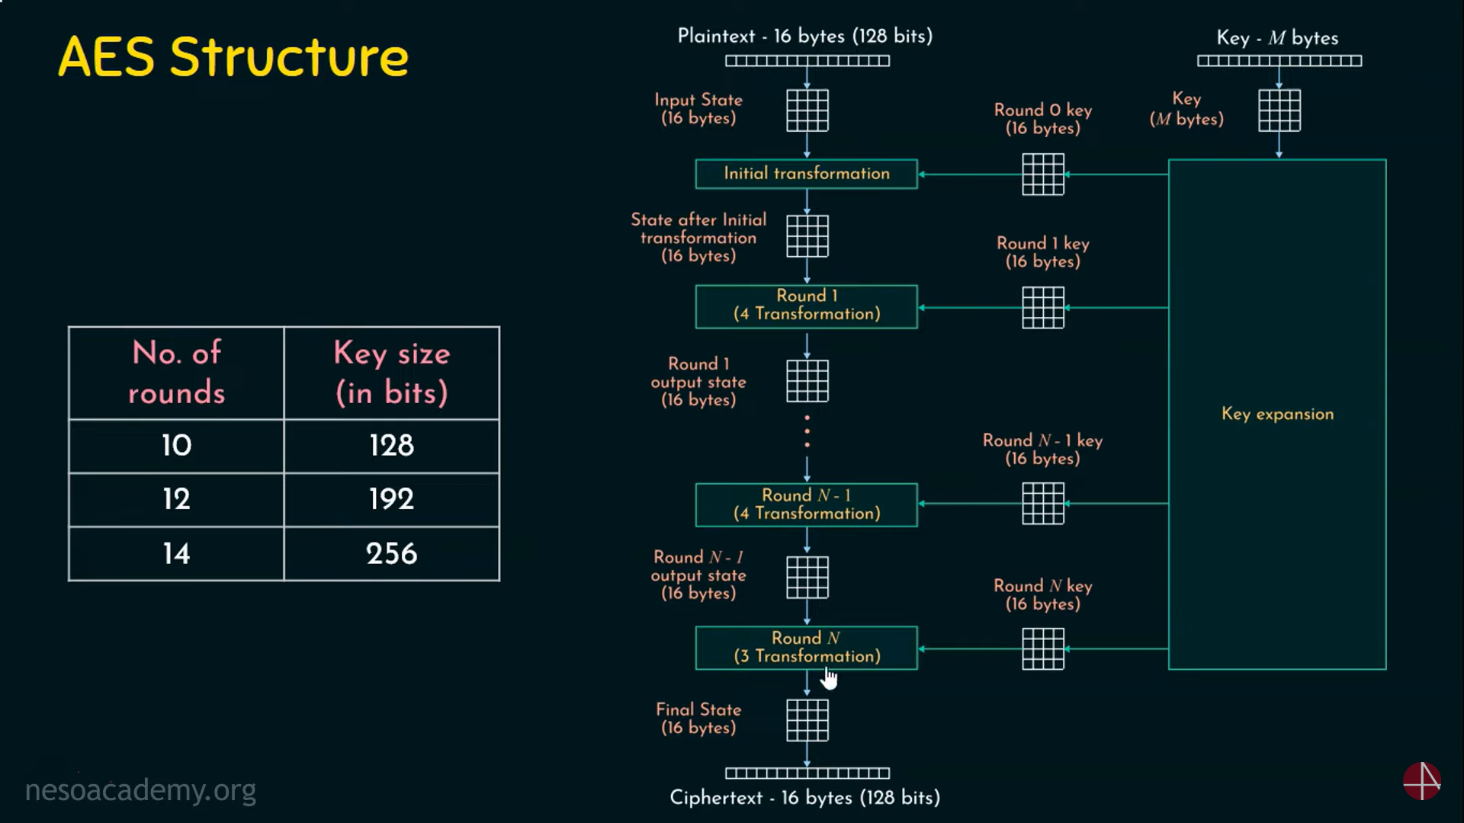
AES Structure

Slide 8
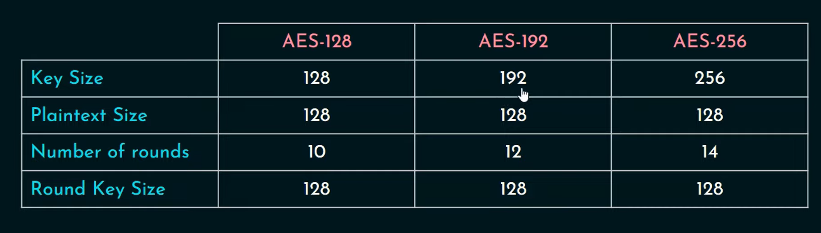
AES Parameters

Slide 9
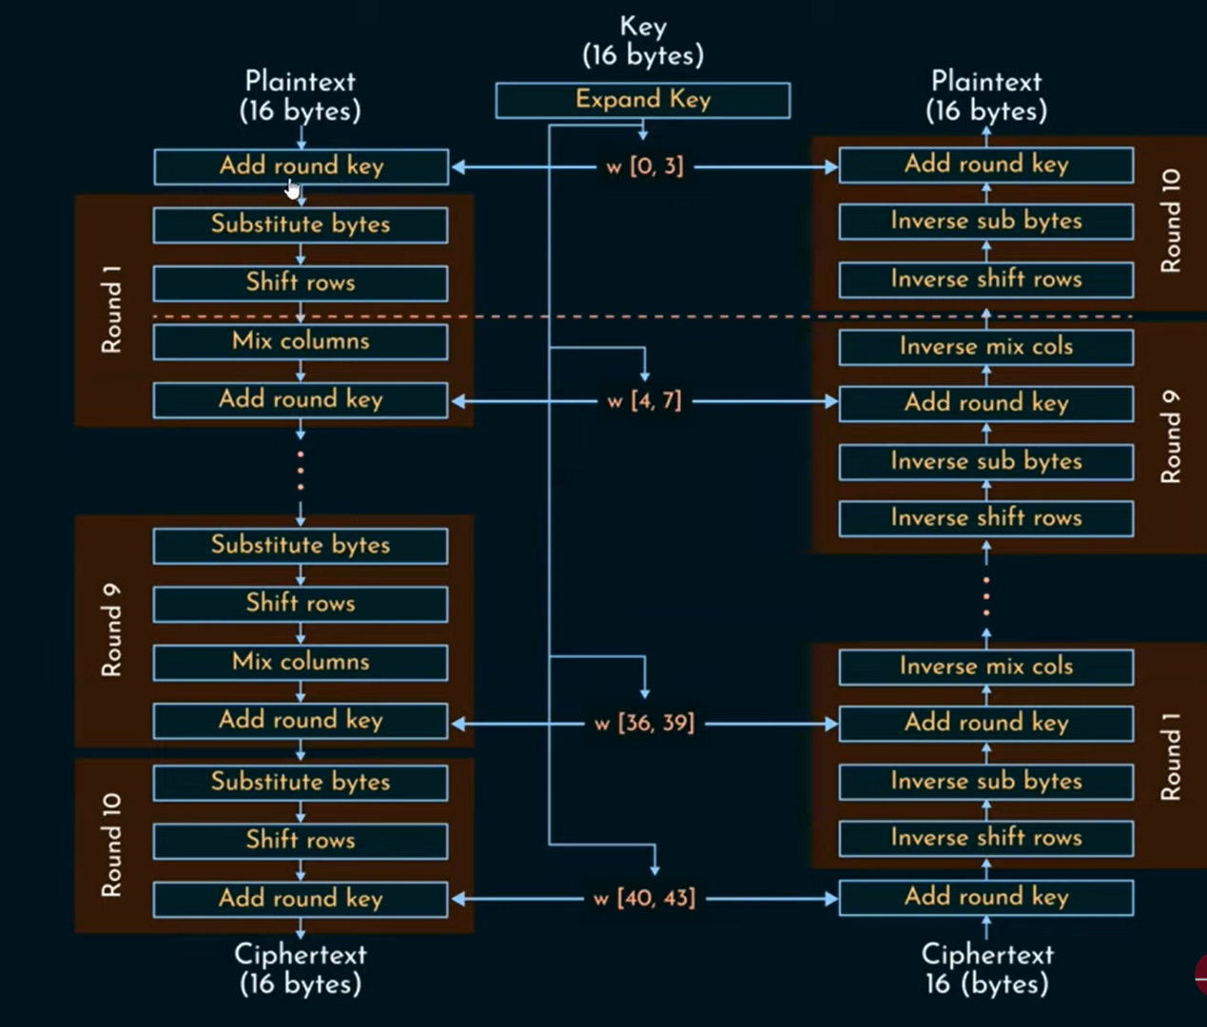
AES Encryption and Decryption

Slide 10
Input / State Array
In AES, a word is defined as 4 bytes, which is equal to 32 bits. The block size of AES is 128 bits, which is equal to 16 bytes or a 4x4 state matrix. the block size of AES is 128 bits which is equal to 16 bytes.

Slide 11
AES Transformation Functions
Substitute Bytes
Shift Rows
Mix Columns
Add Round Key

Slide 12
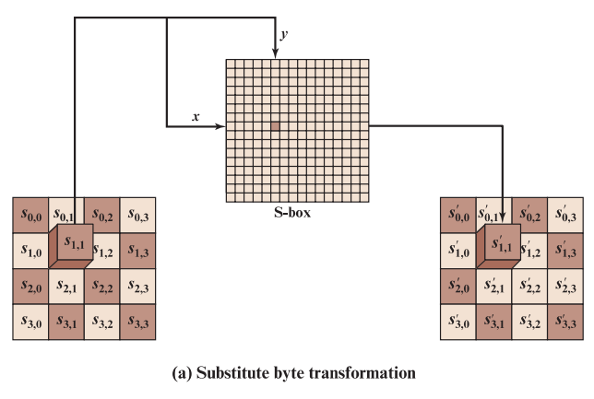
Substitute Byte Transformation
A simple substitution of each byte
Uses one table of 16x16 bytes containing a permutation of all 256 8-bit values
Each byte of state is replaced by byte indexed by row (left 4-bits) & column (right 4-bits)
eg. byte {95} is replaced by byte in row 9 column 5
which has value {2A}

Slide 13
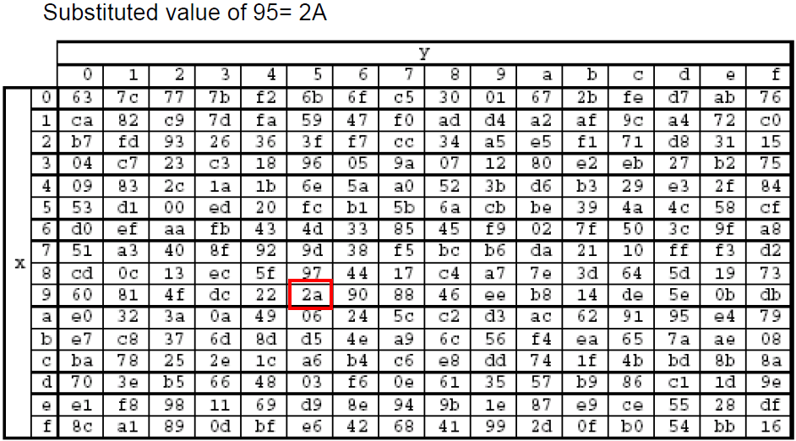

Slide 14
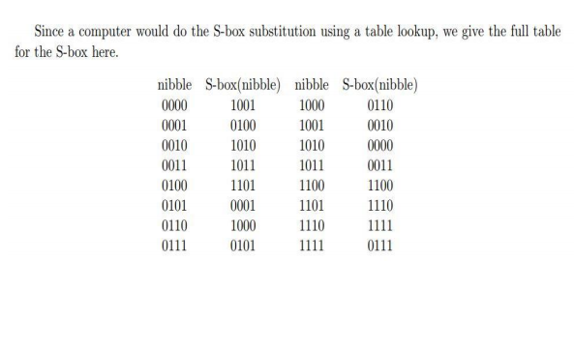

Slide 15
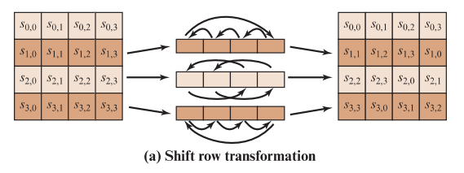
Shift Row Transformation
A circular byte shift in each row
1st row is unchanged
2nd row does 1 byte circular shift to left
3rd row does 2 byte circular shift to left
4th row does 3 byte circular shift to left
Since state is processed by columns, this step permutes bytes between the columns

Slide 16
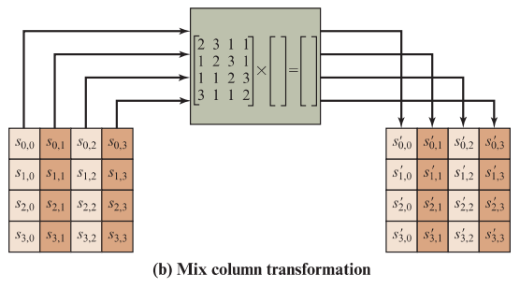
Mix Column Transformation
Each column is processed separately
Each byte is replaced by a value dependent on all 4 bytes in the column

Slide 17

Row of first matrix (predefined matrix) into column of second matrix (state array)

Slide 18
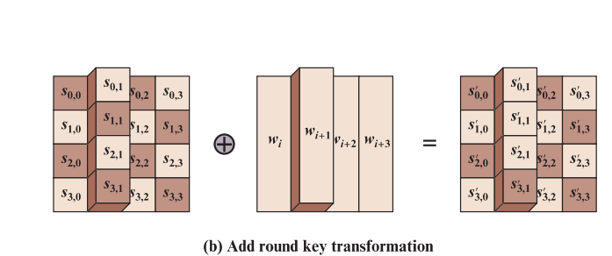
Add Round Key
XOR state with 128-bits of the round key
Again processed by column (though effectively a series of byte operations)
Designed to be as simple as possible

Slide 19
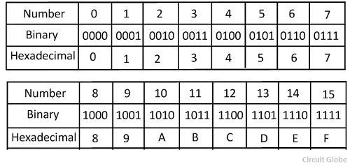
Encryption
Plain Text : 6F 6B
HexaDecimal to Binary Values
0110 1111 0110 1011
Key: A7 3B
HexaDecimal to Binary Values
1010 0111 0011 1011
First Step:
P: 0110 1111 0110 1011
K: 1010 0111 0011 1011
----------------------------------
1100 1000 0101 0000
⊕

Slide 20
Substitution Box
Second Step: Substitution Box
=
Third Step: Shift Rows
1100 | 1000
0101 | 0000
1100 | 0110
0001 | 1001
1100 | 0110
1001 | 0001

Slide 21
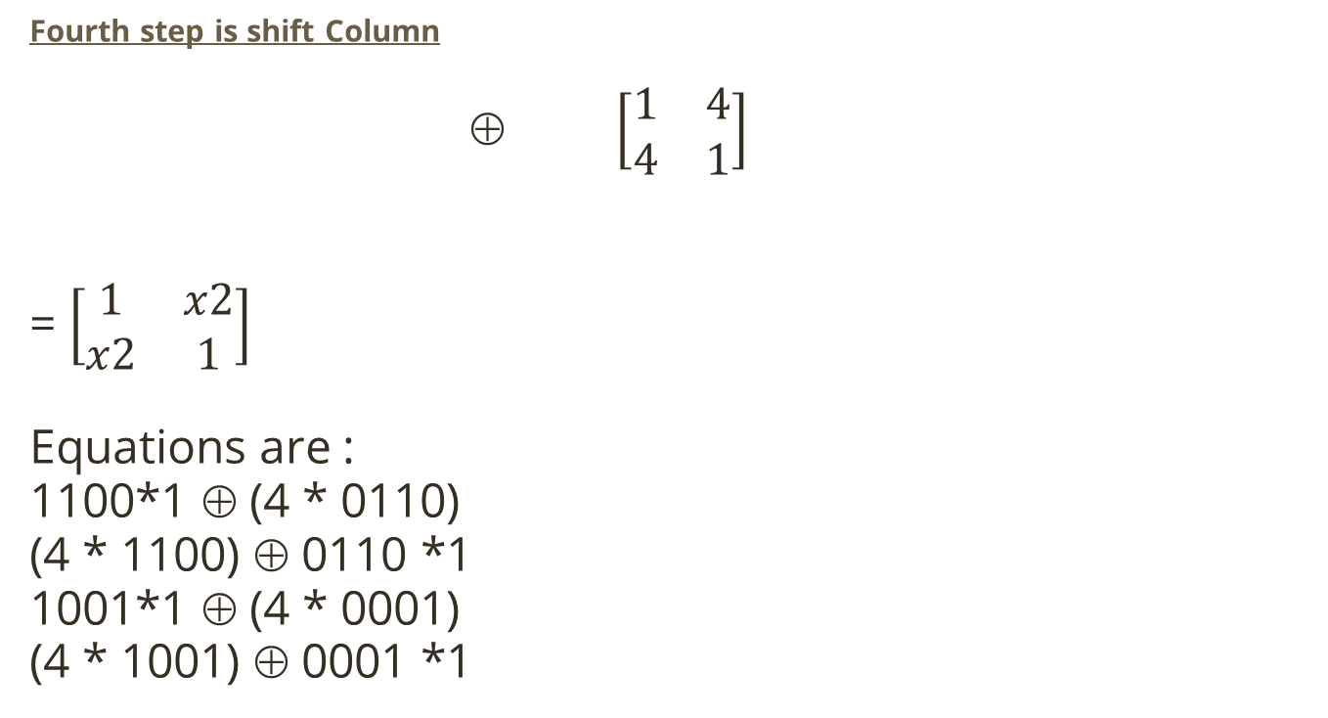
Fourth step is shift Column
⊕ $\left[\begin{matrix}1 & 4 \\ 4 & 1\end{matrix}\right]$
= $\left[\begin{matrix}1 & x2 \\ x2 & 1\end{matrix}\right]$
Equations are :
1100*1 ⊕ (4 * 0110)
(4 * 1100) ⊕ 0110 *1
1001*1 ⊕ (4 * 0001)
(4 * 1001) ⊕ 0001 *1
1100 | 0110
1001 | 0001

Slide 22
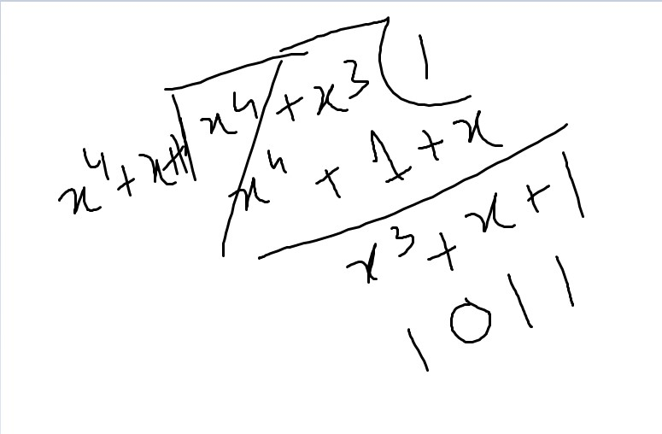
Shift Column
1100*1 ⊕ (4 * 0110)
=(x2 * x2+x)
= (x4+ x3) (reducible to x4+x+1)
1100*1 ⊕ (4 * 0110)
1100 ⊕ 1011
0111
0111

Slide 23
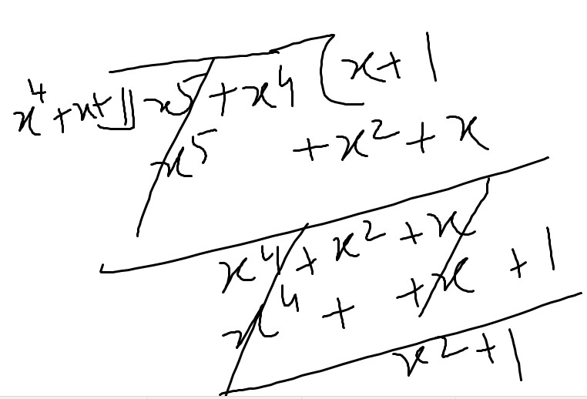
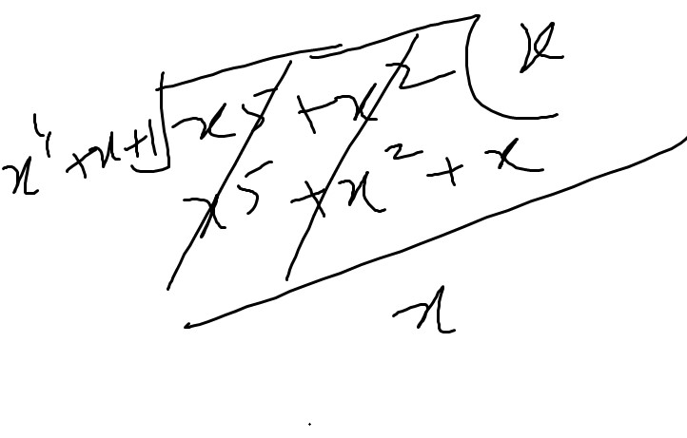
(4 * 1100) ⊕ 0110 *1
(x2* x3+x2) ⊕ 0110 *1
x5+x4 ⊕ 0110
0101 ⊕ 0110
0011
1001*1 ⊕ (4 * 0001)
1001*1 ⊕ (x2 * 1)
1001 ⊕ 0100
1101
(4 * 1001) ⊕ 0001 *1
(x2 * x3+1) ⊕ 0001
x5+x2 ⊕ 0001
0010 ⊕ 0001
0011
0111 | 0011
1101 | 0011

Slide 24
Fifth Step: Add round key
Key1 = 0001 1100 0010 0111
P =0111 0011 1101 0011
-------------------------------------------
CIPHER TEXT = 0110 1111 1111 0100
⊕

Slide 25
Thank you!

