Slide 1
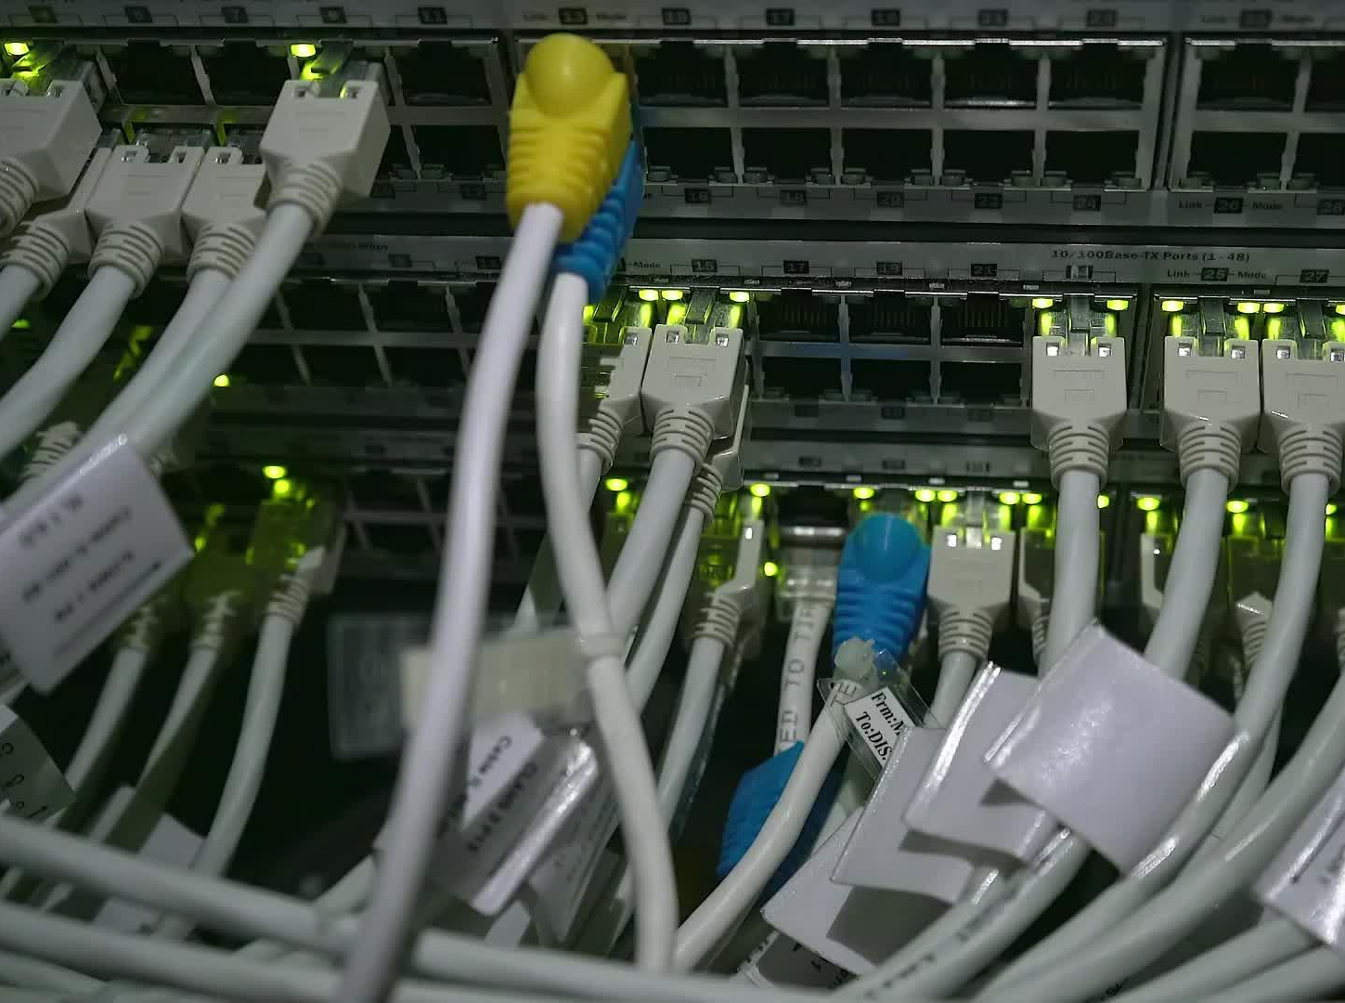


CSDC-446 Parallel and Distributed Computing
Dr. Sehrish Amjad

Slide 2
Topics Covered
Parallel Programming Models
Notes:
https://www.run.ai/guides/distributed-computing/parallel-computing

Slide 3
Parallel Programming Models
There are several parallel programming models in common use:
  Shared Memory (without threads)
  Threads
  Distributed Memory / Message Passing
  Data Parallel
  Hybrid
  Single Program Multiple Data (SPMD)
  Multiple Program Multiple Data (MPMD)
Notes:
https://www.run.ai/guides/distributed-computing/parallel-computing

Slide 4
Parallel Programming Models
Parallel programming models exist as an abstraction between hardware and memory architectures.
These models are NOT specific to a particular type of machine or memory architecture. In fact, any of these models can (theoretically) be implemented on any underlying hardware. Two examples from the past are discussed below.
Notes:
https://www.run.ai/guides/distributed-computing/parallel-computing

Slide 5
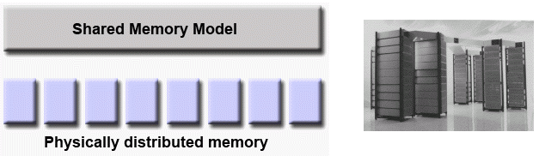
Parallel Programming Models
SHARED memory model on a DISTRIBUTED memory machine
  Machine memory is physically distributed across networked machines, but appeared to the user as a single shared memory global address space. Generically, this approach is referred to as "virtual shared memory".
Notes:
https://www.run.ai/guides/distributed-computing/parallel-computing

Slide 6
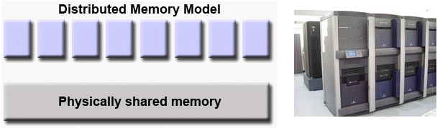
Parallel Programming Models
DISTRIBUTED memory model on a SHARED memory machine
  Every task has direct access to global address space spread across all machines. However, the ability to send and receive messages using MPI, as is commonly done over a network of distributed memory machines, was implemented and commonly used.
Notes:
https://hpc.llnl.gov/documentation/tutorials/introduction-parallel-computing-tutorial##Models

Slide 7
Parallel Programming Models
Which model to use?
  This is often a combination of what is available and personal choice. There is no "best" model, although there certainly are better implementations of some models over others.
Notes:
https://hpc.llnl.gov/documentation/tutorials/introduction-parallel-computing-tutorial##Models

Slide 8
Parallel Programming Models
Shared Memory Model (without threads)
  In this programming model, processes/tasks share a common address space, which they read and write to asynchronously.
  Various mechanisms such as locks / semaphores are used to control access to the shared memory, resolve contentions and to prevent race conditions and deadlocks.
  This is perhaps the simplest parallel programming model.
  An advantage of this model is the notion of data "ownership" is lacking, so there is no need to specify explicitly the communication of data between tasks. All processes see and have equal access to shared memory.
Notes:
https://hpc.llnl.gov/documentation/tutorials/introduction-parallel-computing-tutorial##Models

Slide 9
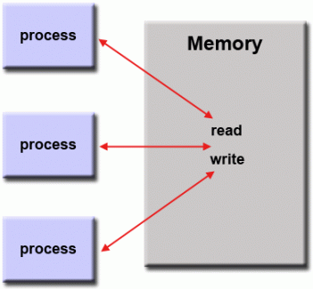
Parallel Programming Models
Shared Memory Model (without threads)
  An important disadvantage in terms of performance is that it becomes more difficult to understand and manage data locality:
    Keeping data local to the process that works on it conserves memory accesses, cache refreshes and bus traffic that occurs when multiple processes use the same data.
    Unfortunately, controlling data locality is hard to understand and may be beyond the control of the average user.
Notes:
Data Locality is the practice of storing data near the processing unit that will consume it, reducing data movement and latency in data-intensive applications.

Slide 10
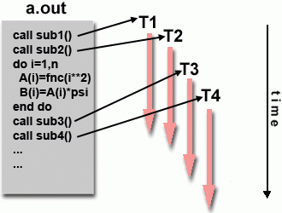
Parallel Programming Models
Threads Model
  This programming model is a type of shared memory programming.
  In the threads model of parallel programming, a single "heavy weight" process can have multiple "light weight", concurrent execution paths.
  For example:
    The main program a.out is scheduled to run by the native operating system. a.out loads and acquires all of the necessary system and user resources to run. This is the "heavy weight" process.
Notes:
https://hpc.llnl.gov/documentation/tutorials/introduction-parallel-computing-tutorial##Models

Slide 11
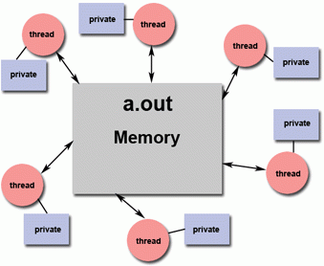
Parallel Programming Models
Threads Model (Example)
    a.out performs some serial work, and then creates a number of tasks (threads) that can be scheduled and run by the operating system concurrently.
    Each thread has local data, but also, shares the entire resources of a.out. This saves the overhead associated with replicating a program's resources for each thread ("light weight"). Each thread also benefits from a global memory view because it shares the memory space of a.out.
    A thread's work may best be described as a subroutine within the main program. Any thread can execute any subroutine at the same time as other threads.
Notes:
https://hpc.llnl.gov/documentation/tutorials/introduction-parallel-computing-tutorial##Models

Slide 12
Parallel Programming Models
Threads Model (Example)
    Threads communicate with each other through global memory (updating address locations). This requires synchronization constructs to ensure that more than one thread is not updating the same global address at any time.
    Threads can come and go, but a.out remains present to provide the necessary shared resources until the application has completed.
    Example:
      Two very different implementation of threads: POSIX Threads and OpenMP
Notes:
https://hpc.llnl.gov/documentation/tutorials/introduction-parallel-computing-tutorial##Models

Slide 13
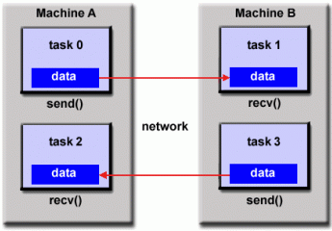
Parallel Programming Models
Distributed Memory / Message Passing Model
  This model demonstrates the following characteristics:
    A set of tasks that use their own local memory during computation. Multiple tasks can reside on the same physical machine and/or across an arbitrary number of machines.
    Tasks exchange data through communications by sending and receiving messages.
    Data transfer usually requires cooperative operations to be performed by each process. For example, a send operation must have a matching receive operation.
    Implementation: Message Passing Interface
Notes:
https://hpc.llnl.gov/documentation/tutorials/introduction-parallel-computing-tutorial##Models

Slide 14
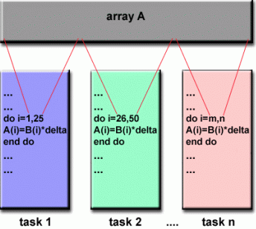
Parallel Programming Models
Data Parallel Model
  May also be referred to as the Partitioned Global Address Space (PGAS) model.
  The data parallel model demonstrates the following characteristics:
    Address space is treated globally
    Most of the parallel work focuses on performing operations on a data set. The data set is typically organized into a common structure, such as an array or cube.
    A set of tasks work collectively on the same data structure, however, each task works on a different partition of the same data structure.
Notes:
https://hpc.llnl.gov/documentation/tutorials/introduction-parallel-computing-tutorial##Models

Slide 15
Parallel Programming Models
Data Parallel Model
    Tasks perform the same operation on their partition of work, for example, "add 4 to every array element".
  On shared memory architectures, all tasks may have access to the data structure through global memory.
  On distributed memory architectures, the global data structure can be split up logically and/or physically across tasks.
  Implementation:
    Coarray Fortran Unified Parallel C (UPC)
    Global Arrays X10: a PGAS
    Chapel
Notes:
https://hpc.llnl.gov/documentation/tutorials/introduction-parallel-computing-tutorial##Models

Slide 16
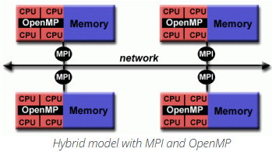
Parallel Programming Models
Hybrid Model
  A hybrid model combines more than one of the previously described programming models.
  Currently, a common example of a hybrid model is the combination of the message passing model (MPI) with the threads model (OpenMP).
    Threads perform computationally intensive kernels using local, on-node data
    Communications between processes on different nodes occurs over the network using MPI
Notes:
https://hpc.llnl.gov/documentation/tutorials/introduction-parallel-computing-tutorial##Models

Slide 17
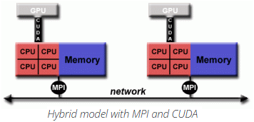
Parallel Programming Models
Hybrid Model
  This hybrid model lends itself well to the most popular (currently) hardware environment of clustered multi/many-core machines.
  Another similar and increasingly popular example of a hybrid model is using MPI with CPU-GPU (graphics processing unit) programming.
    MPI tasks run on CPUs using local memory and communicate with each other over a network.
    Computationally intensive kernels are off-loaded to GPUs on-node.
Notes:
https://hpc.llnl.gov/documentation/tutorials/introduction-parallel-computing-tutorial##Models

Slide 18
Parallel Programming Models
Hybrid Model
    Data exchange between node-local memory and GPUs uses CUDA (or something equivalent).
  Other hybrid models are common:
    MPI with Pthreads
    MPI with non-GPU accelerators
Notes:
https://hpc.llnl.gov/documentation/tutorials/introduction-parallel-computing-tutorial##Models

Slide 19
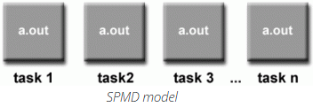
Parallel Programming Models
Single Program Multiple Data (SPMD)
  SPMD is actually a "high level" programming model that can be built upon any combination of the previously mentioned parallel programming models.
  SINGLE PROGRAM: All tasks execute their copy of the same program simultaneously. This program can be threads, message passing, data parallel or hybrid.
  MULTIPLE DATA: All tasks may use different data
Notes:
https://hpc.llnl.gov/documentation/tutorials/introduction-parallel-computing-tutorial##Models

Slide 20
Parallel Programming Models
Single Program Multiple Data (SPMD)
  SPMD programs usually have the necessary logic programmed into them to allow different tasks to branch or conditionally execute only those parts of the program they are designed to execute. That is, tasks do not necessarily have to execute the entire program - perhaps only a portion of it.
  The SPMD model, using message passing or hybrid programming, is probably the most commonly used parallel programming model for multi-node clusters.
Notes:
https://hpc.llnl.gov/documentation/tutorials/introduction-parallel-computing-tutorial##Models

Slide 21
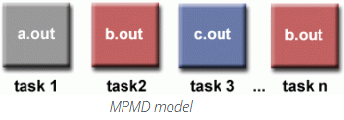
Parallel Programming Models
Multiple Program Multiple Data (SPMD)
  Like SPMD, MPMD is actually a "high level" programming model that can be built upon any combination of the previously mentioned parallel programming models.
  MULTIPLE PROGRAM: Tasks may execute different programs simultaneously. The programs can be threads, message passing, data parallel or hybrid.
  MULTIPLE DATA: All tasks may use different data
Notes:
https://hpc.llnl.gov/documentation/tutorials/introduction-parallel-computing-tutorial##Models

Slide 22
Parallel Programming Models
Multiple Program Multiple Data (SPMD)
  MPMD applications are not as common as SPMD applications, but may be better suited for certain types of problems, particularly those that lend themselves better to functional decomposition than domain decomposition (discussed later under Partitioning).
Notes:
https://hpc.llnl.gov/documentation/tutorials/introduction-parallel-computing-tutorial##Models

