Slide 1
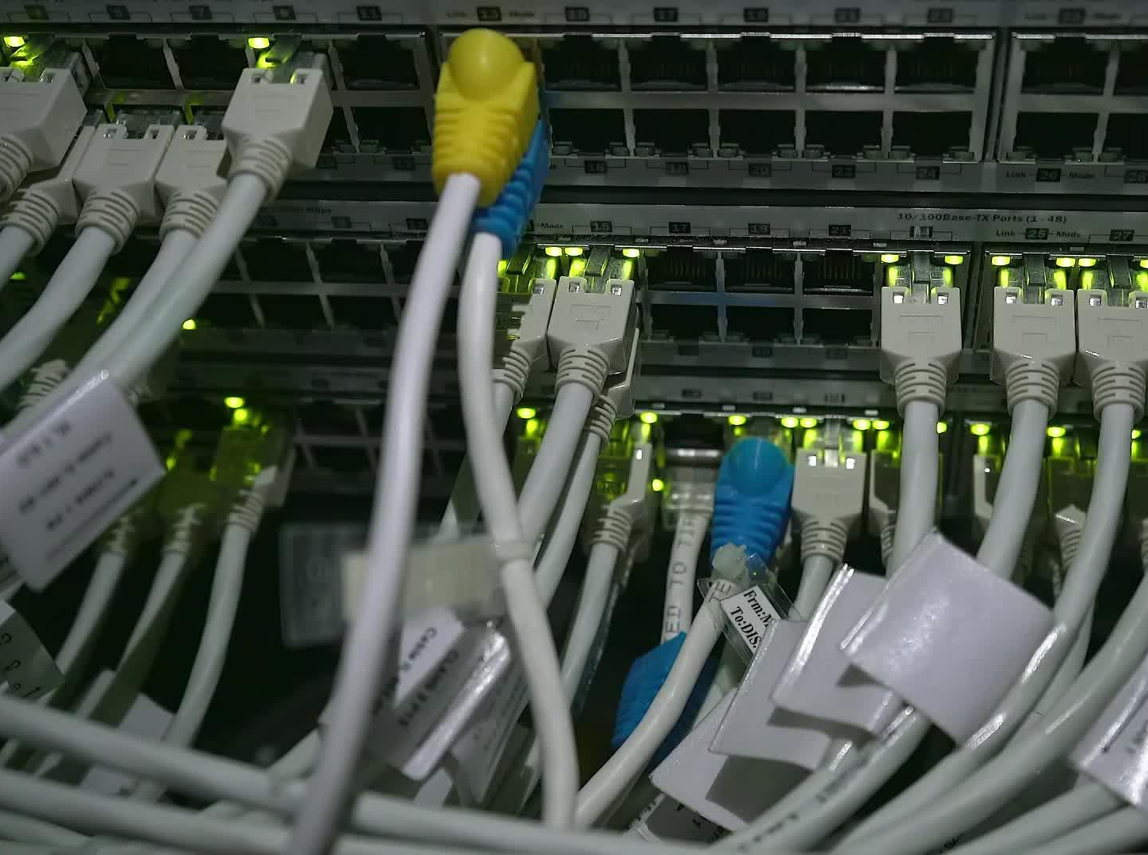


CSDC-446 Parallel and Distributed Computing
Dr. Sehrish Amjad

Slide 2
Topics Covered
Amdahls Law, Flops and Profiling

Slide 3
FLOPS
Floating-point operations per second (FLOPS) is a measure of a computer's performance based on the number of floating-point arithmetic calculations that the processor can perform within a second.

Slide 4
FLOPS
When FLOPS is used as a performance metric, it is typically expressed with a prefix multiplier such as tera or peta, as in teraFLOPS or petaFLOPS. The following table provides a breakdown of several FLOPS prefix multipliers.

Slide 5
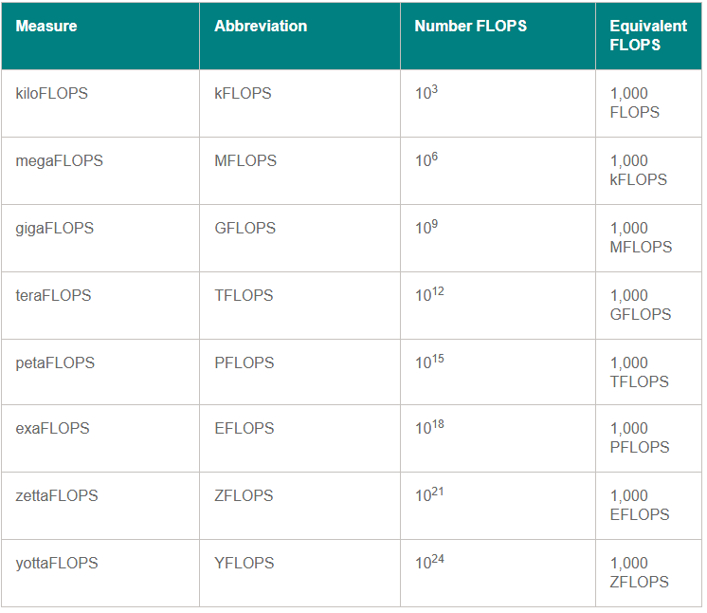
FLOPS

Slide 6









FLOPS
Floating point operations per second
Measure of theoretical peak performance

Slide 7
FLOPS
Servers are the only computers that sometimes have more than one socket; for most home computers (desktop or laptop), “sockets” will be 1.
Cores per socket depends on your CPU. It could be 2 (dual- core), 3, 4 (quad-core), 6 (hexa-core), or 8. There are some prototype CPUs with as many as 80 cores.
“Clock cycles per second” refers to the speed of your CPU. Most modern CPUs are rated in gigahertz. So 2 GHz would be 2,000,000,000 clock cycles per second.
The number of FLOPs per cycle also depends on the CPU. One of the fastest (home computer) CPUs is the Intel Core i7–970, capable of 4 double-precision or 8 single-precision floating-point operations per cycle.

Slide 8
FLOPS
Servers are the only computers that sometimes have more than one socket; for most home computers (desktop or laptop), “sockets” will be 1.
Cores per socket depends on your CPU. It could be 2 (dual- core), 3, 4 (quad-core), 6 (hexa-core), or 8. There are some prototype CPUs with as many as 80 cores.
“Clock cycles per second” refers to the speed of your CPU. Most modern CPUs are rated in gigahertz. So 2 GHz would be 2,000,000,000 clock cycles per second.
The number of FLOPs per cycle also depends on the CPU. One of the fastest (home computer) CPUs is the Intel Core i7–970, capable of 4 double-precision or 8 single-precision floating-point operations per cycle.

Slide 9
FLOPS
An application requires 10^12 floating-point operations. The system that has been used for this application has a peak performance of 6 PFLOPS (PetaFLOPS). How long will this system take to complete the simulation in seconds?
Time taken by the system = total number of operation required/System Flops
          = 10^12 float point operations/6 Pflops per second
          = 10^12 / 6 * 10 ^ 15
          = 1 / 6 * 10 ^ 3

Slide 10
Test
Intel Core i7–970 has 6 cores. If it is running at 3.46 GHz and can perform 8 floating point operations per second, calculate the theoretical compute power of this machine.

Slide 11
Example
Intel Core i7–970 has 6 cores. If it is running at
3.46 GHz, the formula would be:
1 (socket) * 6 (cores) * 3,460,000,000 (cycles per second) * 8 (single-precision FLOPs per second) = 166,080,000,000 single-precision FLOPs per second or 83,040,000,000 double- precision FLOPs per second.
109 GFLOPS.

