Slide 1



CSDC-446 Parallel and Distributed Computing
Dr. Sehrish Amjad

Slide 2
Topics Covered
Dependency Analysis

Slide 3
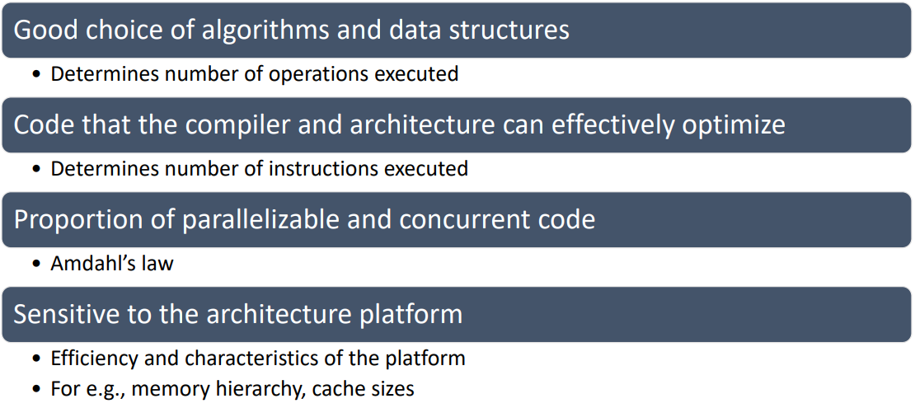
How to Write Efficient and Scalable Programs?

Slide 4
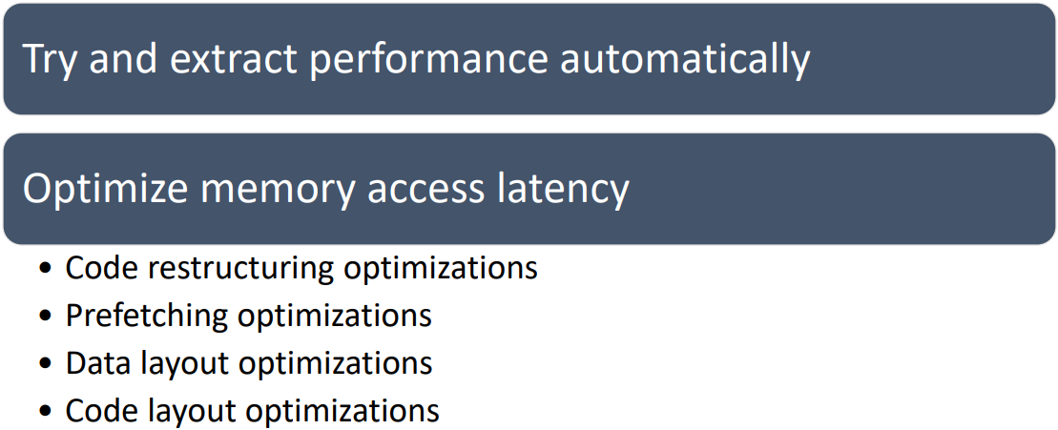
Role of a Good Compiler

Slide 5
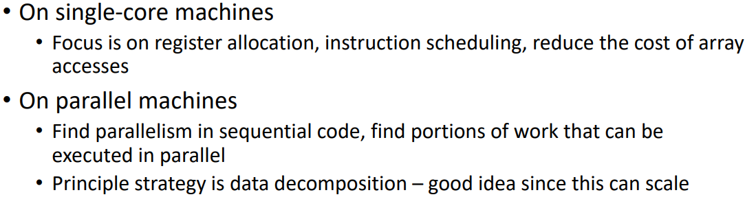
Parallelism Challenges for a Compiler

Slide 6
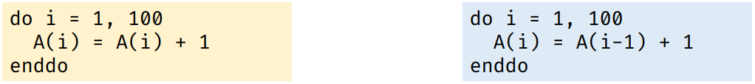
Can we parallelize the following loops?
Notes:
Do i=1 to 100
A(i) = A(i) + 1
Enddo
For i=1
A(1) = A(1) + 1
For i=2
A(2) = A(2) + 1
For i=3
A(3) = A(3) + 1
For i=4
A(4) = A(4) + 1
A=1 to 100
A(i) = A(i-1) + 1
Enddo
For i=1
A(1) = A(0) + 1
For i=2
A(2) = A(1) + 1
For i=3
A(3) = A(2) + 1
For i=4
A(4) = A(3) +1

Slide 7
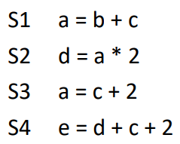
Dependences

Slide 8
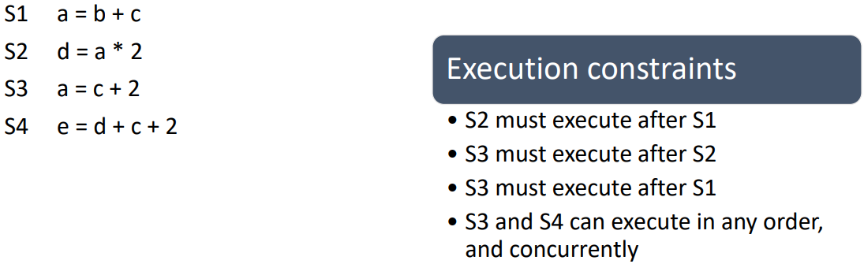
Dependences

Slide 9
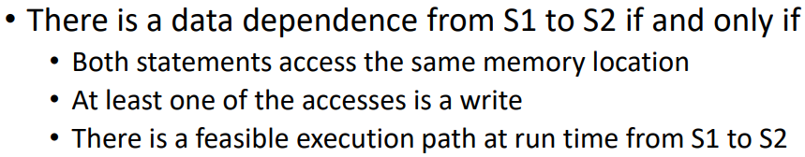
Data Dependence

Slide 10
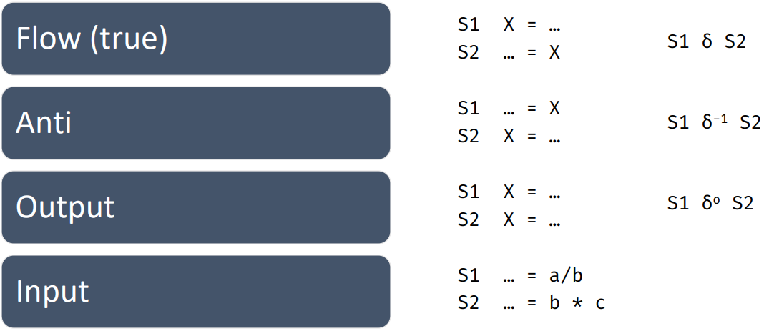
Types of Dependences
Notes:
Flow: One output (variable assigned) of S1 is used as input to S2. A data dependency occurs with instruction S2 as it is dependent on the
completion of instruction S1. Also Called RAW hazard
Statement S2 is antidependent on the statement S1 if S2 follows S1 in program order and instruction S2 tries to writes a register or memory location before instruction S1 reads. The original order must be preserved to ensure that S1 reads correct value. Also called WAR hazard
two statements S1 and S2 are output dependent if they write to the same memory location(S2 tries to write an operand before it is written by S1). Can occur WAW hazard
I/O Dependence: Read and write are I/O statements. I/O dependence occurs not because the same variable is involved but because the same file referenced by both I/O statement

Slide 11
Data Dependence
Flow: Output (variable assigned) of S1 is used as input to S2. A data dependency occurs with instruction S2 as it is dependent on the completion of instruction S1. Also Called RAW hazard
Anti: S2 is anti-dependent on the statement S1 if S2 follows S1 in program order and instruction S2 tries to writes a register or memory location before instruction S1 reads. Also called WAR hazard
Output: two statements S1 and S2 are output dependent if they write to the same memory location(S2 tries to write an operand before it is written by S1). Can occur WAW hazard

Slide 12
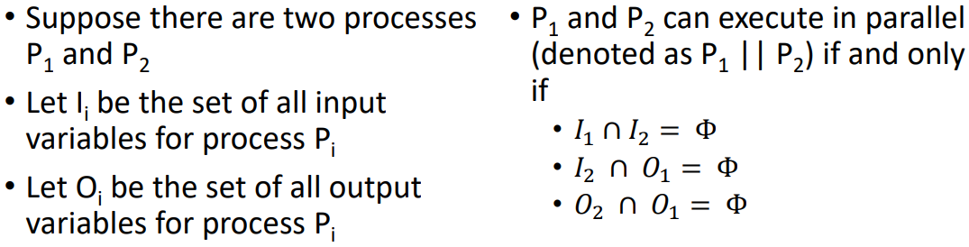
Bernstein’s Conditions

Slide 13
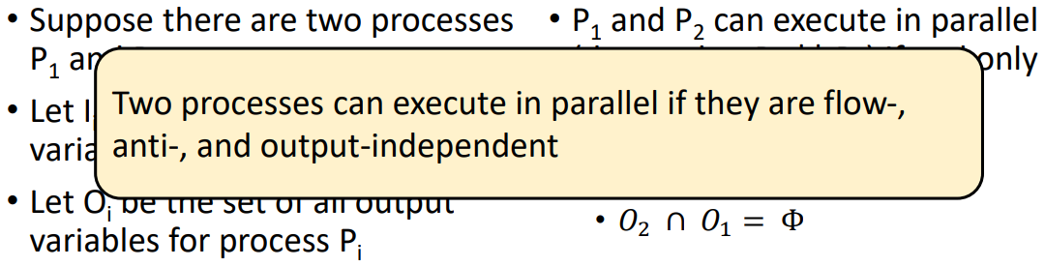
Bernstein’s Conditions

Slide 14
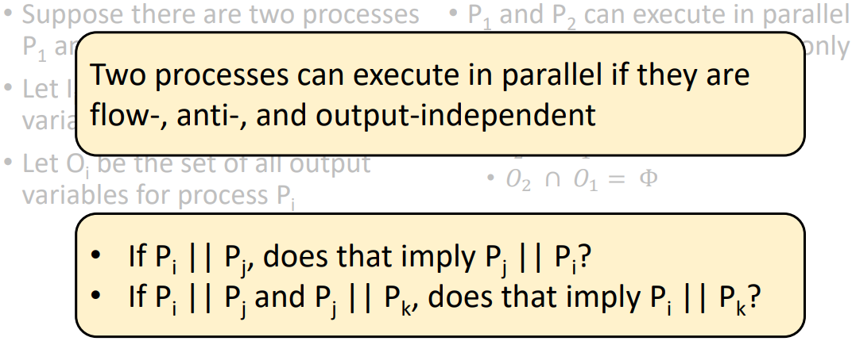
Bernstein’s Conditions

Slide 15
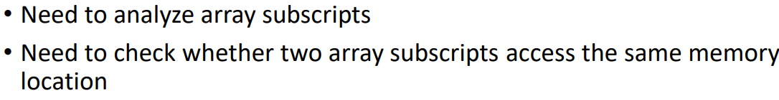
Find Parallelism in Loops – Is it Easy?

Slide 16
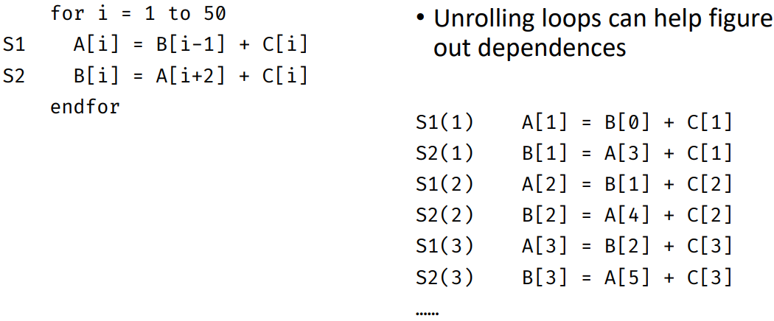
Dependence in Loops

Slide 17
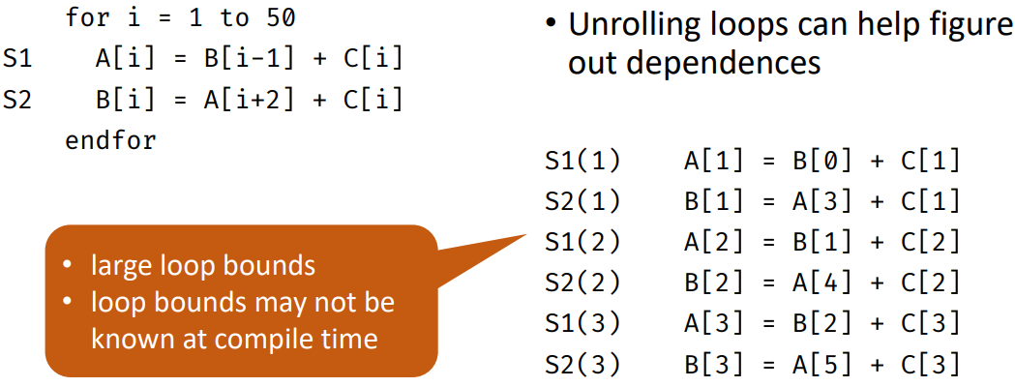
Dependence in Loops
Notes:
A loop bound is an upper bound of the number of loop iterations for a given program
Loop Bound = iteration count

Slide 18
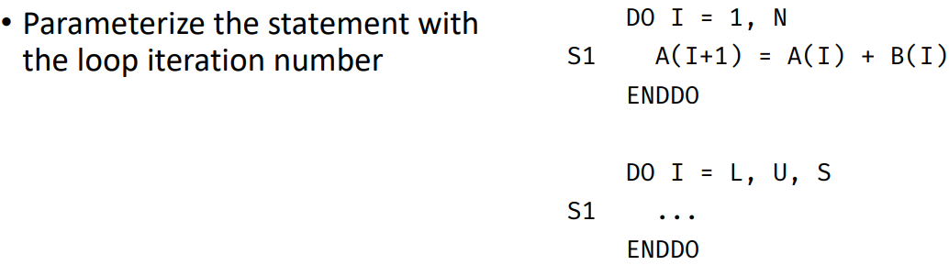
Dependence in Loops

Slide 19
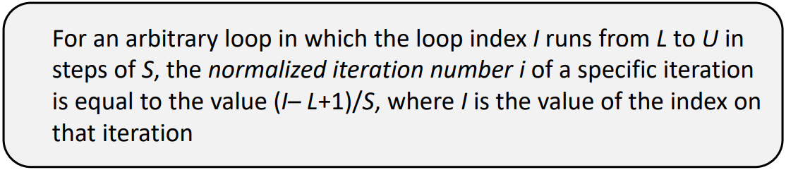
Normalized Iteration Number

Slide 20
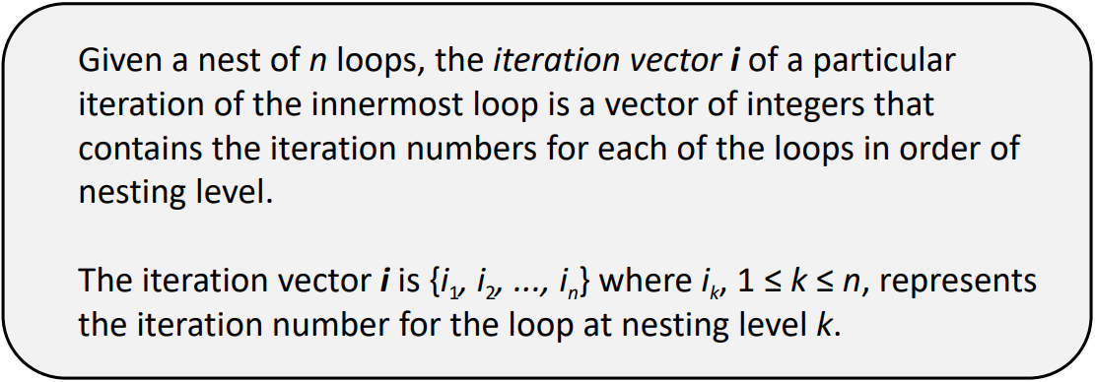
Iteration Vector

Slide 21
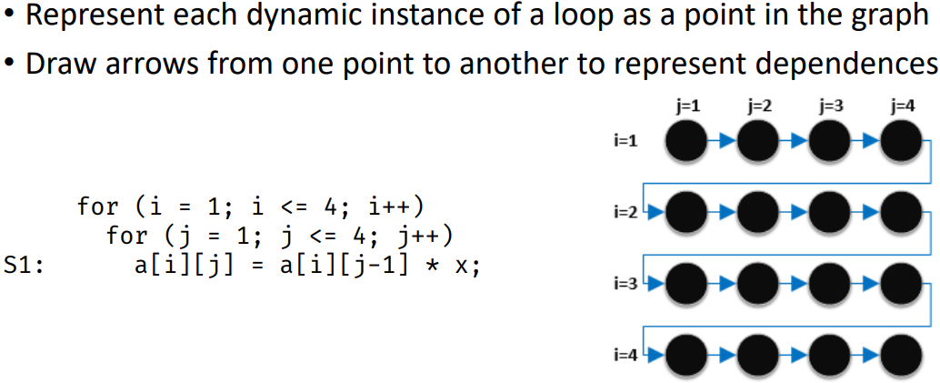
Iteration Space Graph

Slide 22
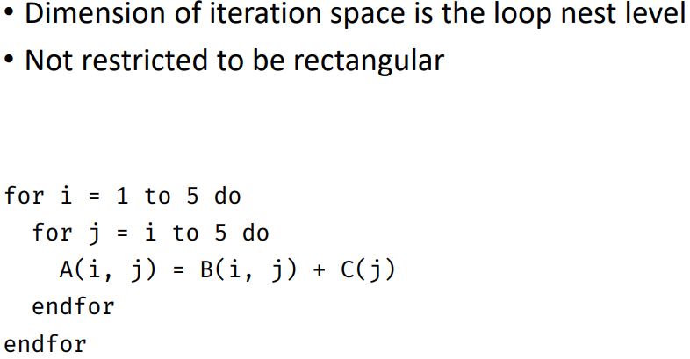
Iteration Space Graph
i=1
i=1
i=3
i=4
i=1

Slide 23
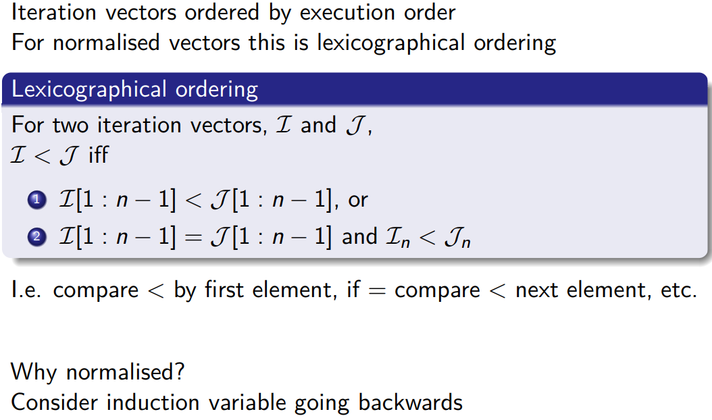
Iteration Vector Ordering

Slide 24
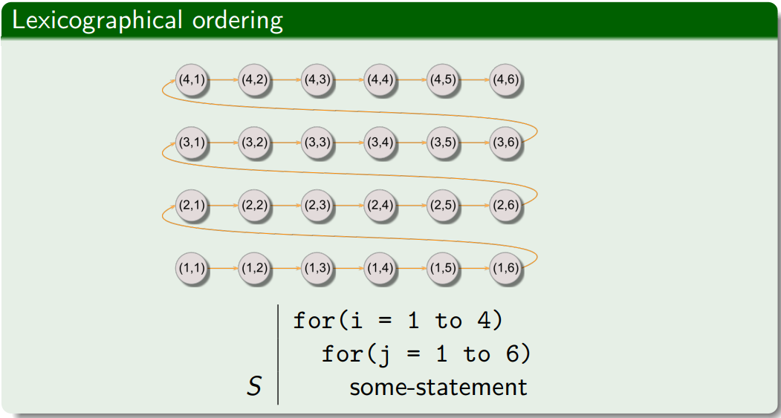
Lexicographic Ordering of Iteration Vectors

Slide 25
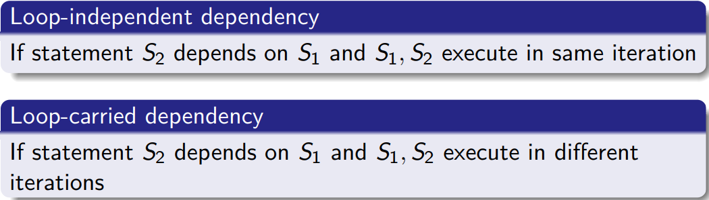
Dependence
(Dependencies between iterations)

Slide 26
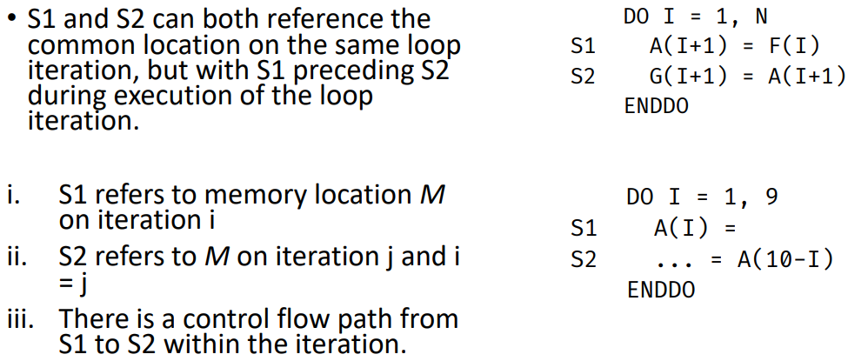
Loop-Independent Dependences
Notes:
For I=1
A(2) = F(1)
G(2) = A(2)
For I=2
A(3) = F(2)
G(3) = A(3)

Slide 27
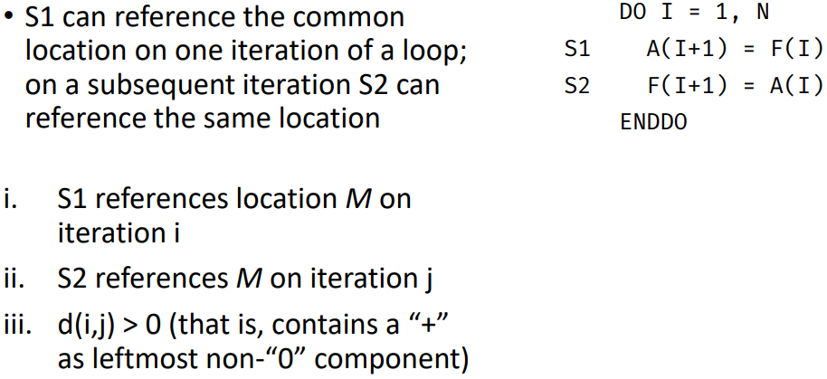
Loop-Carried Dependences
Notes:
For I=1
A(2) = F(1)
F(2) = A(1)
For I=2
A(3) = F(2)
F(3) = A(2)

Slide 28
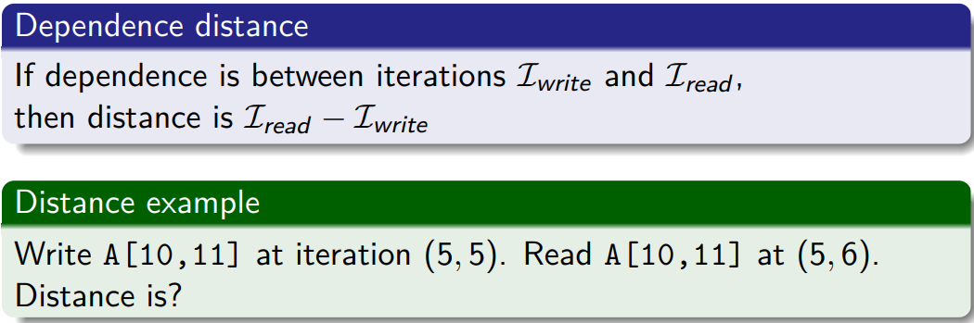
Dependence
(Dependencies between iterations)

Slide 29
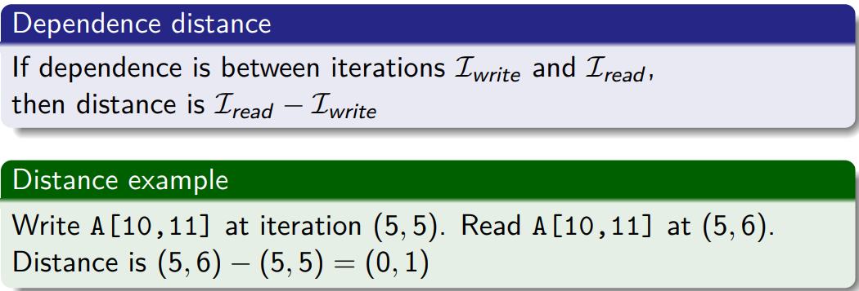
Dependence
(Dependencies between iterations)

Slide 30
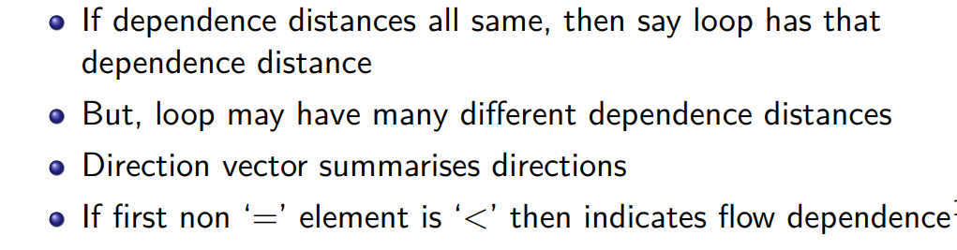
Dependence
(Dependencies between iterations)

Slide 31
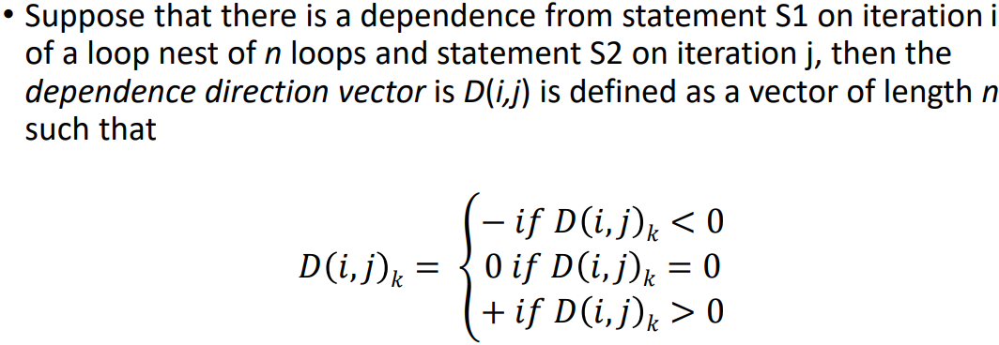
Distance Vectors

Slide 32
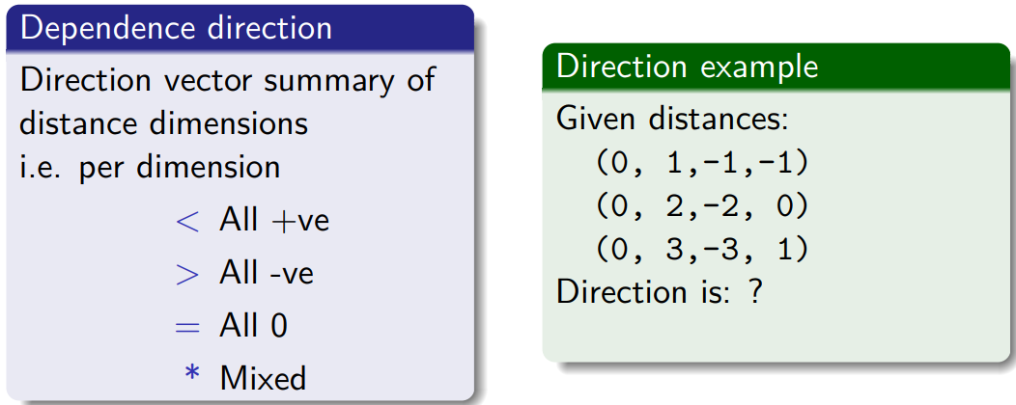
Dependence
(Dependencies between iterations)

Slide 33
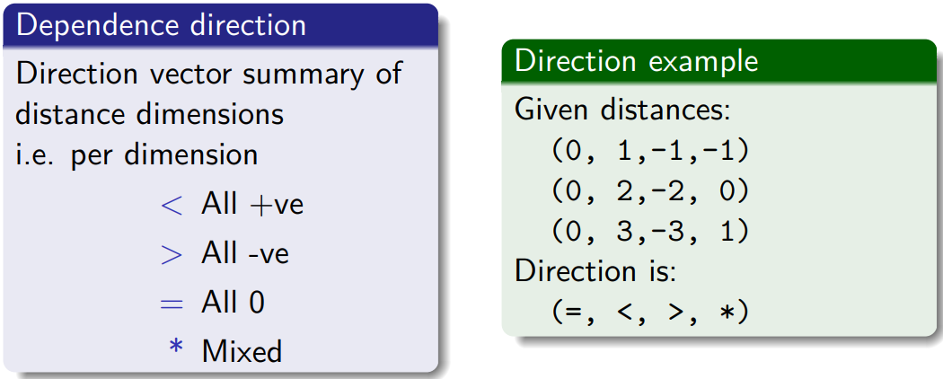
Dependence
(Dependencies between iterations)

Slide 34
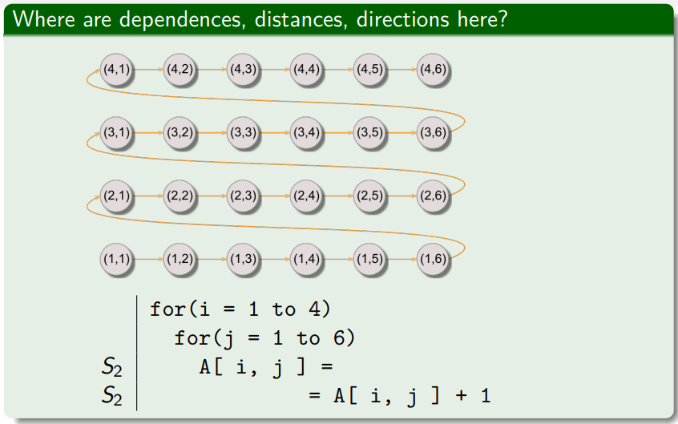

Dependence
(Dependencies between iterations)
Notes:
A[i,j] = A[i, j]
When i=1, j=1
A[1,1] = A[1,1] + 1 reading at iteration (1,1), writing at iteration (1,1)
Distance: Iread – Iwrite
(1,1) – (1,1) = (0,0)
Direction vector: (=,=)
When i=1, j=2
A[1,2] = A[1,2] + 1
When i=1, j=3
A[1,3] = A[1,3]+1
i=1, j=4
A[1,4] = A[1,4] +1
A[1,1] reading at iteration (1,1) and writing at iteration (1,1)
Distance = Iread – Iwrite
(1,1) – (1,1) = (0,0) = (=,=)

Slide 35
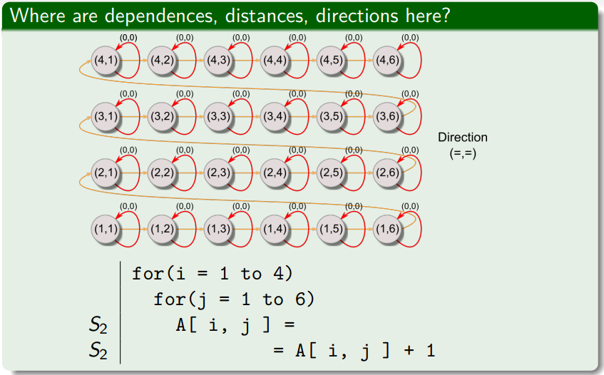
Dependence
(Dependencies between iterations)

Slide 36
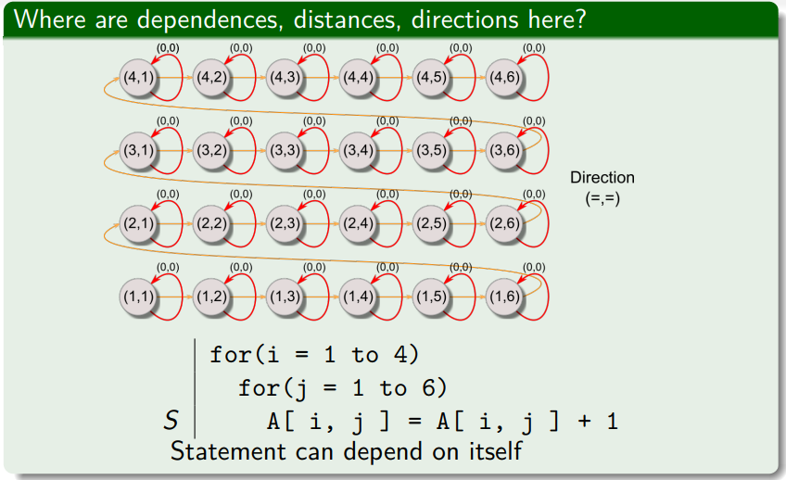
Dependence
(Dependencies between iterations)

Slide 37
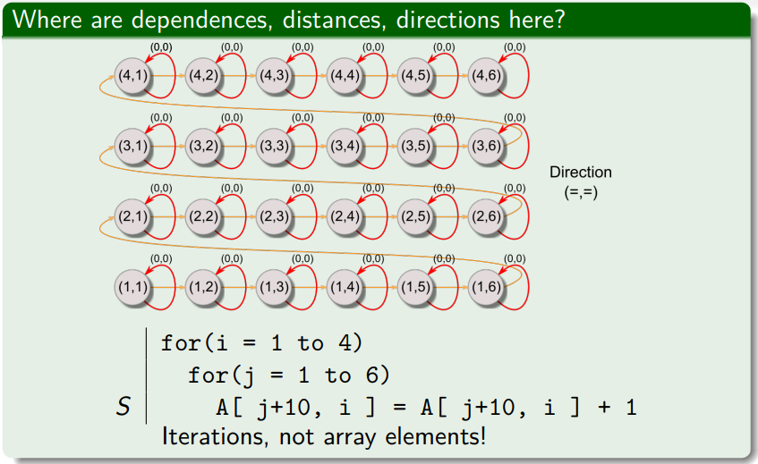
Dependence
(Dependencies between iterations)

Slide 38
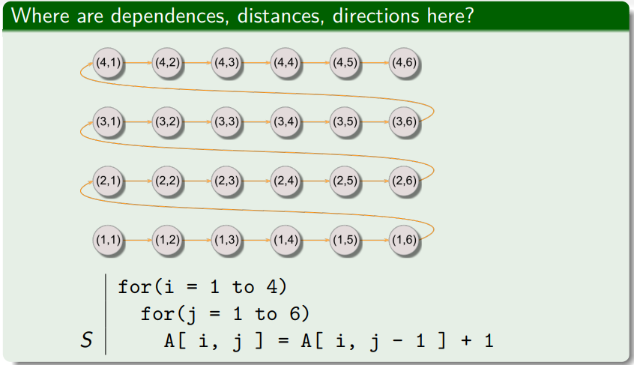
Dependence
(Dependencies between iterations)
Notes:
A[I,j] = A[I,j-1] + 1
When i=1, j=1
A[1,1] = A[1,0] + 1
When i=1, j=2
A[1,2] = A[1,1] + 1
When i=1, j=3
A[1,3] = A[1,2] + 1
When i=1, j=2
A[1,4] = A[1,3]+1
Writing A[1,1] at iteration (1,1)
Reading A[1,2] at iteration (1,2)
Distance = Iread – Iwrite = (1,2) – (1,1) = (0,1) = (=, <)

Slide 39
For(i=1 to 4)
For(j=1 to 6)
S1: A(i,j) = A(i-1,j) + A(i,j-1)
Notes:
For i=1, j=1
A(1,1) = A(0,1) + A(1,0)
For i=1,j=2
A(1,2) = A(0,2) + A(1,1)
For i=2, j=1
A(2,1) = A(1,1) + A(2,0)
A(1,1) w.r.t i Writing at iteration 1,1 reading at iteration = 2,1 Distance w.r.t = (2,1) – (1,1) = (1,0) = (<, =)
A(1,1) w.r.t j writin at iteration 1,1, reading at iteration 1,2 Distance w.r.t j = (1,2) – (1,1) = (0,1) = (=,<)

Slide 40
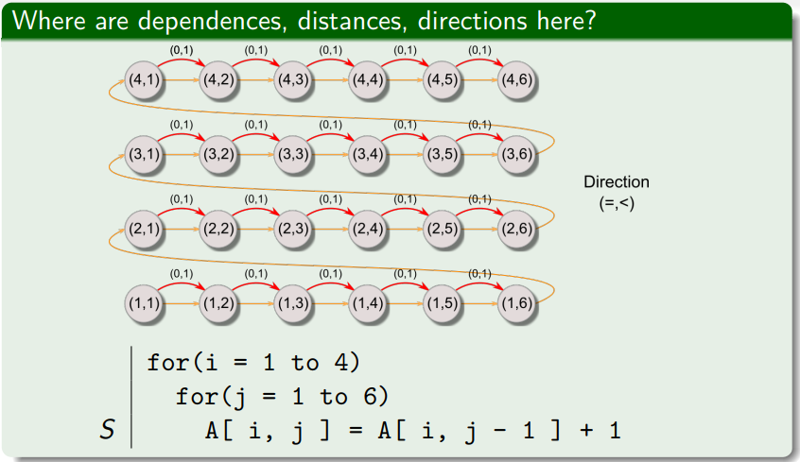
Dependence
(Dependencies between iterations)
Notes:
A[1,2] writing at iteration (1,2)
A[1,2] reading at iteration (1,3)
Distance: Iread – Iwrite
(1,3) – (1,2)
(1-1, 3-2)
(0,1)
Direction: ( =, <)

Slide 41
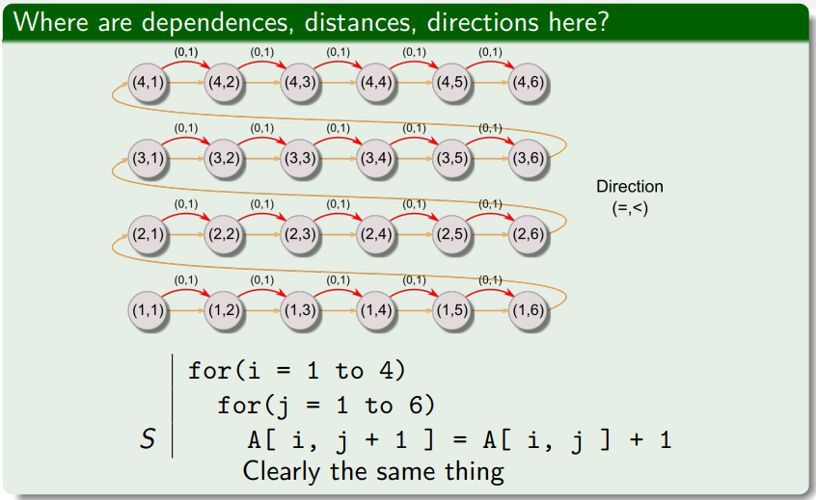
Dependence
(Dependencies between iterations)

Slide 42
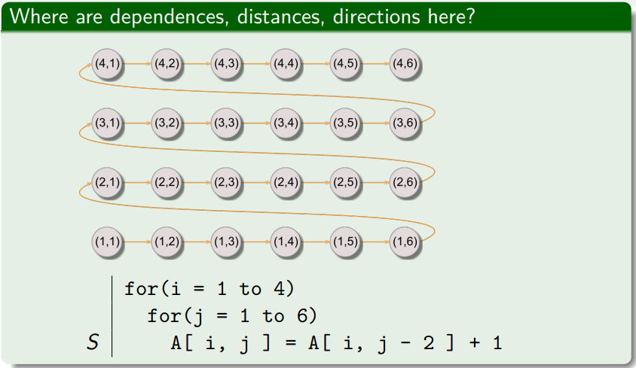
Dependence
(Dependencies between iterations)
Notes:
i=1, j=1
A[1,1] = A[1, -1] + 1
i=1, j=2
A[1,2] = A[1, 0] +1
i=1, j=3
A[1,3] = A[1, 1] + 1
i=1, j=4
A[1,4] = A[1,2] + 1
Distance: Iread – Iwrite
A[1,1] writing at iteration (1,1)
A[1,1] reading at iteration (1,3)
(1,3) – (1,1) = (1-1, 3-1) = (0,2)

Slide 43
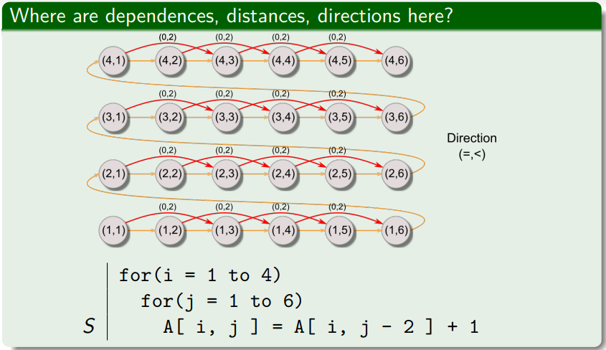
Dependence
(Dependencies between iterations)

