Slide 1



CSDC-446 Parallel and Distributed Computing
Dr. Sehrish Amjad

Slide 2
Topics Covered
Dependency Analysis
Designing Parallel Programs

Slide 3
Program Transformations and Validity

Slide 4
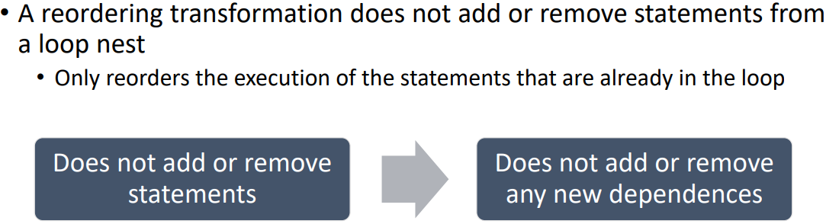
Reordering Transformations

Slide 5
Validity of Dependence-Based Transformations

Slide 6
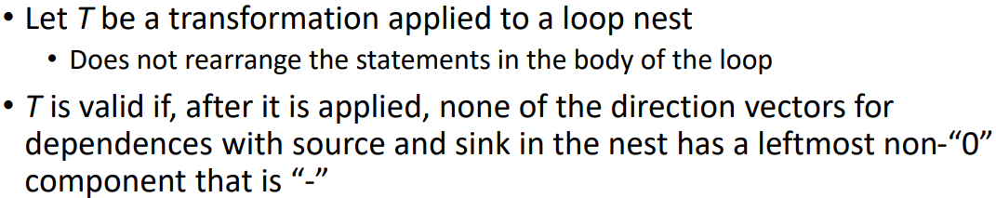
Direction Vector Transformation

Slide 7
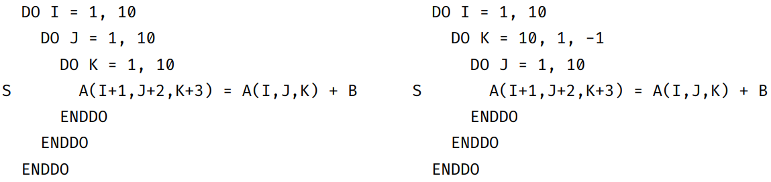
Is this transformation valid?
Notes:
For I=1 to 10
For J = 1 to 10
For k = 1 o 10
For I=1, j=1 and K=1
A(2,3,4) = A(1,1,1) + B
For I=1, J=1 and K=2
A(2,3,5) = A(1,1,2) + B
For I=1, J=1, and K=10
A(2,3,13) = A(1,1,10) + B
I=1 to 10
K = 10 to 1
J = 1 to 10
A(2, 3, 13) = A(1,1, 10) + B
A(2,4,13) = A(1,2,10) + B

Slide 8
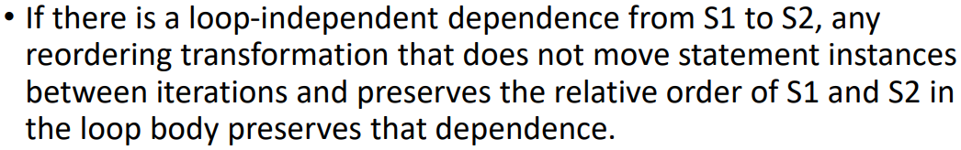
Validity of Transformations for Loop-Independent Dependences

Slide 9
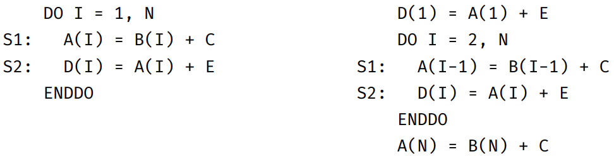
Is this transformation valid?

Slide 10
Designing Parallel Programs

Slide 11
Designing Parallel Programs
Manual vs. Automatic Parallelization
  Designing and developing parallel programs has been a very MANUAL process.
  The programmer is responsible for both:
    Identifying & Implementing parallelism
  Manually developing parallel codes is a
    Time consuming
    Complex
    Error-prone
    Iterative process
Notes:
https://hpc.llnl.gov/documentation/tutorials/introduction-parallel-computing-tutorial##Designing

Slide 12
Designing Parallel Programs
Manual vs. Automatic Parallelization
  Most common type of tool used to automatically parallelize a serial program into parallel programs
  Parallelizing Compiler works in 2 different ways:
    Fully Automatic
    Programmer Directed
Notes:
https://hpc.llnl.gov/documentation/tutorials/introduction-parallel-computing-tutorial##Designing

Slide 13
Designing Parallel Programs
Parallelizing Compiler (Fully Automatic)
  The compiler analyzes the source code and identifies opportunities for parallelism
  The analysis includes:
    Identifying inhibitors to parallelism
    Possibly a cost weighting on whether or not the parallelism would actually improve performance
    Loops (do, for) loops are the most frequent target for automatic parallelization
Notes:
https://hpc.llnl.gov/documentation/tutorials/introduction-parallel-computing-tutorial##Designing

Slide 14
Designing Parallel Programs
Parallelizing Compiler (Programmer Directed)
  Using “compiler directives” or possibly compiler flags, the programmer explicitly tell the compiler how to parallelize the code
  May be able to be used in conjunction with some degree of automatic parallelization also
Notes:
https://hpc.llnl.gov/documentation/tutorials/introduction-parallel-computing-tutorial##Designing

Slide 15
Designing Parallel Programs
Automatic Parallelization(Caveats)
  Wrong results may be produced
  Performance may actually degrade
  Much less flexible than manual parallelization
  Limited to a subset (mostly loops) of code
  May actually not parallelize code if the analysis suggest there are inhibitors or the code is too complex
Notes:
https://hpc.llnl.gov/documentation/tutorials/introduction-parallel-computing-tutorial##Designing

Slide 16
Roadmap to Designing Parallel Programs
Code Analysis
Partitioning
Communication
Numerical Complexity
Efficiency and Scalability
  Understand the Program and the Problem
Notes:
https://hpc.llnl.gov/documentation/tutorials/introduction-parallel-computing-tutorial##Designing

Slide 17
Roadmap to Designing Parallel Programs
Code Analysis
  Understand the problem that you wish to solve in parallel (from serial program you need to understand the existing code)
  Before spending time : determine whether or not the problem is one that can actually be parallelized
  Identify the program’s hotspots (Know where of the real work is being done. Performance analysis tools can help here)
  Identify bottlenecks ( I/O is usually something that slows a program down. Change algorithms to reduce or eliminate unnecessary slow areas)
  Investigate other algorithms
Notes:
https://hpc.llnl.gov/documentation/tutorials/introduction-parallel-computing-tutorial##Designing

Slide 18
Roadmap to Designing Parallel Programs
Code Analysis
  Investigate inhibitors to parallelism . One common class of inhibitor is data dependence
Example of Parallelizable Problem
  Calculate the potential energy for each of several thousand independent conformations of a molecule. When done, find the minimum energy conformation
  Each of the molecular conformation is independently determinable. The calculation of the minimum energy conformation is also a parallelizable problem
Notes:
https://hpc.llnl.gov/documentation/tutorials/introduction-parallel-computing-tutorial##Designing

Slide 19
Roadmap to Designing Parallel Programs
Example of Non-Parallelizable Problem
  Calculation of the Fibonacci series (1,1,2,3,5,8,13,21)
  F(K + 2) = F(K + 1) + F(K)
  The calculation of the Fibonacci sequences as shown would entail dependent calculations rather than independents ones. The calculation of the k + 2 values uses those of both k + 1 and k. These three terms cannot be calculated independently and therefore, not in parallel
Notes:
https://hpc.llnl.gov/documentation/tutorials/introduction-parallel-computing-tutorial##Designing

Slide 20
Roadmap to Designing Parallel Programs
Partitioning
  Break the problem into discrete “chunks” of work that can be distributed to multiple tasks
  Two basic ways to partition computational work among parallel tasks:
    Domain decomposition &
    Functional decomposition
Notes:
https://hpc.llnl.gov/documentation/tutorials/introduction-parallel-computing-tutorial##Designing

Slide 21
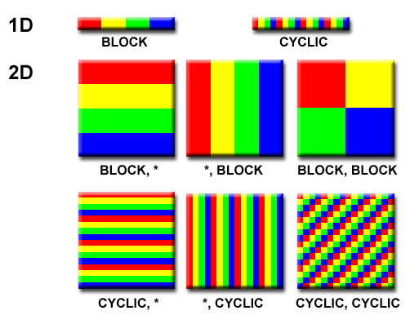
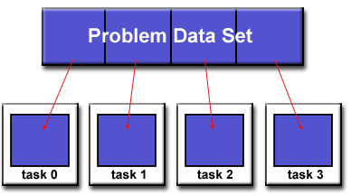
Roadmap to Designing Parallel Programs
Domain Decomposition
  The data associated with a problem is decomposed. Each parallel task then works on a portion of the data. Each parallel task then works on a portion of the data.
Notes:
https://hpc.llnl.gov/documentation/tutorials/introduction-parallel-computing-tutorial##Designing

Slide 22
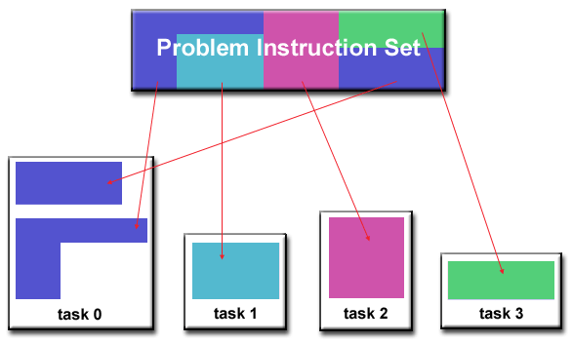
Roadmap to Designing Parallel Programs
Functional Decomposition
  In this approach, the focus is on the computation that is to be performed rather than on the data manipulated by the computation. The problem is decomposed according to the work that must be done. Each task then performs a portion of the overall work.
Notes:
https://hpc.llnl.gov/documentation/tutorials/introduction-parallel-computing-tutorial##Designing

Slide 23
Roadmap to Designing Parallel Programs
Communication
  Who needs Communications :
  You don’t Need! Some types of problems can be decomposed and execute in parallel virtually no need for task to share data. Embarrassingly parallel.
  Very little inter-task communication is required
  Eg. Image processing operation, every pixel in a black and white image needs to have its color reversed
  You do Need! Most parallel applications do require to share data with each other. (Eg. Ecosystem)
Notes:
https://hpc.llnl.gov/documentation/tutorials/introduction-parallel-computing-tutorial##Designing

Slide 24
Roadmap to Designing Parallel Programs
Communication (Factors to Consider)
  There are a number of important factors to consider when designing program’s inter-task communications:
    Communication Overhead
    Latency vs. Bandwidth
    Visibility of Communications
    Synchronous vs. Asynchronous communication
    Scope of communications
    Efficiency of communications
Notes:
https://hpc.llnl.gov/documentation/tutorials/introduction-parallel-computing-tutorial##Designing

Slide 25
Roadmap to Designing Parallel Programs
Communication Overhead
  Inter-task communication virtually always implies overhead
  Machine cycles and resources that could be used for computation are instead used to package and transmit data.
  Communications frequently require some type of synchronization between tasks, which can result in tasks spending time "waiting" instead of doing work.
  Competing communication traffic can saturate the available network bandwidth, further aggravating performance problems
Notes:
https://hpc.llnl.gov/documentation/tutorials/introduction-parallel-computing-tutorial##Designing

Slide 26
Roadmap to Designing Parallel Programs
Communications (Latency vs. Bandwidth)
  Latency is the time it takes to send a minimal (0 byte) message from point A to point B. Commonly expressed as microseconds.
  Bandwidth is the amount of data that can be communicated per unit of time. Commonly expressed as megabytes/sec or gigabytes/sec.
  Sending many small messages can cause latency to dominate communication overheads. Often it is more efficient to package small messages into a larger message, thus increasing the effective communications bandwidth.
Notes:
https://hpc.llnl.gov/documentation/tutorials/introduction-parallel-computing-tutorial##Designing

Slide 27
Roadmap to Designing Parallel Programs
Communications (Visibility)
  Message passing Model: Communications are explicit (under control of the programmer)
  Data Parallel Model: Communications occur transparently to the programmer, usually on distributed memory architectures.
Notes:
https://hpc.llnl.gov/documentation/tutorials/introduction-parallel-computing-tutorial##Designing

Slide 28
Roadmap to Designing Parallel Programs
Communications (Synchronous vs. Asynchronous)
  Synchronous requires some type of “handshaking” between task that are sharing data.
  Synchronous : Blocking communications, as there is waiting time
  Asynchronous allow tasks to transfer data independently from one another.
  Asynchronous: Non-Blocking communications, no waitting time
  Interleaving computation with communication is the greatest benefit.
Notes:
https://hpc.llnl.gov/documentation/tutorials/introduction-parallel-computing-tutorial##Designing

Slide 29
Roadmap to Designing Parallel Programs
Communications (Scope)
  Knowing which tasks must communicate with each other is critical during design stage of a parallel code.
  Two types of scope can be implementing sync. Or async.
    Point to Point: 2 task (sender/producer of data and receiver/consumer)
    Collective: data sharing between more than two tasks
Notes:
https://hpc.llnl.gov/documentation/tutorials/introduction-parallel-computing-tutorial##Designing

Slide 30
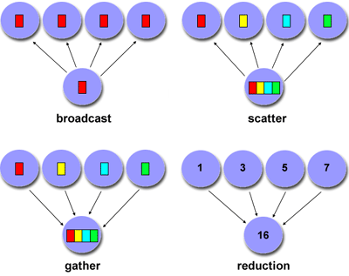
Roadmap to Designing Parallel Programs
Communications (Scope)
Notes:
https://hpc.llnl.gov/documentation/tutorials/introduction-parallel-computing-tutorial##Designing

Slide 31
Roadmap to Designing Parallel Programs
Efficiency of Communications
  Very often, the programmer will have a choice with regard to factors that can affect communications performance.
  Which implementation for a given model should be used? (e.g. MPI implementation may be faster on a given hardware platform than another)
  What type of communication operations should be used? (e.g. asynchronous communication operations can improve overall program performance)
  Network media - some platforms may offer more than one network for communications. Which one is best?
Notes:
https://hpc.llnl.gov/documentation/tutorials/introduction-parallel-computing-tutorial##Designing

Slide 32
Roadmap to Designing Parallel Programs
Synchronization
  Managing the sequence of work and the tasks performing it
Types
  Barrier
    All tasks are involved
    Each task perform its work. When the last task reaches the barrier, all task are synchronized
  Lock / semaphore
    Typically used to serialize access to global data or section of code. Task must wait to use the code
Notes:
https://hpc.llnl.gov/documentation/tutorials/introduction-parallel-computing-tutorial##Designing

Slide 33
Roadmap to Designing Parallel Programs
Synchronization
Types
  Synchronous communication operations
    Lock / semaphore
      Involves only those tasks executing a communication operations (handshaking)
Notes:
https://hpc.llnl.gov/documentation/tutorials/introduction-parallel-computing-tutorial##Designing

