Slide 1



CSDC-446 Parallel and Distributed Computing
Dr. Sehrish Amjad

Slide 2
Topics Covered
Designing Parallel Programs
Inter-process Communication, Message Passing System

Slide 3
Roadmap to Designing Parallel Programs
Data Dependencies
  A dependence exists between program statements when the order of statements execution affects the results of the program
  A data dependence results from multiple use of the same location(s) in storage by different tasks.
  Dependencies are important to parallel programming because they are one of the primary inhibitors to parallelism
Notes:
https://hpc.llnl.gov/documentation/tutorials/introduction-parallel-computing-tutorial##Designing

Slide 4
Roadmap to Designing Parallel Programs
Data Dependencies
  Loop carried data dependence (most important)
  DO J = MYSTART,MYEND
  A(J) = A(J-1) * 2.0
  CONTINUE
  The value of A(J-1) must be computed before the value of A(J), therefore A(J) exhibits a data dependency on A(J-1). Parallelism is inhibited.
  If Task 2 has A(J) and task 1 has A(J-1), computing the correct value of A(J) necessitates: 1 Calculate, 2 get value
Notes:
https://hpc.llnl.gov/documentation/tutorials/introduction-parallel-computing-tutorial##Designing

Slide 5
Roadmap to Designing Parallel Programs
Data Dependencies
  Loop independent data dependence
    task 1 task 2
  X = 2 X = 4
  Y = X**2 Y = X**3
  As with the previous example, parallelism is inhibited. The value of Y is dependent on:
Notes:
https://hpc.llnl.gov/documentation/tutorials/introduction-parallel-computing-tutorial##Designing

Slide 6
Roadmap to Designing Parallel Programs
Data Dependencies
  How to handle data dependencies
    Distributed memory architectures - communicate required data at synchronization points.
    Shared memory architectures -synchronize read/write operations between tasks.
Notes:
https://hpc.llnl.gov/documentation/tutorials/introduction-parallel-computing-tutorial##Designing

Slide 7
Roadmap to Designing Parallel Programs
Load Balancing
  Refers to the practice of distributing work among tasks so that all task are kept busy all of the time.
  It can be considered a Minimization of task idle time
  Important for performance reasons
Notes:
https://hpc.llnl.gov/documentation/tutorials/introduction-parallel-computing-tutorial##Designing

Slide 8
Roadmap to Designing Parallel Programs
Load Balancing
  How to achieve?
    Equally partition the work each task receives
    Use dynamic work assignment
Notes:
https://hpc.llnl.gov/documentation/tutorials/introduction-parallel-computing-tutorial##Designing

Slide 9
Roadmap to Designing Parallel Programs
Load Balancing
  Equally partition the work each task receives
    For array/matrix operations where each task performs similar work, evenly distribute the data set among the tasks.
    For loop iterations where the work done in each iteration is similar, evenly distribute the iterations across the tasks.
Notes:
https://hpc.llnl.gov/documentation/tutorials/introduction-parallel-computing-tutorial##Designing

Slide 10
Roadmap to Designing Parallel Programs
Load Balancing
  Use dynamic work assignment
    When the amount of work each task will perform is intentionally variable, or is unable to be predicted, it may be helpful to use a scheduler - task pool approach. As each task finishes its work, it queues to get a new piece of work.
    It may become necessary to design an algorithm which detects and handles load imbalances as they occur dynamically within the code.
    Sparse arrays:some task with zeros
    Adaptive grid methods: some task need to refine their mesh
Notes:
https://hpc.llnl.gov/documentation/tutorials/introduction-parallel-computing-tutorial##Designing

Slide 11
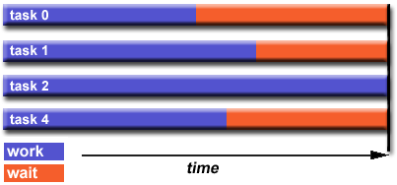
Roadmap to Designing Parallel Programs
Load Balancing
Notes:
https://hpc.llnl.gov/documentation/tutorials/introduction-parallel-computing-tutorial##Designing

Slide 12
Roadmap to Designing Parallel Programs
Granularity (Computation / Communication Ratio)
  Granularity is a qualitative measure of the ratio of computation to communication
  Periods of computation are typically separated from periods of communication by synchronization events
  Two types
    Fine-grain Parallelism
    Coarse-grain Parallelism
Notes:
https://hpc.llnl.gov/documentation/tutorials/introduction-parallel-computing-tutorial##Designing
Granualiry = Computation/Communication
= 10 sec/2 sec = 5

Slide 13
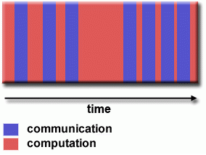
Roadmap to Designing Parallel Programs
Granularity (Fine-grain Parallelism)
  Relatively small amounts of computational work are done between communication events
  Low computation to communication ratio
  Implies high communication overhead
  If granularity is too fine it is possible that the overhead
  required for communications and synchronization
  between tasks takes longer than the computation
Notes:
https://hpc.llnl.gov/documentation/tutorials/introduction-parallel-computing-tutorial##Designing

Slide 14
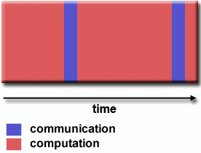
Roadmap to Designing Parallel Programs
Granularity (Coarse-grain Parallelism)
  Relatively large amounts of computational work are done between communication/synchronization events
  High computation to communication rate
  Implies more opportunity for performance increase
  Harder to load balance efficiently
Notes:
https://hpc.llnl.gov/documentation/tutorials/introduction-parallel-computing-tutorial##Designing

Slide 15
Roadmap to Designing Parallel Programs
Granularity (Which is best?)
  The most efficient granularity depend on the algorithm and the hardware environment in which it runs
  In most cases the overhead associated with communication and synchronization is high relative to execution speed so it is advantageous to have coarse granularity
  Fine-grain parallelism can help reduce overheads due to load imbalance. Facilitates load balancing
Notes:
https://hpc.llnl.gov/documentation/tutorials/introduction-parallel-computing-tutorial##Designing

Slide 16
Roadmap to Designing Parallel Programs
I/O
  I/O operations are inhibitors to parallelism
  Parallel I/O systems may be immature or not available for all platforms
  If all of the tasks see the same file space, WRITE operations can result in file overwriting
  Read operations can be affected by the file server’s ability to handle multiple read requests at the same time
  I/O over networks can cause bottlenecks/crash file servers

Slide 17
Roadmap to Designing Parallel Programs
Complexity
  Parallel applications are much more complex than corresponding serial applications.
  Cost of complexity is measured in programmer time in every aspect of the software development cycle
  Design, Coding, Debugging, Tuning, Maintenance

Slide 18
Roadmap to Designing Parallel Programs
Portability
  There are standardization in some API’s s.t. MPI
    Implementations will differ in a number of details, requiring code modifications
    HW architectures can affect portability
    Operating systems can play a key role in code portability issues
    All of the portability issues associated with serial programs apply to parallel programs

Slide 19
Roadmap to Designing Parallel Programs
Resource Requirements
  Goal of Parallel programming is to decrease execution wall clock time, more CPU time is required. e.g. 1 parallel code that runs 1 hour on 8 processors actually use 8 hours of CPU time
  Amount of memory can be greater in parallel
  Short parallel code is possibly a decrease in performance. (setting up the parallel environment, task creation/termination, communication)

Slide 20
Roadmap to Designing Parallel Programs
Scalability
  Result of a number of interrelated factors
  Adding more machines is rarely the answer
  At some point, adding more resources causes performance to decrease
  Hardware factors play a significant role in scalability.
    Communications network bandwidth
    Amount of memory available on any machine
  Parallel support libraries and subsystems (limit)

Slide 21
Inter-Process Communication

Slide 22
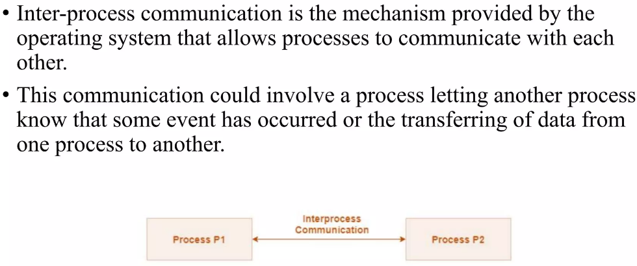
Inter-Process Communication (IPC)
Notes:
https://hpc.llnl.gov/documentation/tutorials/introduction-parallel-computing-tutorial##Designing

Slide 23
Approaches of Inter-Process Communication

Slide 24
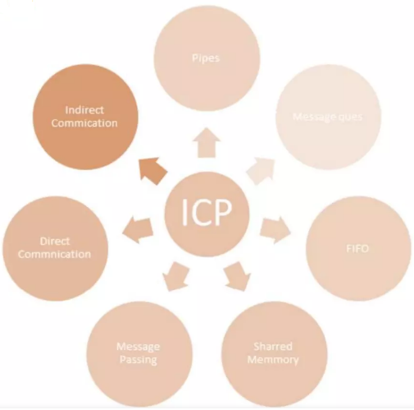
Approaches of IPC

Slide 25
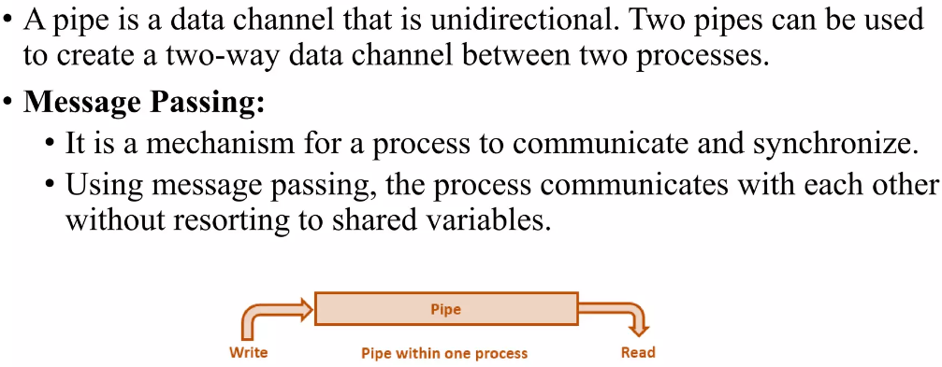
Approaches of IPC: PIPES

Slide 26
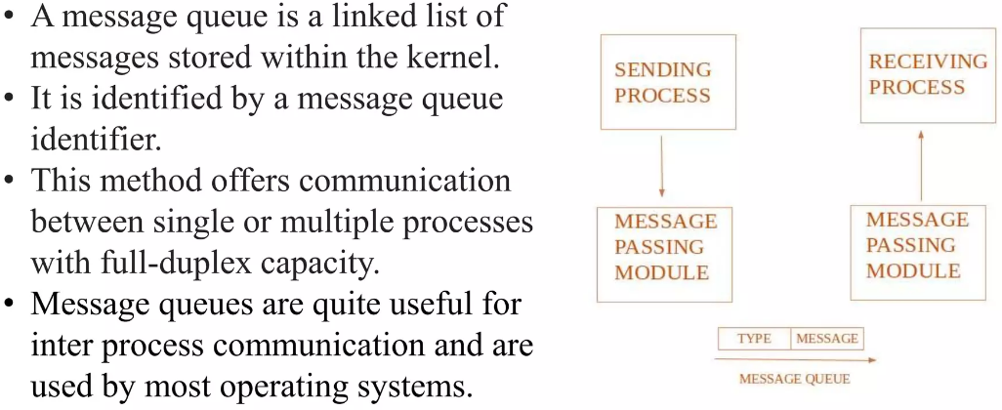
Approaches of IPC : MESSAGE QUEUES

Slide 27
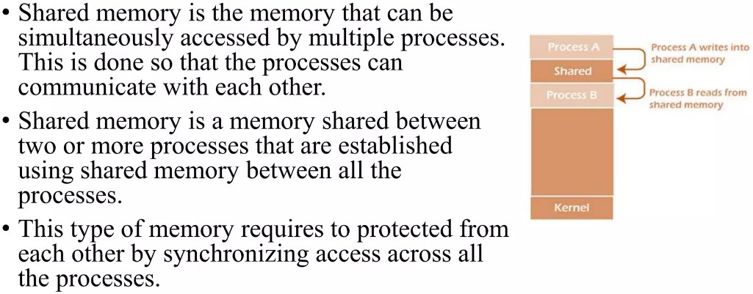
Approaches of IPC : Shared Memory

Slide 28
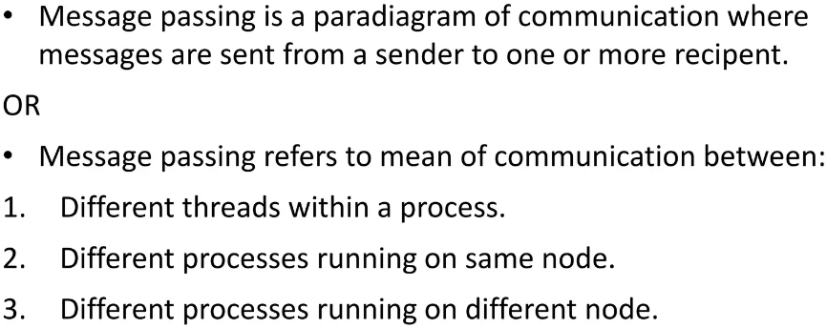
Approaches of IPC : Message Passing

Slide 29
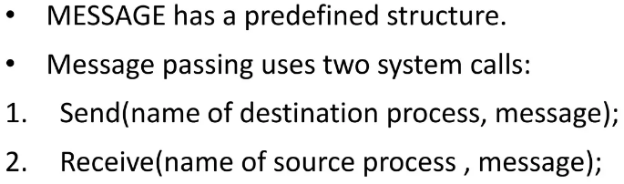
Approaches of IPC : Message Passing

Slide 30
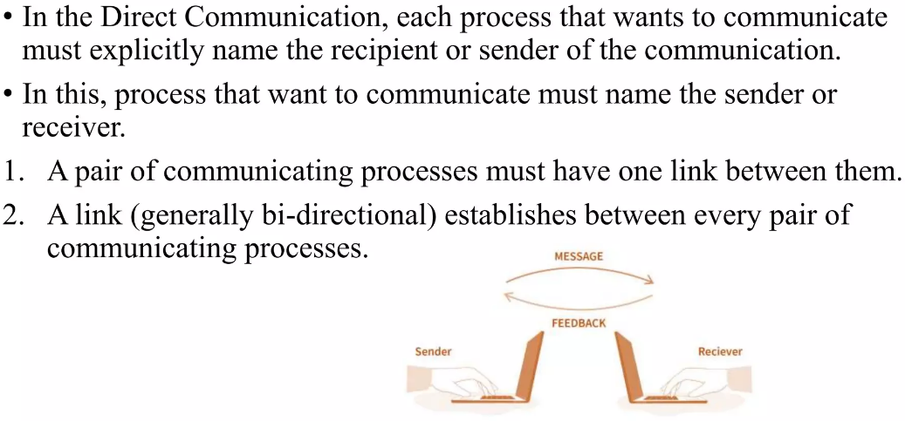
Approaches of IPC: DIRECT COMMUNICATION

Slide 31
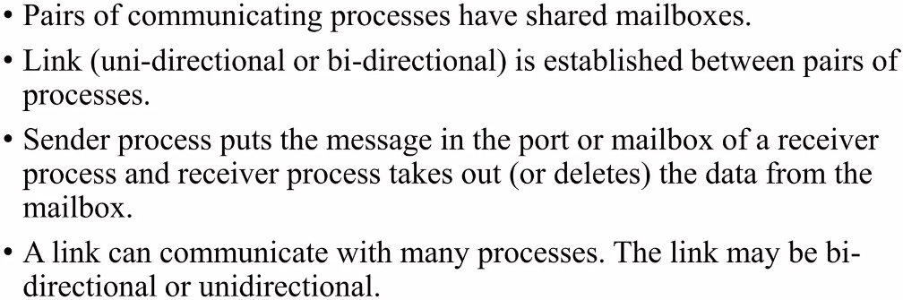
Approaches of IPC : INDIRECT COMMUNICATION

Slide 32
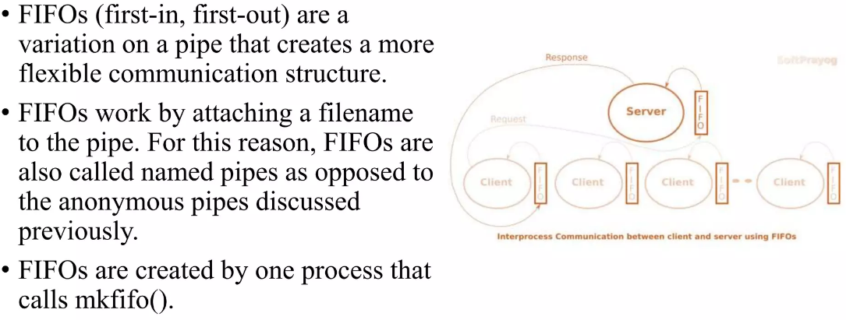
Approaches of IPC: FIFO

Slide 33
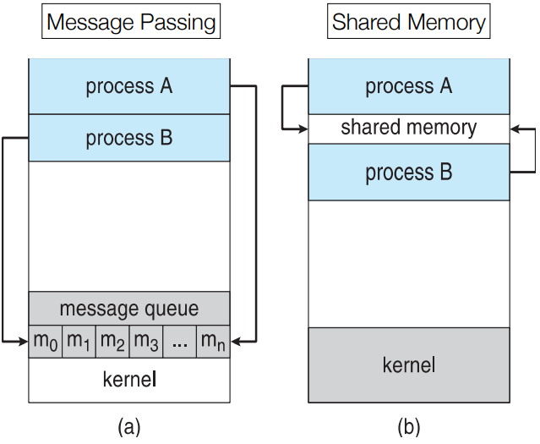
Communication Models

Slide 34
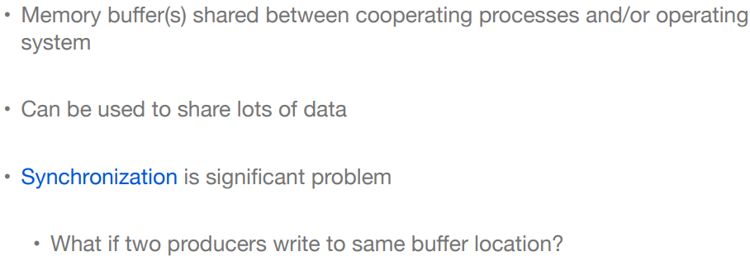
Shared Memory Model

Slide 35
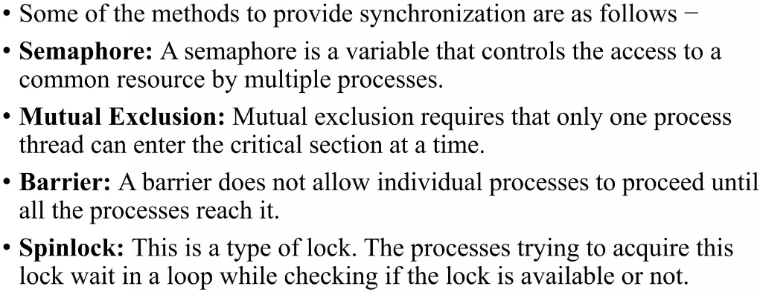
Methods to Provide Synchronization in Shared Memory Model

Slide 36
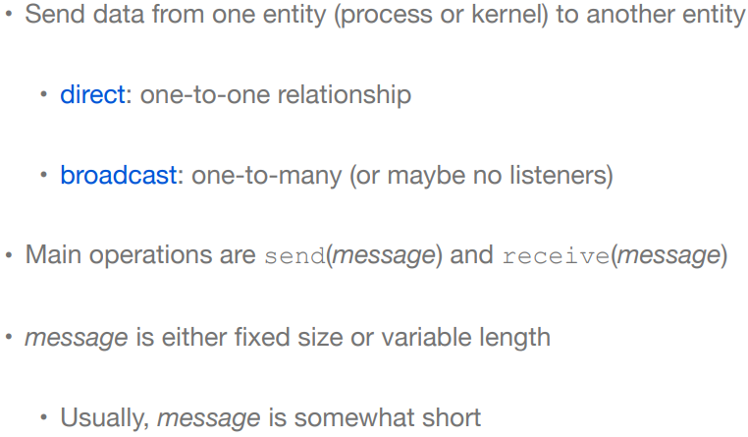
Message Passing Model

Slide 37
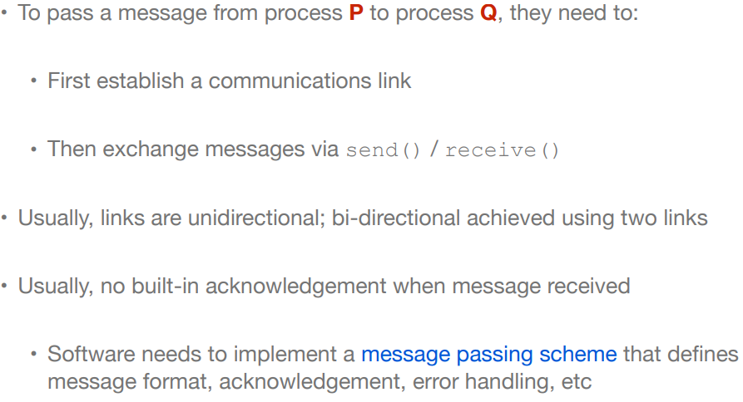
Message Passing Implementation

Slide 38
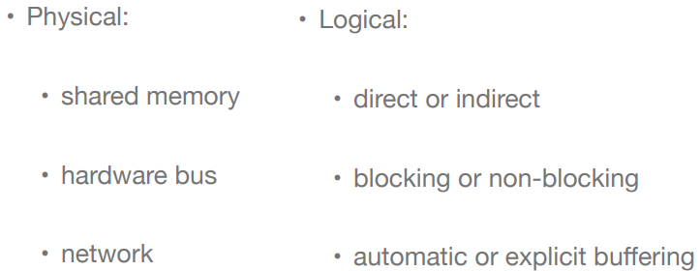
Communication Links

Slide 39
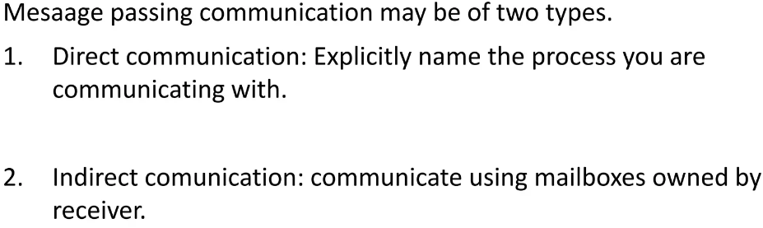
Message Passing Communication

Slide 40
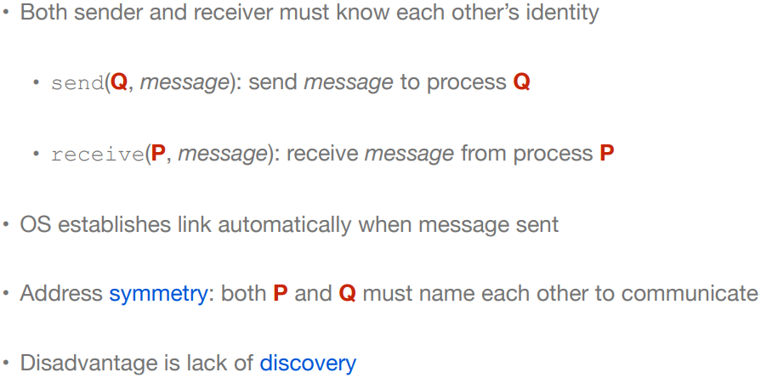
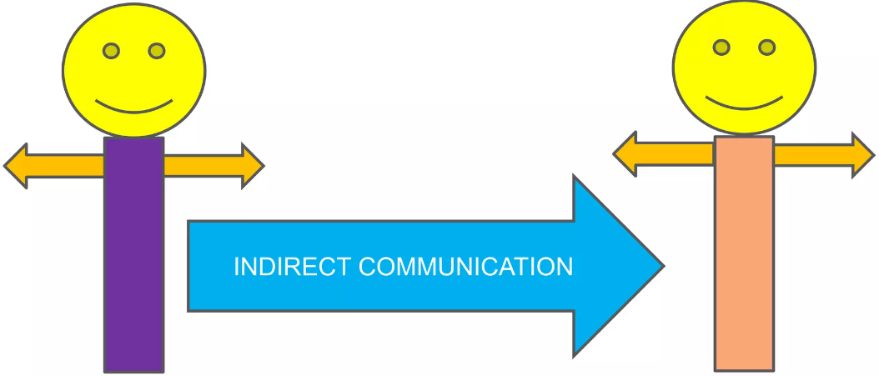
Direct Communication in Message passing System

Slide 41
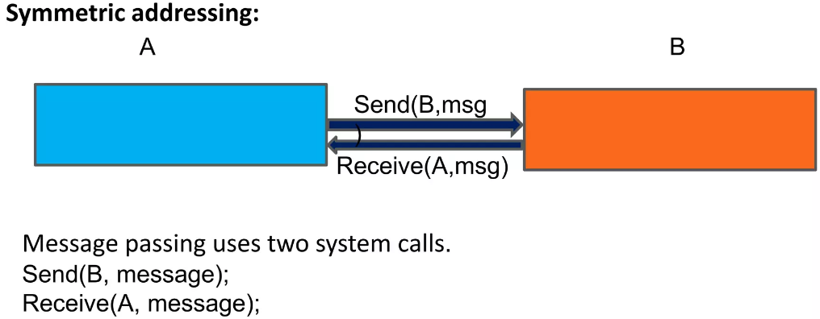
Direct Communication in Message Passing System

Slide 42
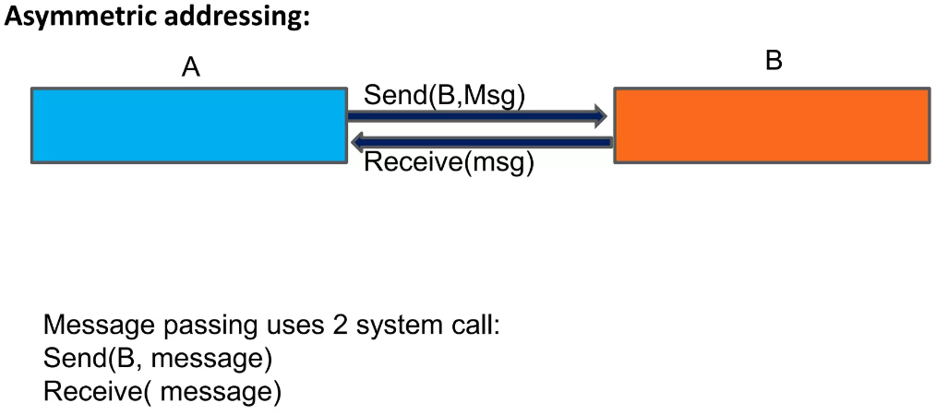
Direct Communication in Message Passing System

Slide 43
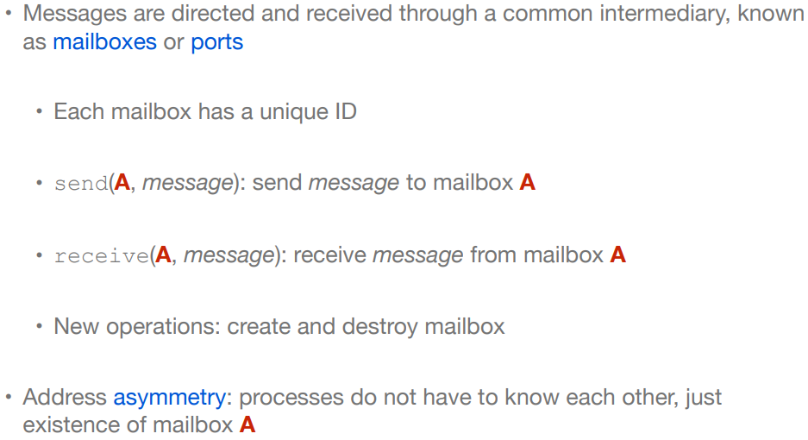
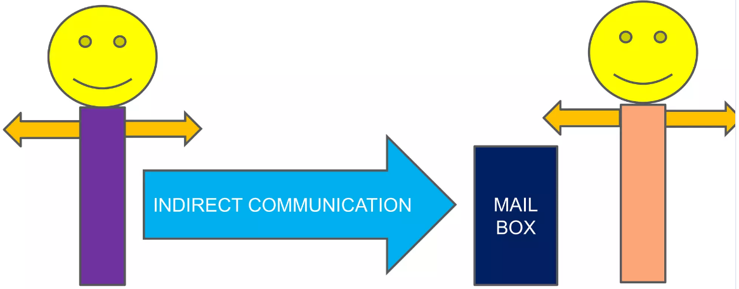
Indirect Communication in Message Passing System

Slide 44
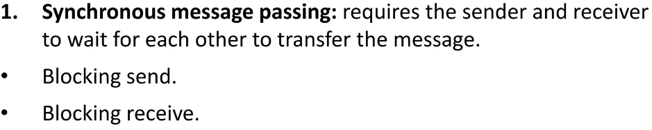
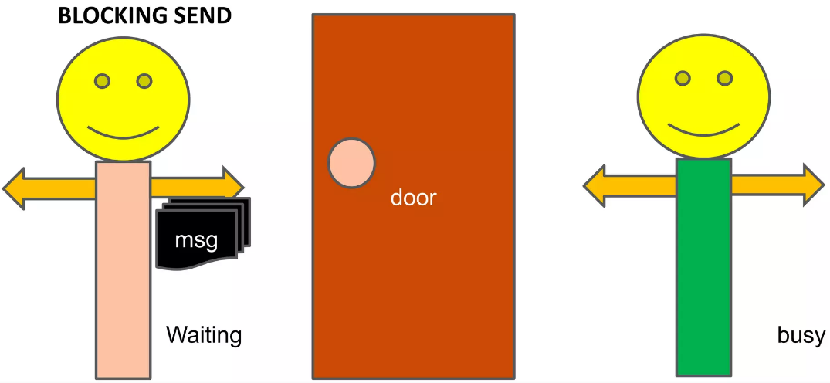
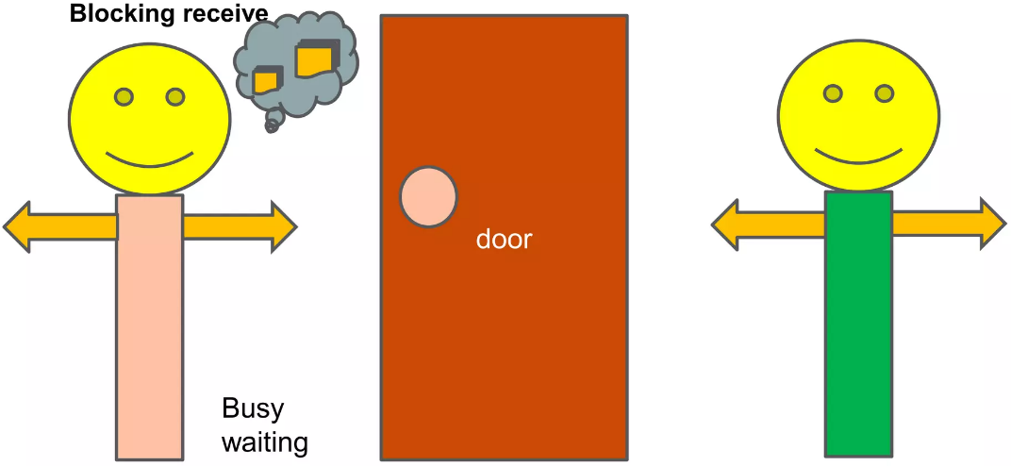
Message Synchronization in Indirect Communication
Notes:
Blocking Send: the sending process is blocked until the message is received either by the receiving process or by the mailbox.
Block Receive: the receiver blocks until a message is available.

Slide 45
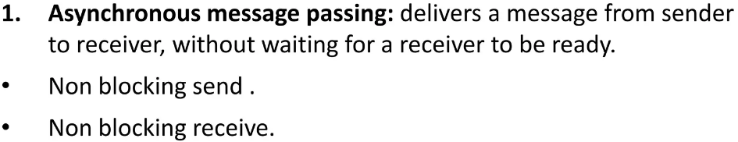
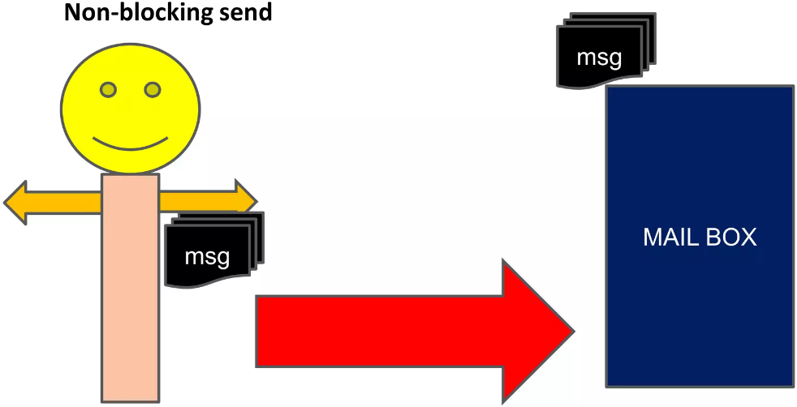
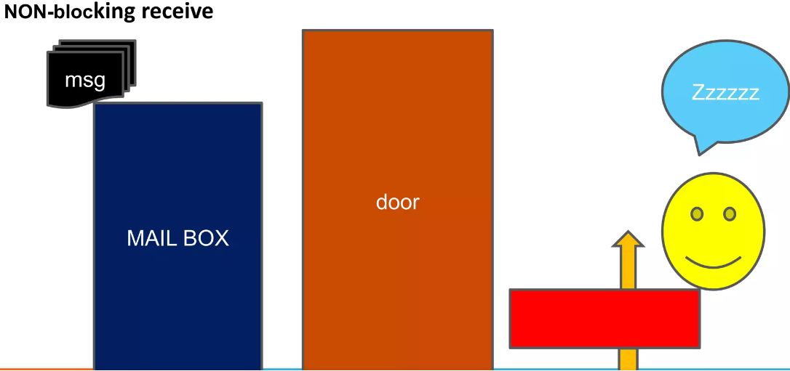
Message Synchronization in Indirect Communication
Notes:
Non Blocking Send: the sending process sends the message and immediately resumes operation.
Non Blocking Receive: if there is no waiting message, the process continues executing, abandoning the attempt to receive.

