Slide 1
ETL Basics

Slide 2
Course Goals and Non Goals
Course Goals
At the end of this program, participants gain an
understanding of basic concepts in ETL.
Course Non Goals
Implementation of ETL tools.

Slide 3
Pre-requisites
Fair knowledge of DW concepts

Slide 4
Intended Audience
Software Engineers and Senior Software Engineers

Slide 5
Day Wise Schedule
Day 1
Lesson 1: Basic Concepts
Lesson 2: ETL Process
Lesson 3: Operational considerations
Lesson 4: ETL Tools

Slide 6
Table of Contents
Lesson 1: Basic concepts
1.1: Data warehouse
1.2: Data warehousing strategies
1.3: Data warehouse architecture
1.4: ETL Meaning
1.5: Need for ETL
Lesson 2: ETL process
2.1: Data extraction
2.2: Data transformation
2.3: Data Loading

Slide 7
Table of Contents
Lesson 3: Operational Considerations
3.1: Exceptional Handling
3.2: Alerts and Notification
3.3: Process restart-ability
3.4: Job Scheduling and Monitoring
Lesson 4: ETL Tools
4.1: Choosing the correct ETL tool
4.2:Leading ETL tool vendors

Slide 8
References
Student material:
Class Book (presentation slides with notes)
Book:
The Data Warehousing ETL Toolkit – Ralph Kimball
Web-site:
http://www.datawarehouse.org
http://etl-tools.info/

Slide 9
Next Step Courses (if applicable)
BI related tool training

Slide 10
Lesson 1 : Basic Concepts

Slide 11
Lesson Objectives
On completion of this lesson on ETL basics, you will be able to:
Understand Data warehousing strategies and architecture
Know the meaning and need of ETL

Slide 12
Datawarehouse
A single, complete and consistent store of data obtained from a variety of different sources made available to end users in a format that they can understand and use in a business context.

Slide 13
Datawarehousing Strategies
Enterprise-wide warehouse, top down, the Inmon methodology
Data mart, bottom up, the Kimball methodology
When properly executed, both result in an enterprise-wide data warehouse

Slide 14
Inmon methodology - Top Down approach
Bill Inmon saw a need to transfer data from diverse OLTP systems into a centralized place where the data could be used for analysis
Inmon’s philosophy recommends to start with building a large centralized enterprise-wide data warehouse, followed by several data-marts

Slide 15
Top Down Approach
Data Sources Staging Area Warehouse Data mart
Operational system
Sales
Operational system
Purchase
Operational system
Inventory

Slide 16
Kimball methodology – Bottom Up approach
Kimball’s philosophy recommends to start with building several data marts that serve the analytical needs of departments, followed by “virtually” integrating these data marts.
Inventory

Slide 17
Bottom up Approach
Source Staging Data Mart
Data warehouse
Operational system
Sales
Operational system
Purchase
Inventory
Operational system
Notes:
The bottom-up approach reverses the positions of the Data warehouse and the Data marts. Data marts are directly loaded with the data from the operational systems through the staging area. The ODS may or may not exist depending on the business requirements.
The data flow in the bottom up approach starts with extraction of data from operational databases into the staging area where it is processed and consolidated and then loaded into the ODS. The data in the ODS is appended to or replaced by the fresh data being loaded. After the ODS is refreshed the current data is once again extracted into the staging area and processed to fit into the Data mart structure. The data from the Data Mart, then is extracted to the staging area aggregated, summarized and so on and loaded into the Data Warehouse and made available to the end user for analysis.

Slide 18
Hybrid Approach
Source Mart Staging
Data warehouse
Data
Operational system
Sales
Operational system
Purchase
Inventory
Operational system
Notes:
The bottom-up approach reverses the positions of the Data warehouse and the Data marts. Data marts are directly loaded with the data from the operational systems through the staging area. The ODS may or may not exist depending on the business requirements.
The data flow in the bottom up approach starts with extraction of data from operational databases into the staging area where it is processed and consolidated and then loaded into the ODS. The data in the ODS is appended to or replaced by the fresh data being loaded. After the ODS is refreshed the current data is once again extracted into the staging area and processed to fit into the Data mart structure. The data from the Data Mart, then is extracted to the staging area aggregated, summarized and so on and loaded into the Data Warehouse and made available to the end user for analysis.

Slide 19
Data Warehouse Architecture Components
Source Systems
ETL Layer
Data and Metadata Repository Layer
Presentation Layer
Execution Systems
CRM
ERP
Legacy
e-Commerce
Extract, Transformation, and Load (ETL) Layer
Cleanse Data
Filter Records
Standardize Values
Decode Values
Apply Business Rules
Householding
Dedupe Records
Merge Records
Enterprise
Data
Warehouse
ODS
Reporting Tools
OLAP Tools
Ad Hoc Query Tools
Data Mining Tools
Data Mart
External
Data
Purchased Market Data
Spreadsheets
Metadata Repository
Data Mart
Data Mart
Sample Technologies:
Custom Tools
HTML Reports
Cognos
Business Objects
Micro Strategy
Oracle Discoverer
Brio
Data Mining Tools
Portals
ETL Tools:
Informatica
Data Stage
Oracle Warehouse Builder
Custom programs
SQL scripts
Oracle
SQL Server
Teradata
DB2
PeopleSoft
SAP
Siebel
Oracle Applications

Slide 20
What is ETL?
ETL stands for Extract Transform & Load
The process of updating the data warehouse
ETL is the automated and auditable data acquisition process from source system that involves one or more sub processes of data extraction, data transportation, data transformation, data consolidation, data integration, data loading and data cleaning.

Slide 21
Need for ETL
The process of ETL is required so that data from different heterogeneous sources can be combined and brought into one common source.
The Advantage of having the process of ETL is that, as data from different sources can be brought together, highly complex and user friendly reports can be generated for decision making

Slide 22
Need for ETL
Data stored in different formats in different types of databases
Some data sources might be archives while others may be active operational systems
Data extraction and cleansing - time-consuming and difficult Aggregation of data

Slide 23
Summary
In this module, you learned about the following:
Datawarehousing strategies
Datawarehousing architecture
Need for ETL
Meaning of ETL
Notes:
Add the notes here.

Slide 24
Lesson 2: ETL Process

Slide 25
Lesson Objectives
On completion of this lesson on Data Modeling, you will be able to understand:
The ETL process
The steps in Data Cleansing

Slide 26
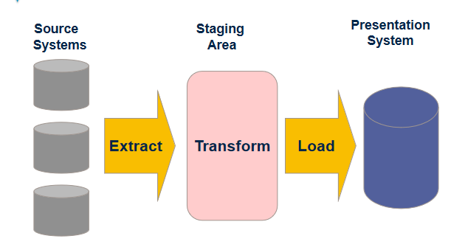
The ETL Process

Slide 27
The ETL Process
Extract
Extract relevant data
Transform
Transform data to DW format
Build keys, etc.
Cleansing of data
Load
Load data into DW
Build aggregates, etc

Slide 28
EXTRACTION PHASE

Slide 29
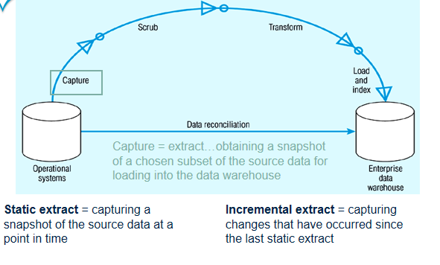
ETL – DATA CAPTURE

Slide 30
Change Data Capture
Data warehousing involves the extraction and transportation of data from one or more databases into a target system or systems for analysis.
But this involves the extraction and transportation of huge volumes of data and is very expensive in both resources and time.
The ability to capture only the changed source data and to move it from a source to a target system(s) in real time is known as Change Data Capture (CDC).

Slide 31
Change Data Capture
CDC helps identify the data in the source system that has changed since the last extraction.
Set of software design patterns used to determine the data that has changed in a database.

Slide 32
Change Data Capture
Based on the Publisher/Subscriber model.
Publisher
Identifies the source tables from which the change data needs to be captured
Captures the change data and stores it in specially created change tables
Allows the subscribers controlled access to the change data
Subscriber
Subscriber needs to know what change data it is interested in
It creates a subscriber view to access the change data to which it has been granted access by the publisher

Slide 33
Data Staging
Often used as an interim step between data extraction and later steps
Accumulates data from asynchronous sources using native interfaces, flat files, FTP sessions, or other processes
At a predefined cutoff time, data in the staging file is transformed and loaded to the warehouse
There is usually no end user access to the staging file
An operational data store may be used for data staging

Slide 34
Reasons for “Dirty” Data
Dummy Values
Absence of Data
Multipurpose Fields
Cryptic Data
Contradicting Data
Inappropriate Use of Address Lines
Violation of Business Rules
Reused Primary Keys,
Non-Unique Identifiers
Data Integration Problems

Slide 35
ETL – DATA Extraction
The extraction process can be done either by hand coded method or by using tools.
Advantages and disadvantages Of Custom-programmed )/Hand Coded Extraction (PL SQL Scripts) and Tool based extraction.
Tools have Well Defined disciplined approach and Documentation.
Tools provide an easier way to perform the extraction method by providing click, drag and drop features.
Hand coded extraction techniques allow extraction in cost effective manner since the PL/SQL construct are available with the RDBMS.
Hand coded extraction are used when the extraction is to be taken place where the programmer has clear data structure known.

Slide 36
ETL - Extraction Techniques
Extraction Technique
Bulk Extraction-
The entire data warehouse is refreshed periodically by extraction's from the source systems.
All applicable data are extracted from the source systems for loading into the warehouse.
This approach heavily uses the network connection for loading data from source to target databases, but such mechanism is easy to set up and maintain.

Slide 37
Data Extraction
Capture of data from Source Systems
Important to decide the frequency of Extraction
Sometimes source data is copied to the target database using the replication capabilities of standard RDBMS (not recommended because of “dirty data” in the source systems)

Slide 38
Data Transformation
Transforms the data in accordance with the business rules and standards that have been established
Example include: format changes, de-duplication, splitting up fields, replacement of codes, derived values, and aggregates

Slide 39
Data Transformation
Validating
Process of ensuring that the data captured is accurate and transformation process is correct
E.g. Date of Birth of a Customer should not be more than today’s date

Slide 40
Data Transformation
Data Cleansing
Source systems contain “dirty data” that must be cleansed
ETL software contains rudimentary data cleansing capabilities
Specialized data cleansing software is often used.
Important for performing name and address correction and house holding functions
Leading data cleansing vendors include Vality (Integrity), Harte-Hanks (Trillium), and Firstlogic (i.d.Centric)

Slide 41
Data Transformation
Steps in Data Cleansing
Parsing
Correcting
Standardizing
Matching
Consolidating
Conditioning
Enrichment

Slide 42
Data Transformation
Parsing
Parsing locates and identifies individual data elements in the source files and then isolates these data elements in the target files
Examples include :
parsing the first, middle, and last name;
street number and street name; and city and state

Slide 43
Data Transformation
Parsing

Slide 44
Data Transformation
Correcting
Corrects parsed individual data components using sophisticated data algorithms and secondary data sources.
Example include replacing a vanity address and adding a zip code.

Slide 45
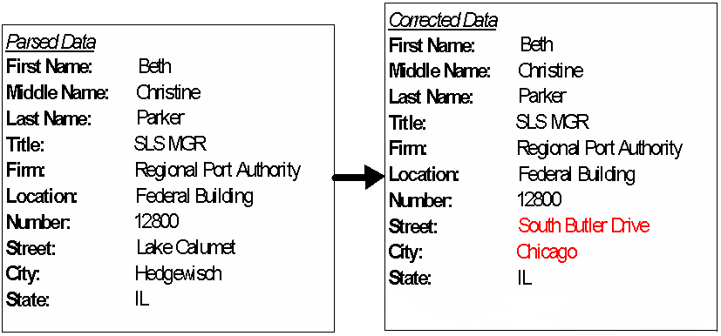
Data Transformation
Correcting

Slide 46
Data Transformation
Standardizing
Standardizing applies conversion routines to transform data into its preferred (and consistent) format using both standard and custom business rules.
Examples include adding a pre name, replacing a nickname, and using a preferred street name.

Slide 47
Data Transformation
Standardizing

Slide 48
Data Transformation
Matching
Searching and matching records within and across the parsed, corrected and standardized data based on predefined business rules to eliminate duplications.
Examples include identifying similar names and addresses.

Slide 49
Data Transformation
Matching

Slide 50
Data Transformation
Consolidating
Analyzing and identifying relationships between matched records and consolidating/merging them into ONE representation.

Slide 51
Data Transformation
Consolidating

Slide 52
Data Transformation
Conditioning
The conversion of data types from the source to the target data store (warehouse) -- always a relational database
Eg. OLTP Date stored as text (DDMMYY); DW format is Oracle Date type

Slide 53
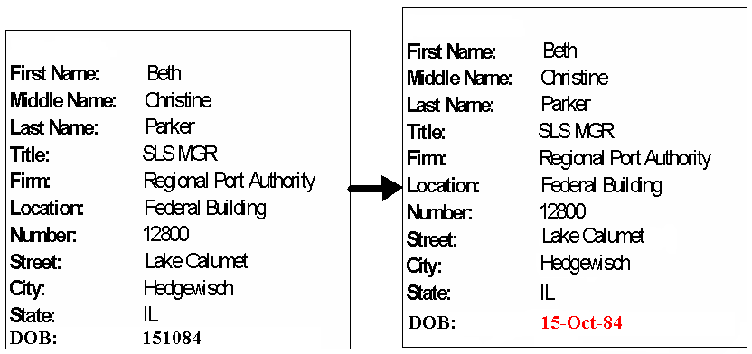
Data Transformation
Conditioning

Slide 54
Data Transformation
Enrichment
Adding/combining external data values, rules to enrich the information already existing in the data
E.g. If we can get a list that provides a relationship between Zip Code, City and State, then if a address field has Zip code 06905 it be safely assumed and address can be enriched by doing a lookup on this table to get Zip Code 06905 –> City Stamford –> State CT

Slide 55
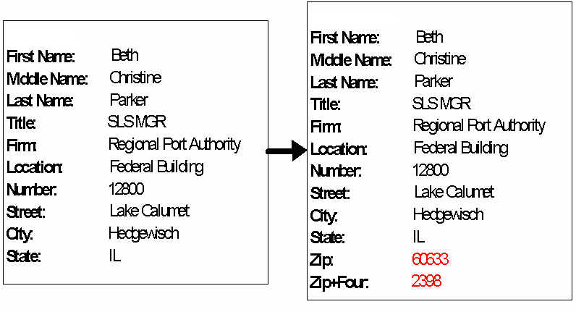
Data Transformation
Enrichment

Slide 56
Data Loading
Data are physically moved to the data warehouse
The loading takes place within a “load window”
Loading the Extracted and Transformed data into the Staging Area or Data Warehouse.

Slide 57
Data Loading
First time bulk load to get the historical data into the Data Warehouse
Periodic Incremental loads to bring in modified data
Design load strategy to using appropriate Slowly Changing Dimension type .
The Loading window should be as small as possible
Should be clubbed with strong Error Management process to capture the failures or rejections in the Loading process

Slide 58
Slowly Changing Dimension Types
Three types of slowly changing dimensions
Type 1
Updates existing record with modifications
Does not maintain history
Type 2
Adds new record
Maintain history
Maintains old record
Type 3:
Keep old and new values in the existing row
Requires a design change

Slide 59
Meta Data
Data about data
Needed by both information technology personnel and users
IT personnel need to know data sources and targets; database, table and column names; refresh schedules; data usage measures; etc.
Users need to know entity/attribute definitions; reports/query tools available; report distribution information; help desk contact information, etc.

Slide 60
Meta Data
Metadata is more comprehensive and transcends the data.
Metadata provide the format and name of data items
It actually provides the context in which the data element exists.
provides information such as the domain of possible values;
the relation that data element has to others;
the data's business rules,
and even the origin of the data.

Slide 61
Importance of Metadata
Metadata establish the context of the Warehouse data
Metadata facilitate the Analysis Process
Metadata are a form of Audit Trail for Data Transformation
Metadata Improve or Maintain Data Quality

Slide 62
Feature of ETL Tools
Support data extraction, cleansing, aggregation, reorganization, transformation, and load operations
Generate and maintain centralized metadata
Filter data, convert codes, calculate derived values, map source data fields to target data fields
Automatic generation of ETL programs
Closely integrated with RDBMS
High speed loading of target data warehouses using Engine-driven ETL Tools

Slide 63
Advantages of using ETL Tools
GUI based design of jobs – ease of development and maintenance
Generation of directly executable code
Engine driven technology is fast, efficient and multithreaded
In-memory data streaming for high-speed data processing
Products are easy to learn and require less training

Slide 64
Advantages of using ETL Tools
Automatic generation and maintenance of open, extensible metadata
Support for multiple data formats and platforms
Large number of vendor supplied data transformation objects

Slide 65
Example of ETL requirements
Integration of masters across different systems
E.g. State code AP could mean Andhra Pradesh in one system while it could mean Arunachal Pradesh in another
De-duplication of data from different systems
E.g. State Karnataka could be represented as KA in one system and KN in another system
Mapping of old codes to Data Warehouse codes
Data Cleansing - Changing to upper case, assigning defaults to unavailable data elements

Slide 66
Summary
In this module, you learned about the following:
ETL process
Cleansing steps

Slide 67
Lesson 3: Operational Considerations

Slide 68
Lesson Objectives
On completion of this lesson on ETL basics, you will be able to understand:
Handling Exceptions in ETL
Notifications and Alerts in ETL
Recovery and Restartability

Slide 69
ETL Testing Considerations
UNIT Testing (ensures that each component within the system successfully performs its individual responsibility when executed individually. )
Checking extraction rules
Transformation validation
Target system data integrity
Checking input data validation
Test the error-handling logic
Test slowly changing dimension implementation by checking the integrity of surrogate keys

Slide 70
ETL Testing Considerations
Test Notifications/Warnings/Error messages
Integration Testing (ensure seamless run of the entire process within an application, or a specific stage with an eye on the details of each of the steps/modules, capturing the responses as the data moves across the system.

Slide 71
ETL Testing Considerations (contd..)
Successful extraction of data
Order of Extraction
Application and validation of transformation logic
Order of precedence in which various algorithms are applied (phasing of ETL streams)
Rejects based on applied algorithms
Recovery and Restart

Slide 72
ETL Testing Considerations (contd..)
Proper generation of the code
Proper generation of surrogated keys in conjunction with processing the order of precedence
Error handling
Scheduling
Job triggers
Job dependencies
Alerts and notification

Slide 73
ETL Testing Considerations (contd..)
Integration Testing (Cont/-)
Warnings and check point validations
Data Auditing/Logs
Metadata recording/deliver to internal/external repositories
Perform delivery of the data, including format and layout
Bulk load performance Checking extraction rules
Transformation validation

Slide 74
ETL Testing Considerations (contd..)
User Acceptance Testing (This testing should be for specific BI functions, including data transformation rules, and data correctness )
Information Accuracy
Source Data Rejections
Data Transformation/Aggregation Rules
Key performance metrics/reports

Slide 75
Exception Handling
Exception Handling deals with any abnormal termination, unacceptable event or incorrect data that can impact the data flow or accuracy of data in the warehouse/mart.
Exceptions in ETL could be classified as Data Related Exceptions and Infrastructure Related Exceptions.
The process of recovering or gracefully exiting when an exception occurs is called exception handling.
Data related exceptions are caused because of incorrect data format, incorrect value, incomplete data from the source system. This leads to Data validation exceptions and Data Rejects.
The process of handling the Data Rejects is called Data Reprocessing.

Slide 76
Exception Handling
Infrastructure related exceptions are caused because of issues in the Network , the Database and the Operating System.
Common Infrastructure exceptions are FTP failure, Database connectivity failure, File system full etc.
The data related exceptions are usually documented in the requirements, if not they must be because if the data related exceptions are not handled they lead to inaccurate data in the warehouse/mart.
We also keep a threshold of maximum number of validation or reject failures allowed per load.
Any value above the threshold would mean the data would be too inaccurate due to too many rejections.

Slide 77
Exception Handling
There is one more exception which is the presence of inaccurate or incorrect data in the warehouse. This could happen due to
Incorrect requirement or missed, leading to incorrect ETL.
Incorrect interpretation of requirements leading to incorrect ETL.
Uncaught coding defects.
Incorrect data from source.
The process of Correction of the data already loaded in the warehouse involves fixing the data already loaded and also preventing the inaccuracy to persist in the future.

Slide 78
Notification
Methods of Notification
Email
Pager
Front-End
Phases of Notification
Extraction – Start /End
Transformation – Start / End
Load – Start / End
Error Messages
Aborts

Slide 79
Notification
Whom to Notify
System Administrator,
Business Users

Slide 80
Recovery & Restartability
Design of Rollback and Recovery Procedures
Rollback and Recovery Procedures define the strategy for handling load failures.
This includes recommendations on whether milestone points and staging are required for restarts.
The concept of rollback and recovery of ETL processes needs to be considered during the preliminary design stage as it affects all ETL jobs.
For long ETL processing blocks such as a data warehouse load the end to end process may take hours or even days to run.
It is important to have built in restartability to recover from fatal errors during the processing cycle.

Slide 81
Recovery & Restartability
Milestone Recovery
The simplest form of recovery is to introduce vertical bands into the ETL processing cycle.
A vertical band is a set of jobs that run together and when complete they arrive at a milestone point.
If the following block of jobs fail it can be restarted from this milestone.
A milestone point requires some type of data staging, with the data being placed in temporary files or tables where they can be extracted by the next block.

Slide 82
Recovery & Restartability
The best practice for complex data loads is to have 3 vertical bands: Data Sourcing, Data Mediation & Quality/Transformation and Data Load.
Data Sourcing involves retrieving the data from sources and delivering it to files or tables with some type of time stamping to allow for time based processing.
This data undergoes as little transformation as possible and once delivered it is stable.
This milestone point means the Data Transformation block can be started and restarted without having the source data affected by user transactions.

Slide 83
Recovery & Restartability
Data Mediation & Quality/Transformation covers a large area of data conversion, cleansing, enrichment, aggregation, etc.
This step benefits from having ETL patterns that describe common transformations as shown in the sections below.

Slide 84
Recovery & Restartability
Data Load involves delivering the final data to the target database.
This band holds as little of the transformation logic as possible.
It is focused on achieving a robust database update by controlling transaction sizing and trapping database rejects.
Database updates are the most volatile part of the process due to the complexity of RDBMS communications and the difficulty most ETL engines have with correctly rolling back and restarting a failed update.

Slide 85
Recovery & Restartability
Individual Job Recovery
In many instances it is possible to recover from a fatal error by restarting the job that failed and continuing the ETL cycle from that point.
Many ETL and scheduling tools provide the functionality to automate this process.
It may be necessary for production support to first investigate the problem and fix it before the automated recovery begins.
This is a short cut to restarting from previous milestone points.

Slide 86
Recovery & Restartability
Individual Job Recovery
It is usually easy to do job recovery on the Sourcing and Transformation bands as these typically stage the data to temporary files or tables.
Restarting an individual job recreates the target output of these jobs without rollback problems.
In these cases the ETL scheduling tool can be used to restart the sequence from the correct point.

Slide 87
Recovery & Restartability
Individual Job Recovery
The Data Load band is the most difficult for rollback and recovery as a job may fail in the process of updating a database.
If the update is an insert, or an update to an aggregated table then it is difficult to determine how many rows of stage data have already been processed.
A simple job restart may result in duplicate rows or duplicate increases to aggregate results.
For a Data Load job it may be possible to restart the job or it may be necessary to build full table rollback into a job restart.
It is worth considering enhancing the design to assist with rollback – for example, a batch number could be added to transaction tables to facilitate deletion of partial or erroneous insertions.

Slide 88
ETL Job Scheduling
ETL Job Scheduling is an operational process which is required to determine the sequence and time of execution of the various data flows (Jobs/Mappings).
ETL schedule is dependent on the following
Load Order
Order in which target data will be populated.
External Dependencies like
Timeframe of the source data availability.
Warehouse/Mart database Maintenance, like database backup time.
Operating System Maintenance, like file system backup time.
ETL's inter process flow dependencies like conformed dimensions ETL before the subject area specific dimension ETL, Dimension table ETL before the Fact Table ETL etc.

Slide 89
ETL Job Scheduling
Load Window
Time frame in which target should be populated.
Scheduling Tools
Scheduling the workflow / ETL jobs
Job Triggering
Event based / Time based

Slide 90
ETL Job Monitoring
Monitoring in ETL System
ETL monitoring takes many aspects of the process into consideration.
Resources outside the scope of the ETL system such as hardware and infrastructure administration and usage, as well as the source and target environments, play crucial parts in the overall efficiency of the ETL system.

Slide 91
ETL Job Monitoring
Measuring ETL Specific Performance Indicators
Duration in seconds.
Rows processed per second.
Rows read per second.
Rows written per second.
Throughput.

Slide 92
Summary
In this module, you learned about the following:
Exception handling
Alerts and Notifications
Process restart-ability
Job scheduling and Monitoring

Slide 93
Lesson Objectives
On completion of this lesson on ETL basics, you will be able to understand:
Consideration of ETL tool
Different ETL tools

Slide 94
The ETL Process
Extract
Extract relevant data
Transform
Transform data to DW format
Build keys, etc.
Cleansing of data
Load
Load data into DW
Build aggregates, etc

Slide 95
Criteria for tool identification
Criteria for Identifying Tools
The Source System Platform and Database.
Tools cannot access all types of data source on all types of Computing platforms
Data Size
Tools need to handle desired volume and type of data. E.g. Structured and unstructured data.
Functionality required
Tools have build in functionalities
Cost of the tool

Slide 96
SAMPLE Extraction Tools
Extraction Tools include
Apertus Carleton. Passport
Evolutionary Technologies. ETL Extract.
Platinum. InfoPump

Slide 97
Sample ETL Tools
Teradata Warehouse Builder from Teradata
DataStage from IBM
SAS System from SAS Institute
Power Mart / Power Center from Informatica
Sagent Solution from Sagent Software
Hummingbird Genio Suite from Hummingbird Communication
Abinitio
Oracle Warehouse Builder
Talend
Pentaho

Slide 98
Sample Scheduling Tools
AutoSys
Control-M
Flux
IBM Workload Scheduler ( TWS)

Slide 99
Sample Reporting Tools
SAP- Business Object
IBM- Cognos
Microsoft SQL Server Reporting Services -SSRS
Microstrategy
Oracle Business Intelligence Enterprise Edition

Slide 100
Summary
In this module, you learned about the following:
Consideration for selecting ETL tool
Different ETL tools

