Slide 1
NATURAL LANGUAGE PROCESSING · UNIT 2
Representing & Parsing
Syntactic Structure
Dependency graphs, phrase structure trees, and the algorithms that build them
Dependency Trees · Phrase Structure · spaCy · Shift-Reduce · CYK / CNF

Slide 2


What is Pars ing?
Definition
Parsing analyzes the grammatical structure of a sentence to figure out how words relate to each other. It identifies subjects, verbs, objects, and their connections.
Example
In "The boy eats an apple," parsing
identifies:
Grammar Rules
Parsing enforces grammar rules. "The school goes to boy" fails parsing because it doesn't follow correct grammatical structure.
Subject (Noun Phrase): "The boy"
Predicate (Verb Phrase): "eats an
apple"

Slide 3
Why Do We Parse?
Understanding Meaning
Foundation for NLP Tasks
"Ali eats an apple" ≠ "An apple eats Ali"
Text-to-Speech: For correct intonation (e.g., "The cat lives" as verb vs. "The cat has nine lives" as noun)
Summarization: Identifying important parts of sentences
Question Answering: Finding relevant answer phrases
Same words, different structure creates entirely different meanings.
Parsing helps computers understand these differences.
Parsing provides the structural understanding that makes these applications possible.
Notes:
Example: “The operations of the three products vary widely.” Summary: “The operations of the products vary.”

Slide 4
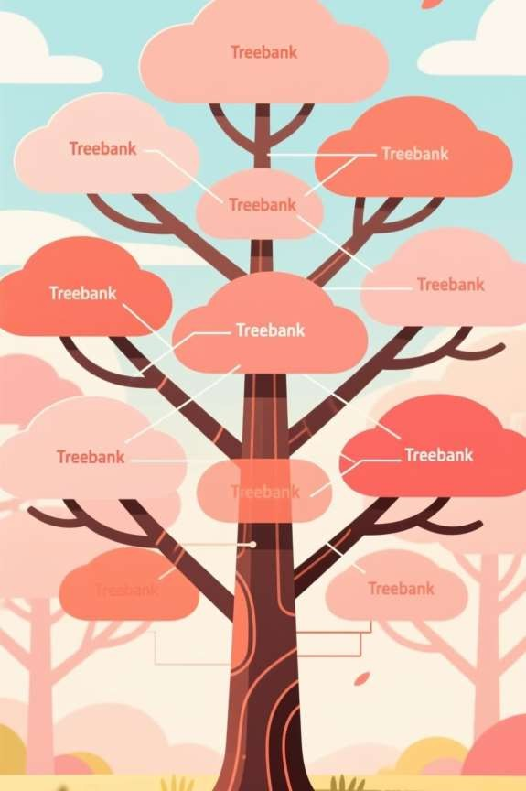
Treebanks: Teaching Machines Grammar
What is a Treebank?
A dataset where each sentence is annotated with its syntactic structure (parse tree). Think of it as a grammar textbook for machines, with examples of correct sentence structures.
Annotation Example
"The boy eats an apple" becomes:
The → Determiner (DT)
boy → Noun (NN), subject of eats
eats → Verb (VBZ), root
an → Determiner (DT)
apple → Noun (NN), object of
eats
Why Treebanks Matter
Writing all grammar rules is too complex. Treebanks help computers learn grammar automatically from data. They resolve ambiguity and help parsers predict the most likely structure for new sentences.

Slide 5
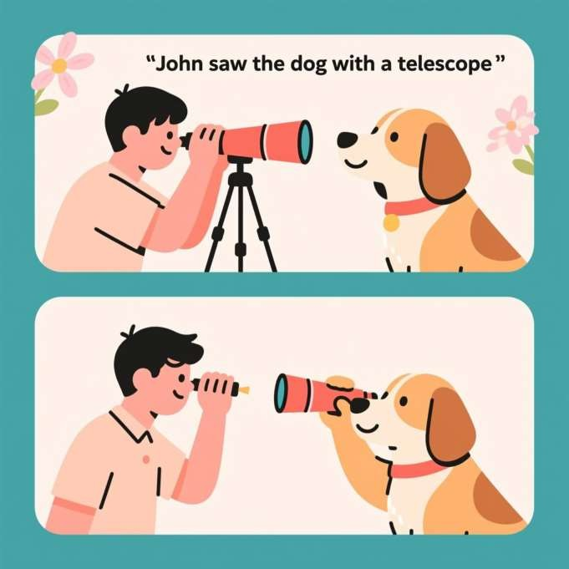
Ambiguity in Parsing
The Challenge
Many sentences have multiple possible interpretations. Consider:
"John saw the dog with a telescope." This has two possible interpretations:
John used a telescope to see the dog.
The dog had a telescope with it.
Treebanks help machines decide the most probable meaning based on patterns learned from human-annotated examples.

Slide 6
Representing Syntactic Structure

Slide 7
Dependency Graphs
Every word depends on another word — one head, the rest dependents
Core idea
“The boy eats an apple.”
The sentence forms a graph: arrows show who depends on whom.
eats
One word is the head; the others are dependents of it.
nsubj
dobj
Focus: word-to-word relationships — who does what?
boy
apple
det
det
Head of this sentence: “eats”
the
an
boy → subject, depends on eats
apple → object, depends on eats
the → determiner, depends on boy
an → determiner, depends on apple
Useful for free word-order languages, such as Hindi or Czech.
Prototype Implementation Report · NLP Unit 2

Slide 8
Phrase Structure Trees
Sentences build up from phrases — groups of words that act as one unit
“The boy eats an apple.”
Core idea
S
Groups of words form constituents: NP, VP, and so on.
The tree shows a hierarchy of phrases, not just word pairs.
NP
VP
Focus: how words combine into chunks.
DT
N
V
NP
Useful for fixed word-order languages, such as English.
The
boy
eats
an apple
Contrast with dependency graphs: same sentence, different representation of the same underlying relationships.
Nested brackets: [S [NP The boy] [VP eats [NP an apple]]]
Prototype Implementation Report · NLP Unit 2

Slide 9
Choosing a Representation
Both describe the same sentence — they emphasize different things
 | Dependency Tree | Phrase Structure Tree
Shows | Relations between words | Grouping into phrases
Notation | Arrows: head → dependent | Nested brackets (NP, VP, …)
Fits best | Free word-order languages (Hindi, Czech) | Fixed word-order languages (English)
Dependency Tree = a family tree
Phrase Tree = a company org chart
KEY TAKEAWAY
Dependency = word relations. Phrase structure = word groups. Both help computers understand grammar.
Who depends on whom.
Groups and departments.
ACTIVITY
“The dog chased the cat.” — draw a dependency tree (chased is root) and a phrase structure tree (NP + VP).
Prototype Implementation Report · NLP Unit 2

Slide 10
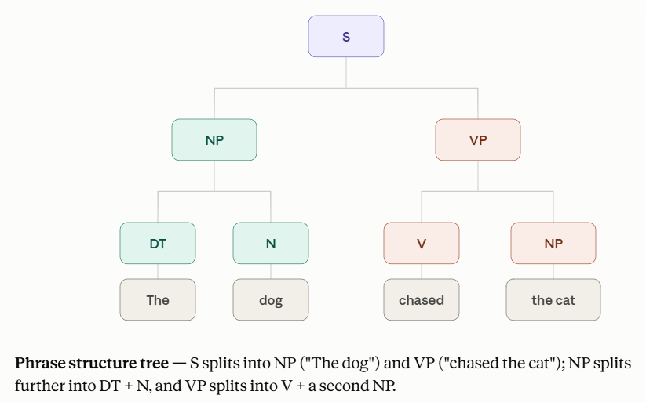
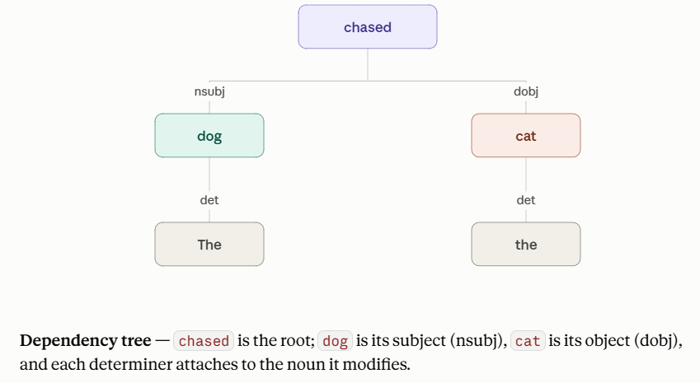

Slide 11
Practical Example — spaCy Code, Line by Line
A pre-trained pipeline assigns each token its head and grammatical relation
PYTHON
What each line does
import spacy
nlp = spacy.load("en_core_web_sm")
doc = nlp("The cat chased the mouse")
for token in doc:
print(token.text, "->", token.dep_,
"->", token.head.text)
import spacy
Imports the spaCy library (a popular NLP tool).
nlp = spacy.load("en_core_web_sm")
Loads a pre-trained English model; it knows POS tagging, dependency parsing, NER, and more.
OUTPUT
The -> det -> cat
cat -> nsubj -> chased
chased -> ROOT -> chased
the -> det -> mouse
mouse -> dobj -> chased
doc = nlp("...")
Runs the model on the sentence. doc holds tokens plus their linguistic annotations.
This shows: “cat” = subject · “chased” = root verb · “mouse” = object
for token in doc: ...
Iterates through each token. token.text = the word; token.dep_ = its relation; token.head.text = the word it attaches to.
Prototype Implementation Report · NLP Unit 2
Notes:
Breakdown of the Nameen: Language (English).core: Capabilities (includes vocabulary, syntax, entities, and vectors).web: Genre (trained on blogs, news, and online articles).
sm: Size (Small; does not include real word vectors, only context tensors).Other Available SizesYou can swap sm in the name to load larger, more accurate models:en_core_web_md: Medium size (includes real word vectors).
en_core_web_lg: Large size (more accurate, larger vocabulary).
en_core_web_trf: Transformer-based (highest accuracy, requires GPU, very slow on CPU).

Slide 12
Reading the Output — Explanation of Each Line
Sentence: “The cat chased the mouse”
The → det → cat
"The" is a determiner (det) of "cat" — it modifies "cat".
cat → nsubj → chased
"cat" is the nominal subject (nsubj) of "chased" — the one doing the action.
chased → ROOT → chased
"chased" is the main verb / root of the sentence. Every dependency tree has a single root.
the → det → mouse
"the" is a determiner (det) of "mouse" — it modifies "mouse".
mouse → dobj → chased
"mouse" is the direct object (dobj) of "chased" — the action is applied to it.
Prototype Implementation Report · NLP Unit 2

Slide 13
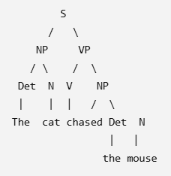
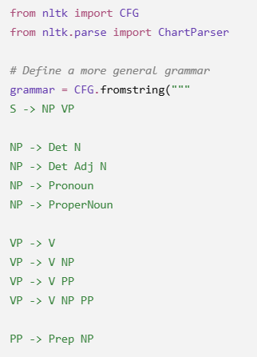
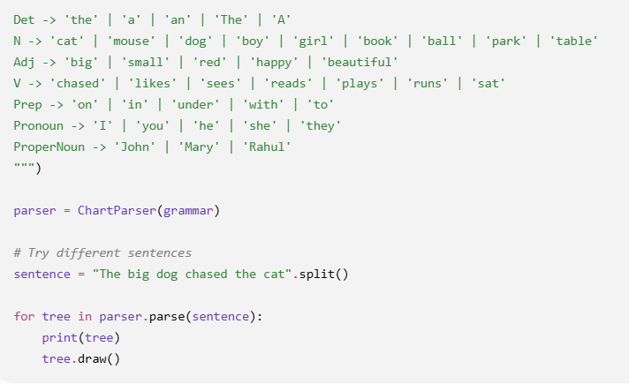
Practical Example —Parse Structure Tree Using NLTK
Notes:
The big dog chased the cat

Slide 16
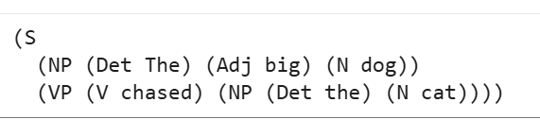
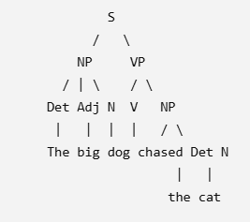
The big dog chased the cat

Slide 17
Parsing Algorithms — Four Strategies
Different ways to build the syntax tree from a sentence
01
02
03
04
Top-Down
Bottom-Up
Shift-Reduce
CYK Algorithm--(Cocke-Younger-Kasami Algorithm)
Start from the Sentence (S) symbol and expand into smaller constituents until the words match.
Start from the individual words and combine them upward until they form a complete sentence.
Move words from an input buffer onto a stack, reducing groups into phrases as grammar rules match. Popular in dependency parsing.
Dynamic-programming approach that fills a triangular table of possible constituents; requires Chomsky Normal Form.
Shift-Reduce and CYK are covered in depth on the following slides.
Prototype Implementation Report · NLP Unit 2

Slide 18
Shift-Reduce Parsing
A stack-and-buffer game: shift words in, reduce them into phrases
Trace
Two moves
Step | Action | Stack
1 | shift The | [The]
2 | shift boy | [The, boy]
3 | reduce Det+N → NP | [NP]
4 | shift eats | [NP, eats]
5 | shift an, shift apple | [NP, eats, an, apple]
6 | reduce Det+N → NP | [NP, eats, NP]
7 | reduce V+NP → VP | [NP, VP]
8 | reduce NP+VP → S | [S]
Shift
Move the next word from the input buffer onto the stack.
Reduce
If the top of the stack matches a grammar rule, replace it with the non-terminal — e.g. NP → Det + N.
✓ Efficient and widely used
✗ Can struggle with ambiguity
Sentence: “The boy eats an apple”
Grammar: S→NP VP · NP→DT N · VP→V NP
Prototype Implementation Report · NLP Unit 2

Slide 19
Shift-Reduce Parsing in Code (NLTK)
The same trace, automated by NLTK's ShiftReduceParser
PYTHON
Output tree
import nltk
from nltk.parse import ShiftReduceParser
grammar = nltk.CFG.fromstring("""
S -> NP VP
NP -> DT N
VP -> V NP
DT -> 'the' | 'an'
N -> 'boy' | 'apple'
V -> 'eats'
""")
sr_parser = ShiftReduceParser(grammar)
sentence = ['the', 'boy', 'eats', 'an', 'apple']
for tree in sr_parser.parse(sentence):
print(tree)
tree.pretty_print()
S
├─ NP
│ ├─ DT → the
│ └─ N → boy
└─ VP
├─ V → eats
└─ NP
├─ DT → an
└─ N → apple
Same grammar, same sentence as the manual trace — the parser automates every shift and reduce step.
Prototype Implementation Report · NLP Unit 2

Slide 20
Context-Free Grammar & Chomsky Normal Form
CYK parsing requires the grammar to be rewritten in a restricted binary form
Two allowed CNF forms
What is a CFG?
Fixing a non-CNF rule
A set of rewrite rules A → α, where A is a non-terminal (S, NP, VP…) and α is a sequence of terminals or non-terminals.
A → B C
Original (invalid):
exactly two non-terminals · e.g. VP → V NP
NP → DT Adj N
3 symbols on the right — not binary
A → a
S → NP VP
NP → DT N
VP → V NP
DT → 'the' | 'an'
N → 'boy' | 'apple'
V → 'eats'
exactly one terminal word · e.g. N → 'boy'
Converted (CNF):
NP → DT Y
Y → Adj N
Not allowed in CNF:
A → B C D (3+ symbols)
A → a B (mixed terminal/non-terminal)
A → ε (empty production)
A new intermediate symbol (Y) absorbs the extra element, restoring binary rules.
Already in CNF — every rule is binary (A→BC) or terminal (A→a).
Full worked example — checking every rule of a non-CNF grammar — is on the next slide.
Writing every grammar rule by hand does not scale — one reason data-driven, treebank-trained parsers are preferred in practice.
Why CNF helps CYK: rules restricted to binary (A→BC) or terminal (A→a) form let the algorithm systematically fill a triangular table.
Prototype Implementation Report · NLP Unit 2

Slide 21
Checking a Grammar Against CNF
Sentence: “The boy eats the apple” — written with a richer, non-CNF grammar
Check rules one by one
GRAMMAR (NOT CNF)
S → NP VP
NP → DT Adj N
VP → V NP PP
PP → P NP
DT → 'the'
Adj → 'big' | 'small'
N → 'boy' | 'apple'
V → 'eats'
P → 'with'
Rule | Form | CNF?
S → NP VP | A → BC | OK
VP → V NP PP | A → BCD | FAIL
NP → DT Adj N | A → BCD | FAIL
PP → P NP | A → BC | OK
DT → 'the' | A → a | OK
Adj → 'big' | 'small' | A → a | OK
N → 'boy' | 'apple' | A → a | OK
V → 'eats' | A → a | OK
P → 'with' | A → a | OK
Two rules break the binary requirement — both have three symbols on the right-hand side.
Fix: VP → V X (X → NP PP) · NP → DT Y (Y → Adj N) — new symbols absorb the extra elements.
Prototype Implementation Report · NLP Unit 2

Slide 22
CYK Parsing — Filling the Table
A triangular dynamic-programming table: each cell holds the non-terminals that can generate that span
Grammar (CNF): S→NP VP · NP→DT N · VP→V NP|V · DT→'the' · N→'boy' · V→'eats'
Sentence: w1 = the w2 = boy w3 = eats
Row 1 — single words
Final CYK table
(1,1)={DT} (1,2)={N} (1,3)={V, VP}
(3,1)
{S}
Row 2 — two-word spans
(2,1)
{NP}
(2,2)
∅
(2,1) “the boy” = DT+N → {NP}
(2,2) “boy eats” = N+V → ∅ (no rule)
(1,1)
{DT}
(1,2)
{N}
(1,3)
{V,VP}
Row 3 — full sentence
(3,1) “the boy eats” = NP+VP → {S} ✓
{S} in the top cell spans the whole sentence — the parse succeeds.
Prototype Implementation Report · NLP Unit 2

Slide 23
CYK / Chart Parsing in Code (NLTK)
Sentence: “The boy eats an apple” — NLTK's ChartParser performs CYK-style chart parsing
PYTHON
Output tree
import nltk
from nltk import CFG, ChartParser
# Grammar in CNF form
grammar = CFG.fromstring("""
S -> NP VP
NP -> DT N
VP -> V NP
DT -> 'the' | 'an'
N -> 'boy' | 'apple'
V -> 'eats'
""")
parser = ChartParser(grammar)
sentence = ['the', 'boy', 'eats', 'an', 'apple']
for tree in parser.parse(sentence):
print(tree)
tree.pretty_print()
S
├─ NP
│ ├─ DT → the
│ └─ N → boy
└─ VP
├─ V → eats
└─ NP
├─ DT → an
└─ N → apple
Identical tree to the Shift-Reduce demo — different algorithm, same correct structure for this grammar.
Prototype Implementation Report · NLP Unit 2

Slide 24
YOUR TURN
Parse it yourself
“The dog chased the cat.”
1
Shift-Reduce method
2
CYK method
Trace the stack and buffer through each shift and reduce step until the sentence reduces to [S].
Convert the grammar to CNF if needed, then fill the triangular table span by span until the top cell holds {S}.
Both methods should arrive at the same underlying structure — chased as the root, with the dog and the cat as its dependents.

Slide 25
Quick Reference — Full Glossary
Every short form used across dependency parsing, constituency parsing, CYK, and related NLP tooling
NLP
V
NER
Natural Language Processing — AI field for language understanding
Verb — action word
Named Entity Recognition — identifies names, places, dates
S
ROOT
CRF
Sentence — root node in constituency parsing
Root of the sentence — main verb, center of the dependency tree
Conditional Random Field — discriminative sequence model
NP
nsubj
HMM
Noun Phrase — e.g. “the cat”
Nominal Subject — who performs the action
Hidden Markov Model — generative sequence model
VP
dobj
SVM
Verb Phrase — e.g. “chased the mouse”
Direct Object — the target of the action
Support Vector Machine — classification model
PP
dep
spaCy
Prepositional Phrase — e.g. “on the mat”
General term for a grammatical link
Python NLP library for parsing, tagging, NER
Det / DT
POS
NLTK
Determiner — a, an, the
Part-of-Speech — noun, verb, adjective…
Natural Language Toolkit — Python NLP library
N
CYK
Penn Treebank
Noun — person, place, or thing
Cocke–Younger–Kasami parsing algorithm
Landmark dataset of parsed sentences for training parsers
Prototype Implementation Report · NLP Unit 2

