Slide 1


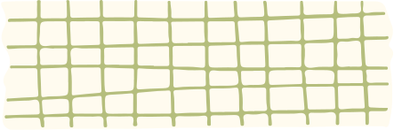
SHADAN WOMEN'S COLLEGE OF ENGINEERING AND TECHNOLOGY
[ An Autonomous Institution Affiliated to JNTUH]
THETA (Θ) NOTATION
Name : Amath ur Rasheed U.A
Ht.no. : 24L51A0508
Class : B.tech 3rd Year 1st Semester
Subject : Design and analysis of algorithms
Department : CSE-A

Slide 2



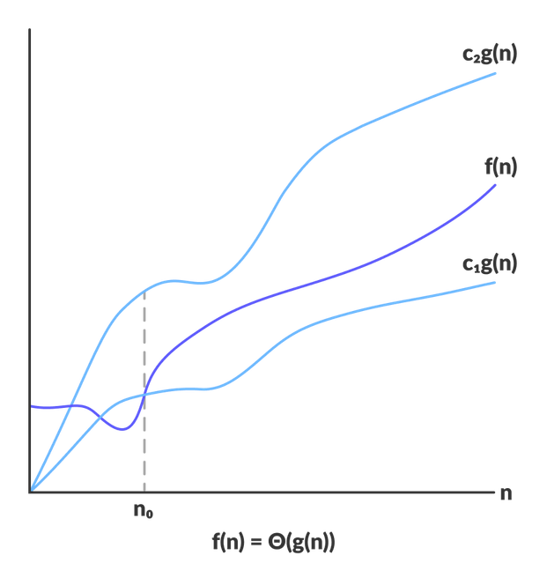
INTRODUCTION
Asymptotic Analysis :It is a technique used to study the performance of an algorithm based on input size (n), independent of specific computer hardware, programming languages, or compiler optimizations.
​The Role of Theta Notation: It represents the tight asymptotic bound of an algorithm.
​ Unlike bounds that only look at a ceiling or a floor, Theta notation bounds an algorithm's running time from both above and below by the same function (up to constant factors). This provides a precise and complete description of how resource usage scales as data grows.

Slide 3
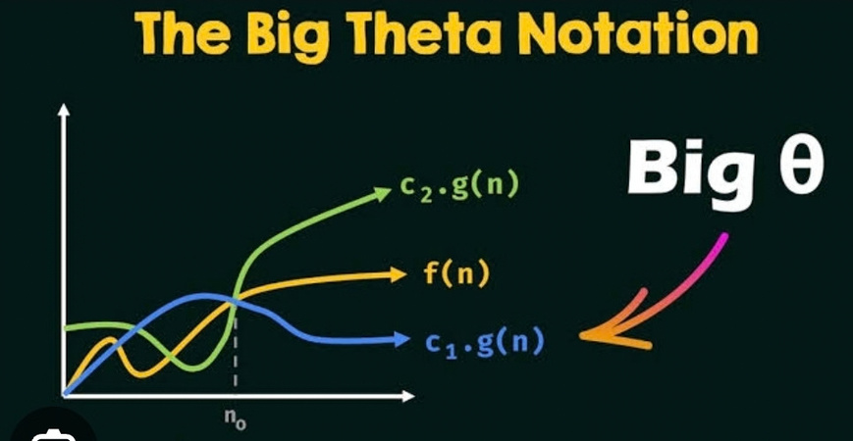
DESIGN
1.
Role in Algorithm Design: During the design phase, engineers use asymptotic notations to predict scalability before writing code.
2.
Focusing on Dominant Growth: Design choices focus on the fastest-growing term because lower-order terms and constant coefficients become negligible for large inputs.
3.
Predictability: Knowing that an algorithm's design yields a specific tight bound helps developers guarantee performance guarantees across varying enterprise scales.

Slide 4



ALGORITHM
Algorithm analysis using Theta notation evaluates how execution steps
scale across typical loop structures:
  Single Loop :
  Double Loop :
  Triple Loop :
for(i = 1; i <= n; i++) {
print(i);
}
▪︎Executes n times
▪︎Time Complexity: Θ(n)
for(i = 1; i <= n; i++){
for(j = 1; j <= n; j++) {
print(i, j);
}}
▪︎Executes n × n time
▪︎Time Complexity: Θ(n2)
for (int i = 1; i <= n; i++) {
for (int j = 1; j <= n; j++) {
for (int k = 1; k <= n; k++) {
print(i, j, k);
}}}
▪︎Executes n × n × n times
▪︎Time Complexity: Θ(n3)

Slide 5

EXAMPLE
Step-by-Step Derivation: Consider the running time function T(n) = 4n2 + 3n + 10.
  Identify terms: 4n2, 3n, and 10.
  Find the highest-order term: n2 grows the fastest.
  Ignore constant coefficients: Drop the factor 4.
  Ignore lower-order terms: Drop 3n and 10.
  Final Result: T(n) = Θ(n2)

Slide 6
APPLICATIONS
▪︎Algorithm Comparison: Provides a standardized metric to determine which of two algorithms performs more efficiently for large datasets.
▪︎Complexity Reduction: Simplifies complex, multi-variable running-time expressions down to their clean, dominant growth term.​
▪︎Software Engineering Decisions: Helps developers choose optimal data structures and sorting/searching algorithms during system architecture design.
▪︎Hardware Independence: Allows performance profiling to remain valid regardless of whether code runs on a vintage processor or a modern supercomputer.

Slide 7
CONCLUSION
Theta (Θ) Notation provides a tight asymptotic bound on an algorithm's running time.
Analyzing simple loops reveals clear growth patterns, such as a single loop taking Θ(n) time, nested loops taking Θ(n2) time, and triple nested loops taking Θ(n3) time.
These principles find wide applications in algorithm comparison, complexity reduction, and hardware-independent software engineering decisions.
Ultimately, it serves as an indispensable tool in computer science to capture the true asymptotic growth rate of computational processes and empower developers to architect scalable, high-performance systems.

Slide 8

THANK
You

