Slide 1
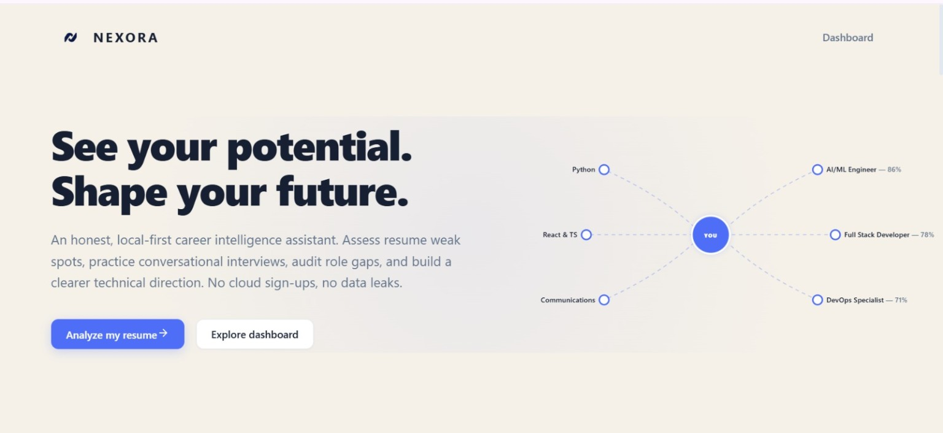
NEXORA
Nexora
AI-powered resume analysis and interview preparation
Turn a target role into clear resume improvements and focused interview practice.
CAREER ASSISTANT
Notes:
Sources: Nexora repository https://github.com/Umama2007/Nexora and user-supplied product screenshots. Cover uses the supplied landing-page screenshot.

Slide 2
02
The gap between applying and understanding
A job description changes the target. Most candidates still review their resume by instinct.
APPLICATION LOOP
01
Rejected without a clear reason
Candidates cannot see which resume sections weaken their fit.
Resume
What should change?
02
Manual comparison takes time
Job description
What matters most?
Every application requires another careful resume and role review.
Application
Why no shortlist?
03
Important keywords stay hidden
Skills may be present in the role but missing from the resume.
Interview
What should I practise?
04
Interview preparation starts too late
A better resume still does not reveal likely role-specific questions.
Notes:
Sources: Nexora repository https://github.com/Umama2007/Nexora and user-supplied product screenshots.

Slide 3
03
One guided path from resume to interview
Nexora connects job matching, resume feedback, improvement, and interview practice in one workflow.
1
3
5
2
4
Upload
Understand
Practise
PDF or DOCX resume
Target
See score, gaps, and strengths
Improve
Run a grounded mock interview
Add role and job description
Review edits and tailored bullets
The result is a practical next step, not a generic verdict.
Notes:
Sources: Nexora repository https://github.com/Umama2007/Nexora and user-supplied product screenshots.

Slide 4
04
What Nexora does
01
Resume analysis
02
Job match
Score breakdown, verdict, strengths, and focused improvements
Compares a selected resume with a pasted job description
03
Missing skills
04
Resume tailoring
Surfaces role-relevant keywords that the resume does not show
Suggests revised bullets and checks new claims against resume facts
05
Mock interview
06
Career roadmap
Technical, HR, and resume-based conversational practice
Builds a month-by-month plan around missing skills
Notes:
Sources: Nexora repository https://github.com/Umama2007/Nexora and user-supplied product screenshots.

Slide 5
05
User journey
1
2
3
4
5
INPUT
PARSE
ANALYZE
ACT
PRACTISE
Resume + target role
Extract document text
Compare evidence and role
Improve the application
Answer relevant questions
Structured output
Compatibility score, missing keywords, strengths, suggested edits, and interview context all trace back to the uploaded resume and target role.
Notes:
Sources: Nexora repository https://github.com/Umama2007/Nexora and user-supplied product screenshots.

Slide 6
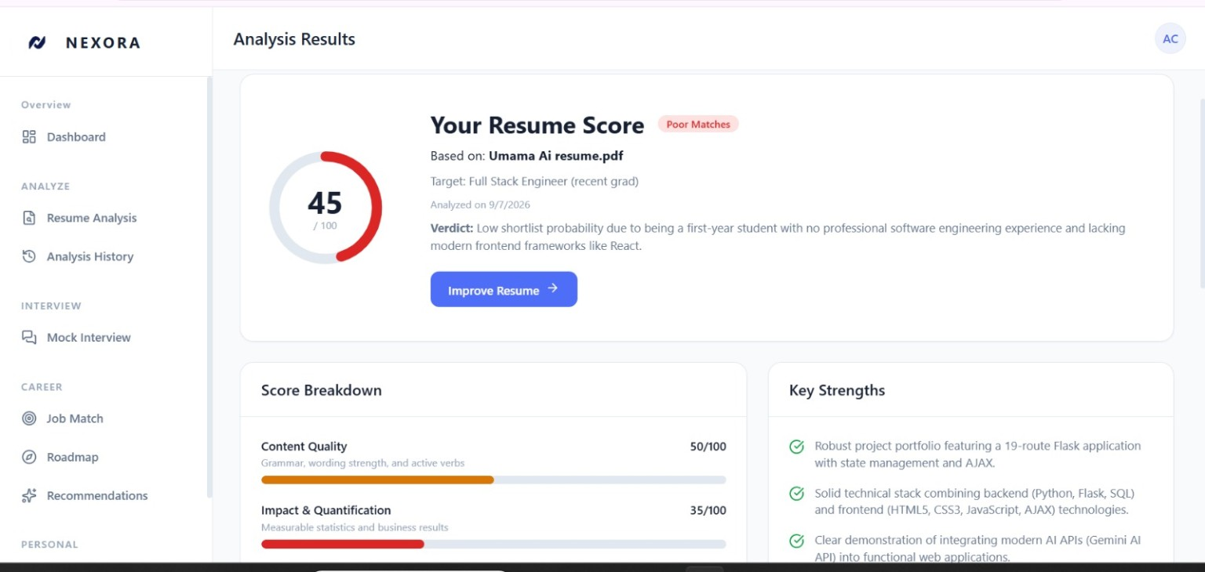
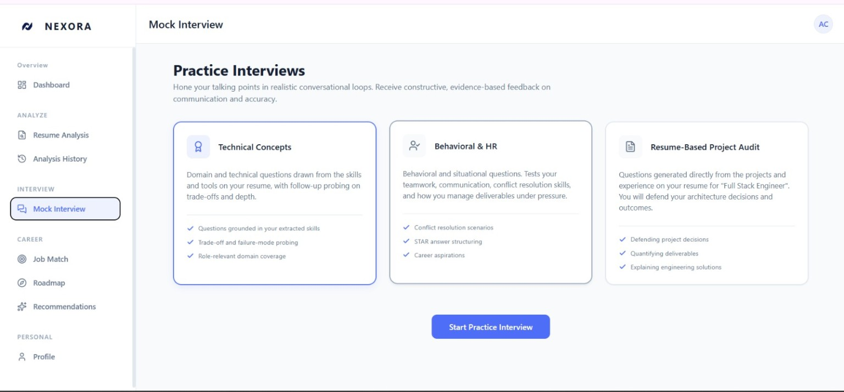
06
The product experience
RESUME REPORT
MOCK INTERVIEW
See the score, breakdown, verdict, strengths, and next edits.
Choose technical, behavioral, or resume-based practice.
Real screens from the current Nexora interface
Notes:
Sources: Nexora repository https://github.com/Umama2007/Nexora and user-supplied product screenshots. Screenshots show the analysis-results and mock-interview mode pages.

Slide 7
07
Technical architecture
USER
FRONTEND
FASTAPI API
PROCESSING
AI + STATE
Browser
React 19
Resume
PyMuPDF / python-docx
Ollama or Gemini
Resume
TypeScript
Job match
Local Truth Guard rules
SQLite persistence
Tailor
Job description
Vite + CSS Modules
Grounding checks
In-memory response cache
Interview
Interview RAG
Gemini or local embeddings
Roadmap
Cloud deployment path verified in the repository: Vercel frontend and Render-ready FastAPI backend.
Notes:
Sources: Nexora repository https://github.com/Umama2007/Nexora and user-supplied product screenshots. Architecture verified from README.md, backend/app/main.py, backend/app/core, frontend package and service files, Vite config, and Procfile.

Slide 8
08
AI and efficiency design
Resume analysis keeps deterministic work local and reserves one structured AI request for the combined evaluation.
LOCAL FIRST
ONE ANALYSIS CALL
Parse PDF or DOCX, extract known skills and projects with deterministic rules
A unified prompt requests score data, missing keywords, strengths, and up to three improvements
STRICT OUTPUT
CACHE HIT
The analyzer expects one JSON object with a defined schema and no extra text
Repeated identical inputs reuse a stored completed analysis without another AI call
Scope note
Provider failover and limited retries exist elsewhere in the shared Gemini client and embedding path.
Notes:
Sources: Nexora repository https://github.com/Umama2007/Nexora and user-supplied product screenshots. Single call and cache behavior verified by backend/app/api/resume.py, backend/app/main.py, and backend/app/test_upload_pipeline.py.

Slide 9
09
Where Nexora helps
The useful outcome is clearer preparation for a specific role.
STUDENTS
FRESH GRADUATES
JOB SEEKERS
CANDIDATES
Internship applications
Entry-level roles
Role-specific applications
Interview preparation
Find gaps before submitting
Turn projects into stronger evidence
Tailor the resume to each description
Practise questions grounded in their resume
Practical value: less guesswork and a clearer next action.
Notes:
Sources: Nexora repository https://github.com/Umama2007/Nexora and user-supplied product screenshots.

Slide 10
NEXORA
TRY NEXORA
Build stronger applications.
Prepare with clarity.
Live application
nexora-blue-rho.vercel.app
Nexora turns resume and role evidence into practical improvements, then carries that context into interview preparation.
GitHub repository
github.com/Umama2007/Nexora
THANK YOU
From uncertainty to a clear next step.
Notes:
Sources: Nexora repository https://github.com/Umama2007/Nexora and user-supplied product screenshots. Live app: https://nexora-blue-rho.vercel.app/ GitHub: https://github.com/Umama2007/Nexora

