Slide 1
Exploring AI and ML Trends Through Topic Modeling Project Presentation
Akshaya Rajarajan(Z1974671)
Srilakshmi UmamaheswariMantena (Z1976148)
Naga jyothi Kota(Z1976758)

Slide 2
Agenda
1. Introduction to Topic Modeling
2. Project Overview
3. Dataset Description
4. Data Preprocessing Steps
5. LSA, LDA, and BERT Implementation
6. Results
7. Why BERT
8. Insights
9. Future Work
10. References

Slide 3

Project Overview
Objective: Discovering the dominant themes and trends in the fields of Artificial Intelligence (AI) and Machine Learning (ML). Additionally, exploring into various techniques for topic modeling.
Methods: LSA, LDA, BERT
Dataset: The dataset typically contains metadata of physics, mathematics, computer science, quantitative biology, quantitative finance, statistics, electrical engineering and systems science, and economics.
Goal: Understand topics within the dataset

Slide 4

Introduction to Topic Modeling
Topic modeling is a type of statistical model for discovering abstract topics that occur in a collection of documents. It is a form of unsupervised learning, as it does not require any prior annotations or labeling of the documents.
It empowers us to extract hidden patterns, discover underlying themes, and gain valuable insights from unstructured information by identifying and categorizing topics within documents, it enhances our ability to navigate, understand, and utilize textual content efficiently.

Slide 5

Dataset Description
The dataset is sourced from arXiv, an open-access archive and distribution service for scholarly articles in various scientific fields.
Collected from Kaggle, json format.
We focused on:
Titles: Short descriptions of the articles’ content.
Authors: Names of the individuals who contributed to the articles.
Abstracts: Concise summaries of the articles, providing a snapshot of the research.
Date: Date when the articles were submitted to arXiv.

Slide 6

Preprocessing Steps
Overview of data cleaning and preparation steps.
Extracting the Date column
Lemmatization
Removing stopwords,punctuations

Slide 7
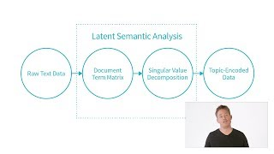
LSA Technique - Overview
Introduction to Latent Semantic Analysis and its application in the project.
LSA is a method that allows us to extract topics from documents by converting their text into word-topic and document-topic matrices
Overview:

Slide 8
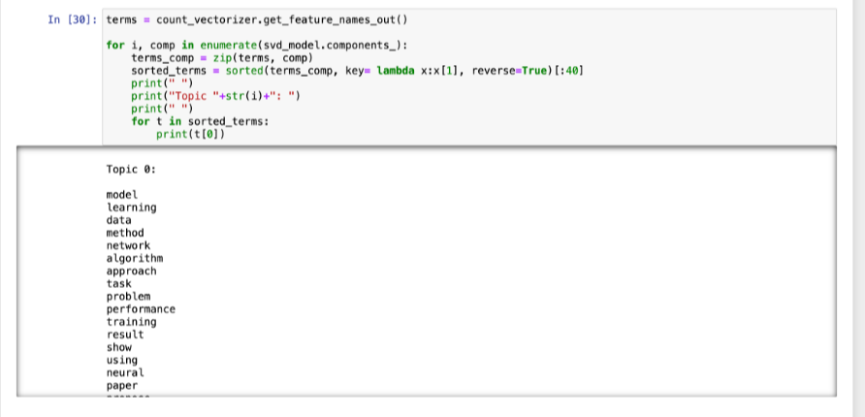
LSA - Results
Results and insights gained from the LSA model.

Slide 9
LDA Technique - Overview
Latent Dirichlet Allocation (LDA) is a topic modeling technique that helps us uncover the hidden themes or topics within a large collection of documents, such as academic articles.
A generative probabilistic model for topic modeling.

Slide 10
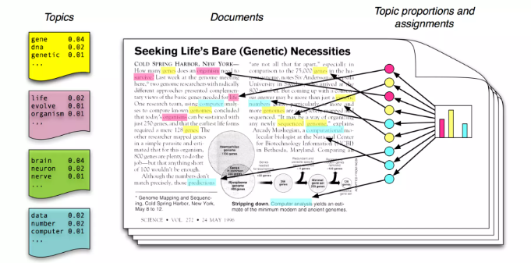
LDA Technique - Overview
The basic idea is:
Each document is a mixture of corpus of topics.
Each topic is a distribution over words.
Each word is drawn from one of those topics.

Slide 11
Methodology
Creates document topics matrix and topic – terms matrix
Document is represented by latent mixture of topics.
The probability of words in the document is calculated as:
p(w|d) = p(t|d)p(w|t)

Slide 12
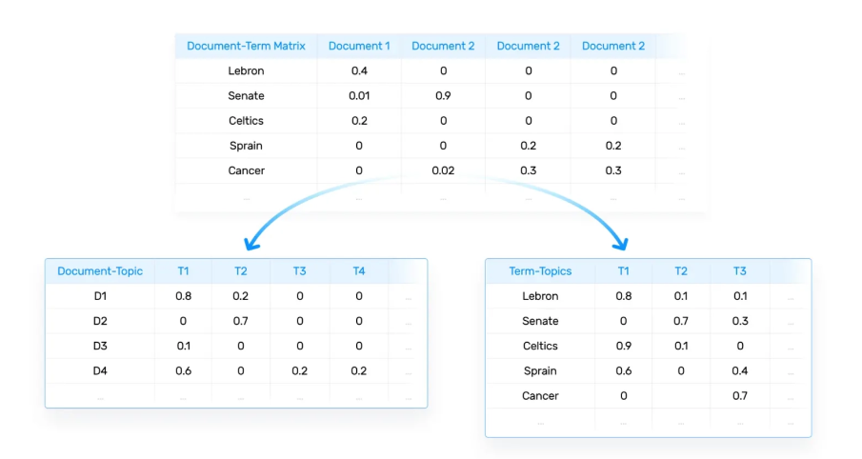
Methodology

Slide 13
Optimal Number of Topics
Used coherence score to find the optimal number of topics.
The graph plotted against coherence score and number of topics shows that the model works best with 8 components.

Slide 14
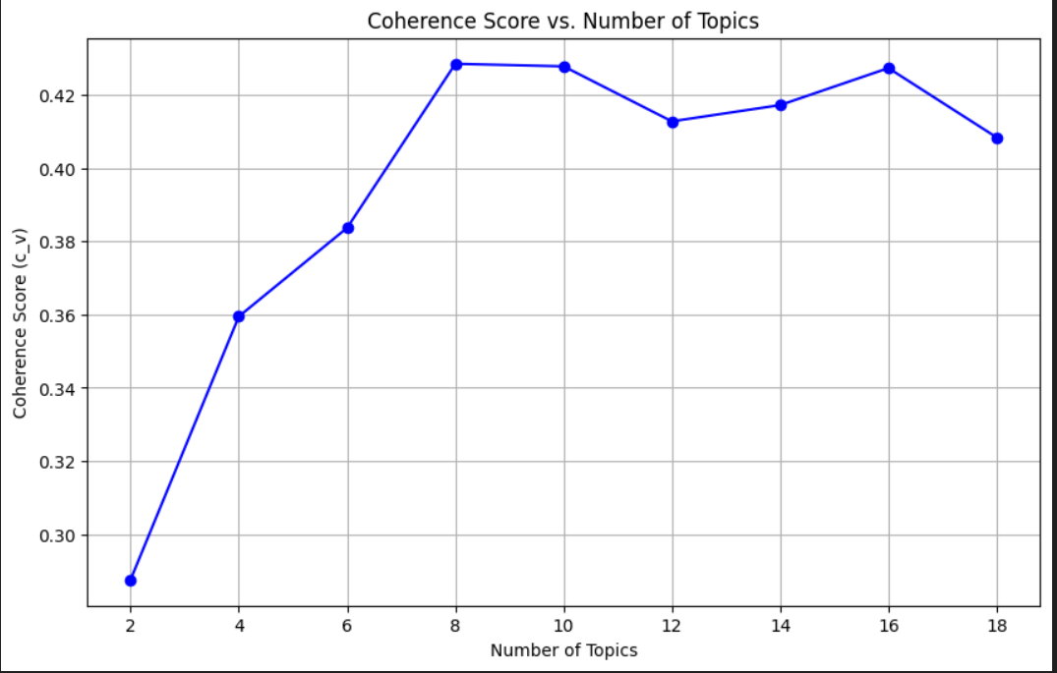
Optimal Number of Topics

Slide 15
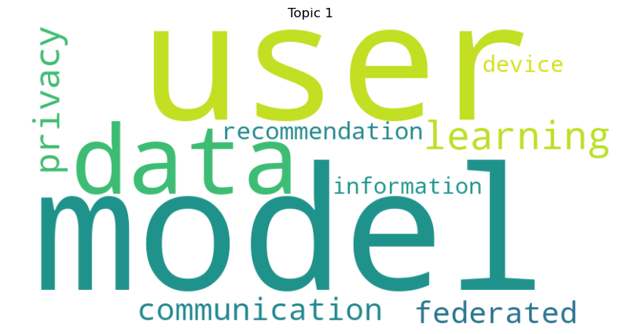
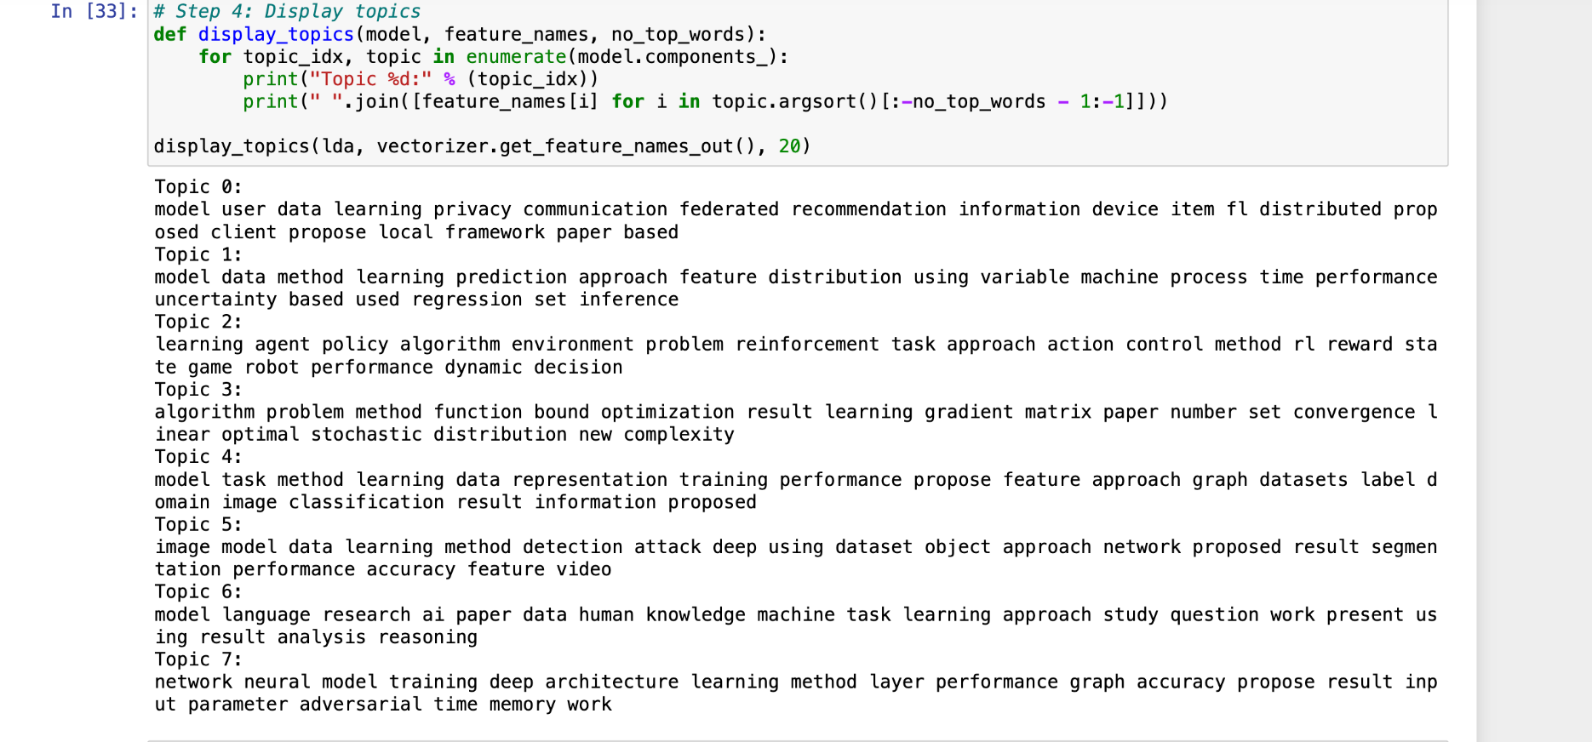
LDA - Results

Slide 16
BERTopic
BERT, or Bidirectional Encoder Representations from Transformers, is a revolutionary model in the field of natural language processing (NLP).
Bertopic is a topic modeling technique that leverages transformers and C-TF-IDF to create dense clusters allowing for easily interpretable topics whilst keeping important words in description.
In our project, we used BERTopic to conduct a deep, data-driven analysis of the arXiv dataset for AI and ML related meta data.
By fine-tuning BERT with this domain-specific collection, we were able to discover topics.

Slide 17
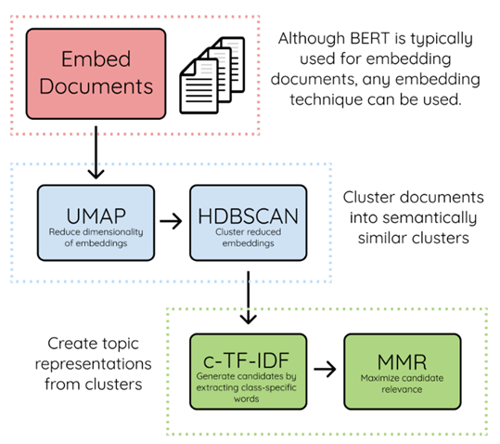
Algorithm

Slide 18
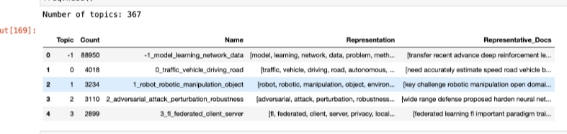
BERT - Results

Slide 19
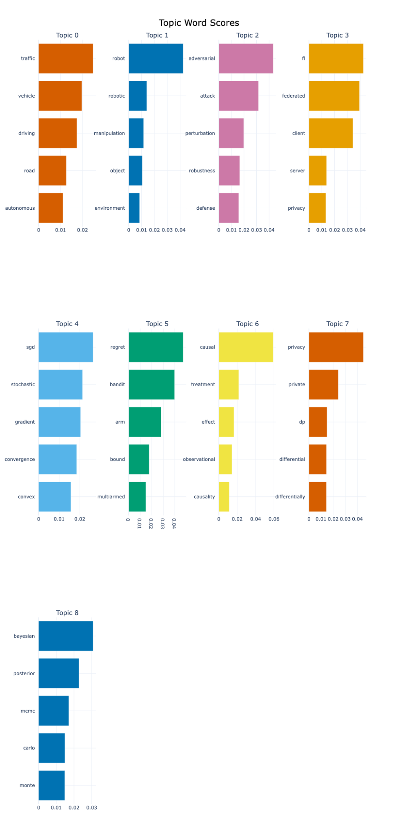
BERT - Results

Slide 20
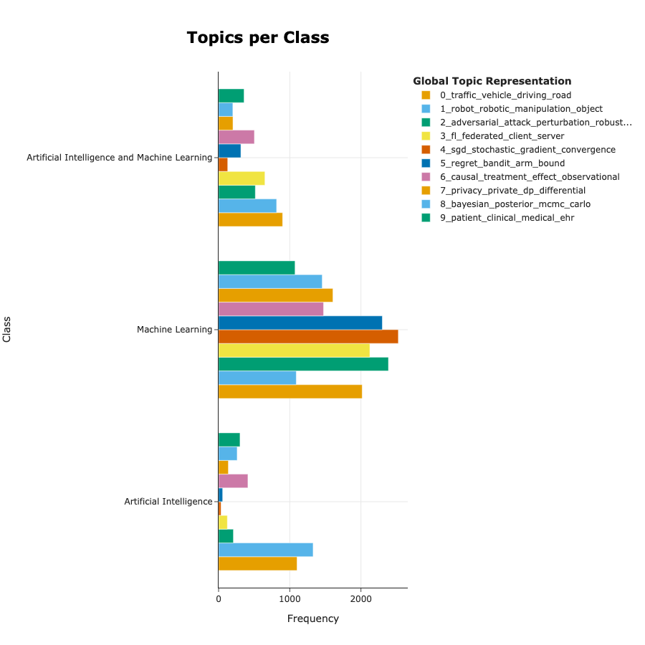
BERT - Results

Slide 21
Why BERTopic
Advantages of BERTopic
Contextual Understanding: BERTopic leverages contextual embeddings from models like BERT, which capture the contextual nature of text far better than traditional methods. This results in more nuanced and semantically rich topic identification.
Flexibility and Adaptability: The structure of BERTopic, combining embeddings, UMAP (for dimensionality reduction), HDBSCAN (for clustering), and c-TF-IDF (for topic representation), makes it highly adaptable to advancements in language models and clustering techniques. This means it can continuously improve as new technologies emerge.
Disadvantages of BERTopic
Computational Resources: BERTopic can be resource-intensive, particularly in embedding documents. Without a GPU, this process can be significantly slower compared to more traditional methods like LDA.
Ease of Use: For many practical applications, especially where resources or technical expertise are limited, simpler models like LDA may be more suitable due to their ease of implementation and lower computational demands.

Slide 22
Insights
Dynamic Topic Modeling:
BERTopic can effectively handle dynamic topic modeling where topics change over time, a feature particularly useful in analyzing trends and temporal data.
LDA typically requires a more static approach to topic modeling and may not capture evolving topics as effectively.
Quality of Topics:
Users often find that BERTopic generates more coherent and interpretable topics compared to LDA, especially with complex texts.

Slide 23
Future Work
Experiment with different embeddings (e.g., RoBERTa) in BERTopic to see if they offer improvements.
Doing topic modeling using ChatGPT API.
Including Text Summarization for the project.

Slide 24
References
https://www.kaggle.com/datasets/Cornell-University/arxiv/data
https://maartengr.github.io/BERTopic/algorithm/algorithm.html#5-topic-representation
https://github.com/MaartenGr/BERTopic/issues/486
http://wordvec.colorado.edu/papers/Deerwester_1990.pdf
https://www.jmlr.org/papers/volume3/blei03a/blei03a.pdf
https://arxiv.org/pdf/2203.05794.pdf

