Slide 1
The Claim File
21 June 2014
Notes:
Guidewire training materials contain Guidewire proprietary information that is subject to confidentiality and non-disclosure agreements. You agree to use the information in this manual solely for the purpose of training to implement Guidewire software solutions. You also agree not to disclose the information in this manual to third parties or copy this manual without prior written consent from Guidewire. Guidewire training may be given only by Guidewire employees or certified Guidewire partners under the appropriate agreement with Guidewire.

Slide 2
Lesson objectives
By the end of this lesson, you should be able to:
Define the primary entities of the ClaimCenter data model
View the primary entities of the claim file
This lesson uses the notes section for additional explanation and information. To view the notes in PowerPoint, choose View→Normal or View→Notes Page. If you choose to print the notes for the lesson, be sure to select “Print hidden slides.”

Slide 3
Lesson outline
The ClaimCenter data model
The claim file

Slide 4
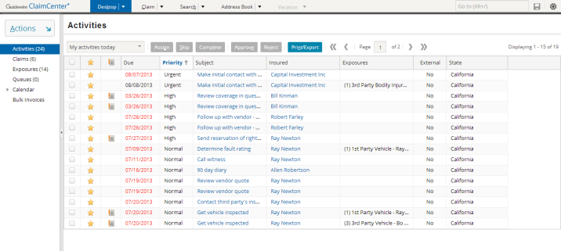
The ClaimCenter data model
An entity is a type of object which ClaimCenter needs to create, modify, or otherwise manage
Examples: claim, activity, user
Base application data model has over 400 entities
Only a small number are central to overall process
Notes:
The data model is the collection of:
Entities used by ClaimCenter, along with the associated data types (generally, you can think of entities as being associated with database tables and entity instances (objects) with rows in those tables)
Typelists (which are sets of hard-coded values typically used for dropdowns and for relationships between LOB (Lines of Business))
Field validators (which are patterns that can be applied to field to ensure the data meets a given format, such as a 5- or 9-digit requirement for a US zip code or a 6-character requirement for a Canadian postal code)

Slide 5
Policies and coverages
policy
A policy is a contract between the carrier and the insured in which the carrier promises to cover the insured for specific types of losses
A coverage is a type of loss that is or can be listed on a policy which the carrier will cover
coverage
Notes:
ClaimCenter does not manage policies and is not the system of record for policies. Instead, it is integrated with an external policy administration system (PAS). Whenever information about a policy is needed, the PAS is queried and the relevant information copied over to ClaimCenter.

Slide 6
Policy and coverage terminology
Property coverages cover tangible assets belonging to the insured, such as a vehicle, home, or the insured's body
property coverages
collision
comprehensive
insured
med. pay
Liability coverages cover the insured's liability when damage is done to a third party
liability coverages
liability - vehicle
third party
liability - injury
Notes:
The term "insured" refers to the person, group of people, or business covered on the policy. The term "third party" refers to a person who suffers a loss for which the insured is responsible. (The "first party" is the insured, and the "second party" is the carrier.)
A property coverage is a coverage in which a tangible asset (a physical object, a real estate location, or the body) of the insured is covered. The coverage exists to repair or replace the asset if it is lost, damaged, or otherwise rendered unusable. (For example, an auto policy's collision coverage covers the car in the event that it is damaged due to a collision. Comprehensive coverage covers the car in the event that it is lost or damaged due to a non-collision event (such as a hail storm or theft). Medical payment coverage covers medical payments (damage done to the insured's body) that results from use of the car.
When a claim is filed, the money from losses covered by property coverages goes to the insured. (In some cases, it may go to a business which provided service to the insured, such as an auto shop which repaired the insured's car. But from a logical standpoint, the money is still going to the insured.
A liability coverage is an coverage in which the liability of the insured is covered. The coverage exists to provide financial remuneration if a third party suffers a loss for which the insured is liable. (For example, an auto policy's "liability - vehicle damage" coverage covers damage done to a third party's car for which the insured is responsible. "Liability - injury" covers damage done to a third party's body which occurred as the result of the insured operating a vehicle.)
When a claim is filed, the money from losses covered by liability coverages goes to the third party.
(continued)

Slide 7
(Notes only slide)
Notes:
Some policies may cover only property exposures (such as a business property policy), some may cover only liability exposures (such as a workers' comp policy), and some may cover both (such as an auto policy).
There are several different categories of insurance. Guidewire currently focuses on the "property and casualty" category. The name "property and casualty" involves policies with property exposure and liability exposures. (Casualty is the issue of who was the cause of the occurrence, and therefore who is liable for financial remuneration.)

Slide 8
The claim
workers' comp policy
auto policy
property policy
workers' comp claim
auto claim
property claim
A claim is an event in which one or more (potentially) covered losses occurred
The policy's line of business determines the claim's line of business
Notes:
A coverage applies for the claim depending on:
Policy effective date
Exclusions
Terms such as limits and deductibles
Initially, a claim must be described as an event in which potentially covered losses occurred. One aspect of the claims process is to reference the relevant policy to ensure that the loss was in fact covered. Even if there is a coverage on the policy, the loss may not be covered because:
It occurred when the policy was not in effect.
It was a kind of loss specifically excluded from a policy (such as a homeowner's policy which specifically excludes earthquake damage).
The amount of loss is outside of the terms of the coverage (such as $250 damage from a collision and a collision coverage with a deductible of $500).

Slide 9
Contacts
policy and coverages
A contact is a person or organization who has a relationship to a claim, such as:
A claimant requesting compensation for a loss
The reporter of the claim
A doctor treating an injury
An auto repair shop providing an estimate
claim
contact
Roles involved with the loss event
Roles involved with providing services
Notes:
Contacts are typically captured when the claim is first created. Some information about contacts may need to be gathered later, but ideally an intake process captures all information about the “who”. Each contact involved in a claim must have one or more roles, such as a reporter, claimant, witness, doctor, attorney, repair shop, and so on. This concept will be explained later in the lesson.
Contacts may be thought of as being involved either in the loss (such as an injured person or a company who’s property has been stolen), or involved in providing services (such as auto service vendors or property restoration or repair).

Slide 10
Incidents
policy and coverages
An incident entity is a collection of information about damage. It typically represents an item that was lost or damaged, such as:
A vehicle
A property
A person suffering one or more injuries
claim
contact
incident
Notes:
The one current case where an incident does not represent the damaged item is the "Living Expenses" incident.
The incident could belong to the insured (which is covered by a property coverage), or belong to a third party (which would be covered by a liability coverage).
Incidents are typically captured when the claim is first created. Some information about incidents may need to be gathered later, but the most ideal circumstance involves an intake process in which all the information about the "what" is captured.
Technically speaking, if incident is defined as "an item that suffered damage", then in a claim where a person is hurt, the incident should be called a "body incident". However, the term "injury incident" is more common in the industry and has been adopted by ClaimCenter.

Slide 11


Services
policy and coverages
A service is a request for work to be performed by a vendor, usually related to an incident.
Examples include auto inspection/repair, roadside assistance, locksmith, appraisal, etc.
Service types can include Quote only, Service only, or both Quote and Service
Services can track quotes and vendor communications
claim
contact
incident
service
Notes:
Services are created either when the claim is first created and saved, or after initial claim creation. When services are created in ClaimCenter, they are automatically submitted to vendors. That way, service requests are submitted as soon as possible and vendors receive these requests typically through an vendor portal. The service request can be for a quote to compare prices, a service to be performed, or for both a quote and service. The vendor can start work right away, specify a time frame for completion, delay the request or decline the request. Typically, a Service is tied to an incident such as requesting locksmith services for a burglarized home, or requesting vehicle damage assessment for one or more damaged vehicles, or requesting towing for a disabled vehicle, and so on. Each incident can have one or many services.
Technically, the name of the entity in ClaimCenter is Service Request, but for the purposes of training the terms Service and Service Request are interchangeable.

Slide 12
Exposures
policy and coverages
An exposure is a set of data used to track a potential payment from one coverage to one claimant
claim
contact
incident
service
exposure
Notes:
For many claims, a single occurrence of loss involves more than one coverage, and more than one claimant. Exposures are the mechanism used by ClaimCenter for tracking the progress of each possible indemnity. (An indemnity is a payment in compensation for a loss. In property and casualty insurance, the goal is to restore a policyholder to the same financial position after the loss as he was in prior to the loss, without allowing the policyholder to profit from the loss.)
The term exposure is used differently in ClaimCenter than it is in PAS systems. The underwriter looks upon the possible coverages as exposures, while in CC it is the coverages that are deemed in effect that lead to the creation of a particular exposure (for a particular claimant).

Slide 13
Activities
policy and coverages
An activity is a task required to process a claim
The set of activities associated to a given claim is often referred to as the claim's "workplan"
Activity due dates and statuses used for business processes and reporting
claim
contact
incident
service
exposure
activity
workplan
Notes:
Every activity is ultimately assigned to a user, who is responsible for completing the task. The activity identifies when the task is expected to be done (due date) and whether it has been done or not (status). Theoretically, one could say the process of processing a claim is identical to the process of completing its activities.
Legacy claim systems often have a "diary" feature. This feature is used to manage claim-handling activities. A user can indicate that he or she (or someone else) has to look at a claim on a particular day. Typically, you can type a short note to remind yourself or the other user why you should look at this claim on a particular day. The diary feature is often limited, particularly in terms of how much text you can enter and how the visibility of this text is controlled, the number of references a given user can make for a claim on a given day (often limited to one), and the logic behind how diary activities get assigned.
ClaimCenter replaces the traditional diary with two features: activities and notes. Activities let both users and the system create and assign tasks. Activity assignment can be done manually or through a robust set of assignment rules. Notes let users record information about a claim and associate it to the relevant part of the claim (such as the claim itself, a contact on the claim, or an exposure) without having to tie the note to a specific date or user. Robust visibility rules can control who can view and/or edit the note.

Slide 14
Documents
policy and coverages
A document is an electronic file or physical piece of paper which contains information relevant to the claim
claim
contact
incident
service
exposure
activity
document
Notes:
A document is an electronic file or physical piece of paper which contains information relevant to the claim, such as:
First Report of Injury
Notification of Pending Inspection
Affidavit of Vehicle Theft
Documents can be used to:
Track information on physical pieces of paper (such as photographs of a damaged car, diagrams of the floor plan for a workplace, assessments from mechanics or diagnoses from a doctor)
Track information that exists electronically (such as email correspondences, word processing documents that were mailed to the insured, and scanned photographs of property that was stolen)
Unlike the other objects, which are often created automatically by ClaimCenter, documents are typically created manually by users.

Slide 15
Notes
policy and coverages
A note is a text entry which details the events, courses of actions, and/or thinking of a user during the processing of a claim
claim
contact
incident
service
exposure
activity
document
note
Notes:
A note is a detailed record of the actions or thinking behind the processing of a claim.
Legacy claim systems often have a "diary" feature. This feature is used to manage claim-handling activities. A user can indicate that he or she (or someone else) has to look at a claim on a particular day. Typically, you can type a short note to remind yourself or the other user why you should look at this claim on a particular day. The diary feature is often limited, particularly in terms of how much text you can enter and how the visibility of this text is controlled, the number of references a given user can make for a claim on a given day (often limited to one), and the logic behind how diary activities get assigned.
ClaimCenter replaces the traditional diary with two features: activities and notes. Activities let both users and the system create and assign tasks. Activity assignment can be done manually or through a robust set of assignment rules. Notes let users record information about a claim and associate it to the relevant part of the claim (such as the claim itself, a contact on the claim, or an exposure) without having to tie the note to a specific date or user. Robust visibility rules can control who can view and/or edit the note. Notes may be manually created by users or generated automatically by ClaimCenter.

Slide 16
Matters
policy and coverages
A matter is a set of data pertaining to a single (potential) lawsuit
claim
contact
incident
service
exposure
activity
document
note
matter

Slide 17
Reserve lines
policy and coverages
A reserve line is an amount of money set aside for expected payments related to a given exposure
claim
contact
incident
service
exposure
activity
document
note
matter
reserve line
Notes:
A reserve line can be thought of as a "T-account" set aside for one specific aspect of exposure processing. It contains both credits and debits, and its size is equal to the sum of the credits minus the sum of the debits. Every exposure ultimately has one or more reserve lines.
A single exposure might have a single reserve line associated to it. It could also have several reserve lines associated to it if there are multiple "sets" of money for different purposes that must be tracked differently. (For example, an exposure for a collision coverage could have separate reserve lines for auto body damage and glass damage because the carrier tracks these two types of payments differently.)

Slide 18
Checks
policy and coverages
A check is a single transfer of money tracked by an exposure to one or more individuals or organizations
claim
contact
incident
service
exposure
activity
document
note
matter
reserve line
check
Notes:
A single reserve line might have a single check associated to it. It could also have several checks associated to it if:
There are multiple payments (such as a recurring payment to treat ongoing medical care).
There are multiple payees (such as a circumstance of litigation where the claimant gets 80% of the settlement and the lawyer gets 20% of the settlement).

Slide 19
Users
Every claim, activity, and exposure is assigned to a user who owns the object
The user is responsible for seeing that the object is processed and closed
user
claim
exposure
activity
Notes:
Technically speaking, there are five assignable entities in ClaimCenter: claim, activity, exposure, service request and matter. Matters are not fundamental to ClaimCenter because they are only needed for claims which involve litigation (whereas every claim which gets paid out involves claims, activities, and exposures). To simplify the discussion of the primary entities, matters have been omitted from the slide above.
Services are also not required for claims that get paid out, although they are more common on claims than matters because usually incidents require at least one service involving repairs, inspections, or assistance of some kind from a vendor.
Each assignable entity on the claim may have its own owner, though it is common for sub-entities (activities, exposures, service requests and matters) to be owned by the claim owner.

Slide 20
Groups
Every claim, activity, and exposure is also assigned to a group
The user who owns the object is a member of that group
Group ownership is used to determine:
Which user becomes the owner
Who can view or edit a given claim and its contents
group & user
claim
exposure
activity
Notes:
Typically, a "group level" set of assignment logic is used to assign an object to a group, and then a separate "user level" set of assignment logic is used to assign the object to a member of that group. Assignment is discussed in the "Assignment" lesson.
ClaimCenter can be configured so that a claim can be viewed and/or edited only by the owner, by anyone in the same group as the owner, or by any ClaimCenter user. Controlling access to claims is discussed in the "Access Control Lists" lesson.

Slide 21
Summary: primary entities in the data model
policy and coverages
A claim has one policy, one owner, and one group
For all other entities listed here, there can be many per claim
group & user
claim
contact
incident
service
exposure
activity
document
note
matter
reserve line
check
Notes:
The relationship between policy and claim is one-to-one. Logically speaking, a policy can have many claims associated to it. However, in ClaimCenter, whenever a claim is created, a copy of the policy is created. If two claims get created against the same policy, there are technically two policy objects in ClaimCenter for that one policy.

Slide 22
Lesson outline
The ClaimCenter data model
The claim file

Slide 23
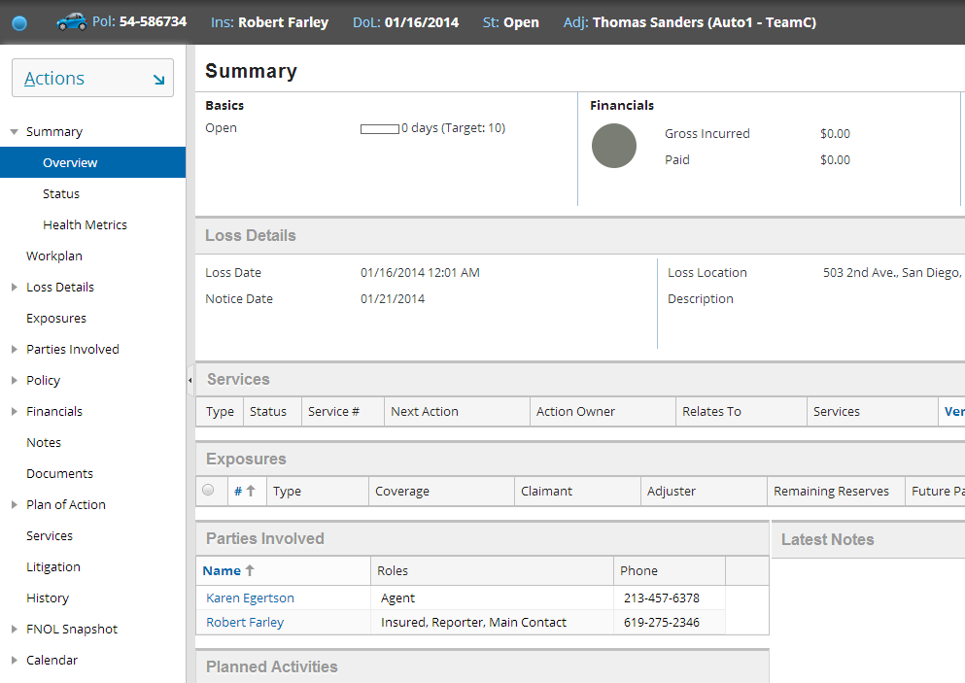
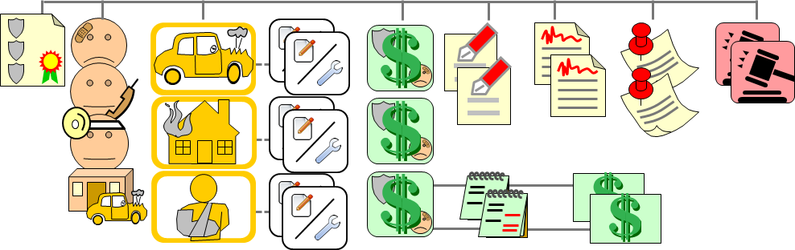
The claim file
The "claim file" is the complete collection of information about a specific claim and all information related to that claim
Rendered on the Claim tab
Notes:
ClaimCenter is a highly configurable application. Consequently, it is impossible to discuss what "should be" or "will be" in the claim file, as this information can and will vary based on the needs of each carrier. This lesson discusses information found in the base application's claim file as well as some information not necessarily found in the base application as examples of how the application can be configured.
This lesson discusses all of the menu links in the base application's claim file except the following:
Plan of Action - This is discussed in the "Specialized Claim Processes" lesson.
FNOL Snapshot - This is discussed in the "New Claim Wizard" lesson.
Calendar - This is discussed in the "Activities" lesson and the "Specialized Claim Processes" lesson.

Slide 24
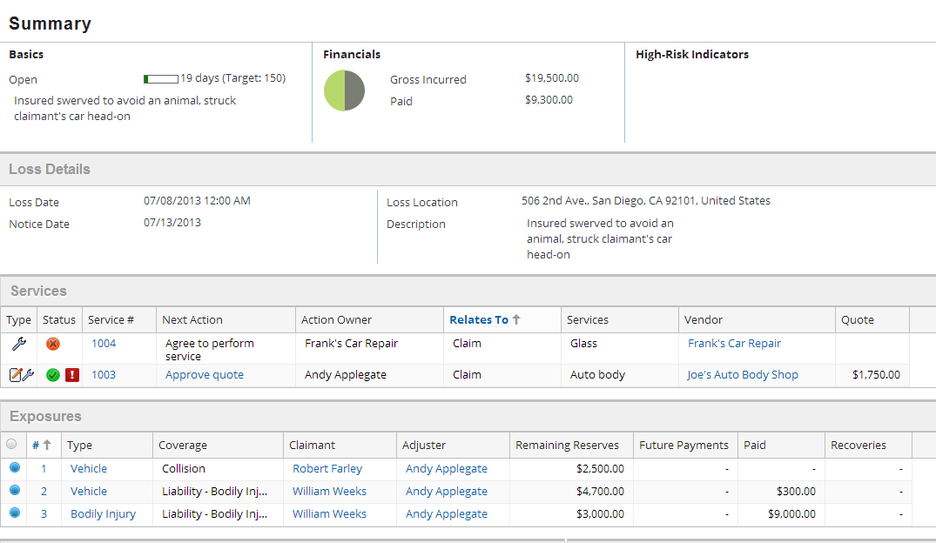
The summary screen
The Summary screen is a read-only summary of important claim file elements, including:
Claim headline information
Financials
Services
Exposures
Notes:
The Summary screen simply repeats information that is available (and in many cases editable) on other screens in the claim file. The Summary screen can help users determine which part of the claim file they need to attend to.

Slide 25
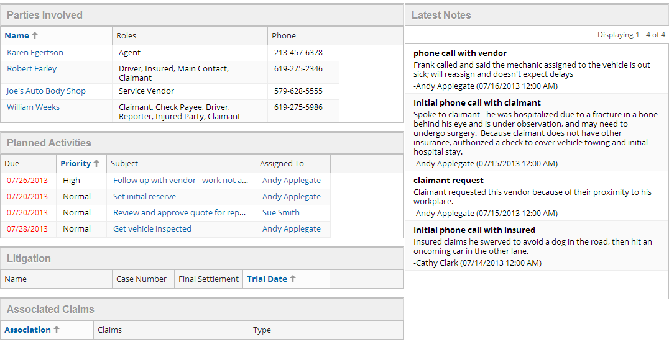
The summary screen (continued)
The Summary screen is a read-only summary of important claim file elements, including:
Parties Involved
Activities
Litigation
Associated
Claims
Notes
Notes:
The Summary screen simply repeats information that is available (and in many cases editable) on other screens in the claim file. The Summary screen can help users determine which part of the claim file they need to attend to.
The Associations screen lists other claims which are associated to the given claim. For example, if a claim involves two claimants who are both insured by the carrier, then it may be helpful for an adjuster working on one claim to be aware of and have easy access to the other claim. A larger image of the Associated Claims list appears below (which is visible if you view PowerPoint in Notes view (View > Notes Page)).
In the base application, claims are associated to one another using the Associations list, which is available from the Loss Details page (in the Associations menu link).

Slide 26
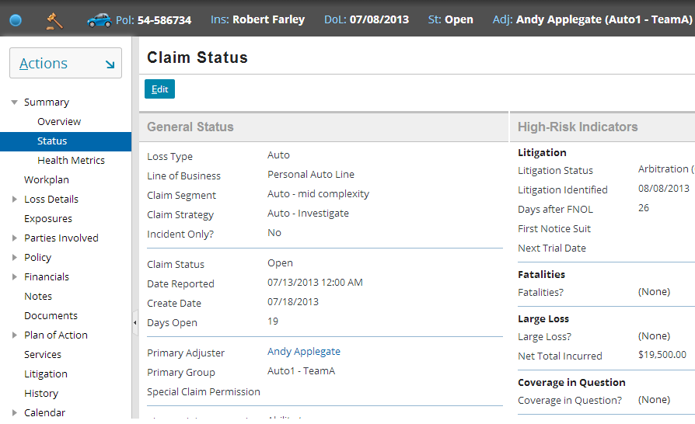
Claim owner and group
Notes:
The owner of the claim and the group to which the claim has been assigned are listed from the Summary > Status menu link, as well as in the info bar.
The process for determining an owner and a group is discussed in the "Assignment" lesson.

Slide 27
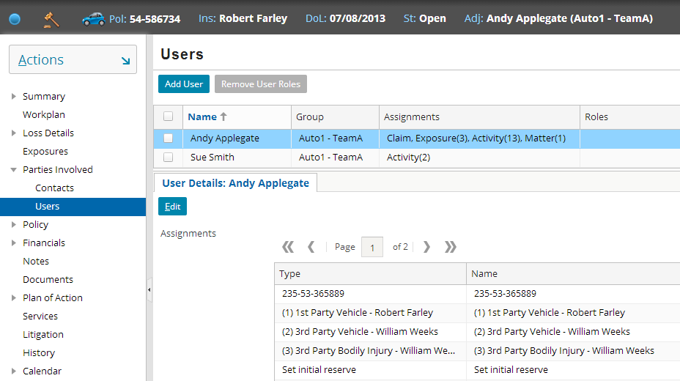
Assigned users and group
Notes:
Any user who owns the claim, an exposure on the claim, or an activity on the claim is listed on the Parties Involved page in the Users menu link. Also, any user who has a claim user role on the claim (such as an Independent Appraiser) is also listed on this screen, even if that user does not own any object on the claim. An alternate example (using a different claim) of this is visible if you view PowerPoint in Notes view (View > Notes Page)).

Slide 28
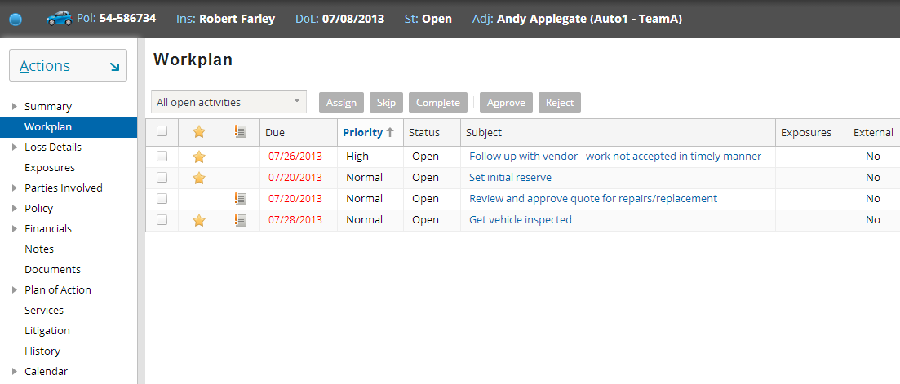
Activities
Notes:
Activities for the given claim are listed from the Workplan menu link. (Recall that activities assigned to a given user are listed on that user's Desktop tab.)
Activities are discussed in the "Activities" lesson.

Slide 29
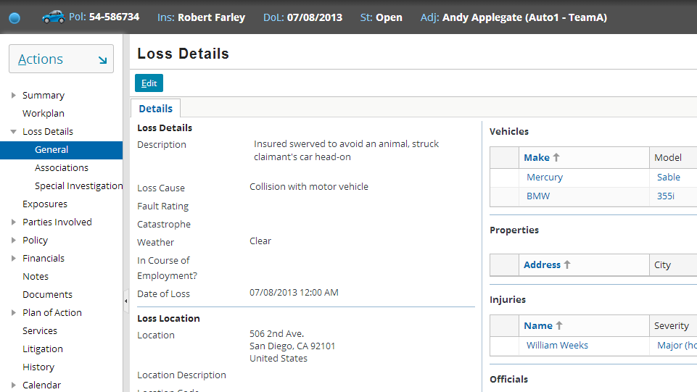
Claim loss details
Notes:
The Loss Details screen lists general information about the claim, including information common to multiple exposures (such as the location of the loss, a list of witnesses, contributing factors to the loss, and so on).
The nature of the Loss Details screen is highly dependent on the claim's line of business.
The Loss Details screen is discussed in detail in the "Adjudicating Claims" lesson.

Slide 30
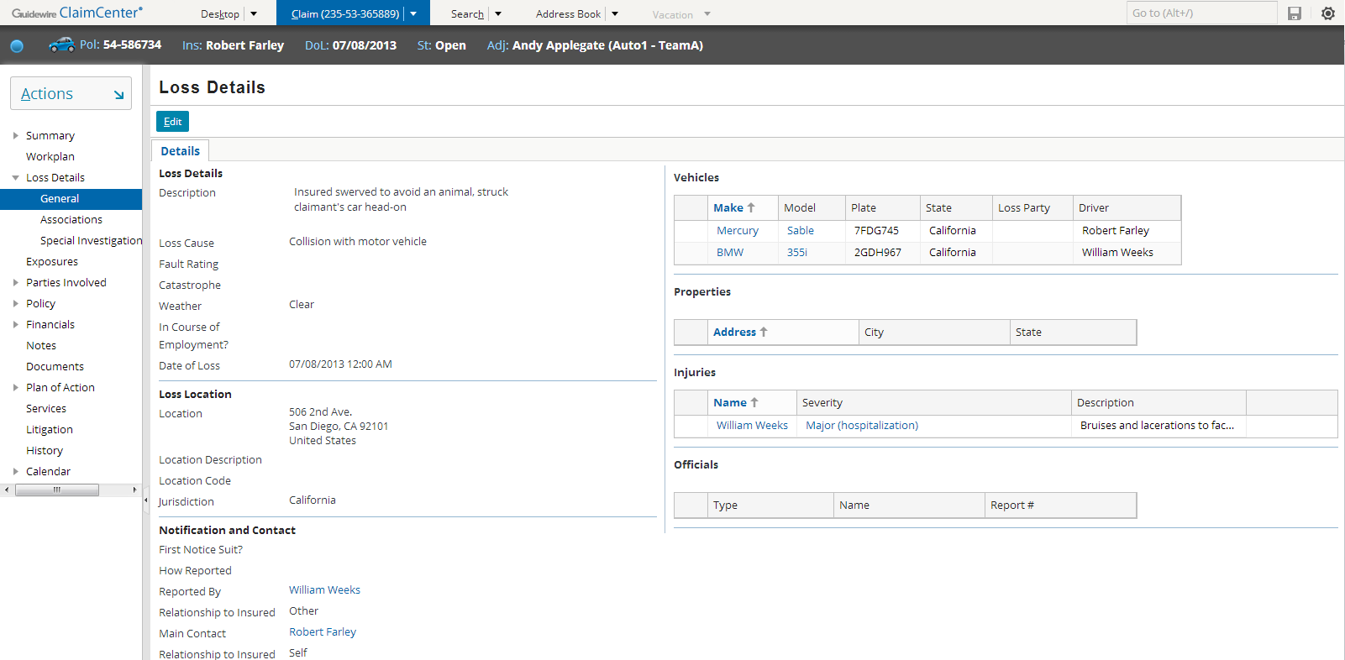
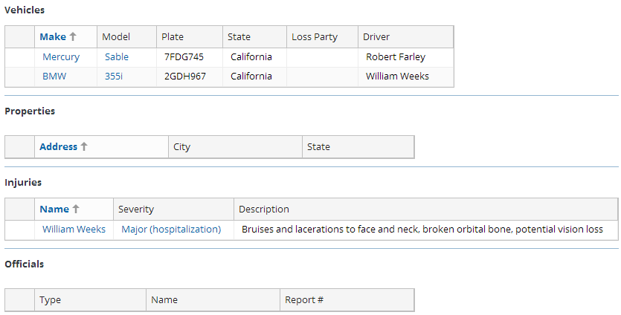
Incidents
Notes:
The list of incidents across the entire claim is shown on the Loss Details screen. Each incident may again appear on each screen of the exposure to which it is associated. The detail of each incident is displayed on its own screen by following the link of each item in the list.
Incidents are discussed in the "New Claim Wizard" lesson.

Slide 31
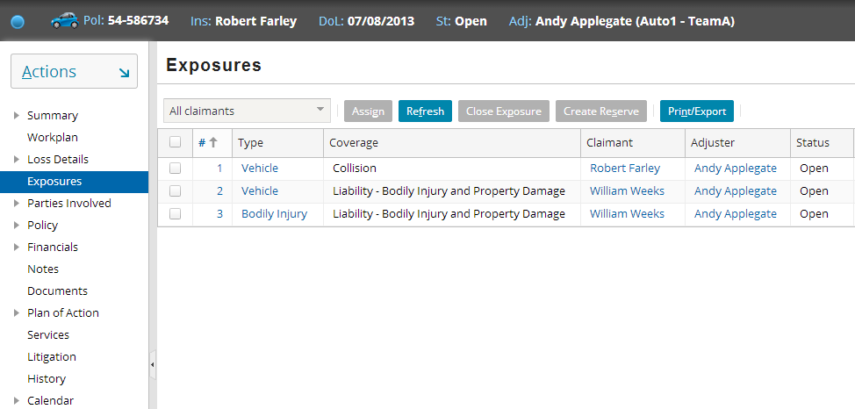
Exposures
Notes:
Each individual exposure is listed from the Exposures menu link. The Type column is a link which navigates to detailed information about the exposure.
Exposures are discussed in the "Exposures" lesson.

Slide 32
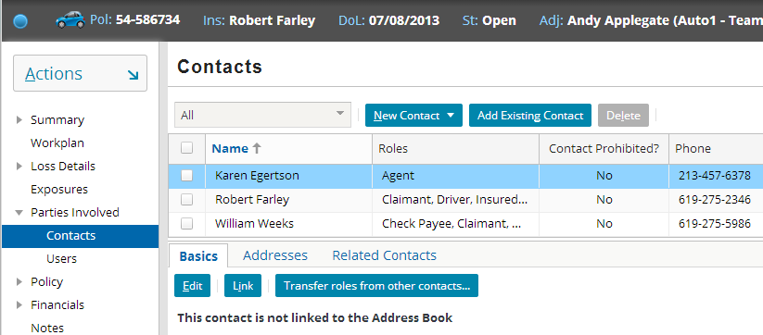
Contacts
Notes:
Contacts are listed on the Parties Involved > Contacts menu link. The list identifies both each contact and the role or roles the contact has with the claim (such as claimant, reporter, or driver).
Contacts are discussed in the "Contacts" lesson.

Slide 33
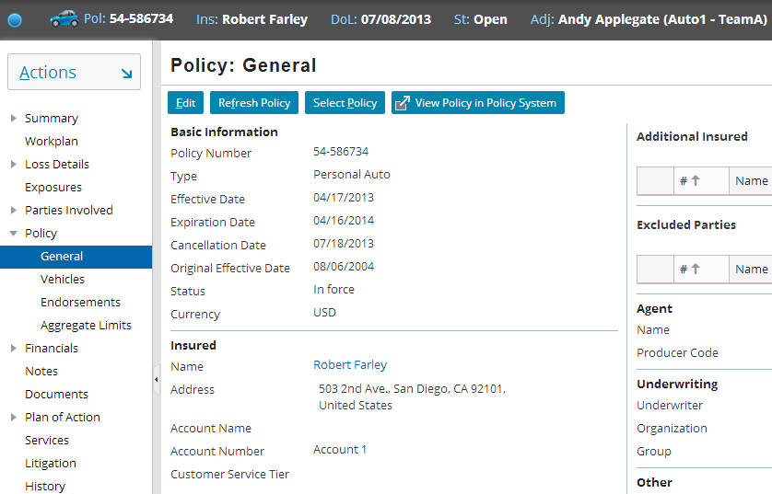
Policies and coverages
Notes:
The policy information is listed on the Policy > General menu link. The information displayed and the location of coverage information can vary based on the line of business and the nature of the coverage. (For example, an auto policy may have the policy-level coverages, such as a liability coverage, listed on the General menu link and the vehicle-level coverages, such as a collision coverage, on the Vehicles menu link.)
In the base application, the General screen lists general information about the policy, including:
Its type
Its effective and expiration dates
Any line-level (policy-level) coverages
A line-level coverage is a coverage which is added to a policy at a general level without being tied to a specific thing covered by the policy. For example, a business owner's policy might have a pollution liability coverage which is general to the entire policy and not tied to any one building owned by the business. Line-level coverages are not typically found on auto policies, but are typical for workers comp' policies.
There is also a screen for property covered on the policy. (Underwriters typically refer to this as the policy's "exposures". The term exposure is used differently in ClaimCenter.)
The Endorsements screen lists any endorsements associated to the policy. Endorsements are physical forms printed when a policy is issued, modified, or renewed. They typically detail what is and what isn't covered on the policy.
The Aggregate Limits screen lists information about aggregate limits (such as a limit on the bodily injury coverage of $500,000 per loss event).
Policies and coverages are discussed in the "New Claim Wizard" lesson.

Slide 34
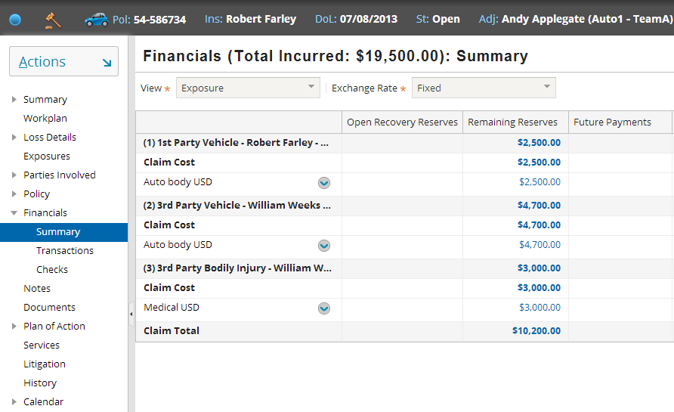
Reserve lines
Notes:
Reserve lines are listed from the Financials > Summary menu link, or from the Financials > Transactions menu link.
Reserve lines are discussed in the "Reserves" lesson. Reserves are created from Exposures to set aside money for payments to claimants. Reserves are known as “Reserve Lines” so the two terms are synonymous in this course.

Slide 35
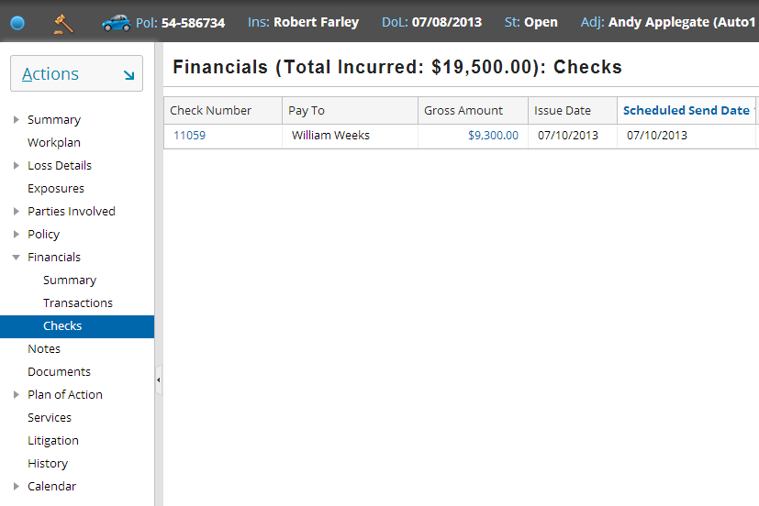
Checks
Notes:
Checks are listed from the Financials > Checks menu link.
Checks are discussed in the "Payments" lesson.

Slide 36
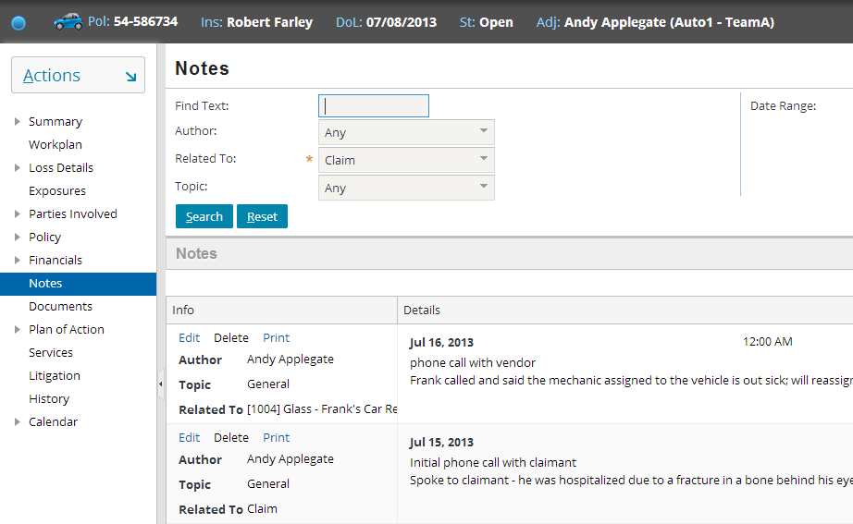
Notes
Notes:
Notes are listed from the Notes menu link. Like documents, the screen consists of a set of search criteria on top and a list of notes meeting that search criteria underneath.
Notes are discussed in the "Notes" lesson.

Slide 37
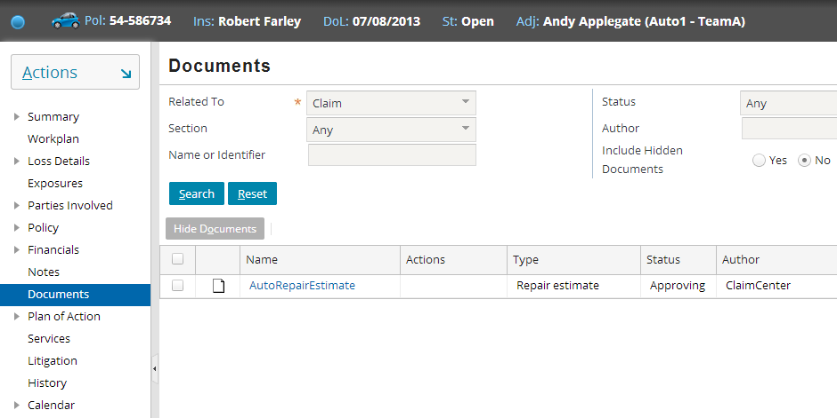
Documents
Notes:
Documents are listed from the Documents menu link. The screen consists of a set of search criteria on top and a list of documents meeting that search criteria underneath.
Documents are discussed in the "Documents" lesson.

Slide 38
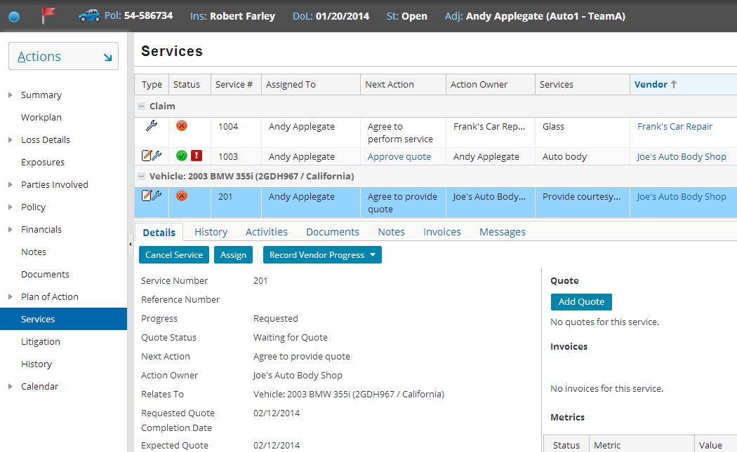
Services
Notes:
Each service is listed from the Services menu link. Clicking the row for each Service displays all information about the Service in the detail view below. The type of service – Quote, Service and Quote and Service are identified in the “Type” column using specific icons (wrench = service, pencil/pad = quote). Services are usually associated to an incident but may be claim-level.
Services are discussed in the “Vendor Service Requests” lesson.

Slide 39
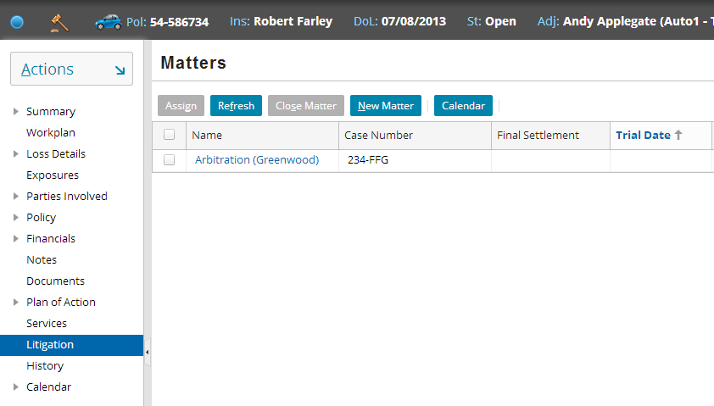
Matters
Notes:
Matters are listed from the Litigation menu link (only if a matter has been created on the claim). A claim is “in litigation” if a matter has been created.
Matters are discussed in the "Specialized Claim Processes" lesson.

Slide 40
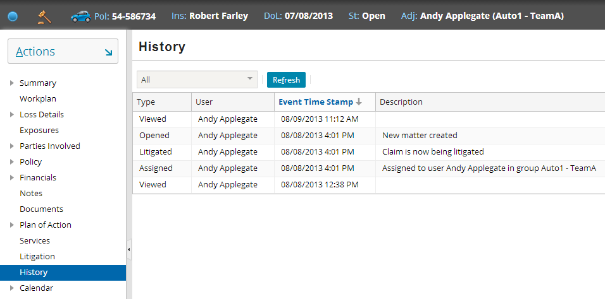
History
Notes:
History is a list of important events that have taken place for the claim (such as when a claim was viewed or when objects on the claim were assigned and to whom).
The History screen can include, through configuration, any kind of event a carrier wants to track, such as when the value of the Loss Cause field changes (and what the old and new values are).

Slide 41
Lesson objectives review
You should now be able to:
Define the primary entities of the ClaimCenter data model
View the primary entities of the claim file

Slide 42
Review questions
Of the primary entities discussed in this lesson (other than claim), which entity:
Captures information about the item that was lost or damaged?
Is used to track payment from one coverage to one claimant?
Is used to create the claim's "workplan"?
Can be seen from the claim file's "Financials" menu link? (Two possible answers)
Has a one-to-one relationship with the claim?
Would be used to store information about the person who is covered by the policy?
Tracks vendor-provided work usually related to an incident?
While a claim is being processed, is there only one ClaimCenter user associated to the claim?
Notes:
Answers
1. a) Incident
b) Exposure
c) Activity
d) Reserve line and check
e) Policy (see Note)
f) Contact
g) Service (or Service Request)
2. Not necessarily. It is not unusual for a claim to have exposures and/or activities assigned to someone other than the claim owner, and it is not unusual for other users to have user claim roles on the claim (such as legal or subrogation specialist). All the ClaimCenter users associated to the claim are listed on the Parties Involves --> Users list.
There is also only one group assigned to the claim, but group-to-claim is one-to-many, as a group presumably owns many claims. But couldn’t you say the same for Policy? There is only a single group object, and it can have many claims associated with it - in fact, there is an array key called Group.OpenClaims. There are, however, as many Policy objects as there are claims, because we make a clone of the PAS exported policy. The now deprecated array key Policy.Claims was a virtual field to provide a way to locate all the claims that were originally derived from the Policy.

Slide 43
Notices
Copyright © 2001-2014 Guidewire Software, Inc. All rights reserved.
Guidewire, Guidewire Software, Guidewire ClaimCenter, Guidewire PolicyCenter, Guidewire BillingCenter, Guidewire Reinsurance Management, Guidewire ContactManager, Guidewire Vendor Data Management, Guidewire Client Data Management, Guidewire Rating Management, Guidewire InsuranceSuite, Guidewire ContactCenter, Guidewire Studio, Guidewire Product Designer, Guidewire Live, Guidewire DataHub, Guidewire InfoCenter, Guidewire Standard Reporting, Guidewire ExampleCenter, Guidewire Account Manager Portal, Guidewire Claim Portal, Guidewire Policyholder Portal, ClaimCenter, BillingCenter, PolicyCenter, InsuranceSuite, Gosu, Deliver Insurance Your Way, and the Guidewire logo are trademarks, service marks, or registered trademarks of Guidewire Software, Inc. in the United States and/or other countries.
All other trademarks are the property of their respective owners.
This material is confidential and proprietary to Guidewire and subject to the confidentiality terms in the applicable license agreement and/or separate nondisclosure agreement.
This file and the contents herein are the property of Guidewire Software, Inc. Use of this course material is restricted to students officially registered in this specific Guidewire-instructed course, or for other use expressly authorized by Guidewire. Replication or distribution of this course material in electronic, paper, or other format is prohibited without express permission from Guidewire.
Guidewire products are protected by one or more United States patents.

