Slide 1
Graph-Based Recommendation
For Tinder
Leveraging social interactions for personalised matches
Team Members:
Dhruvi Shah - 60009200025
Umang Lodaya - 60009200032
Sharvari Chawade - 60009200037
Neil Mehta - 60009200051

Slide 2
Aim
This project aims to develop a recommendation system for Tinder that leverages graph representation learning techniques.
By modeling the social network of users as a graph and learning embeddings for users based on their interactions and connections, the system aims to generate more personalized and relevant match suggestions

Slide 3
Graph Representation learning Techniques
Types of Representations:
Node Embeddings: Capture the structural properties of nodes
Edge Embeddings: Capture the relational information between connected nodes.
Graph Embeddings: Capture the overall structure and properties of the graph that including community structure

Slide 4
Graph Representation learning Techniques
Methods:
Random Walk-Based Approaches
Matrix Factorization
Deep Learning Approaches
Probabilistic Models

Slide 5
Graph Representation learning Techniques
Applications:
Node Classification and Clustering
Link Prediction
Recommendation Systems
Graph Generation and Visualization

Slide 6
Libraries used
Node2Vec - for generating node embeddings in networks using a scalable algorithm based on biased random walks.
Networkx - for creating, manipulating, and studying complex networks or graphs.
Ast - abstract syntax trees (AST) manipulation and analysis

Slide 7
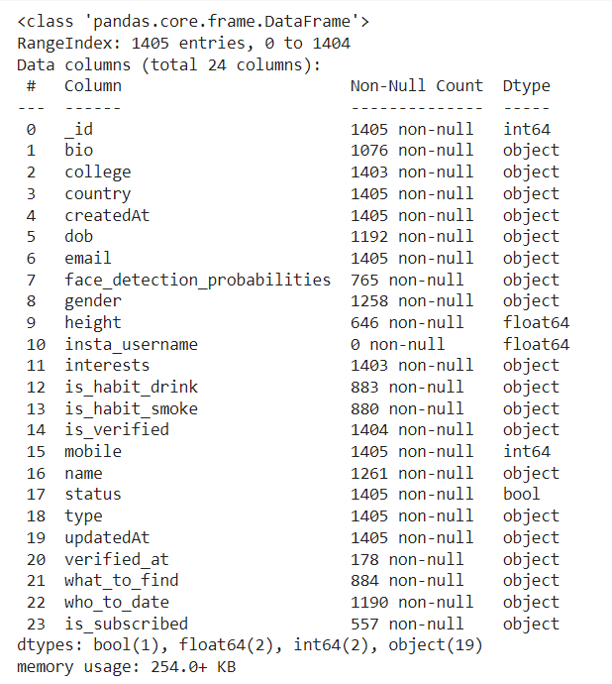
USERS Dataset

Slide 8
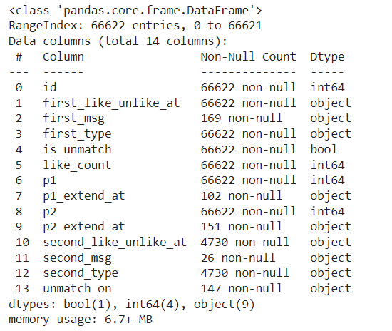
SWIPES dataset

Slide 9
Methodology
Data Preprocessing
Graph Visualization
Implementing Node2Vec Algorithm

Slide 10
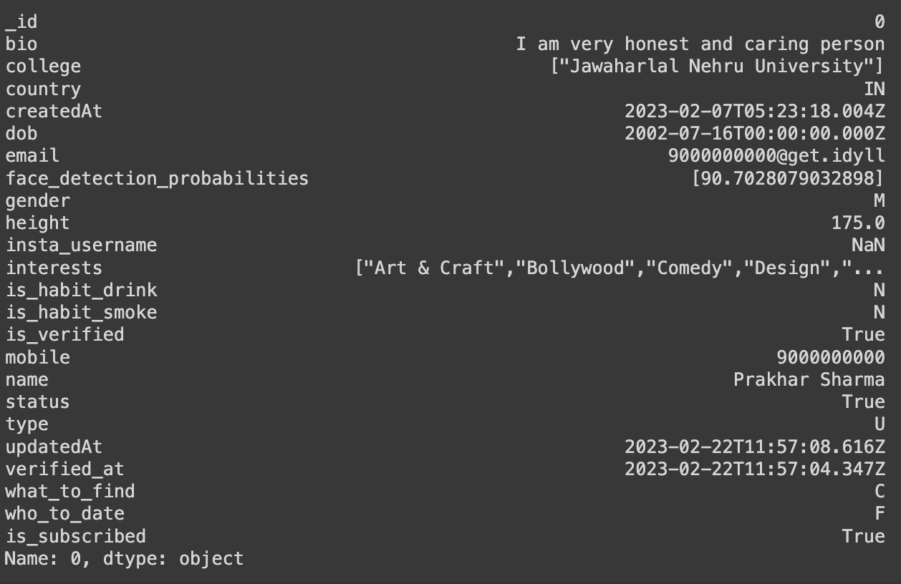
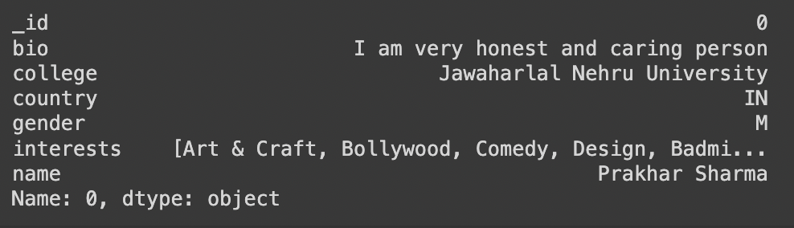
Preprocessing USERS Data

Slide 11
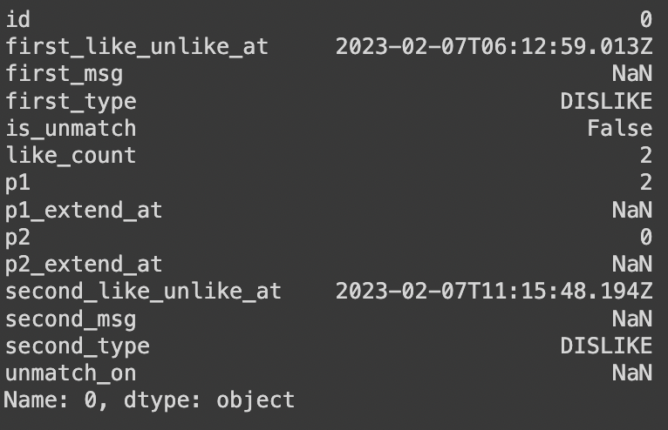
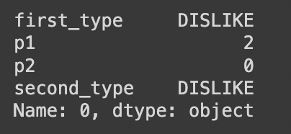
Preprocessing SWIPES Data

Slide 12
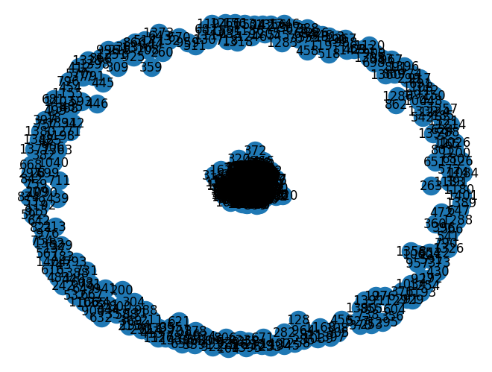
Graph Visualization
DiGraph with 1073 nodes and 8374 edges

Slide 13
Node2Vec Algorithm
Node2Vec converts a graph into a low-dimensional vector representations (embeddings) for each node in the graph.
These embeddings encode structural properties of nodes, such as their local and global connectivity patterns.

Slide 14
Node2Vec Algorithm - Working
Random Walks: Node2Vec starts by generating random walks on the graph. In Node2Vec, the random walk strategy is designed to balance between exploring new neighborhoods and staying within local communities in the graph. It achieves this balance by using two parameters:
Return Parameter (p): Controls the likelihood of revisiting nodes that are already visited.
In-Out Parameter (q): Controls the likelihood of moving away from the immediate neighborhood of the current node.
Learning Embeddings: Once the random walks are generated, Node2Vec learns embeddings for nodes using a technique called Skip-gram. Skip-gram is adapted to learn embeddings for nodes based on the sequences of nodes encountered in random walks.
Skip-gram Adaptation: In the Skip-gram model, given a sequence of nodes from a random walk, the objective is to predict the context nodes (nodes that co-occur nearby) given the current node as input.
Optimization: Node2Vec optimizes the embeddings using techniques like negative sampling to efficiently train the Skip-gram model and stochastic gradient descent to minimize the loss function.

Slide 15
DEMO

Slide 16
Thank You!

