Slide 1

Interactive
Memory Allocation
Simulator
Operating Systems Project
Umang Vekariya
Sarthak Dhawale
Aditya Khunt
01
Notes:
Introduce the team and the project. We simulate contiguous allocation in the browser so each placement decision and its consequences are visible. The deck has fourteen main slides followed by four appendix slides for viva questions. Suggested speaking time is 10 to 12 minutes. Team members can share the concepts, implementation, and demo sections.
Cover artwork is a conceptual AI-generated illustration created with the built-in image tool. It does not depict physical hardware from this project.
Project source: README.md, docs/PROJECT_GUIDE.md, js/core/algorithms.js and js/core/memory-engine.js in OS mem alloc Poject.

Slide 2
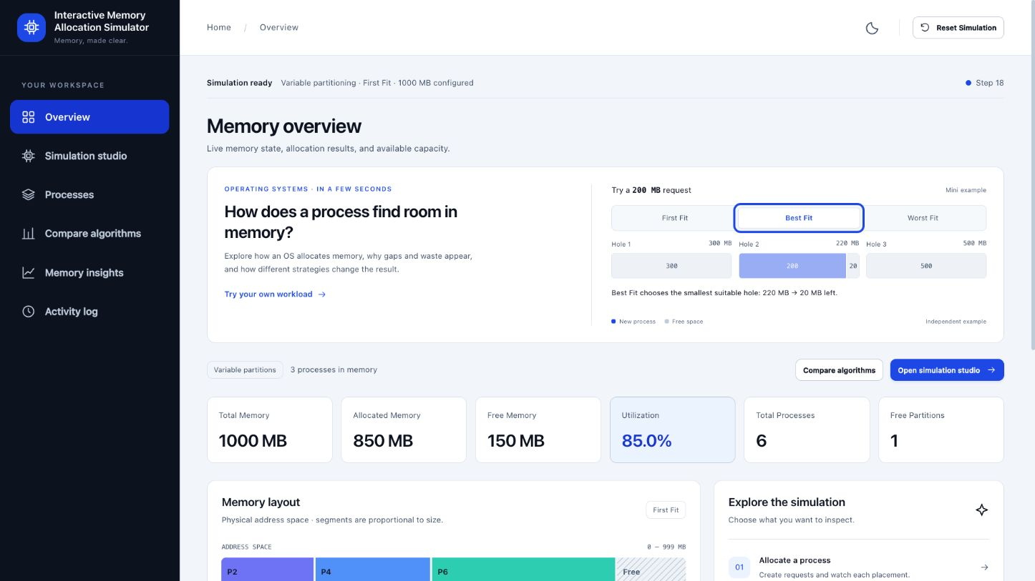
The simulator makes allocation decisions visible
Where does a request fit?
Choose a strategy and watch the memory layout change.
Inspect failed requests, fragmentation, and compaction. Compare the same workload across four algorithms.
Interface example from an earlier demonstration session
02
Notes:
Explain the learning goal rather than listing every feature. Overview introduces placement with a small independent example. The studio supports manual requests, previews, playback, and scenarios. The screenshot is from an earlier demonstration session, before Next Fit and the newest learning views. The current application also shows the saved Next Fit pointer and live metric explanations. All memory sizes and addresses are simulated.
Source image: docs/images/overview.jpg.
Project source: README.md, docs/PROJECT_GUIDE.md, js/core/algorithms.js and js/core/memory-engine.js in OS mem alloc Poject.

Slide 3
Contiguous memory allocation
A process needs one region large enough for its entire request
Before a 200 MB request
After allocation
The 500 MB hole becomes a 200 MB allocation and 300 MB of free space.
03
Notes:
This is an illustrative 1,000 MB layout with two existing 250 MB allocations and a 500 MB free hole. A 200 MB request occupies one contiguous region. In variable mode the engine splits the selected hole. The remaining 300 MB stays available. These memory bars are editable native charts with literal size data. Explain that contiguous means adjacent addresses within a single region.
Project source: README.md, docs/PROJECT_GUIDE.md, js/core/algorithms.js and js/core/memory-engine.js in OS mem alloc Poject.

Slide 4
Four placement strategies
Each strategy uses the same request and current free regions
Strategy | Selection rule
First Fit | The first free region large enough
Best Fit | The smallest free region large enough
Worst Fit | The largest free region large enough
Next Fit | The next suitable region from its saved search position
Next Fit wraps to the beginning when it reaches the end of memory.
04
Notes:
First Fit scans from the beginning. Best Fit and Worst Fit examine all free regions in this list implementation. Next Fit performs a circular First Fit scan from the saved address. All four have O(n) worst-case search time. Explain that no strategy wins every workload. Placement functions return search trails without mutating memory. The engine performs the actual state transition.
Project source: README.md, docs/PROJECT_GUIDE.md, js/core/algorithms.js and js/core/memory-engine.js in OS mem alloc Poject.

Slide 5
Next Fit remembers where its search stopped
Fixed partitions: three regions of 300 MB, then a new 200 MB request
Before: the earlier process has released the first partition
Saved resume address: 600 MB
First Fit
Next Fit
05
Notes:
Initially A and B occupied the first two partitions. A then released its partition, leaving the saved Next Fit address at 600 MB. First Fit restarts at zero and places C in the first partition. Next Fit resumes at the third partition and places C there, then wraps its saved address to zero. A 200 MB request reserves a 300 MB fixed partition, leaving 100 MB internal waste. The live pointer shows the resume address. Failed requests and previews never advance it.
Project source: README.md, docs/PROJECT_GUIDE.md, js/core/algorithms.js and js/core/memory-engine.js in OS mem alloc Poject.

Slide 6
Fixed and variable partitions
The same 200 MB request uses a 300 MB region differently
Fixed partition
Variable partition
300 MB reserved
100 MB internal waste
200 MB reserved
100 MB remains free
Unused space stays inside the process’s partition.
The engine splits the region to match the request.
06
Notes:
The two 300 MB bars have the same physical size. In fixed mode the engine reserves an entire partition. The unused 100 MB is internal fragmentation, not free memory. In variable mode it allocates exactly 200 MB and retains a separate 100 MB free region. In-place growth uses a following free region in variable mode or unused reserved capacity in fixed mode. The labels show the distinction; colors in this explanatory chart distinguish the named series.
Project source: README.md, docs/PROJECT_GUIDE.md, js/core/algorithms.js and js/core/memory-engine.js in OS mem alloc Poject.

Slide 7
550 MB free can still reject a 400 MB request
The request needs a single contiguous hole
550 MB
250 MB
400 MB
Total free
Largest hole
New request
250 + 250 + 50 MB of free space cannot hold this request in one region.
07
Notes:
This is the actual guided fragmentation state. Five initial allocations of 250, 200, 250, 250, and 50 MB fill 1,000 MB. Releasing P1, P3, and P5 leaves holes of 250, 250, and 50 MB. P2 and P4 remain allocated. P6 requests 400 MB and fails. Total free memory is sufficient, but the largest hole is too small. The engine’s variable-mode external fragmentation metric is 550 minus 250, or 300 MB. That fragmented space is still free and can serve smaller requests.
Project source: README.md, docs/PROJECT_GUIDE.md, js/core/algorithms.js and js/core/memory-engine.js in OS mem alloc Poject.

Slide 8
Compaction creates one usable free region
The operation changes addresses and preserves total free memory
Before compaction
After compaction
550 MB free before and after
The 400 MB retry now succeeds
08
Notes:
Compaction moves P2 from 250–449 to 0–199 and P4 from 700–949 to 200–449. It combines all 550 MB of free space into one region at 450–999. It moves two allocated processes and preserves free memory. The retry places P6 at 450–849 and leaves a 150 MB hole. The final state has 850 MB reserved and 150 MB free. Fixed partition mode disables compaction because partition boundaries must remain fixed.
Project source: README.md, docs/PROJECT_GUIDE.md, js/core/algorithms.js and js/core/memory-engine.js in OS mem alloc Poject.

Slide 9
The same workload produces different layouts
Initial regions: 100, 500, 200, 300, 600 MB. Requests: 212, 417, 112, 426 MB.
First Fit
Best Fit
3 allocated, 1 failed
4 allocated, 0 failed
Worst Fit
Next Fit
3 allocated, 1 failed
3 allocated, 1 failed
09
Notes:
These charts come from the current engine and all use the same 1,700 MB scale. Each strategy gets an independent state with the same original regions and request sequence. Best Fit allocates all four. First Fit, Worst Fit and Next Fit allocate three. Colors remain consistent for the same process ID. Free regions use a neutral color. Adjacent configured holes initially remain independently selectable to preserve the textbook hole-list model. This is an example outcome, not a universal ranking.
Project source: README.md, docs/PROJECT_GUIDE.md, js/core/algorithms.js and js/core/memory-engine.js in OS mem alloc Poject.

Slide 10
Best Fit succeeds on this example
Measured results from independent engine runs
Algorithm | Allocated | Searches | Useful use | External frag.
First Fit | 3 / 4 | 14 | 43.6% | 659 MB
Best Fit | 4 / 4 | 20 | 68.6% | 359 MB
Worst Fit | 3 / 4 | 20 | 43.6% | 659 MB
Next Fit | 3 / 4 | 12 | 43.6% | 659 MB
Next Fit examines fewer free regions here. Best Fit serves one more request.
10
Notes:
Values are from the current memory engine. First Fit has 3 successes, 14 free-block examinations, 43.6% useful utilization and 659 MB external fragmentation. Best Fit has 4, 20, 68.6% and 359 MB. Worst Fit has 3, 20, 43.6% and 659 MB. Next Fit has 3, 12, 43.6% and 659 MB. Search effort counts examined free blocks, not CPU time. Best Fit’s extra scans improve successful placement in this example. All ratios use exact engine values before displayed rounding.
Project source: README.md, docs/PROJECT_GUIDE.md, js/core/algorithms.js and js/core/memory-engine.js in OS mem alloc Poject.

Slide 11
Frontend architecture
All simulation calculations run in JavaScript in the browser
01
Core
Placement rules and state transitions
js/core/
02
Controller
User actions, step mode, and comparison
js/app.js
03
Interface
Maps, charts, demonstrations, and saves
js/interface/
HTML defines the pages. CSS styles them. Python only serves the static files.
11
Notes:
Open the project tree if the examiner asks. Core has algorithms.js and memory-engine.js. app.js initializes the application, handles controls and coordinates rendering. Interface files show the state and provide features. Scripts share the page scope and load in the order at the bottom of index.html, with app.js last. Browser storage autosaves committed workload actions and reconstructs the state through replay. This project has no database or backend simulation service. It uses plain JavaScript rather than React or TypeScript.
Project source: README.md, docs/PROJECT_GUIDE.md, js/core/algorithms.js and js/core/memory-engine.js in OS mem alloc Poject.

Slide 12
Live demonstration
A repeatable sequence that explains both failure and recovery
1
Start guided demo
Fill the 1,000 MB memory space.
2
Advance the releases
Show 550 MB free and a 250 MB largest hole.
3
Inspect the failure
The 400 MB request remains waiting.
4
Compact and retry
Show the successful allocation and new addresses.
12
Notes:
Before presenting, start the server with python3 -m http.server 8001 --bind 127.0.0.1 and open http://127.0.0.1:8001/. Open Simulation studio. Start guided demo replaces the current workload after confirmation when needed. Advance with Next stage and avoid unrelated mutations during the lesson. Show the failed P6 request, then compaction, then successful retry. If time allows, open Compare algorithms, run the classic scenario comparison, inspect all four maps and show Next Fit’s saved position. Loading a workload replaces the current session, so save an experiment first if you want to retain it.
Project source: README.md, docs/PROJECT_GUIDE.md, js/core/algorithms.js and js/core/memory-engine.js in OS mem alloc Poject.

Slide 13
Verification covers the memory lifecycle
Automated regression checks and deterministic mixed operation tests
48
4,000
regression checks
mixed operations
Checks include circular search, merge and split, fixed waste, replay,
comparison isolation, and exactly one commit during playback.
node tests/simulator.test.js
13
Notes:
The current suite passes 48 tests. Its deterministic stress case executes 500 mixed actions per algorithm per partition mode, totaling 4,000 actions. It checks capacity conservation, contiguous address ranges, unique block IDs, process ownership and nonnegative waste. Dedicated checks cover Next Fit wraparound, cursor persistence, preview purity, step commits, saved workload replay and independent comparison. Teaching-view checks verify pointer text, metrics, escaped user content, stale snapshots and reset. These are correctness checks, not a claim about runtime performance.
Project source: README.md, docs/PROJECT_GUIDE.md, js/core/algorithms.js and js/core/memory-engine.js in OS mem alloc Poject.

Slide 14
What the project demonstrates
Allocation choices change which requests memory can serve
Placement
The same workload can produce different layouts and search costs.
Fragmentation
Enough total free memory can still be insufficient for one contiguous request.
Recovery
Compaction changes the layout while preserving total free space.
14
Notes:
Close by connecting the observed results to operating-system concepts. Invite questions and use the appendix for metrics, ranking, Next Fit details and viva answers. The application is a simplified contiguous-memory simulation. It does not implement paging, virtual memory, swapping, CPU scheduling or real kernel allocation. These are possible future extensions rather than current capabilities.
Project source: README.md, docs/PROJECT_GUIDE.md, js/core/algorithms.js and js/core/memory-engine.js in OS mem alloc Poject.

Slide 15
Appendix: metric definitions
Metric | Formula or interpretation
Reserved utilization | Reserved allocated memory / total memory
Useful utilization | Requested memory of allocated processes / total memory
Internal waste | Reserved size minus requested size
External fragmentation | Free memory minus the largest hole in variable mode
Utilization percentages multiply by 100. Fixed mode reports external fragmentation as zero.
15
Notes:
Distinguish reserved utilization from useful utilization. Fixed partitions can show high reserved utilization while wasting space internally. External fragmentation is this simulator’s dispersion metric; it does not mean the memory disappeared. Smaller requests can still use it. The external ratio divides by free memory and the internal ratio divides by reserved memory. Both return zero for zero denominators. Fixed partition limitations appear as capacity failures rather than external fragmentation.
Project source: README.md, docs/PROJECT_GUIDE.md, js/core/algorithms.js and js/core/memory-engine.js in OS mem alloc Poject.

Slide 16
Appendix: the comparison recommendation
A transparent project-specific score out of 100
Component | Weight
Successful allocation and growth requests | 65%
Useful payload utilization | 15%
100 minus external fragmentation ratio | 15%
Normalized search economy | 5%
Success receives the largest weight. Exact score ties retain every winner.
16
Notes:
Formula: 0.65 times success rate plus 0.15 times useful payload utilization plus 0.15 times (100 minus external fragmentation ratio) plus 5 times (1 minus searches divided by maximum searches across algorithms, with a minimum denominator of 1). Successful allocations include successful growth attempts. The score is a project-specific comparison aid, not a standard OS theorem. Payload utilization avoids rewarding fixed-partition waste. Every comparison result is a snapshot; rerun it after changing the workload.
Project source: README.md, docs/PROJECT_GUIDE.md, js/core/algorithms.js and js/core/memory-engine.js in OS mem alloc Poject.

Slide 17
Appendix: Next Fit cursor behavior
Operation | Saved search address
Successful Next Fit allocation | End of reserved region plus one, with wraparound
Failure, preview, or step review | Unchanged
Split, merge, or release | Address stays valid across list changes
Configuration, reset, or compaction | Reset to zero
The search starts in the region containing that address and scans at most one full cycle.
17
Notes:
The simulator stores an address rather than a block-list index. This prevents splits and merges from invalidating the saved position. When coalescing makes the cursor fall inside a free hole, the search considers that whole region. Variable mode can immediately use the leftover hole from the last allocation. Fixed mode resumes at the next partition. Other algorithms, algorithm switches and in-place growth do not advance the saved Next Fit position. Compaction resets it because relocation changes addresses. Each replay and comparison state maintains its own cursor.
Project source: README.md, docs/PROJECT_GUIDE.md, js/core/algorithms.js and js/core/memory-engine.js in OS mem alloc Poject.

Slide 18
Appendix: viva questions
Question | Short answer
Is Best Fit always best? | No. The request and release pattern determines the result.
Can compaction create memory? | No. It joins scattered free space by moving allocations.
What does Previous do in step mode? | It reviews the explanation without undoing allocation.
Why is there no backend? | The browser can simulate the entire memory model locally.
18
Notes:
More possible questions: coalescing merges already adjacent free regions, while compaction relocates allocated processes to bring separate holes together. The model uses simulated MB offsets rather than real pointers. Worst-case search is O(n). Comparison fairness comes from identical starting memory and recorded lifecycle actions on independent states. Local JSON saves replay committed actions rather than trusting imported statistics. Be ready to explain why the initially configured variable holes remain independent until merging or compaction, as documented in the model.
Project source: README.md, docs/PROJECT_GUIDE.md, js/core/algorithms.js and js/core/memory-engine.js in OS mem alloc Poject.

