Slide 1
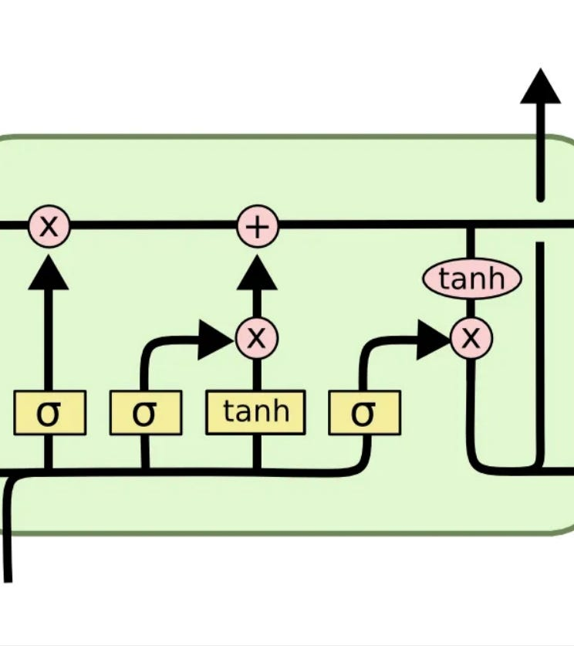
Long Short-term Memory
Presentation from: Umang Arun Blesson

Slide 2


Meet the authors – the When
LONG SHORT-TERM MEMORY Neural Computation 9(8):1735{1780, 1997
Sepp Hochreiter
Jurgen Schmidhuber

Slide 3
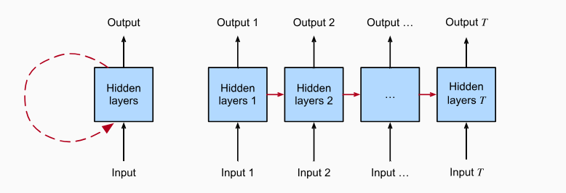
Großes Bild
Introduction – the Why
Lets talk about RNNs:
sequential data where context matters
RNN unfolds over timesteps
Notes:
RNNs by design are similar to deep neural networks.
They have input vectors, weight vectors, hidden states and output vectors.
The hidden state captures the patterns or the context of a sequence into a summary vector.
The outputs are influenced not just by
weights applied on inputs like a regular neural network,
but also by a “hidden” state vector representing the context based information on prior inputs, such that the same input could produce a different output depending on context of inputs in the sequence.

Slide 4
Großes Bild
Challenge with RNNs
output unit k’s target at time t
k
d_{k}(t)
k’s error signal
MSE

Slide 5

Großes Bild
output unit k’s target at time t
output unit k’s error signal
MSE
activation of a non-input unit i

Slide 6

Großes Bild
output unit k’s target at time t
output unit k’s error signal
MSE
activation of a non-input unit i
unit i’s current net input

Slide 7
Großes Bild
output unit k’s target at time t
output unit k’s error signal
MSE
activation of a non-input unit i
indicates how previous states of
the same unit influence it’s current
state
unit i’s current net input
weight on connection from j to i

Slide 8

Großes Bild
output unit k’s target at time t
output unit k’s error signal
MSE
non-output unit j’s
error signal
activation of a non-input unit i
indicates how previous states of
the same unit influence it’s current
state
unit i’s current net input

Slide 9
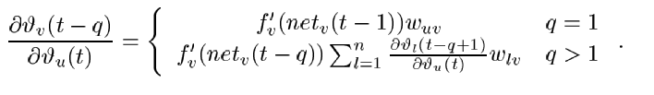

Großes Bild
number of timesteps
number of timesteps gone back in time
u influences the error
on v and is scaled by the factor
v
u
Notes:
The error occurring at an arbitrary unit u at time step t is propagated back into time for q time steps to an arbitrary unit v
This will scale the error by the following factor

Slide 10
Großes Bild
>1
<1
as q increases the error value increases exponentially and
blows up the error
leads to oscillating error
as q increases the error value decreases exponentially and vanishes
Notes:
The error occurring at an arbitrary unit u at time step t is propagated back into time for q time steps to an arbitrary unit v
This will scale the error by the following factor

Slide 11

Großes Bild
to avoid vanishing error signals
enforce constant error flow
Notes:
The error occurring at an arbitrary unit u at time step t is propagated back into time for q time steps to an arbitrary unit v
This will scale the error by the following factor

Slide 12

Großes Bild
to avoid vanishing error signals
enforce constant error flow
integrating
Notes:
The error occurring at an arbitrary unit u at time step t is propagated back into time for q time steps to an arbitrary unit v
This will scale the error by the following factor

Slide 13
Großes Bild
to avoid vanishing error signals
enforce constant error flow
integrating
implies
f_{j} has to be linear
unit j’s activation function has to remain constant
Notes:
The error occurring at an arbitrary unit u at time step t is propagated back into time for q time steps to an arbitrary unit v
This will scale the error by the following factor

Slide 14
Großes Bild
to avoid vanishing error signals
enforce constant error flow
integrating
implies
f_{j} has to be linear
unit j’s activation function has to remain constant
Notes:
The error occurring at an arbitrary unit u at time step t is propagated back into time for q time steps to an arbitrary unit v
This will scale the error by the following factor

Slide 15
Großes Bild
a single unit’s problem is solved,
now how to solve the problem w.r.t other connected units
Input weight conflict
Output weight conflict
Notes:
Input weight conflict for simplicity let us focus on a single additional input weight wji Assume that the total error can be reduced by switching on unit j in response to a certain input and keeping it active for a long time until it helps to compute a desired output Provided i is non zero since the same incoming weight has to be used for both storing certain inputs and ignoring others wji will often receive conflicting weight update signals during this time recall that j is linear these signals will attempt to make wji participate in storing the input by switching on j and protecting the input by preventing j from being switched o by irrelevant later inputs This con ict makes learning di cult and calls for a more context sensitive mechanism for controlling write operations through input weights

Slide 16
Großes Bild
Input weight conflict
needs to be switched on for an input x {e.g. “}
i
w_{ji}
j
needs to remain switched on even if a non-positive input x is received {e.g. “xv}
need to be switched off only when a certain input is received {e.g. “xvy”}
requires context-sensitive mechanism
for write operations through inputs
Notes:
Input weight conflict for simplicity let us focus on a single additional input weight wji Assume that the total error can be reduced by switching on unit j in response to a certain input and keeping it active for a long time until it helps to compute a desired output Provided i is non zero since the same incoming weight has to be used for both storing certain inputs and ignoring others wji will often receive conflicting weight update signals during this time recall that j is linear these signals will attempt to make wji participate in storing the input by switching on j and protecting the input by preventing j from being switched o by irrelevant later inputs This con ict makes learning di cult and calls for a more context sensitive mechanism for controlling write operations through input weights

Slide 17
Großes Bild
Output weight conflict
unit j would influence the output of k
j
w_{kj}
k
this influence too must be context-sensitive
the read operations through output weights
need to be controlled
Notes:
Output weight confict assume j is switched on and currently stores some previous input For simplicity let us focus on a single additional outgoing weight wkj The same wkj has to be used for both retrieving j s content at certain times and preventing j from disturbing k at other times As long as unit j is nonzero wkj will attract conficting weight update signals generated during sequence processing these signals will attempt to make wkj participate in accessing the information stored in j and at di erent times protecting unit k from being perturbed by j For instancewith many tasks there are certain short time lag errors that can be reduced in early training stages However at later training stages j may suddenly start to cause avoidable errors in situations that already seemed under control by attempting to participate in reducing more di cult long time lag errors Again this con ict makes learning di cult and calls for a more contextsensitive mechanism for controlling read operations through output weights

Slide 18
Großes Bild
LSTM Overview –the How
LSTMs have 4 different components, namely
Cell state (Memory cell)
Forget gate
Input gate
Output gate

Slide 19
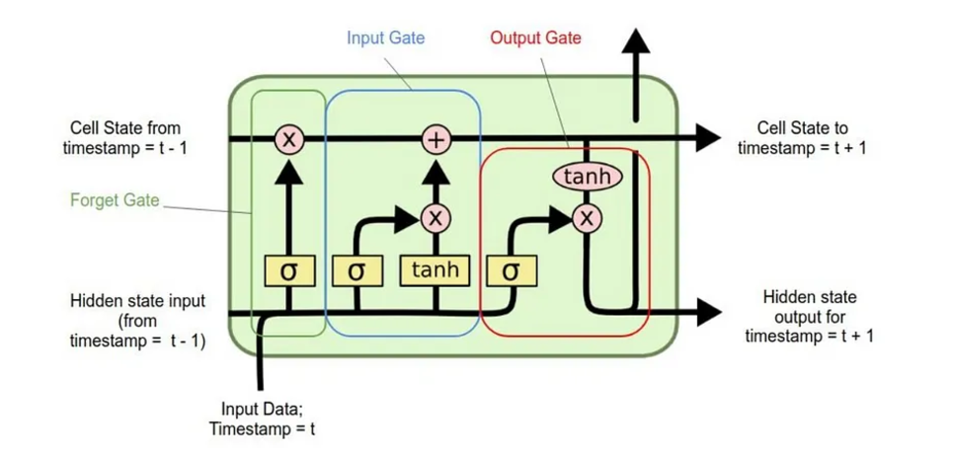
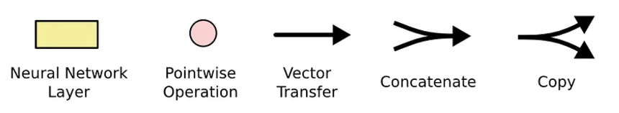
Großes Bild
The Architecture

Slide 20
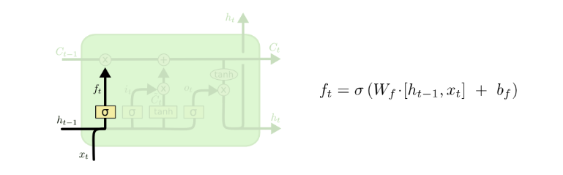
Großes Bild
Forget Gate:
Forget Gate
Main Task of Forget Gate :
Calculate ft
Pointwise operation ft x Ct-1

Slide 21
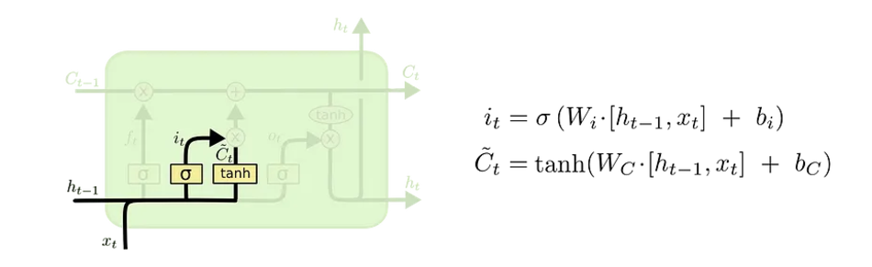
Großes Bild
Input Gate:
Input Gate
Main Task of Input Gate:
Calculate C_{t} (Candidate cell state)
I_{t} calculation (actual values to add in cell state)
C_{t} + i_{t}

Slide 22
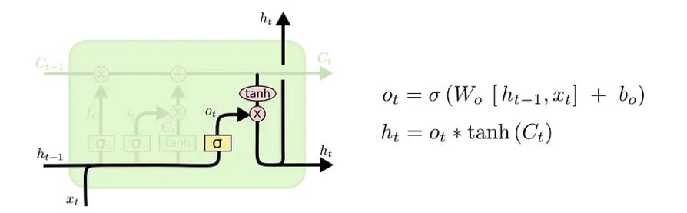
Großes Bild
Output Gate:
Output Gate
Main tasks of output gate :
Calculating O_{t}
O_{t} x tanh(C_{t-1})

Slide 23
Großes Bild
LSTM in Action

Slide 24

Großes Bild
LSTM vs
Backpropagation Through Time (BPTT)
Real-Time Recurrent Learning (RTRL):
Other Architectures like Elman Nets
Classical RNNs
Fails when faced with long time lags because of vanishing or exploding gradients.
Less effective at learning patterns with long temporal dependencies.
RNNs struggle with long-term dependencies due to vanishing gradients.
Suffers from computational inefficiency as the number of weights increases
POV: It's 1997

Slide 25
Großes Bild
Experiments
Embedded Reber grammar
Noise-free and Noisy sequences
Noise and signal on the same channel
Adding problem
Multiplication Problem
Temporal Order
Result : LSTM performed better than algorithms like BPTT, RTRL, etc. Note: "Guessing" the weights randomly led to faster results in some cases.

Slide 26
Großes Bild
Limitations
Difficulty with Non-Decomposable Tasks: calculating the XOR of two bits far apart in a noisy sequence (full backpropagation doesn’t help because $$$)
Additional Complexity Due to Gates: Additional computational cost compared to simple RNNs because of extra units for gates
Similar Problems to Feedforward Networks on Complex Tasks
Counting Discrete Time Steps Precisely: LSTM is not good at tasks requiring exact counting of time steps.

Slide 27
Großes Bild
Applications
Natural Language Processing (NLP): Text generation, language translation, speech recognition, sentiment analysis.
Time Series Analysis: Stock price prediction, weather forecasting, energy load prediction.
Audio and Speech Processing: Speech-to-text, music composition, sound classification.
Healthcare: ECG analysis, patient monitoring, drug discovery.
Video Analysis: Action recognition, video captioning, surveillance systems.
Recommender Systems: Personalized recommendations for products, movies, or music.

Slide 28
Großes Bild
Conclusion

Slide 29

Vielen Dank

