Slide 1

Sparse Transformers [2019]
R. Child S. Gray A. Radford I. Sutskever

Slide 2

Introduction
Time complexity :
Transformers O(n²)
Sparse-transformers O(n*n^{1/2})
n – number of tokens in the input sequence

Slide 3
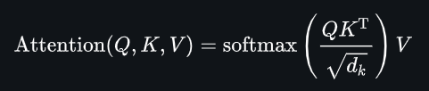
Attention pattern

Slide 4
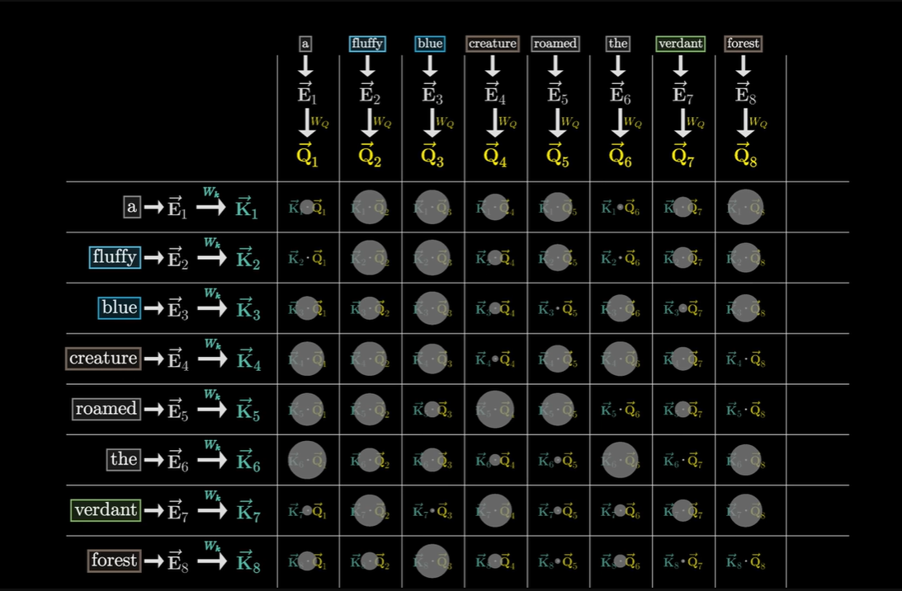

Slide 5
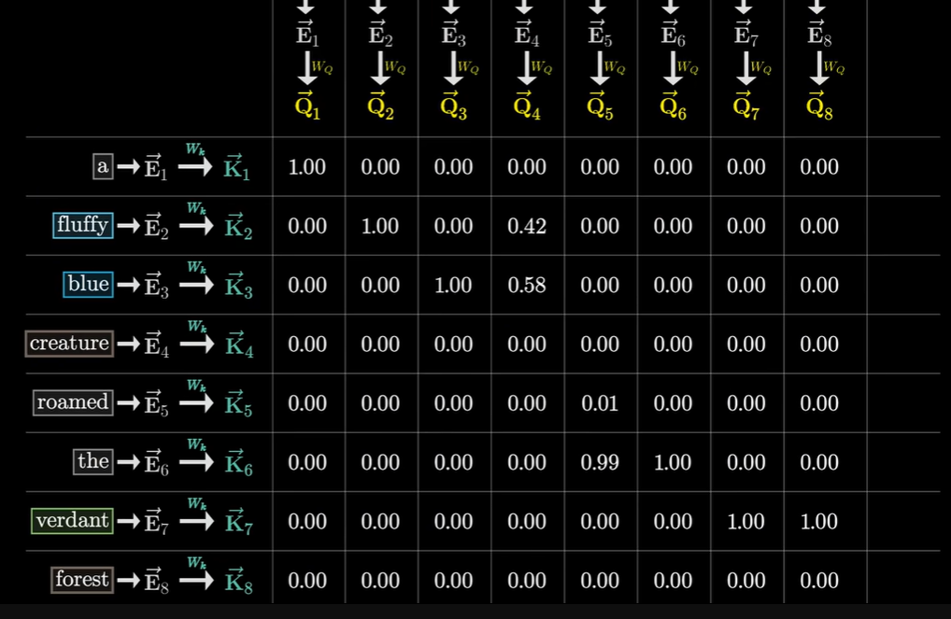

Slide 6
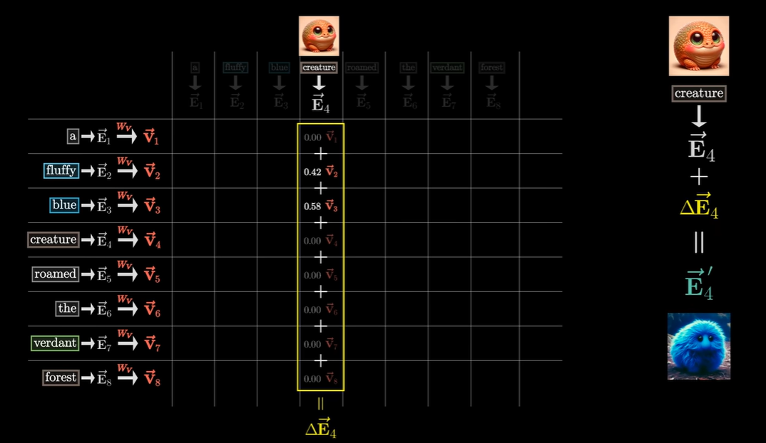

Slide 7
Transformer models transform the input sequence with blocks of multihead self-attention over the entire sequence, followed by dense transformations over each sequence element.
The self attention portion of the network must compute n weightings for each of n elements, however, which can quickly become intractable as the sequence length grows.

Slide 8
Full attention computation is separated into several fast attention operations which when combined approximates the dense attention operation

Slide 9
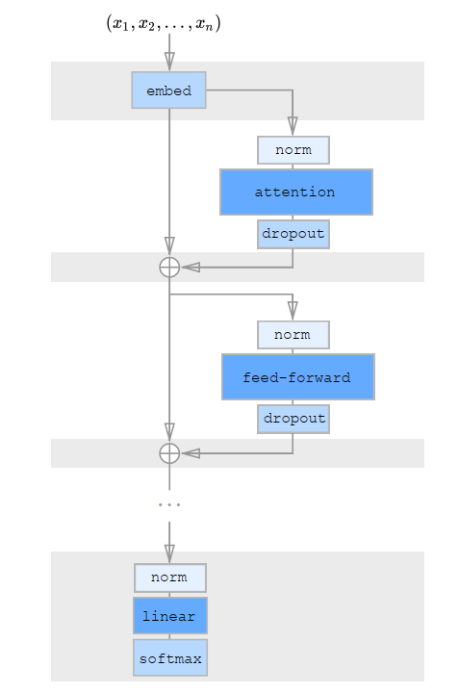
2. Architectural changes

Slide 10
3. Other changes introduced
A restructured residual block and weight initialization to improve training of very deep networks
A set of sparse attention kernels which efficiently compute subsets of the attention matrix
Notes:
residual blocks are used to preserve features from forgetting in deep networks
These kernels allow for the efficient computation of subsets of the attention matrix, which saves a significant amount of time and memory. By using sparse attention kernels, the model can still attend to different parts of the input sequence, but it does so in a more efficient manner.
Finally, the Sparse Transformer recomputes attention weights during the backwards pass. This allows for further reduction of memory usage, as the model only needs to compute the attention weights that are necessary for backpropagation.

Slide 11
Factorized Self Attention
A different mechanism : Attention is calculated over a subset of input embeddings instead of the entire sequence.
Instead of attending to all input vectors, each input attends to a subset of input indices defined by a "connectivity pattern"

Slide 12
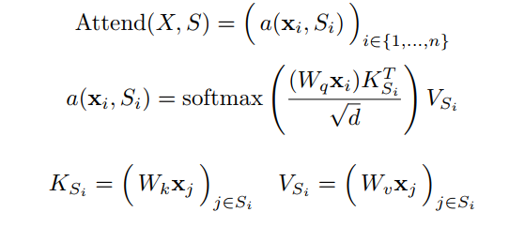
X – Matrix of input embeddings
Wq, Wk, Wv – Weight matrices to project input embeddings
Ks – Key vector
Vs – Value vector
d- dimensionality
Instead of computing attention over all tokens in the sequence , the model attends to a smaller subset. This sparsity reduces computation!

Slide 13
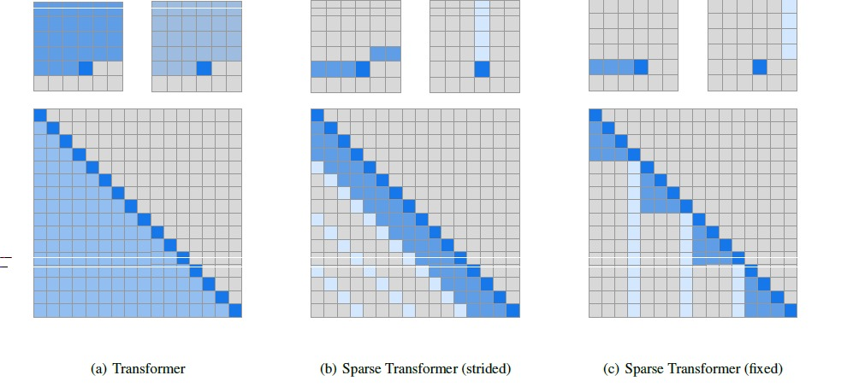
The last row in the connectivity matrix corresponds to the last output token, and it shows which input tokens it attends to.

Slide 14
Two-Dimensional Factorized Attention
Strided Attention: One attention head attends to a strided subset of tokens
Fixed Attention: Another head attends to a fixed block of tokens
Combined Attention: Using two heads (one strided, one fixed), any output position can indirectly attend to any input position. This ensures global connectivity while maintaining sparsity.

Slide 15



Factorized attention heads
Standard dense attention simply performs a linear transformation of the attend function:
Wp - post-attention weight matrix
For integrating factorized self-attention we use one attention type per residual block, and interleave them sequentially or at a ratio determined as a hyperparameter: ( r is the index of the current residual block and p is the number of factorized attention heads)
Merged head: A single head attend to the locations of the pixels that both factorized heads would attend to, called as a merged head. Its more computationally expensive.

Slide 16
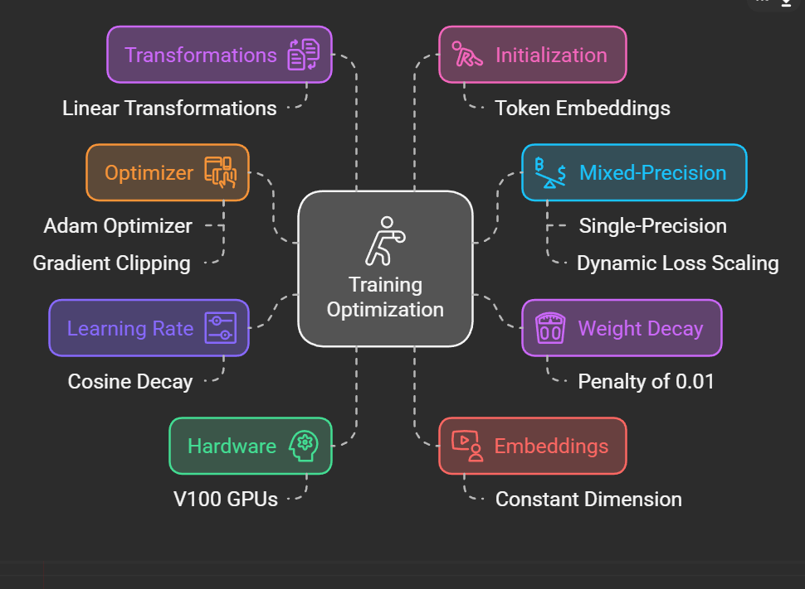
Training

Slide 17
Experiments
The paper tested Sparse Transformers on density modelling tasks across diverse data types: images, text, and raw audio.
The goal was to show that Sparse Transformers achieve comparable or superior results to standard Transformers, with significantly reduced computational demands.
The experiments revealed that sparse patterns converged to lower errors and were faster than dense attention.

Slide 18
CIFAR-10
Data: CIFAR-10 images represented as sequences of 3072 bytes.
Model: They trained a Sparse Transformer with "strided attention". Strided attention captures both local relationships (things nearby in the sequence) and some long-range dependencies.
Training: 120 epochs, learning rate 0.00035, dropout 0.25.
Results: Achieved 2.80 bits per dimension, outperforming the previous state-of-the-art of 2.85. Strided attention had the lowest error and was faster than dense attention.

Slide 19
Enwik8:
Data: Enwik8 dataset (Text as Sequence), representing the first 10^8 bytes of Wikipedia.The aim was to see how well the model could predict the next character in a very long text sequence.
Model: They trained a Sparse Transformer with "fixed attention".
Training: 80 epochs, stride 128, c=32, merged factorized attention heads.
Results: The Sparse Transformer achieved 0.99 bits per dimension, which is comparable to a much larger model and significantly better than previous state-of-the-art for models with a similar number of parameters. The results also showed that the model was able to make better predictions when it could access a longer context

Slide 20
ImageNet 64x64
Data: Downsampled ImageNet 64x64.(Larger Images, Longer Sequences)
Model: They trained a Sparse Transformer with strided attention and evaluated its performance..
Training: 70 epochs, stride of 128, dropout of 0.01.
Results: Achieved 3.44 bits per dimension, improving upon the previous 3.52. The model was also able to generate realistic images, demonstrating its ability to learn complex patterns and relationships within large image data sets.

Slide 21
Classical Music (Raw Audio)
Data: Classical music dataset.
Methodology: Explored the scaling of model capacity with increasing sequence length.
Findings: Found that increasing the sequence length by a factor of 4, required a reduction in model capacity by approximately 8.
Results: The Sparse Transformer was able to generate coherent audio samples, that showed an understanding of the underlying patterns in the music. They found that increasing the sequence length required a reduction in the model size.

Slide 22
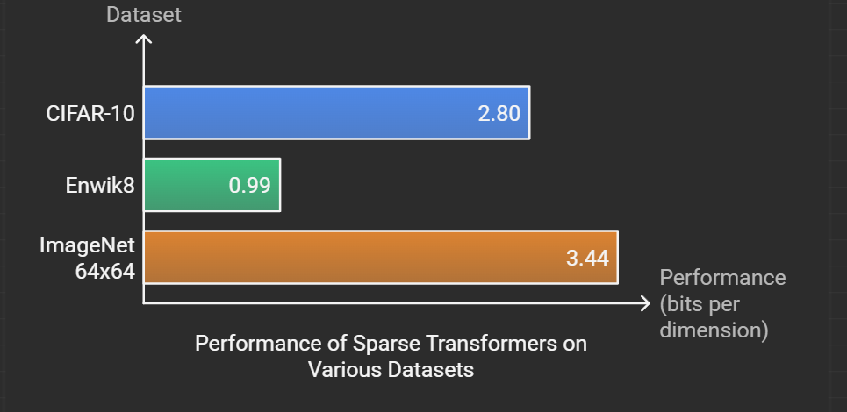

Slide 23
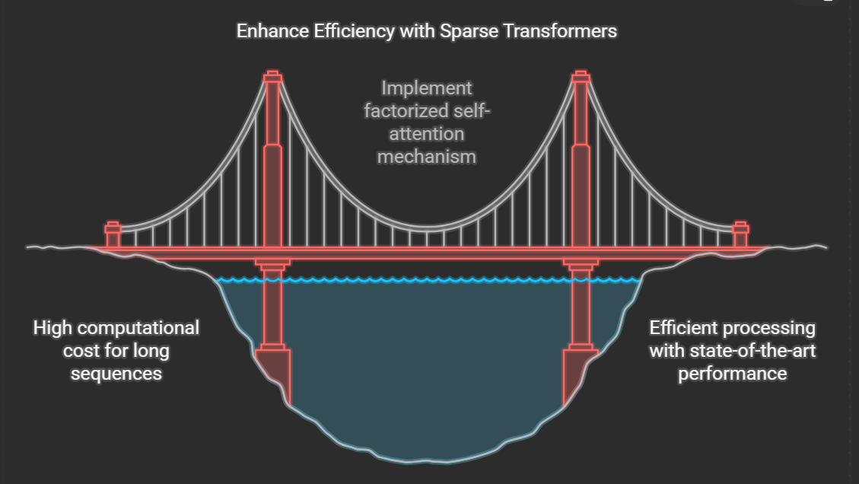
Summary

Slide 24

Presented by:
Blesson
Arun
Umang

