Slide 1



Project RoadShow
Resume Reviewver

Slide 2
✅ Automate resume screening so you don’t bother the Professors.
✅ Provide AI-based insights for resume improvement.
✅ Improve job match percentage using Applicant Tracking System (ATS) criteria.
✅ Offer real-time feedback for better job applications

Slide 3
Frameworks & Libraries
📌 Streamlit – Web application framework
📌 Google Generative AI (Gemini-Pro) – AI-powered text analysis
📌 PIL (Pillow) – Image handling
📌 Base64 & pdf2image – PDF content extraction

Slide 4
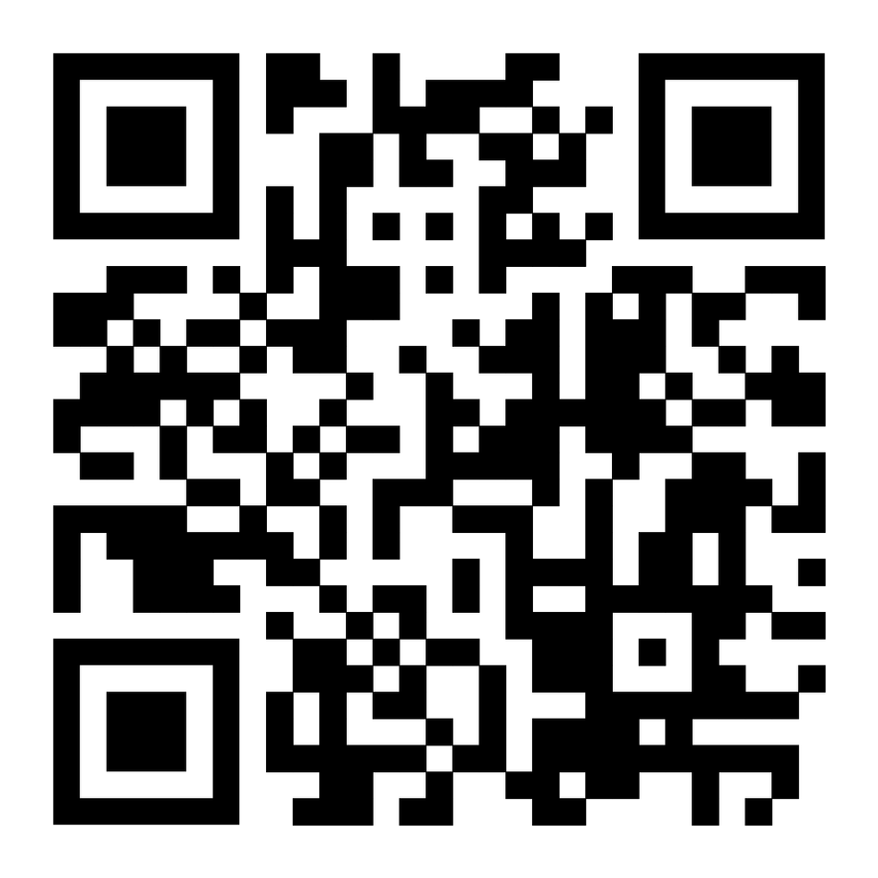
Try it for yourself

Slide 5
Thank you

