Slide 1
SQL Project: Pizza Sales Analysis
Data Analysis using SQL
By Umang Gurjar

Slide 2
Project Introduction
This project analyzes pizza sales data to uncover business insights.
Objectives include identifying best-selling pizzas, revenue trends, and customer preferences.
Tools used: SQL (MySQL), PowerPoint.

Slide 3
Dataset Overview
Dataset Files:
- orders.csv: Order timestamps
- order_details.csv: Items per order
- pizzas.csv: Pizza size, type, price
- pizza_types.csv: Description and category
Total Rows: ~5000+
Used in SQL via table import.

Slide 4
Database Schema
Tables and Key Columns:
- orders (order_id, date, time)
- order_details (order_details_id, order_id, pizza_id, quantity)
- pizzas (pizza_id, pizza_type_id, size, price)
- pizza_types (pizza_type_id, name, category, ingredients)
Relationships via pizza_id and pizza_type_id.

Slide 5
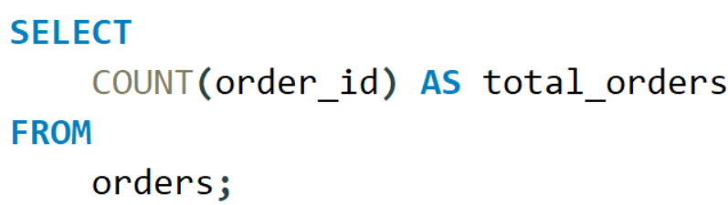
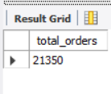
Basic SQL Queries
1. Retrieve the total number of orders placed.

Slide 6
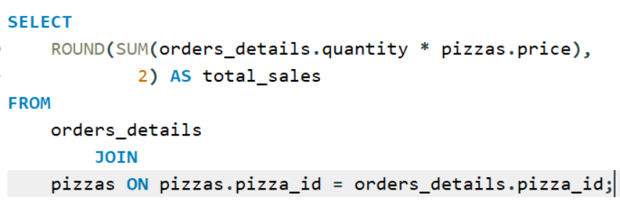
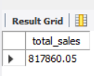
Basic SQL Queries
2. Calculate the total revenue generated from pizza sales.

Slide 7
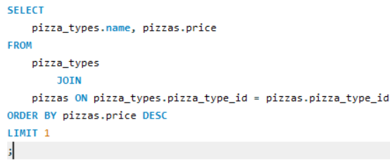

Basic SQL Queries
3. Identify the highest-priced pizza.

Slide 8
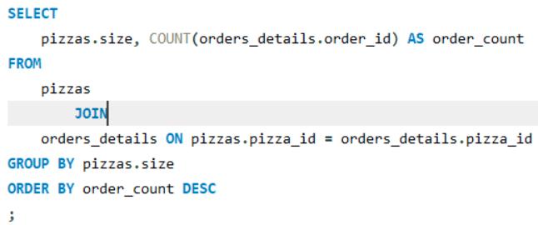
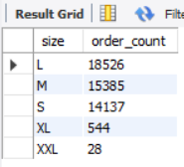
Basic SQL Queries
4. Identify the most common pizza size ordered.

Slide 9
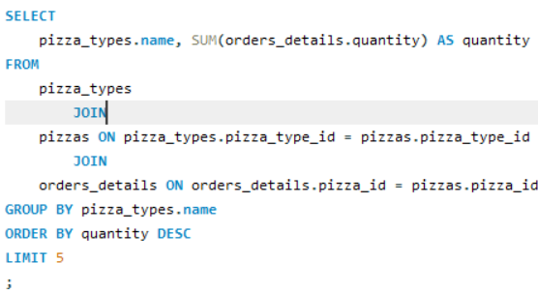
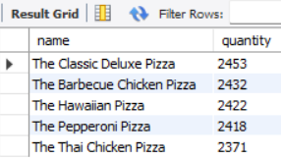
Basic SQL Queries
5. List the top 5 most ordered pizza types along with their quantities.

Slide 10
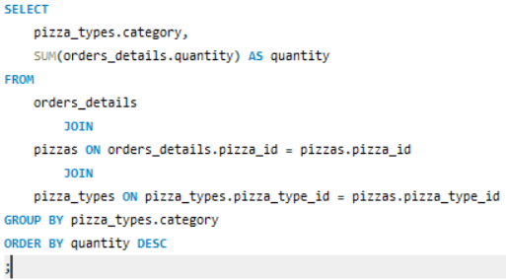
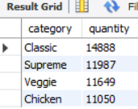
Intermediate SQL Queries
1. Join the necessary tables to find the total quantity of each pizza category ordered.

Slide 11
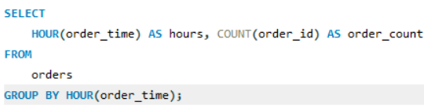
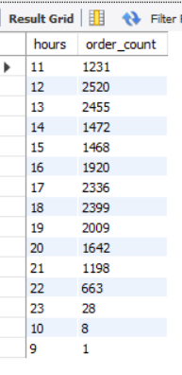
Intermediate SQL Queries
2. Determine the distribution of orders by hour of the day.

Slide 12
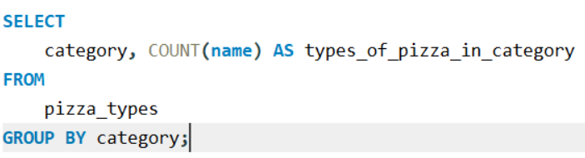
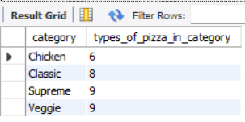
Intermediate SQL Queries
3. Join relevant tables to find the category-wise distribution of pizzas.

Slide 13
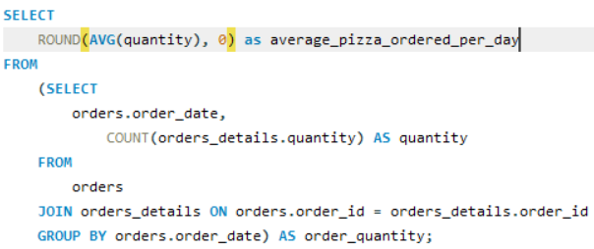

Intermediate SQL Queries
4. Group the orders by date and calculate the average number of pizzas ordered per day.

Slide 14
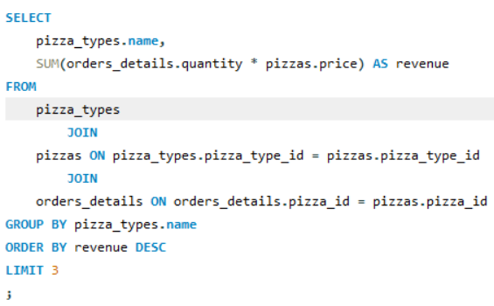
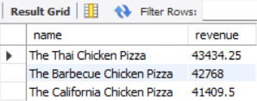
Intermediate SQL Queries
5. Determine the top 3 most ordered pizza types based on revenue.

Slide 15
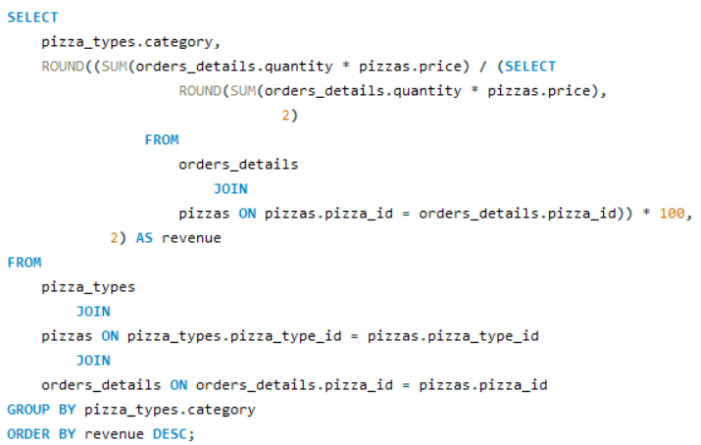
Advanced SQL Queries
Calculate the percentage contribution of each pizza type to total revenue.

Slide 16
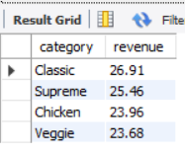
Advanced SQL Queries
Calculate the percentage contribution of each pizza type to total revenue.

Slide 17
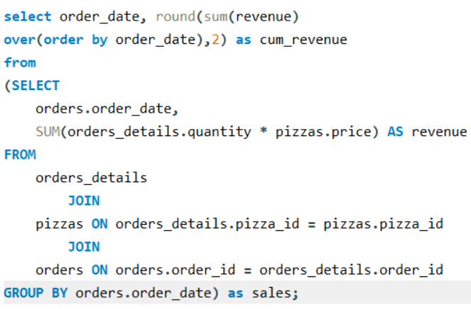
Advanced SQL Queries
2. Analyze the cumulative revenue generated over time.

Slide 18
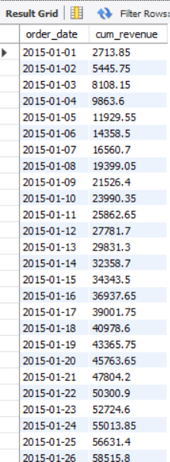
Advanced SQL Queries
2. Analyze the cumulative revenue generated over time.

Slide 19
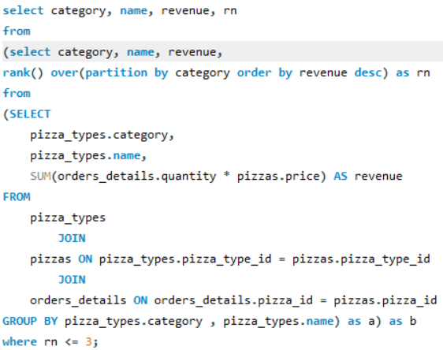
Advanced SQL Queries
3. Determine the top 3 most ordered pizza types based on revenue for each pizza category.

Slide 20
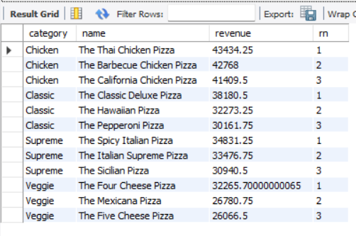
Advanced SQL Queries
3. Determine the top 3 most ordered pizza types based on revenue for each pizza category.

Slide 21
Insights & Summary
- Classic and Supreme pizzas dominate revenue.
- Medium size is most popular among customers.
- Peak orders happen during evening hours.
- Strong correlation between category and pricing.

Slide 22
Challenges & Learnings
- Handling NULL values in quantity/price fields.
- Parsing date/time for hourly trends.
- Learned advanced SQL (CTEs, window functions).
- Gained experience with JOINs and GROUP BY clauses.

Slide 23
Thank You
Thank you for reviewing my project.
Questions and feedback are welcome.
Presented by: Umang Gurjar

