Slide 1
SHIKSHA EKIKARAN
By Umang Basuthkar

Slide 2
Functional Requirements
The website should be able to display any information regarding the educational status of any group of students.
It should able to display enough educational data for the education-controlled agencies to form policies.
The data must vary across various groups like, girls, boys, SC’s, ST’s etc. and the data must be easily accessible to those who want to use the website.
The website should be able to group and display a specific set of data based on the preference of the user like, “Data on girl’s technical education”, “Data on all high school education”, etc.
The website should be easy to access and easy to navigate so that there’s a smooth flow of information between the user and the website.

Slide 3
Primary Users
The primary users refers to those who will want to use the website. They could be people like:-
The Education controlling agencies
The colleges
The schools

Slide 4
Number of Screens
There are going to be four screens. They are:-
Home :- The home page will contain a brief overview on what the website is about, what is its primary use and a detailed explanation of how it will work.
About Us :- This page will contain a detailed explanation of the main goal of the website and will also contain information about the developer team.
Login :- This will allow people, mainly those who work in education controlling agencies, to login and add, update, analyse the data present in the database.
Contact Info :- This page will contain E-mail ID’s of the customer service of their respective agencies, in case of queries.

Slide 5
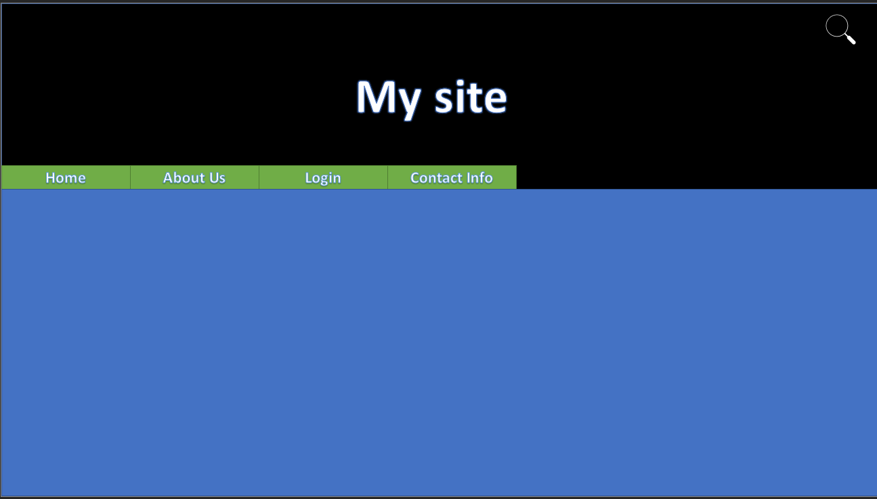
Basic Layout Of The Website
*By basic layout, I meant the core look of the website on every screen, the data in it will differ*

Slide 6
Week 2

Slide 7
Most Valuable Points (MVPs)
The data would be visualized into various pictorial representations like graphs, pie charts, histograms, etc.
When the users accesses the website and when they search for specific parts, they should be greeted with the above said representations.
This would make the student’s data more easy to understand and analyse for the respective agencies to work on them.

Slide 8
The above bar graph displays the percentage of boys and girls who passed the respective subjects.
If a user wants to filter out the percentage of boys and girls who passed the respective subjects, this is how the data would be visualized

Slide 9
Similar to the bar graphs in the previous slide, these pie charts show the percentage of students who received a particular range of grade in their respective final examinations.
And in a similar scenario as presented in the previous slide, it would be easy for the user to filter and analyse the data.

Slide 10
Week 3

Slide 11
Functional Requirements
The website should be user friendly so that the user can navigate through it smoothly.
The institutions (schools and colleges) should be able to upload the data of their respective institutions.
They should also be able to download previously uploaded data, to edit and re-uploaded the data.
The government official should be only view the data, so that he/she can analyse it to form policies.
The data should be displayed using graphs, charts, etc.

Slide 12
Website Users
The users of the website include institutions like schools, colleges and government officials.
Schools and Colleges : Schools and Colleges can register themselves and will have the ability to upload new data and also download and edit previously uploaded data.
Government Officials : They will be able to view the data in the form of graphs, charts etc.

Slide 13
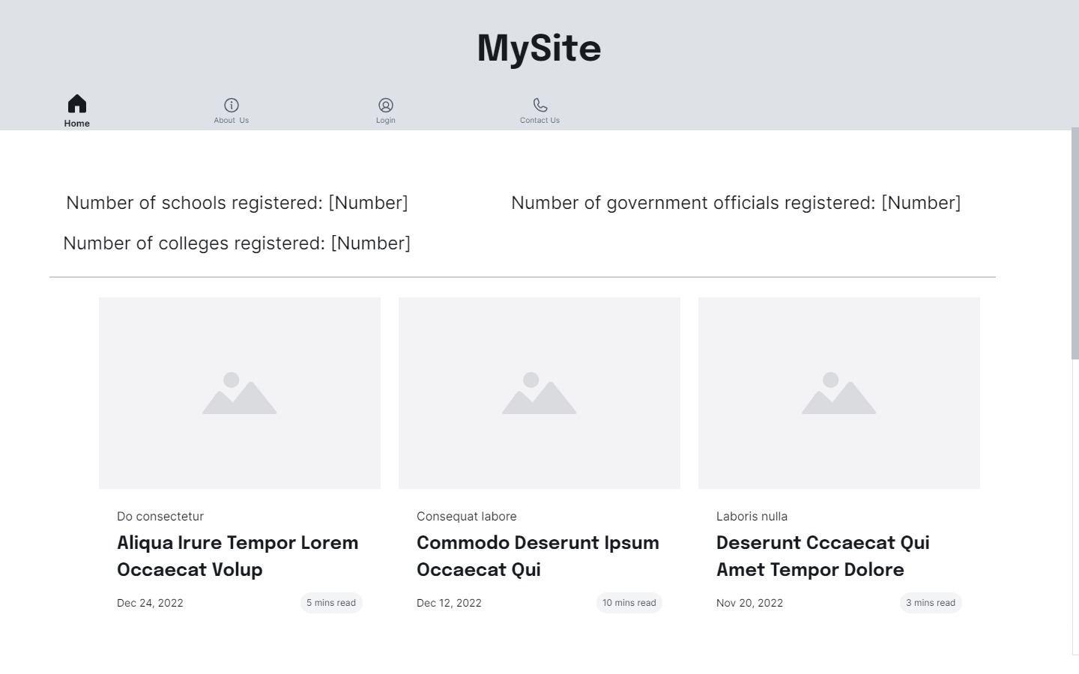
Basic Layout of the Website

Slide 14
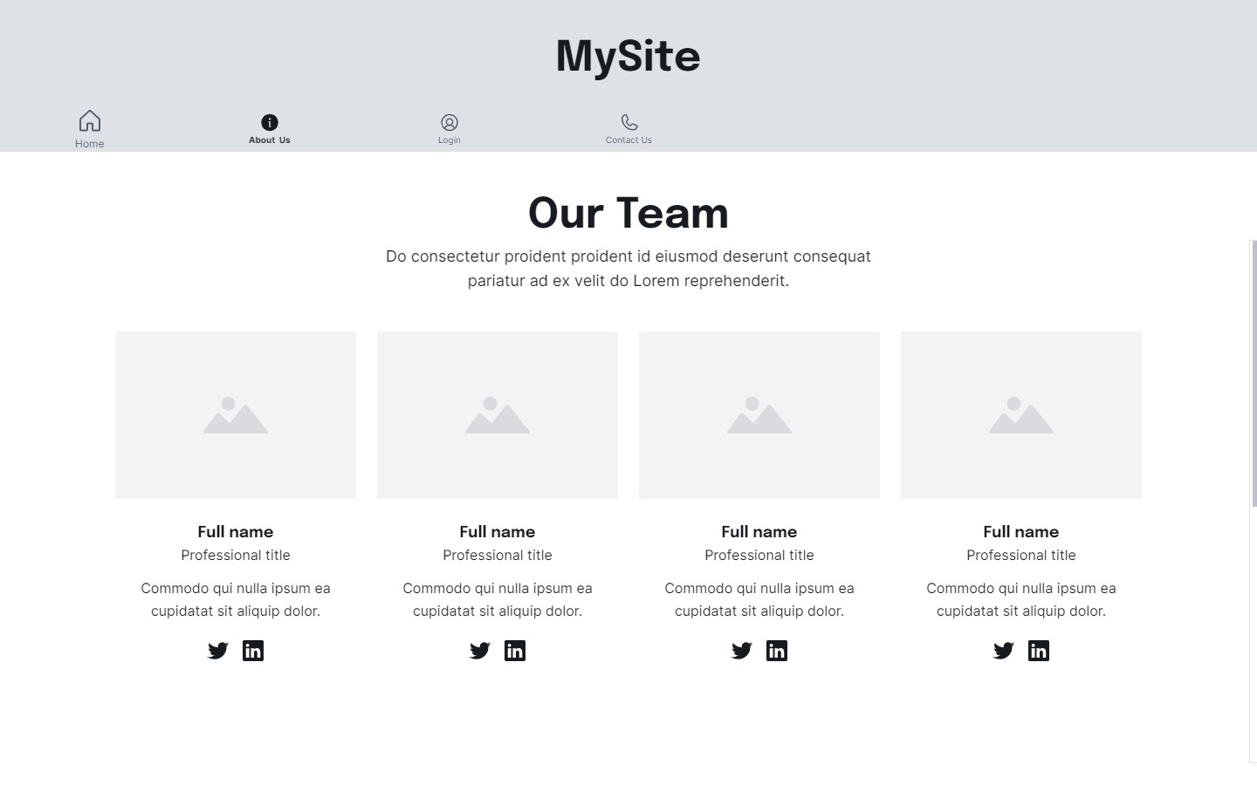
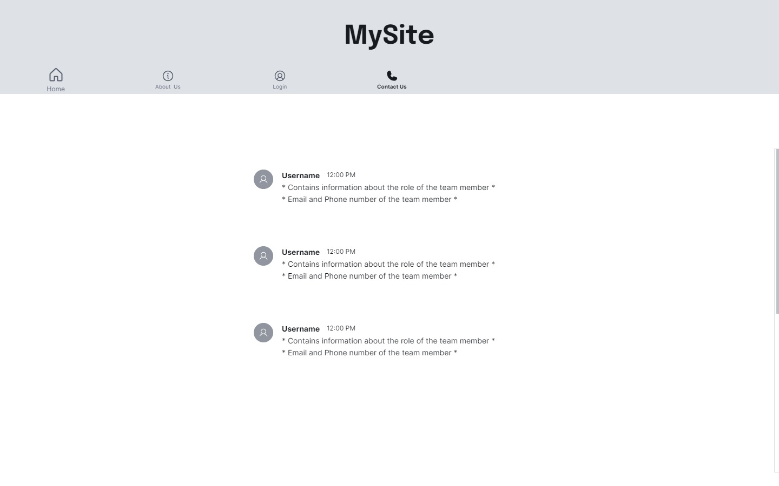

Slide 15
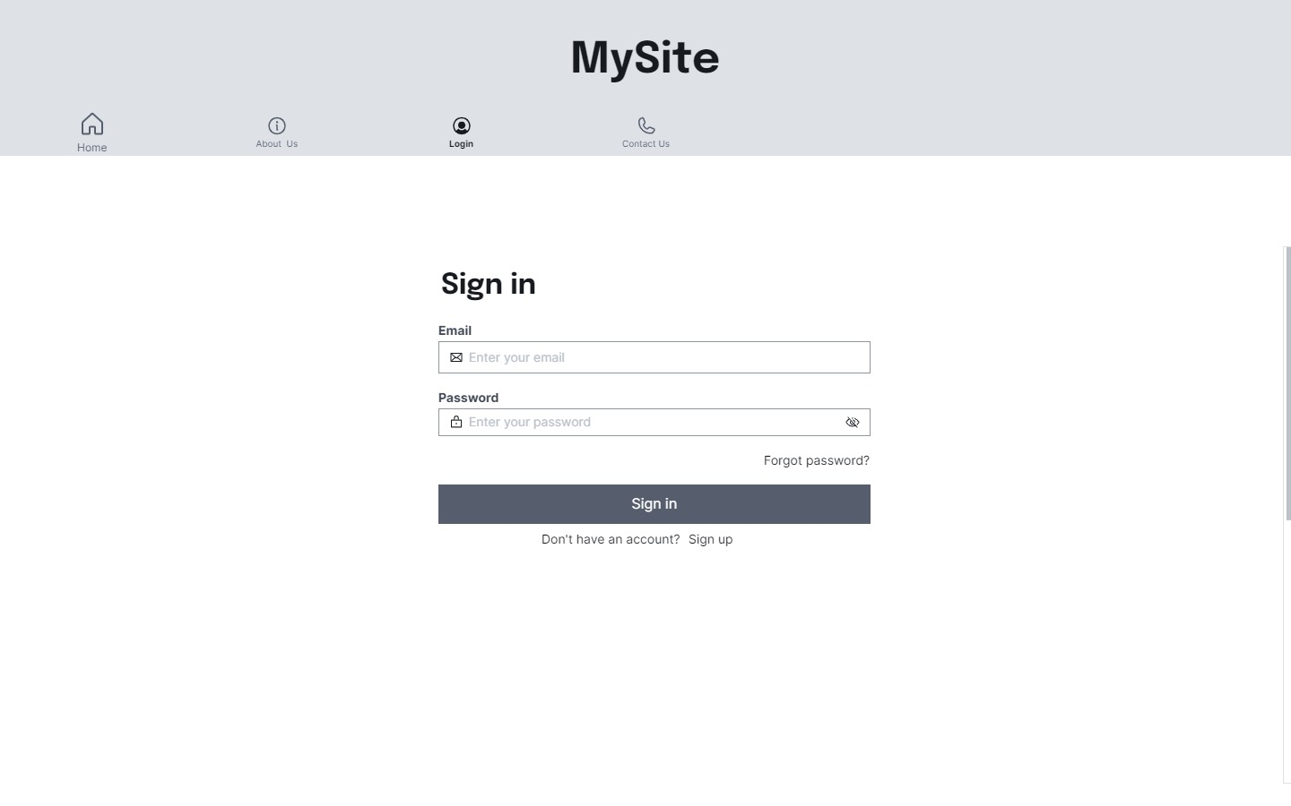
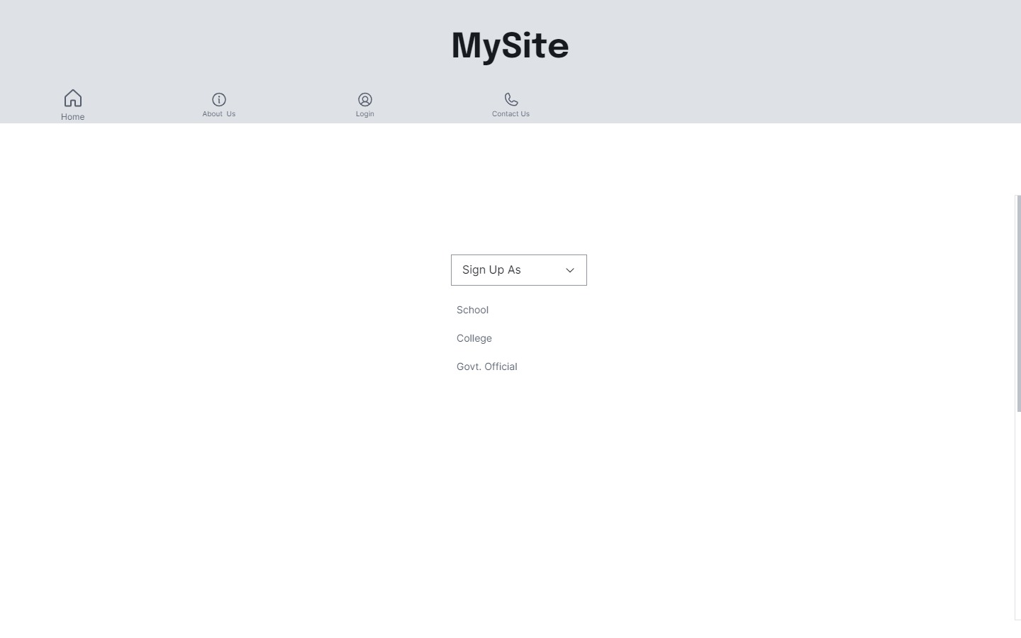

Slide 16
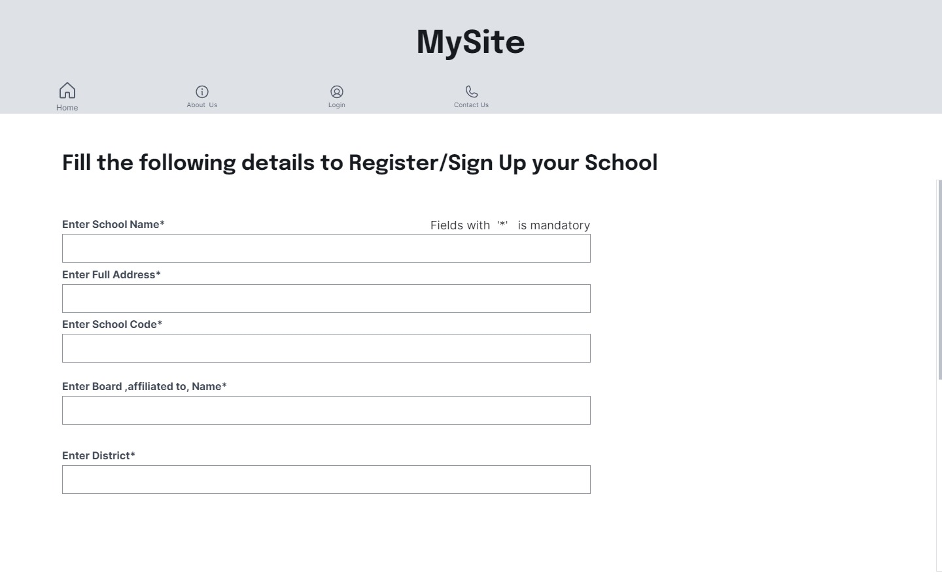
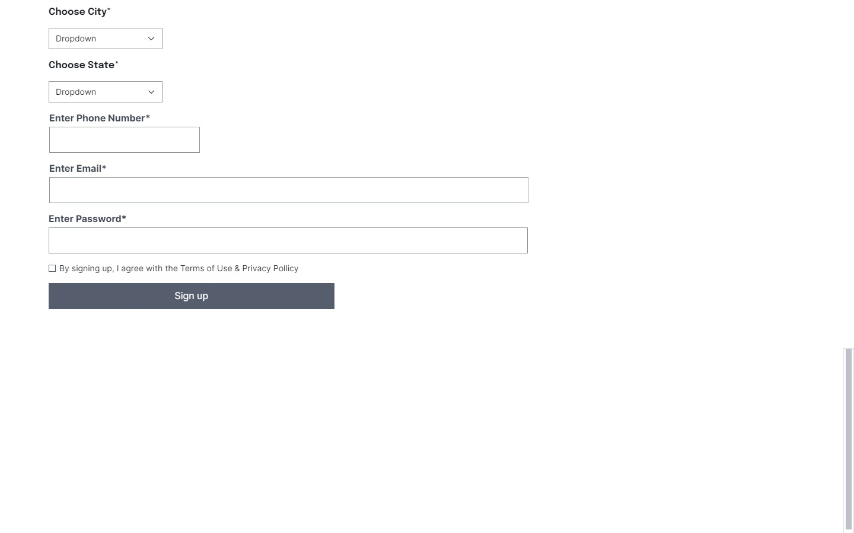

Slide 17
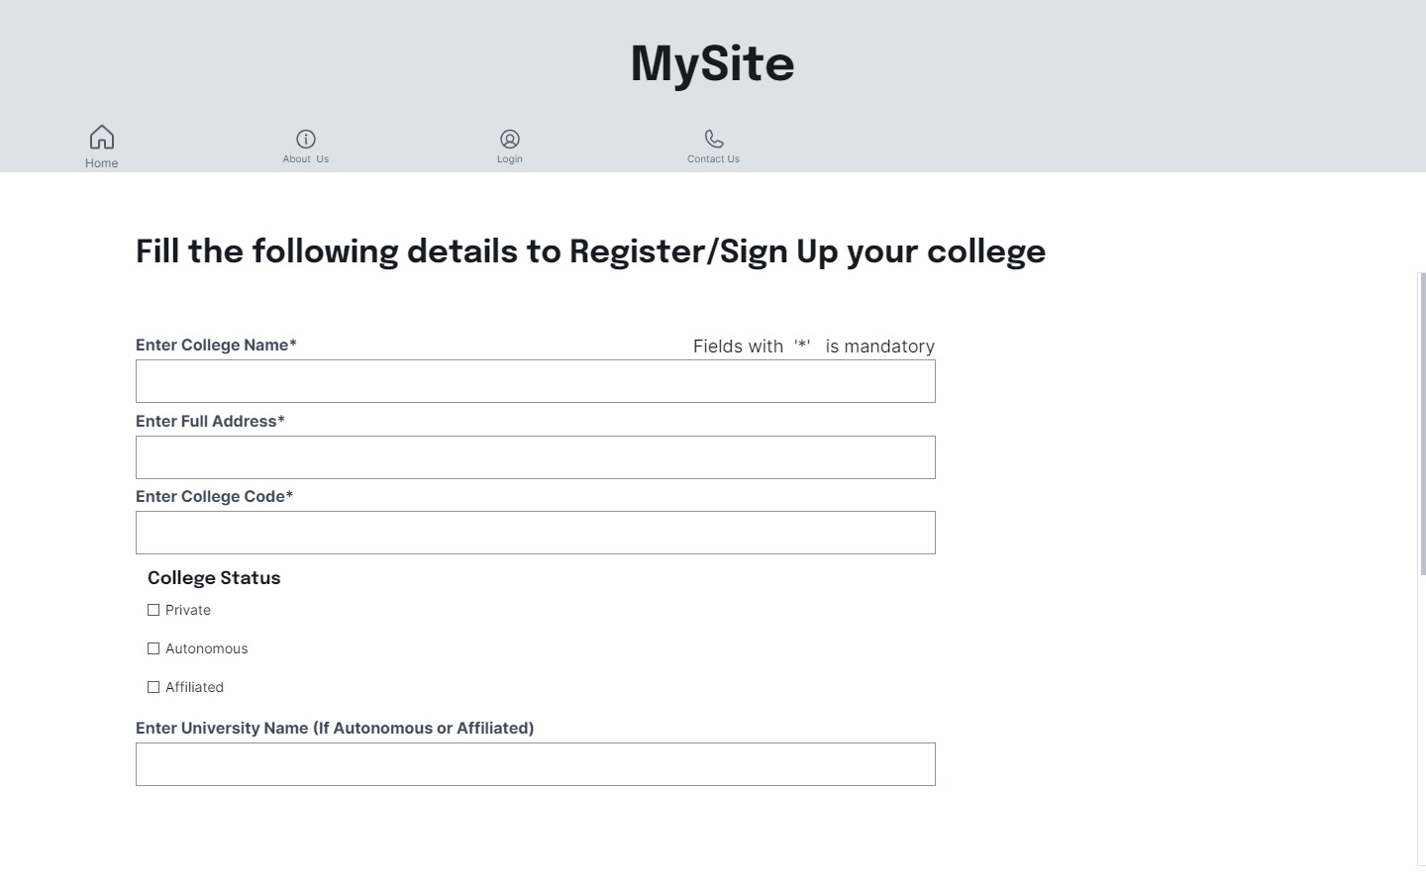
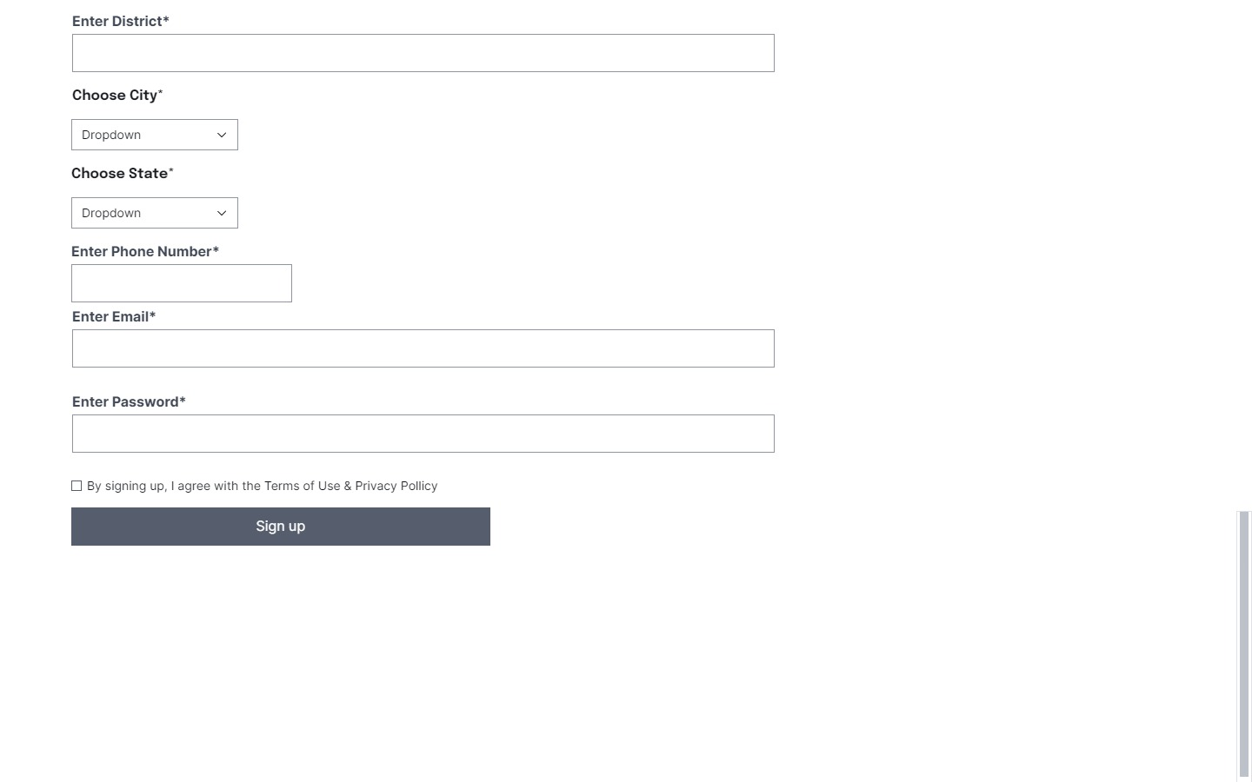

Slide 18
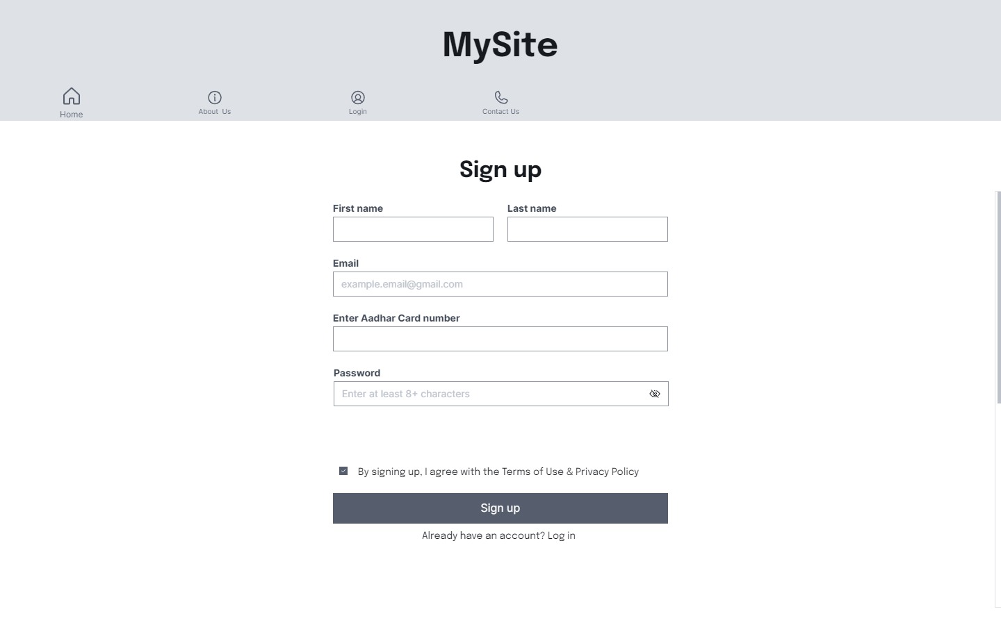

Slide 19
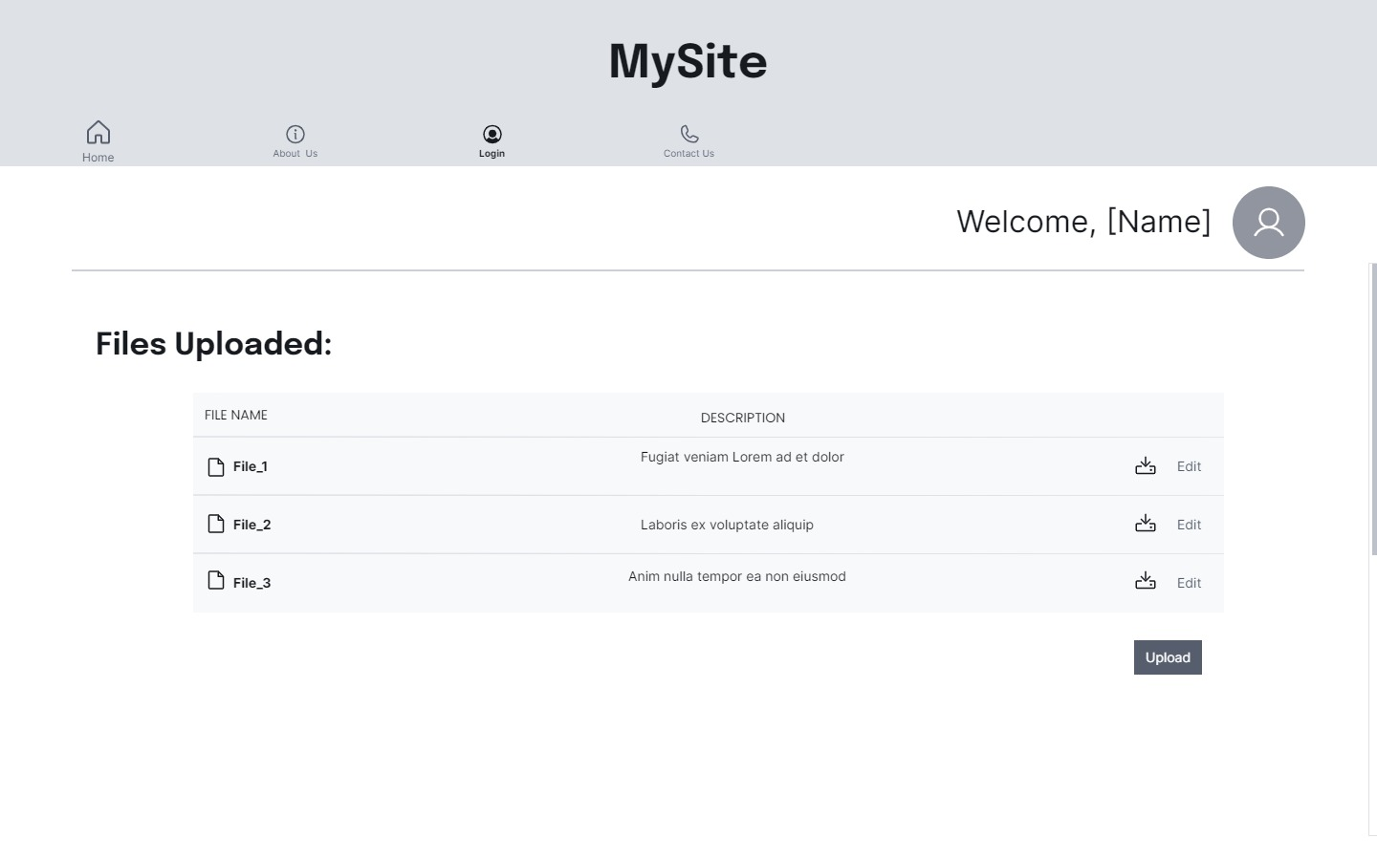
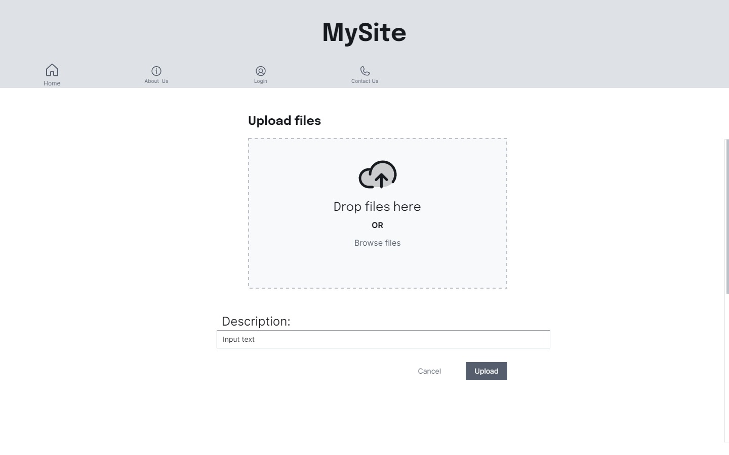

Slide 20
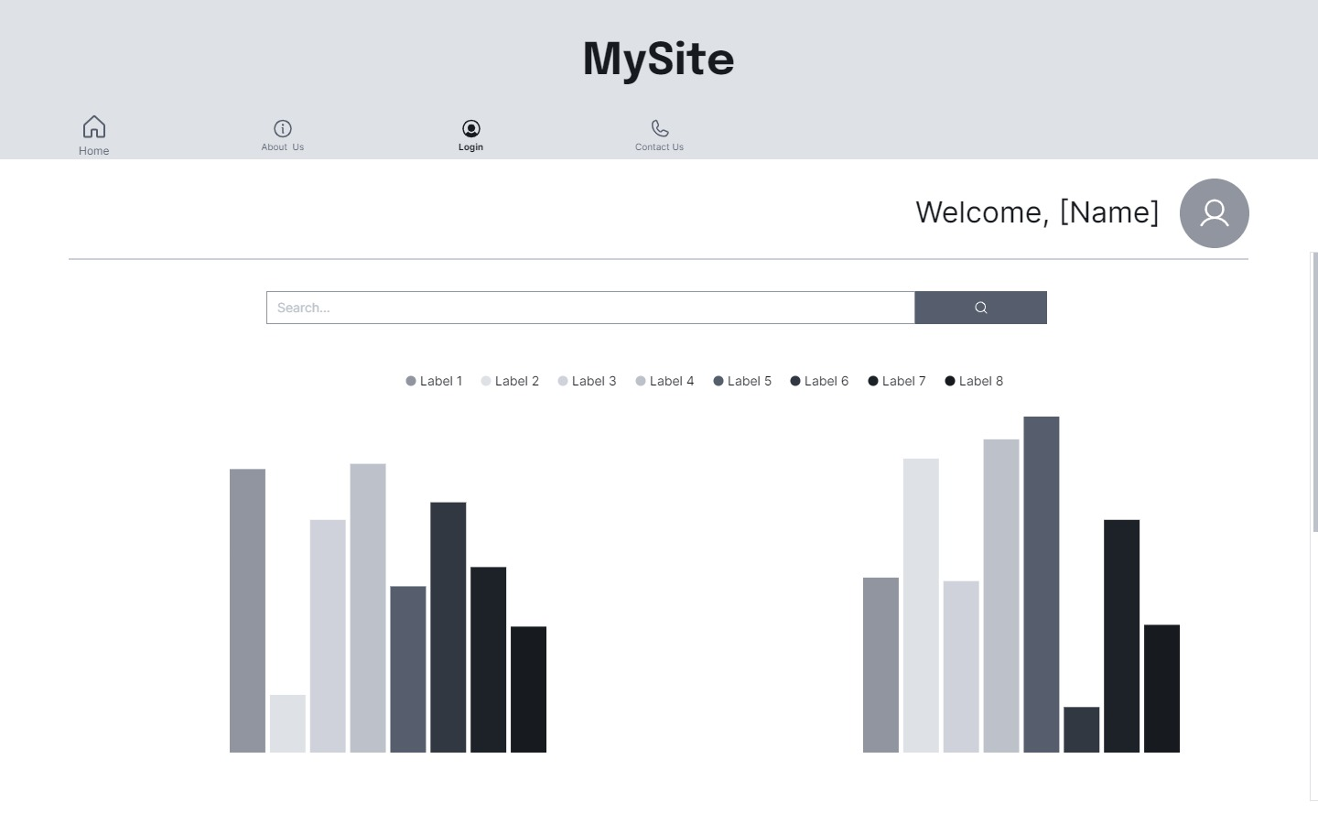

Slide 21
Week 4

Slide 22
Functional Requirements
The website should be user friendly so that the user can navigate through it smoothly.
The institutions (schools and colleges) should be able to upload the data of their respective institutions.
They should also be able to download previously uploaded data, to edit and re-uploaded the data.
The government official should be only view the data, so that he/she can analyse it to form policies.
The data should be displayed using graphs, charts, etc.

Slide 23
Website Users
The users of the website include institutions like schools, colleges and government officials.
Schools and Colleges : Schools and Colleges can register themselves and will have the ability to upload new data and also download and edit previously uploaded data.
Government Officials : They will be able to view the data in the form of graphs, charts etc.

Slide 24
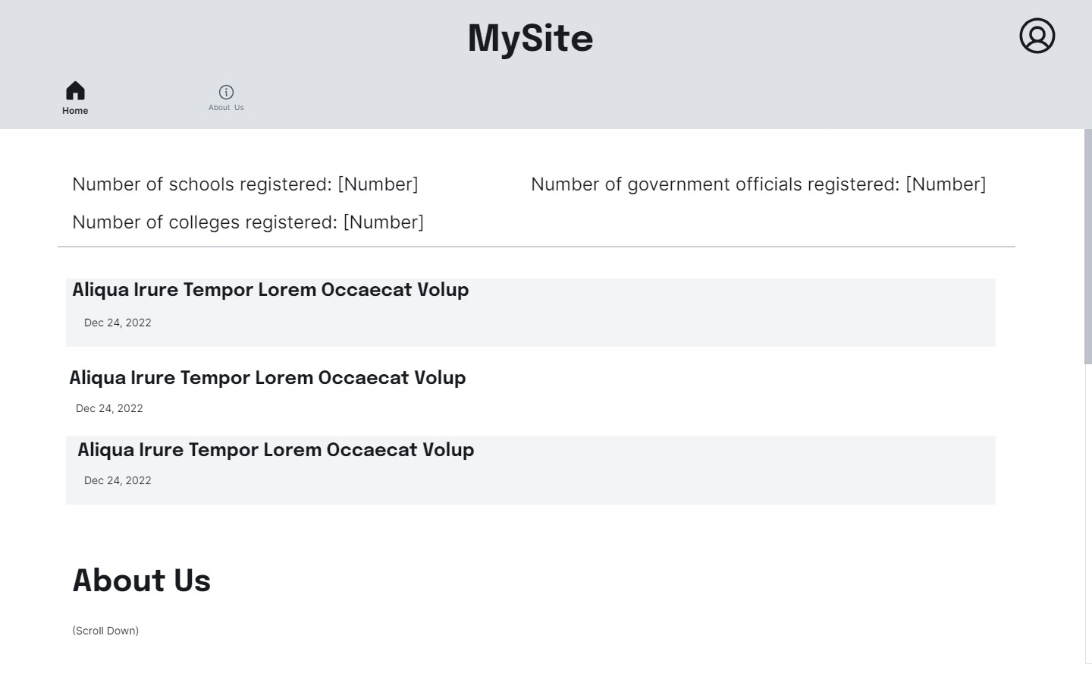
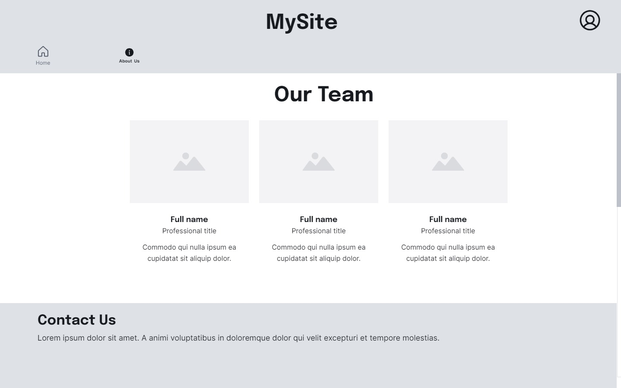
Basic Layout of the Website

Slide 25
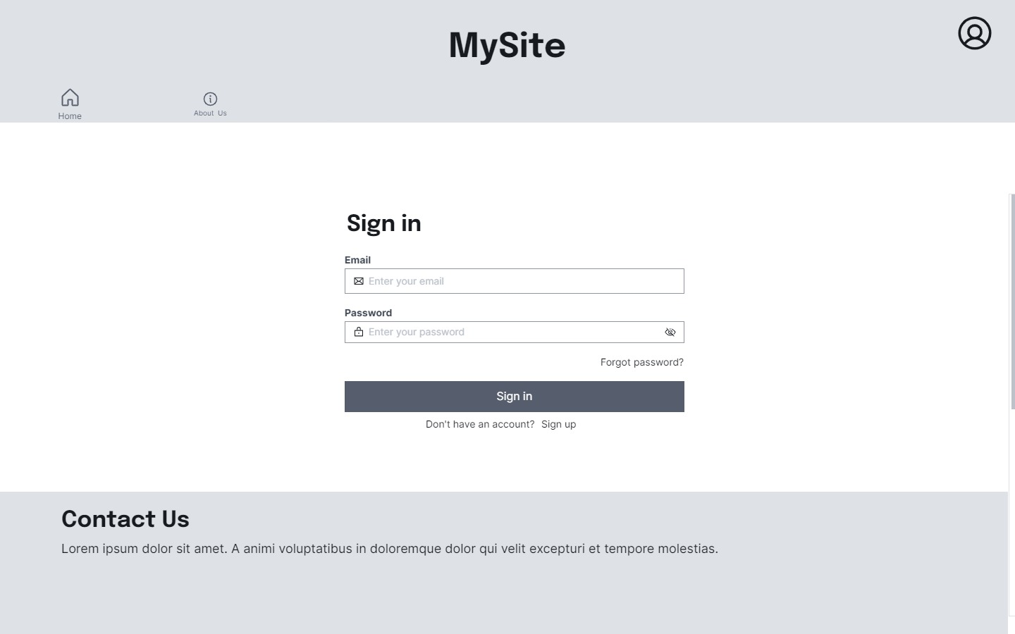
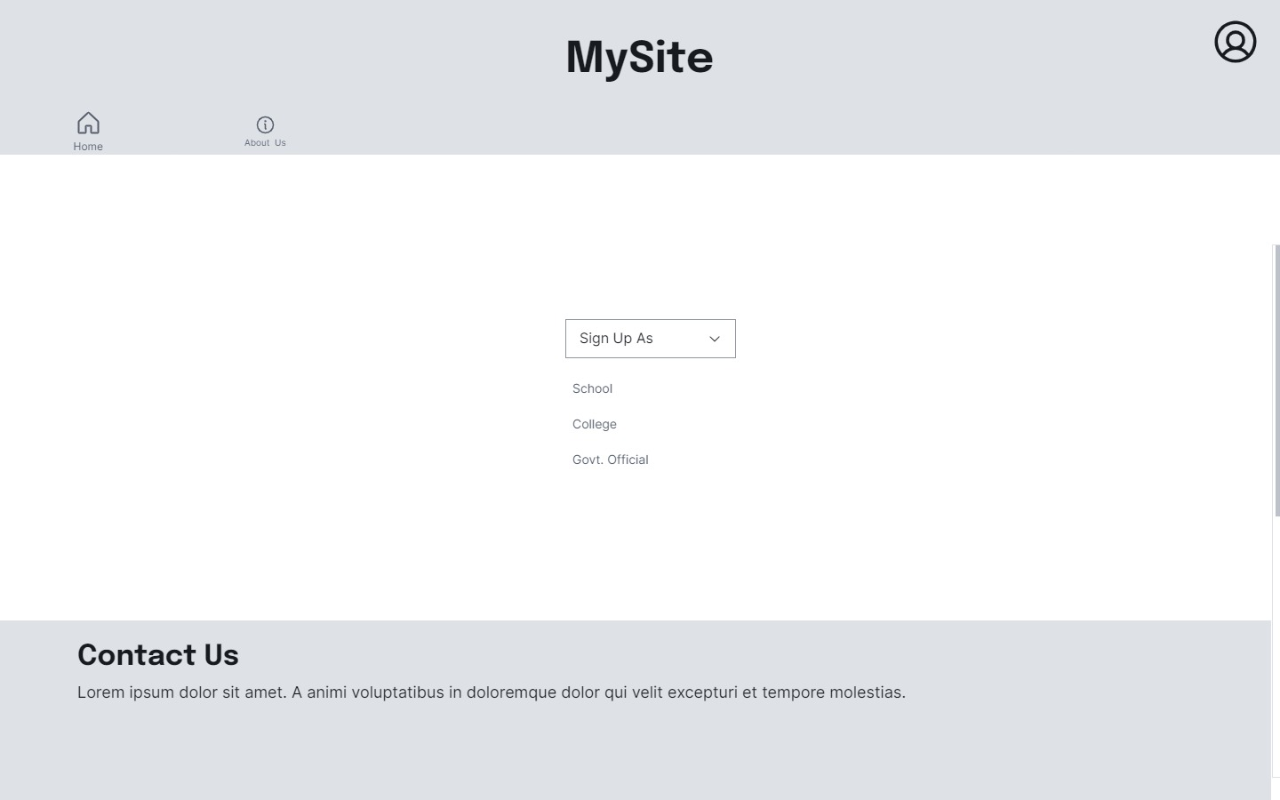

Slide 26
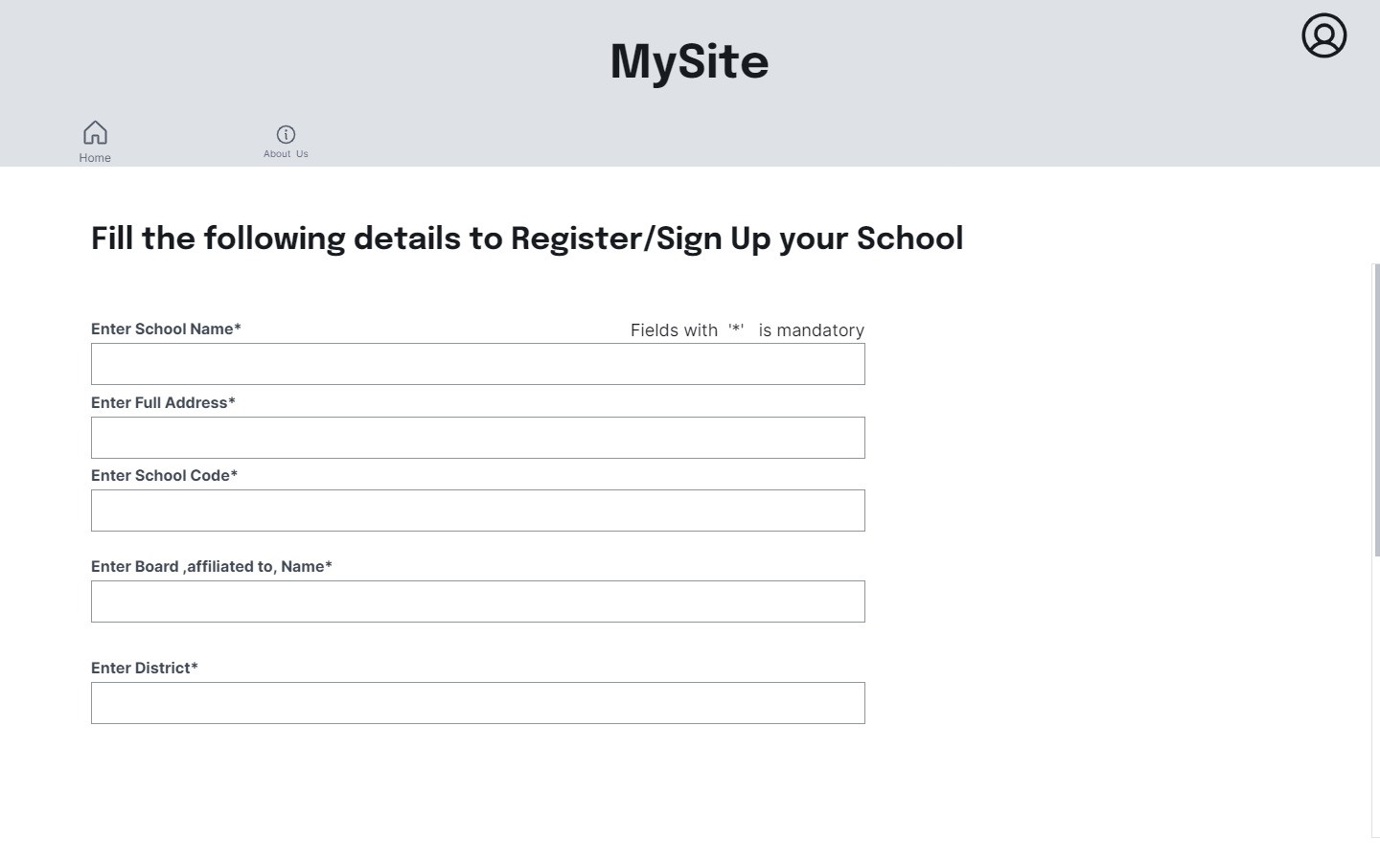
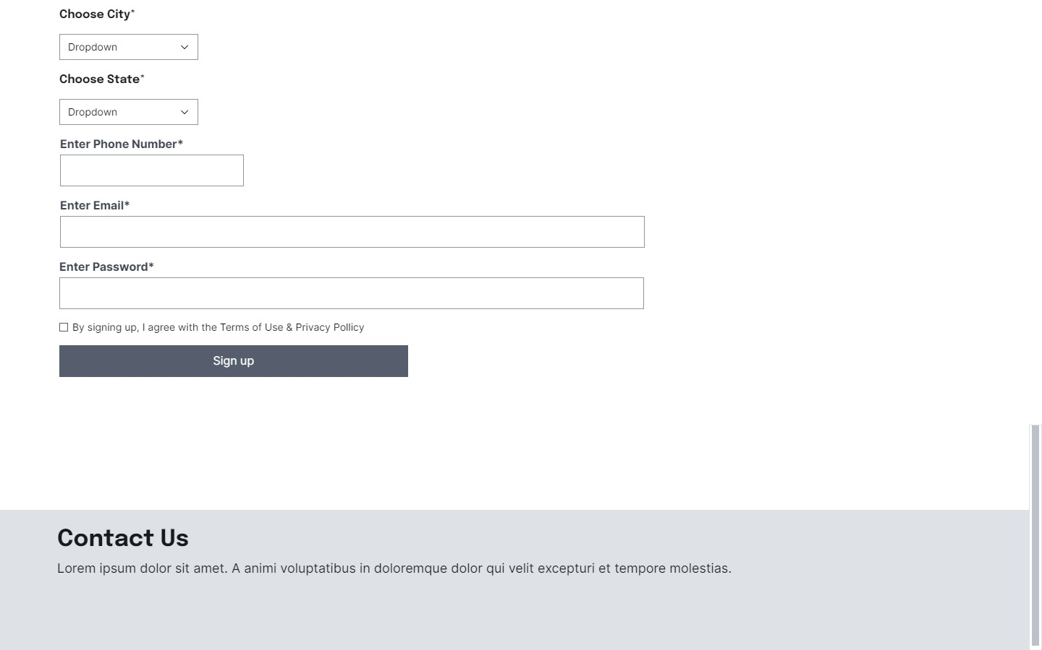

Slide 27
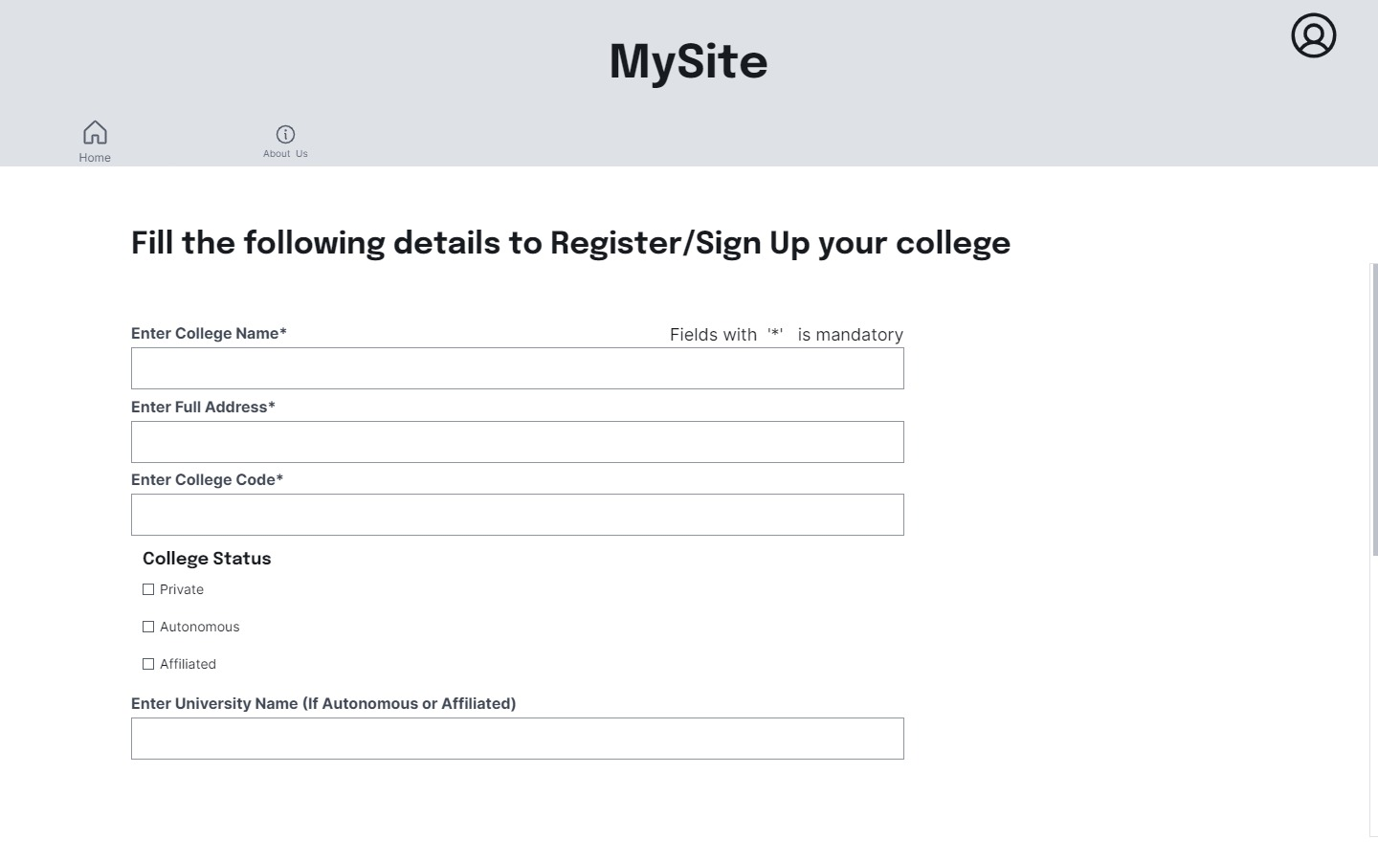
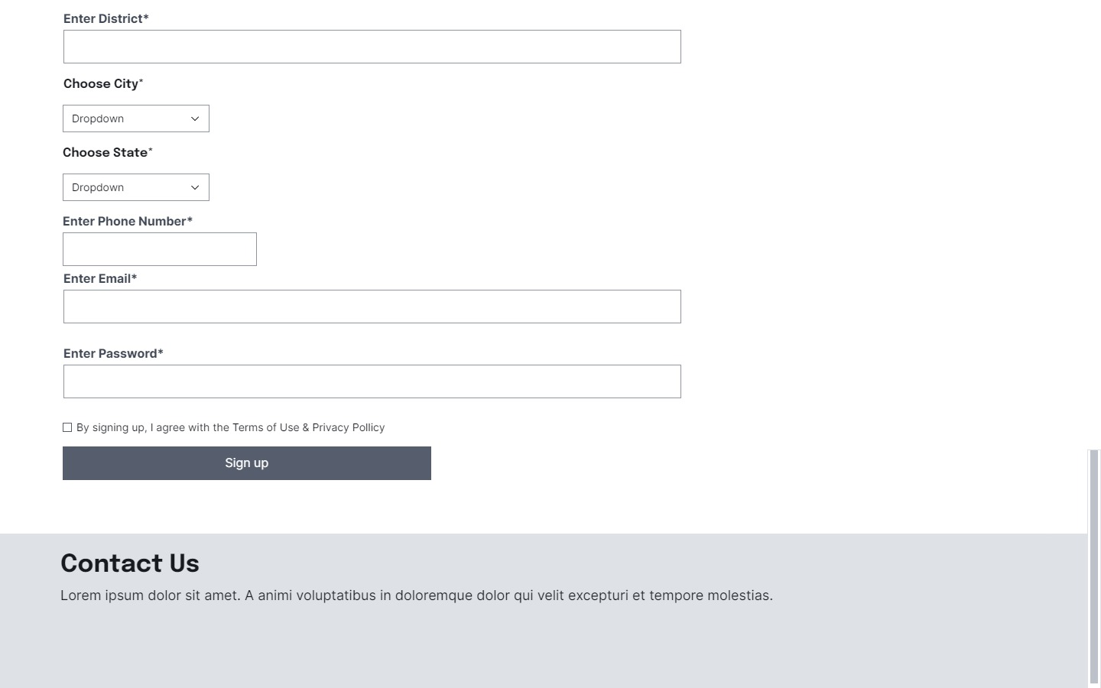

Slide 28
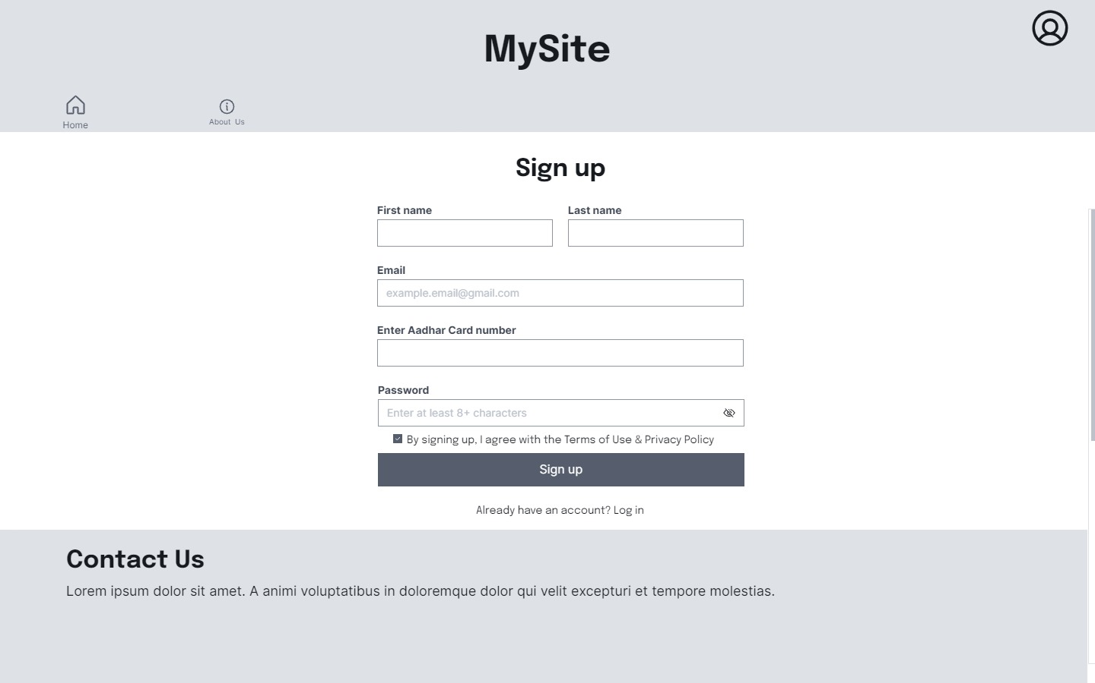

Slide 29
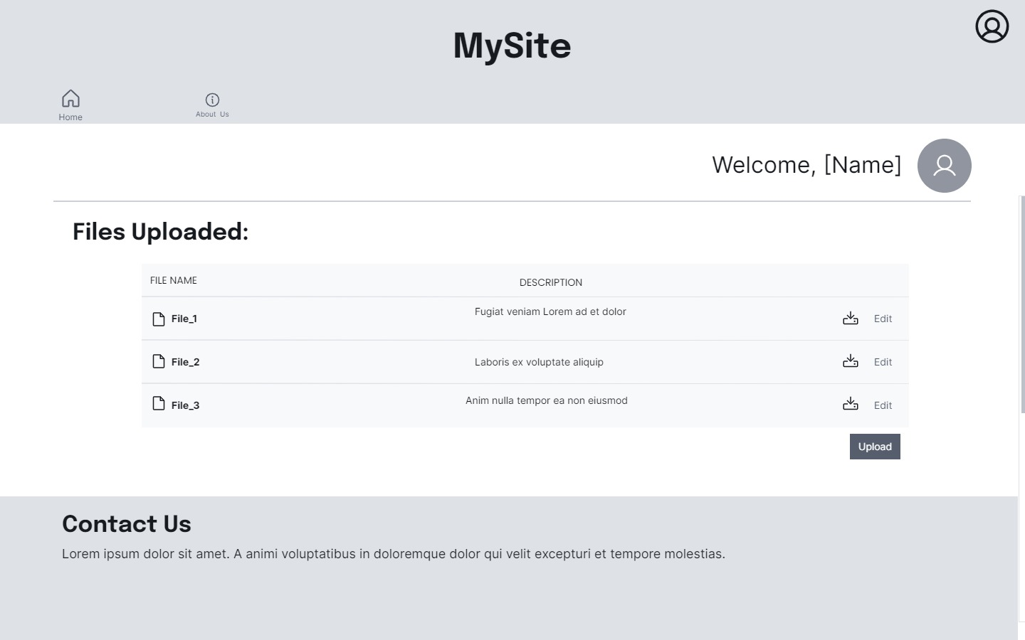
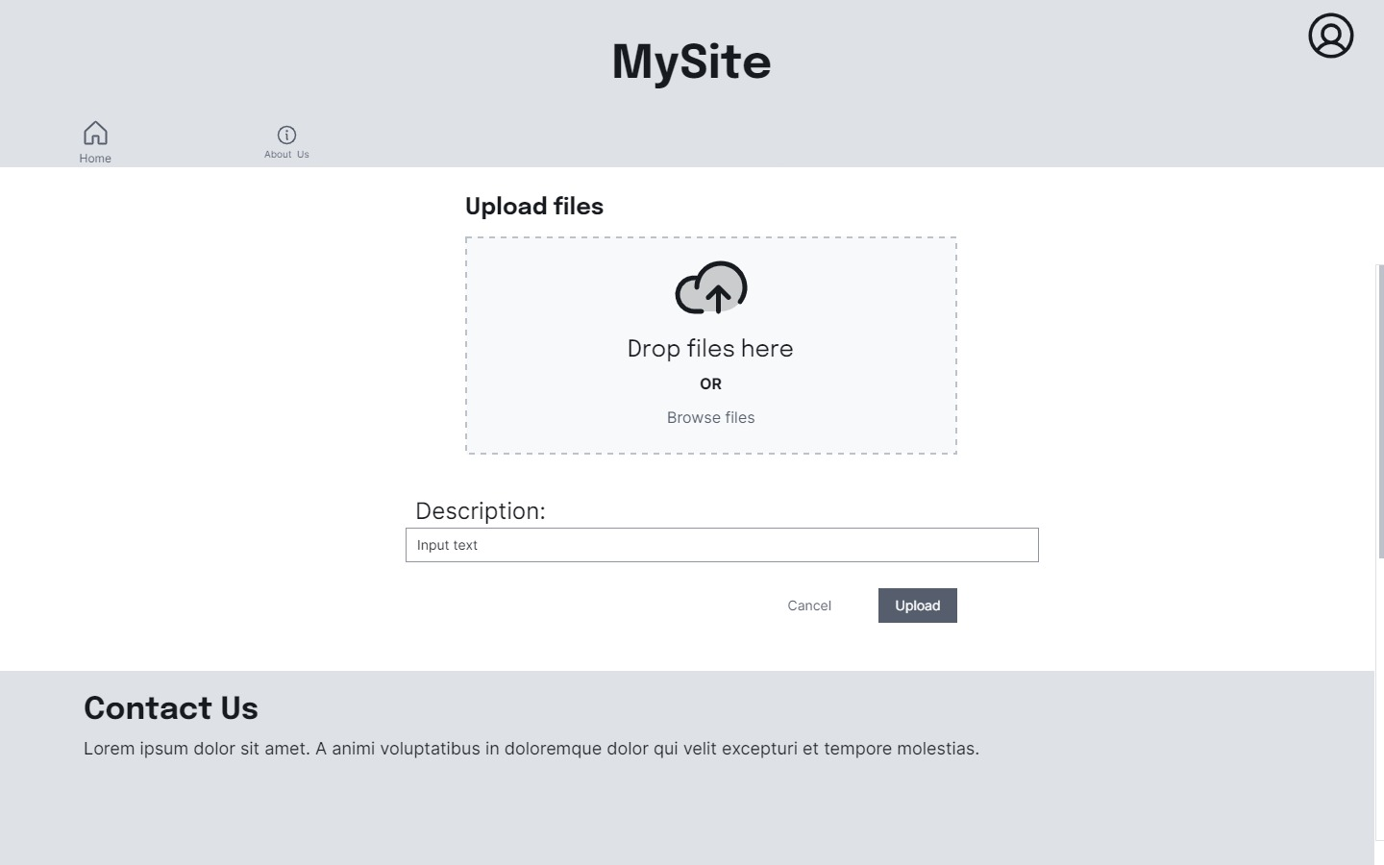

Slide 30


Slide 31
Week 5

Slide 32
Website Layout (Updated)

Slide 33


Slide 34
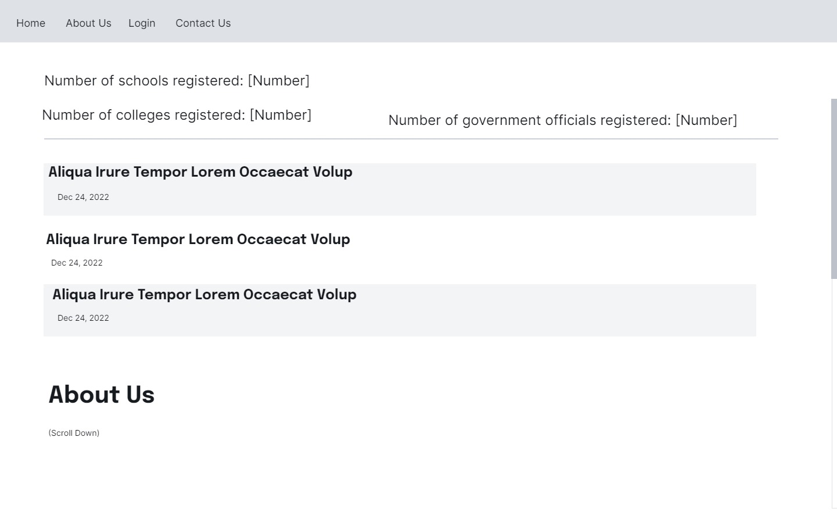
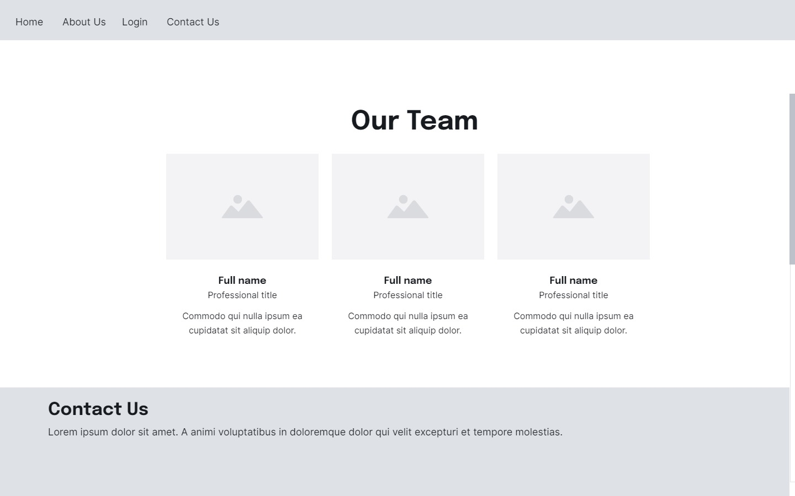

Slide 35
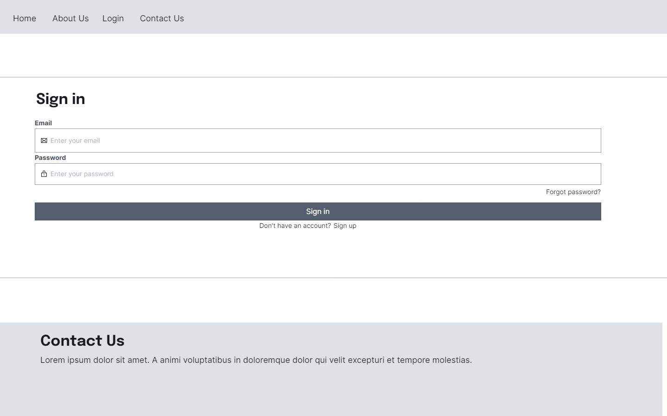
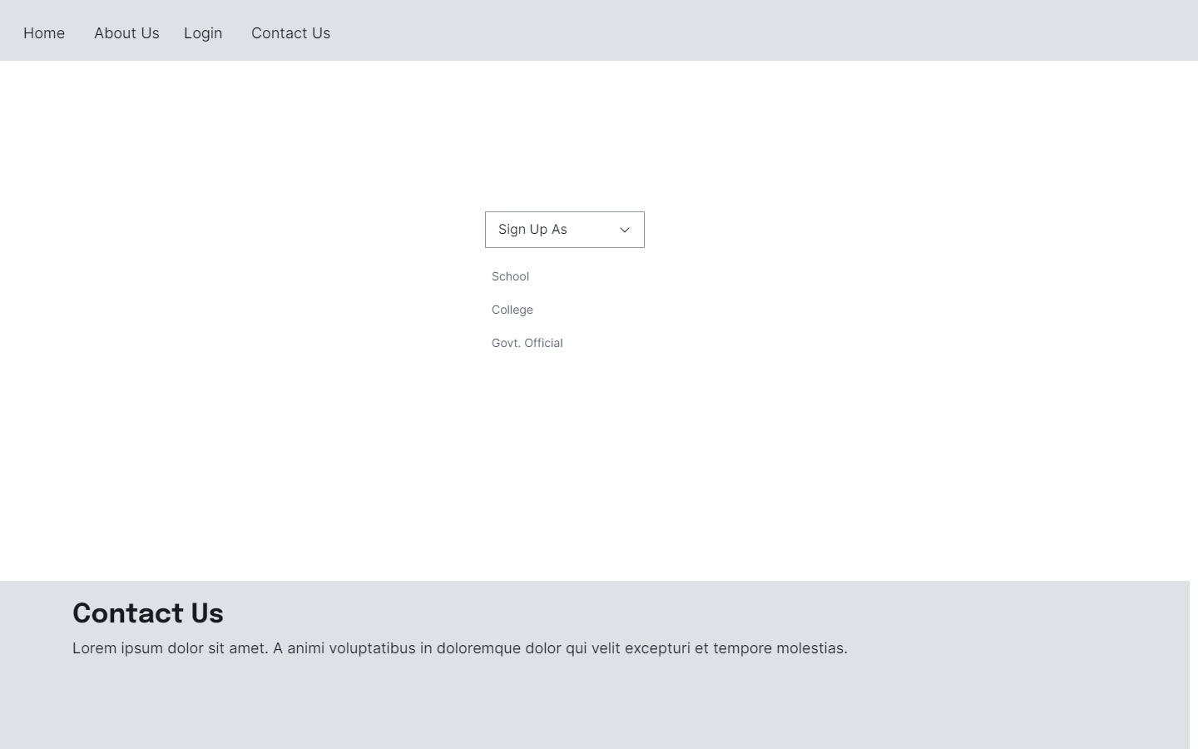

Slide 36
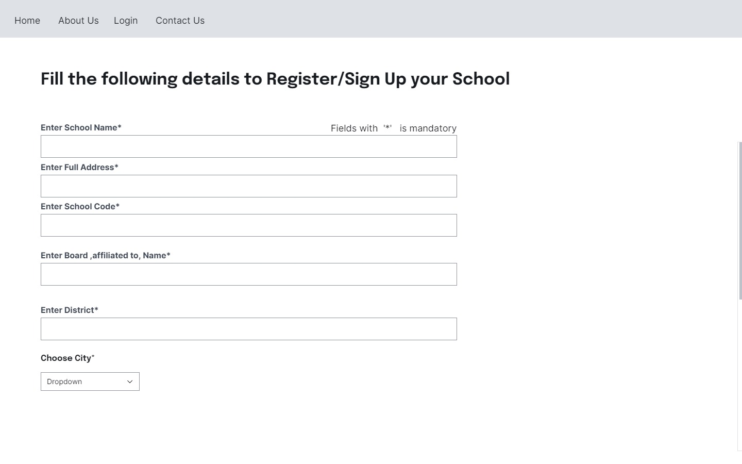
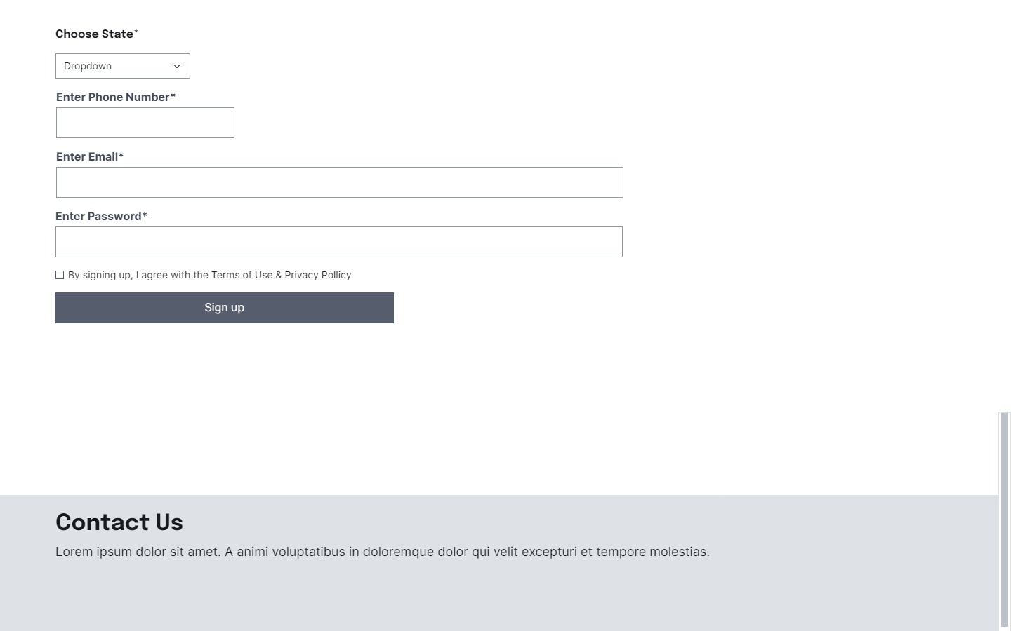

Slide 37
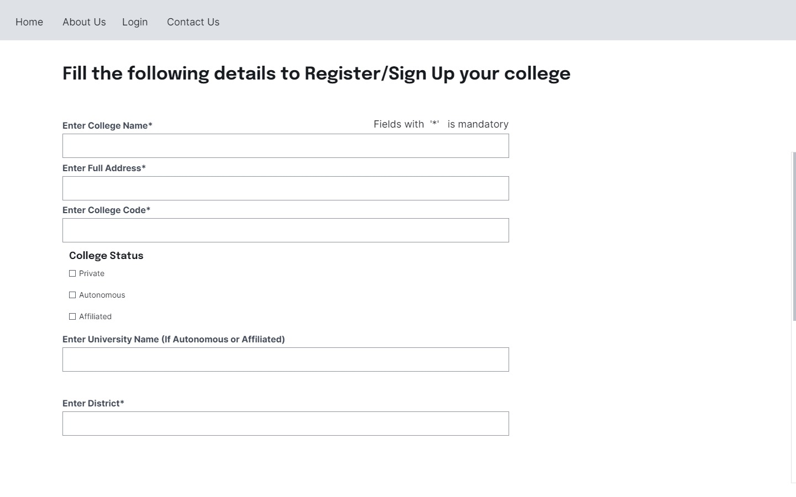
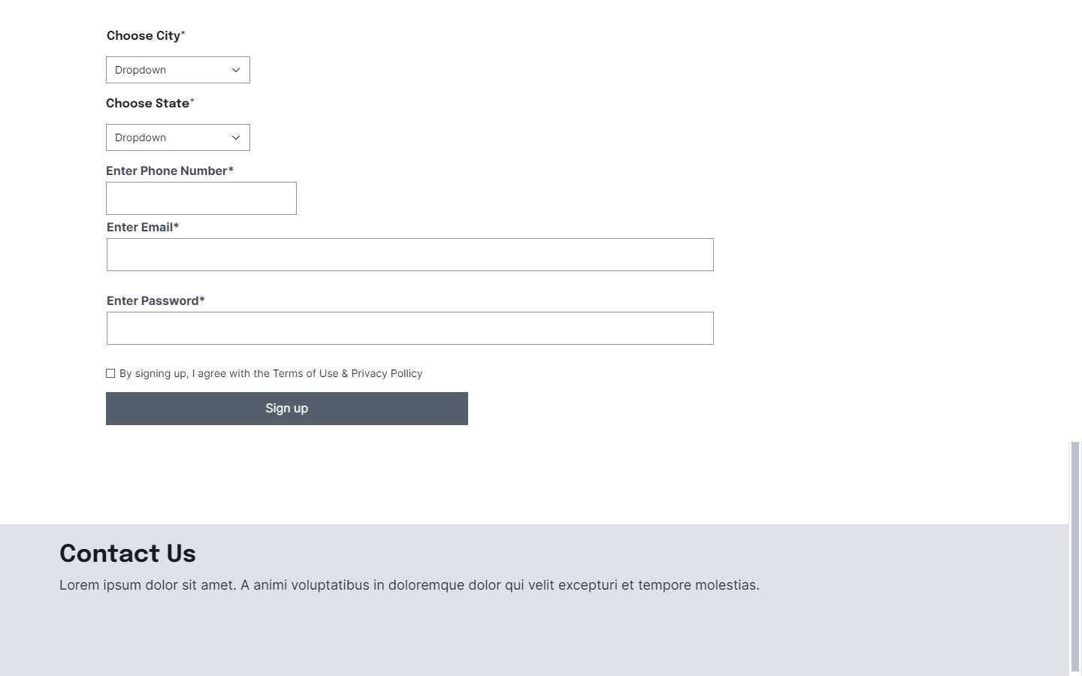

Slide 38
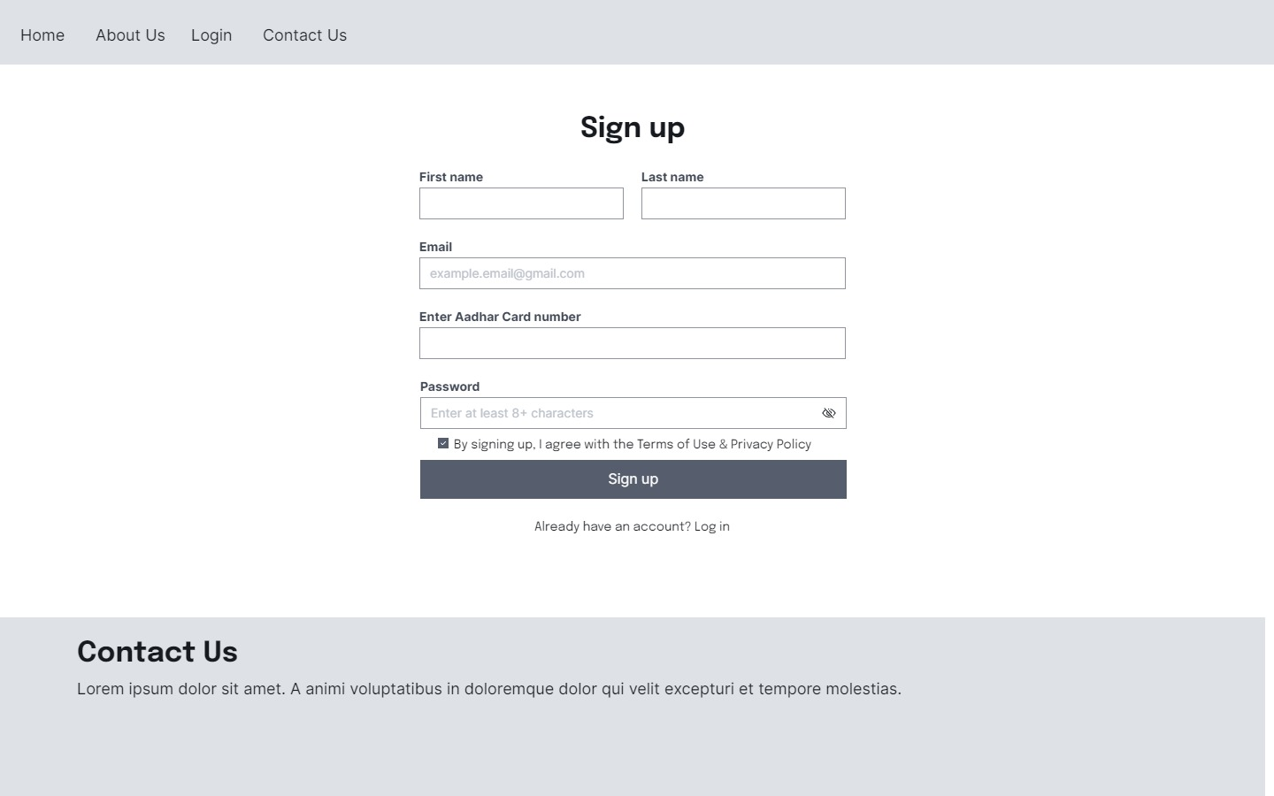

Slide 39
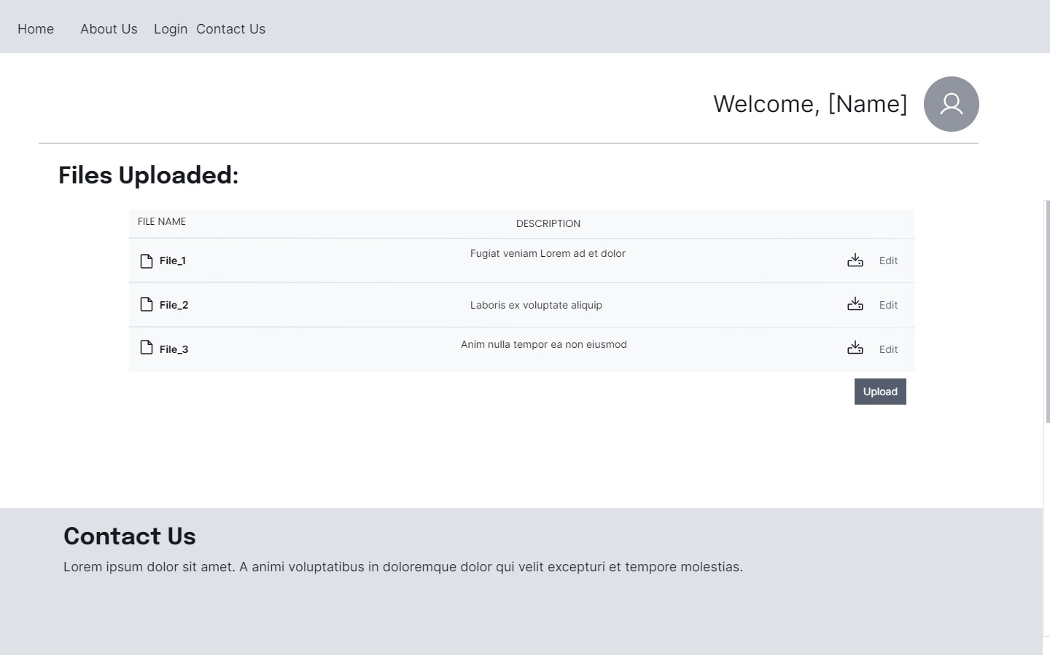

Slide 40
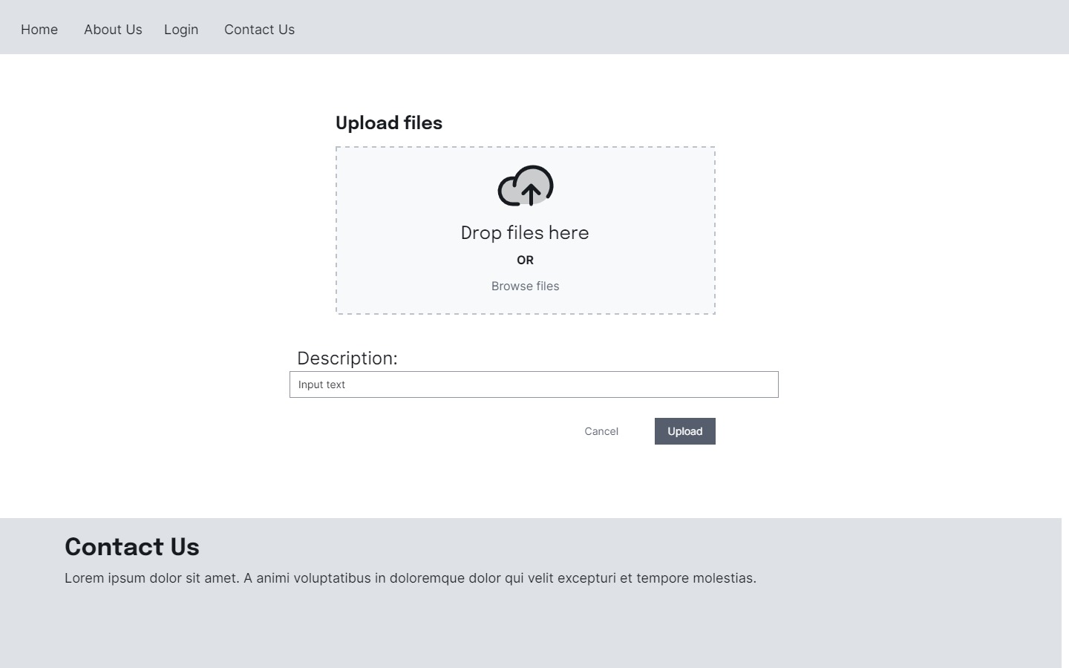

Slide 41
