Slide 1


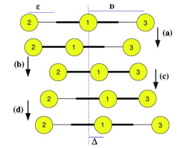
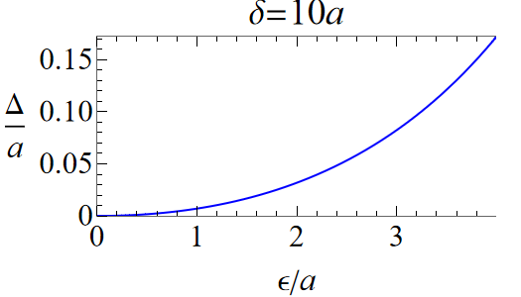
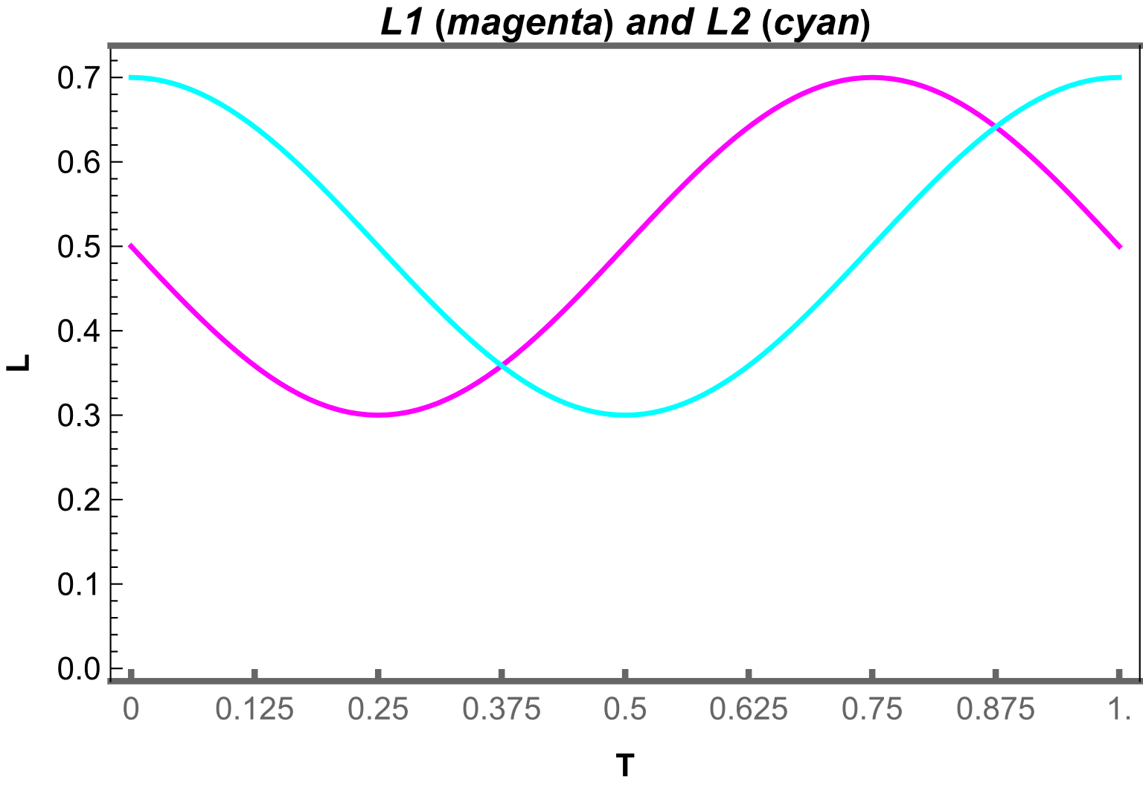
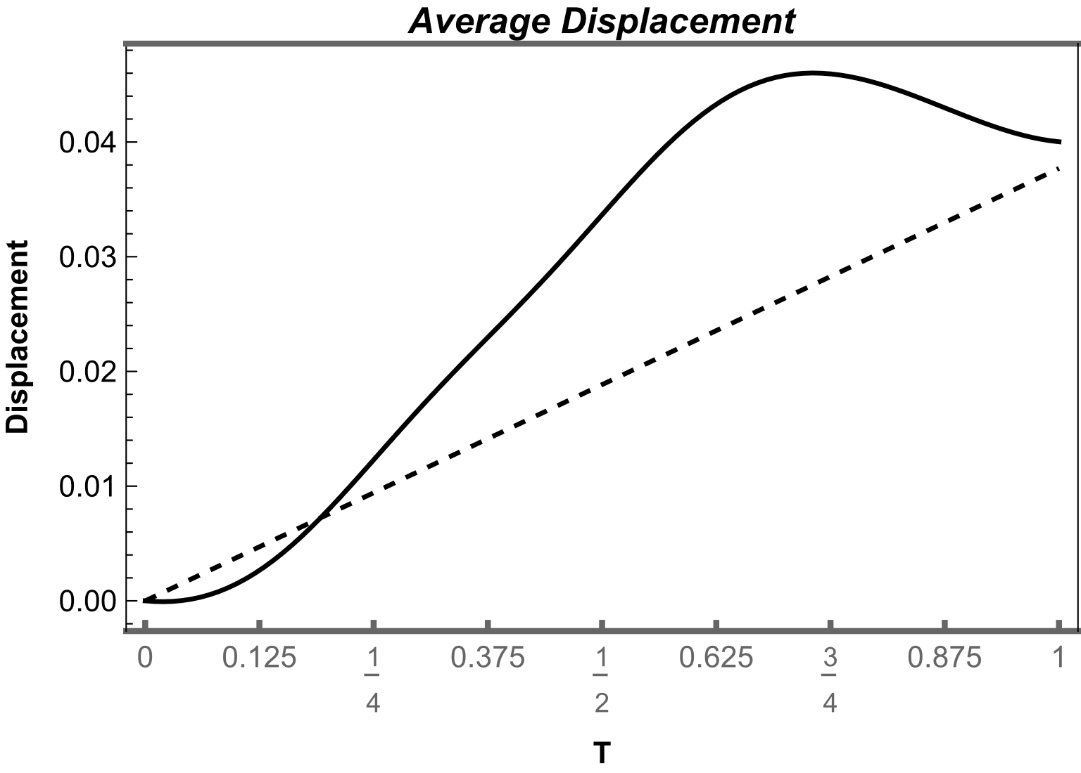
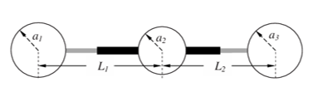
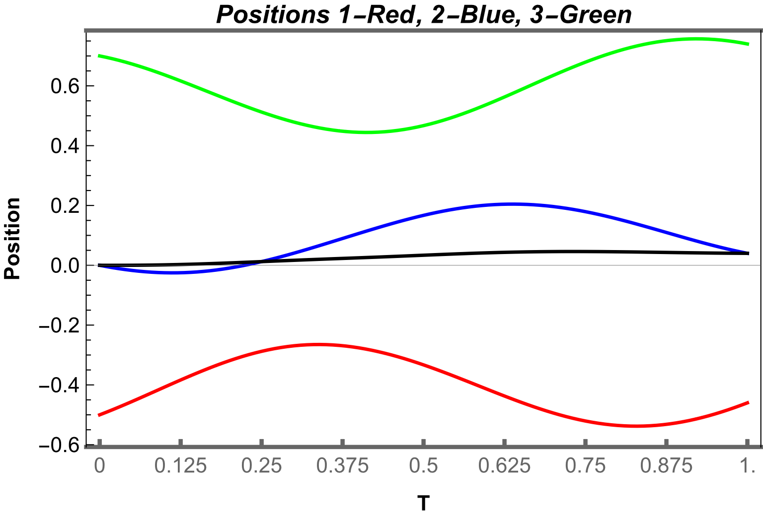
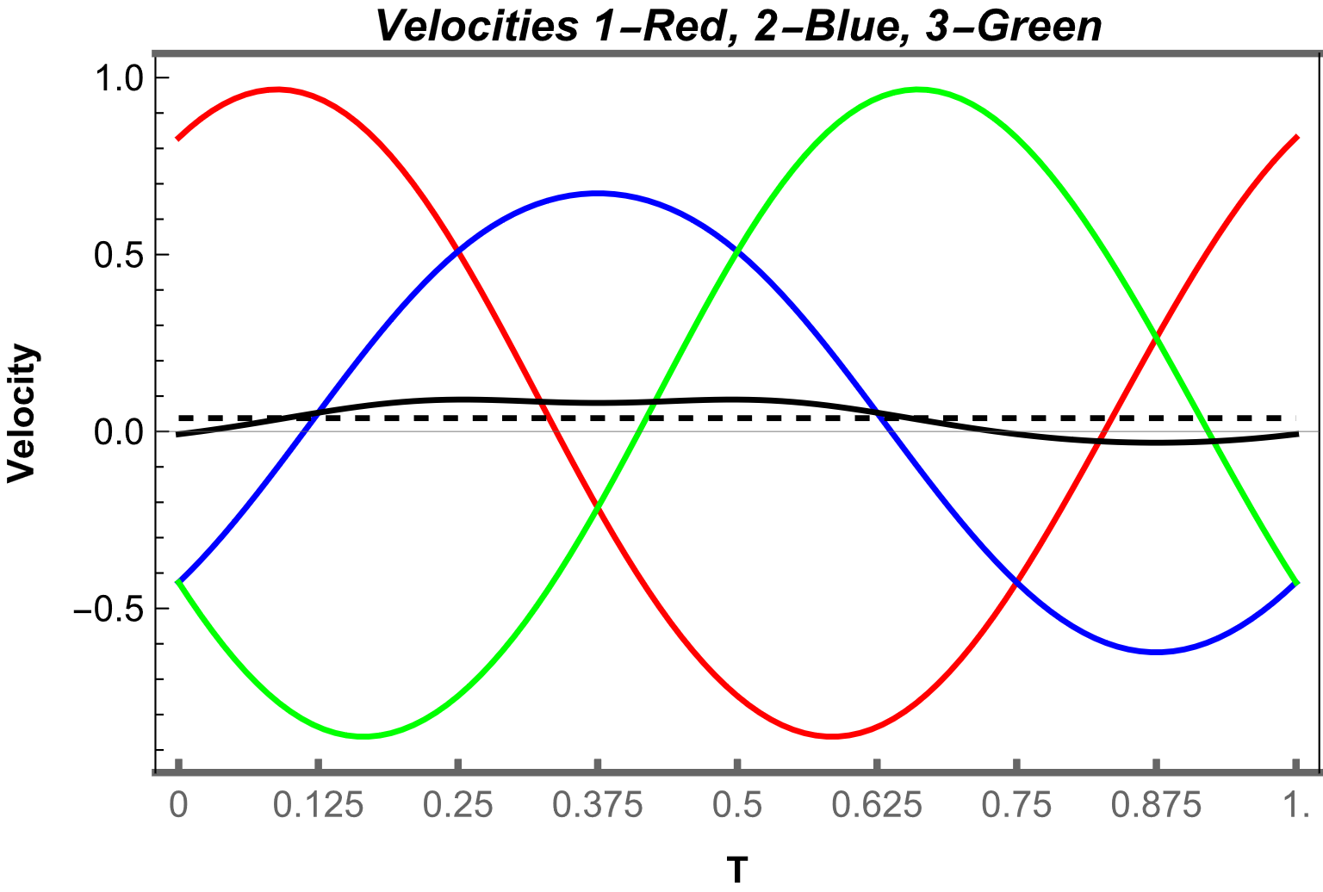
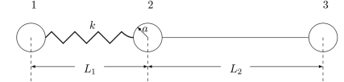
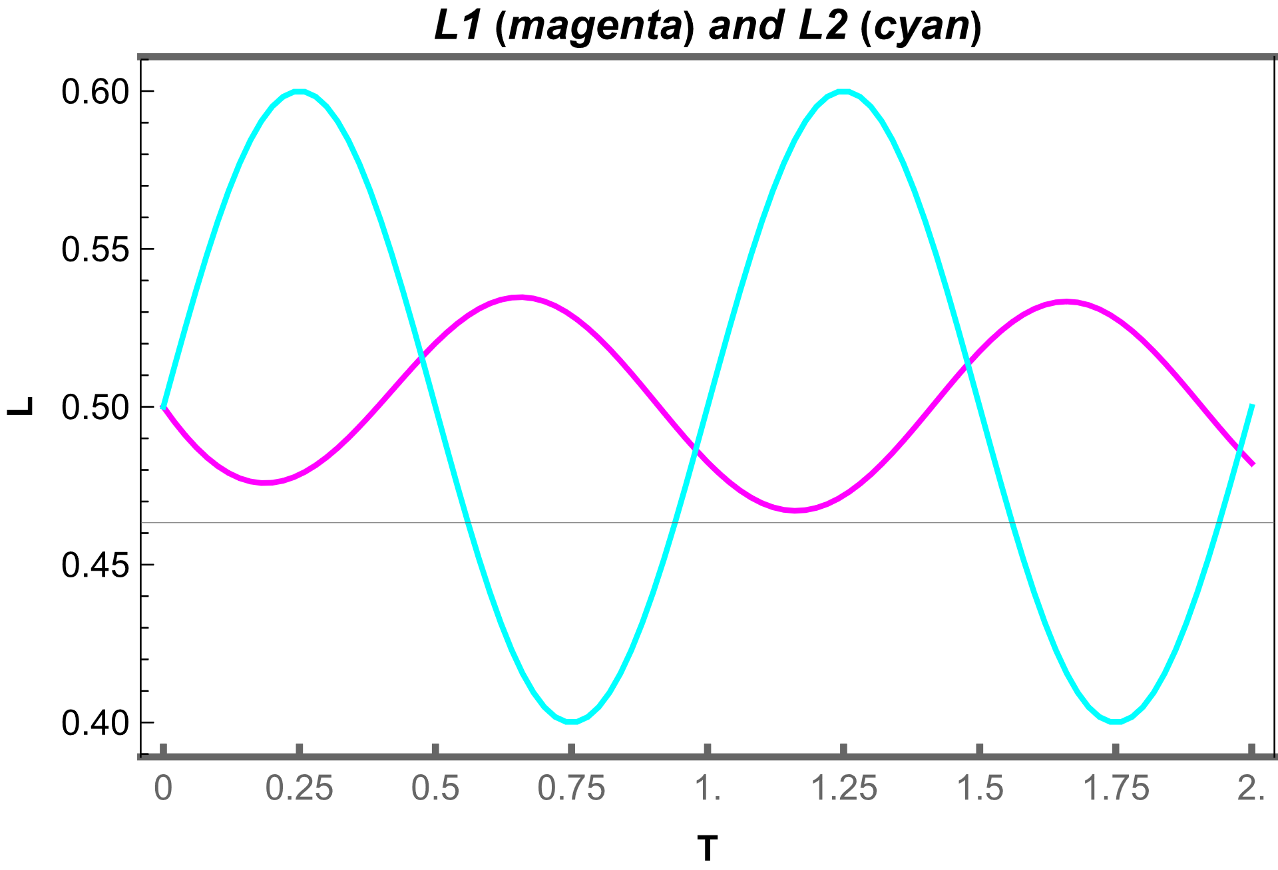
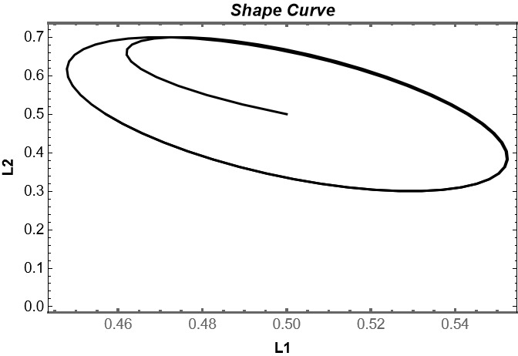


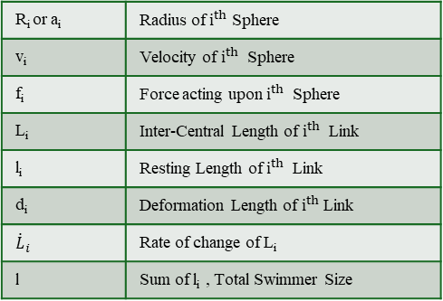



Hydrodynamics of
Linked Model Micro-Swimmers
Umang Garg (221156) under Prof. Akash Choudhary
Introduction
Results and Discussion
In the usual case of swimming of a human being in water, the displacement gained in the first half period of the cyclic motion is not cancelled out by that of the second half period predominantly because of the inertial effects. Such a mechanism, however, does not work in the microscopic world of biological objects (such as bacteria), where the effects of inertia are not important, and the viscous effects dominate. So, for the case of low Reynolds number, we need to break this time reversal symmetry. To do so, we design some micro swimmers which have more than one degree of freedom.
1. Stagewise Linear deformations of three spheres, two active link
Key Equations
2. Harmonic deformations of three spheres, two active link
$v_{1}=\frac{f_{1}}{6π η a_{1}}+\frac{f_{2}}{6π η L_{1}}$+ $\frac{f_{3}}{6π η {(L}_{1}+L_{2})}$
$${\dot{L}}_{1}=v_{2}−v_{1}$$
$v_{2}=\frac{f_{1}}{6π η L_{1}}+\frac{f_{2}}{6π η a_{2}}$+ $\frac{f_{3}}{6π η L_{2}}$
$${\dot{L}}_{2}=v_{3}−v_{2}$$
$v_{3}=\frac{f_{1}}{6π η {(L}_{1}+L_{2})}+\frac{f_{2}}{6π η L_{2}}$+ $\frac{f_{3}}{6π η a_{3}}$
$$f_{1}+f_{2}+f_{3}=0$$
R_{i} or a_{i} | Radius of $i^{th}$ Sphere
v_{i} | Velocity of $i^{th}$ Sphere
f_{i} | Force acting upon $i^{th}$ Sphere
L_{i} | Inter-Central Length of $i^{th}$ Link
l_{i} | Resting Length of $i^{th}$ Link
d_{i} | Deformation Length of $i^{th}$ Link
$${\dot{L}}_{i}$$ | Rate of change of L_{i}
l | Sum of l_{i} , Total Swimmer Size
3. Harmonic deformations in one elastic, one active link
Methodology
We will mainly deal with lengths, time, velocities and force.
For length scale we use the total swimmer length.
For time scale we use the timespan of one deformation cycle.
Characteristic velocity can be derived by length & time scales
For force scale, we use the ratio of characteristic velocity and Stoke’s Law mobility of the middle sphere (sphere 2)
Conclusion
The study reveals that net displacement in micro-swimmers occurs due to Oseen interactions and time-reversal asymmetry. Without Oseen interactions, there is no net displacement, even with added degrees of freedom.
The internal mechanics of the cycle indicate that certain splits contribute more to the displacement based on their average rate of change of link length and the contraction of the link
$$mob=\frac{1}{6 πμ R}$$
$$v=f×mob$$
We used Wolfram Mathematica for symbolic computations and numerical analysis to study locomotion variations.
[1] Najafi, A., & Golestanian, R. (2004). Phys. Rev. E, 69(6), 062901
[2] Golestanian, R., & Ajdari, A. (2008). Phys. Rev. E, 77(3), 036308.
[3] DeSimone, A., & Tatone, A. (2015). J. Elasticity, 118(1), 1-15.
[4] Marcel, R. (2023). Phys. Fluids, 35(5), 053101.

