Slide 1
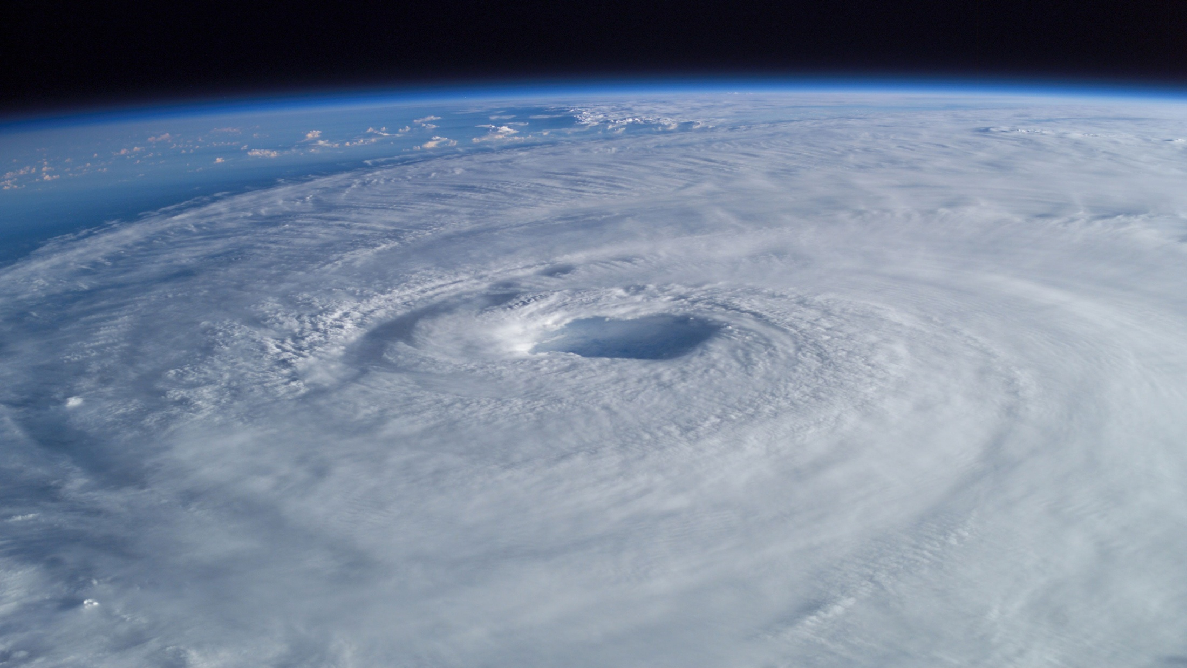


TOPIC
TEAM
DESCRIPTION
CLASSES
PAPERS
IDEA / SOLN
MODELS USED
DEEP LEARNING BASED
CYCLONE INTENSITY ESTIMATION
USING INSAT-3D IR IMAGERY
- S4ISROINDM

Slide 2
TOPIC
TEAM
DESCRIPTION
CLASSES
PAPERS
IDEA / SOLN
MODELS USED
TEAM MEMBERS :
JANATH SHIV K S
DHANUSH KRISHNA K
ANKLESH G
UMANG KUMAR
BHARATHI M
SHENBAGA RAJ S
TEAM MENTOR :
DR. G. SIVAKAMASUNDARI

Slide 3
TOPIC
TEAM
DESCRIPTION
CLASSES
DESCRIPTION :
PAPERS
IDEA / SOLN
MODELS USED
Development of a deep CNN for Tropical Cyclone
intensity estimation using half-hourly INSAT-3D IR Images and development of a
web application for visualization of the imagery.
INSAT3D/3DR observations are available at every
30-minute interval and these observations are very useful in understanding the
instantaneous structural changes during evolution, intensification, and landfall of
Tropical Cyclones.
Datasets of Cyclones captured by INSAT-3D over the
Indian Oceans are available since 2014. These datasets can be used for training and
testing of the Model.
Traditional methods for Intensity estimation require
accurate center determination for intensity estimation. Development of this estimation
will be very useful during the initial stage of cyclone formation when determination
of accurate center becomes difficult.

Slide 4
TOPIC
TEAM
DESCRIPTION
CLASSES
CLASSIFICATION :
PAPERS
IDEA / SOLN
MODELS USED
DEPRESSION
17 - 27 knots [ 31 - 49 kmph ]
DEEP DEPRESSION
28 - 33 knots [ 50 - 61 kmph ]
CYCLONIC STORM
34 - 47 knots [ 62 - 88 kmph ]
SEVERE CYCLONIC STORM
48 - 63 knots [ 89 - 117 kmph ]
VERY SEVERE CYCLONIC STORM
64 - 90 knots [ 118- 167 kmph ]
EXTREMELY SEVERE CYCLONIC STORM
91 - 119 knots [ 168 - 221 kmph ]

Slide 5
TOPIC
TEAM
DESCRIPTION
CLASSES
ARTICLES REQUIRED:
PAPERS
IDEA / SOLN
MODELS USED
PAPER TITLE | AUTHOR | DATA SETS | ARCHITECTURE/ SPECIAL FEATURES
CNN for estimating TC wind intensity through infrared satellite imagery | J.S.Combinido et al 2018 | HURSAT-images HURDAT2 db-wind speed records | Optimized Date downloading Cropping satellite images Merge HURSAT & HURDAT2 with their wind speed Architecture-VGG 19
Estimation of tropical cyclone intensity by satellite imagery utilizing CNN | Buo-Fu-chen 2019 | IR image , Microwave , Rain rate | Random Rotation and z-score normalization for each channel

Slide 6
TOPIC
TEAM
DESCRIPTION
CLASSES
PAPERS
IDEA / SOLN
MODELS USED
PAPER TITLE | AUTHOR | DATA SETS | ARCHITECTURE/ SPECIAL FEATURES
Deepti Article | Mani Maskey, Rahul Ramachandran 2020 | HURDAT2 storm intensity, time and location | Use the bounding box and time to download GOES- 8, GOES-10, GOES-11, GOES-12, GOES-13, GOES- 15, and GOES-16 IR channel (band 4 GOES-8 through GOES-15 and band 13 for GOES-16) data from NOAA CLASS data catalog Architecture-VGG16

Slide 7
TOPIC
TEAM
DESCRIPTION
CLASSES
IDEA / SOLUTION :
PAPERS
IDEA / SOLN
MODELS USED
The images and the intensities of Cyclones are collected from
MOSDAC Website.
Based on the wind speed the cyclone is classified into 6 different
classes as mentioned above.
We designed a model in Google Colaboratory to classify the
cyclone type.
The Front-end is created using HTML,CSS and JAVASCRIPT and
we import Google Colaboratory code using Python framework Flask.
In Front-end we can drag or browse Picture and upload it to get
desire intensity and the type of Cyclone as output.
Finally both the Front-end and Back-end is combined to form a final
product as a Website.

Slide 8
TOPIC
TEAM
DESCRIPTION
CLASSES
MODELS USED :
PAPERS
IDEA / SOLN
MODELS USED
CNN:
It is used mainly for image processing, classification, segmentation and
also for other auto correlated data.
A convolution is essentially sliding a filter over the input.
VGG16:
It is one of the CNN model used for image processing.
Accuracy is high comparing with mobile net model.
VGG16 has
13 convolutional layers to extract features
3 dense layers for classification.
PYTHON FLASK:
It is a small and lightweight Python web framework
Provides features that make creating web applications in Python easier.
Gives developers flexibility and is a more accessible framework for new developers

Slide 9
SAMPLES TAKEN :
- Cyclone Tauktae
- From 14/05/2021 to 19/05/2021.
- Images taken : 257
- Cyclone Amphan
-From 16/05/2020 to 21/05/2020.
- Images taken : 200
- Non-Cyclonic days:
-20/05/2021 and 21/05/2021.
-Images taken : 96
Total number of images taken : 553 (before augmentation).

Slide 10
AUGMENTATION PROCESSES :
Rotation
Horizontal flip.
Width shift.
Height shift
Shear.
Zoom.
IMAGES AFTER AUGMENTATION | 6300
IMAGES TAKEN FOR TRAINING | 4410
IMAGES TAKEN FOR TESTING | 2890
PARAMETERS USED FOR MODEL BUILDING :
Epochs : 300
Steps per epochs : 50
Batch Size : 8

Slide 11
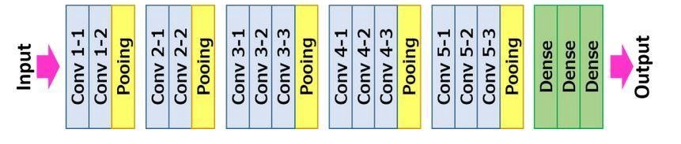
INPUT ( 3D IR IMG)
AUGMENTATION
TRAIN TEST DATA SPLIT
SYSTEM ARCHITECTURE :
TRAIN THE MODEL
TEST THE IMAGE
CYCLONE INTENSITY INPUT
VGG16 ARCHITECTURE :

Slide 12
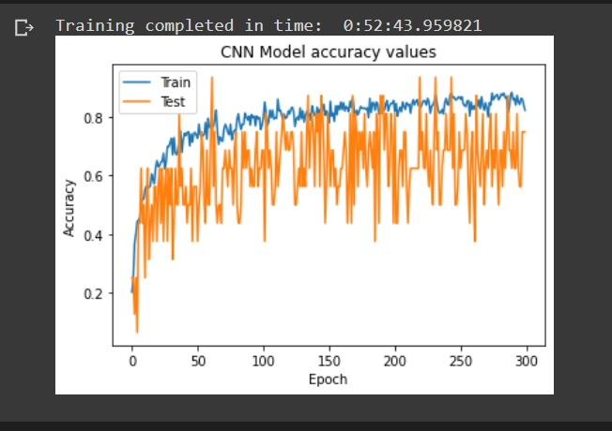
TRAINING vs VALIDATION ACCURACY :

Slide 13
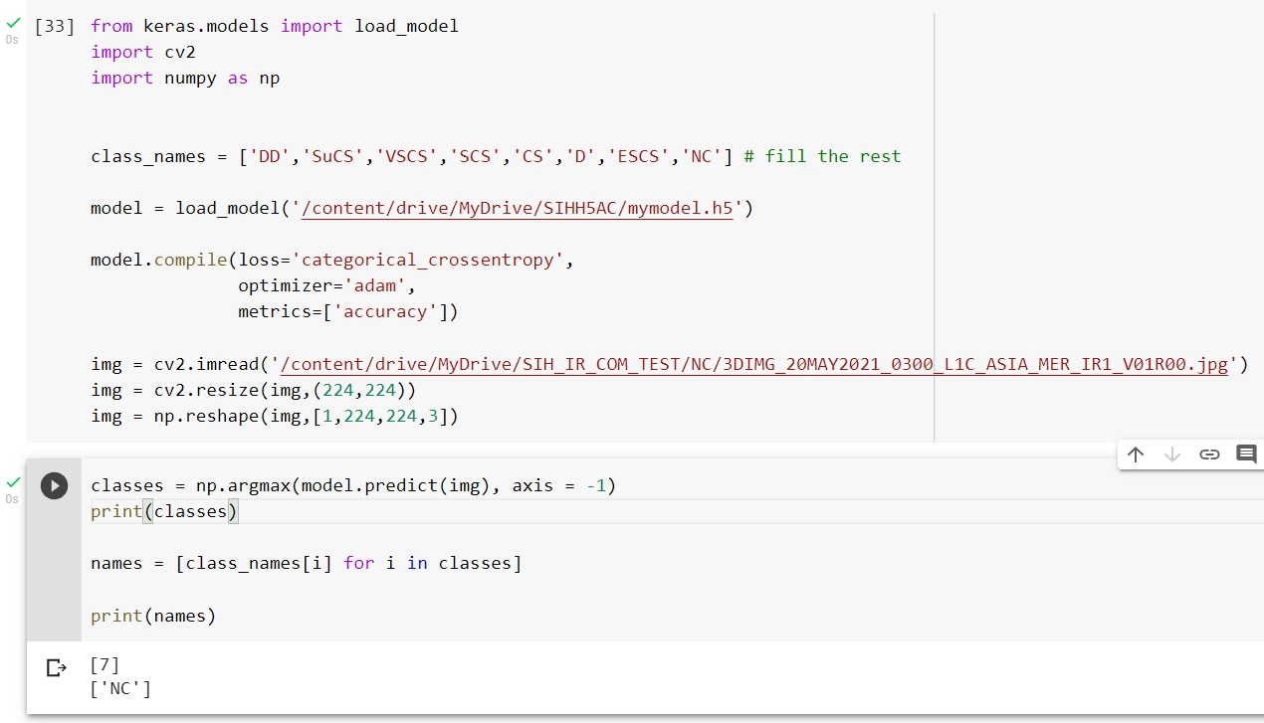
TESTING AN IMAGE :
NC :-

Slide 14
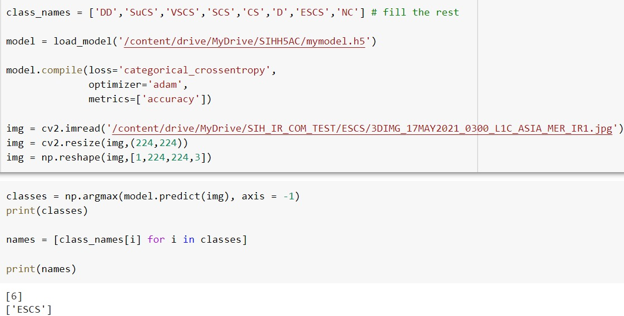
TESTING AN IMAGE :
ESCS : -

Slide 15
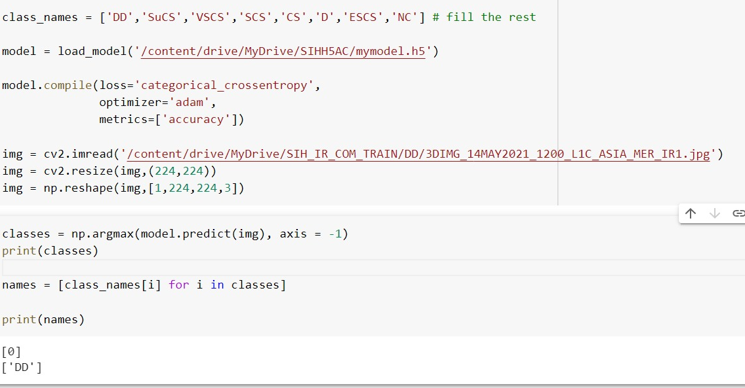
TESTING AN IMAGE :
DD : -

Slide 16
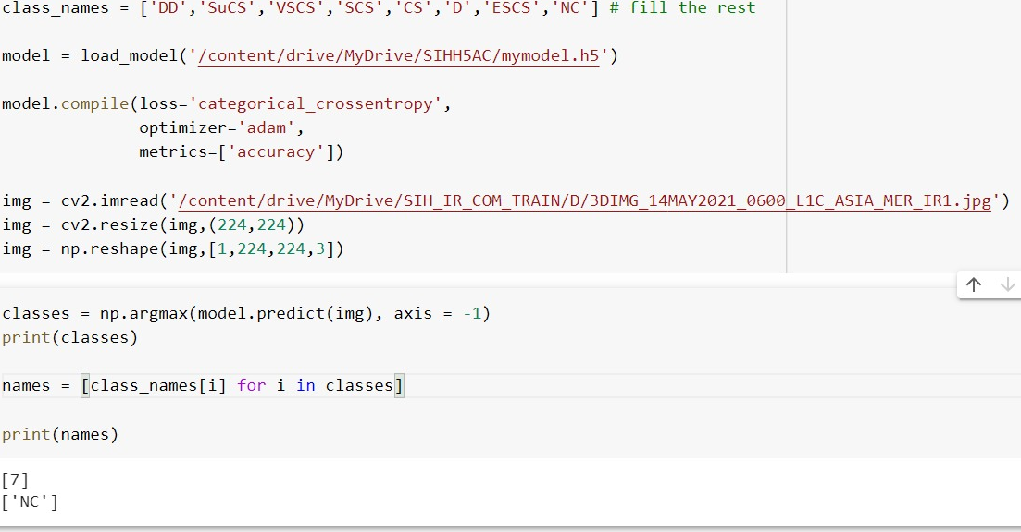
TESTING AN IMAGE :
D : -

Slide 17
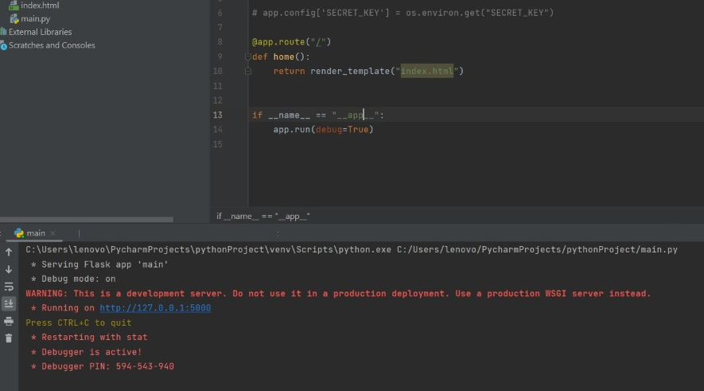
SCREENSHOTS (FROND END) :

Slide 18
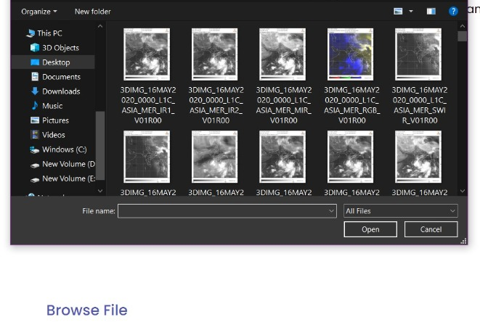
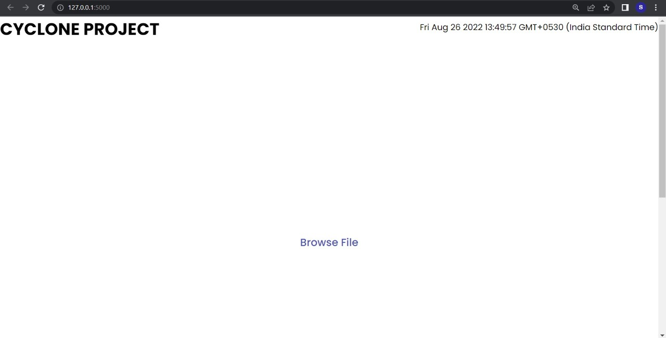
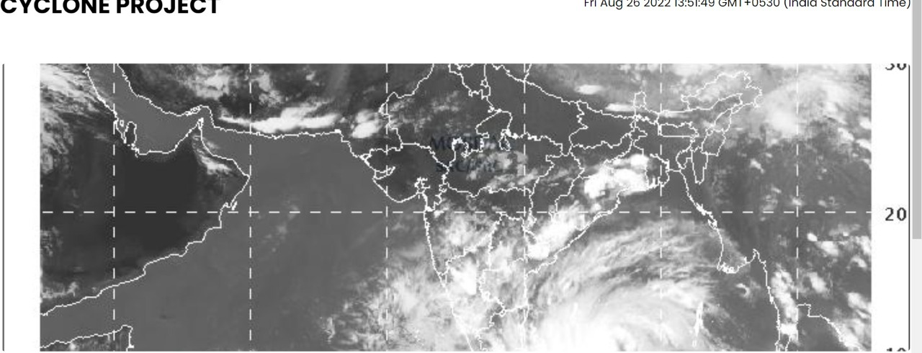
SCREENSHOTS (FROND END) :

Slide 19
CONCLUSION
Using VGG16 model, considering two types of cyclones Tauktae and Amphan with images of 553 and with 300 epochs we got the accuracy of 0.8779 .
If we increases the epochs, the accuracy will also increases.
FUTURE ENHANCEMENT :-
Currently we are manually giving the test images.
In future, we will automate it such that a new image will be uploaded for every 30 minutes.

Slide 20
THANK YOU

