Slide 1

MEDICARE FRAUD DETECTION
By - Umangi Mistry

Slide 2
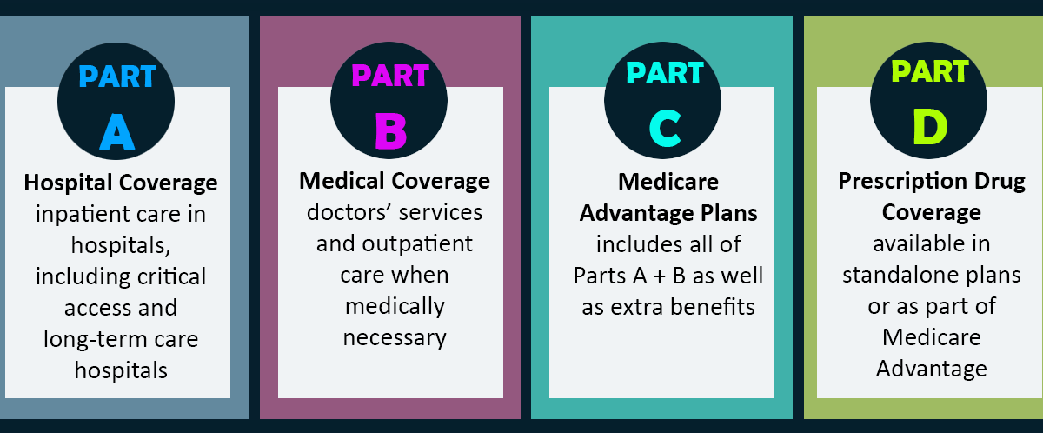
Introduction of Medicare
Federal Government healthcare program
People age 65 or older
People under age 65 with certain disabilities
People of all ages with End-Stage Renal Disease (Permanent kidney failure)

Slide 3
Fraud Activities
Billing services and equipment that you never got
Billing for excessive medical supplies
Giving Medicare number for "Free" services
Alteration of documents
Unnecessary claims services
Excessive x-rays and lab tests

Slide 4
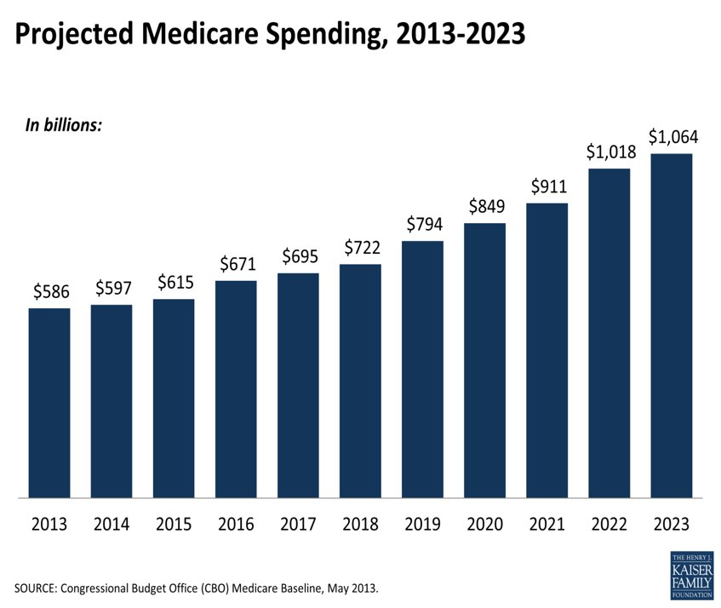

Slide 5
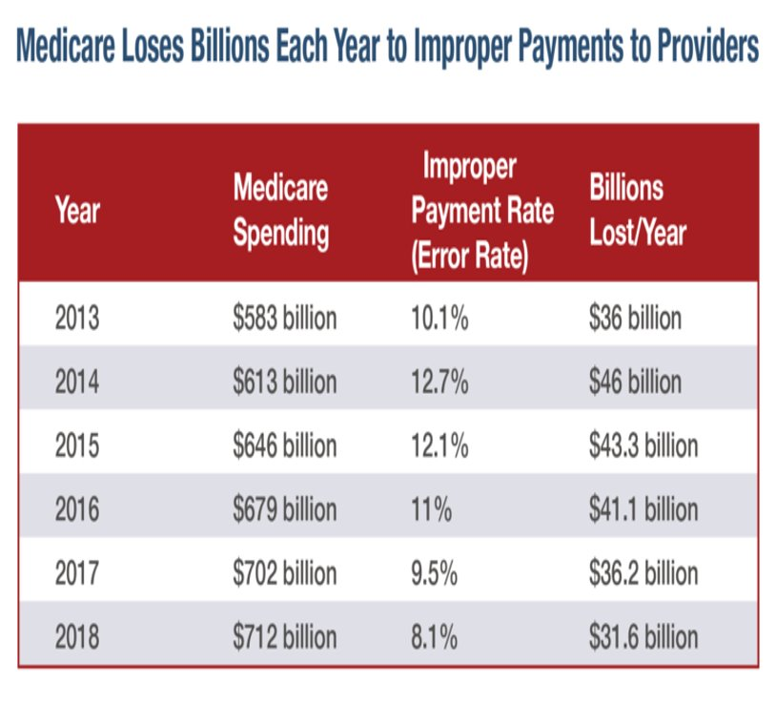

Slide 6
Why Fraud detection with Machine Learning?
Traditional method is time consuming and costly
Skilled labor required to review each of the thousands of claims that are filed a day is simply unfeasible
These were preprogrammed, meaning the fraudulent claims had to fit into a particular template or else they would not be recognized
Using ML, data is processed in very short periods of time.
Continuous revision of this process helps to find new fraud schemes.

Slide 7
Data science process
Problem Definition
Data Collection
Data Preparation
Model Creation
Model Evaluation

Slide 8
Problem Statement
Build a simple Data Model to show the relationships among the different datasets and identify the key feature-sets for fraud detections
Build a comprehensive machine learning model to detect fraud pattern based on the different features: Service Providers (Doctors, Pharmacies), Insurance subscribers (patients) and commonly abuse drugs prescriptions
Setup a benchmark metrics to measure and evaluate the experimental result

Slide 9
Data collection
Drug information
Claim count
Generic type
Drug cost
Prescriber data (Part D)
Opioid prescriber data
Provider and their aggregated supplier data
Physician payment data
Excluded provider data
Prescriber’s summary file
Opioid prescriber rate
Prescription claims
Provider’s name, city, specialty
Medicare payment
Allowed amount
Submitted Charges
Payments from Pharma companies
Ownership of physician
Consulting fees
Excluded providers
Date of exclusion

Slide 10
Data cleaning and merging
Unique column : NPI (National Provider Identifier)
Provider's name, city, zip code
Handling nulls
Joined first and last name

Slide 11

Frauds in datasets
Prescriber data (Part D)
405
Opioid prescriber data
534
Provider and their aggregated supplier data
118

Slide 12
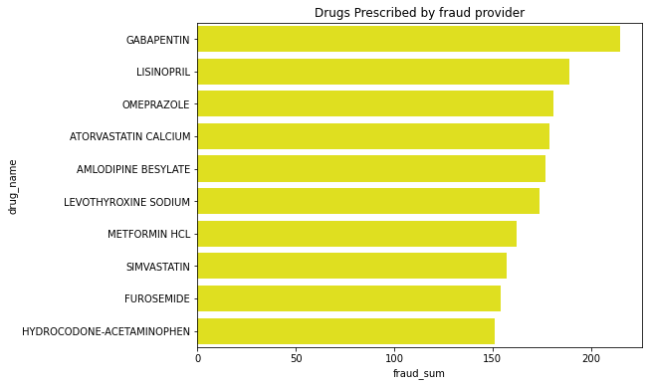
Drugs involved in fraud

Slide 13

Data Pre-processing
Non fraud - 177973
Fraud - 116
SMOTE :
Synthetic Minority Oversampling Technique
Oversample the minority class
Do not add any new information

Slide 14
Predictors and target variable
Predictors
Total drug cost
Total claim count
Total day supply
Opioid Claim Count
Opioid Prescribing Rate
Long-Acting Opioid Claim
Long-Acting Opioid Prescribing Rate
Total Payment Sum
Number of Suppliers
Number of Supplier Beneficiaries
Number of Supplier Claims
Average Supplier Submitted Charge
Average Supplier Medicare Allow Amount
Average Supplier Medicare Payment Amount
Average Supplier Medicare Standard Amount
Target Variable
Is Fraud

Slide 15
Classificaticon Models
Logistic Regression
Recall – 0.33
K Neighbor Classifier
Random Forest Classifier
Bernoulli Naïve Bayes
Precision - 0.60
Recall – 0.08
Precision - 0.93
Recall - 0.45
Precision - 0.62
Decision tree Classifier
Recall - 0.19
Precision - 0.98
Recall - 0.09
Precision - 1.00

Slide 16
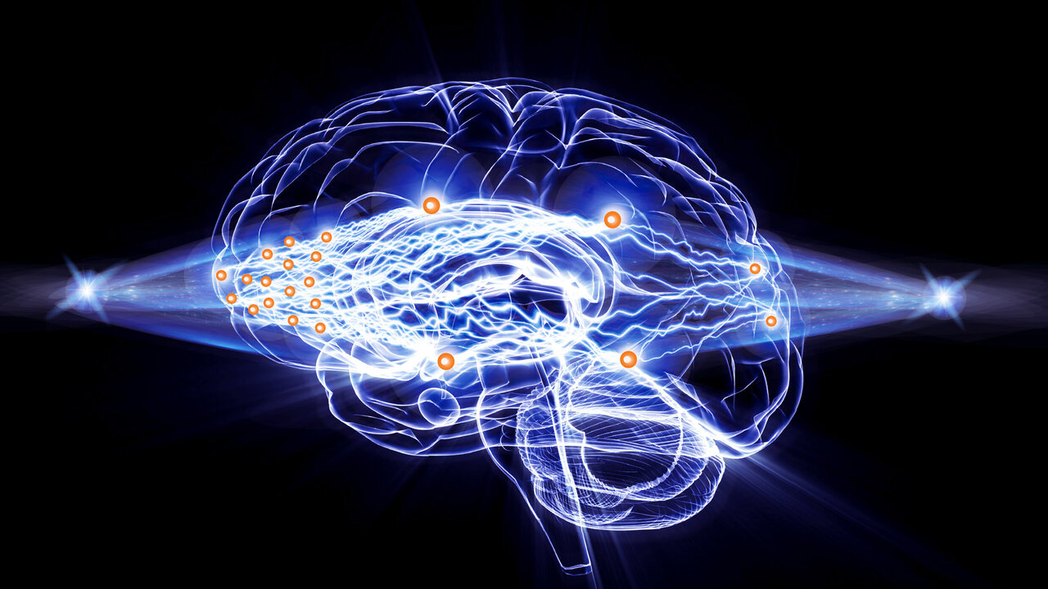
Neural Network
Consists of an interconnected group of artificial neurons
Motivated by the functions of the brain
Pattern recognition
Associative memory
Able to learn from the past
Faster and more efficient

Slide 17
Model Evaluation
False Negative
25
True Negative
35089
True positive
13
False positive 9396
Precision
0.001
Recall 0.64

Slide 18

Future work
Gather more data
Find missing NPI
Use different classification method
More cleaning and EDA
Perform Unsupervised learning

Slide 19
Thank you

Slide 20


