Slide 1
Steps Performed are:
Loaded data into dataframe and check the info of the data frame ( Found out column credit product have about 11% of value NaN)
In order to decide what to do with missing value we tried initial modelling to see if we get better result by keeping or removing missing data
a) Tried Modelling by dropping missing data
b) Tried Backward fill
c) Tried forward fill method
So as a outcome of above steps , dropping missing value give better result as compared to keeping data either via forward fill or backward fill method
3) Check for duplicate entries was also done .
Post step 1 to step 3 , now we have to perform encoding to handle categorical data, so encoding used was one hot encoding

Slide 2

After performing encoding we checked skewness of data , to see whether we have skewness in continuous data column which are ( Age, Vintage and Avg_Account_Balance), we saw minor skewness in all 3
In order to handle skewness in data, tried 3 different Transformation on data.
a) Log Transformation
b) Square root Transformation
c) Reciprocal Transformation
Out of all 3 mentioned above Log transformation gave satisfactory results

Slide 3
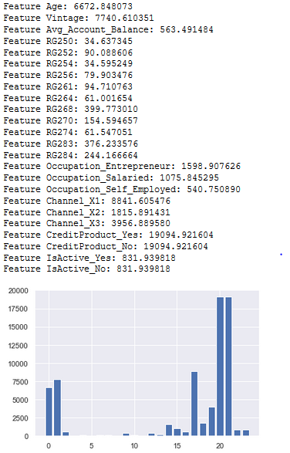
6) After data is ready for modeling one last steps is performed on data so that model can easily learn from the data, Scaling of data is also performed , and for this Standard Scalar is used.
7) After Scaling of data , feature importance is performed on that scaled data to get only most important features which is further will get used for modelling.

Slide 4
8) Even after performing step 1-7 the result we not satisfactory , and the data which is used for training is imbalanced , so we perform Sampling and check which sampling gave better result
a) Under Sampling
b) Over Sampling
So after performing sampling and training 2 different model on 2 different data , we found out the Under Sampling data performed really well as compared to Over Sampled data
9) Now after performing EDA and feature importance now we tried 3 different algorithms:
a) Random Forest
b) LGBM
c) CatBoost
All the models gave more or less similar results post hyper parameter tuning as well .
So tried Voting Classifier to get a average result from all these

