Slide 1

Personal Finance Data Analysis
This project analyzes personal finance data to uncover key insights about income, expenses, savings, debt management, and financial habits. Using SQL for structured queries and Python (Pandas, Matplotlib, Seaborn) for advanced analysis and visualization, the project provides actionable recommendations for budgeting, investment planning, and financial health improvement — simulating a financial advisory system that helps individuals make smarter money decisions.

Slide 2

PYTHON ANALYSIS
Income & Expense Analysis
Five visualizations reveal spending behavior, savings patterns, and income-to-expense dynamics across the customer base.
1
Income vs. Expense Trend
Line chart tracking monthly income and expense movement over time.
2
Expense Category Breakdown
Pie chart showing share of top expense categories across all customers.
3
Savings Distribution
Distribution of savings (income – expense) across individuals.
4
Outlier Detection
Boxplots identifying statistical outliers in income and expense data.
5
Yearly Growth Comparison
Line chart comparing year-over-year expense growth vs. income growth.

Slide 3
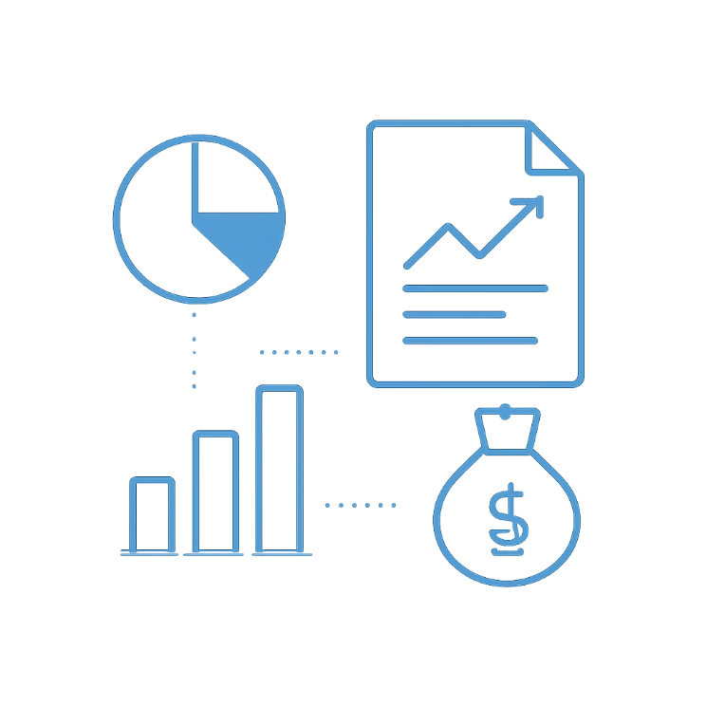
PYTHON ANALYSIS
Savings & Investment Patterns
These five analyses segment savers by behavior, map investment concentration, and quantify the income-to-savings relationship.
Top 10% Savers
Identify high-performing savers by savings-to-income ratio.
Savings Rate Histogram
Distribution of savings rates across the full customer base.
Investment by Category
Bar chart comparing investment amounts across asset categories.
Top 5 Investors
Highlight the highest total investment contributors.
Savings vs. Income Scatterplot
Visualize correlation between income level and savings behavior.

Slide 4
PYTHON ANALYSIS
Loans & Debt Management
These five visualizations assess debt burden, age-group loan patterns, and interest rate sensitivity across the portfolio.
EMI-to-Income Ratio
Loan Amounts by Age
Default Risk by Loan Type
Bar chart showing debt burden relative to income per individual.
Boxplot comparing loan distribution across age groups.
Compare probability of default across loan categories.
Interest Rate Shock
EMI Distribution
Simulate a 1% rate rise and plot risk bucket shifts.
Full distribution of EMI values across all customers.

Slide 5

PYTHON ANALYSIS
Demographics & Financial Behavior
These five analyses reveal how marital status, gender, profession, and age shape financial outcomes.
Marital Status & Savings
Gender Income-Savings Gap
Profession vs. Stability
Age Group Expenses
Bar chart comparing savings between married and single individuals.
Visualize the gap in income and savings across genders.
Heatmap of profession against financial stability score.
Stacked bar chart of top 3 expenses by age group.
Financial Correlation Matrix
Heatmap of income, expenses, savings, investments, and EMI.

Slide 6
PYTHON ANALYSIS
Risk Assessment & Scenario Simulation
These five simulations stress-test customer financial health under adverse conditions and identify vulnerable segments.
Risk Bucket Distribution
1
Plot customer distribution across Low, Medium, and High risk tiers.
Tax Rebate Beneficiaries
2
Estimate eligible customers and visualize with a pie chart.
15% Income Drop Simulation
3
Model the impact of income reduction and plot affected customers.
10% Inflation Shock
4
Compare expense profiles before and after an inflation spike.
At-Risk Customer Identification
5
Scatterplot highlighting low-savings, high-EMI individuals.

Slide 7
SQL ANALYSIS
Income & Expense — SQL Queries
Five foundational queries establish baseline financial metrics and surface customers under financial pressure.
1
Average Income vs. Expense
Compute monthly averages across the full customer base.
2
Highest Expense Category
Identify the category consuming the largest share of income.
3
Paycheck-to-Paycheck Count
Count customers where expenses ≥ income.
4
Total Aggregate Savings
Sum total savings generated across all customers.
5
Top 10 by Monthly Surplus
Rank customers by highest income-minus-expense surplus.

Slide 8
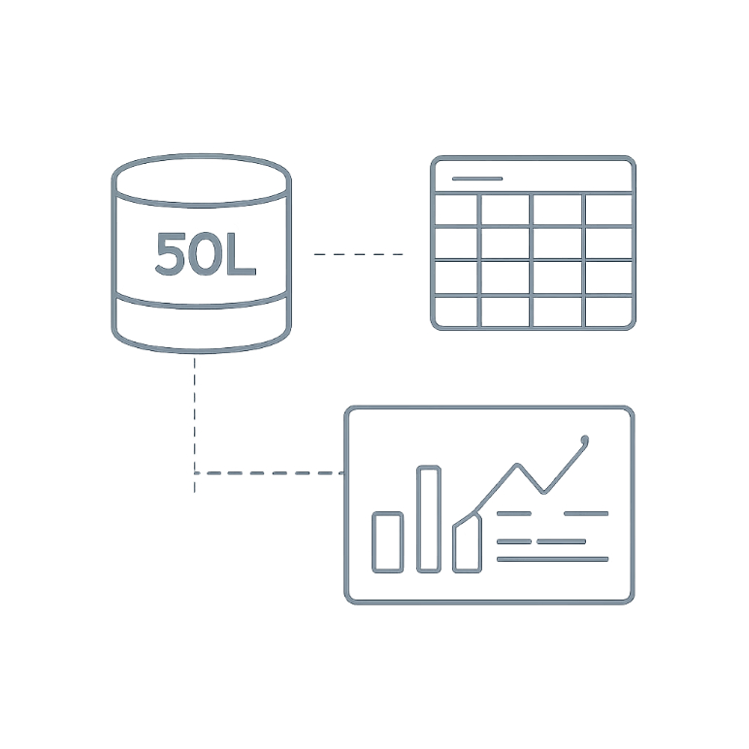
SQL ANALYSIS
Savings & Investments — SQL Queries
These five queries profile savings behavior, surface top investors, and benchmark investment participation across income tiers.
1
Median Savings Rate
Calculate the median savings rate across all individuals.
2
20%+ Savers
Find customers saving more than 20% of income.
3
Most Popular Investment
Identify the category with the highest participation rate.
4
Top 5 Investors
List customers with the highest total investment amounts.
5
Investment-to-Income by Group
Compare ratios across income segments.

Slide 9
SQL ANALYSIS
Loans & Debt — SQL Queries
These five queries quantify debt exposure, flag high-risk borrowers, and assess repayment behavior.
Average Loan Amount
Highest EMI Payers
High-Risk Customers
Calculate average loan by type and age group.
Identify top 10 customers by EMI burden.
Count customers with EMI-to-income > 40%.
Loan Default Rate
Outstanding Loan Exposure
Compute default rate by loan type.
Total outstanding loan amount per customer.

Slide 10
SQL ANALYSIS
Demographics, Risk & Key Insights
These five queries complete the demographic and risk picture, then synthesize findings into actionable recommendations.
Savings by Marital Status
Gender-Based Financial Gap
Profession vs. Financial Health
Compare average savings between married and single customers.
Analyze income and savings differences by gender.
Rank professions by financial stability score.
Risk Category Distribution
Key Insights & Recommendations
Count customers in Low, Medium, and High risk buckets.
Summarize findings and provide financial advisory suggestions.

Slide 11




SQL ANALYSIS
Loans & Debt
EMI Burden
Outstanding Loan by Age
Highest Default Risk
What percentage of people have EMI-to-Income ratio above 40%?
What is the average outstanding loan amount per age group?
Which loan type has the highest default risk based on EMI burden?
Loan Denial Filter
Top EMI Customers
Which users would be denied loans under DTI above 50% and Credit Score below 650?
Find the top 5 customers with the highest EMI amounts.

Slide 12





SQL ANALYSIS
Demographics & Finance
Marital Savings
Income by Gender
Savings Ratio by Job
Do married people save more than single people?
Is there a gender difference in average income?
Which profession has the highest savings-to-income ratio?
Age-Based Spending
Regional Income
What are the top 3 expense categories by age group?
Which region or city has the highest average income?

Slide 13

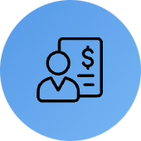



SQL ANALYSIS
Risk & Policy Rules
Risk Classification
Tax Rebate Check
Poverty Line Scenario
Classify customers as Low, Medium, or High Risk using EMI-to-Income thresholds.
Find how many qualify when savings are above 20% of income.
Measure how many fall below the poverty line if income drops by 15%.
Inflation Impact
Most At Risk
List customers whose expenses exceed income after a 10% inflation rise.
Identify customers with low savings, high EMI, and high debt.

Slide 14
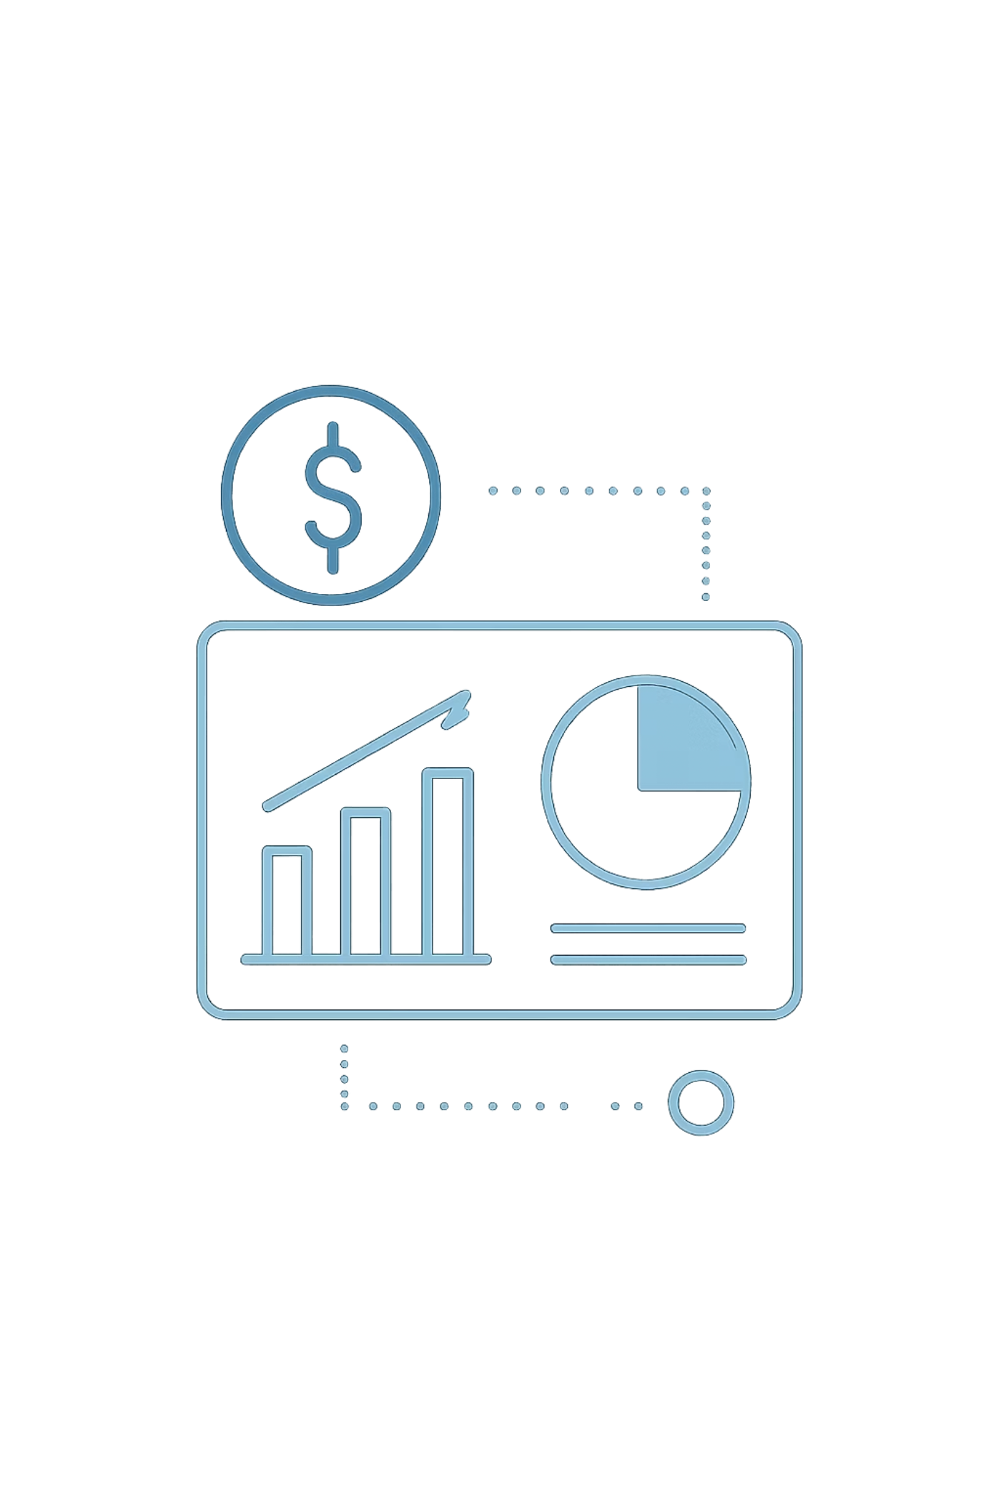
Thank you for your time and attention
UMANG SHRIVASTAVA

