Slide 1
722- Deliverable 3
Team 1

Slide 2
Architecture
Global Query
Canonical Table
Inventory
Ordering
Ordering2
Sub Query 1
Sub Query 3
Sub Query 2

Slide 3
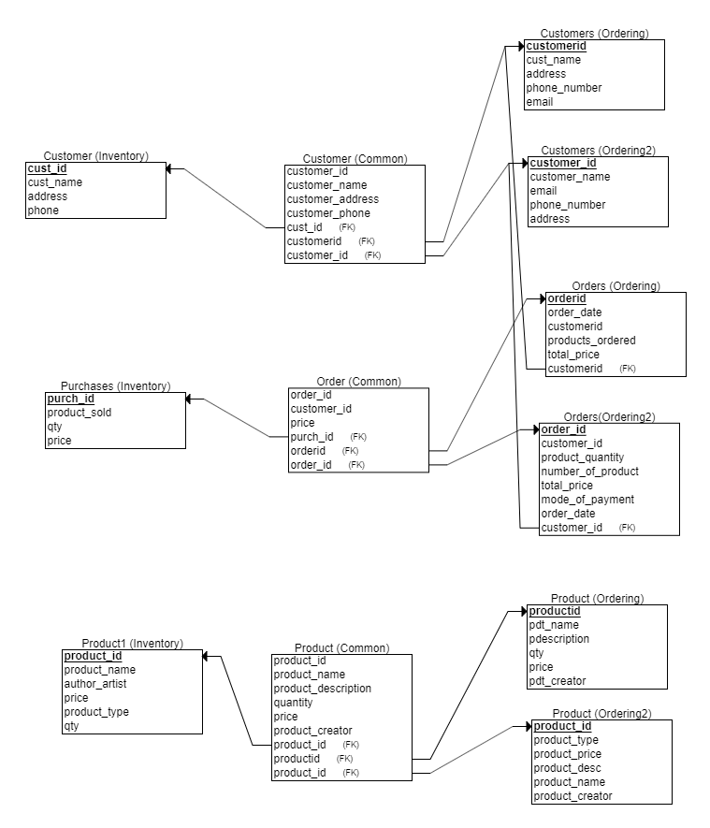
ER Diagram

Slide 4
What's different in our project
We are creating dynamic table based on number of columns in the canonical query.
In result display, the column names that were queried are displayed even though the table is created with static column names.
We have two separate tables for table details and SQL keywords.

