Slide 1
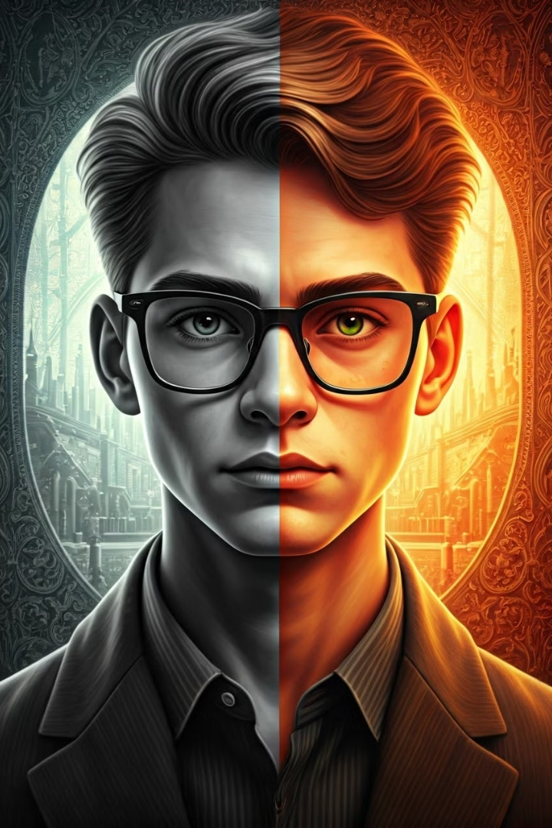
RevivingPxls: Bringing Black-and-White Images to Life
RevivingPxls is an innovative tool that uses machine learning to breathe new life into black-and-white images. This technology transforms faded photographs into vibrant, colorful versions, bringing history and memories back to life.
RevivingPxls

Slide 2
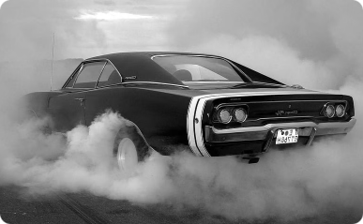
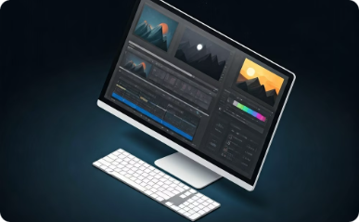
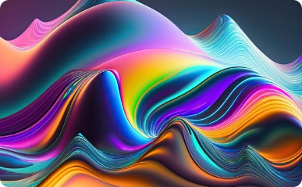
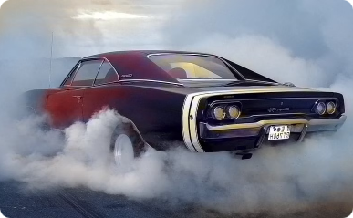
How RevivingPxls Works
Input Image
Preprocessing
Colorization
Output Image
RevivingPxls begins by receiving a black-and-white image as input, ready to be transformed.
The image undergoes preprocessing, ensuring it's ready for the AI model. This involves resizing and optimizing the image.
The heart of RevivingPxls lies in the AI model that analyzes the image and predicts the most likely colors for each pixel.
The model generates the final colorized image, bringing the past back to life in vibrant colors.
RevivingPxls

Slide 3
Technology Stack
Python
HTML, CSS, & Flask
NumPy & TensorFlow
Python serves as the primary programming language for RevivingPxls, providing flexibility and efficiency for image manipulation.
HTML, CSS, and Flask are utilized to create the user interface and web framework for RevivingPxls, offering a seamless experience for users.
NumPy is a powerful numerical computing library that enables efficient array operations for image processing, while TensorFlow provides the core machine learning infrastructure for RevivingPxls' colorization capabilities.
RevivingPxls

Slide 4
Features and Capabilities
1
High-Speed Processing
2
Resolution Support
3
Batch Image Colorization
RevivingPxls supports various image resolutions, from low-resolution snapshots to high-resolution historical photographs, allowing for versatility in applications.
RevivingPxls processes images quickly, transforming black-and-white photos into colorful ones in a matter of seconds, making it efficient for large datasets.
RevivingPxls enables batch processing, allowing you to colorize multiple images simultaneously, saving time and effort for projects involving numerous photos.
4
User-Friendly Interfaces
RevivingPxls offers intuitive interfaces, making it easy for users of all skill levels to upload images, choose colorization options, and download the final results.
RevivingPxls

Slide 5
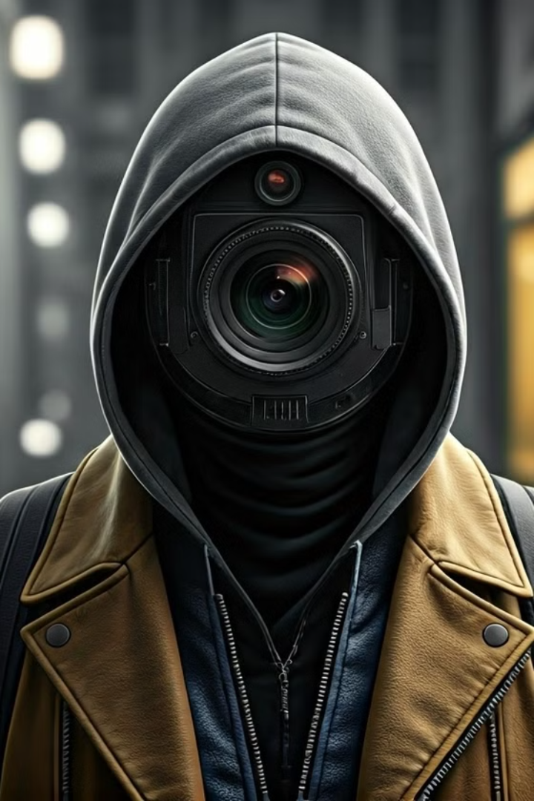
Applications - Forensic Investigation
Crime Scene Analysis
RevivingPxls can enhance black-and-white CCTV footage by adding color, making it easier for investigators to identify suspects, analyze crime scenes, and collect evidence.
Suspect Identification
Colorized footage can reveal crucial details like clothing, facial features, and other characteristics that might be missed in grayscale, aiding in suspect identification.
RevivingPxls

Slide 6
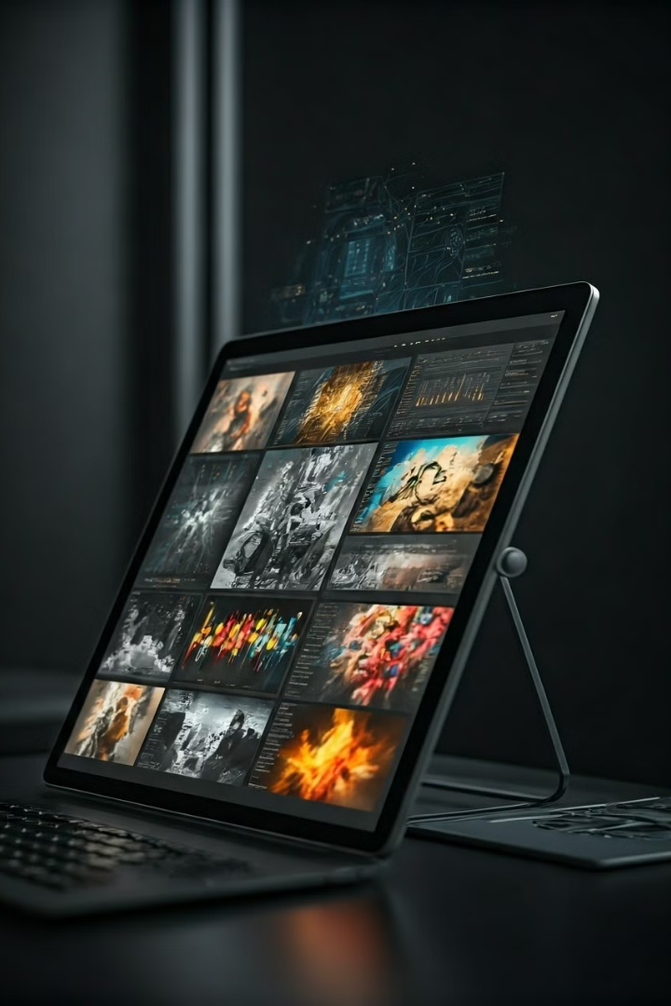

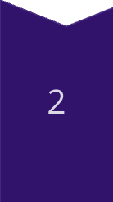
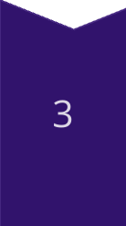
Applications - AI & Machine Learning
Data Enrichment
RevivingPxls can transform grayscale datasets into colored ones, providing richer and more detailed data for training AI models.
Model Accuracy
Color images provide more information for AI models, leading to improved accuracy in tasks like object recognition, image classification, and image segmentation.
AI Advancements
Colorized datasets can contribute to the development of more advanced AI models that can better understand and interpret visual information.
RevivingPxls

Slide 7
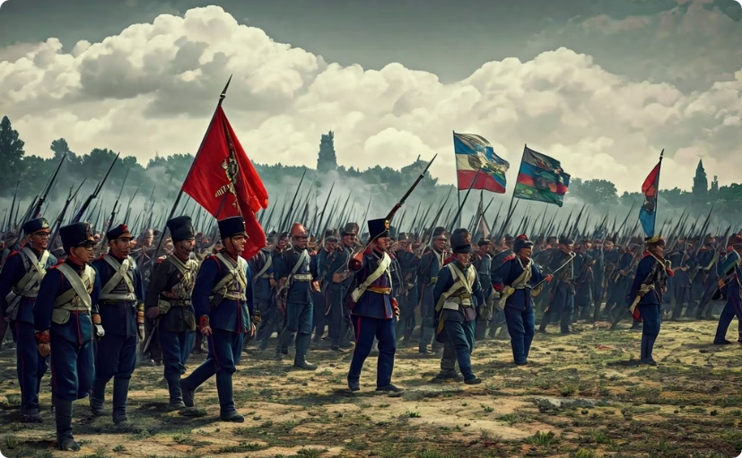
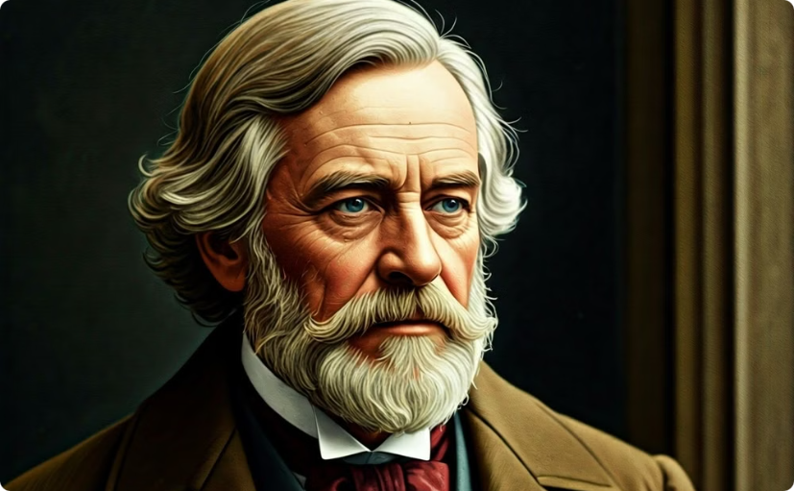
Applications - Education & History
Visual Engagement
Enhanced Understanding
Colorized historical images can bring history to life for students, making learning more engaging and immersive.
Visualizing historical events in color allows students to better understand the context, atmosphere, and details of the past.
RevivingPxls

Slide 8
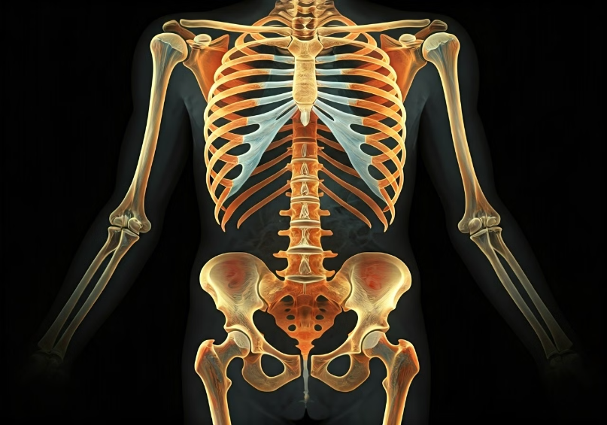
Applications - Medical Imaging
Current X-rays provide limited information. Colorized X-rays offer improved understanding and clarity for medical professionals. This is especially beneficial for diagnosing and treating complex conditions like fractures, tumors, and infections. Colorization helps differentiate between different tissues and structures, making it easier to identify abnormalities and assess the severity of injuries. Moreover, it can enhance the visibility of subtle details, leading to more accurate diagnoses and more effective treatment plans.
RevivingPxls

Slide 9
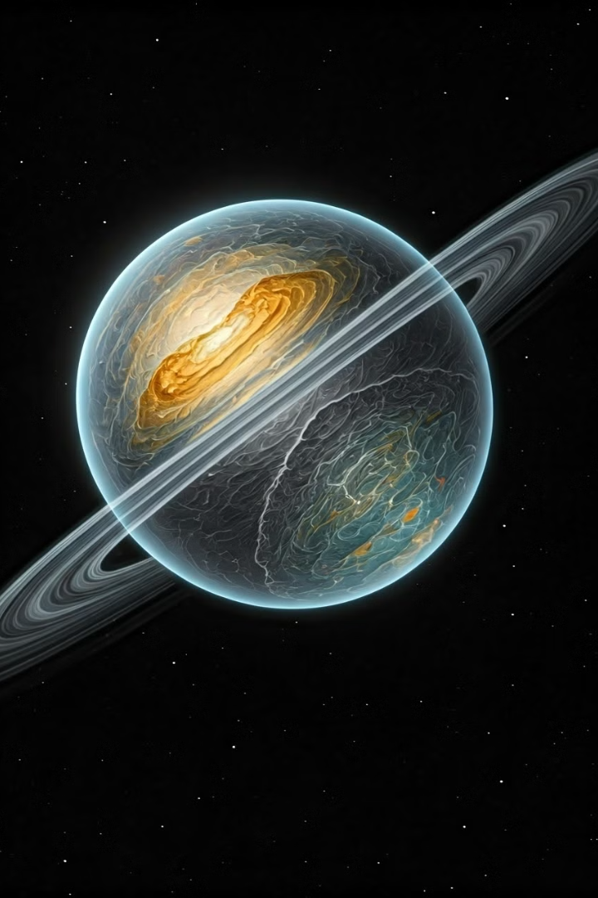


Applications - Space Study
Data Analysis
Colorizing satellite images enhances the visualization of planetary surfaces, atmospheric features, and celestial objects.
Scientific Research
Colorized space images provide valuable data for scientists studying planetary geology, atmospheric dynamics, and celestial phenomena.
RevivingPxls

Slide 10
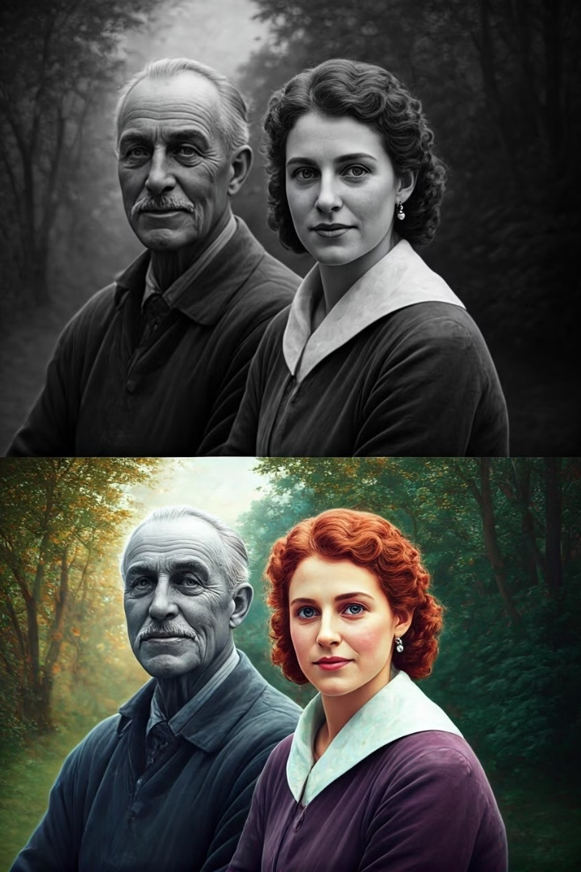
Applications - Emotional Impact (Old Memories)
Reviving Memories
Colorizing old family photos can bring back vivid memories, making them more personal and heartwarming for families.
Sentimental Value
Transforming faded black-and-white pictures into colorful images can evoke strong emotions, creating cherished keepsakes for generations to come.
RevivingPxls

