Slide 1

Team Details
Team name:Tech Crew
Team leader name:Umar Bakhtiyar Mulla
Problem Statement: Pata Nahi Jo Pasand Aajaye rakh loo mkc tumhari

Slide 2
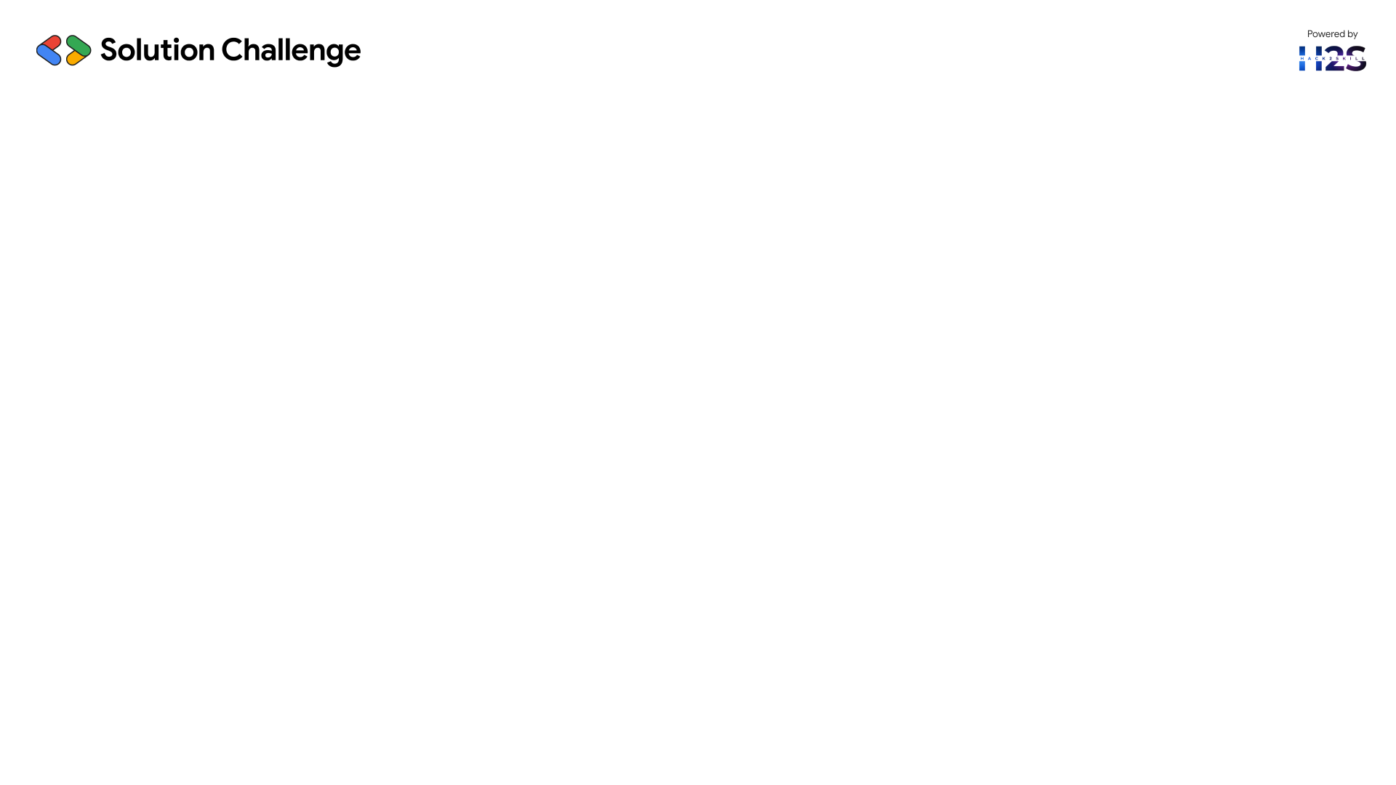
🧪 Unani Medicine Recommendation System
This project is a Django-based web app that provides Unani medicine suggestions using Google’s Gemini API. It combines traditional healing with modern AI to recommend natural remedies for common health issues.
🔧 Key Features:
User Authentication: Secure login & registration.
AI Integration: Gemini API processes user symptoms and returns tailored remedies.
Ingredient Extraction: System parses responses to list Unani ingredients.
Database Support: Uses SQLite to store users, chats, and remedy data.
Clean UI: Built with Django templates, HTML & CSS.
🌿 Unani Logic:
Illness keywords are mapped to traditional remedies (e.g., fever → Joshanda, headache → Arq Gulab) based on Unani principles.
This smart fusion of AI and ancient medicine delivers an intuitive and reliable user experience.

Slide 3
🔍 Opportunities
A.) How is it different from existing ideas?
Most AI health assistants focus on modern allopathic treatments. Our system uniquely combines Unani healing principles with AI-driven personalization, offering natural, side-effect-free remedies. It’s a niche yet unexplored fusion of traditional medicine and AI.
B.) How does it solve the problem?
It helps users get quick, reliable, and personalized Unani remedies for common ailments without needing a physical consultation. Through natural language understanding, it suggests traditional treatments that are easily accessible and culturally familiar.
C.) USP of the Proposed Solution:
First-of-its-kind Unani + AI integration
Uses Gemini API for accurate remedy generation
Ingredient extraction for transparency
Lightweight, user-friendly web app built in Django
This system modernizes ancient wisdom, making Unani medicine more accessible and personalized for today’s digital users.

Slide 4
✅ Features Offered by the Solution
User Authentication: Secure login and registration system for personalized access.
AI-Based Remedy Generator: Utilizes the Gemini API to provide Unani remedies for user queries.
Natural Language Interface: Users can ask health-related questions in plain language.
Ingredient Extraction: Clearly lists herbal/natural ingredients in each remedy for transparency and safety.
Conversation History: Tracks previous chats for easy reference and continuity.
Remedy Storage (Database Integration): Saves user queries, remedies, and conversations in a SQLite database.
Clean UI/UX: Simple and user-friendly interface for smooth interaction.
Fast Response Time: Near-instant answers through optimized backend calls.

Slide 5
🔄 Process Flow / Use-Case Explanation
User Registration/Login Users sign up or log in to access the platform securely.
Input Query Users enter their health-related query in natural language.
Query Processing with Gemini API The system sends the query to the Gemini AI model, which processes it and generates a suitable Unani remedy.
Response & Remedy Display The AI-generated remedy along with ingredients is displayed to the user.
Data Storage (SQLite) The query, response, and user details are stored in the database for future reference.
View Past Conversations Users can review their chat history and remedies anytime.

Slide 6
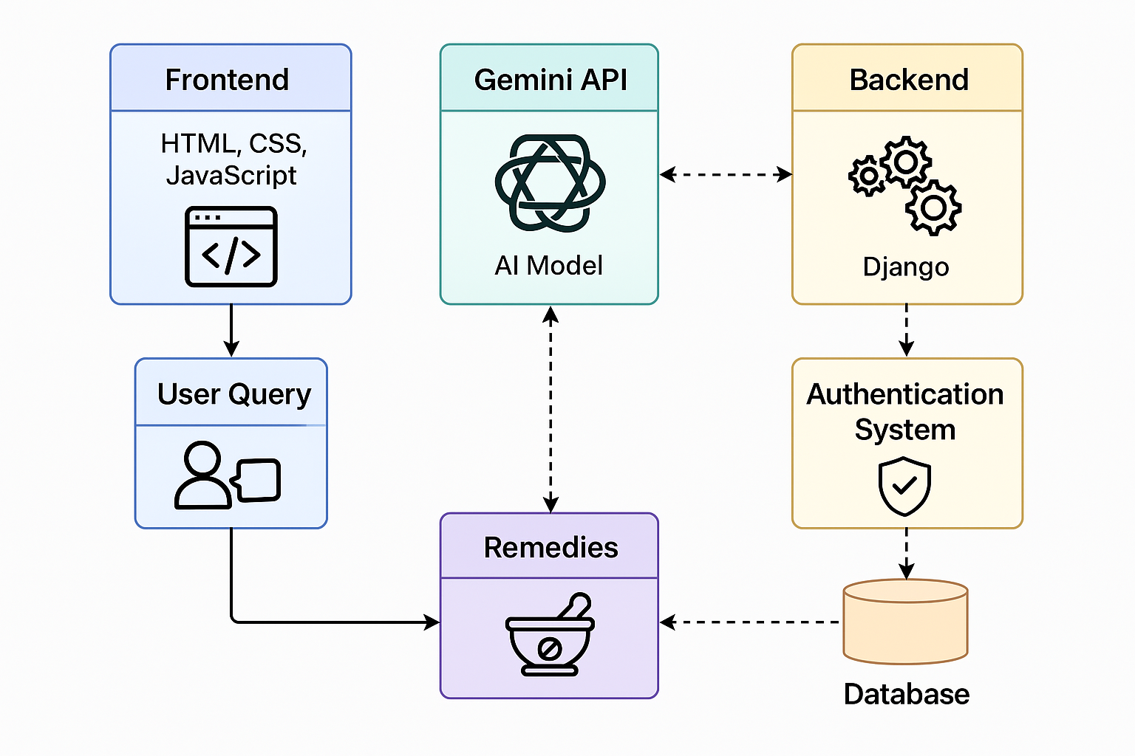
Architecture diagram of the proposed solution

Slide 7
Technologies to be used in the solution
Frontend: HTML, CSS (for a clean and user-friendly interface)
Backend: Django – used for building the server-side logic, handling API calls, and managing user sessions
Database: SQLite – stores user data, conversation history, and Unani remedies
Authentication: Django's built-in authentication system for secure user login and signup
AI Integration: ✅ Gemini API (Google Generative AI)
Integrated using the google.generativeai Python SDK
Powers intelligent, natural language-based recommendations for Unani treatments
Enhances user interaction by generating responses dynamically based on symptoms and user prompts
IDE: Developed locally using Visual Studio Code

Slide 8
Snapshots of the MVP

Slide 9
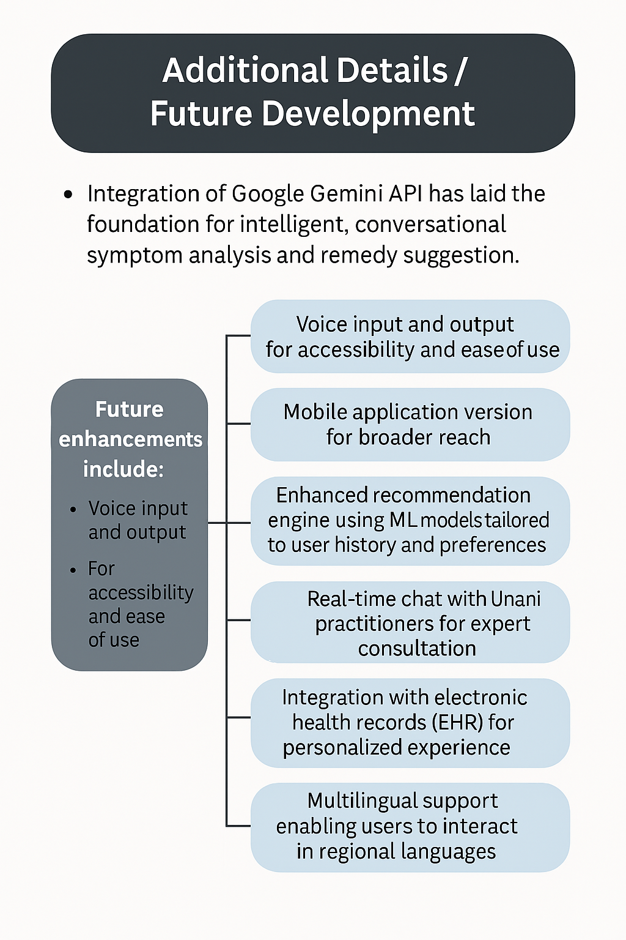
Additional Details / Future Development
Integration of Google Gemini API has laid the foundation for intelligent, conversational symptom analysis and remedy suggestions.
Future enhancements may include:
Voice input and output for accessibility and ease of use
Mobile application version for broader reach
Enhanced recommendation engine using machine learning models tailored to user history and preferences
Real-time chat with Unani practitioners for expert consultation
Integration with electronic health records (EHR) for a more personalized experience
Multilingual support, enabling users to interact in regional languages for better understanding
Hosting on cloud platforms (like Firebase or GCP) for scalability and performance

Slide 10
Provide links to your:
https://github.com/Umar-MultiverseCode/UnaniAi.git
https://drive.google.com/file/d/1K30YdngOsLKf7cEpM-s0QCF0A2x-FklU/view?usp=drivesdk
https://unaniai.onrender.com/

Slide 11
